Slide 1
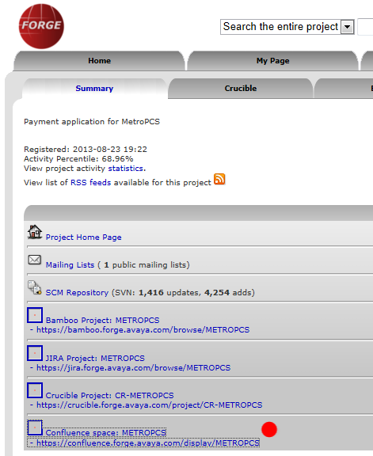

Confluence de Avaya Forge
Logearse en la VPN de Avaya
Ir a la pagina Forge del proyecto en cuestion
En la pestaña “Summary”, seleccionar el link al “Confluence Space” para ese proyecto
Hay que añadir en el Confluence TODA la informacion de interes para desarrollo y soporte tecnico, que se detalla en los siguientes slides.

Slide 2
Informacion del Confluence
Environment
  La información del Avaya Lab que se usó.
VPN
  Todo lo relevante a la VPN, cual es el cliente, como se accede, etc.
Contact Information
  Acá va la información de quienes están involucrados en el proyecto, su rol y su dato de contacto y que rol tuvieron en el proyecto.
Technical Information
  Incluir todo lo relevante al desarrollo de la app. Por ejemplo versión exacta de OD, bundles utilizados con su versión, patches que se haya requerido.
  Versión del EP y que service pack tiene.

Slide 3
Informacion del Confluence
Development Guidelines
  Global commands, cuales son y cómo se manejan en la app.
  Otra página dentro de esté la estructura del SVN (y con el Links al SVN)
  Página con link al JIRA
  Información de las CAVs si tiene, cuales son, valores default.
  Información de las capas. Si se usó Spring, Maven (que versión)
  Otra página Backend Interfaces que describa que tipo de backend tiene (WebService (que tipo?) – DataBase –Store Procedures). En esta página agregar la API de esas interfaces. WSDLs de los WS. Uso de certificados, etc.
  Otra llamada Third Party Software si es que se consume algo hecho por terceros.

Slide 4
Informacion del Confluence
Project Status reports
  Poner el Status Report SEMANAL del proyecto, marcando los delays que hubiese, las fechas de los deliverables, etc.
  Cada reporte es una página nueva, copia de la anterior cambiando su Título (ej. Status 2013 – 11 – 29) y sobre lo ya escrito, modificado a su nuevo estado. Este reporte lo pueden armar los Viernes o Lunes ya que es semanal. Ver ejemplo en slides subsiguientes.

Slide 5
Project Status - Example
Project status
Application 1
Under QA
- CMRA for removing Assign Money functionality delivered to QA.
Pending tasks:
• Add reporting on webservices fields used in BOC.
• Provide to Customer a list of BOC where there is no explicit Else condition in the design.
Application 2
Under QA
Pending tasks:
• Provide to Customer a list of BOC where there is no explicit Else condition in the design.
• Work with Ben Witso on reporting metrics for Cognizant.
Application 3
Pending tasks:
• Implement changes to transfer to the same VDN instead of RDN. (Waiting for updated design)
Outbound applications
Under QA

Slide 6
Project Status - Example (cont.)
Risks
Risk Date opened Status Description Possible impact Comments Mitigation Plan
1 6/7/2011 Closed Servion work not started. Waiting for PO issue. IST deadline for App1 could be missed PO was issued and Servion started working last week.
2 6/13/2011 Closed TTS audios to be provided before June 17th TTS audios were generated by SE and the developers
3 6/13/2011 Closed Grammars to be provided for testing before June 17th Internal testing of first release may be delayed or not tested with final grammars. SE working with Dev. on this. SE provided date grammars. Dev. developed dynamic grammars. Dev. will engage SE if required for any other grammar. Use standard DTMF grammars without validation.
4 6/13/2011 Open 3 open issues on the design documents that need to be addressed The release delivered to QA does not include the resolution to these issues. Re-work and re-testing may be required. JIRA-xxxx will require a change in the design. No mitigation plan available
5 7/1/2011 Closed Store procedures definition for App 1 does not match store procedures in Customer dev environment IST for App2 may be delayed until the issue is corrected (code changed either on Customer side or Avaya side). Dev. to escalate to PM. This was resolved and tested successfully last Friday.
6 7/19/2011 Closed Servion's VPN access is disabled Highest impact will be on connector's testing. Servion contacted Customer to have their VPN Access restored.
This was resolved and it's working.
7 7/25/2011 Closed Issue JIRA-xxx is still unresolved. This was reported on July 11th to Customer. App2 IST can't start July 26th as planned. Neither QA will happen next week. We are still waiting for clarification and an updated design document in order to finalize App2. No mitigation plan available.
8 8/15/2011 Closed Transidiom protocol is not working as expected Transidiom backend connector may require changes in the code once we find out the correct protocol. Dev. is working with Customer to figure out the problem. Customer is looking at the source code of the current application to find out what is missing in the protocol.
The problem was identified and the connector was updated accordingly.
9 9/15/2011 Open Customer QA ASR / VP integration not working. QA cannot start for Bridge, Backoffice and App2. This was resolved on September 21st.
10 9/23/2011 Closed VP agents are not able to login into PC IST for outbound applications cannot proceed. PM is leading resolution with SA's support
11 9/26/2011 Open Test data on going requirement. IST completed. Test data is being requested in a daily basis. PM is following up. PM following up on a daily basis on test data deliverables.

