Slide 1
Certificates Installation Procedure
How to import or view the list of installed certificates in a keystore using the 'keytool' command Java console

Slide 2

Certificates Installation Procedure
In Java security certificates are stored in so-called "Storage of Keys" (keystore).
The keystore is a file with extension '. jks'.
There may be more than one keystore in the same server.

Slide 3
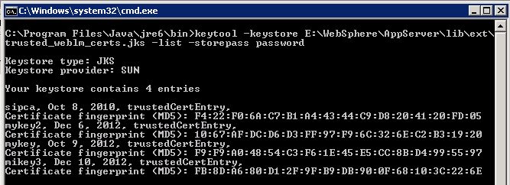
Certificates Installation Procedure
To see the list of installed certificates, use the command keytool -list -keystore {keystore} -storepass {password}
Example:

Slide 4
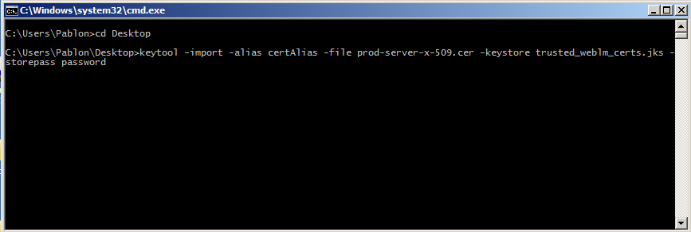
Certificates Installation Procedure
To import a certificate use the command keytool -import -alias {alias} -file {certificate} -keystore {keystore}
-storepass {password}
Example:

Slide 5
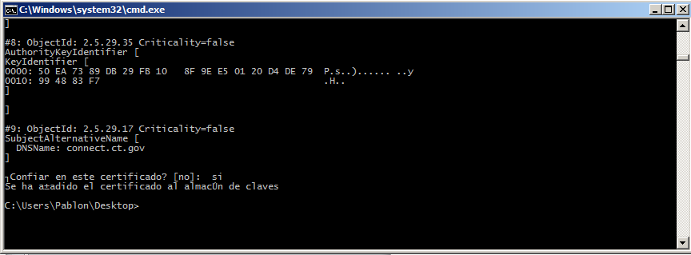
Certificates Installation Procedure
Note:
If, when a command returns "'keytool' is not recognized as an internal or external command, operable program or batch file." Have to re-run it from the 'bin' folder in java

Slide 6
Certificates Installation Procedure
Amdocs Servers
###################
# Linux Server I #
###################
Tomcat URL: 10.99.127.125
User : root
Password: root123
###################
# Linux Server II #
###################
Tomcat URL: 10.99.255.125
User : root
Password: root123

Slide 7
Certificates Installation Procedure
Cerfificates must be installed on both Java Virtual Machine and Tomcat locations.
/usr/java/jdk1.6.0_45/jre/lib/security
→ Install .jks cerfificate in file cacerts
/usr/local/apache-tomcat-6.0.37/lib
→ Keep a copy of .jks cerfificate in this location

Slide 8
Certificates Installation Procedure
Configure Avaya Framework to use the .jks local copy as the certificate keystore.
/usr/local/apache-tomcat-6.0.37/lib
→File: ddconfig.xml
There is an xml node indicating if the certificates are being read either locally (the .jks file in Tomcat /lib) or externally (Java security). Set useExternal to “false”.
<certificateInfo>
<useExternal value="false"/>
<keystore value="/usr/local/apache-tomcat-6.0.37/lib/trusted_weblm_certs.jks"/>
<password value="EKMe49TTioeLn8+iU0612g=="/>
</certificateInfo>

