Slide 1
Tomcat Configuration
Essentials

Slide 2
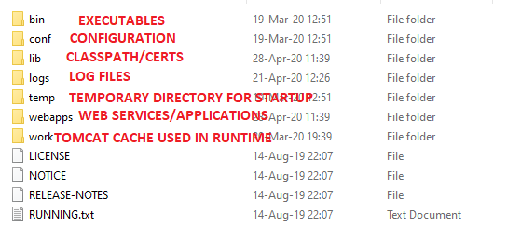
Tomcat Structure

Slide 3
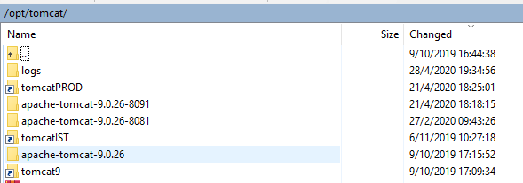
Folder naming convention
A good tomcat convention is to name folders including the port name and then creating a symbolic link/shortcut to each folder indicating the use (this can be used to define the server path). For example:

Slide 4
Creating a symbolic link in Unix
Creating the link:
ln -s {source-dir-name} {symbolic-dir-name}
Overwrite:
ln -f -s {source-dir-name} {symbolic-dir-name}
Delete:
rm {symbolic-dir-name} / unlink {symbolic-dir-name}

Slide 5
BIN
.BAT is for windows, .SH is for Unix.
Startup and shutdown to start and tear down.
To set the Java Path, instead of using the default, setenv.bat/sh must be created. Startup calls setenv by default if it exists.
Catalina.sh/bat has most of tomcat initial configuration (we don’t touch this).

Slide 6
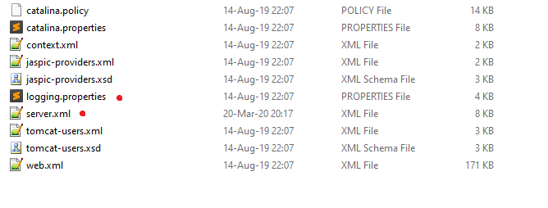
CONF

Slide 7

Server.xml
Tomcat Server Configuration, used for port mapping.
If you have various tomcat, you need to change these ports, except the redirect.
This is the one used to hit tomcat by browser or from the AEP.

Slide 8
Enable https on tomcat
Detailed Guide: http://tomcat.apache.org/tomcat-9.0-doc/ssl-howto.html
Quick Guide: https://mkyong.com/tomcat/how-to-configure-tomcat-to-support-ssl-or-https/
Easy Steps:
Generate Keystore: First, uses “keytool” command to create a self-signed certificate. Tomcat needs a certificate for https.
Add the connector:
<Connector port="8443" protocol="HTTP/1.1" SSLEnabled="true"
maxThreads="150" scheme="https" secure="true"
keystoreFile="/root/.keystore" keystorePass="your-key-password"
clientAuth="false" sslProtocol="TLS" />

Slide 9
Logging.properties
Tomcat owns a series of logs:
Catalina: is the container log file, tomcat logs.
localhost_access: (only one defined in server.xml) the access log (all requests like in http).
Localhost: the log of the host.
host-manager and manager: the logs of the related web applications.
Catalina.out: Only in Unix, not a log but the standard output of the console.
All the logging is configured in logging.properties inside of conf, using log4j.

Slide 10
Context.xml
Tomcat checks every reference to an external resource. Making its start somewhat slower. To avoid that this line (in red) could be added to “context.xml”.
<Context>
<!-- Default set of monitored resources. If one of these changes, the -->
<!-- web application will be reloaded. -->
<WatchedResource>WEB-INF/web.xml</WatchedResource>
<WatchedResource>WEB-INF/tomcat-web.xml</WatchedResource>
<WatchedResource>${catalina.base}/conf/web.xml</WatchedResource>
<JarScanner scanClassPath="false" scanAllFiles="false" scanAllDirectories="false"></JarScanner>
<!-- Uncomment this to disable session persistence across Tomcat restarts -->
<!--
<Manager pathname="" />
-->
</Context>

Slide 11
Logs
Besides the tomcat's logs, all applications should write their logs here, so they are centralized. Unless there is a requirement on the contrary.

Slide 12
Work & Temp
Work: The work directory is where Tomcat writes any files that it needs during run time. Conceptually you can think of it as Tomcat's cache; instead of reloading the web application from Tomcat\webapps, it can just load the cached version from the Tomcat\work directory.
Temp: When you startup Tomcat, using startup.bat (Windows) or startup.sh, it calls catalina.bat/catalina.sh respectively. Catalina then needs a temp directory to be set.

Slide 13
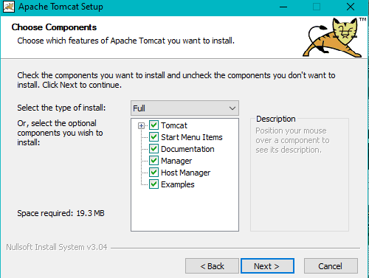
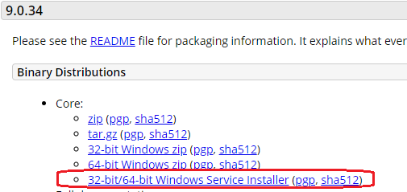
Create Tomcat as a Service Windows
On Windows, run the tomcat Installer, it will create the service automatically.
If tomcat was copied or extracted as a zip, you can add the service: http://dotnetlearners.com/windowsservice/installing-windows-service-using-sc-exe-in-windows-command-prompt
One note, in some versions of Windows Server, like the 2016, this process may not work and may require editing the registry.

Slide 14
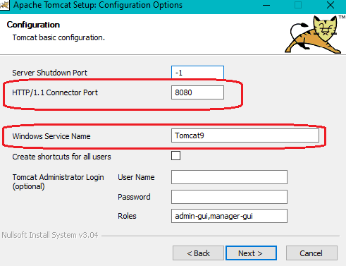
Create Tomcat as a Service Windows
Set Java and then the Tomcat path. Make sure to have permissions.

Slide 15
Create Tomcat as a Service Unix
This can be done at any time during tomcat lifetime. It involves, first adding it as a service and second making that service start on system boot.
First, make sure you have a dedicated user for tomcat (not root).
sudo adduser <name>
Create a file with the script (modify the init if you use it):
sudo vim /etc/init.d/<service-name>
Make it executable:
sudo chmod 755 /etc/init.d/tomcat
Tomcat se inicia/detiene con “sudo service <service-name> start/stop”

Slide 16
Create Tomcat as a Service Unix
Habilitar el servicio.
chkconfig --add <service-name>
chkconfig <service-name> on
Verificar:
chkconfig --list <service-name>
De esta forma tomcat se iniciaría al reiniciar el servidor.

Slide 17
PREGUNTAS?

