Slide 1
Send Information to Context Store through Oceana

Slide 2
Oceana
Avaya Oceana is the first delivery of Avaya’s next generation multi-touch contact center solution that helps organizations deliver a seamless customer experience across any channel of the customer's choosing. With Oceana, contact centers can seamlessly handle customer interactions in context across all devices and channels – mobile, web, chat, SMS, social media, voice, email and video – supported by strategic business rules and criteria, modern omnichannel agent desktop workspaces (Avaya Oceana™ Workspaces), and, with Avaya Oceanalytics™, cradle to grave reporting of the end to end customer journey across all omnichannel touch points.

Slide 3
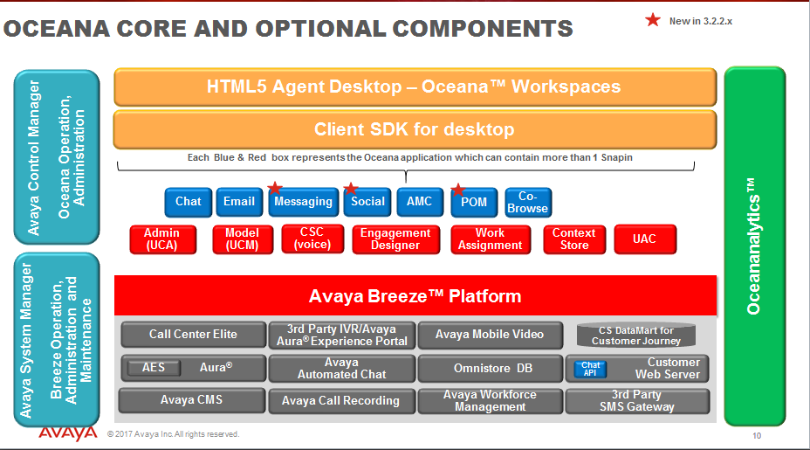
Oceana

Slide 4
Oceana
Questions:
https://confluence.forge.avaya.com/display/JOULE/Oceana+3.x+Knowledge+Base+Library

Slide 5
Oceana Context Store
Avaya Oceana enables organizations to map the customer journey across self-service and assisted service channels by storing data during the journey in the context store in-memory data grid. Data may consist of customer information either historical or provided in real-time, enterprise data, as well as situational / environmental data (e.g. device using, location, etc.). This customer journey data can be used by the workflows, resource matching engine, as well as agents and staff to make smarter real-time decisions on behalf of the customer and business.
This information is temporary.

Slide 6
Context Store Request Contents

Slide 7
Oceana Service Maps
When making a transfer to an agent it may occur that the calls need to be routed to an agent with specific skills. That’s the reason why service maps exist.
Service Maps contain attribute information on what agents can take the call.
The Service Map attributes are compared against the agent attributes in order to get an agent with the specific skills.

Slide 8
How to Use It
There are to ways to write information to Context Store. One is hitting that service directly and the other is through Oceana. Keep in mind that the Service Maps are used by Oceana when routing the call, so the first method won’t work with Service Maps.
In both cases, we have two ways of accomplishing this. By consuming the REST API, these services have published (this is equivalent to a WS call like when we access a customer back), or by using an OD plugin (DO NOT USE THIS METHOD).

Slide 9
Using the REST API through Oceana
All the URLs use HTTPS, with SSL.
There is no Authorization.
Requests and Responses are JSON.
What do you need?
The URL of the cluster where the Context Store is.
The information to build the service maps, which attributes are you going to pass.
The custom information you want to pass to the agent.

Slide 10
The POST Request
The URL will be http://<IP or DNS>/services/OceanaCoreDataService/oceana/data/context/schema
With Header: [Content-Type: application/json]
You can optionally send [lease=number of seconds] as a parameter, it Will be the duration of the registry in the ContextStore DB.
And body:

Slide 11
The Response
If no contextId was specified in the request, the response will be a contextId.
The Body:

Slide 12
Example Code

Slide 13
The GET Customer Id
Before calling the above method, we need a customerId to pass on the Request body.
This is obtained by a different API call, to another service, the getCustomerId.
It’s a REST GET call to http://<IP or DNS>/ services/CustomerManagement/rest/customers/customerId?phone=<caller ani>
The IP/DNS is the same as before, the Cluster IP or DNS.
We use the caller ANI as parameter.

Slide 14
The GET Customer Id
The response is a Json that contains the customerId.
We will always get a customerId, even with new caller. All customerIds are valid to be used in the ContextStore Request.
The Body is:

Slide 15
Questions?

