Slide 1
Quality Assurance - Overview
Quality Assurance
The main goal of the QA activities carried out in a voice application are the functional testing of the app, this is done using a telephone (landline or softphone) calling the DID (Direct Inward Dialing) or an extensión pointed to the AAEP (Experience Portal).
QA resources must be involved in the Project From the early stages in order to understand the design fully.

Slide 2
Quality Assurance – Design Review
Documents to review
The documents necessary to design a thorough QA testing are:
Voice User Interface (VUI)
Technical Design Specificaiton (TDS)
Report Nodes
Prompts List
Other Customer Design Documents
After the walk-through session by the Solution Architect has been carried out, it is very important to clarify all doubts and questions in writing. If there are discrepancies between documents, a precedence order or hierarchy of documents must be set

Slide 3
Quality Assurance – Test Case Strategy
Strategy
Once you are VERY familiar with the application’s functionality, and only after most of the doubts have been resolved, then you sit down to think about the test cases.
The philosophy about writing test cases is: WITH THE SMALLER AMOUNT OF TEST CASES COVER THE MOST PATHS in the application.
Test cases should be as complete as possible From CALL THE IVR to the final outcome: TRANSFER, END CALL, etc.
All functionality has to be tested, including Flow lines which are usually not included in the VUI, such as global behaviors for NoInput/NoMatch, MainMenu, Agent, etc, as defined

Slide 4
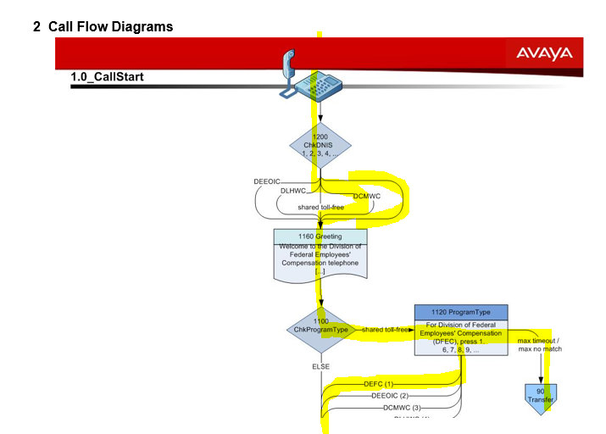
Quality Assurance – Test Case Design
Design
You must try to include, whenever possible the options which allow you to stay in the Flow (such as previous menu, repeat, go back to main menu).
The best approach is to highlight the branch/es covered by a particular Test Case.
At the end of the design stage, all application branches should be highlighted.

Slide 5
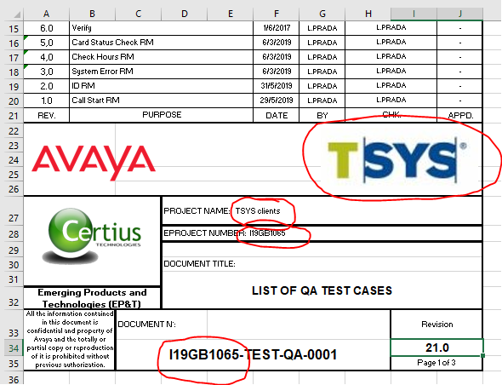
Quality Assurance – Preparation for Zephyr
Zephyr
Zephyr for JIRA is a native application that exists in JIRA and brings quality test management capabilities to any JIRA project. When Zephyr is used with JIRA, the test can be created, viewed in any JIRA project, and executed immediately or as part of a testing cycle that may be linked to other issues
Excel File
In order to BULK IMPORT test cases into Jira to be used later on by Zephyr, it must be done via an excel file.
We create an official project deliverable (with cover sheet for revision history) and from that document we use the second spreadsheet to be used in the upload.
See the attached sample, (the cover sheet must be edited to meet the project’s information (eProject number, description, logos, etc.)

Slide 6
Quality Assurance – Preparation for Zephyr (cont.)
Excel File (cont.)
Summary: This should be something that helps you identify the Test case easily, example: “PA07 - Has Play Balance -Has Payment Options, chooses balance payment” (Arbitrary Short Code - Brief Description)
Priority, fixed value, “P3 - Normal Queue”
Component/s, must match Jira component, it can be an app or subflow or submodule, example: “payment-ivr“
Linked Issues, leave blank
Description, similar to Summary, but it provides a more extensive verbiage on what will happen, and what is expected. Example: “User calls in and does not choose what language he wants to use. He is then handled in English, in the main option he chooses 1 (YES) and the guarantor number is found no previous credentials are present so he is asked for DOB and maxes out and gets transferred”
Labels, these must be WITHOUT SPACES, they should be something meaningful for filtering, some examples: “NoInput, NoMatch, DTMF_Positive, DTMF_Negative, WSError, SUCCESSPATH”
Test Automation, fixed value “Manual“
Test Step, describe step by step what to do, first Test Step is always Pre-requisites, it can be “Prerequisite: none” or something else, for example “Prerequisite: CAVs exist and have values, config file exists, properties are populated, CallDataModel data exists”, subsequent ones are should describe what needs to be done, for example “Call IVR” or “Press 1”, “Say customer service”, these cannot be left blank, so if no action required state “No Interaction”
Expected Result, First one should always be a description of the path, listing the nodes “NODES ACCESSED 1000-1040-1010-1020-1030-1050-END CALL“, subsequent ones describe what is the result from the step right to its left. Example “14120 - Please press 1 to pay your balance, 2 for the minimum amount or 3 for another amount”
Target Release, must match JIRA’s exact name of release, for example: “paymentivr-1.0”
Test Areas, fixed value “13- User Interface”
Test Activites, fixed value “Functional”
Asignee, who will execute the tests, Avaya handle, example “prada4”
The following fields should be present in your excel file
Summary (below see example)
Priority
Component/s
Linked Issues
Description
Labels
Test Automation
Test Step
Expected Result
Target Release
Test Areas
Test Activites
Asignee

Slide 7
Quality Assurance – Preparation for Zephyr (cont.)
Excel File (cont.)
Uploader
Uploader is a JAVA program, it can be downloaded from
https://bitbucket.org/zfjdeveloper/zfj-importer/downloads/ For More information you can visit https://www.getzephyr.com/insights/getting-started-zephyr-jira-importer-utility

Slide 8
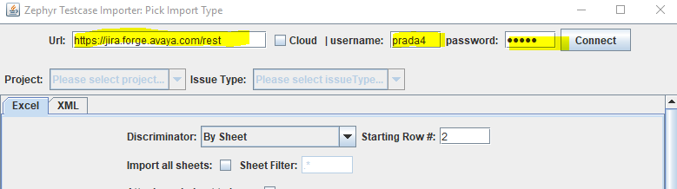
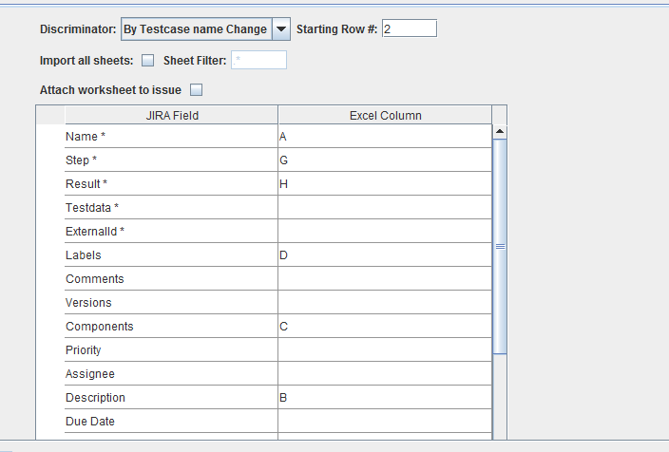
Quality Assurance – Uploading files to Jira
Uploader (cont.)
1-Run zfj-importer-utility-0.38.jar
In URL write: https://jira.forge.avaya.com/rest
Avaya Handle / Password
Select Project and in Issue Type Choose "Test"
Discriminator is "By test case Name change".
Starting at row# 2
Then match your columns in Excel with the required fields, If a field marked with a * is not in your Excel, such as externalID, match it to an empty Column, for instance column T.

Slide 9
Quality Assurance – Uploading files to Jira (Cont.)
Uploader (cont.)
Choose the file and start import.
At the end you will get a report stating was it successful or not.
If it fails, go back to the Excel file, corrected and rename it (version it somehow)

Slide 10
Quality Assurance – Jira Setup
Jira
After the Bulk upload is successfully finalized, it will create 1 Jira for each case uploaded. These tickets are the “test” type.
Each test ticket can be “Executed” many times in different test cycles.
Filter
Create a Filter for the recently uploaded test tickets, this will be used in the next step to add the tests to a cycle. You must use your imagination to create a filter specific enough to produce only test cases for that particular cycle.

Slide 11
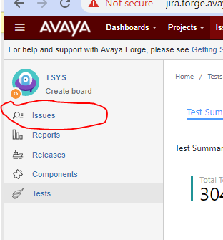
Quality Assurance – Jira Setup (cont.)
Filter (cont.)
On your main Project window in Jira, go to Issues
Click on View all Issues and Filters
Write your filter (again, be creative) This is where the Summary Description may help you, or maybe the component, below some examples Type 14 is “Test” ticket. It can also be written as type = test :
project = EPTINOVA AND resolution = Unresolved AND type = 14 AND summary ~ ENGLISH
project = TSYS AND resolution = Unresolved AND type = 14 AND component = "VBV Flow" ORDER BY summary ASC

Slide 12
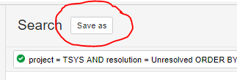
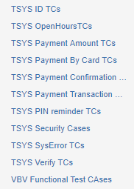
Quality Assurance – Jira Setup (cont.)
Filter (cont.)
Click on the Magnifying Glass
Then click on Save
and give the filter a significant name

Slide 13
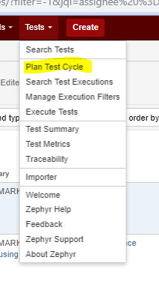
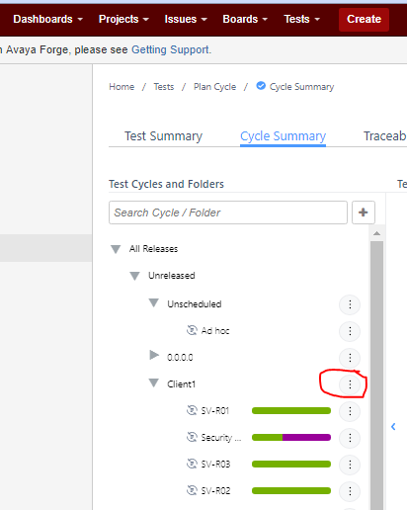

Quality Assurance – Zephyr Setup
Cycle Creation
In the Project Jira go to Tests and choose Plan Test Cycles
Select the Release you are creating a Test Cycle for
Then Name the cycle, and it will be ready to add the test cases.

Slide 14
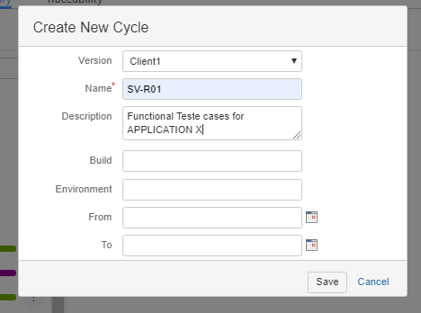
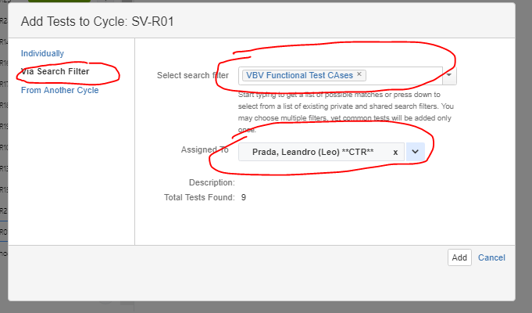
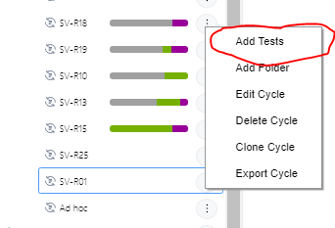
Quality Assurance – Zephyr Setup (cont.)
Cycle Creation (cont.)
Then Name the cycle, and it will be ready to add the test cases.
Add the cases to the cycle

Slide 15
Quality Assurance – Zephyr Setup (cont.)
Follow-up
Once that cycle is completed, create a new cycle including in it ONLY the cases which need to be further retested.

