Slide 1
An Introduction to Parallel Programming
Peter Pacheco
Chapter 4
Shared Memory Programming with Pthreads
Copyright © 2010, Elsevier Inc. All rights Reserved
Notes:
The University of Adelaide, School of Computer Science
Chapter 2 — Instructions: Language of the Computer

Slide 2
Roadmap
# Chapter Subtitle
Problems programming shared memory systems.
Controlling access to a critical section.
Thread synchronization.
Programming with POSIX threads.
Mutexes.
Producer-consumer synchronization and semaphores.
Barriers and condition variables.
Read-write locks.
Thread safety.
Copyright © 2010, Elsevier Inc. All rights Reserved
Notes:
The University of Adelaide, School of Computer Science
Chapter 2 — Instructions: Language of the Computer

Slide 3
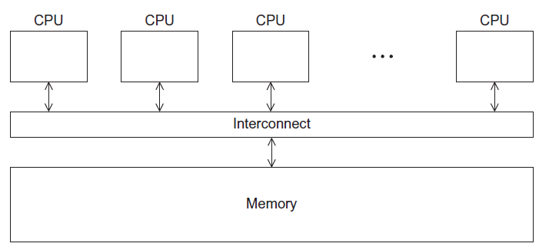
A Shared Memory System
Copyright © 2010, Elsevier Inc. All rights Reserved

Slide 4
Processes and Threads
A process is an instance of a running (or suspended) program.
Threads are analogous to a “light-weight” process.
In a shared memory program a single process may have multiple threads of control.
Copyright © 2010, Elsevier Inc. All rights Reserved

Slide 5
POSIX® Threads
Also known as Pthreads.
A standard for Unix-like operating systems.
A library that can be linked with C programs.
Specifies an application programming interface (API) for multi-threaded programming.
Copyright © 2010, Elsevier Inc. All rights Reserved

Slide 6
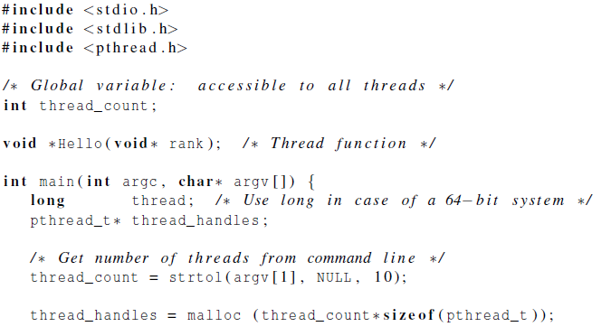
Hello World! (1)
declares the various Pthreads
functions, constants, types, etc.
Copyright © 2010, Elsevier Inc. All rights Reserved

Slide 7
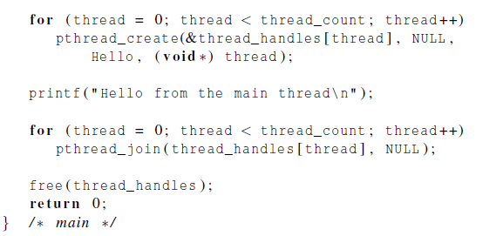
Hello World! (2)
Copyright © 2010, Elsevier Inc. All rights Reserved

Slide 8
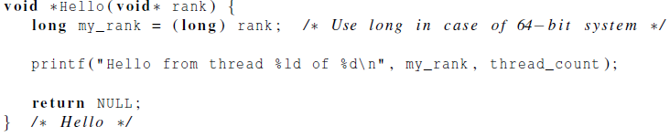
Hello World! (3)
Copyright © 2010, Elsevier Inc. All rights Reserved

Slide 9
Compiling a Pthread program
gcc −g −Wall −o pth_hello pth_hello . c −lpthread
link in the Pthreads library
Copyright © 2010, Elsevier Inc. All rights Reserved

Slide 10
Running a Pthreads program
. / pth_hello <number of threads>
. / pth_hello 1
Hello from the main thread
Hello from thread 0 of 1
. / pth_hello 4
Hello from the main thread
Hello from thread 0 of 4
Hello from thread 1 of 4
Hello from thread 2 of 4
Hello from thread 3 of 4
Copyright © 2010, Elsevier Inc. All rights Reserved

Slide 11

Global variables
Can introduce subtle and confusing bugs!
Limit use of global variables to situations in which they’re really needed.
  Shared variables.
Copyright © 2010, Elsevier Inc. All rights Reserved

Slide 12
Starting the Threads
Processes in MPI are usually started by a script.
In Pthreads the threads are started by the program executable.
Copyright © 2010, Elsevier Inc. All rights Reserved

Slide 13
Starting the Threads
pthread.h
One object for each thread.
pthread_t
int pthread_create (
pthread_t* thread_p /* out */ ,
const pthread_attr_t* attr_p /* in */ ,
void* (*start_routine ) ( void ) /* in */ ,
void* arg_p /* in */ ) ;
Copyright © 2010, Elsevier Inc. All rights Reserved

Slide 14
pthread_t objects
Opaque
The actual data that they store is system-specific.
Their data members aren’t directly accessible to user code.
However, the Pthreads standard guarantees that a pthread_t object does store enough information to uniquely identify the thread with which it’s associated.
Copyright © 2010, Elsevier Inc. All rights Reserved

Slide 15
A closer look (1)
int pthread_create (
pthread_t* thread_p /* out */ ,
const pthread_attr_t* attr_p /* in */ ,
void* (*start_routine ) ( void ) /* in */ ,
void* arg_p /* in */ ) ;
We won’t be using, so we just pass NULL.
Allocate before calling.
Copyright © 2010, Elsevier Inc. All rights Reserved

Slide 16
A closer look (2)
int pthread_create (
pthread_t* thread_p /* out */ ,
const pthread_attr_t* attr_p /* in */ ,
void* (*start_routine ) ( void ) /* in */ ,
void* arg_p /* in */ ) ;
Pointer to the argument that should
be passed to the function start_routine.
The function that the thread is to run.
Copyright © 2010, Elsevier Inc. All rights Reserved

Slide 17
Function started by pthread_create
Prototype:
void* thread_function ( void* args_p ) ;
Void* can be cast to any pointer type in C.
So args_p can point to a list containing one or more values needed by thread_function.
Similarly, the return value of thread_function can point to a list of one or more values.
Copyright © 2010, Elsevier Inc. All rights Reserved

Slide 18
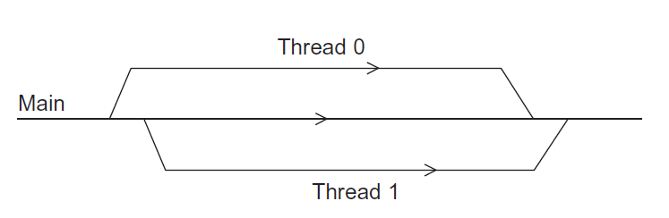
Running the Threads
Main thread forks and joins two threads.
Copyright © 2010, Elsevier Inc. All rights Reserved

Slide 19
Stopping the Threads
We call the function pthread_join once for each thread.
A single call to pthread_join will wait for the thread associated with the pthread_t object to complete.
Copyright © 2010, Elsevier Inc. All rights Reserved

Slide 20
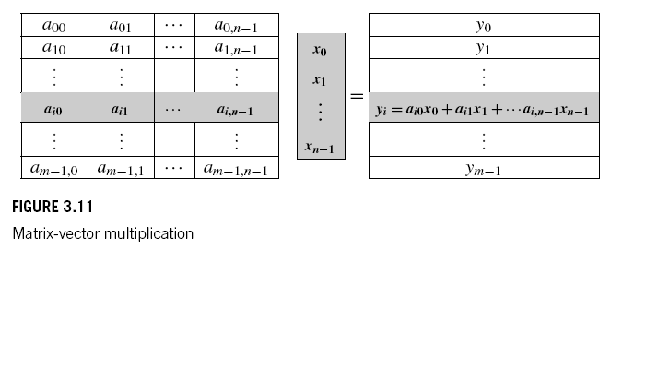
MATRIX-VECTOR MULTIPLICATION IN PTHREADS
Copyright © 2010, Elsevier Inc. All rights Reserved

Slide 21
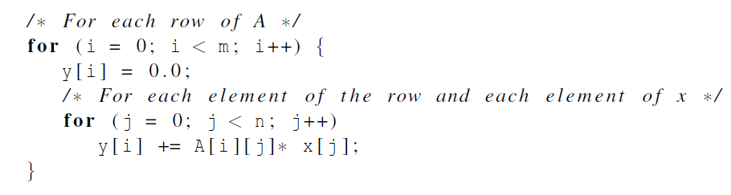
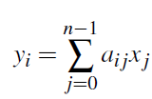
Serial pseudo-code
Copyright © 2010, Elsevier Inc. All rights Reserved

Slide 22
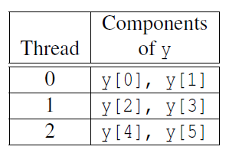
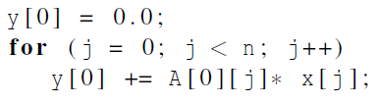
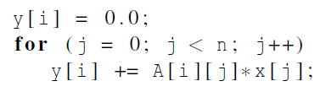
Using 3 Pthreads
thread 0
general case
Copyright © 2010, Elsevier Inc. All rights Reserved

Slide 23
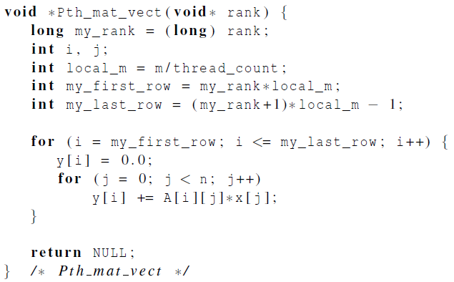
Pthreads matrix-vector multiplication
Copyright © 2010, Elsevier Inc. All rights Reserved

Slide 24
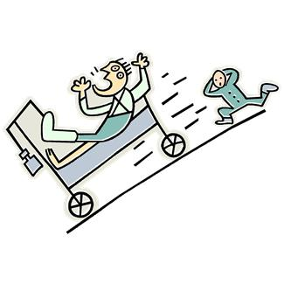
CRITICAL SECTIONS
Copyright © 2010, Elsevier Inc. All rights Reserved

Slide 25
Race Condition / Race Hazard
It is the behavior of the software where the system's substantive behavior is dependent on the sequence or timing of other uncontrollable events
Example: Run sum+=1 in a loop with sum as a shared variable
Copyright © 2010, Elsevier Inc. All rights Reserved

Slide 26
Critical Section (Região Crítica)
A Critical Section is a code segment that accesses shared variables and has to be executed as an atomic action
Example: The shared variable sum+=1 itself
Solution: Mutual Exclusion. (see next slide)
Copyright © 2010, Elsevier Inc. All rights Reserved

Slide 27
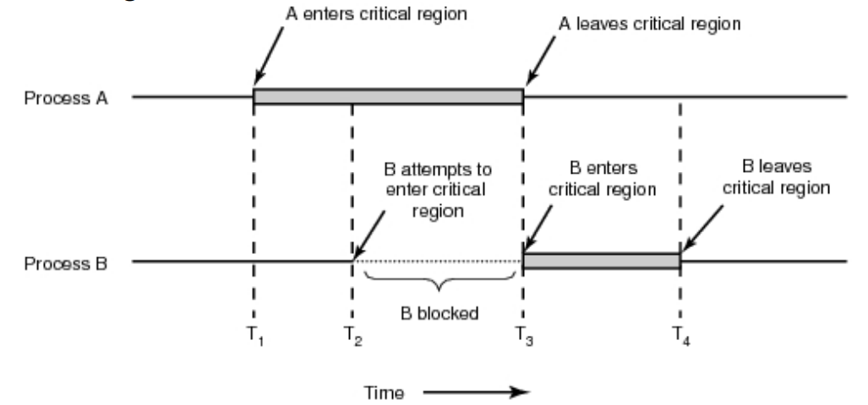
Mutual Exclusion
We can use as Mutual Exclusion:
- Busy-waiting (espera ocupada)
- Semaphore
- Mutex (it is a special case of Semaphore)
Copyright © 2010, Elsevier Inc. All rights Reserved

Slide 28
Mutual Exclusion by Examples
Estimating π
See: Leibniz formula for π
Copyright © 2010, Elsevier Inc. All rights Reserved

Slide 29
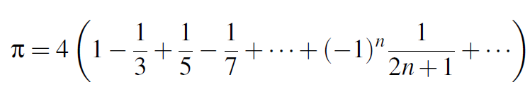
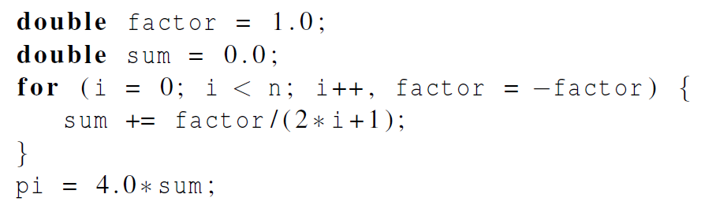
Estimating π
Copyright © 2010, Elsevier Inc. All rights Reserved

Slide 30
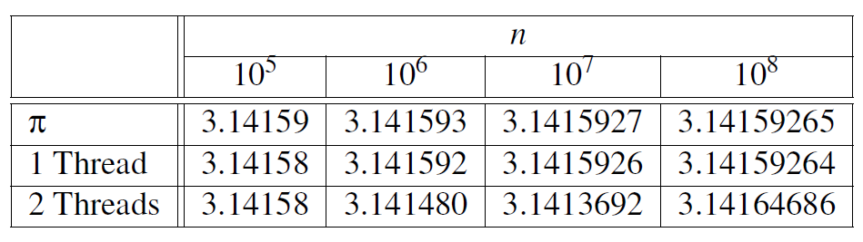
Using a dual core processor
Note that as we increase n, the estimate with one thread gets better and better.
Copyright © 2010, Elsevier Inc. All rights Reserved

Slide 31
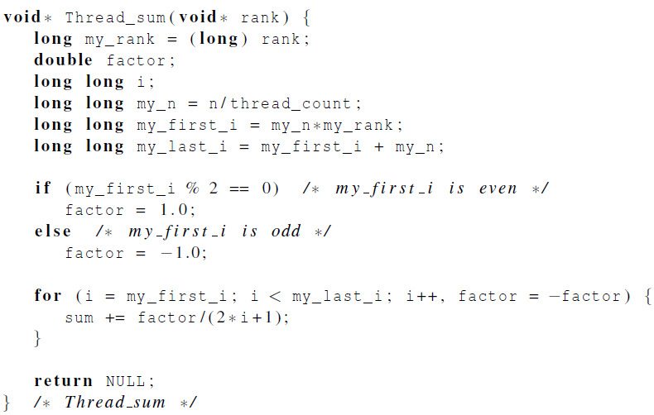
A thread function for computing π
Copyright © 2010, Elsevier Inc. All rights Reserved

Slide 32
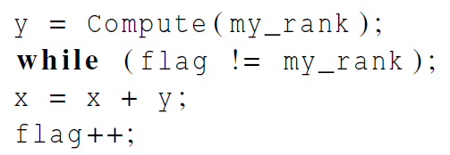
Busy-Waiting
A thread repeatedly tests a condition, but, effectively, does no useful work until the condition has the appropriate value.
Beware of optimizing compilers, though!
flag initialized to 0 by main thread
Copyright © 2010, Elsevier Inc. All rights Reserved

Slide 33
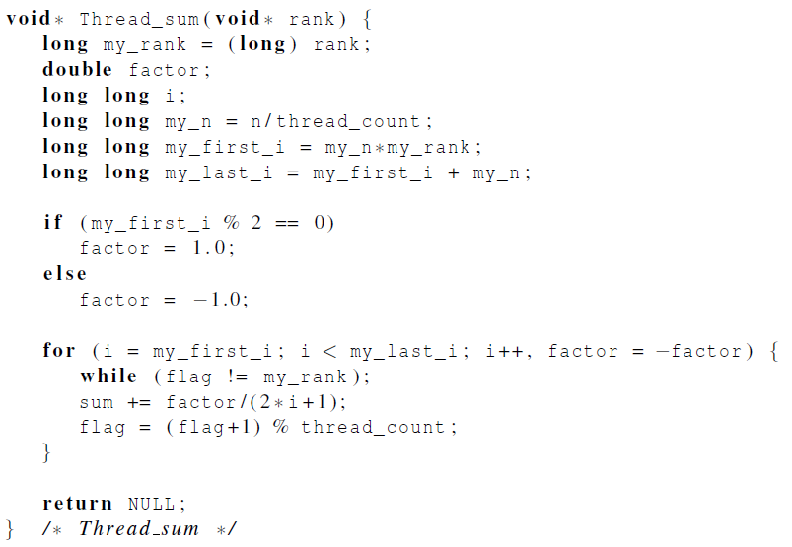
Pthreads global sum with busy-waiting
Copyright © 2010, Elsevier Inc. All rights Reserved

Slide 34
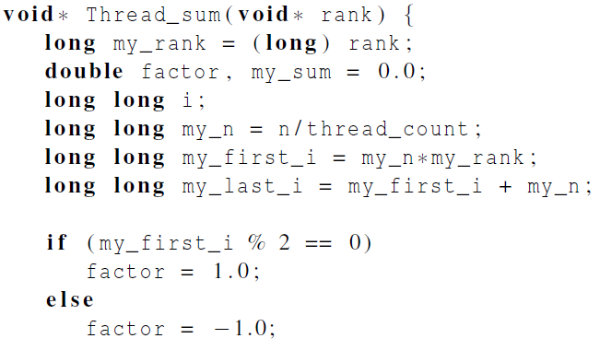
Global sum function with critical section after loop (1)
Copyright © 2010, Elsevier Inc. All rights Reserved

Slide 35
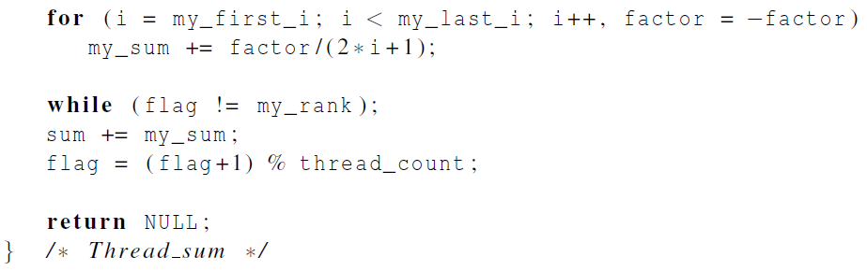
Global sum function with critical section after loop (2)
Copyright © 2010, Elsevier Inc. All rights Reserved

Slide 36
SEMAPHORE & MUTEX
Copyright © 2010, Elsevier Inc. All rights Reserved

Slide 37
Mutexes
A thread that is busy-waiting may continually use the CPU accomplishing nothing.
Mutex (mutual exclusion) is a special type of variable that can be used to restrict access to a critical section to a single thread at a time.
Copyright © 2010, Elsevier Inc. All rights Reserved

Slide 38
Mutexes
A special type of variable
You can LOCK or UNLOCK
  LOCK: no one can run that part of the code, except me (thread)
  UNLOCK: everybody can try to lock
Lines of the code between LOCK and UNLOCK: it is a critical section with mutual exclusion.
Copyright © 2010, Elsevier Inc. All rights Reserved

Slide 39

Mutexes
Used to guarantee that one thread “excludes” all other threads while it executes the critical section.
The Pthreads standard includes a special type for mutexes: pthread_mutex_t.
Copyright © 2010, Elsevier Inc. All rights Reserved

Slide 40
Mutexes
When a Pthreads program finishes using a mutex, it should call
In order to gain access to a critical section a thread calls
Copyright © 2010, Elsevier Inc. All rights Reserved

Slide 41
Mutexes
When a thread is finished executing the code in a critical section, it should call
Copyright © 2010, Elsevier Inc. All rights Reserved

Slide 42
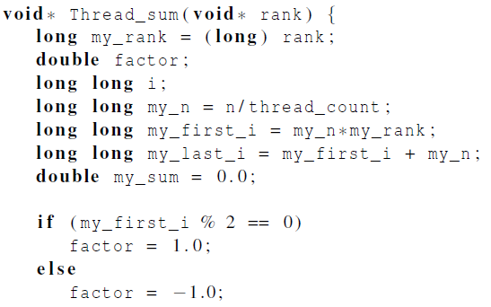
Global sum function that uses a mutex (1)
Copyright © 2010, Elsevier Inc. All rights Reserved

Slide 43
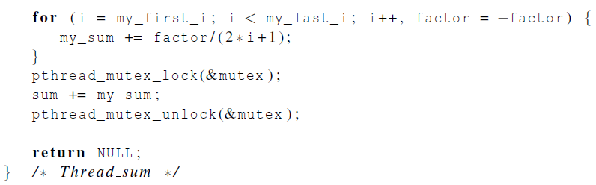
Global sum function that uses a mutex (2)
Copyright © 2010, Elsevier Inc. All rights Reserved

Slide 44
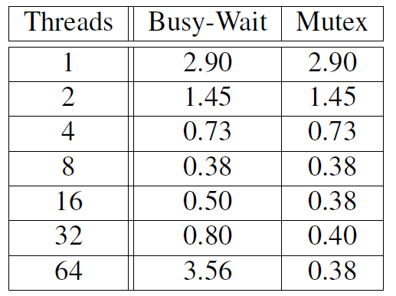
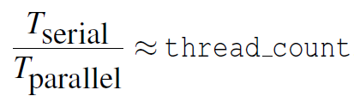
Run-times (in seconds) of π programs using n = 108 terms on a system with two four-core processors.
Copyright © 2010, Elsevier Inc. All rights Reserved

Slide 45
Semaphores
It is an integer, nonnegative variable in which you can only do two operations (other than initialization):
  P or DOWN: reduce the number (like lock in mutex)
  V or UP: increments the number (link unlock in mutex)
Those instructions are atomic.
Mutex is a special case of semaphore with counter equals 1;
Copyright © 2010, Elsevier Inc. All rights Reserved

Slide 46
Semaphores
Let “s” as a semaphore
  Down(s): If s>0, decreases s. Otherwise suspends the task
  Up(s): If there is any task suspended in s, release one of them, otherwise increment s.
    It is not specified which process is released
Copyright © 2010, Elsevier Inc. All rights Reserved

Slide 47
Semaphores
  void p1(void) {
    for(;;) {
    Down(s1);
    /*Critical Section*/
    Up(s1);
    ...
    }
    ...
  }
  void p2(void) {
    for(;;) {
    Down(s1);
    /*Critical Section*/
    Up(s1);
    ...
    }
    ...
  }
Copyright © 2010, Elsevier Inc. All rights Reserved

Slide 48
Semaphores
Instruction | Description
sem_init | Initialization
sem_wait | Down.
sem_trywait | Non-blocking Down. Try to lock sem.
sem_post | Up. It is s the same as sem_wait(), except that if the decrement cannot be immediately performed, then call returns an error instead of blocking.
sem_get_value | Returns the semaphore counter value.
sem_destroy | Destroys the semaphore
Copyright © 2010, Elsevier Inc. All rights Reserved

Slide 49

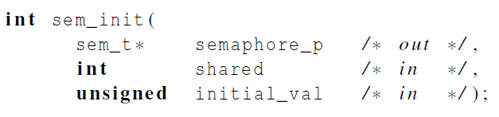
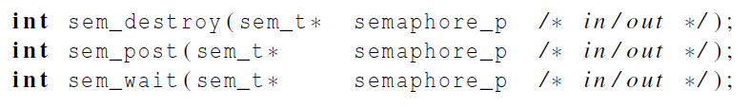
Syntax of the various semaphore functions
Semaphores are not part of Pthreads;
you need to add this.
Copyright © 2010, Elsevier Inc. All rights Reserved

Slide 50
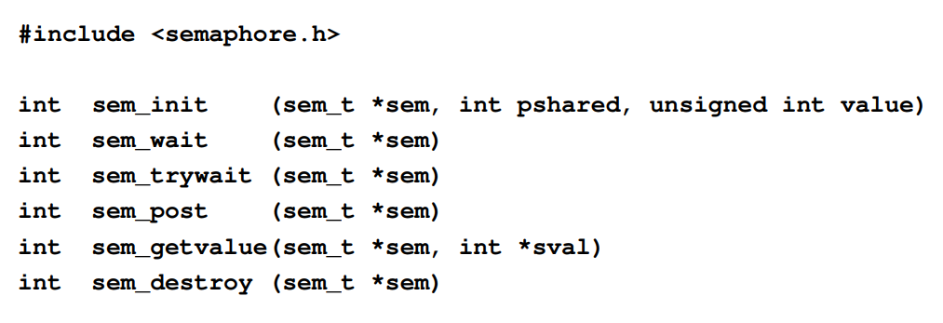
Semaphores
If pshared has the value 0, then the semaphore is shared between the threads of a process.
http://man7.org/linux/man-pages/man3/sem_init.3.html
Copyright © 2010, Elsevier Inc. All rights Reserved

Slide 51
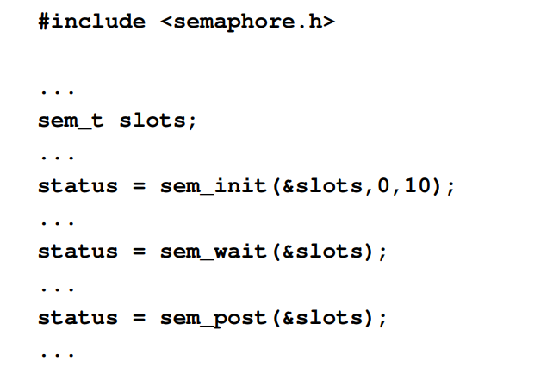
Semaphores
Copyright © 2010, Elsevier Inc. All rights Reserved

Slide 52

BARRIERS AND CONDITION VARIABLES
Copyright © 2010, Elsevier Inc. All rights Reserved

Slide 53
Barriers
Synchronizing the threads to make sure that they all are at the same point in a program is called a barrier.
No thread can cross the barrier until all the threads have reached it.
Copyright © 2010, Elsevier Inc. All rights Reserved

Slide 54
Busy-waiting and a Mutex
Implementing a barrier using busy-waiting and a mutex is straightforward.
We use a shared counter protected by the mutex.
When the counter indicates that every thread has entered the critical section, threads can leave the critical section.
Copyright © 2010, Elsevier Inc. All rights Reserved

Slide 55
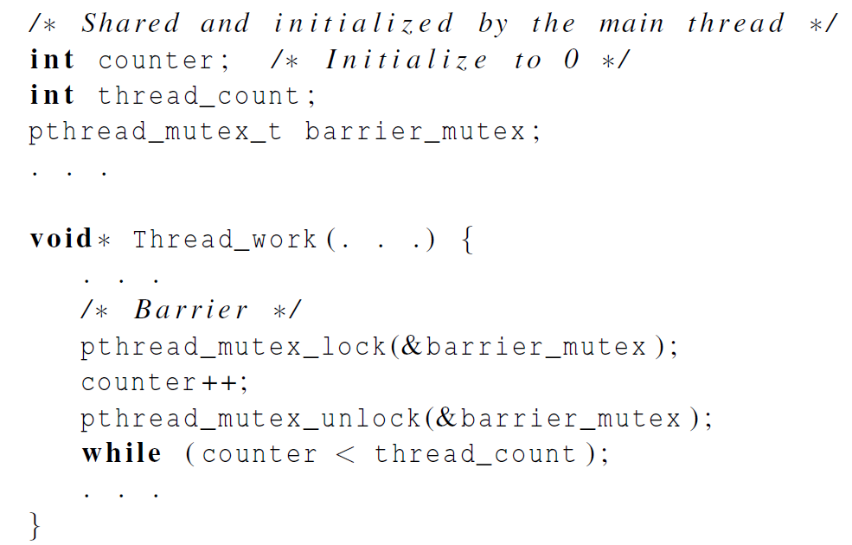
Busy-waiting and a Mutex
We need one counter
variable for each
instance of the barrier,
otherwise problems
are likely to occur.
Copyright © 2010, Elsevier Inc. All rights Reserved

Slide 56
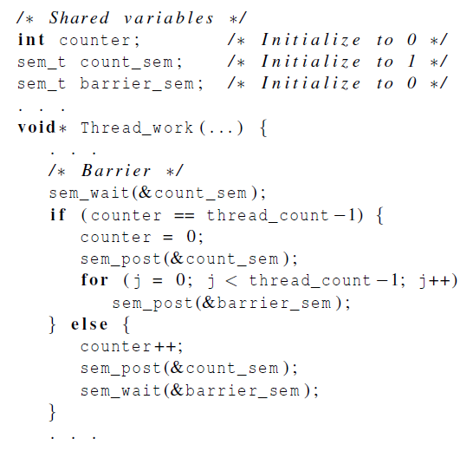
Implementing a barrier with semaphores
Copyright © 2010, Elsevier Inc. All rights Reserved

Slide 57
Concluding Remarks (1)
A thread in shared-memory programming is analogous to a process in distributed memory programming.
However, a thread is often lighter-weight than a full-fledged process.
In Pthreads programs, all the threads have access to global variables, while local variables usually are private to the thread running the function.
Copyright © 2010, Elsevier Inc. All rights Reserved

Slide 58
Concluding Remarks (2)
When indeterminacy results from multiple threads attempting to access a shared resource such as a shared variable or a shared file, at least one of the accesses is an update, and the accesses can result in an error, we have a race condition.
Copyright © 2010, Elsevier Inc. All rights Reserved

Slide 59
Concluding Remarks (3)
A critical section is a block of code that updates a shared resource that can only be updated by one thread at a time.
So the execution of code in a critical section should, effectively, be executed as serial code.
Copyright © 2010, Elsevier Inc. All rights Reserved

Slide 60
Concluding Remarks (4)
Busy-waiting can be used to avoid conflicting access to critical sections with a flag variable and a while-loop with an empty body.
It can be very wasteful of CPU cycles.
It can also be unreliable if compiler optimization is turned on.
Copyright © 2010, Elsevier Inc. All rights Reserved

Slide 61
Concluding Remarks (5)
A mutex can be used to avoid conflicting access to critical sections as well.
Think of it as a lock on a critical section, since mutexes arrange for mutually exclusive access to a critical section.
Copyright © 2010, Elsevier Inc. All rights Reserved

Slide 62
Concluding Remarks (6)
A semaphore is the third way to avoid conflicting access to critical sections.
It is an unsigned int together with two operations: sem_wait and sem_post.
Semaphores are more powerful than mutexes since they can be initialized to any nonnegative value.
Copyright © 2010, Elsevier Inc. All rights Reserved

Slide 63
Concluding Remarks (7)
A barrier is a point in a program at which the threads block until all of the threads have reached it.
Copyright © 2010, Elsevier Inc. All rights Reserved

