Slide 1
F# Tutorial
The F# Team
Microsoft Developer Division
Microsoft Research, Cambridge

Slide 2
Tutorial Contents
Topic | Covered Today
Fundamentals | ✓
Functional Data | ✓
Pattern Matching | ✓
Imperative Basics | ✓
Object Basics | ✓
Sequences | ✓
Parallel and Async | ✓
Units of Measure | ✓

Slide 3
What is F# about?
Or: Why is Microsoft investing in functional programming anyway?

Slide 4
Simplicity

Slide 5
Economics

Slide 6
Fun

Slide 7
Code!
//F#
open System
let a = 2
Console.WriteLine a
//C#
using System;
namespace ConsoleApplication1
{
class Program
{
static int a()
{
return 2;
}
static void Main(string[] args)
{
Console.WriteLine(a);
}
}
}
More Noise
Than Signal!

Slide 8
Pleasure
Pain
type Command = Command of (Rover -> unit)
let BreakCommand =
Command(fun rover -> rover.Accelerate(-1.0))
let TurnLeftCommand =
Command(fun rover -> rover.Rotate(-5.0<degs>))
abstract class Command
{
public virtual void Execute();
}
abstract class MarsRoverCommand : Command
{
protected MarsRover Rover { get; private set; }
public MarsRoverCommand(MarsRover rover)
{
this.Rover = rover;
}
}
class BreakCommand : MarsRoverCommand
{
public BreakCommand(MarsRover rover)
: base(rover)
{
}
public override void Execute()
{
Rover.Rotate(-5.0);
}
}
class TurnLeftCommand : MarsRoverCommand
{
public TurnLeftCommand(MarsRover rover)
: base(rover)
{
}
public override void Execute()
{
Rover.Rotate(-5.0);
}
}

Slide 9
Pleasure
Pain
let swap (x, y) = (y, x)
let rotations (x, y, z) =
[ (x, y, z);
(z, x, y);
(y, z, x) ]
let reduce f (x, y, z) =
f x + f y + f z
Tuple<U,T> Swap<T,U>(Tuple<T,U> t)
{
return new Tuple<U,T>(t.Item2, t.Item1)
}
ReadOnlyCollection<Tuple<T,T,T>> Rotations<T>(Tuple<T,T,T> t)
{
new ReadOnlyCollection<int>
(new Tuple<T,T,T>[]
{ new Tuple<T,T,T>(t.Item1,t.Item2,t.Item3);
new Tuple<T,T,T>(t.Item3,t.Item1,t.Item2);
new Tuple<T,T,T>(t.Item2,t.Item3,t.Item1); });
}
int Reduce<T>(Func<T,int> f,Tuple<T,T,T> t)
{
return f(t.Item1) + f(t.Item2) + f (t.Item3);
}

Slide 10
Pleasure
Pain
type Expr =
| True
| And of Expr * Expr
| Nand of Expr * Expr
| Or of Expr * Expr
| Xor of Expr * Expr
| Not of Expr
public abstract class Expr { }
public abstract class UnaryOp :Expr
{
public Expr First { get; private set; }
public UnaryOp(Expr first)
{
this.First = first;
}
}
public abstract class BinExpr : Expr
{
public Expr First { get; private set; }
public Expr Second { get; private set; }
public BinExpr(Expr first, Expr second)
{
this.First = first;
this.Second = second;
}
}
public class TrueExpr : Expr { }
public class And : BinExpr
{
public And(Expr first, Expr second) : base(first, second) { }
}
public class Nand : BinExpr
{
public Nand(Expr first, Expr second) : base(first, second) { }
}
public class Or : BinExpr
{
public Or(Expr first, Expr second) : base(first, second) { }
}
public class Xor : BinExpr
{
public Xor(Expr first, Expr second) : base(first, second) { }
}
public class Not : UnaryOp
{
public Not(Expr first) : base(first) { }
}

Slide 11
F#: Influences
OCaml
C#/.NET
F#
Similar core
language
Similar object
model

Slide 12
F#: Combining Paradigms
I've been coding in F# lately, for a production task. F# allows you to move smoothly in your programming style... I start with pure functional code, shift slightly towards an object-oriented style, and in production code, I sometimes have to do some imperative programming.
I can start with a pure idea, and still finish my project with realistic code. You're never disappointed in any phase of the project!
Julien Laugel, Chief Software Architect, www.eurostocks.com

Slide 13
Code: Let’s WebCrawl…

Slide 14
Weakly Typed? Slow?
//F#
#light
open System
let a = 2
Console.WriteLine(a)
//C#
using System;
namespace ConsoleApplication1
{
class Program
{
static int a()
{
return 2;
}
static void Main(string[] args)
{
Console.WriteLine(a);
}
}
}
Looks Weakly typed? STRONG TYPES!
Maybe Dynamic?
COMPILED!
Notes:
But why does F# omit any type information? Is it not type safe? Is it coercive maybe? Or weakly typed? Maybe this is one of those dynamic languages I read about at 37 signals?

Slide 15
Tutorial: Fundamentals

Slide 16
Your First F# Application
printfn "Hello World"
C:\test> fsc test.fs
C:\test> test.exe
Hello World
C:\test>

Slide 17
Your Second F# Application
open System.Windows.Form
let form = new Form (Visible=true)
form.Click.Add (fun _ -> printfn "click")
Application.Run form

Slide 18
Your Third F# Application
let rec fib x =
if x < 2 then 1
else fib (x–1) + fib (x-2)
let results = Array.map fib [| 1 .. 40 |]
printfn "results = %A" results

Slide 19
Your Third F# Application
let rec fib x =
if x < 2 then 1
else fib (x–1) + fib (x-2)
let results = Array.Parallel.map fib [| 1 .. 40 |]
printfn "results = %A" results

Slide 20
Fundamentals: Let
Type inference. The safety of C# with the succinctness of a scripting language
Let “let” simplify your life…
Bind a static value
let data = (1, 2, 3)
let f (a, b, c) =
let sum = a + b + c
let g x = sum + x*x
(g a, g b, g c)
Bind a static function
Bind a local value
Bind a local function

Slide 21
Fundamentals - Whitespace Matters
let computeDeriative f x =
let p1 = f (x - 0.05)
let p2 = f (x + 0.05)
(p2 – p1) / 0.1
Offside (bad indentation)

Slide 22
Fundamentals - Whitespace Matters
let computeDeriative f x =
let p1 = f (x - 0.05)
let p2 = f (x + 0.05)
(p2 – p1) / 0.1

Slide 23
Fundamentals - Comments
Comments
// comment
(* comment *)
/// XML doc comment
let x = 1

Slide 24
Fundamentals - Comments
/// Computes the approximate numerical derivative
/// of 'f' at 'x'.
let computeDerivative f x =
let p1 = f (x - 0.05)
let p2 = f (x + 0.05)
(p2 – p1) / 0.1

Slide 25
Fundamentals - Comments
/// <summary>
/// Computes the approximate numerical derivative
/// of 'f' at 'x'.
/// </summary>
let computeDerivative f x =
let p1 = f (x - 0.05)
let p2 = f (x + 0.05)
(p2 – p1) / 0.1
Standard XML docs

Slide 26
Functional: Functions
Functions: like delegates + unified and simple
One simple
mechanism,
many
uses
Anonymous
Function value
(fun x -> x + 1)
let f x = x + 1
(f, f)
val f : int -> int
predicate = 'a -> bool
send = 'a -> unit
Declare a
function value
threadStart = unit -> unit
A pair
of function values
comparer = 'a -> 'a -> int
hasher = 'a -> int
A function type
equality = 'a -> 'a -> bool

Slide 27
Fundamentals – Basic Operators
Overloaded Arithmetic
x + y Addition
x - y Subtraction
x * y Multiplication
x / y Division
x % y Remainder/modulus
-x Unary negation
Booleans
not expr Boolean negation
expr && expr Boolean “and”
expr || expr Boolean “or”

Slide 28
Fundamentals: Basic Types (cont.)
Basic Types/Literals
int 76
string "abc", @"c:\etc"
float 3.14, 3.2e5
char '7'
bool true, false
unit ()

Slide 29
Fundamentals: Basic Types (cont.)
Basic Types and Literals
sbyte = System.SByte 76y
byte = System.Byte 76uy
int16 = System.Int16 76s
uint16 = System.UInt16 76us
int32 = System.Int32 76
uint32 = System.UInt32 76u
int64 = System.Int64 76L
uint64 = System.UInt64 76UL
string = System.String "abc", @"c:\etc"
single = System.Single 3.14f
double = System.Double 3.14, 3.2e5
char = System.Char '7'
nativeint = System.IntPtr 76n
unativeint = System.UIntPtr 76un
bool = System.Boolean true, false
unit = FSharp.Core.Unit ()
obj = System.Object box 5
exn = System.Exception new ArgumentException()
bigint = FSharp.Math.BigInt 1024I * 1024I * 1024I * 1024I

Slide 30
Functional– Pipelines
x |> f
The pipeline operator

Slide 31
Functional– Pipelines
Successive stages
in a pipeline
x |> f1
|> f2
|> f3

Slide 32
Functional – Pipelining
open System.IO
let files =
Directory.GetFiles(@"c:\", "*.*",
SearchOption.AllDirectories)
let totalSize =
files
|> Array.map (fun file -> FileInfo file)
|> Array.map (fun info -> info.Length)
|> Array.sum
Sum of file sizes

Slide 33
Functional – Pipelining
open System.IO
let files =
Directory.GetFiles(@"c:\", "*.*",
SearchOption.AllDirectories)
let totalSize =
files
|> Array.map (fun file -> FileInfo file)
|> Array.sumBy (fun info -> info.Length)
Combining stages
from a pipeline

Slide 34
Tutorial: Functional Data

Slide 35
Generating Data with [ … ]
Simple list
let kindergartenActivities () =
[ "Baking.fs"
"PlayingInGarden.fs"
"SayingGoodbye.fs" ]

Slide 36
Generating Data with [ … ]
Same thing
let kindergartenActivities () =
[ yield "Baking.fs"
yield "PlayingInGarden.fs"
yield "SayingGoodbye.fs" ]

Slide 37
Generating Data with [ … ]
Yield + Conditionals
let kindergartenActivities () =
[ yield "PlayingInGarden.fs"
if DateTime.Now.DayOfWeek = Monday then
yield "Baking.fs"
yield "SayingGoodbye.fs" ]

Slide 38
Generating Data with [ … ]
Match too
let kindergartenActivities() =
[ yield "PlayingInGarden.fs“
match DateTime.Now.DayOfWeek with
| Monday -> yield "Baking.fs"
| Tuesday -> yield "Building.fs"
| _ -> yield "Singing.fs"
yield "StoryTelling.fs"
yield "SayingGoodbye.fs" ]

Slide 39
Generating Data with [ … ]
Yield many!
let weekDay () =
[ yield! kindergartenActivities ()
yield! afternoonActivities ()
yield "GoToBed.fs" ]

Slide 40
Generating Data with [ … ]
For loops
let tableOfSquares n =
[ for x in 1 .. n do
yield (x, x*x) ]
let allActivities children =
[ for child in children do
yield "WakeUp.fs"
yield! morningActivities child ]
For loops

Slide 41
Generating Data with [ … ]
We can do I/O here
This is F#, not Haskell
open System.IO
let rec allFiles dir =
[ for file in Directory.GetFiles dir do
yield file
for subdir in Directory.GetDirectories dir do
yield! allFiles subdir ]
allFiles @"C:\Demo"

Slide 42
Generating Data with seq { … }
Same syntax, but generated on demand
open System.IO
let rec allFiles dir =
seq { for file in Directory.GetFiles dir do
yield file
for subdir in Directory.GetDirectories dir do
yield! allFiles subdir }
allFiles @"C:\WINDOWS"
|> Seq.take 100
|> show

Slide 43
Generating Data with seq { … }
let someFilesOnDemand =
seq { printfn "about to yield #1"
yield "File1.fs"
printfn "about to yield #2"
yield "File3.fs"
printfn "finishing..." }
someFilesOnDemand
someFilesOnDemand |> Seq.toList
Does nothing!
Does everything!

Slide 44
Generating Data with seq { … }
Because it's on-demand, things can now be infinite
let rec randomWalk x =
seq { yield x
yield! randomWalk (x+rnd()) }

Slide 45
Functional Data – Recap
Range
Expressions
[ 0..1000 ]
[ for x in 0..1000 -> (x, x * x) ]
[| for x in 0..1000 -> (x, x * x) |]
seq { for x in 0..1000 -> (x, x * x) }
List via query
Array via query
Sequence
via query

Slide 46
Functional Data – Generating Structured Data
Union type
(no data = enum)
type Suit =
| Heart
| Diamond
| Spade
| Club
type PlayingCard =
| Ace of Suit
| King of Suit
| Queen of Suit
| Jack of Suit
| ValueCard of int * Suit
Union type
with data

Slide 47
Functional Data – Generating Structured Data (2)
let suits = [ Heart; Diamond; Spade; Club ]
let deckOfCards =
[ for suit in suits do
yield Ace suit
yield King suit
yield Queen suit
yield Jack suit
for value in 2 .. 10 do
yield ValueCard (value, suit) ]
Generate a deck
of cards

Slide 48
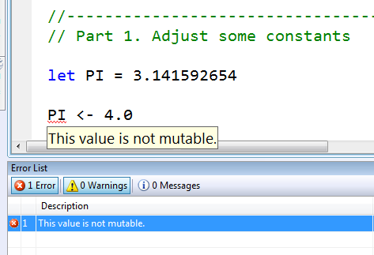
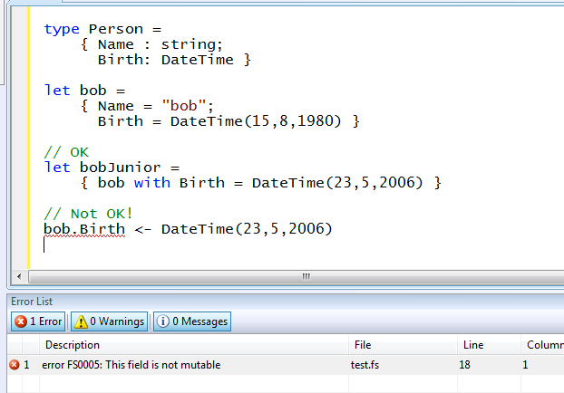
Immutability the norm…
Data is immutable by default
Values may not be changed
✓ Copy & Update
✗ Not Mutate

Slide 49
In Praise of Immutability
Immutable objects can be relied upon
Immutable objects can transfer between threads
Immutable objects can be aliased safely
Immutable objects lead to (different) optimization opportunities

Slide 50
Sample Task
Implement Blackjack.
(To keep things simple, Aces are always worth 11.)
Design:
type Card = ...
type Result = Busted | Blackjack | Hand of int
let judgeHand (cards : Card list) : HandType = …

Slide 51
Tutorial: Pattern Matching

Slide 52
Functional– Patterns
match expr with
| pat -> expr
…
| pat -> expr

Slide 53
Patterns – Tables
/// Truth table for AND via pattern matching
let testAnd x y =
match x, y with
| true, true -> true
| true, false -> false
| false, true -> false
| false, false -> false
val testAnd : bool -> bool -> bool
> testAnd true true;;
val it : bool = true
Truth table

Slide 54
Patterns– Wildcards
/// Truth table for AND via pattern matching
let testAnd x y =
match x, y with
| true, true -> true
| _ -> false
val testAnd : bool -> bool -> bool
> testAnd true true;;
val it : bool = true
“Match anything”

Slide 55
Patterns – Missing Cases
/// Truth table for AND via pattern matching
let testAnd x y =
match x, y with
| true, true -> true
| true, false -> false
| false, false -> false
warning FS0027: Missing case, ‘(false, true)'
Missing case

Slide 56
Patterns – Naming Things
let formatGreeting name =
match name with
| "Robert" -> "Hello, Bob"
| "William" -> "Hello, Bill"
| x -> sprintf "Hello, %s" x
> formatGreeting "Earl";;
Hello, Earl

Slide 57
Patterns – Naming Things (2)
let billLong = "William"
let formatGreeting name =
match name with
| "Robert" -> "Hello, Bob"
| billLong -> "Hello, Bill!"
| x -> sprintf "Hello, %s" x
warning FS0026: This rule will never be matched.

Slide 58
Patterns – Literal Patterns
[<Literal>] let BillLong = "William"
[<Literal>] let BobLong = "Robert"
let formatGreeting name =
match name with
| BobLong -> "Hello, Bob"
| BillLong -> "Hello, Bill!"
| x -> sprintf "Hello, %s" x

Slide 59
Patterns – Or Patterns
[<Literal>] let BillLong = "William"
[<Literal>] let BobLong = "Robert"
let formatGreeting name =
match name with
| "Bob" | BobLong -> "Hello, Bob"
| "Bill" | BillLong -> "Hello, Bill!"
| x -> sprintf "Hello, %s" x

Slide 60
Patterns – when Guards
open System
let rng = new Random()
let secretNumber = rng.Next() % 100
let rec highLowGameStep () =
printfn "Guess the secret number:"
let guess = Console.ReadLine() |> int32
match guess with
| _ when guess > secretNumber ->
printfn "The secret number is lower."
highLowGameStep()
| _ when guess < secretNumber ->
printfn "The secret number is higher."
highLowGameStep()
| _ ->
printfn "You've guessed correctly!"
“Guard”

Slide 61
Patterns – Matching Structured Data
let rec listLength l =
match l with
| [] -> 0
| [_] -> 1
| [_; _] -> 2
| [_; _; _] -> 3
| hd :: tail -> 1 + listLength tail
A series of structured
patterns

Slide 62
Patterns – Everywhere!
let pat = expr
Binding
try expr
with
| pat -> expr
| pat -> expr
Exception
Handling
fun pat -> expr
Function Values
Sequence
expressions
let f pat ... pat = expr
seq { for pat in expr do
for pat in expr do
let pat = expr
...
yield expr }
Function
binding
match expr with
| pat -> expr
| pat -> expr
| pat -> expr
Match
expressions

Slide 63
Tutorial: Imperative Programming

Slide 64
Imperative – Changing Values
You can do it:
let mutable x = 1
x <- x + 1
x <- x + 2

Slide 65
Imperative – Reference Cells
Some data structures are inherently mutable
type ReferenceCell<'T> =
{ mutable contents : 'T }
let ref x = { contents = x }
let refCell = ref 3
refCell <- refCell.contents + 1
refCell <- refCell.contents + 3

Slide 66
Imperative – Mutable Collections
Some Other Mutable Collections
ResizeArray<'T>
Dictionary<'Key, 'Value>
HashSet<'T>
'T[]

Slide 67
Sample Exercise
Open a file and return
a dictionary of the number of times each line occurs in the file.
Design:
let countLines (filePath:string) = ...

Slide 68
Tutorial: Objects

Slide 69
Objects
Class Types
type ObjectType(args) =
let internalValue = expr
let internalFunction args = expr
let mutable internalState = expr
member x.Prop1 = expr
member x.Meth2 args = expr
Interface Types
type IObject =
interface ISimpleObject
abstract Prop1 : type
abstract Meth2 : type -> type
Constructing Objects
new FileInfo(@"c:\misc\test.fs")

Slide 70
F# - Objects + Functional
type Vector2D(dx:double, dy:double) =
member v.DX = dx
member v.DY = dy
member v.Length = sqrt(dx*dx+dy*dy)
member v.Scale(k) = Vector2D(dx*k,dy*k)
Inputs to object construction
Exported properties
Exported method

Slide 71
F# - Objects + Functional
type Vector2D(dx:double,dy:double) =
let norm2 = dx*dx+dy*dy
member v.DX = dx
member v.DY = dy
member v.Length = sqrt(norm2)
member v.Norm2 = norm2
Internal (pre-computed) values and functions

Slide 72
F# - Objects + Functional
Immutable inputs
type HuffmanEncoding(freq:seq<char*int>) =
...
< 50 lines of beautiful functional code>
...
member x.Encode(input: seq<char>) =
encode(input)
member x.Decode(input: seq<char>) =
decode(input)
Internal tables
Publish access

Slide 73
F# - Objects + Functional
type Vector2D(dx:double,dy:double) =
let mutable currDX = dx
let mutable currDX = dy
member v.DX = currDX
member v.DY = currDY
member v.Move(x,y) =
currDX <- currDX+x
currDY <- currDY+y
Internal state
Publish internal state
Mutate internal state

Slide 74
Code: Some OO Design Patterns in F#

Slide 75
Sample Exercise
Exposes a .NET class which implements this design:
type LineAnalysis (filePath : string) =
member x.LineCount(line) = ...
member x.UniqueLines = ...
member x.AverageLineLength = ...
member x.AverageLineFrequency = ...

Slide 76
Tutorial: F# Scripting

Slide 77
Scripting – Directives
e.g. see Programming F#, out soon
Directives:
#I
#r
__SOURCE_DIRECTORY__
__SOURCE_FILE__
#load
Recipes:
Walking directories
Producing sound
Starting processes
Working with COM and Office

Slide 78
Tutorial: Async/Parallel/Reactive

Slide 79
F# is a Parallel Language
(Multiple active computations)
F# is a Reactive Language
(Multiple pending reactions)
e.g.
GUI Event
Page Load
Timer Callback
Query Response
HTTP Response
Web Service Response
Disk I/O Completion
Agent Gets Message

Slide 80
async { ... }
A Building Block for
Writing Reactive Code
async { ... }
For users:
You can run it, but it may take a while
Or, your builder says...
OK, I can do the job, but I might have to talk to someone else about it. I’ll get back to you when I’m done

Slide 81
async { ... }
Asynchronous "non-blocking" action
async { let! image = ReadAsync "cat.jpg"
let image2 = f image
do! WriteAsync image2 "dog.jpg"
do printfn "done!"
return image2 }
Continuation/
Event callback
You're actually writing this (approximately):
async.Delay(fun () ->
async.Bind(ReadAsync "cat.jpg", (fun image ->
let image2 = f image
async.Bind(writeAsync "dog.jpg",(fun () ->
printfn "done!"
async.Return())))))

Slide 82
Code: Async Basics

Slide 83
The many uses of async { ... }
Sequencing CPU computations
Sequencing I/O requests
async { let result1 = fib 39
let result2 = fib 40
return result1 + result2 }
async { let! lang = CallDetectLanguageService text
let! text2 = CallTranslateTextService (lang, "da", text)
return text2 }

Slide 84
The many uses of async { ... }
Sequencing CPU computations and I/O requests
async { let! lang = callDetectLanguageService text
let! text2 = callTranslateTextService (lang, "da", text)
let text3 = postProcess text2
return text3 }

Slide 85
The many uses of async { ... }
Parallel CPU computations
Parallel I/O requests
Async.Parallel [ async { return fib 39 };
async { return fib 40 }; ]
Async.Parallel
[ for targetLang in languages ->
async { let! lang = callDetectService text
let text2 =
callTranslateService (lang,targetLang,text)
let! text3 = postProcess text
return text3 } ]

Slide 86
The many uses of async { ... }
Mixed with control flow:
async { let! lang = callDetectLanguageService text
if isLangSupported lang then
let! response = callTranslateService (lang, "da", text)
return response.Contents
else
return "couldn’t translate" }

Slide 87
The many uses of async { ... }
Repeating tasks
Repeating tasks with state
async { while true do
let! msg = queue.ReadMessage()
<process message> }
let rec loop () =
async { let! msg = queue.ReadMessage()
printfn "got a message"
return! loop () }
loop ()
let rec loop count =
async { let! msg = queue.ReadMessage()
printfn "got a message"
return! loop (count + msg) }
loop 0

Slide 88
The many uses of async { ... }
Representing Agents (approximate)
let queue = new Queue()
let rec loop count =
async { let! msg = queue.ReadMessage()
printfn "got a message"
return! loop (count + msg) }
Async.Start (loop 0)
queue.Enqueue 3
queue.Enqueue 4

Slide 89
The many uses of async { ... }
Representing Agents (real)
let agent =
Agent.Start(fun inbox ->
let rec loop count =
async { let! msg = inbox.Receive()
printfn "got a message"
return! loop (count + msg) }
loop 0)
agent.Post 3
agent.Post 4
Note:
type Agent<'T> = MailboxProcessor<'T>

Slide 90
Let’s do Web Translation!

Slide 91
Let’s do Twitter!

Slide 92
Typical F# Reactive Architecture
Async.Start (async { ... }
...
Single Threaded GUI
Or
Single Threaded Page Handler
Or
Command Line Driver
Async.Parallel [ ... ]
(queued)
new Agent<_>(async { ... })
new WebCrawler<_>()
Internally: new Agent<_>(...) ...
event x.Started
event x.CrawledPage
event x.Finished

Slide 93
Why not just use .NET/Java/OS Threads?
Ultimately, the CPU portions of async { ... } run on various .NET threads.
However:
No cooperative cancellation
Blocking threads is expensive
Async using callbacks is insanely complicated and very error prone
Very bad error propagation (no exception continuation)

Slide 94
Code: Your First F# Async Agent

Slide 95
Code: Async Web Crawler

Slide 96
Interlude: Case Study

Slide 97
F# and adCenter
4 week project, 4 machine learning experts
100million probabilistic variables
Processes 6TB of training data
Real time processing

Slide 98
AdPredict: What We Observed
F#’s powerful type inference means less typing, more thinking
Type-inferred code is easily refactored
Quick Coding
Agile Coding
Scripting
Performance
Memory-Faithful
Succinct
Symbolic
.NET Integration
“Hands-on” exploration.
Immediate scaling to massive data sets
mega-data structures, 16GB machines
Live in the domain, not the language
Schema compilation and “Schedules”
Especially Excel, SQL Server

Slide 99
Smooth Transitions
Researcher’s Brain → Realistic, Efficient Code
Realistic, Efficient Code → Component
Component → Deployment

Slide 100
Tutorial: Units of Measure

Slide 101
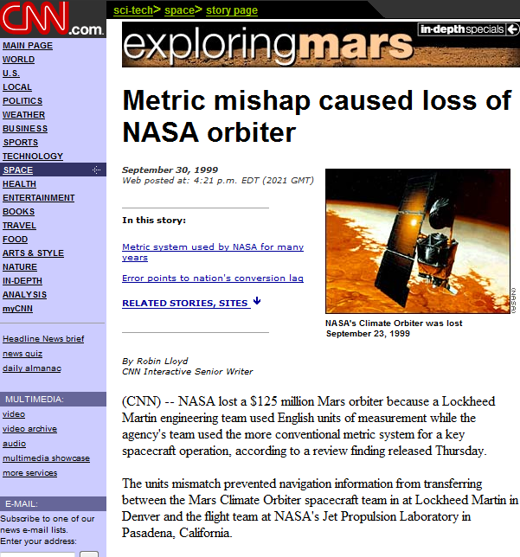
NASA Mars Climate Orbiter, 1999

Slide 102
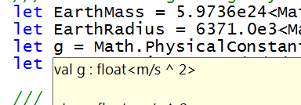
let EarthMass = 5.9736e24<kg>
// Average between pole and equator radii
let EarthRadius = 6371.0e3<m>
// Gravitational acceleration on surface of Earth
let g = PhysicalConstants.G * EarthMass / (EarthRadius * EarthRadius)

Slide 103
Units of Measure – Basics
[<Measure>]
type kg
[<Measure>]
type m
[<Measure>]
type s
let gravityOnEarth = 9.81<m/s^2>
let heightOfMyOfficeWindow = 3.5<m>
let speedOfImpact =
sqrt (2.0 * gravityOnEarth + heightOfMyOfficeWindow)

Slide 104
Units of Measure – Converting
[<Measure>]
type ft
let feetPerMeter = 3.28084<ft/m>
let heightOfMyOfficeWindow = 11.5<m>
let heightOfMyOfficeWindowInMeters =
heightOfMyOfficeWindow * feetPerMeter
let elapsed (start : DateTime) =
(DateTime.Now - start).TotalSeconds * 1.0<s>

Slide 105
Units of Measure – Converting
let squareMass (m: float<kg>) = m*m
let squareDistance (d: float<m>) = d*d
let squareSpeed (x: float<m/s>) = x*x
BETTER IS:
let square (x: float<'u>) = x*x
square : float<'u> -> float<'u^2>

Slide 106
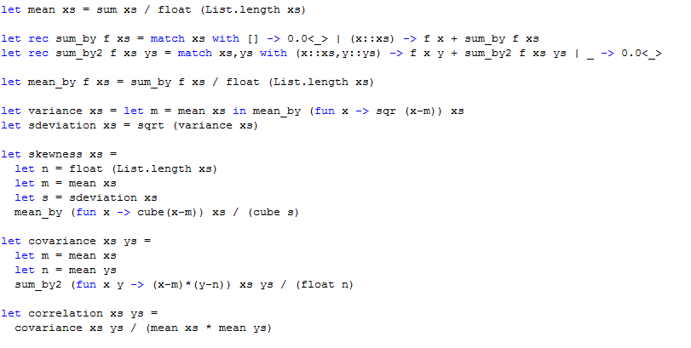
Units of Measure – Sample Code

Slide 107
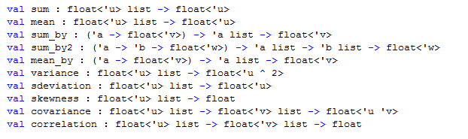
Units of Measure – Inferred Types

Slide 108

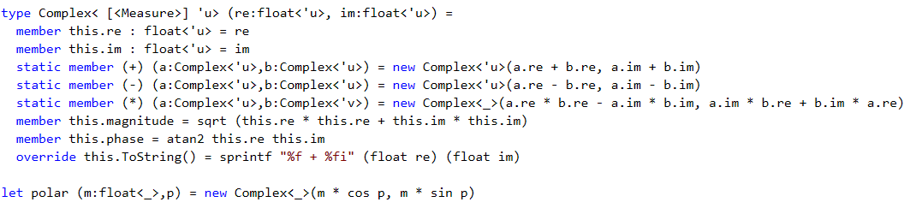
Units on Types

Slide 109
8 Ways to Learn
FSI.exe
Samples on MSDN
Go to definition
Lutz’ Reflector
http://cs.hubfs.net
Codeplex Fsharp Samples
Books
OCaml or Haskell

Slide 110
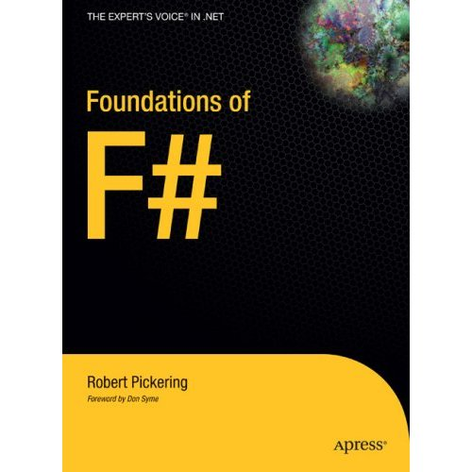
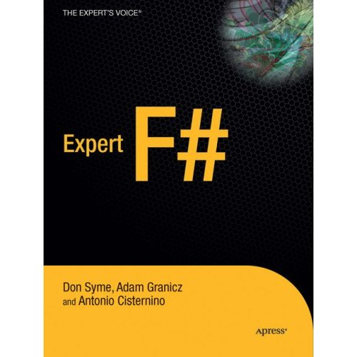
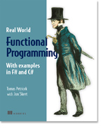

Books about F#
Visit www.fsharp.net

Slide 111
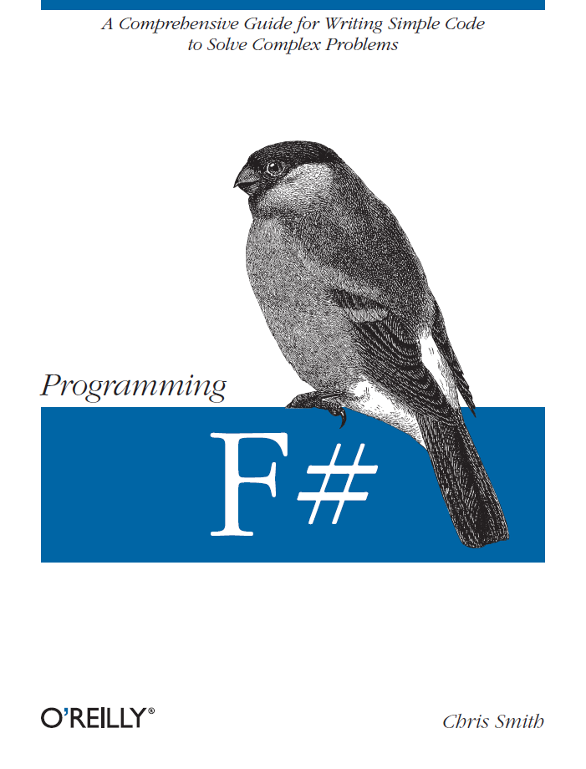
Books about F#
Visit www.fsharp.net

Slide 112
Getting F#
F# will be a supported language in
Visual Studio 2010
Next stop: Visual Studio 2010 Beta 2
Look for it soon!

Slide 113
Questions & Discussion

Slide 114



© 2007 Microsoft Corporation. All rights reserved. This presentation is for informational purposes only. MICROSOFT MAKES NO WARRANTIES, EXPRESS OR IMPLIED, IN THIS SUMMARY.

