Slide 1

Systèmes Embarqués Microprogrammés
Trooper Maze
Léane Donzé & Alice Guntli

Slide 2
NDS features: checklist (1/3)
ARM Processors
ARM 9 : Arrow/Start Keys, Graphics for screens, Secondary Storage
ARM 7 : Touchscreen, Audio
Timers / Interrupts
Timer interrupt : count time to defeat two troopers
Start key interrupt : restart button (always active)
Keypad
Arrow keys : move the Yoda Sprite around
A Key : (re)start the game
Start key : restart

Slide 3
NDS features: checklist (2/3)
Touchscreen
Start the game by touching
Defeat the trooper by touching his weakness zone
Sound
Star Wars theme song as background music
Sound effects :
Starting game
Hitting a wall
Starting a fight
Hitting the trooper
Secondary Storage
Store the best time to defeat 2 troopers
Display at the end of the game

Slide 4
NDS features: checklist (3/3)
Graphics
Main & Sub engine in Mode 0 2D
4 Tiled Backgrounds per screen : Menu, Maze, Fight, End
Only palettes are copied at runtime (everything else at init)
Menu on Sub engine has shifting animation
End on Sub engine writes high score dynamically
Storage organization on next slide
Sprites
2 sprites : Yoda & Trooper
Appear in Maze mode

Slide 5
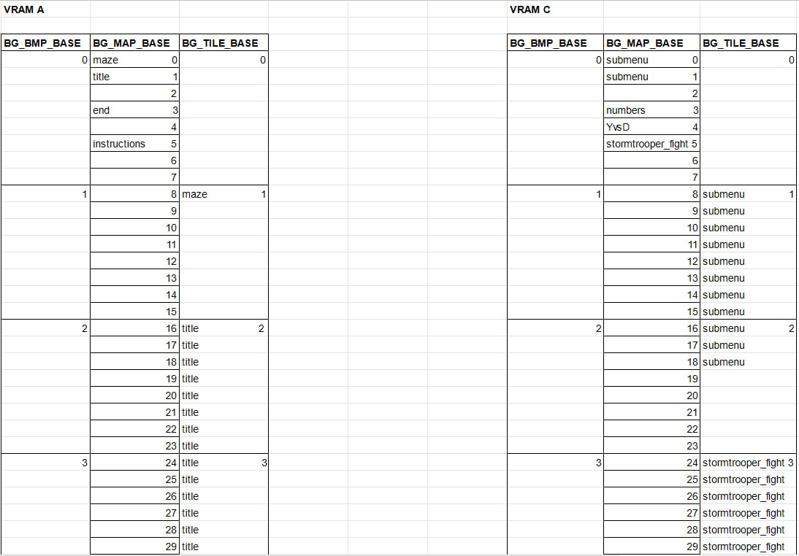
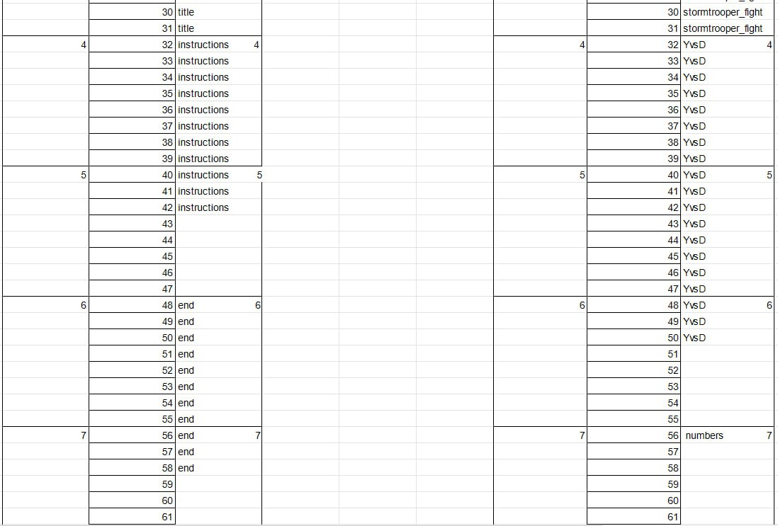
Storage
Memory management
Only one VRAM per screen
Maps at the top
Tiles everywhere else

Slide 6
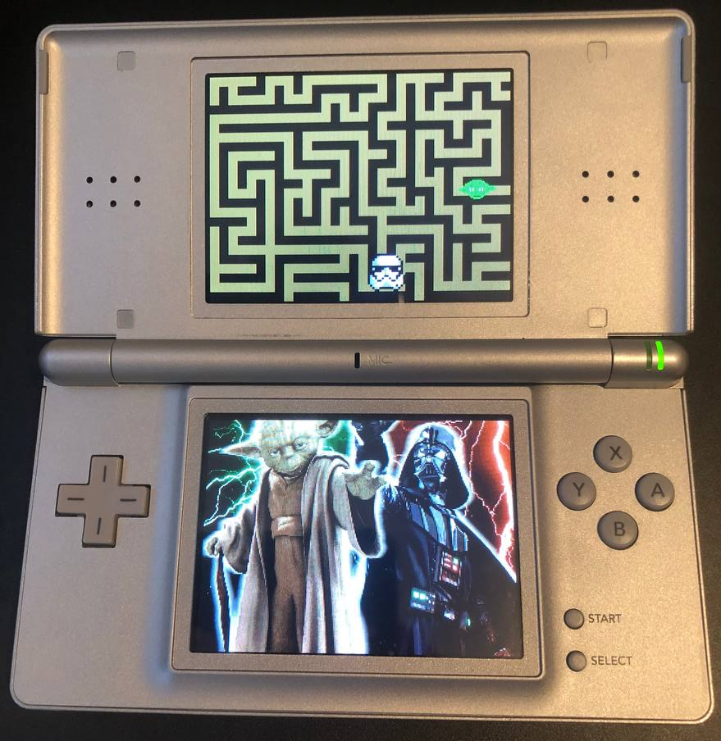
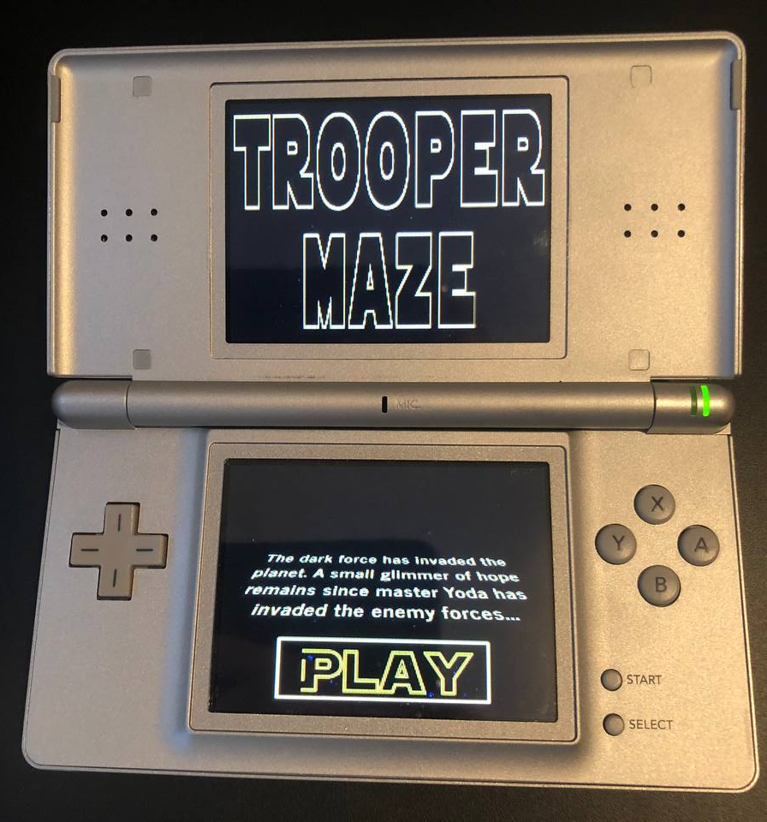
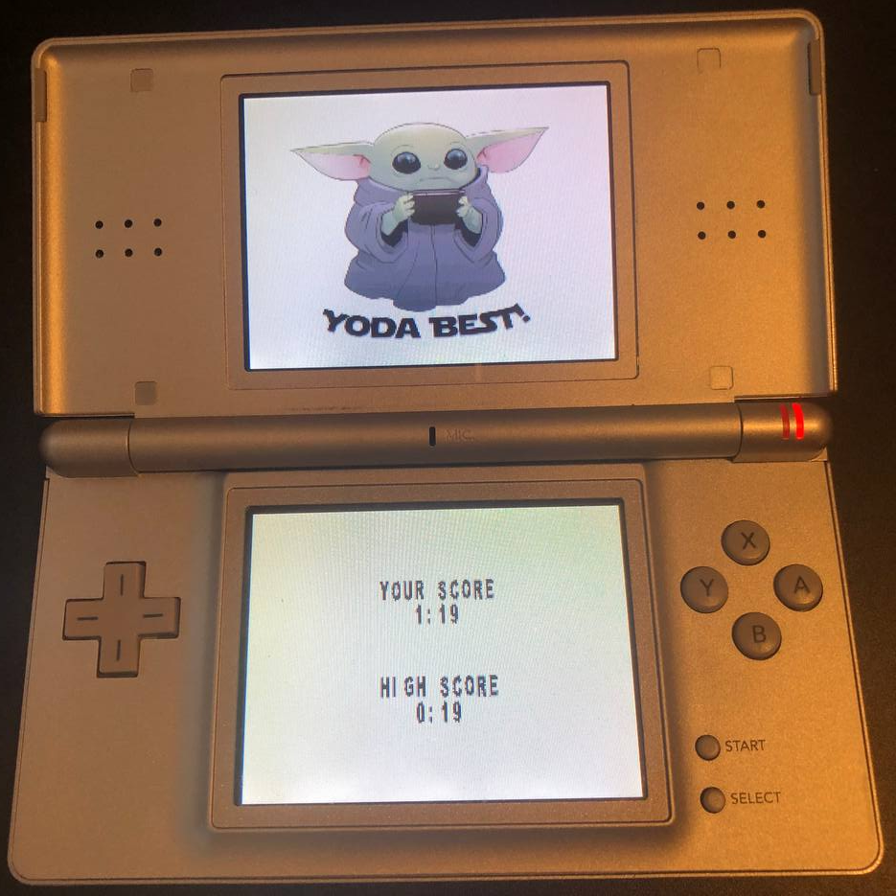
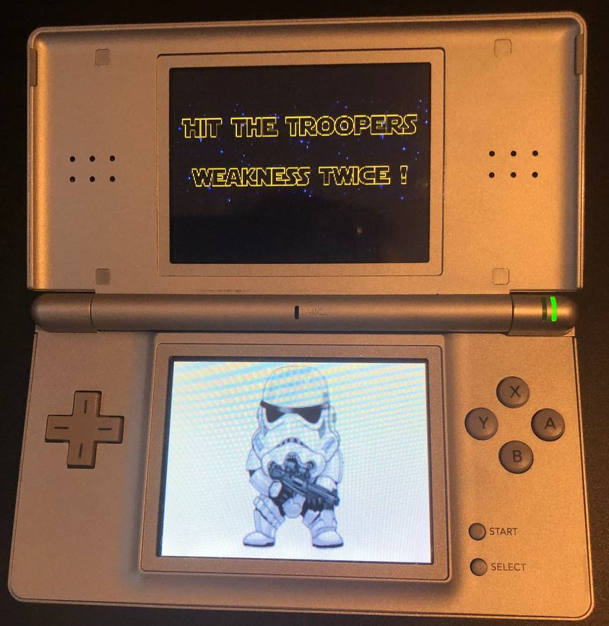
NDS project screenshot

