Slide 1
MASTER OF SCIENCE IN INFORMATION TECHNOLOGY · ASSESSMENT 2
Evaluating the Effectiveness of Terraform and GitHub Actions for AWS Infrastructure Automation
Terraform on GitHub Actions (measured) vs manual AWS console (simulated)
Kao Leangseng
Student ID: UPS240590
Supervisor: Dr. Chen Sovann
Faculty of Science and Technology · University of Puthisastra · October 2026
Notes:
Introduce the study: it measured what changes when an AWS architecture moves from hand-built to Terraform run through GitHub Actions.

Slide 2
Research Topic and Background
02 / 15
Cloud infrastructure can be built from code, but many teams still build it by hand.
1
Infrastructure as Code (IaC)
253 s
A file describes the network, load balancer and services; a tool such as Terraform makes AWS match it.
Terraform build in prior work
2
CI/CD pipelines
Regvart et al. (2026), smaller architecture
GitHub Actions already builds and ships application code automatically in most teams.
43.9%
3
The split pipeline
Application delivery is automated, but the environment it runs on is still changed through the console.
of active repos use GitHub Actions
Decan et al. (2022), 69,147 repositories
4
Why Cambodia
Banks supervised by the National Bank of Cambodia need auditable change. No local IaC evidence exists.
Notes:
Background: IaC and CI/CD matured separately; organisations often automate the app first.

Slide 3
Research Problem
03 / 15
The pipeline automated the application. The AWS environment it deployed into was created and changed by hand.
1
2
3
No audit trail
Environments drift
Rebuilds depend on memory
Nobody can see who changed the network, load balancer or IAM, when, or why.
Development, staging and production slowly stop matching.
Recovery or a new region relies on what engineers remember.
THE CONTESTED QUESTION
Not whether this is a problem, but how much fixing it with Terraform actually changes, and at what cost.
Prior studies compare Terraform with other tools, never with the manual work it replaces.
Notes:
State the problem and why it needs measurement in a specific setting.

Slide 4
Aim, Objectives and Research Questions
04 / 15
AIM Build the AWS architecture in Terraform, run it through GitHub Actions, measure four outcomes against manual provisioning, and explain what made the change hard.
OBJECTIVES
RESEARCH QUESTIONS
Document how the architecture is provisioned
Build a modular Terraform codebase
Integrate it into GitHub Actions
Measure duration, drift, reproducibility, coverage
Explain barriers; recommend
RQ1
How is it provisioned, and how much is under version control?
RQ2
How does Terraform differ from manual work on the four outcomes?
RQ3
Does pipeline integration depth moderate drift?
RQ4
What barriers and enablers arise in practice?
Notes:
Five objectives, four research questions; RQ1-3 quantitative, RQ4 qualitative.

Slide 5
Key Literature and Research Gap
05 / 15
20 peer-reviewed studies reviewed, every DOI verified
IaC tool performance
Regvart et al. (2026): Terraform 253 s vs CloudFormation 623 s; no failures in 30 cycles
THREE GAPS
Empirical: no study measures Terraform against manual provisioning of the same system
Theoretical: IaC and the pipeline are studied apart, so the effect of review is never isolated
Contextual: no IaC evidence from Cambodia or a regulated setting
IaC quality and security
Verdet et al. (2025): encryption neglected in 812 projects; Rahman et al. (2019, 2020): smells, defects
Dependency maintenance
Begoug et al. (2025): module lag about 10 months; AWS provider lag about 9 months
CI/CD and GitHub Actions
Hilton et al. (2016); Kinsman et al. (2021); Rostami Mazrae et al. (2023): migration to GitHub Actions
Notes:
Summarise the four strands of literature and the three gaps.

Slide 6
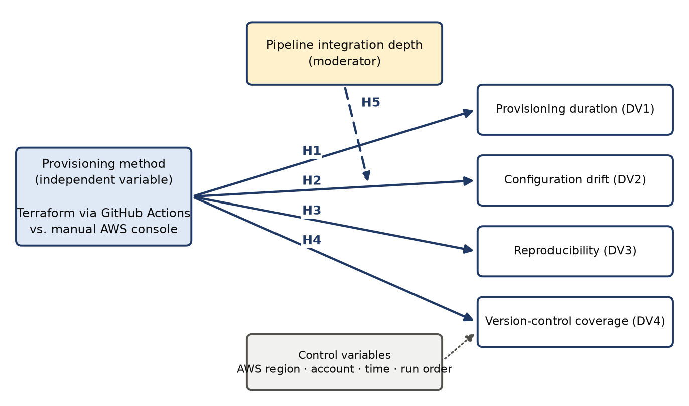
Conceptual Framework and Hypotheses
06 / 15
H1
Terraform is faster to provision
H2
Terraform reduces drift between environments
H3
Terraform rebuilds succeed more often
H4
Pipeline raises version-control and review coverage
H5
Integration depth moderates the drift effect
Grounded in IaC principles, the deployment pipeline concept and DevOps outcome measurement; acceptance models (TAM, UTAUT) set aside because the outcomes are system properties.

Slide 7
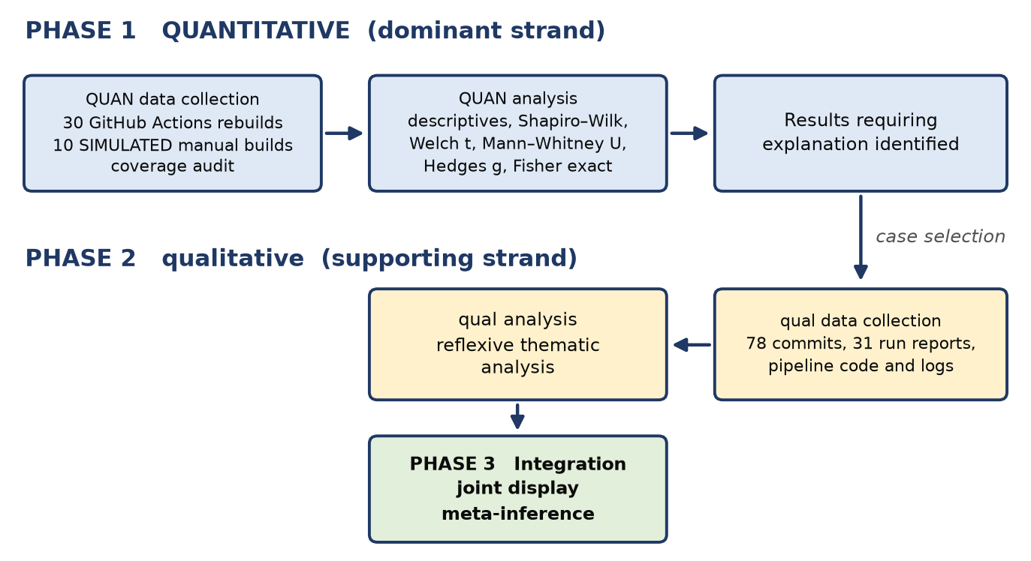
Research Methodology
07 / 15
PHILOSOPHY
APPROACH
DESIGN
SETTING
Pragmatism
Abductive
Explanatory sequential mixed methods
Isolated AWS account, one region
NO HUMAN PARTICIPANTS
Outcomes are machine-recorded, not self-reported
Qualitative data: the real implementation record (78 commits, 31 run reports, logs)
Ethics: confidentiality, no live data, credential handling, cost control

Slide 8
Data Collection and Analysis
08 / 15
30
10
152
24
pipeline rebuilds
manual builds
AWS resources
inventory items
GitHub Actions, measured
SIMULATED, seeded model
140 rebuilt every cycle
coverage audit
PLANNED VS ACHIEVED
ANALYSIS
Measure | Planned | Achieved
Terraform cycles | 30 | 30 (14 + 16 chained)
Manual runs | 10 observed | 10 simulated
Environments for drift | 3 | 1
Integration depth levels | 3 | 1
Descriptives, CV, Shapiro–Wilk, Tukey outliers
Stability: trigger, day, run order, hour of day
Welch t + Mann–Whitney U; Hedges' g
Fisher's exact test for rebuild success
Manual condition SIMULATED: stated parameters, fixed seed, sensitivity analysis
Reflexive thematic analysis; joint display
Notes:
Be explicit: manual runs were not observed; the baseline is a model and labelled as such. The planned 30 Terraform cycles were achieved: 14 were triggered by a commit and 16 by a chained workflow_dispatch, 31 run reports in total including the redeploy. Every pipeline run destroys and recreates 140 of the 152 resources; ECR repositories are kept.

Slide 9
Findings 1: Terraform Pipeline Results (Measured)
09 / 15
8.3 min
to build from empty
SD 21 s · CV 4.2% · n = 30
20.1 min
to destroy
service stacks = 64.1% of cycle
30 / 30
rebuilds succeeded
155 / 155 HTTP 200
Notes:
All values on this slide are measured from the GitHub Actions pipeline over 30 rebuilds. Building from empty took 8.3 minutes (95% CI 8.2–8.5); destroying took 20.1 minutes; a whole cycle about 28.4 minutes. Destruction, not creation, dominates: the five service stacks are destroyed one after another, about 3.6 minutes each. Services reached steady state in 89 s on average; one finance start-up in run 14 has no steady-state timestamp but answered HTTP 200.

Slide 10
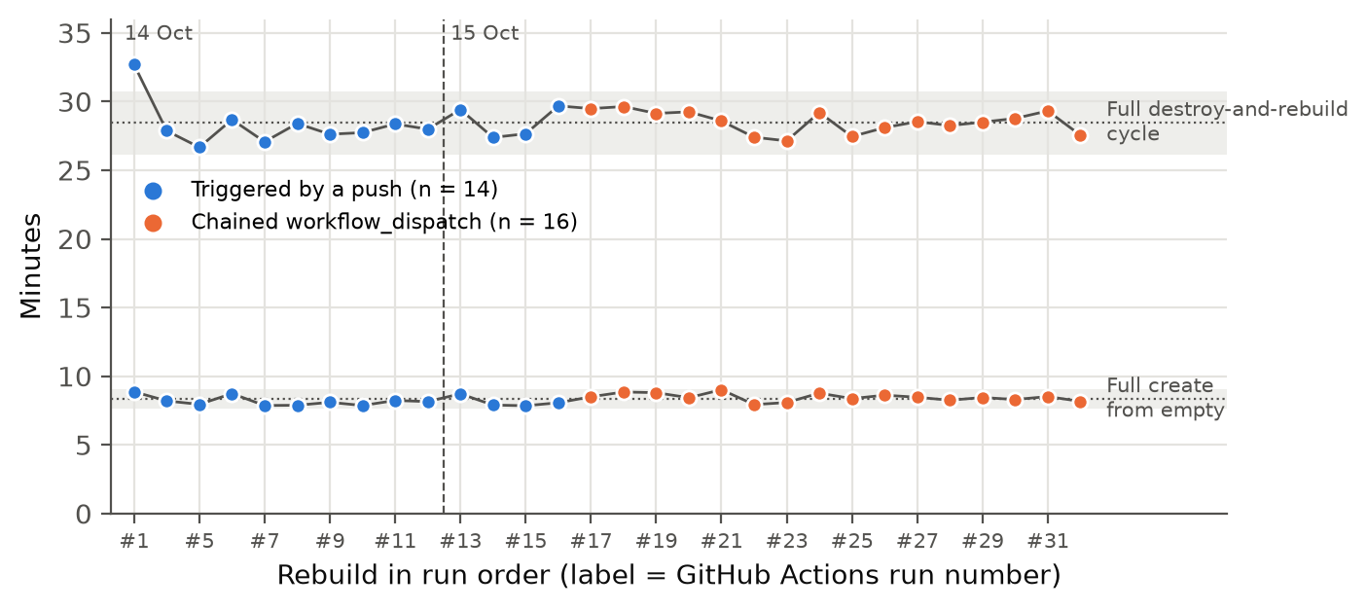
Findings 2: Stable Across 30 Runs (Measured)
10 / 15
WHAT 30 RUNS ADD
No trend: run 1 is the only cycle outside the band
95% CI of the build narrowed from ±15 s (10 runs) to ±8 s
Chained runs built 18 s (3.7%) slower; destroy and total cycle did not differ
Likely cloud-side conditions, not the trigger: same steps, and the day effect alone was not significant
Success rate 30/30: lower 95% bound 89% (was 72% with 10)
Blue: triggered by a push (n = 14) · Orange: chained workflow_dispatch (n = 16) · bands = mean ± 2 SD
Check (full build) | Result | p
Trend over run order | ρ = 0.25 | .177
Hour of day | ρ = -0.24 | .192
14 Oct vs 15 Oct | 8.2 vs 8.4 min | .124
Push vs dispatch | 8.2 vs 8.5 min | .019
Push vs dispatch, total cycle | 28.4 vs 28.5 min | .747
Notes:
Thirty cycles ran over two days: 14 triggered by editing rebuild.sh and pushing, then 16 chained by a repeat option in which each run started the next. The pipeline steps were identical. Durations show no trend with run order or hour of day. The only difference detected: the back-to-back dispatched runs built about 18 seconds slower (Welch p = .019), while destroy and the total cycle did not differ. The day comparison points the same way but is not significant, so the most plausible explanation is AWS and runner conditions during the back-to-back runs. It is tiny next to the H1 gap, so the 30 cycles were pooled. Thirty cycles also match Regvart et al. (2026), so the variability comparison is like for like.

Slide 11
Findings 3: Terraform vs Manual Console
11 / 15
H | Result | Decision
H1 Duration | 8.3 vs 105.3 min (simulated) | Supported*
H2 Drift | Only one environment | Not tested
H3 Reproducibility | 30/30 vs 3/10 (simulated) | Supported*
H4 Coverage & review | Coverage 0% → 79.2%; review 0 of 48 | Partially supported
H5 Depth × drift | Drift not measured | Not tested
12.6× faster · Welch t(9.0) = -65.2, p < .001 · rebuilds identical 30/30 vs 3/10 (Fisher p < .001)
* conditional on the simulated manual condition
Manual values are SIMULATED from a stated, seeded model; results hold from 20 s to 120 s per resource.
Notes:
Be explicit that the manual condition is simulated: Terraform is measured over 30 cycles, the manual side comes from a published, seeded model of 10 builds. The ratio is 12.6; with only the first ten Terraform cycles it was 12.9, so the extra runs do not change the decision. Even at 20 s per resource in the console, a manual build would take 55 minutes.

Slide 12
Findings 4: Why It Was Hard (RQ4)
12 / 15
1
The architecture was found by rebuilding it
2
State is the hardest part
Per-service load balancers and gateways merged in stages; easy because it was code
State files in Git; the bucket that holds state can't hold its own; rebuild built around it
3
Destruction, not creation, is the bottleneck
4
Version control without review
Destroying the five service stacks takes 18.2 minutes, one after another
48 direct commits, none reviewed; 15 only edited a script to start a run
Notes:
Themes from reflexive thematic analysis of 78 commits (48 by the researcher, 30 by the pipeline), 31 run reports and the pipeline code. Theme 4 grew during the campaign: 15 commits existed only to trigger a run, and when that became tedious the answer was more automation (a repeat option chaining 16 runs), not review.

Slide 13
Main Contributions and Recommendations
13 / 15
1
Theoretical
Code and review are separable: coverage reached 79% while review stayed at 0%
TOP RECOMMENDATIONS
Plan on pull request; approve before apply; protect main
Short-lived OIDC credentials instead of access keys
Destroy service stacks in parallel
Create the state bucket once, outside the rebuild
Pin provider versions and commit the lock file
Codify TLS, WAF and DNS; keep two environments with drift checks
2
Practical
Reusable modules and rebuild procedure; measured 8.3 min to build, 20.1 min to remove, over 30 runs
3
Methodological
Mixed methods on an engineering artefact, using the commit history as qualitative data
4
Policy
For regulated Cambodian institutions, require a code history and a review record

Slide 14
Research Timeline
14 / 15
Dec 2025
Aug 2026
14 Oct 2026
15 Oct 2026
Oct 2026
Build
Proposal
Build + Phase 1
Phase 1
Phases 2–3
1
2
3
4
5
Terraform modules; shared ALB and API Gateway
Chapters 1–3 (Assessment 1)
Pipeline; 10 rebuilds and 1 redeploy (push)
20 rebuilds: 4 push, 16 chained
Analysis, themes, joint display, writing
The proposal planned 12 weeks from July to September 2026; measurement slipped to October 2026, when all 30 planned cycles were run in two days.

Slide 15
References
15 / 15
Begoug, M., Ouni, A., & Chouchen, M. (2025). How do infrastructure-as-code practitioners update their dependencies? MSR 2025, 642–653. https://doi.org/10.1109/MSR66628.2025.00100
Braun, V., & Clarke, V. (2021). One size fits all? Qualitative Research in Psychology, 18(3), 328–352. https://doi.org/10.1080/14780887.2020.1769238
Creswell, J. W., & Plano Clark, V. L. (2018). Designing and conducting mixed methods research (3rd ed.). SAGE.
Decan, A., Mens, T., Rostami Mazrae, P., & Golzadeh, M. (2022). On the use of GitHub Actions in software development repositories. ICSME 2022, 235–245. https://doi.org/10.1109/ICSME55016.2022.00029
Hilton, M., et al. (2016). Usage, costs, and benefits of continuous integration in open-source projects. ASE 2016, 426–437. https://doi.org/10.1145/2970276.2970358
Rahman, A., Farhana, E., Parnin, C., & Williams, L. (2020). Gang of eight: A defect taxonomy for infrastructure as code scripts. ICSE 2020, 752–764. https://doi.org/10.1145/3377811.3380409
Regvart, D., Vlahović, I., & Balković, M. (2026). A controlled comparative evaluation of infrastructure as code tools. Applied Sciences, 16(6), 2971. https://doi.org/10.3390/app16062971
Rostami Mazrae, P., Mens, T., Golzadeh, M., & Decan, A. (2023). On the usage, co-usage and migration of CI/CD tools. Empirical Software Engineering, 28(2), 52. https://doi.org/10.1007/s10664-022-10285-5
Verdet, A., Hamdaqa, M., Da Silva, L., & Khomh, F. (2025). Assessing the adoption of security policies by developers in Terraform. Empirical Software Engineering, 30(3), 74. https://doi.org/10.1007/s10664-024-10610-0
Full list of 44 references (APA 7th) in the dissertation.

