Slide 1


Alexander Cushing
James Erardi
TJ Tracy
Leangseu Kim

Slide 2
The Goal of The Project
Our app will allow users to write and send delayed
text messages.
Users will be able to create, delete, and update
delayed texts.
Users will be able to check their history of sent
delayed texts.
Users will be able to create repeating delayed texts

Slide 3
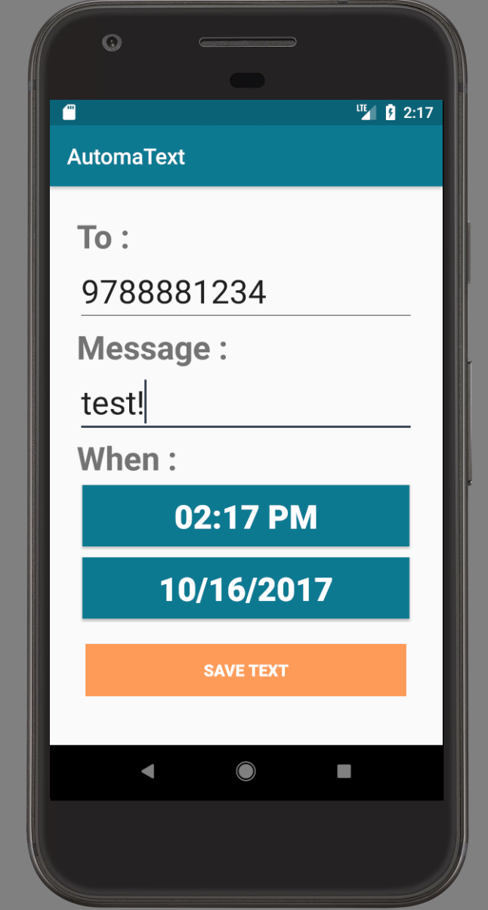
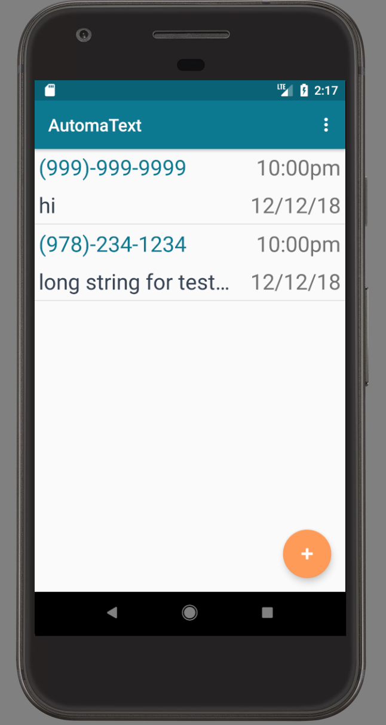
Visual Demo of Current Prototype

Slide 4
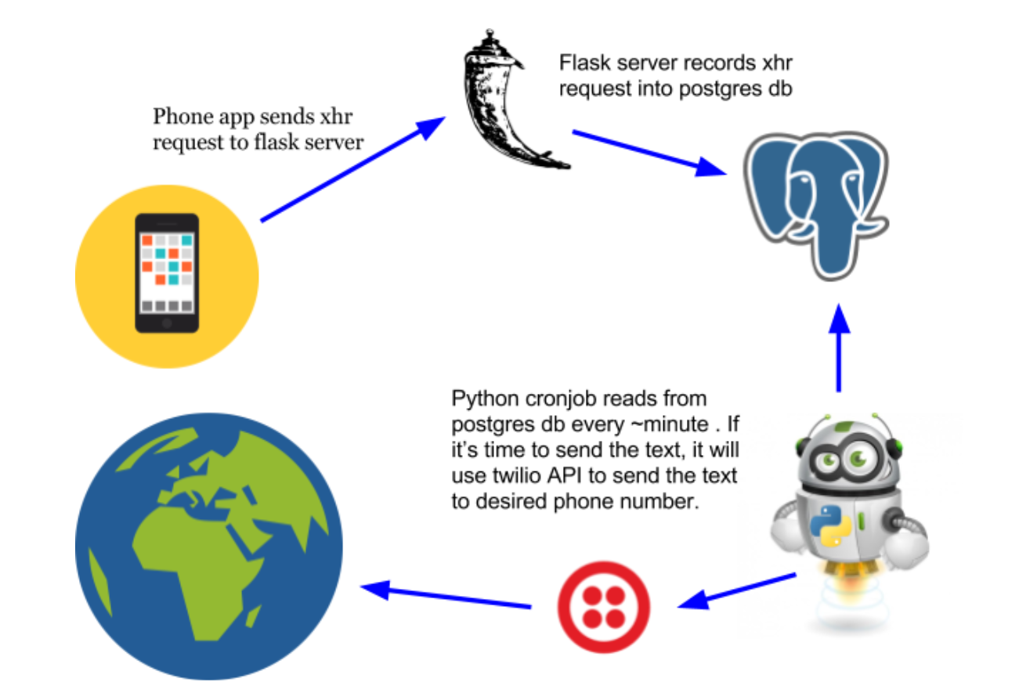

Slide 5
What Each of The Teammate Has Done
Alexander Cushing : Styling/Design
James Erardi : Database/Server
TJ Tracy : Client/api requests
Leangseu Kim: Update UI

Slide 6
Challenges
Afford the time to meet up
Java library from Twilio does not work

