Slide 1



WAY TO ENTERPRISE
REACT JS

Slide 2

COMPONENT LIFECYCLE

Slide 3
Mount and Unmount
Mount is to add React element to DOM
Unmount is to remove React element from DOM

Slide 4
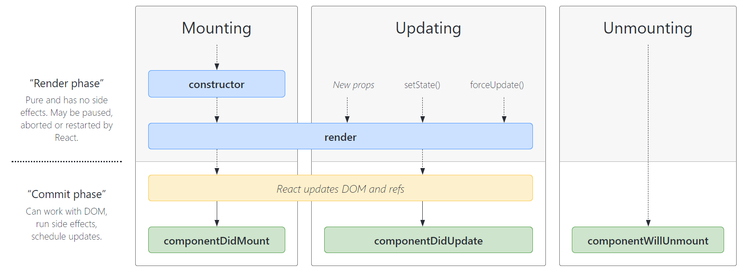
Component Lifecycle

Slide 5
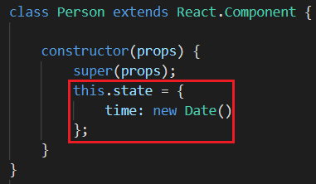
constructor()
initial state
super(props)

Slide 6
render()
Required method in a class component
Return react elements

Slide 7
componentDidMount()
This method is called after a component is mounted.
Used
Set state
Load data (Call API)

Slide 8
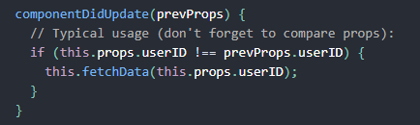
componentDidUpdate()
This method is called after updating occurs

Slide 9
componentWillUnmount()
This method is called before a component is unmounted
Used
Cleanup timeout
Clear interval

Slide 10
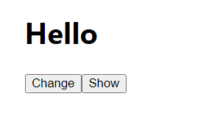

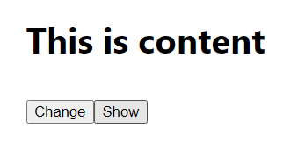

Slide 11
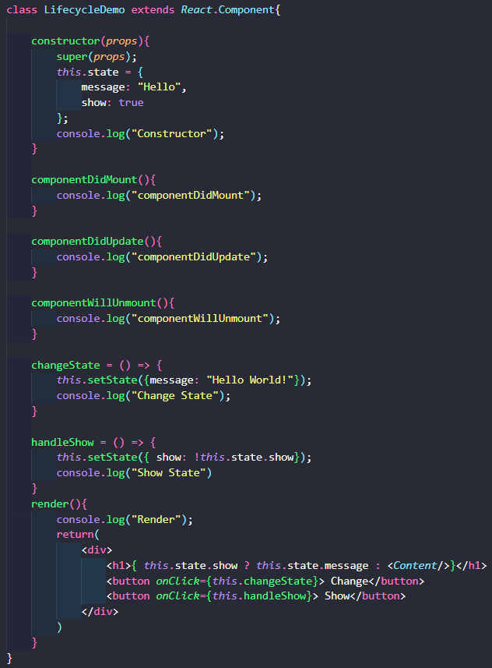
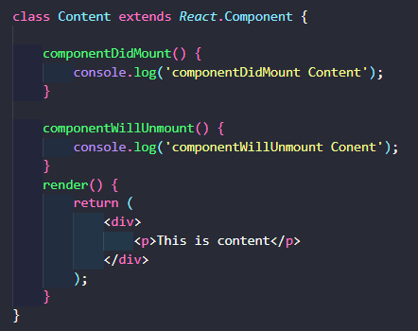

Slide 12
HIGHER ORDER COMPONENT

Slide 13
Higher Order Component (HOC)
HOC can take one or more components (like arguments) and return a new Component

Slide 14
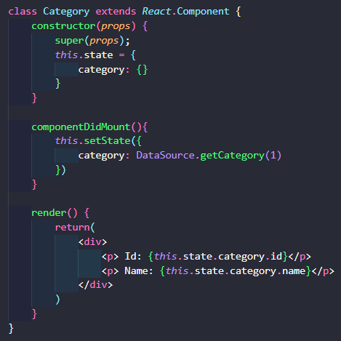
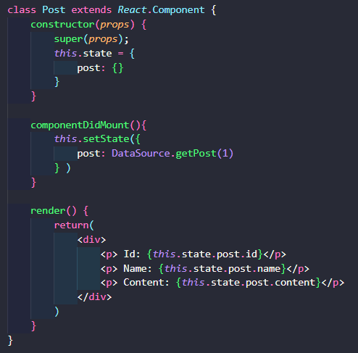

Slide 15
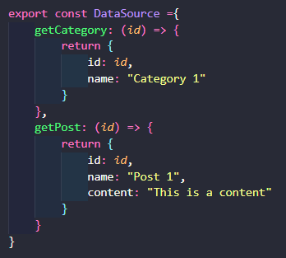
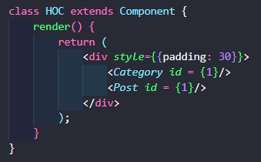
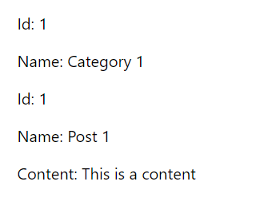

Slide 16
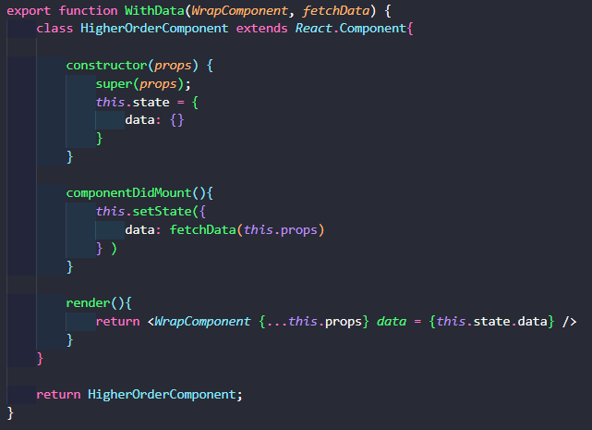

Slide 17
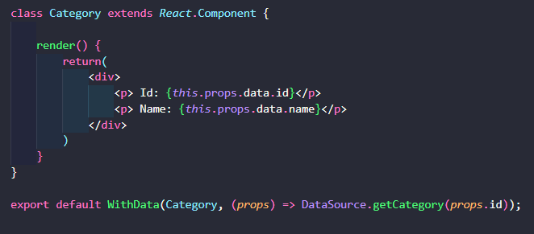
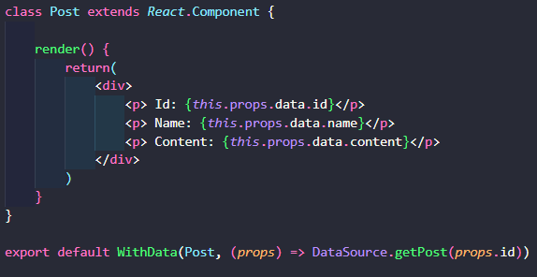

Slide 19
React Hook

Slide 20
React hook
Added in React version 16.8
Only used in Functional components (allow Functional Component to use lifecycle as Class Component)
Built-in Hook
State hook
Effect hook
Ref hook
Callback hook
Memo hook
Context hook
…

Slide 21
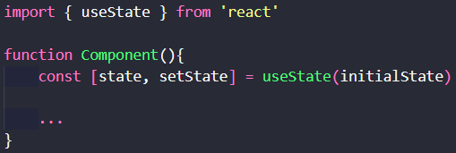
State hook
When you want the data to change, the interface is automatically updated (re-render data)
Initial state is only used for the first time
setState is to replace state with new value
setState as callback
Component is re-rendered after setState

Slide 22
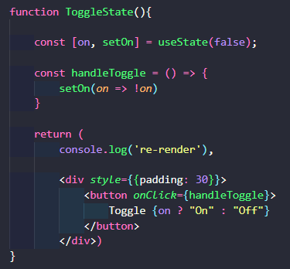


State hook

Slide 23
Effect hook
Handle the side effects
Update DOM
Call API
Listen DOM events: Click, Scroll, Resize, ...
Cleanup: Remove listeners, Clear timer,...

Slide 24
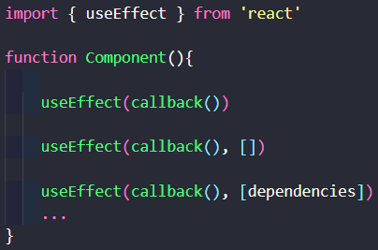
Effect hook
Callback is always called after component mounted
1. useEffect(callback())
Call callback() every time the component re-render
2. useEffect(callback(), [])
Only call callback() once after component mounted
3. useEffect(callback(), [dependencies])
callback() will be called again every time dependencies changes

Slide 25
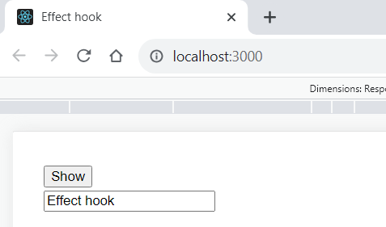


Effect hook

Slide 26
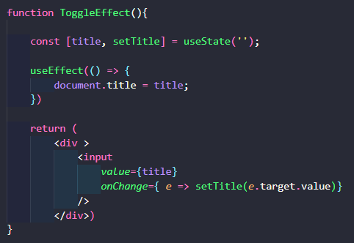
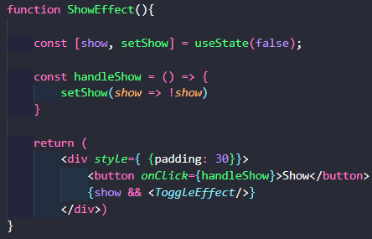
Effect hook

Slide 27
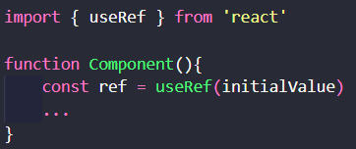
Ref hook
Store a reference to the DOM element
Return a mutable object
These is a property called current
The return object will persist for the full lifetime of the component

Slide 28
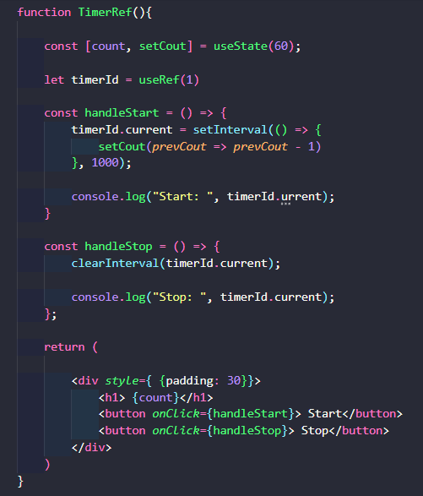
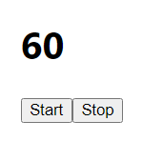
Ref hook

Slide 29
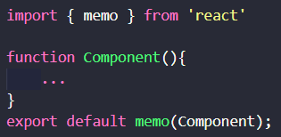
React memo (HOC)
Higher Order Component
Avoid render unnecessary the component
re-render often and re-render with same props

Slide 30
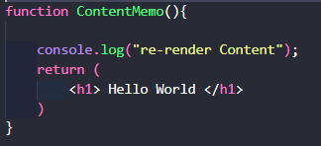
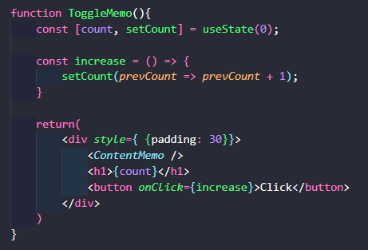

React memo (HOC)

Slide 31
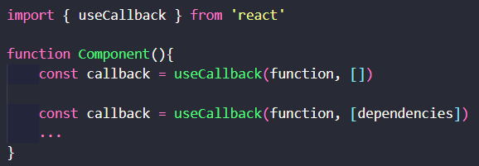
Callback hook

Slide 32
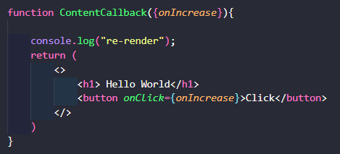
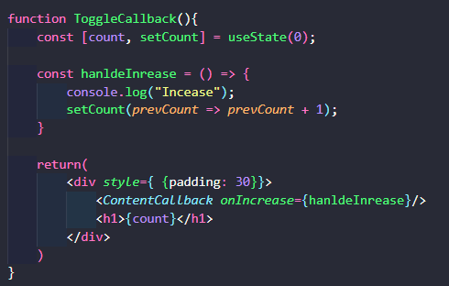
Callback hook

Slide 33
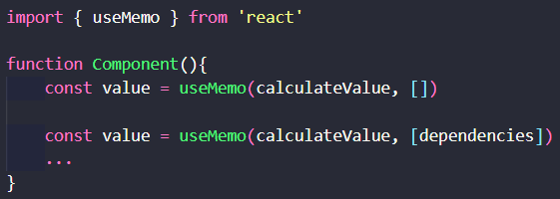
Memo hook
Avoid unnecessary recalculated

Slide 34
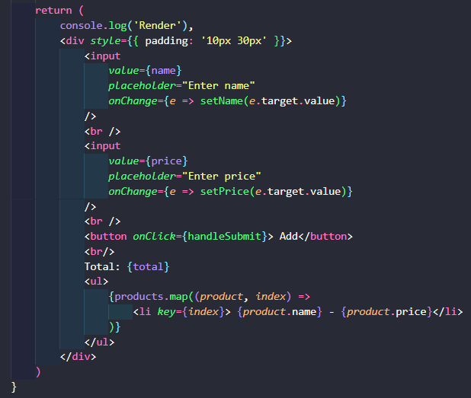
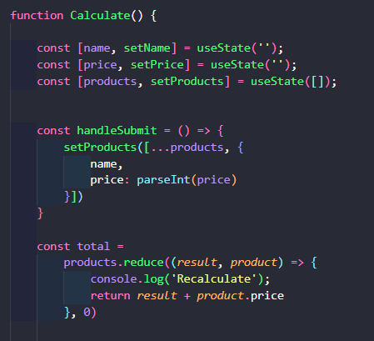
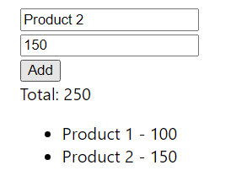
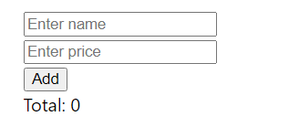
Memo hook

Slide 35
useCallback and useMemo
useCallback is a react hook that returns a memorized callback
useMemo is a react hook that returns a memorized value

Slide 36
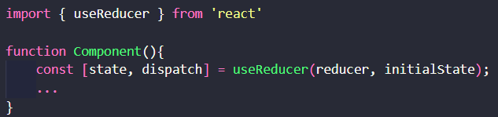
Reducer hook

Slide 37
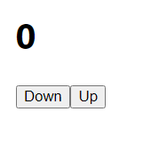
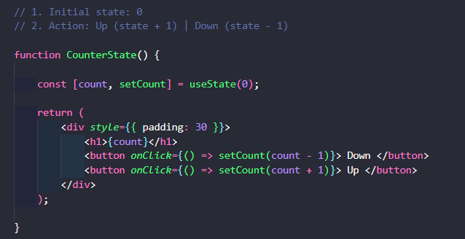
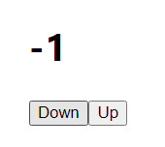
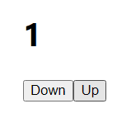
Reducer hook

Slide 38
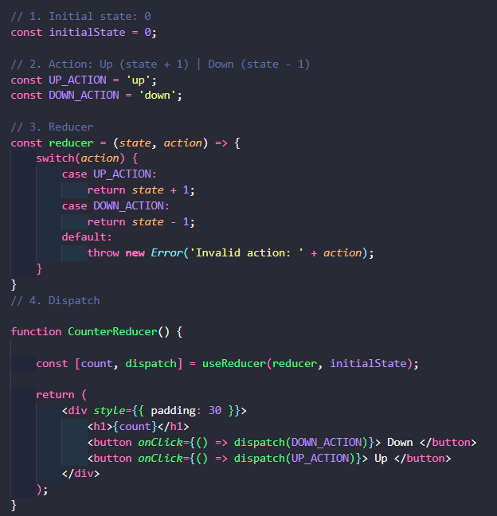
Reducer hook

Slide 39
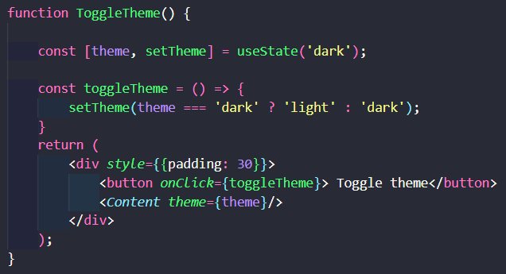
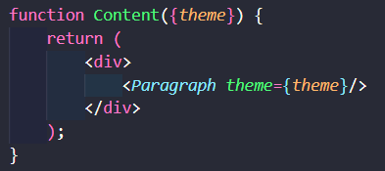
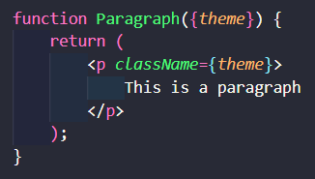
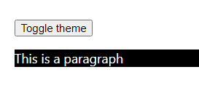
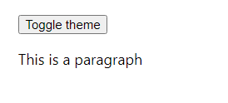
Context hook

Slide 40
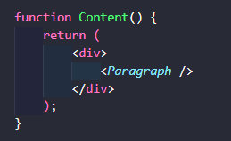
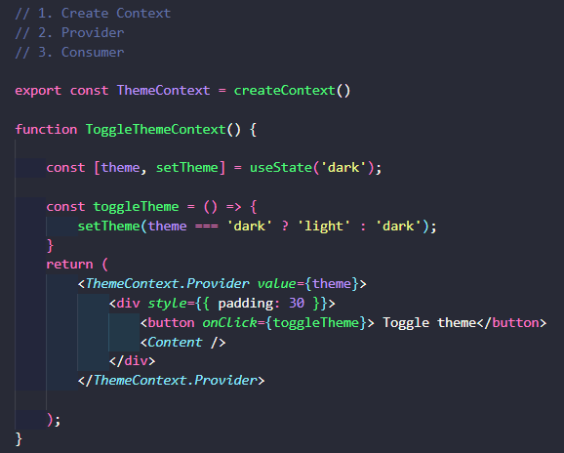
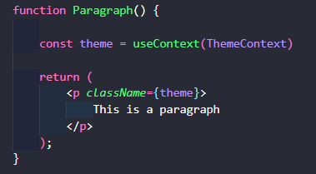
Context hook

Slide 41
Thank You!

