Slide 1
FINNISH LEARNING ASSISTANT
AI-assisted Finnish learning loop
Grammar feedback that becomes targeted practice
WRITE
CHECK
UNDERSTAND
PRACTICE
Final project presentation
Notes:
Introduce the project as a local educational MVP that connects grammar checking, history, weakness detection, vocabulary, and targeted practice.

Slide 2
PROBLEM
Finnish learners need more than a correction
The learning problem is recurring structure, not a single typo
15
A learner may receive the right form and still repeat the same mistake
productive cases
Immediate feedback should identify the grammar category.
A useful explanation should connect the form to a Finnish rule.
Stored mistakes should guide the next practice task.
Rich inflection makes one surface error hard to diagnose without context.
Project goal: turn correction into a repeatable learning loop.
Source: docs/PROJECT_SPEC.md
02
Notes:
Source: docs/PROJECT_SPEC.md. The number of Finnish cases is general linguistic context, not an evaluated project metric.

Slide 3
SOLUTION
The personalized learning loop
Each step is implemented as an explicit application action
WRITE
CHECK
UNDERSTAND
REMEMBER
ANALYZE
PRACTICE
Grammar results become learner history. Learner history becomes a ranked weakness. The weakness selects a practice target.
Source: docs/PROJECT_SPEC.md and app/ui
03
Notes:
The loop is the product's central differentiator. Demonstrate it in the same order during the live walkthrough.

Slide 4
ARCHITECTURE
Implemented system architecture
Production grammar and exercise flows share one provider-isolated LLM transport
Grammar Service
LLM Service
Chat Completions
STREAMLIT UI
6 pages
Experimental ML baseline
Vocabulary Service
Lexical index
UD + FinnWordNet
TF-IDF + Logistic Regression
Evaluation component
It does not power the production grammar flow.
Database + Profile
Exercise Service
validated output
Source: docs/ARCHITECTURE.md
04
Notes:
Source: docs/ARCHITECTURE.md. Emphasize that the Phase 5 model is an experimental comparison artifact, not the production checker.

Slide 5
DATA
Traceable Finnish data pipeline
Public treebanks remain distinct from derived learner-error and evaluation artifacts
UD Finnish-TDT
CC BY-SA 4.0
Strict CoNLL-U parsing
33,859 sentences
361,818 word tokens
Controlled synthetic errors
source IDs + leakage_group_id
versioned manifests and hashes
UD Finnish-FTB
CC BY 4.0
FinnWordNet adds English sense candidates to the separate vocabulary index. It does not label grammar errors.
Sources and licenses: docs/DATA_SOURCES.md
05
Notes:
Sources: https://github.com/UniversalDependencies/UD_Finnish-TDT and https://github.com/UniversalDependencies/UD_Finnish-FTB. Counts come from the Phase 3 preprocessing manifest documented in docs/DATA_SOURCES.md.

Slide 6
DATA TRANSFORMATION
Controlled synthetic learner errors
A narrow, reproducible proxy for the classical baseline
CORRECT
Minä menen kouluun.
SYNTHETIC ERROR
Minä menee kouluun.
TRANSFORMATION
VERB_CONJUGATION
minä + 3rd person verb
Why synthetic data: reproducible transformations were feasible within scope, while suitable authentic learner data was not available. The result does not prove real-learner generalization.
Source: data/errors/error_generation_manifest_v1.json
06
Notes:
The production generator uses corpus-observed compatible forms and records the exact transformation. The presentation example is the project’s canonical verb-agreement example.

Slide 7
MACHINE LEARNING
Classical ML baseline
Character TF-IDF and Logistic Regression on three synthetic error classes
Test set
71.0%
Accuracy
Macro F1 70.9%
Group-aware 70/15/15 approximation
Zero leakage-group overlap
Pipeline fitted on training data only
Shortcut risk remains visible
n = 3,000 synthetic examples; test n = 449
07
Notes:
Source: reports/final_evaluation_v1.json and models/error_classifier_v1_metadata.json. This baseline classifies an already-incorrect sentence into one of three synthetic categories.

Slide 8
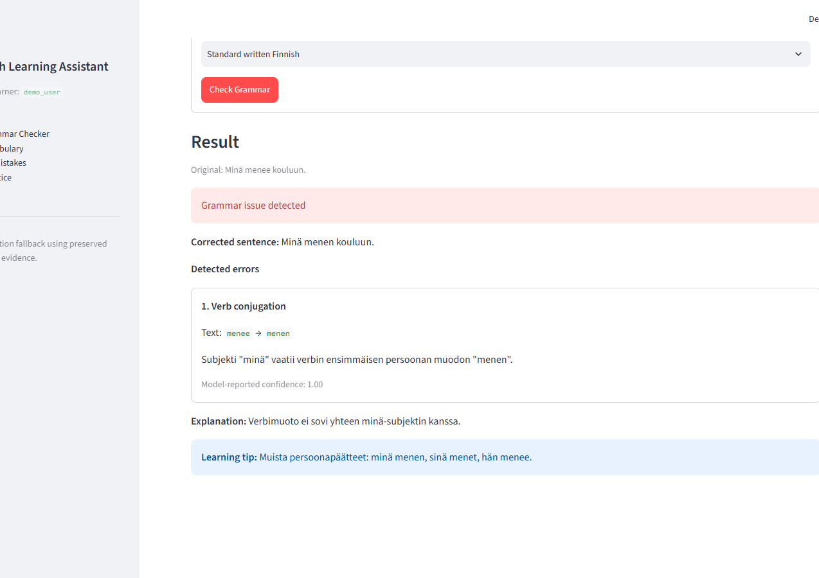
PRODUCTION AI
Validated LLM grammar checker
Contextual detection, correction, explanation, and learning tips
Grammar Service
LLM Service
JSON extraction
GrammarResult validation
Minä menee kouluun. → Minä menen kouluun.
Screenshot: previously recorded real Phase 11 system output
08
Notes:
Source: app/services/grammar_service.py, app/services/llm_service.py, and the preserved Phase 11 grammar output for single_verb_01. The screenshot is explicitly a previously recorded real output, not a current live call.

Slide 9
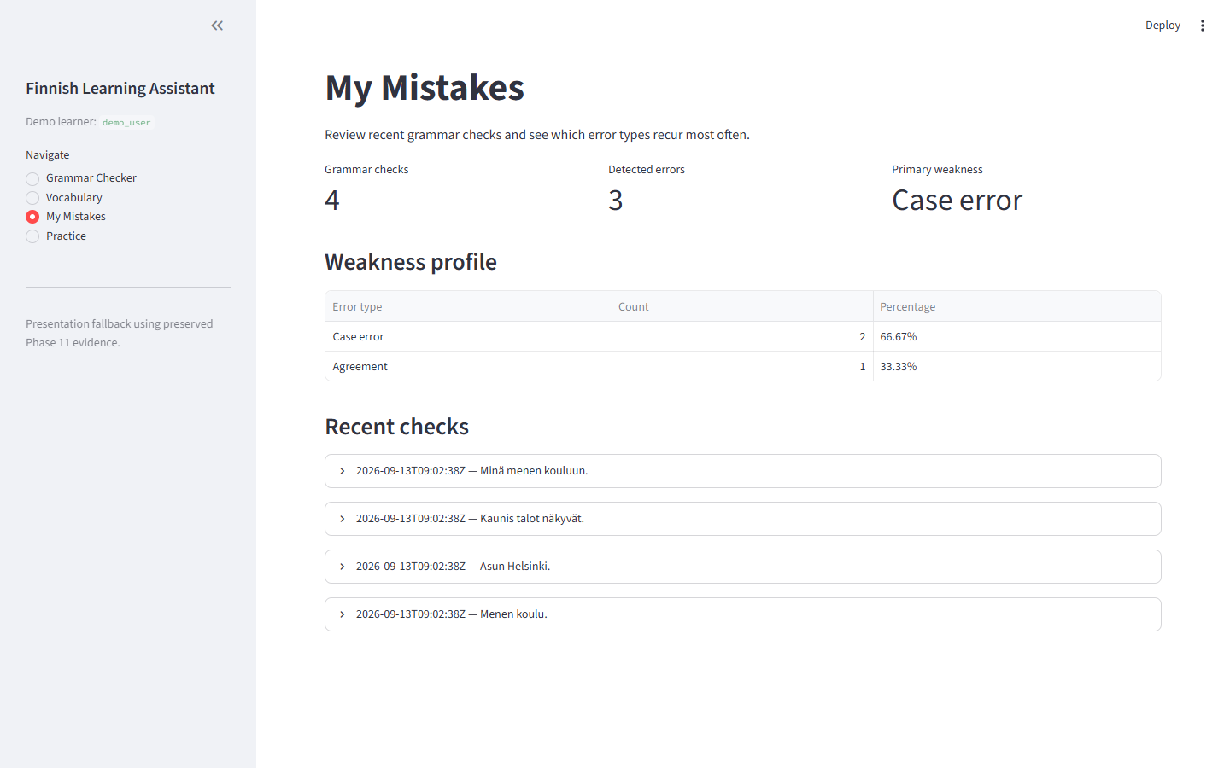
LEARNER PROFILE
Personalization from stored mistakes
Deterministic aggregation selects the learner's highest supported weakness
1
Persist once
One grammar check and its errors use one SQLite transaction.
2
Aggregate
Counts and percentages come from stored error rows.
3
Select target
Highest supported category drives the next exercise.
Controlled demo_user state; no production database is committed
09
Notes:
Source: app/services/database_service.py and app/services/profile_service.py. The screenshot uses the disposable demo database prepared for the presentation.

Slide 10
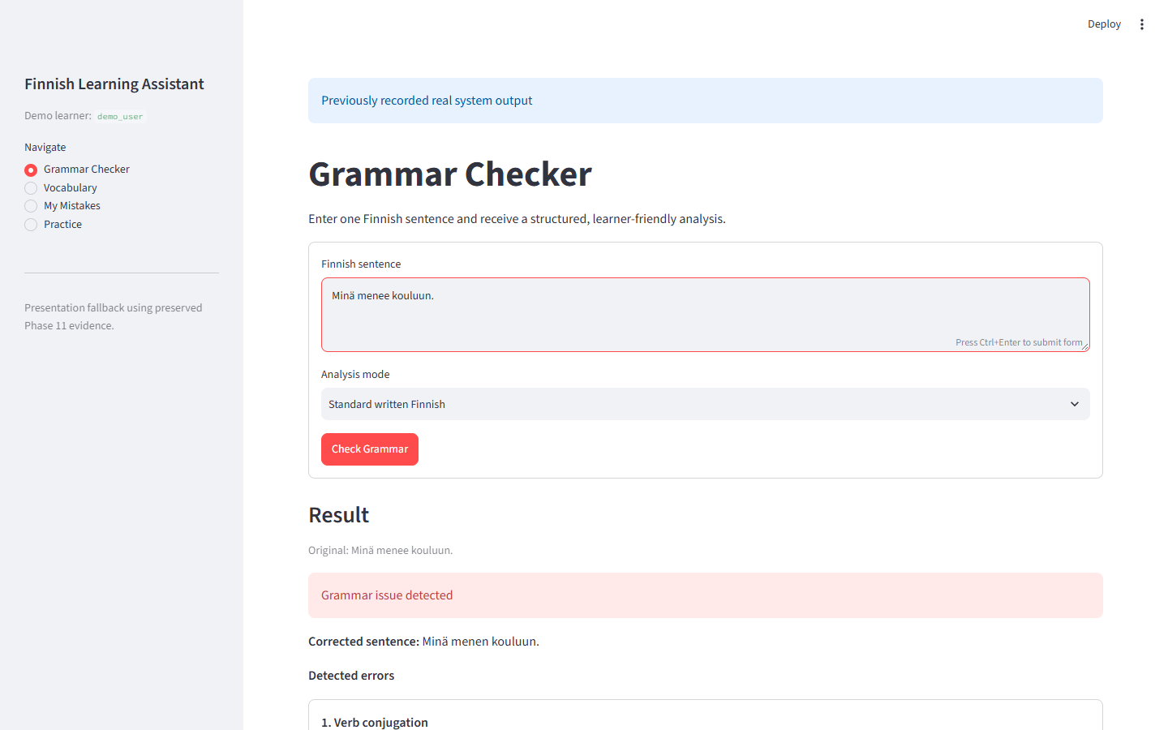
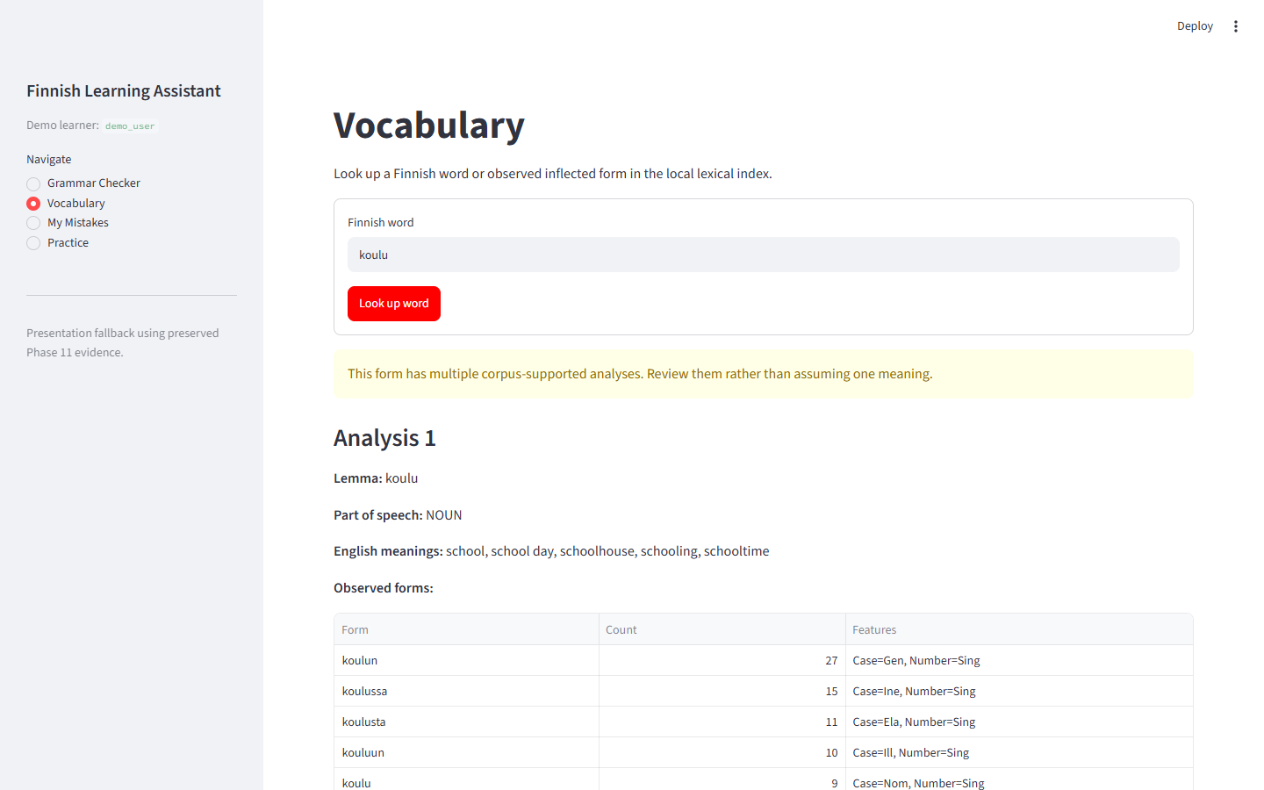
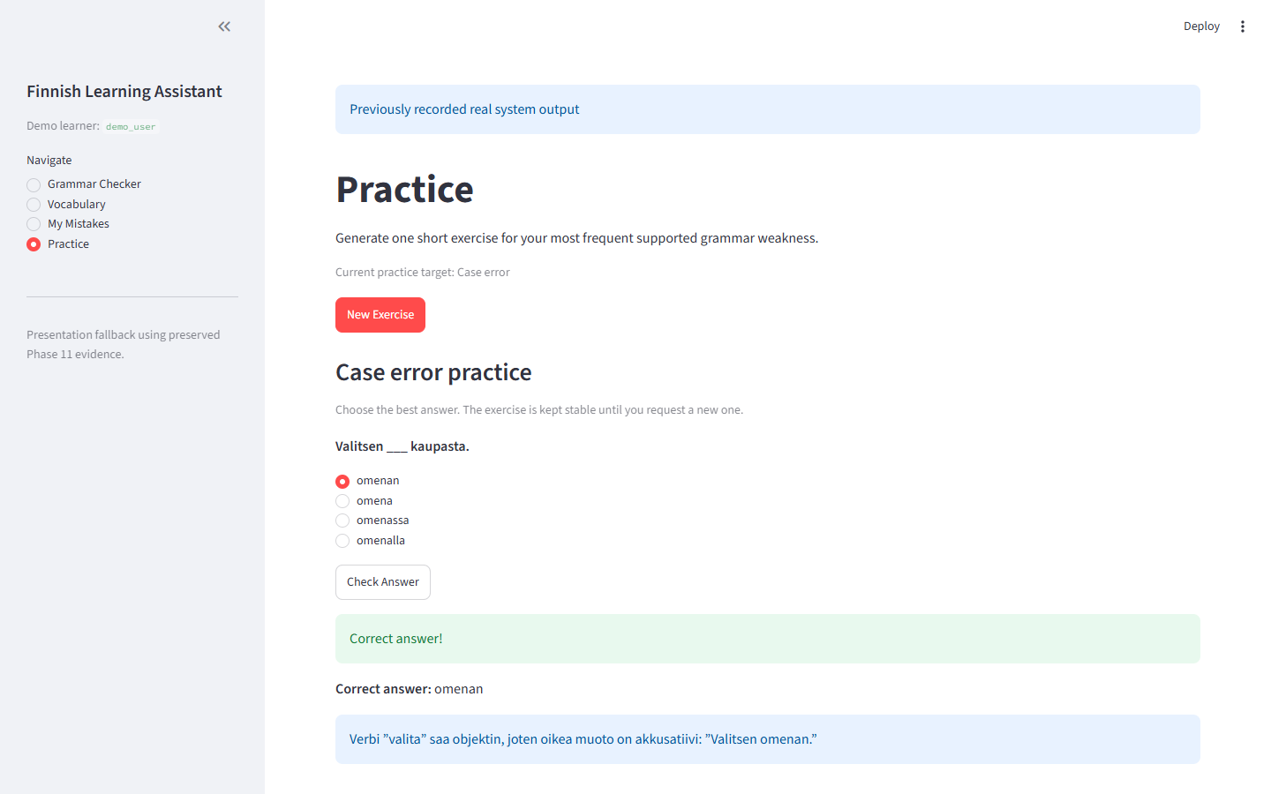
PRODUCT DEMO
Integrated Streamlit product
Focused views support the complete learner flow
Grammar
Vocabulary
Targeted practice
Explicit actions make Streamlit reruns safe: rendering does not repeat API calls or database inserts, and answer checking keeps the exercise stable.
Screenshots from the actual application components; fallback outputs are labeled
10
Notes:
Screenshots were captured from the project Streamlit UI. Grammar and exercise screenshots use preserved real Phase 11 outputs because the Phase 12 live grammar smoke encountered provider unavailability.

Slide 11
EVIDENCE
Phase 11 evaluation
Quantitative structure and AI-assisted linguistic review are reported separately
Selected evidence
94.44%
Grammar detection F1
39 predictions from 40 cases
1/22
False positives among valid cases
4.55% frozen-set rate
AI-assisted qualitative linguistic review, not Finnish-teacher validation
Grammar n = 40; exercise n = 20; ML test n = 449
11
Notes:
Source: reports/final_evaluation_v1.json. Displayed rates are loaded from the machine-readable report. Grammar output validity was 39/40. Exercise structural validity was 20/20. Exercise distractor PASS rate was 11/20.

Slide 12
LIMITATIONS AND NEXT EVIDENCE
A complete MVP with honest boundaries
The ML baseline uses controlled synthetic learner errors.
The grammar set has 40 cases and the exercise sample has 20 items.
Qualitative review was AI-assisted, not a Finnish-teacher evaluation.
LLM output and latency depend on the external provider.
Vocabulary coverage is corpus-bounded and meanings are not context-ranked.
SQLite and demo_user suit a local MVP, not multi-user production.
Future validation
Authentic learner corpus
Finnish-teacher review
Larger evaluation sample
Stronger exercise validation
Managed identity and persistence
The project demonstrates an evidence-backed learning loop from input to personalized practice.
Notes:
Close by summarizing what the system proves today and what still requires authentic learner data, Finnish-teacher validation, and production infrastructure.

