Slide 1
RAW Pointers
By: Dr. (James) Elliott Coleshill, P.Eng

Slide 2
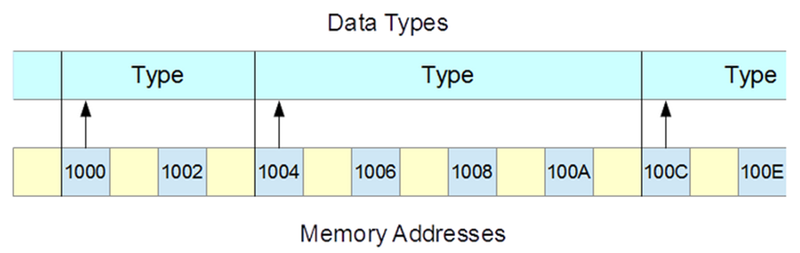
RAW POINTERS
Access memory at its lowest level
  Byte-addressible
    Means smallest region of memory a program can access is 1-byte
Model is one contiguous sequence of bytes
The address of any type is the first byte of the region of memory
RAW Pointer holds the starting address
Pointer type identifies the type of the value at the address
  i.e. the number of bytes reserved
“dereferencing” a raw pointer access the value stored

Slide 3
C-STYLE CHARACTER STRINGS
C-Style strings are the simplest form of RAW pointers
  Single byte arrays
  “std::hex” switches output format in cout to hexidecimal
  Casting (int) with the “&” will print the address of a given array element
  Without the cast cout will take the address and print out to the first available null byte
int main() {
char s[] = "A C string";
for (int i = 0; s[i]; i++)
std::cout << (int)&s[i] << " : " << s[i] << std::endl;
std::cout << std::hex;
for (int i = 0; s[i]; i++)
std::cout << (int)&s[i] << " : " << s[i] << std::endl;
int WaitKey;
std::cin >> WaitKey;
}
char* p = "May be overwritten";
char s[19];
std::strcpy(s, p);
s[0] = 'm'; // OK
std::cout << std::hex;
std::cout << s << std::endl;
std::cout << "s = " << (int)s << std::endl;
std::cout << "p = " << (int)p << std::endl;
std::cout << p << std::endl;

Slide 4
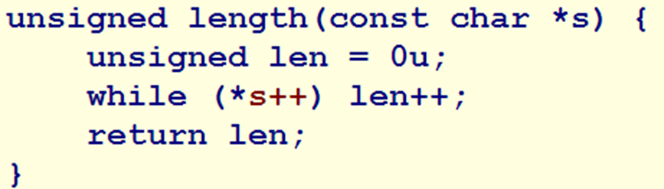
ARITHMETIC OPERATIONS
Addition (+)
  Adds one to the operand
  If the operand is a pointer one is added to the address
    Based on the size of pointer type
Subtraction (-)
  Difference between two pointers is of type ptrdiff_t
  Stores the number of types between two addresses
Increment (++) and Decrement (--)
Used to move pointers forward/backwards in memory
This code moves through memory until a nullptr is hit

Slide 5
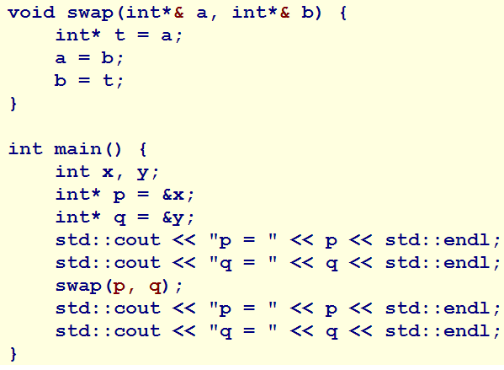
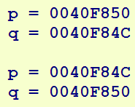
REFERENCE TO A POINTER
References to a pointer allows a pointer to change
  Similar to changing the value of a variable

Slide 6
Smart Pointers

Slide 7
SMART POINTERS
Manages memory of the object or resources to which it points
  Acts like a proxy
Supports:
  Dereferencing (*)
  Indirect member selection (->)
When it goes out of scope:
  Destructor is run
  Deallocates the dynamic memory
  Flushes the stream buffers
  Closes the stream
They implement the RAII idiom of OOP
  Resource Acquisition Is Initialization
RAII specifies resource acquisition occurs at initialization time
  Eg: memory is allocated at the same time the smart pointer is created

Slide 8
EXCEPTION HANDLING
Simplify memory of objects that throw exceptions
  Helps avoid memory leaks common to raw pointers
Smart pointer takes ownership of the object itself
  Link the lifetime of the object with the pointer
This is done by defining a pointer class that takes ownership of class Title
Let’s look at some
Code

Slide 9
EXCLUSIVE OWNERSHIP
A smart pointer that manages a one-to-one relationship with its object (or resource)
  Called a “Unique Smart Pointer”
Unique Smart Pointers satisfy the following requirements:
  Provides exception safety for dynamically allocated memory
  Passes ownership of object on returning from function
  Passes ownership of object on entering a function
  Collects the object inside a container
A unique smart pointer:
  Owns its object
  Stores a raw pointer to its object
  Transfers ownership of object in move construction/assignment operations
  Calls its object’s destructor when it itself is destroyed
  Cannot copy construct or copy assign
Let’s look at some
Code

Slide 10
SHARED OWNERSHIP
A set of smart pointers can share a single object or resource
  Many-to-one relationship
Managed through a “reference-counting”
  Keeps track of the number of smart pointers currently pointing to the object
  Only if counter == 1 does the smart pointer call the destructor
A reference-counter smart pointer
  Stores a raw pointer to its object
  Shares ownership of its object
  Transfers ownership in move construction/assignment operations
  Copies itself in a copy construction
  Releases itself from its object and reattaches in a copy assignment operation
  Can be compared for equality
  Calls its object destructor only if itself is being destroyed and no other smart pointer shares ownership

Slide 11
Thank You
Dr. (James) Elliott Coleshill, P.Eng
elliott.coleshill@senecacollege.ca
416-491-5050 x.33704

