Slide 1
Compositions, Aggregations and Associates
By: Dr. (James) Elliott Coleshill, P.Eng

Slide 2
OVERVIEW
Are relationships found in many programming solutions
  Composition (strongest)
    The composer object owns the component (one class completely contains the other class)
  Aggregation (weaker)
    Has an instance of an independent object (has it’s own life)
  Association (weakest)
    One class accesses or uses another class

Slide 3
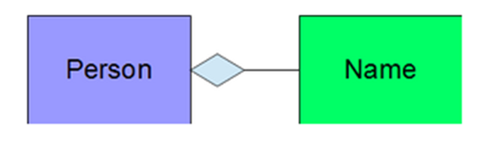
COMPOSITIONS
Are “has-a” relationship
Composer object is responsible for destroying its component object(s)
  Before or during it’s own destruction
More flexible than inheritance
  Updates to component class need not affect the composer class
Implementation
  Subobject, or
  Pointer

Slide 4
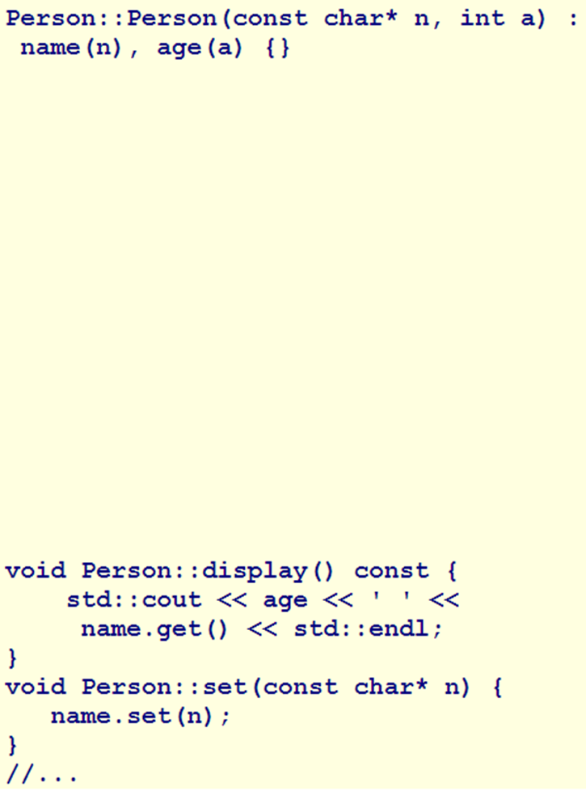
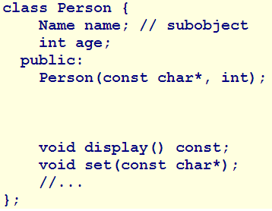
Notes:
SubObject
Constructor creates the “name” subobject
Assignment operator destroys old and creates new
Destructor destroys it
Default copy and assignment rules apply They are sufficient for this
implementationPointer
Deep copying and assignment are necessary
You must code the:
Copy constructor
Assignment operator
destructor

Slide 5
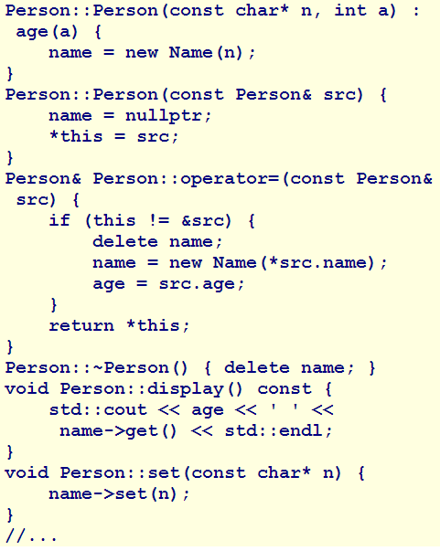
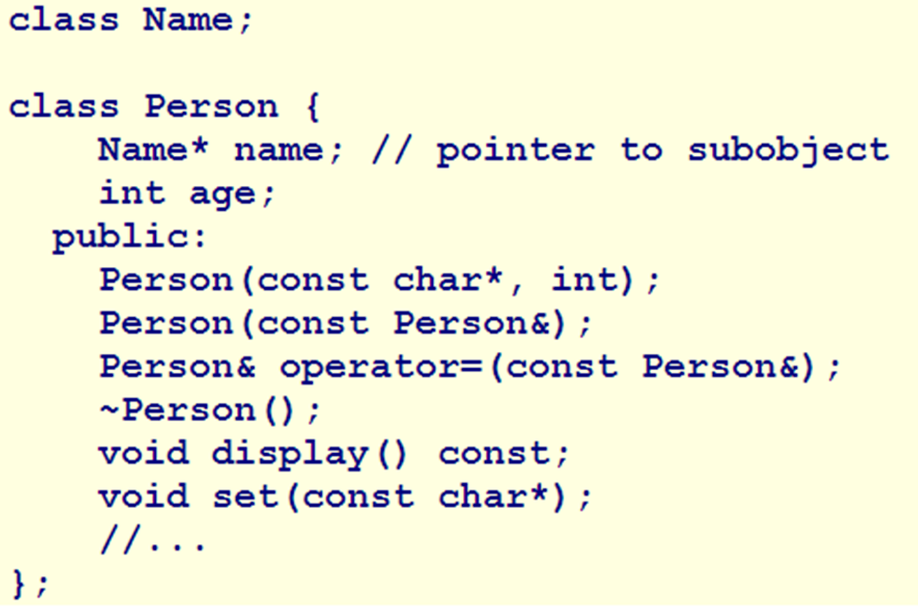

Slide 6

AGGREGATIONS
Composition that does not manage the creation or destruction of the objects it uses
  This happens outside the aggregator class
Aggregator is complete whether or not any of the objects exist
More flexible than composition
  Updates do not interfere with the design of the aggregator type

Slide 7
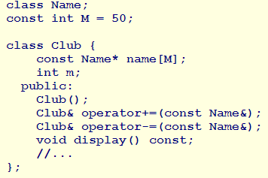
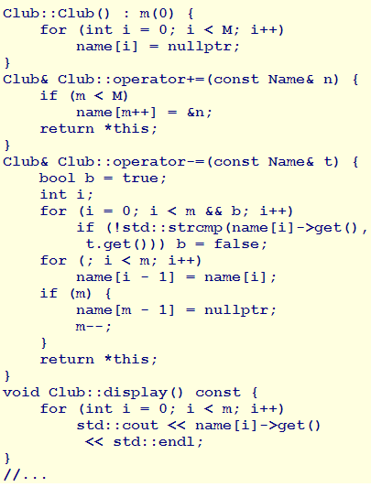
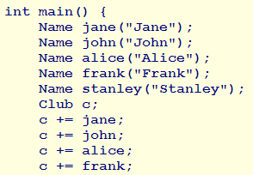

Slide 8

ASSOCIATIONS
Is a service relationship
Does not involve ownership of one type over another
Least coupled relationship
Example – Classroom scheduler
  Class Room
  Class Course

Slide 9
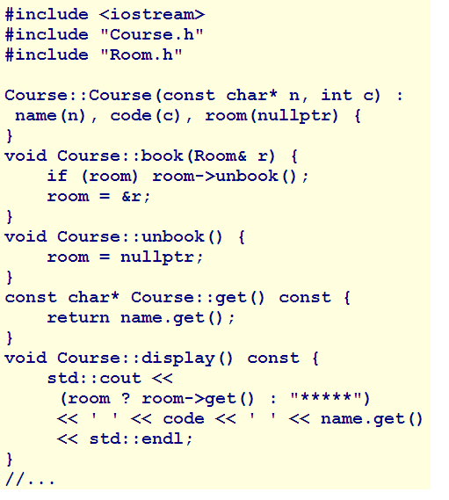
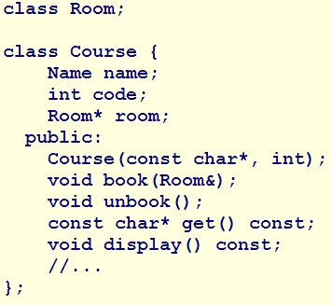

Slide 10
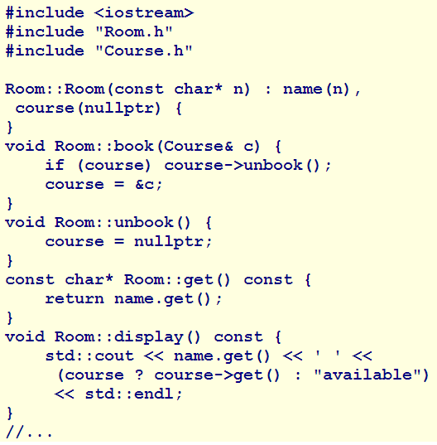
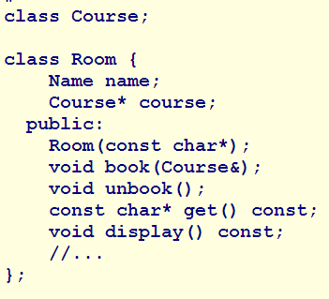

Slide 11
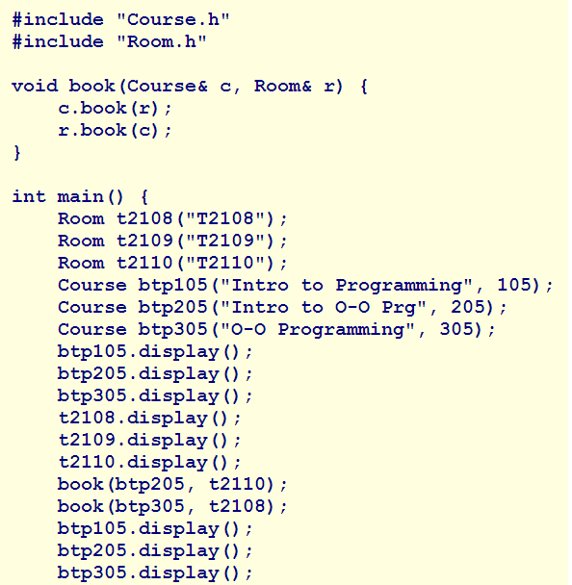
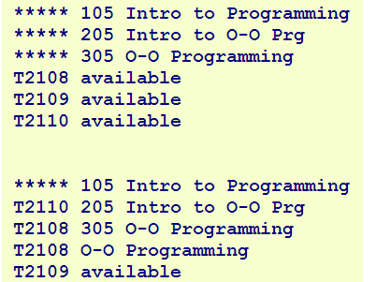

Slide 12
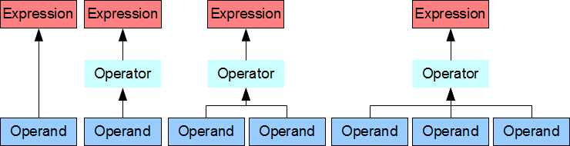
EXPRESSIONS
Combines values, variables, constants and operators to create new values
Two types
  Primary or Compound
    Compound is ultimately a set of primary expressions
    Consists of an operator and one or more operands

Slide 13
ORDER OF EVALUATION
New value is determined by order
Defined through precedence rules for all operators (C++)
Operators provide facilities for:
  Constructing compound expressions from primary ones
  Accessing and manipulating bits within the bytes

Slide 14
OPERATOR PRECEDENCE
Classified under 6 categories
  Primary
  Postfix
  Prefix
  Unary
  Binary
  Ternary

Slide 15
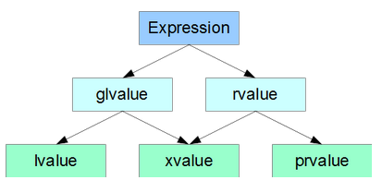
LVALUES AND RVALUES
Categorized expressions
  glvalue – evaluates to an object or function
  rvalue – a temporary object or subobject, or a value not associated with an object
Any expression belongs to one of the following:
  lvalue – a glvalue that is not an rvalue
  xvalue – a glvalue that can be reused – an object near the end of its lifetime
  prvalue – pure rvalue – initializes an object

Slide 16
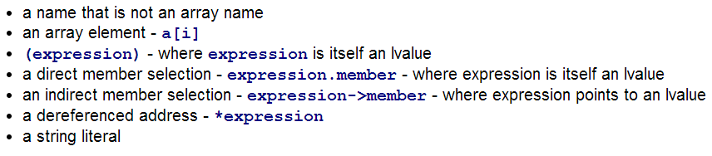


LVALUE OPERANDS
Lvalue operands include:
Operands must be lvalues
Left operands must be lvalues

Slide 17

POSTFIX EXPRESSIONS
Subscripting Operator
  Left operand is a pointer of type T
  Right operand is a value of integral type
a[10] holds address of array
a[i] refers to i-th element beyond start of a

Slide 18
NEGATIVE SUBSCRIPTS
C++ accepts negative subscripts provided the element is within bounds. Example:
char name[] = "Jane Doe";
char* surname = NULL;
surname = &name[5];
surname[-1] = '.'; // changes "Jane Doe" to "Jane.Doe"

Slide 19
MEMBER SELECTION
Identifies an object by the left operand and a member by the right
Two forms:
  Direct Selection (key symbol: “.”)
  Indirect Selection (key symbol: “->”)

Slide 20
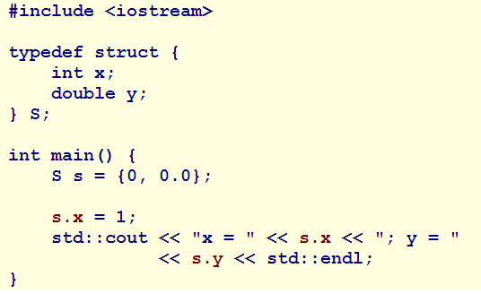
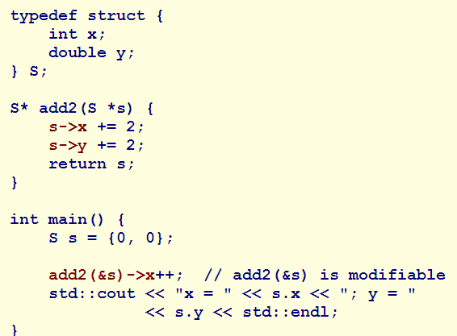
POSTFIX EXPRESSIONS
Direct Selection
Indirect Selection

Slide 21
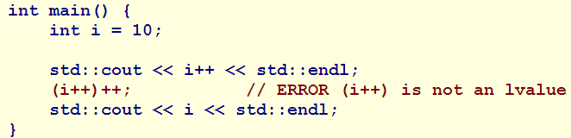
POSTFIX EXPRESSIONS
Increment and Decrement
  Change lvalue by one unit “after” accessing the value
  Symbols are “++” and “- -”
  Located on the right side of the operand

Slide 22
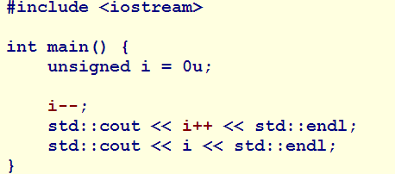

POSTFIX EXPRESSIONS
Results at Integer Limits
  If operand is unsigned and 0
    “- -” changes the value to the largest unsigned value
  If operand is signed and operation creates an overflow/underflow
    Result is undefined

Slide 23
PREFIX EXPRESSIONS
Increment/decrement expressions
  Operator precedes operand (on the left)
  Symbols “++” or “- -”
Change the lvalue by one unit “before” accessing the value
Range Results
  Similar to postfix expressions, but backwards

Slide 24
CONSTRAINED CAST OPERATORS
Operator converts expression v to type T
  T is an lvalue reference to a type
    Result = xvalue
  T is an rvalue reference to a function type
    Prvalue
Usage:
  Standard Conversions
  Related classes
  Enumerators
  Rvalue references
  void
static_cast<T>(v)
NOTE: Cannot be used on constants

Slide 25
CONSTRAINED CAST OPERATORS
Operator converts expression v to type T
  T is an lvalue reference to a type
    Result = lvalue
  T is an rvalue reference to a function type
    Result = xvalue
Usage:
  Pointers
    Functions, objects, members, etc…
reinterpret_cast<T>(v)
NOTE: Cannot be used on constants
const_cast<T>(v)
dynamic_cast<T>(v)

Slide 26
UNARY EXPRESSIONS
Are expressions in which operator precedes a single operand
Include:
  Size evaluations
  Logical and bit-wise negation
  Arithmetic plus/negation
  Addressing
  Indirection
  Type casting
Unary operators associate from right to left

Slide 27
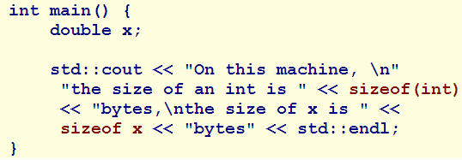

SIZEOF
Evaluates type of operand
Returns its size in bytes (size_t)
sizeof without ( ) evaluates to size of:
  Variable
  Object
  Expression

Slide 28
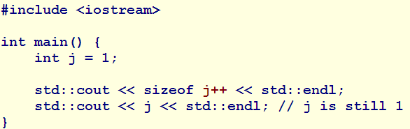

SIZEOF
Compiler evaluates sizeof expressions at compile time
If operand is expression, compiler does not evaluate it

Slide 29
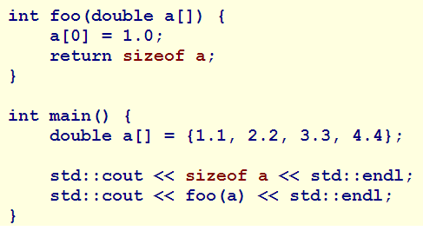

SIZEOF
If operand is an array
  sizeof returns size of array in bytes
    Number of elements * the size of the type
If operand is a function parameter that holds address of array
  sizeof returns size of pointer that holds address

Slide 30
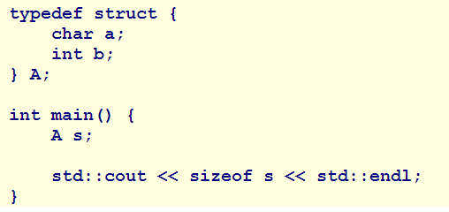

SIZEOF
If operand is an object of class type
  sizeof returns sum of the sizes of subobjects
    Including padding

Slide 31
LOGIC NEGATION
Symbol: “!”
Converts operand to bool value
Returns converse of that value
Examples
  0, 0.0, nullptr → true
  Otherwise → false

Slide 32
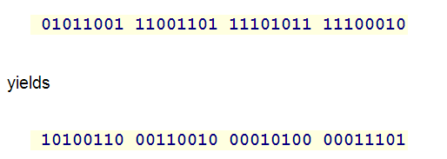
BITWISE NEGATION
Symbol: “~”
Converts its operand to its one’s complement

Slide 33
ARITHMETIC PLUS/NEGATION
Plus
  Symbol: “+”
  Evaluates to its operand
Negation
  Symbol: “-”
  Evaluates operand with its sign reversed
  WARNING:
    Special attention must be made to “unsigned” types
    Result equal to 2n-operand
      Where ‘n’ is the number of bits used to store the number

Slide 34
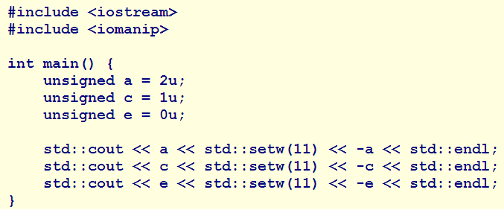

UNSIGNED NEGATION EXAMPLE

Slide 35
OTHER UNARY EXPRESSIONS
Address of:
  Symbol: “&”
  Returns a pointer to its operand
    Value of the address
Indirection
  Symbol: “*”
  Returns value stored in the address the operand contains

Slide 36
OTHER UNARY EXPRESSIONS
Cast
  Consists of a type name followed by the operand to be converted
  Two styles
    C-Style – enclose the target with ( )
    C++-Function-Style – enclose the operand with ( )
noexcept Operator
  Symbol: “noexcept()”
  Used for error handling
  Returns true if argument does not throw exception

Slide 37
INDIRECTION
The indirection and address-of operators are inverses of one another. The result of *&x is x.
int main()
{
  int x = 3;
  int* p = &x;
  std::cout << x << std::setw(11) << p << std::endl;
  *&x = 4;
  std::cout << x << std::setw(11) << p << std::endl;
}

Slide 38
ALIGNOF() OPERATOR – DECLTYPE() SPECIFIER
alignof() returns the alignment requirements of its operand
  Std::size_t integral type
decltype() evaluates the type and value category of its arguments
int i = 3, j = 6;
double x = 4.5;
double& r = x;
decltype(i + j) y = i + j; // int y
decltype(i + x) z = i + x; // double z
decltype(r) s = r; // double& s

Slide 39
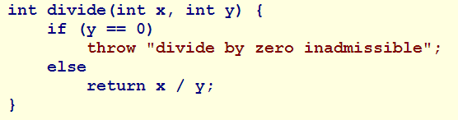

OTHER UNARY EXPRESSIONS
Throw Operator
  Symbol: “throw”
  Identifies an exception to normal execution
  Creates a temp object for exception handler

Slide 40
BINARY EXPRESSIONS
Consist of two operands and one operator
Include:
  Arithmetic
  Relative
  Logical
  Bit-wise expressions

Slide 41
ARITHMETIC
Multiplicative
  Evaluates product, quotient or remainders
  Symbols: *, /, %
Addition
  Adds values of its operands
  Symbol: +
Subtraction
  Subtracts values of its second operand from the first
  Symbol: -

Slide 42
BIT SHIFTING
Moves bit pattern of left operand towards left or right end
  Right operand specifies the number of bit positions to shift
  Left operand is of integral or unscoped enumeration type (the variable to be shifted)

Slide 43
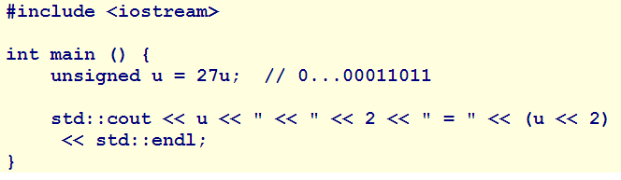
BIT SHIFTING
Left-Shift
  Symbol: <<
  Vacated bits are filled with 0
11011 → 1101100

Slide 44

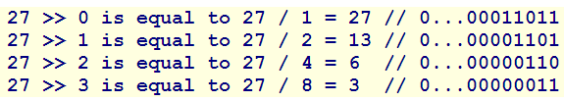
BIT SHIFTING
Right-Shift
  Symbol: >>
  Bits pushed off the end are lost
Bit shifting provides fast multiplication or division by powers of 2

Slide 45
RELATIONAL
Compares values of two operands for:
  Relative magnitude
  Equality
  Inequality
Less-Than Symbol: <, <=
Greater-Than Symbol: >, >=
Equality Symbol: ==
Inequality Symbol: !=

Slide 46

BITWISE AND
Compares every bit of the left operand with the right operand (Mask)
Symbol: &
Truth Table
Left Operand | Right Operand | Result
0 | 0 | 0
0 | 1 | 0
1 | 0 | 0
1 | 1 | 1

Slide 47
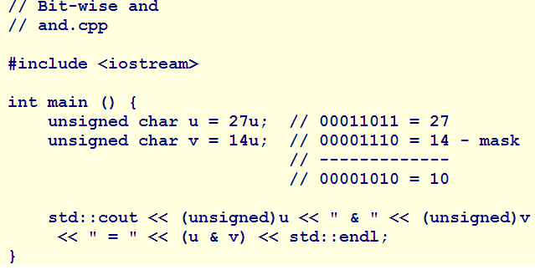

BITWISE AND EXAMPLE

Slide 48
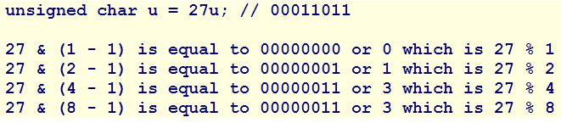
OTHER USES
Oddness Teset
  Bit-wise “and” with a right operand of 1 returns oddness of left operand
  bool odd = (bool)(value & 1)
Fast Remainder
  Bit-wise “and” can extract the remainder of a division by powers of 2
    More efficient than the modulus operator

Slide 49

BITWISE OR
Compares every bit of the left operand with the right operand (Mask)
Symbol: |
Truth Table
Left Operand | Right Operand | Result
0 | 0 | 0
0 | 1 | 1
1 | 0 | 1
1 | 1 | 1

Slide 50
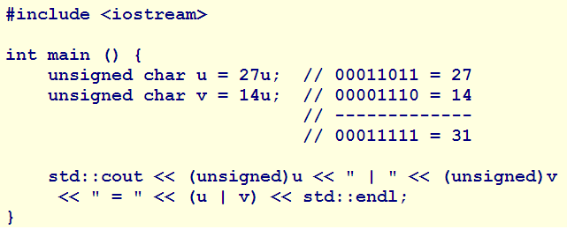

BITWISE OR EXAMPLE

Slide 51

BITWISE EXCLUSIVE OR (XOR)
Compares every bit of the left operand with the right operand (Mask)
Symbol: ^
Truth Table
Left Operand | Right Operand | Result
0 | 0 | 0
0 | 1 | 1
1 | 0 | 1
1 | 1 | 0

Slide 52
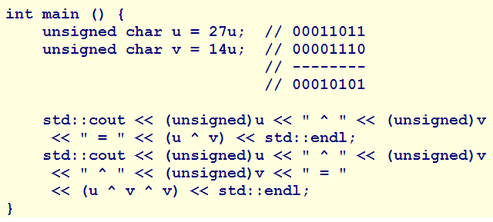

BITWISE XOR EXAMPLE

Slide 53
LOGICAL
Evaluate the combined truthfulness of their operands
  Must be: integral, floating-point or pointer types
  Returns bool: false or true
Logical AND “&&”
  True – if both operands are true
  False – if either of the operands is false
Logical OR “||”
  True – if either operand is true
  False – if both operands are false

Slide 54
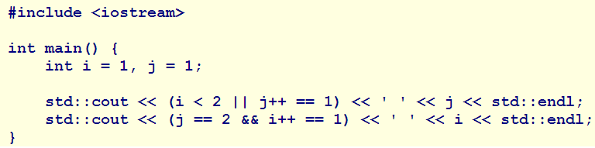


LOGICAL
Always evaluated left to right
  For Example: If using && and left operand false, the right operand is not evaluated
Therefore, Order Matters

Slide 55

ASSIGNMENT EXPRESSIONS
Copies from the right operand to the left
  Left operand must be modifiable
Simple Assignment: Symbol: =
Compound Assignments:
  +=, -=, *=, /=, %=, >>==, <<==, ~=, &=, |=, ^=

Slide 56
ASSIGNMENT EXPRESSIONS
Sequential Expressions
  “,” divides expressions
  Separate evaluation from the left
Mixed-Type Binary Expressions
  If operands are not of type defined for operator, one operand must be converted
  Compiler promotes based on the following hierarchy

Slide 57
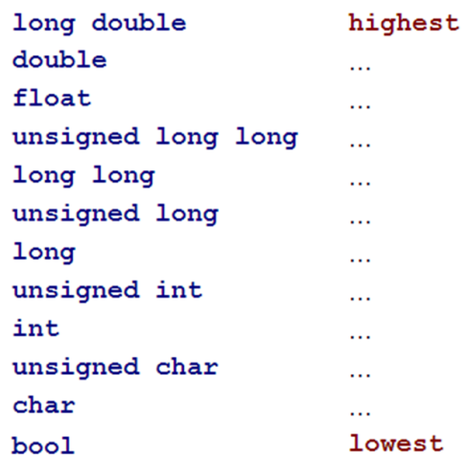
ASSIGNMENT EXPRESSIONS

Slide 58
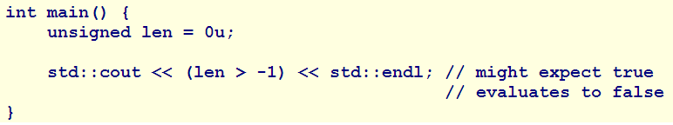
ASSIGNMENT EXPRESSIONS
If one operand is (void *)
  compiler converts the non-generic to generic
If one operand is unsigned and other is signed
  Compiler converts signed to unsigned type
  May produce counter-intuitive results

Slide 59

TERNARY EXPRESSION
Is a conditional expression
  “?” identifies the expression as a selection construct
  “:” separates the choices

