Slide 1
Functions/Error Handling
By: Dr. (James) Elliott Coleshill, P.Eng

Slide 2
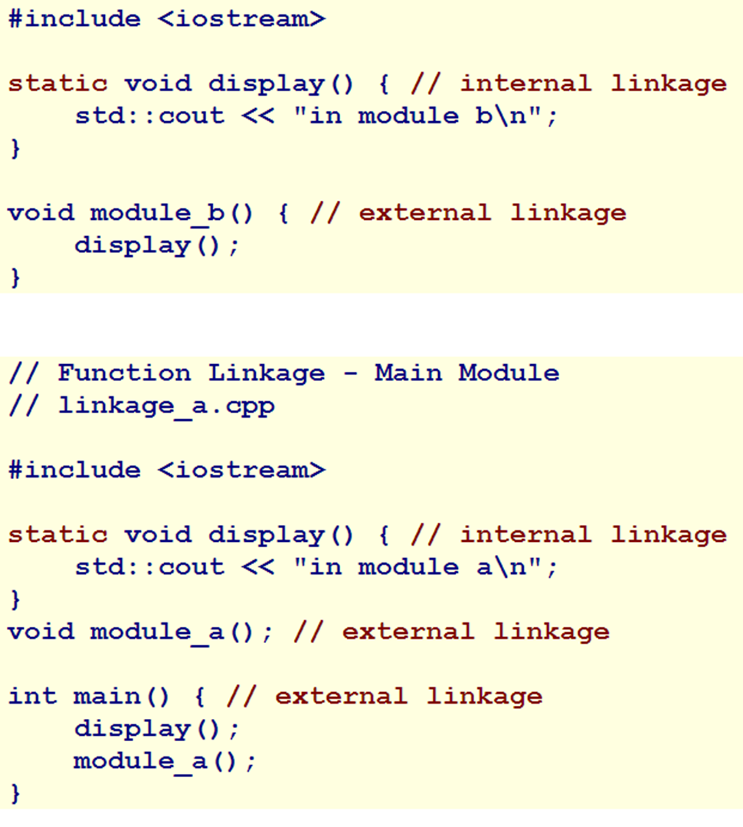
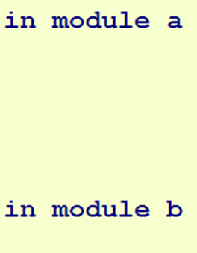
LINKAGE
Function types can has either Internal or External linkage
  External linkage – visible outside translation unit
  Internal linkage – visible only inside translation unit
External linkage by default
  Can specify redundantly using “extern”
Internal linkage specified using “static”

Slide 3
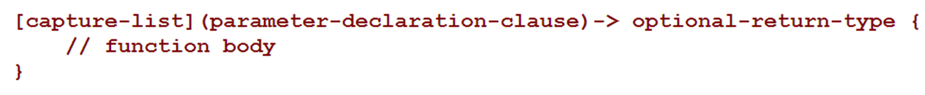
COOL STUFF WITH FUNCTIONS
Recursive Functions – function that calls itself
  Must have exit type – prevents stack overflow, when true steps back through stack
Pointers to Functions – calling a function using an address
Arrays of Pointers to Functions
Function Objects – instance of class that overloads a function call
  Advantages…. It stores states
Lambda Expressions – anonymous functions nested in code

Slide 4
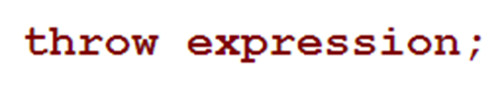
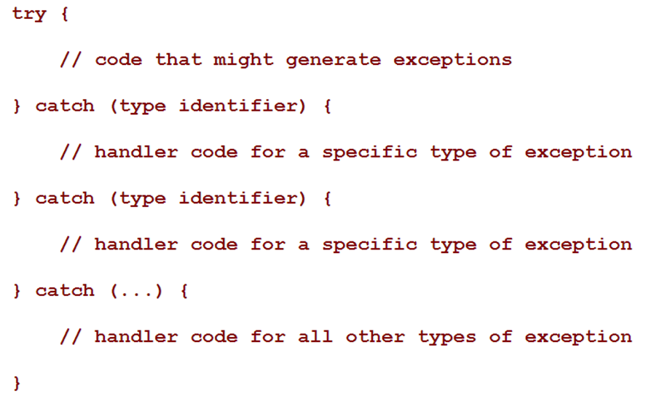
ERROR HANDLING
Keyword: “throw”
Handling the Exception

Slide 5
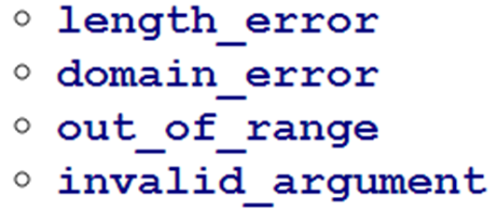
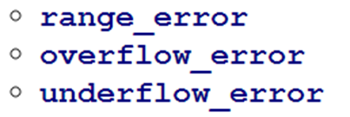
STANDARD C++17 EXCEPTIONS
C++11 includes a standard library of exception classes
  Based called name “exception”
  Defined in <exception>
Classes derived from base class include:
  “logic_error” – handles problems in a program’s internal logic
  “runtime_error” – handles problems that can only be caught during execution
  “bad_alloc” – handles the allocation exception thrown by “new”
    Requires header <new>
  “bad_cast” – handles exception thrown by “dynamic_cast”
    Requires header <typeinfo>

Slide 6
NOEXCEPT()
void d() { throw "d() throws\n"; }
void e() {
try {
d();
}
catch(const char* msg)
{
std::cout << msg;
}
}
void f() { throw "f() throws\n"; }
void g() noexcept { e(); }
void h() noexcept { f(); }
int main() {
std::cout << "Calling g: ";
g(); std::cout << "Calling h: ";
h(); std::cout << "Normal exit\n";
}
Identifies a function as one that will not throw an exception

Slide 7
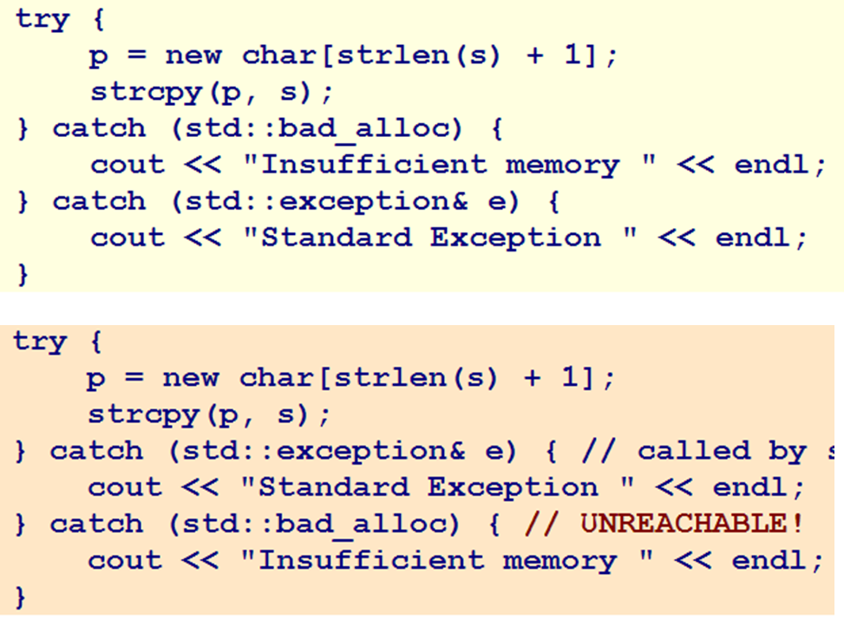
EXAMPLE
Order is important
Exceptions are only caught if thrown inside a “try” “catch” block
“noexcept”
  Identifies a function as one that will not throw an exception
  Allows an uncaught exception to escape at runtime
  Program terminates immediately
  Informs compiler that it can perform certain optimizations

Slide 8
PROGRAM EXITS
Normal termination involves
  Calling destructors
  Flushing memory
  Closing all input/output streams
  Returning status integers to the operating system
C++11 provides two functions for standard exits
  int atexit(void (*) (void))
  int exit(int)

Slide 9
Thank You
Dr. (James) Elliott Coleshill, P.Eng
elliott.coleshill@senecacollege.ca
416-491-5050 x.33704

