Slide 1
Types
By: Dr. (James) Elliott Coleshill, P.Eng

Slide 2
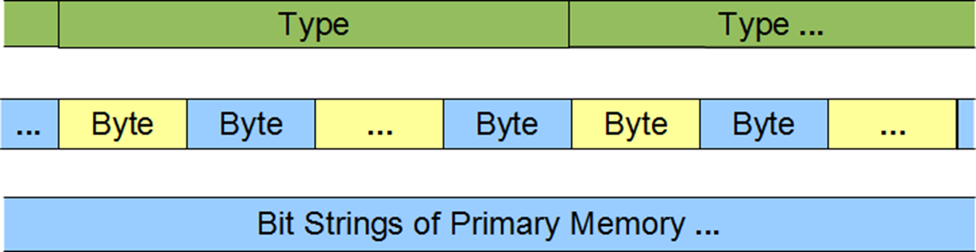
DEFINITION
Type informs the compiler
  How to interpret a bit string in memory
  What operations are valid
Fundamental Types
  Integral
  Floating-Point
  Void

Slide 3
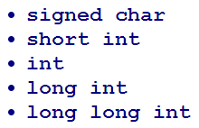
INTEGER TYPES
Consist of:
  Standard ints
    Signed (negative and positive values)
    Unsigned (no negative values)
  Booleans
  Character types
Represented using binary numeration system
Byte order depends on host platform
  PowerPC – typically big-endian
  Intel – typically little-endian
Leading word before “int” is the size specifier

Slide 4
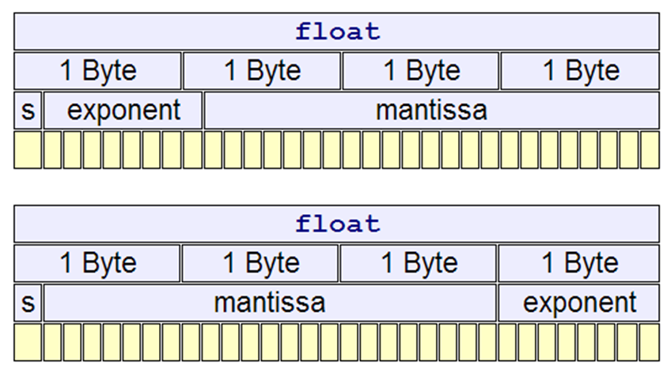
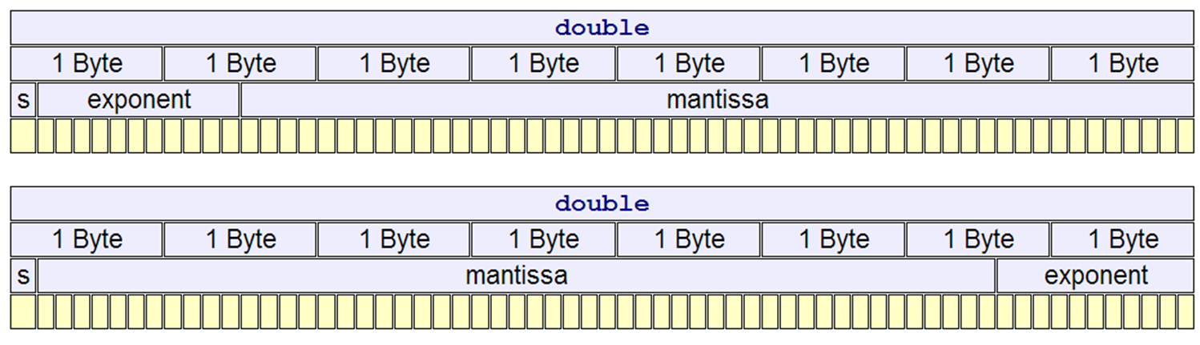
FLOATING-POINT TYPES
C++11 defines 3 types
  Float – single-precision
  Double – double-precision
  Long double – double-precision
Most popular implementation is IEEE-754
  Binary and floating-point arithmetic

Slide 5
FLOATING-POINT TYPES
IEEE 754
Where
  is the value of bit “i” of the mantissa
  is the exponent (-127 to 128)
Float Type

Slide 6
VOID
Incomplete type
Describes empty set of values
Typical uses
  Function return
  Generic pointers

Slide 7
INFERENCE
// Type Inference
// auto.cpp
#include <iostream>
int main () {
int a[] {1, 2, 3, 4, 5, 6};
const auto n = 6;
for (auto i = 0; i < n; i++)
std::cout << a[i] << ' ';
std::cout << std::endl;
}
Note that auto cannot appear in the top-level declaration of an array type. That is, we cannot write:
auto a[] {1, 2, 3, 4, 5, 6};

Slide 8
TYPE ALIGNMENT
Every object type has an alignment requirement. This requirement represents the number of bytes between successive addresses of objects of that type.
We specify the alignment of an object type using alignas().
The alignof() operator returns the alignment requirement of its argument type.
// A is allocated at 4-byte boundaries
struct A {
int n; // size 4 alignment 4
char c; // size 1 alignment 1
}; // size 8 alignment 4
// B is allocated at 16-byte boundaries
struct alignas(16) B {
int n; // size 4 alignment 4
char c; // size 1 alignment 1
};
// size 8 alignment 16

Slide 9



POINTER TYPES
Memory address
Each type has an associated pointer
  Just add the “*” to the end of the type name
Each synonym type defined has a pointer
Different pointer types are not assignment compatible. Casting required
Keyword: “nullptr”
Good Design Style
  Always initialize and reset pointers to “nullptr”

Slide 10
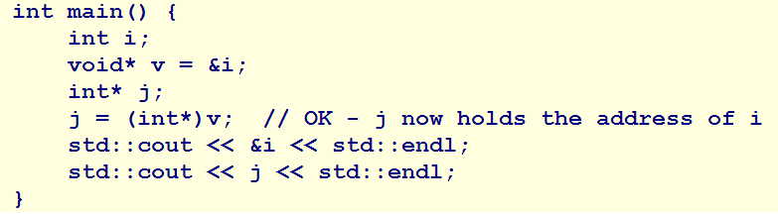
GENERIC POINTER
Not associated with any particular type
Can hold address of variable or object without type information
Conversion to and from a generic type can be done without loss of address
Cannot be dereferenced due to lack of info describing memory
  Accessing the memory requires casting to the type of data represented in memory

Slide 11
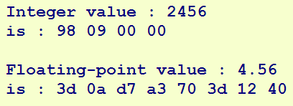
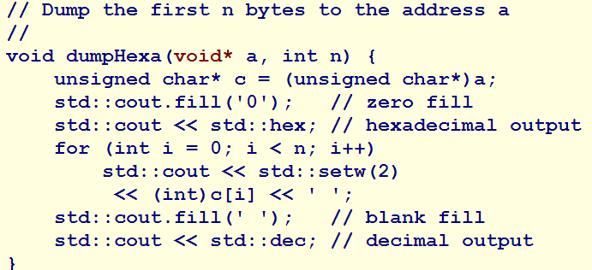
GENERIC POINTER - CONT
What does this do?

Slide 12



ARRAYS
A linear data structure of contiguously stored identical types
  Element – represents a single data value
Arrays can have one or more dimensions
Can occupy either static or dynamic memory
Static Memory
  Type is the type of every element
  c is the number of elements
  i (optional) braces, command-separated initial values
Dynamic Memory
Keywords for Dynamic Memory

Slide 13
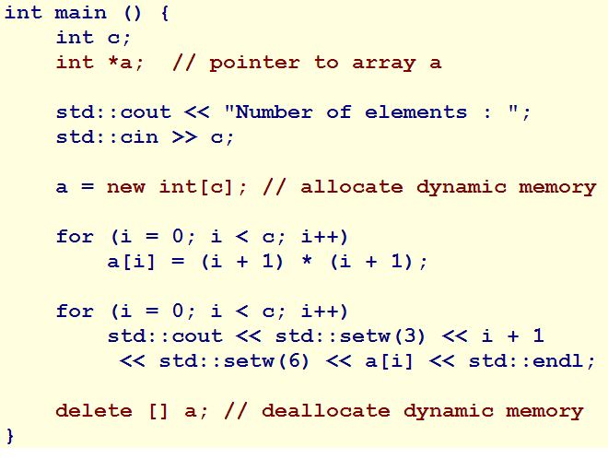
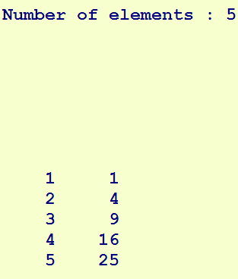
ARRAYS – DYNAMIC EXAMPLE
What’s the output?

Slide 14
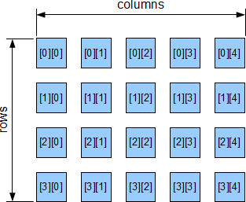
2D ARRAYS
Uses two indices to refer to its elements
  Row index
  Column index
Definition:
Where
  r = number of rows
  c = number of columns
  Size of array is r * c

Slide 15
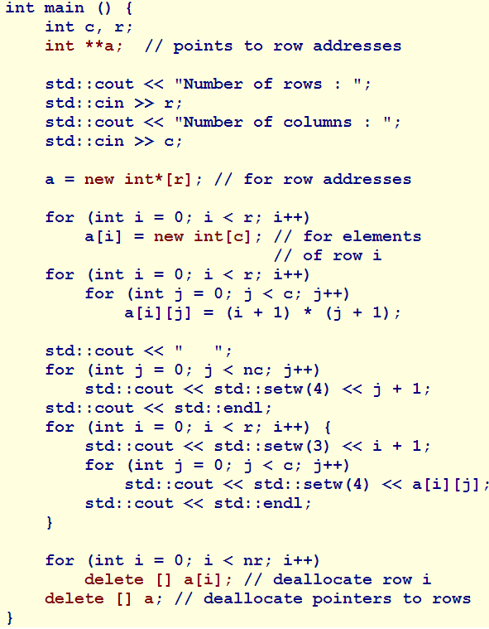
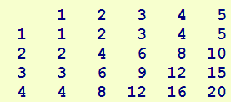
DYNAMIC MEMORY – 2D ARRAY
Requires five steps:
  Allocate static memory for a 1D array of pointers
  Allocate dynamic memory for a 1D array of pointers
    Holds the addresses of rows
  Allocating dynamic memory for each row of the 2D array
  Deallocating memory for each row of 2D array
  Deallocating memory for the array of pointers

Slide 16
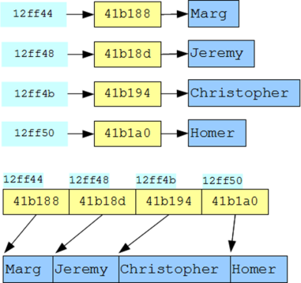
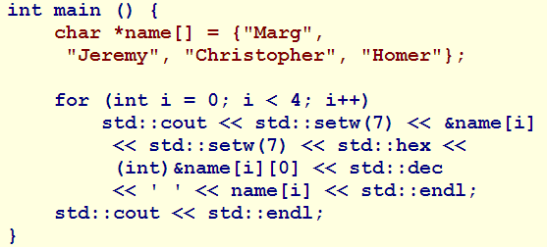
MULTI-DIMENSIONAL ARRAYS
Number of dimensions is not restricted
Ragged Arrays
  Common use – storing lists of strings
  Array of addresses
  Data stored in each address may be of different size

Slide 17
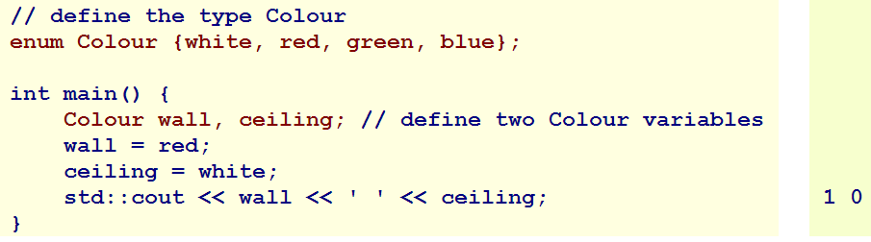
ENUMERATIONS
A type that holds a constant from a set of named constants
  Simplify readability
Each enum has an underlying type (int)
Used to refer to a name from a pre-defined set
Keyword “enum”
Format
  Enum <name> ( named_c1, named_c2 ….};
  <name> identifier

Slide 18
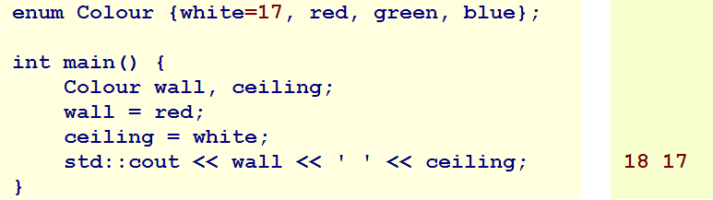
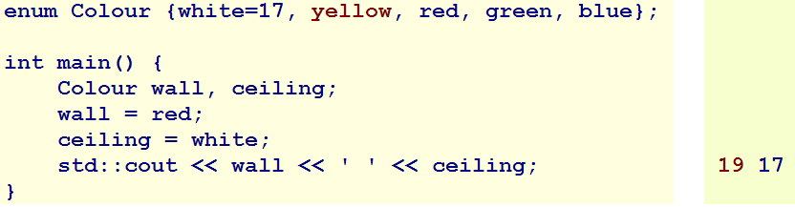
ENUMERATIONS - CONT
NOTE: Adding a constant into the list causes a re-ordering of the integer values

Slide 19
REFERENCES
Is an alias for an existing object or function
Types
  lvalue – denoted by “&”
  rvalue – denoted by “&&”
lvalue -- Refers to an accessible region of memory
rvalue -- Refers to
    An object near the end of its life
    A temporary object or subobject
    A value not associated with an object
C++11 does not allow references of references, arrays of references or pointers to references

Slide 20
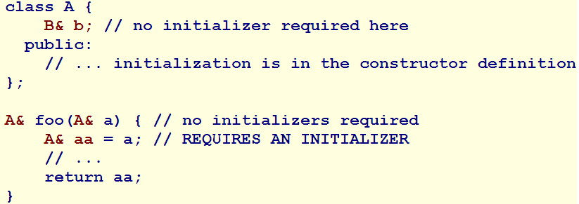
LVALUE REFERENCES
Declaration requires an initializer unless
  Specifies external linkage
  Is a class memory
  Is the declaration of a parameter or return type

Slide 21
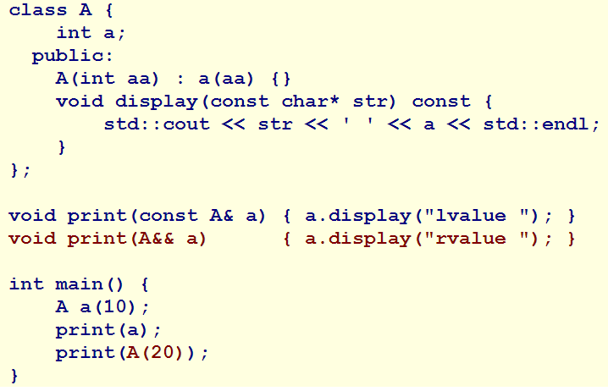

RVALUE REFERENCES
Distinguish temp objects from permanent objects
Typically used for move-constructors and move-assignment operators
What’s the output?

Slide 22
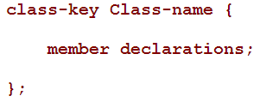

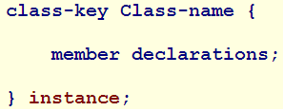
OBJECTS
Three different class keys
  “class”
  “struct”
  “union”
A class is a sequence of types
  Not necessarily identical
  They are called members
Data members are not necessarily stored contiguously
“class” members are private by default
“struct” and “union” members are public by default
Declarations & Definitions

Slide 23
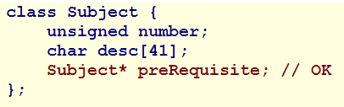
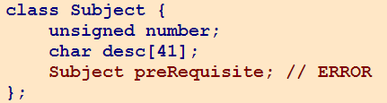
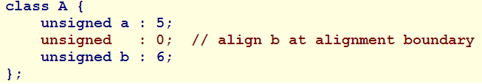
MEMBER DECLARATIONS
Members may include most types
Pointers that point to an instance of the class itself
  Not allowed to declare a member of itself
Member declarations can be broken into bit fields
Bit alignment can be achieved by adding a bit field of 0 prior to the variable
Bit-field allocation is implementation defined
  Not always portable

Slide 24
DATA INITIALIZATION
Done via a class constructor
Constructor takes the same name as the class
Initialization are comma-separated and embedded between a single colon and the {} of the function definition
Typically used to init unmodifiable members that cannot be manipulated in the body of the constructor (eg const)
Let’s look at an example

Slide 25
RETURNING A REFERENCE
Returning a reference exposes the data member to be modified
Good practice to create “dummy elements”
Let’s look at an example

Slide 26
MOVE/COPY CONSTRUCTORS
Large classes require considerable computation to copy
To avoid copies at the end of life we can define a move-constructor and move-assignment operator
Let look at an example

Slide 27
Thank You
Dr. (James) Elliott Coleshill, P.Eng
elliott.coleshill@senecacollege.ca
416-491-5050 x.33704

