Slide 1

Create a personal web page using github
A tutorial

Slide 2
Summary of steps to create your personal web Page …using github
Complete pre-requisite steps in this guide to create two documents
Navigate to www.github.com
Follow the steps to create a GitHub account (it’s free!)
Create a new GitHub repository
Copy the two files that you created in step 1 into the repository
View your new GitHub web page by entering the page name in a browser
Congratulations!

Slide 3

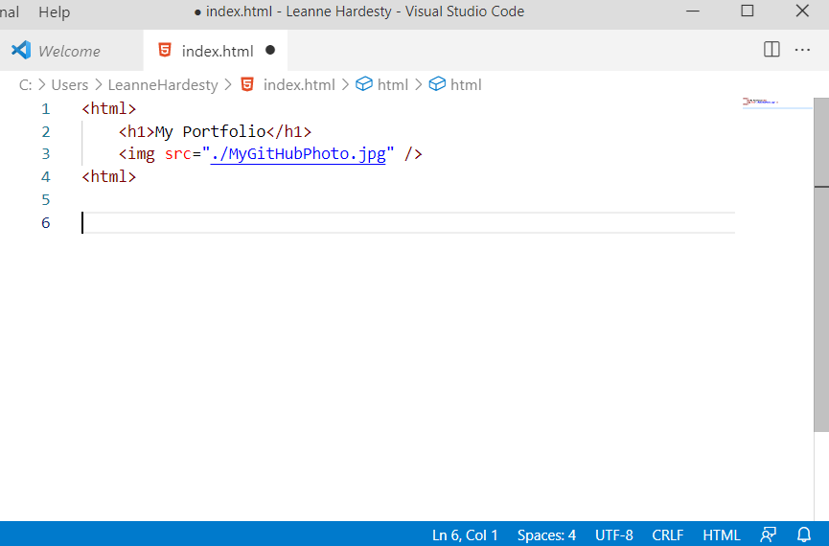
Pre-requisite steps: create two documents
Find a photo of yourself for your GitHub profile, name it MyGitHubPhoto.jpg, and place it on your Desktop
Using a text editor such as NotePad or VS Code, enter the following text into a new file. Save the file on your Desktop and name it index.html
<html>
<h1>My Portfolio</h1>
<img src="./MyGitHubPhoto.jpg" />
<html>

Slide 4
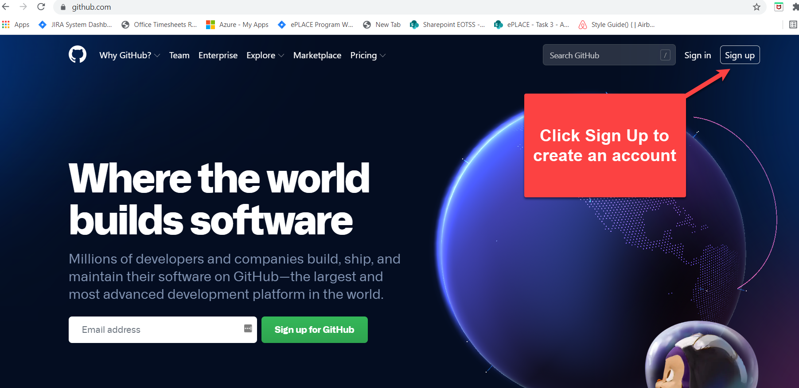
Navigate to www.github.com

Slide 5

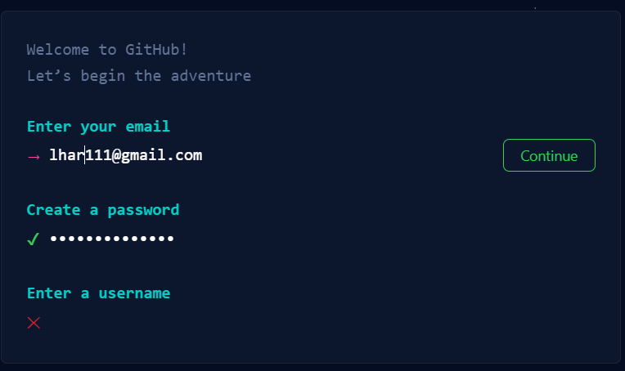
Follow the steps to create a Github account

Slide 6
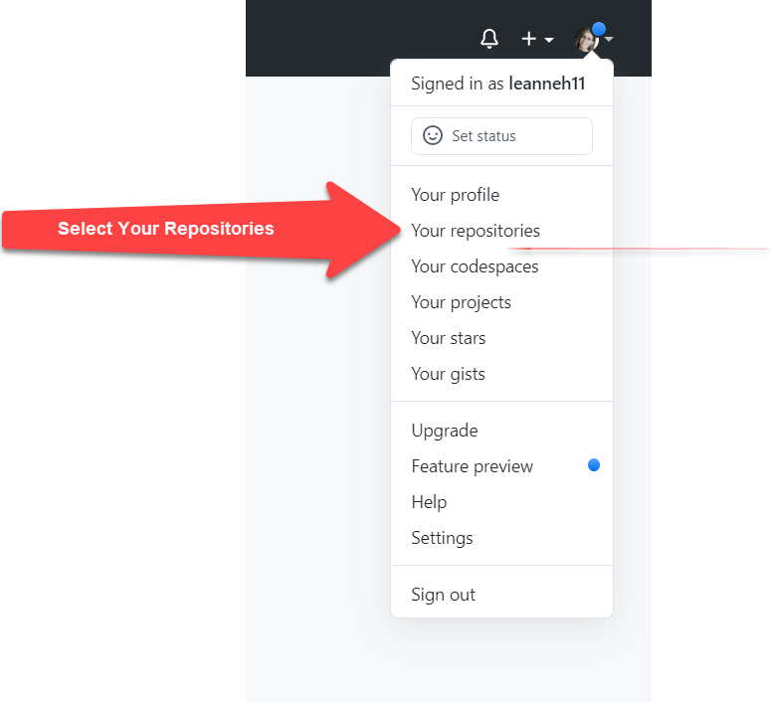
Create your repository
Once you have created your account and are logged into GitHub, create a new GitHub repository.
In the upper right of the page, click on your photo or initials, select Your repositories.

Slide 7
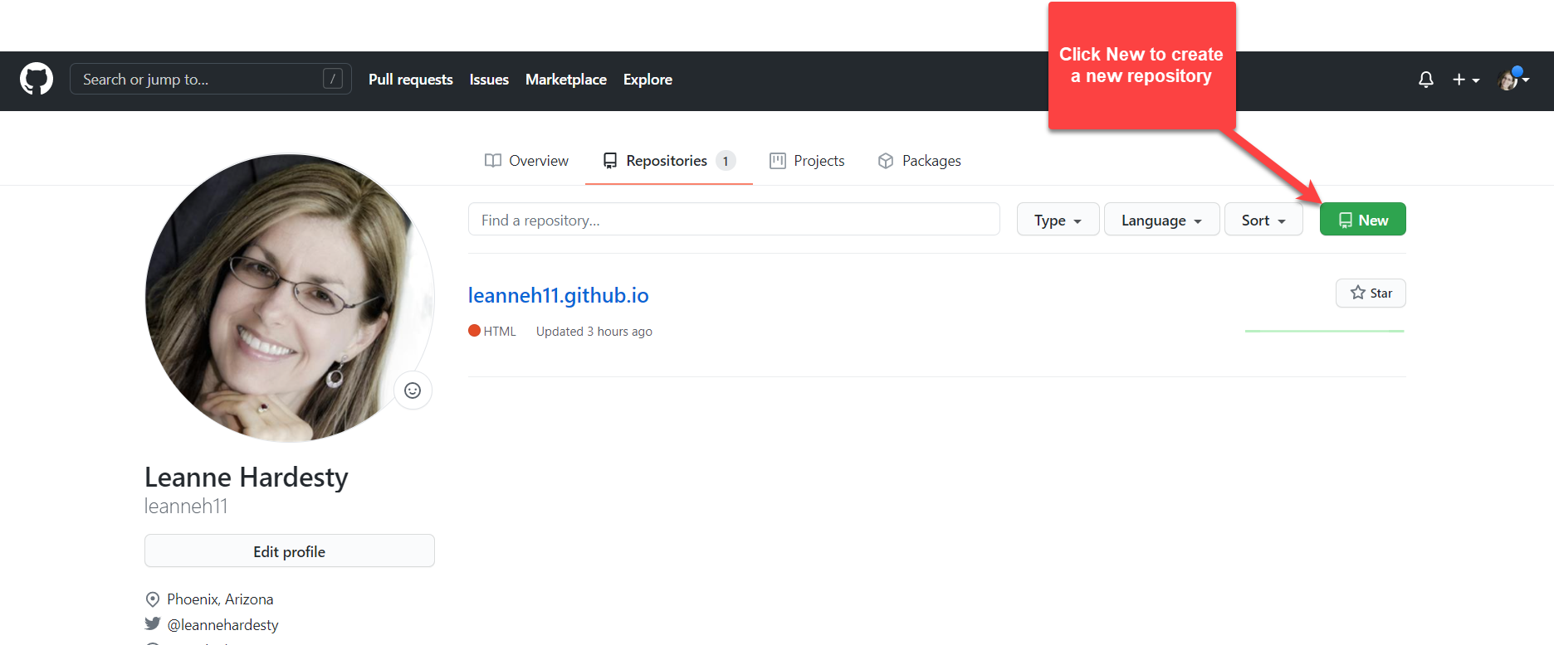
Create your repository
Click the New button to create a repository with your name.
This will become the shell for your GitHub portfolio website.

Slide 8
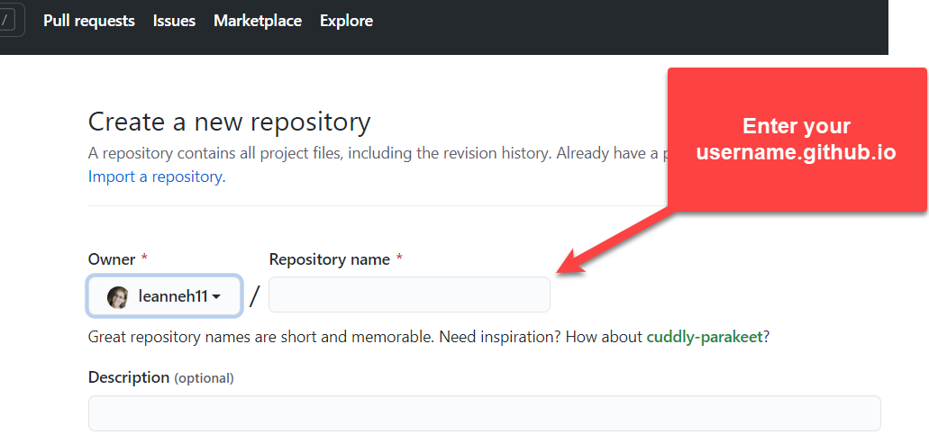
Create your repository
In the Repository name textbox, enter the name followed by .github.io
For example: smith.github.io
Adding github.io will allow you to access this repository via a browser.

Slide 9
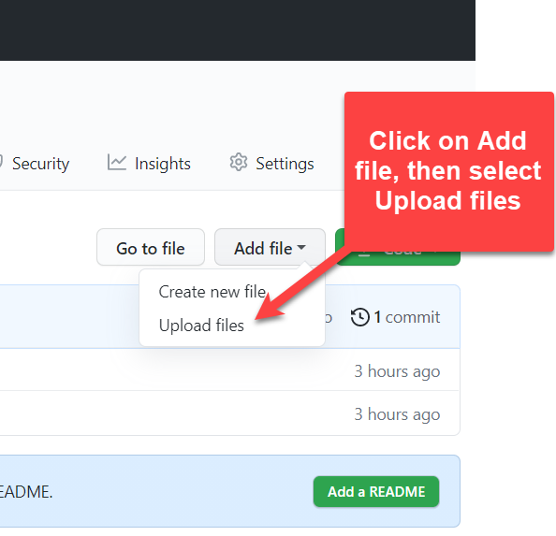
Copy files to repository
Copy the two files that you created in Step 1 into the repository.
1. Click Add file
2. Select Upload files
3. Navigate to your Desktop and upload:
a. MyGitHubPhoto.jpg
b. index.html

Slide 10
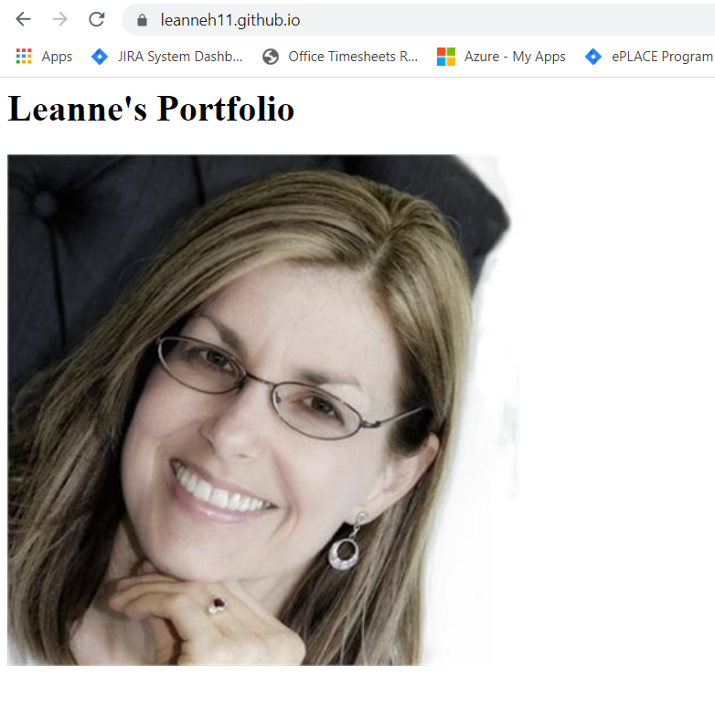
View your github web page
View your github web page:
1. Enter your repository name into the browser’s URL.
Congratulations!

