Slide 1
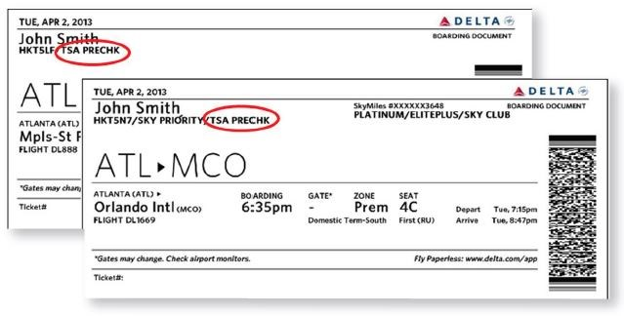
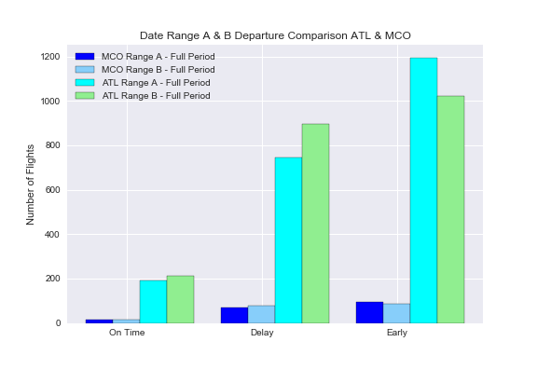
Findings and conclusions
In the date range A, MCO airport has handled less than 8.5 % of the Delta flights comparing with the numbers of Delta flights in ATL airport. Even that MCO airport shows a higher proportional number of delayed departure flights.
In the shutdown period (range B) this difference has increased, showing that even operating a much higher number of flights, Atlanta airport has had a smaller impact with the shutdown than Orlando airport, when it comes to flight departures delays.

Slide 2
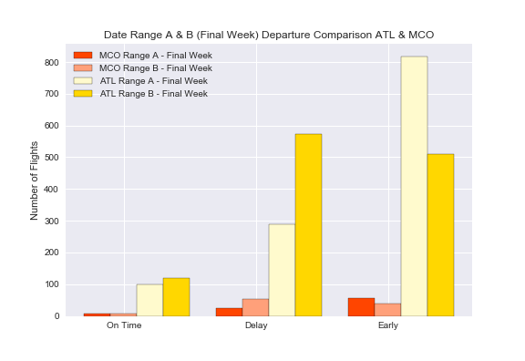
Findings and conclusions
In the last week of the shutdown the number of
delayed departure flights has increased, representing over half of total delays for full shutdown period. (MCO full period 79, 52 in the last week – ATL full period 895, 574 in the last week) The increase might be related with TSA sickouts reaching 10% on Jan 20, 2019.
https://www.forbes.com/sites/michaelgoldstein/2019/01/22/us-airlines-take-stock-market-hit-as-government-shutdown-reaches-32-days/#68ff706a79de

Slide 3
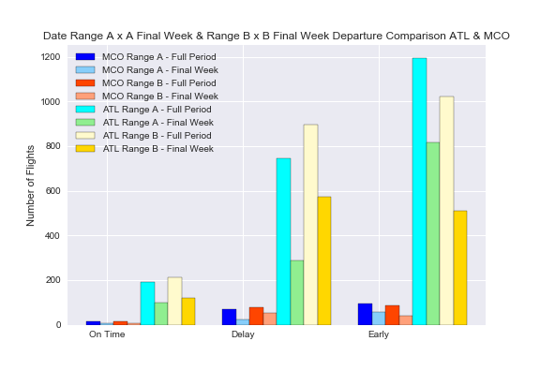
Findings and conclusions
Comparing the numbers of flights in each date range per airport, we can conclude that MCO airport has being more affected by the shutdown in number of flights departure delays, than Atlanta airport, however, in the subject “delays” historically MCO airport has been behind ATL airport .
The MCO average delays for customs/security is 24,45 min. against 12,27 in ATL airport.
The average departures delays in MCO is 68 min. against 58 in ATL.
Atlanta Airport has a Delay Index of B – (401,78) and MCO Delay Index is D (517,80).
Based on these numbers we can assume that ATL airport was better prepared to deal with the shutdown than MCO airport.
https://www.orlandoweekly.com/Blogs/archives/2018/11/21/orlando-international-airport-ranked-among-most-likely-to-delay-your-flight

Slide 4
Summary
Watch Out! Data Analysts Beware! – Some API vendors charge by transaction (10 cents per flight)

