Slide 1
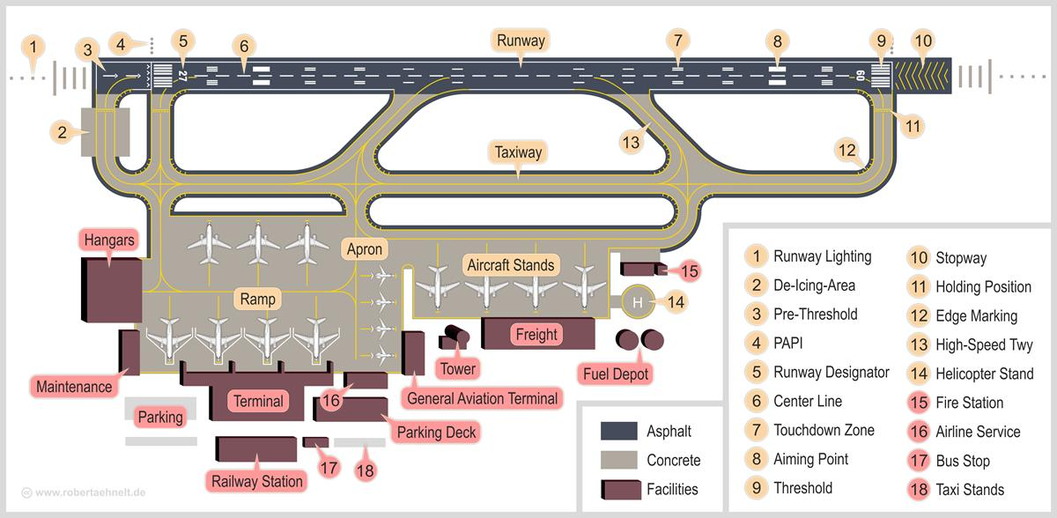
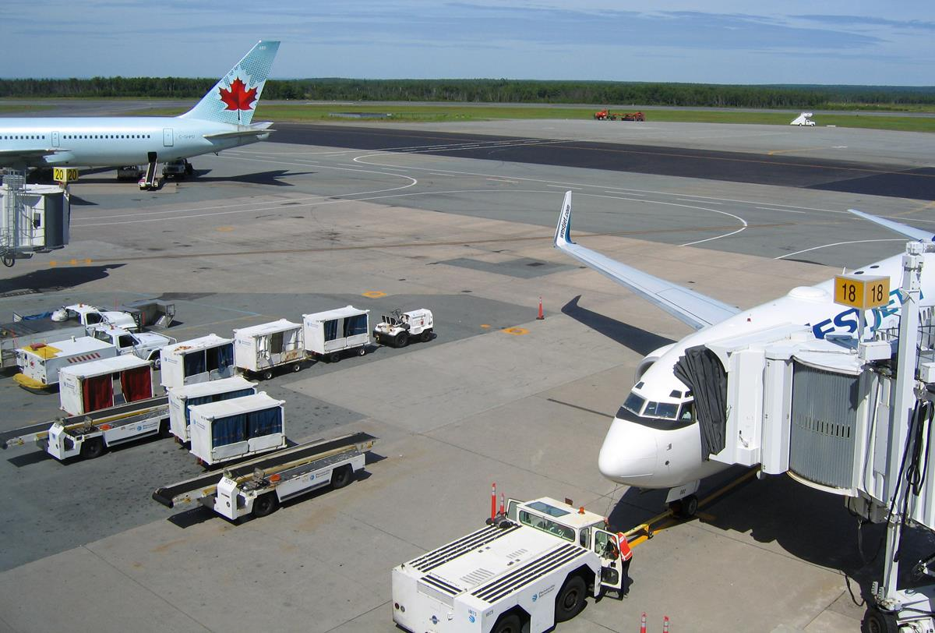
Airport DELAYS DURING GOVERNMENT SHUTDOWN
Team BAMF: LeAnne Sevier, Luciano, Lilian Bolfer, Like Machata, Lob Phillips

Slide 2
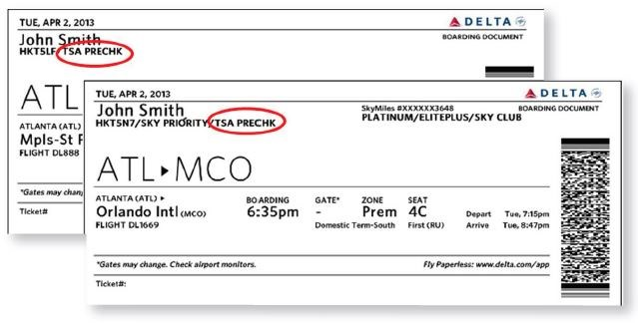
Contents
Hypothesis
A guide to air travel during the government shutdown
Asking the right questions
Finding relevant data
Data exploration and clean up
Analysis process
Findings and conclusions
Implications for the industry and the traveler
Summary

Slide 3
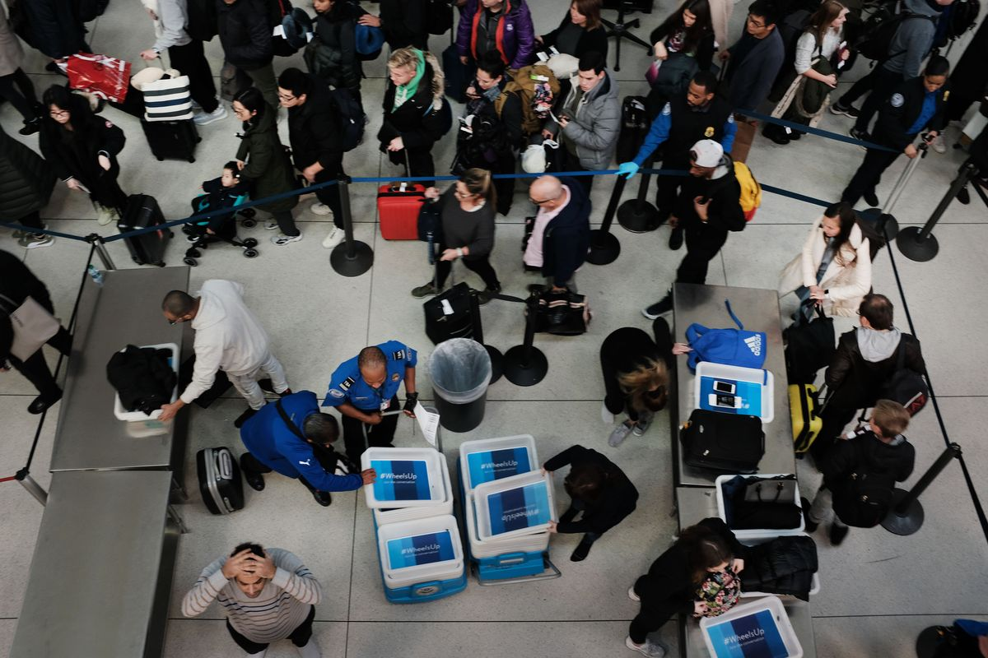
Hypothesis: The recent government shutdown during the period of December 22nd 2018 through January 25th 2019 impacted airline and airport operations. What evidence is there that airports or airlines experienced significant delays? What can we learn from an analysis of data available on flight delays?
Government shutdown impacts U.S. airline industry
January 14, 2019 Henry Carmichael
Because of the now record-breaking partial government shutdown, the U.S. aviation industry is beginning to feel the consequences of lapsed federal funding.
"This partial shutdown has already inflicted real damage to our nation’s aviation system and the impacts will only worsen over time. We urge you to act quickly to resolve these issues.‘’
The letter highlights 11 major areas of concern affecting travel.
The greatest impact that the Federal Aviation Administration (FAA) is facing from the shutdown comes from a slowdown in hiring new workers. While the 25,000 air traffic controllers are exempt from furloughs, training for new controllers has been suspended, which may lead to a shortage of controllers. At the same time, airports have seen longer lines stemming from Transportation Safety Administration (TSA) workers calling in “sick” due to not being paid. The situation is powerful enough to impact the overall functionality of major U.S. airports. For example, Miami International’s (MIA) spokesman Greg Chin announced that one of its terminals would be partially closed over the weekend.
“Due to an increased number of TSA screeners not reporting to work, we decided to take this precautionary step and relocate about 12 flights to adjoining concourses in the afternoons,” said Chin, responding to concerns that not enough screeners would be available to manage MIA’s 11 checkpoints.
U.S. air carriers are also facing the impact of 4,000 FAA inspectors being furloughed by the shutdown. A proposed solution to aviation industry uncertainty that has been brought forward previously (and given new life by the shutdown) is to privatize the FAA. Lawmakers have suggested moving air traffic controllers out of federal authority to a non-for-profit entity that would be overseen by industry members. This would theoretically insulate the FAA from government inefficiencies and allow the agency to change with the economy.

Slide 4
A guide to air travel during the government shutdown
https://www.ajc.com/news/world/will-airports-affected-possible-partial-government-shutdown/wQRRXS5s5By3daQFnz12bN/
As the longest government shutdown in US history continues, Americans are restructuring their travel plans.
How is the shutdown affecting agents?
TSA agents make up 51,000 of the 420,000 federal employees who are deemed “essential,” and while they will be paid for their work eventually, they have no clue when exactly that day will come.
Are airport lines longer?
Short answer: maybe. Although it depends on the airport, many major hubs have reported longer lines. “While national average wait times are within normal TSA times of 30 minutes for standard lanes ... some airports experienced longer than usual wait times,” TSA said in a statement.
At Hartsfield-Jackson Atlanta on January 15, travelers waited more than an hour in security lines. And at Dallas Love Field Airport, travelers waited 44 minutes.
Are flights getting delayed or canceled?
Not yet. Flight delays may be caused by winter storms across the Midwest, but so far, the government shutdown has not led to widespread delays or cancellations. There is, however, potential for future delays because of air traffic controllers. Air traffic controllers are also essential employees, and therefore have also been working without paychecks. If they start calling in sick, the government may have to limit the amount of air traffic, but it hasn’t come to that yet

Slide 5
Potential implications for industry and the traveler
https://www.cnbc.com/2019/01/16/united-ceo-worried-about-shutdown-but-impact-not-yet-significant.html
United Airlines CEO Oscar Munoz on Wednesday said the airline is getting worried about the partial U.S. government shutdown as it drags on but added that the company isn't yet seeing a "significant" impact on bookings.
Munoz's comments come a day after the CEO of rival Delta Air Lines, Ed Bastian, said the shutdown that began Dec. 22 will cost the airline $25 million this month.
"There is some impact there," Munoz told CNBC's Phil LeBeau in an interview Wednesday. "It's not discernible and it's not significant. Clearly the longer this goes, of course there's going to be impact, and we do worry about that.“
On Tuesday, Delta's Bastian said the airline is losing $25 million in revenue this month alone because fewer government employees and contractors are traveling.
Transportation Security Administration officers, air traffic controllers and federal safety inspectors are among the some 420,000 government employees who are deemed essential and have been ordered to work without a regular paycheck.
Major airports in Atlanta, Miami, Houston and Washington, D.C., this week said they closed passenger screening lanes or checkpoints as more TSA officers than usual were absent.

Slide 6
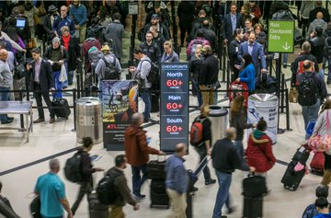
Asking the right questions
What data can we analyze to determine impacts on flights during the period of the government shutdown?
Cirium Flightstats API
https://helpdesk.cirium.com/hc/en-us/categories/202631018-FlightStats-by-Cirium
What are we looking for in the data specifically?
1) An increase in the number of flights delayed
2) An increase in the delayed departure times
How do we want to frame or scope the investigation?
1) Limit the analysis to one Airline (Delta Airlines)
2) Limit the analysis to two Airports (Major Hub Atlanta and Orlando)
3) Afternoon flights where delays might accumulate (2pm-8pm)
4) First and final weeks of the government shutdown period
What are we comparing this data to?
1) Data for the first and final weeks of the previous year

Slide 7
Finding relevant data
"flights": 84,
"observations": 83,
"canceled": 0,
"onTime": 59,
"delayed15": 4,
"delayed30": 4,
"delayed45": 16,
Cirium’s API supports retrieval of current Flight Delay data at a specified airport
SOURCE: https://developer.flightstats.com/api-docs/delayindex/v1
JUPYTER: AirportDelays.ipynb OUTPUT: Delay_Request_MCO.txt
The flight delay response json provided some interesting metrics on flight delays (such as bins)
however free access is limited to 100 current flights a month, so we need to use the Historical Flight Status API
Cirium’s Historical Flight Status API supports retrieval of Historical airport status (departures) by date, airport, airline, and time period (up to 6 hour block)
SOURCE: https://developer.flightstats.com/api-docs/historical-flight-status/v3
API DOC: https://developer.flightstats.com/api-docs/historical-flight-status/v3/historicalFlightStatusResponse#extendedOptions
JUPYTER: https://github.com/leannesevier/BAMF-Project-7/blob/master/Xtra%20Files/MCO9Read.ipynb
OUTPUT: https://github.com/leannesevier/BAMF-Project-7/blob/master/Xtra%20Files/Historic_Request_MCO_20190122_9.json
BINS !!!

Slide 8
Data exploration and cleanup #1
Our first attempt at extracting “departureGateDelayMinutes”
SOURCE: https://github.com/leannesevier/BAMF-Project-7/blob/master/FlightCounter.ipynb

Slide 9
Data exploration and cleanup #2
Our first attempt at extracting “departureGateDelayMinutes”
SOURCE: https://github.com/leannesevier/BAMF-Project-7/blob/master/FlightCounter.ipynb

Slide 10
Analysis process

Slide 11
Findings and conclusions

Slide 12
Summary
Watch Out! Data Analysts Beware! – Some API vendors charge by transaction (10 cents per flight)

