Slide 1
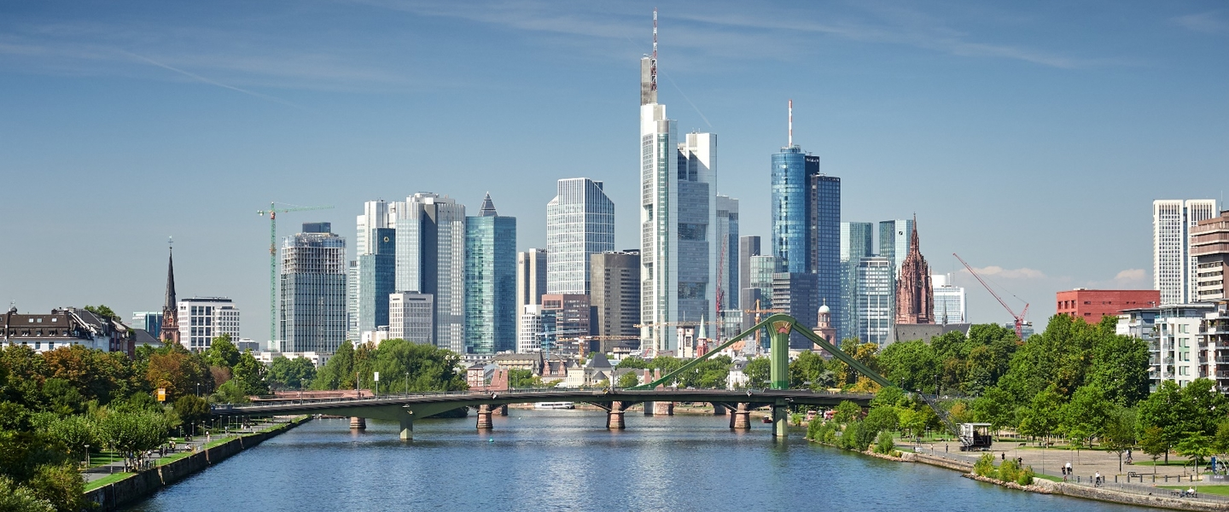
MARKET ANALYSIS IN FRANKFURT AM MAIN - GERMANY

Slide 2

Challenge

Slide 3

Rules for the business location

Slide 4
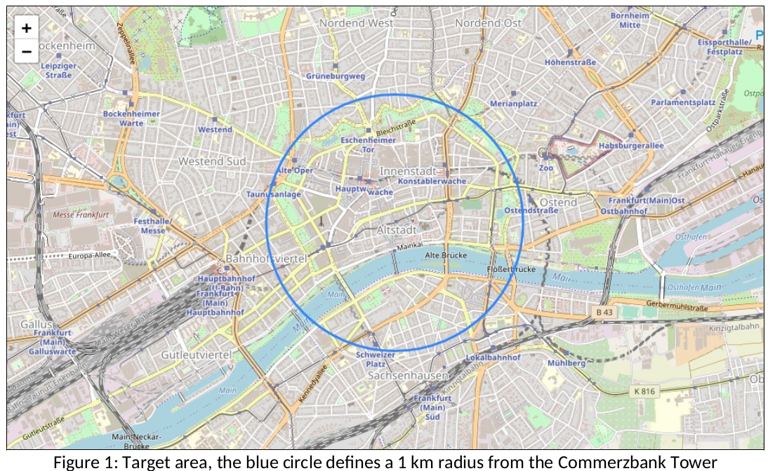

Slide 5

Data

Slide 6


Methodology

Slide 7
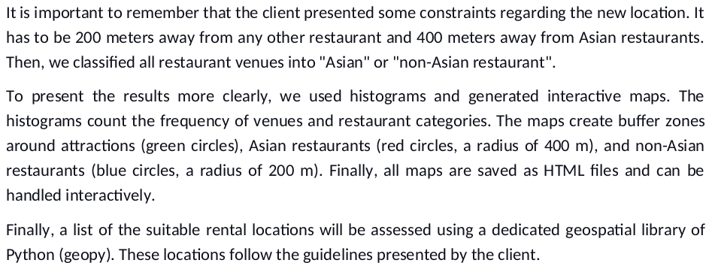
Methodology

Slide 8
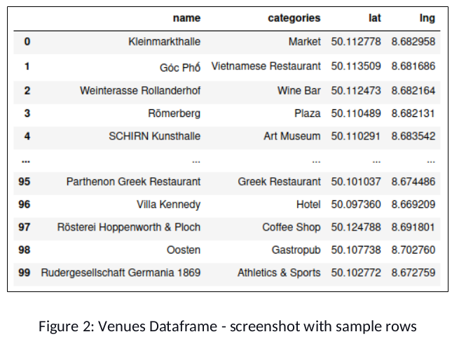

Slide 9
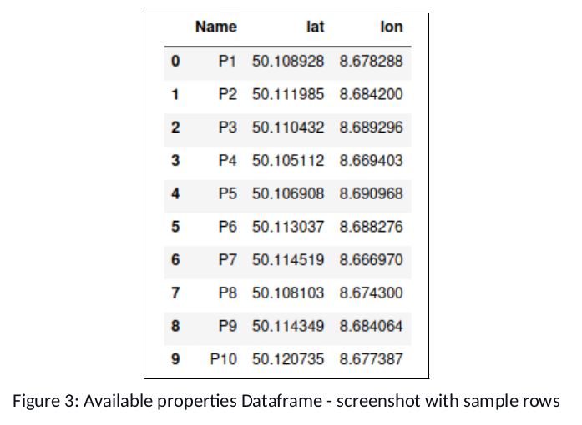

Slide 11
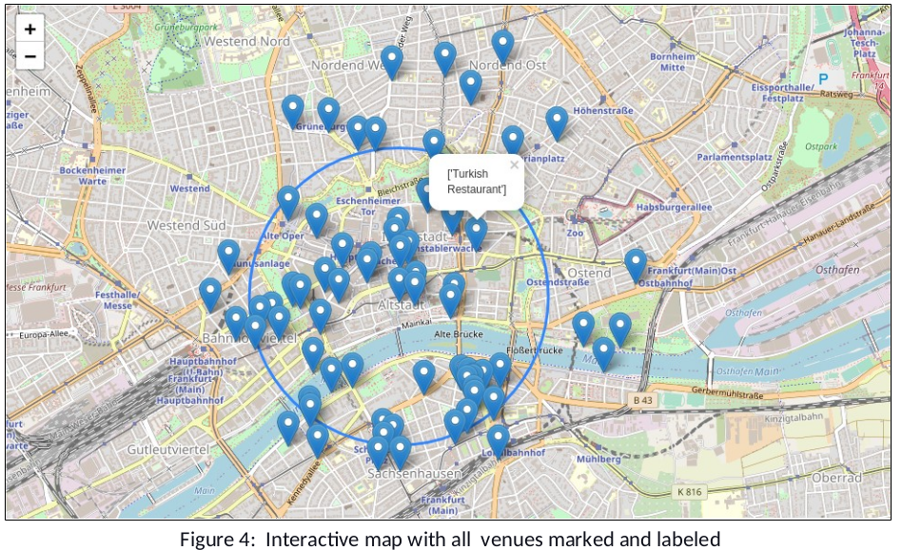

Slide 12
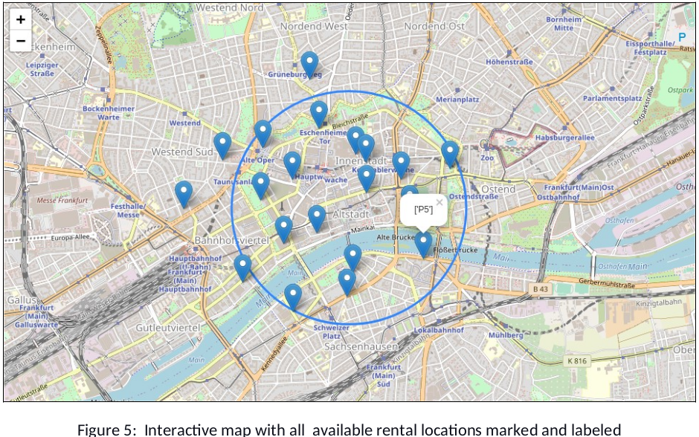

Slide 13

Results

Slide 14
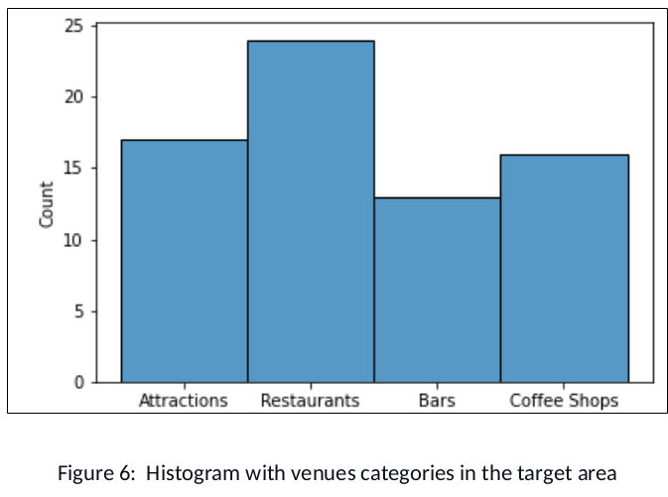

Slide 15
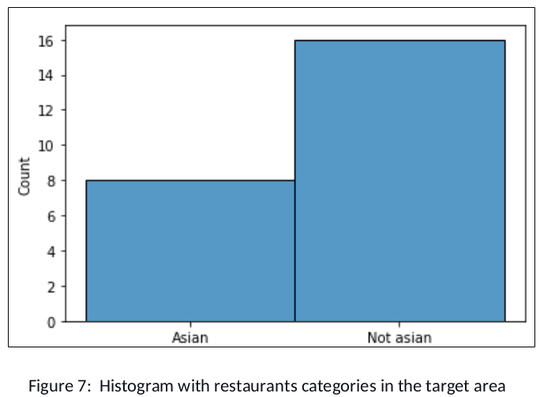

Slide 16
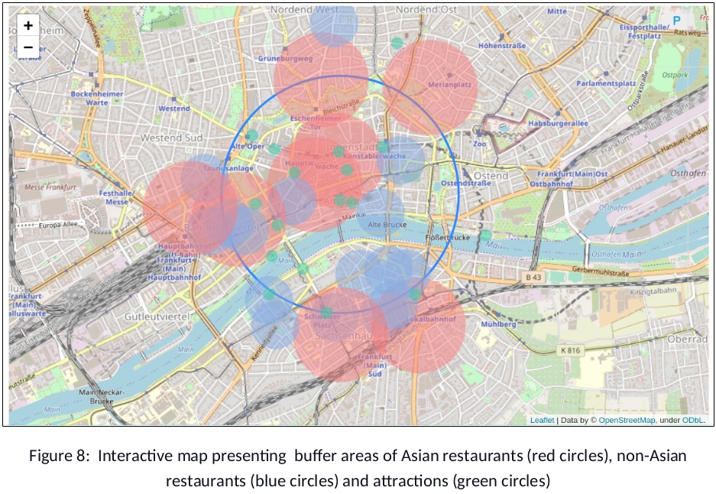

Slide 17
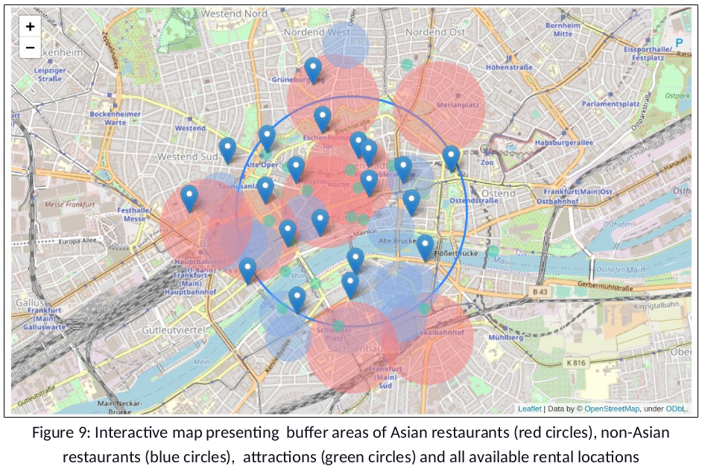

Slide 18
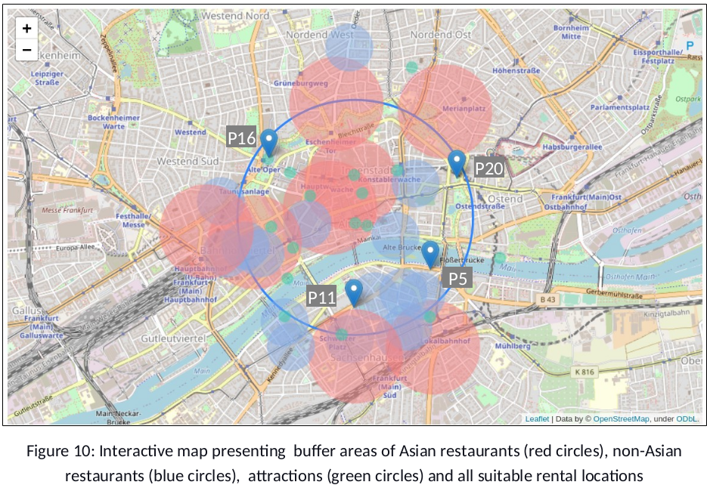

Slide 19
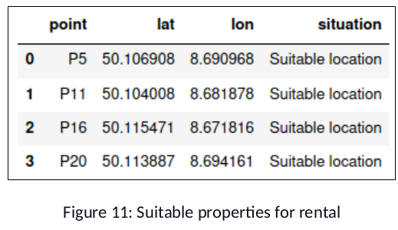
Discussion

Slide 20

Discussion

Slide 21

Discussion

Slide 22

Discussion

Slide 23

Discussion

Slide 24

Conclusion

