Slide 1
LEAP – Bitmask
RiseupVPN - Calyx
By Cyberta & kwadronaut
<kwadronaut@leap.se>
PTIM
2020 Oct 15
Cyberspace
Notes:
Started around 2011 scalable ambitions: make it easy for providers and users to communicate securely.

Slide 2
What and for whom
VPN
Big groups without the intimacy of Outline
Easy for providers
Easy for users

Slide 3
General features
Logs? None!
Administration of users? Nope!
Easy registration, there is none!
Few servers, many users
Notes:
Fancy panels for operators: alright
Differences with Outline: few providers, many users
Differences with Tunnelbear: not backed by McAffee, all freemium, no subscriptions
ON TO THE CIRCUMVENTION

Slide 4

We’re the mouse

Slide 5
Bootstrapping
Some providers preloaded
Provider API
  Gateways
  Capabilities
  Load
This is where the fun starts
Notes:
Not a bland OVPN but colorful, moving now to TLS 1.3, ciphers etc.

Slide 6
Transports
Started with TCP
Integrating now UDP (and Ipv6)
Shapeshifter-dispatcher for circumvention
Shapeshifter as a go library
  (right now just obfs4 and we have to test UDP)
Notes:
Shapeshifter as a Go library because then we don’t have to spin up a second process, get it working in all platforms

Slide 7
Provider Angle
Extending OONI, testing DPI
Testing
  API
  Transports
  gateways
Parse results and show in the dashboard
The Blocked Results
Notes:
Talked about how clients can find ways around/use PT, now it’s time for the providers
Problem: if blocked, how does the node tell?

Slide 8
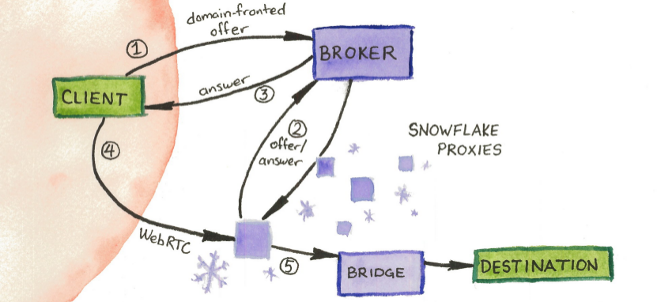
Snowflake

Slide 9
Credits & License
Content by kwadronaut&Cyberta
https://bitmask.net
OpenOffice.org template by Raphaël Hertzog
http://raphaelhertzog.com/go/ooo-template
License: GPL-2+
Cat image by GPS 56
https://flic.kr/p/vffUXo
License: CC BY 2.0
Snowflake: Tor Project

