Slide 1

Microservices
The gateway corp.

Slide 2
Introduction & Purpose
Binkal Patel
Technical Leader
The Gateway Corp.
Binkal Patel

Slide 3
What is Microservices?
Microservices are an architectural approach to building applications.
As an architectural framework, Microservices are distributed and loosely coupled, so one team’s changes won’t break the entire app.
The benefit to using Microservices is that development teams are able to rapidly build new components of apps to meet changing business needs.
You are developing a server-side enterprise application. It must support a variety of different clients including desktop browsers, mobile browsers and native mobile applications. The application might also expose an API for 3rd parties to consume. It might also integrate with other applications via either web services or a message broker.
Binkal Patel

Slide 4

Monolithic Architecture
Application Instance
A monolithic architecture is an architecture where all components for an application are collocated within a single unit.
Monolithic application often consist of User interface, Business logic and Data Access layer.
All this layers are combined on a single runtime instance of an application.
Often suitable for small application
Business Logic
Data Access Layer
Database
Binkal Patel

Slide 5
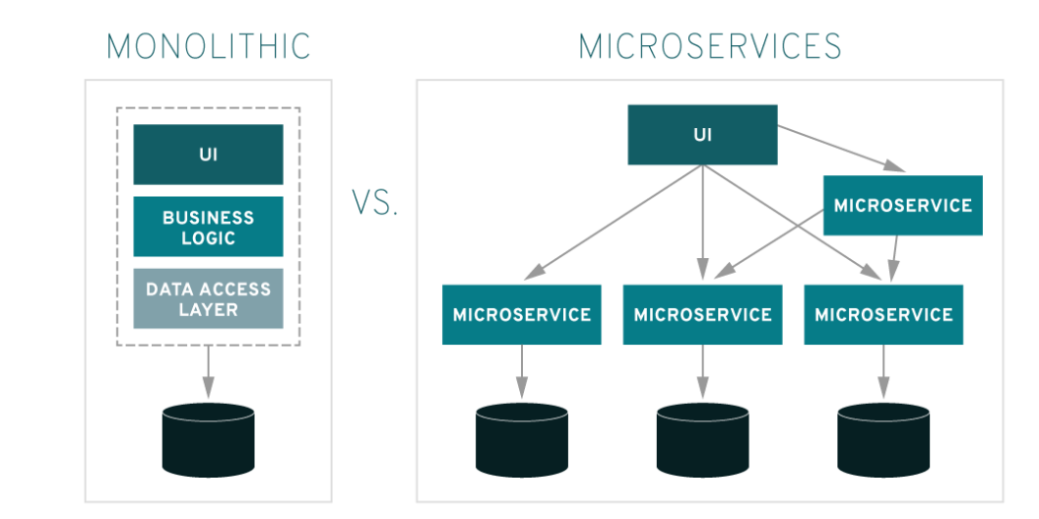
Architecture
Binkal Patel

Slide 6
Limitations of Monolithic
Difficult to maintain
Difficult to scale
Difficult to manage deployments
Tied to single technology stack, which limits innovation in new platforms and SDKs
Difficult to reuse – Part of the application inside another application
Fault in application instance brings down the entire application
Difficult to update database schema
Binkal Patel

Slide 7
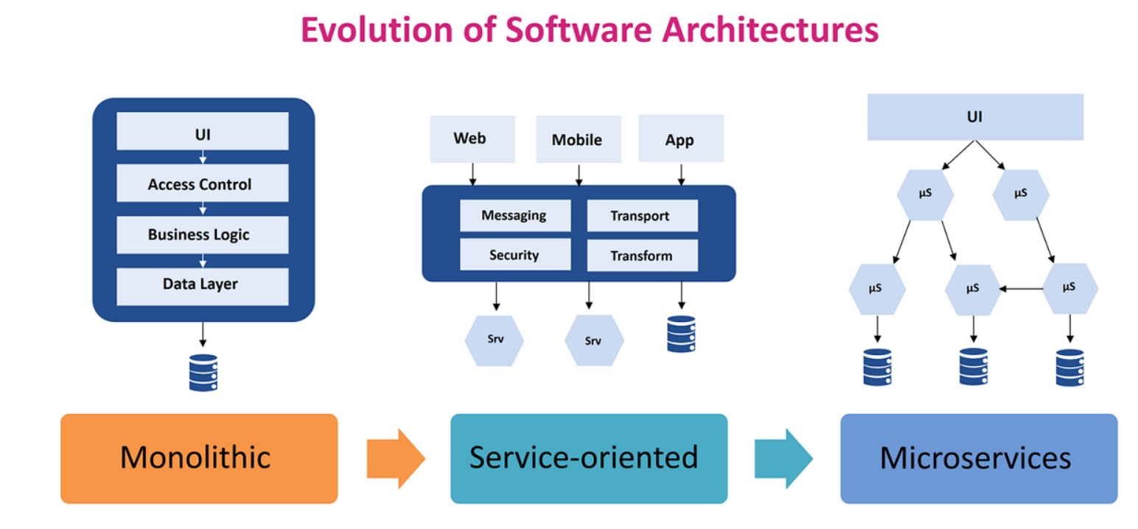
Evolution of Microservice
Binkal Patel

Slide 8
Microservices Architecture
Microservices are a software architecture style. It is a software development technique.
Structure an application as collection of services.
Each service implement a single business capability
These services communicate with each other to achieve business goal
These services are small, independent, and loosely coupled
Services can be deployed independently. Facilitates continues delivery and deployment
Services are responsible for persisting their own data or external state.
Services don't need to share the same technology stack, libraries, or frameworks.
Binkal Patel

Slide 9
Why use Microservice
Easier to scale service
Better fault isolation
Use the best approach
Deliver value faster
Easier to maintain and deploy
Enables us to choose latest technologies
Supports continuous integration and continuous delivery
Easier to understand
Facilitates code reuse
Easier to integrate with other systems
Suitable for large applications
Binkal Patel

Slide 10
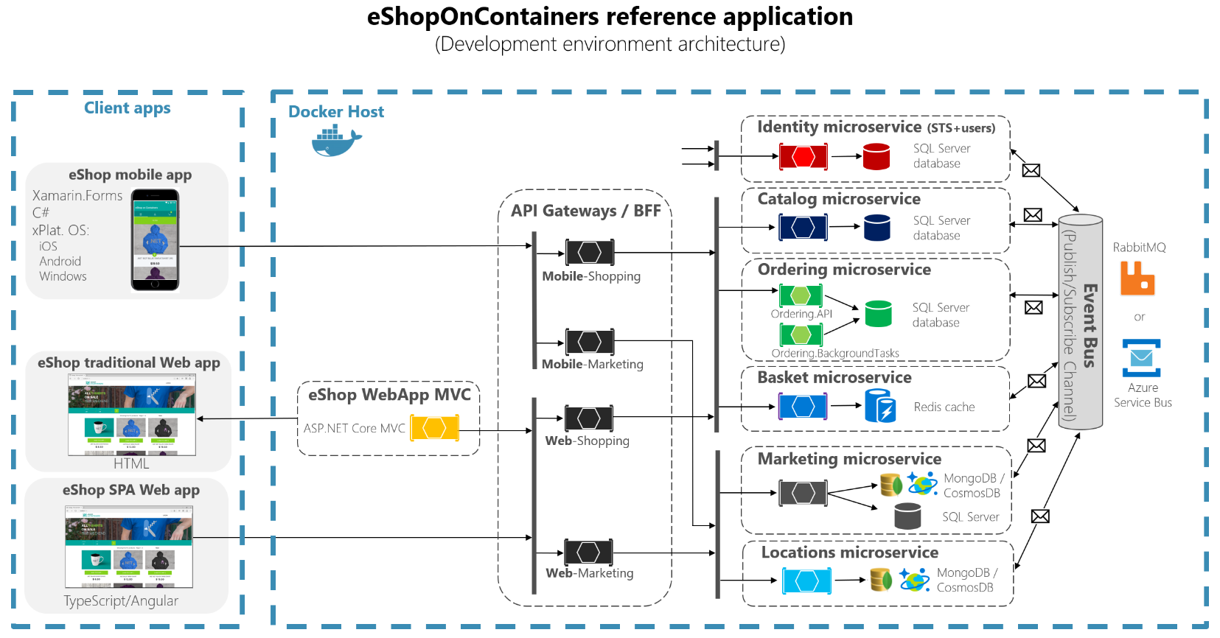
Binkal Patel
Notes:
https://sec.ch9.ms/ch9/06f0/23eee9dc-57b4-4db9-8ac2-85b37d3906f0/T6051.mp4
Code
https://dotnet.microsoft.com/learn/aspnet/microservices-architecture
https://github.com/dotnet-architecture/eShopOnContainers

Slide 11
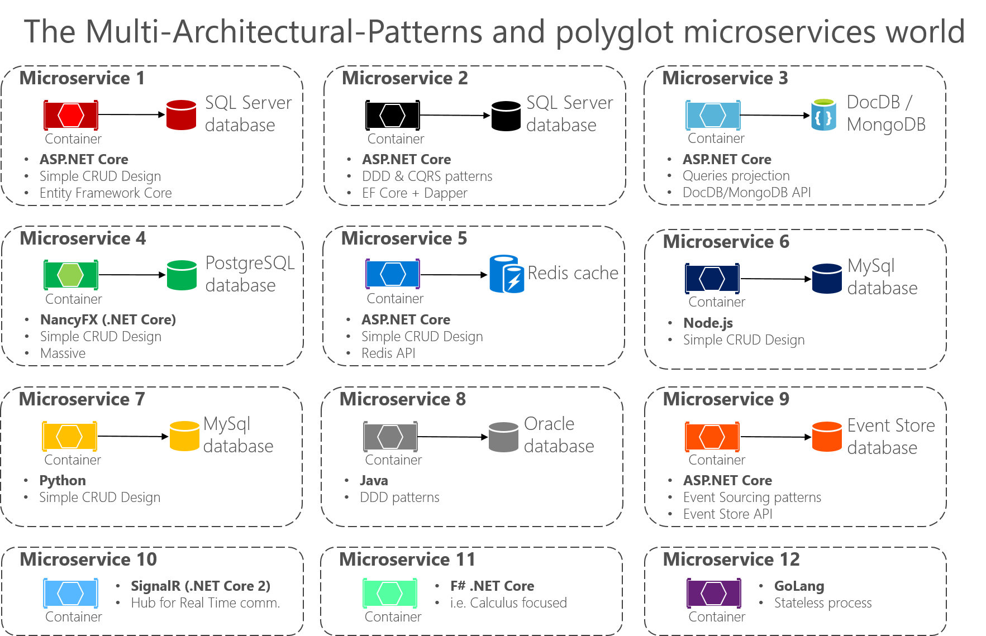
Binkal Patel

Slide 12
What are the problems causing people move toward the Microservice world
How much of the workload should be moved to Microservices?
Should you allow code to be migrated to different services?
How do you decide what the boundaries of each microservice will be while the operation is running?
How do you monitor the performance of Microservices?
Binkal Patel
Notes:
https://www.appdynamics.com/blog/product/4-challenges-you-need-to-address-with-microservices-adoption/

Slide 13
challenges of Microservices
Due to distributed deployment, testing can become complicated
Increasing number of services can result in information barriers
The architecture brings additional complexity as the developers have to mitigate fault tolerance, network latency, and deal with a variety of message formats as well as load balancing
Being a distributed system, it can result in duplication of effort
Handling use cases that span more than one service without using distributed transactions is not only tough but also requires communication and cooperation between different teams
Partitioning the application into Microservices requires experienced and skilled architects
Binkal Patel

Slide 14
How to convert monolith arch to Microservices evolution
Address
Address Type
Person
B2C
B2C
Company
B2B
Customer
Supplier
Driver
B2B customer UI online
B2C or B2B
Business Consumer
Vehicle
Binkal Patel

Slide 15
API Gateway / HTTP Client or GRPC Client
Vehicle
User
Login
Role Management
Person
Driver
Company
a) Supplier b) Customer
c) Company
Contract
Discount
OTR
Price
Invoice
Funder
Insert / update operation
Event Bus
Azure Bus
Binkal Patel

Slide 16
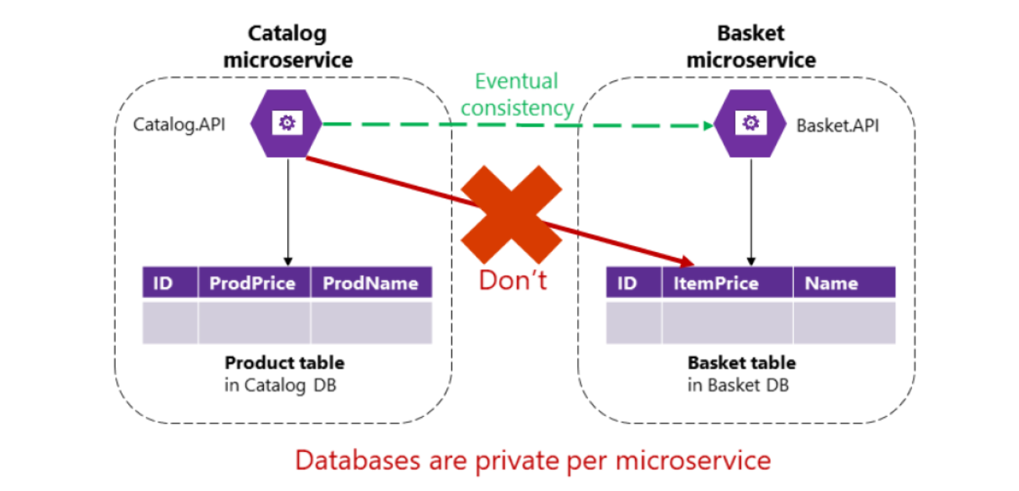
Microservice boundaries
Binkal Patel

Slide 17
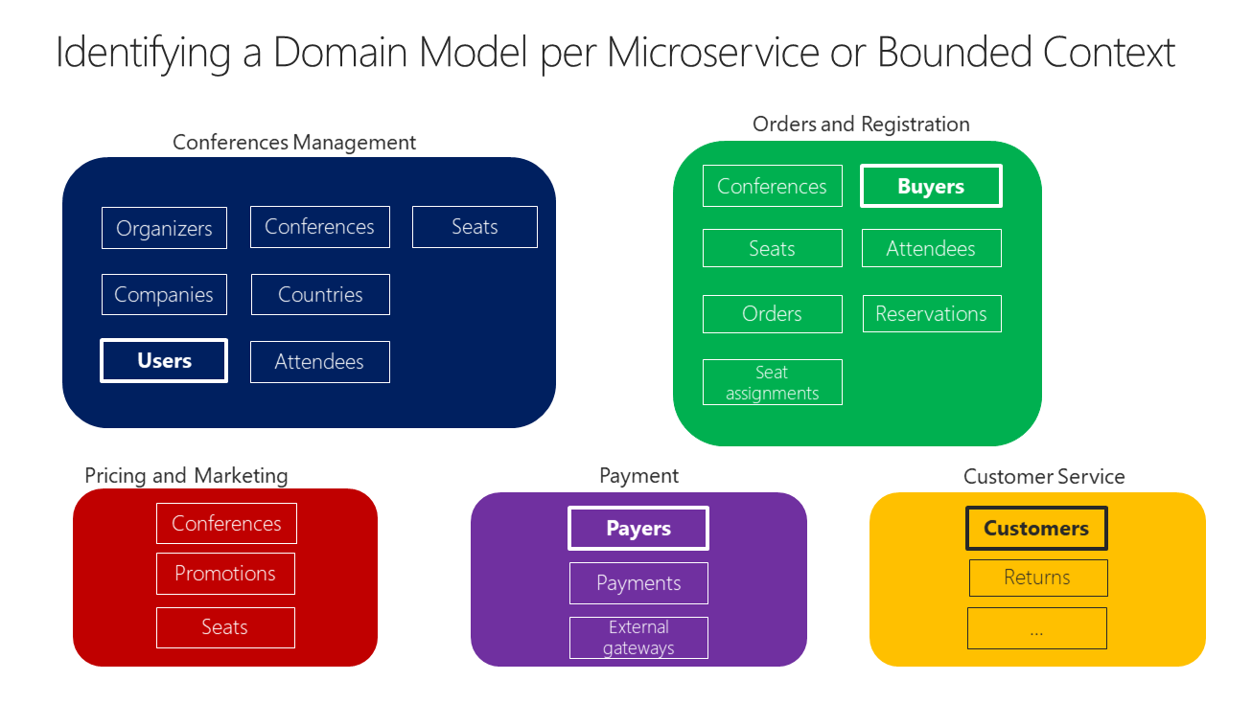
Identify domain-model boundaries for each microservice
Binkal Patel

Slide 18
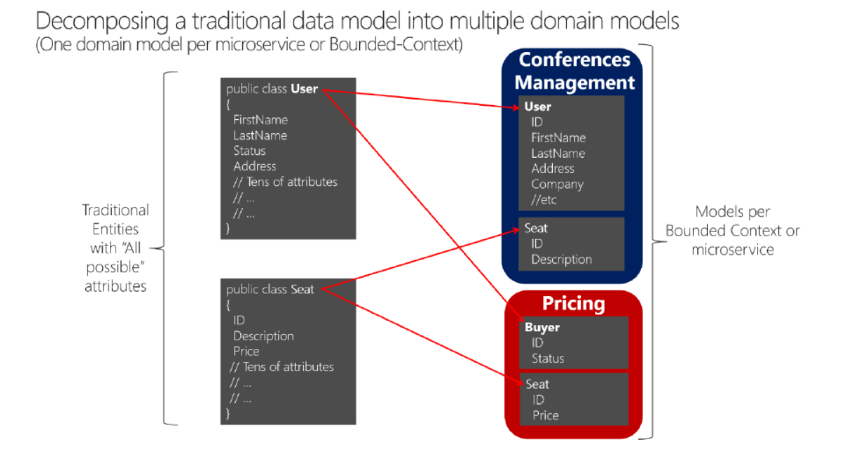
Database
Binkal Patel

Slide 19
Microservice Fundamentals
The Scope Of Functionality
High Cohesion Combined With Loose Coupling
Unique Source Of Identification
API Integration
Data Storage Segregation
Traffic Management
Automating The Process
Minimal Database Tables
Constant Monitoring
Binkal Patel
Notes:
https://dzone.com/articles/9-fundamentals-to-a-successful-microservice-design

Slide 20
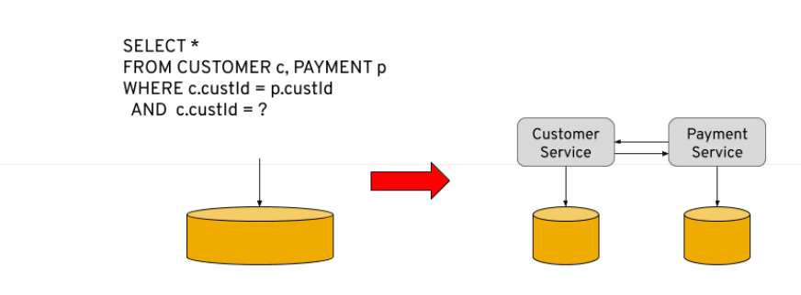
Microservice Data
Binkal Patel
Notes:
https://microservices.io/patterns/data/database-per-service.html

Slide 21
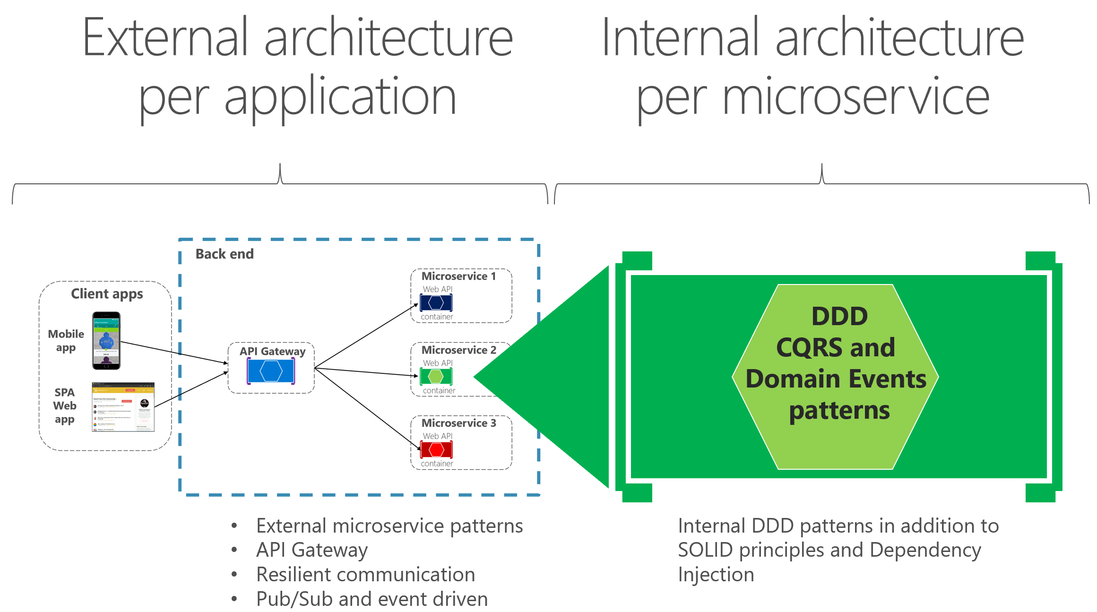
Different types of microservise , Moduler, DDD
Binkal Patel
Notes:
https://docs.microsoft.com/en-us/dotnet/architecture/microservices/microservice-ddd-cqrs-patterns/

Slide 22
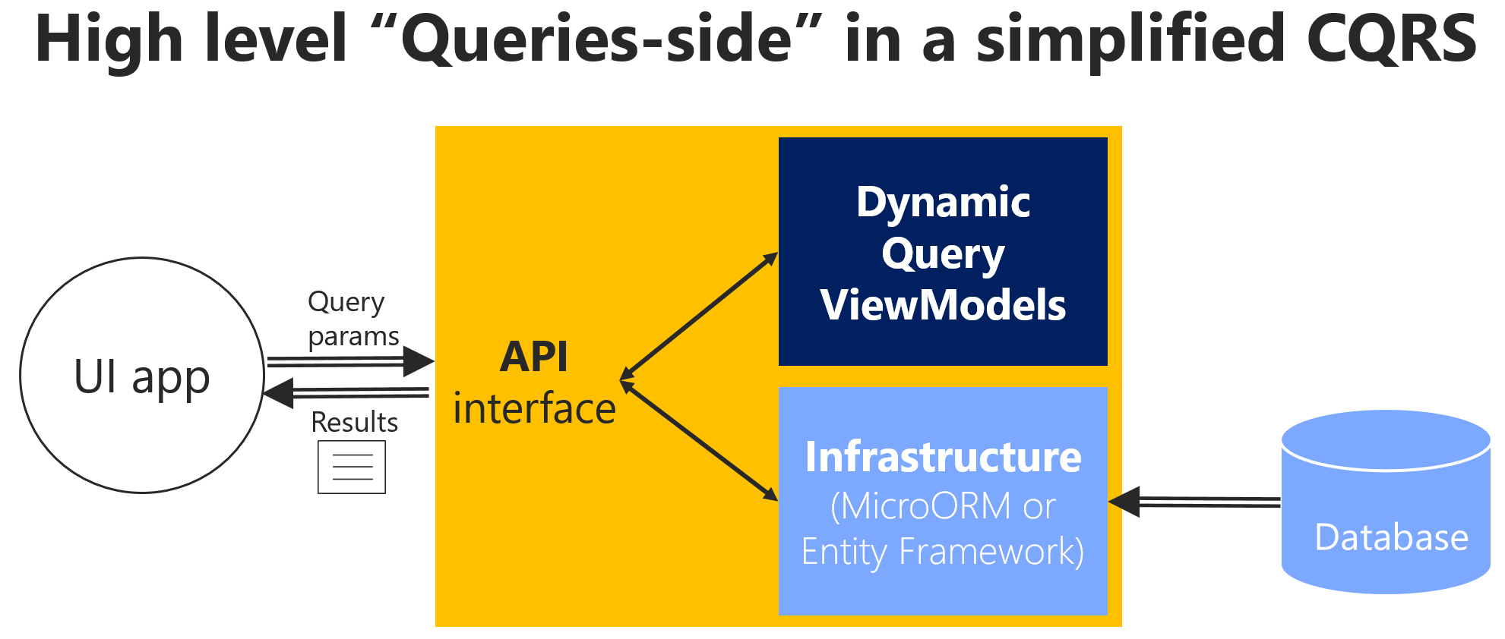
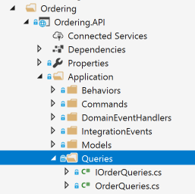
Implement reads/queries in a CQRS microservice
Binkal Patel
Notes:
https://www.youtube.com/watch?v=pUGvXUBfvEE
Document : https://dzone.com/articles/cqrs-by-example-simple-aspnet-core-implementation
Code
https://github.com/phenixita/TutorialCQRS

Slide 23
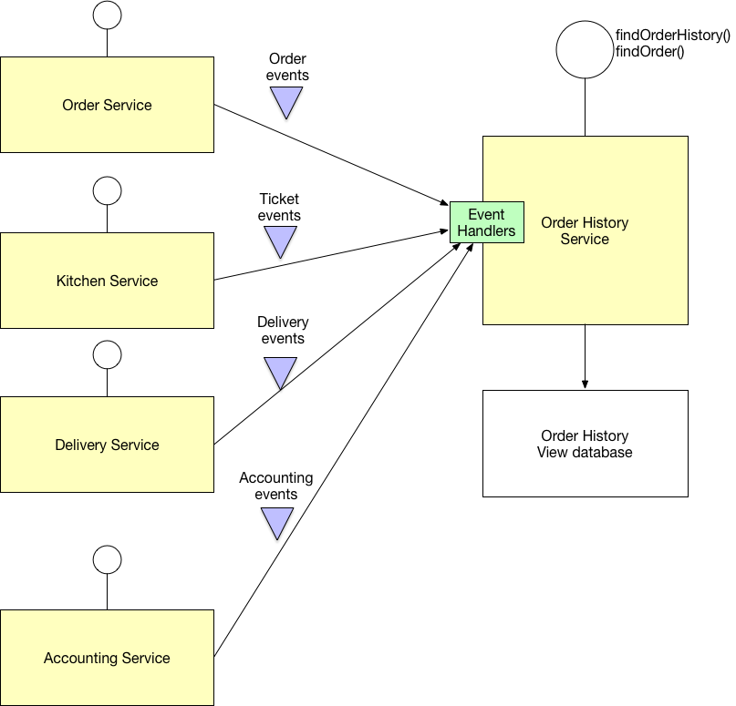
Binkal Patel

Slide 24
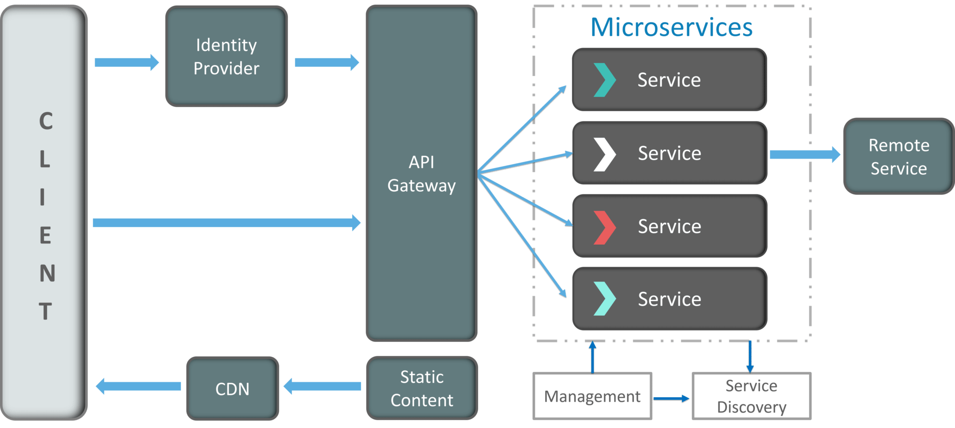
Microservice Components
Clients.
Identity Providers.
API Gateway.
Messaging Formats.
Databases.
Static Content.
Management.
Service Discovery.
Binkal Patel

Slide 25
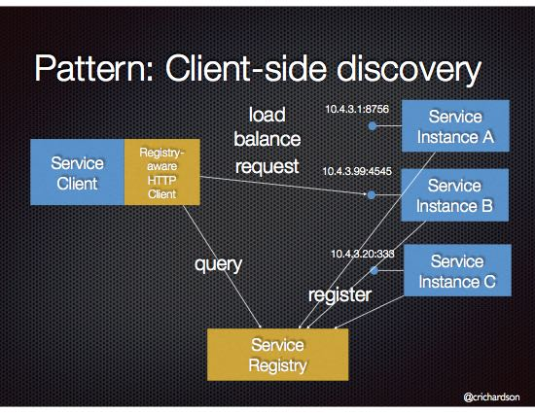
Service Discovery.
Binkal Patel
Notes:
https://microservices.io/patterns/client-side-discovery.html

Slide 26
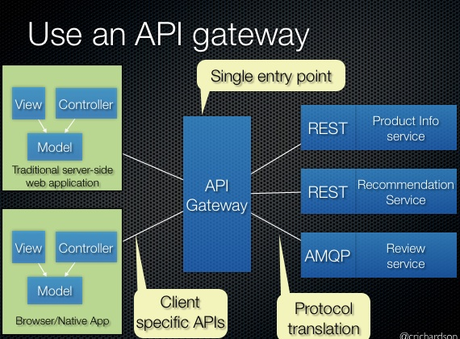
API Gateway
Binkal Patel

Slide 27
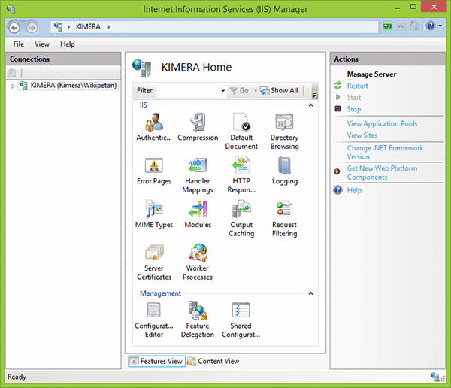
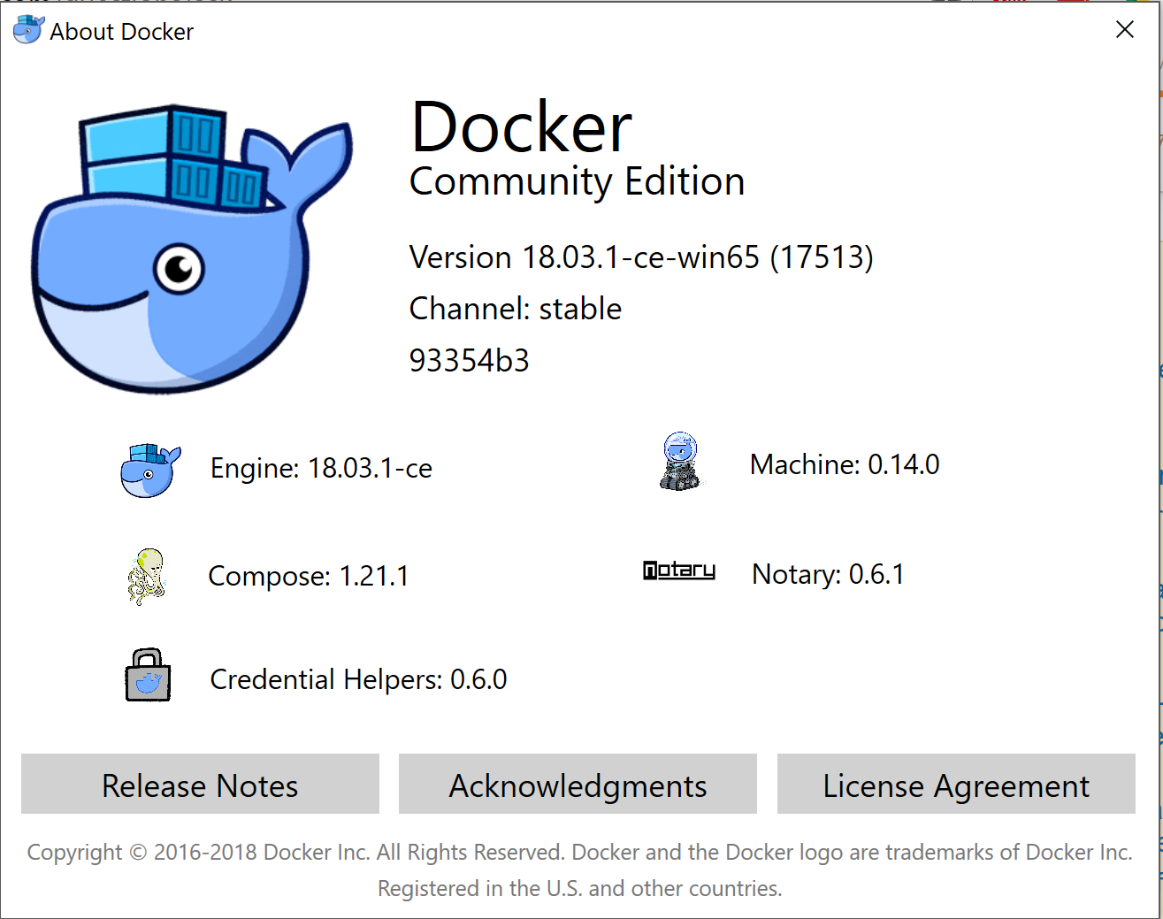
deployment Microservice
IIS
Docker Host
OR
Binkal Patel

Slide 28
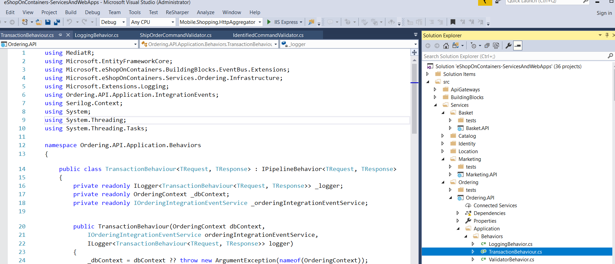
Sample application on microservice based architecture
https://github.com/dotnet-architecture/eShopOnContainers
Binkal Patel

Slide 29
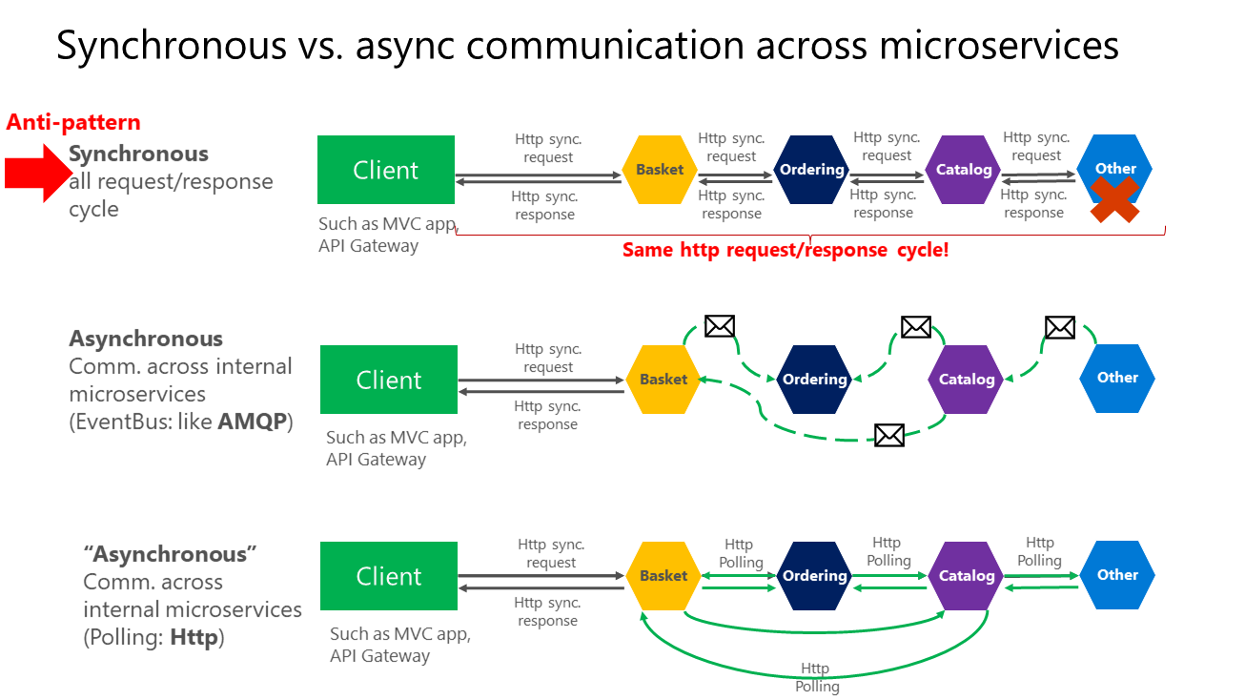
Different communicaiton patterns between microservices
Binkal Patel

Slide 30
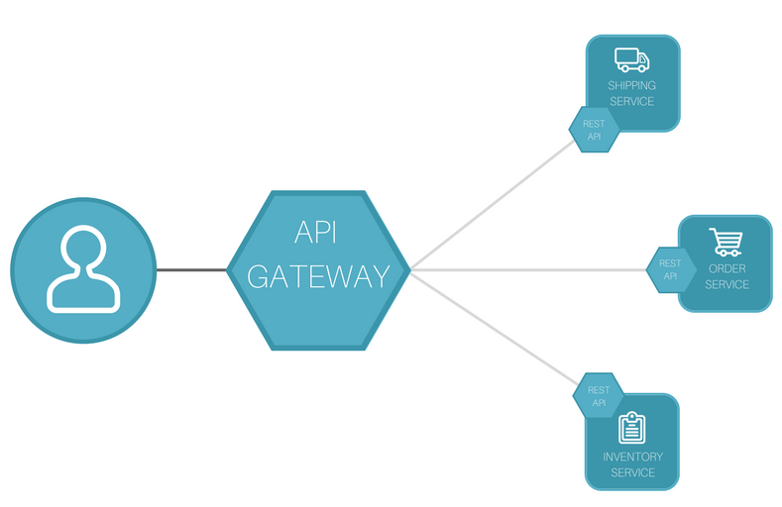
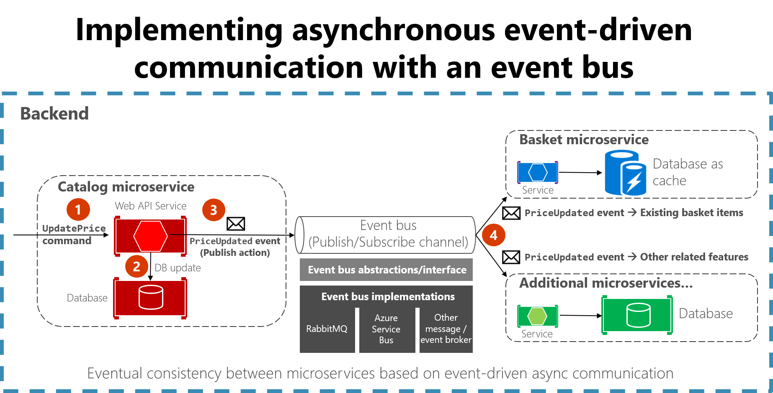
Microservice Communication
API Gateway
Event Bus /Azure Bus
CQRS

Slide 31
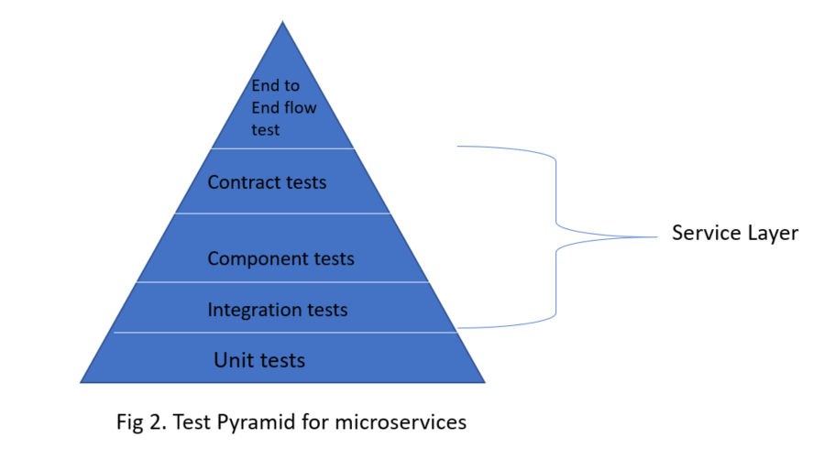
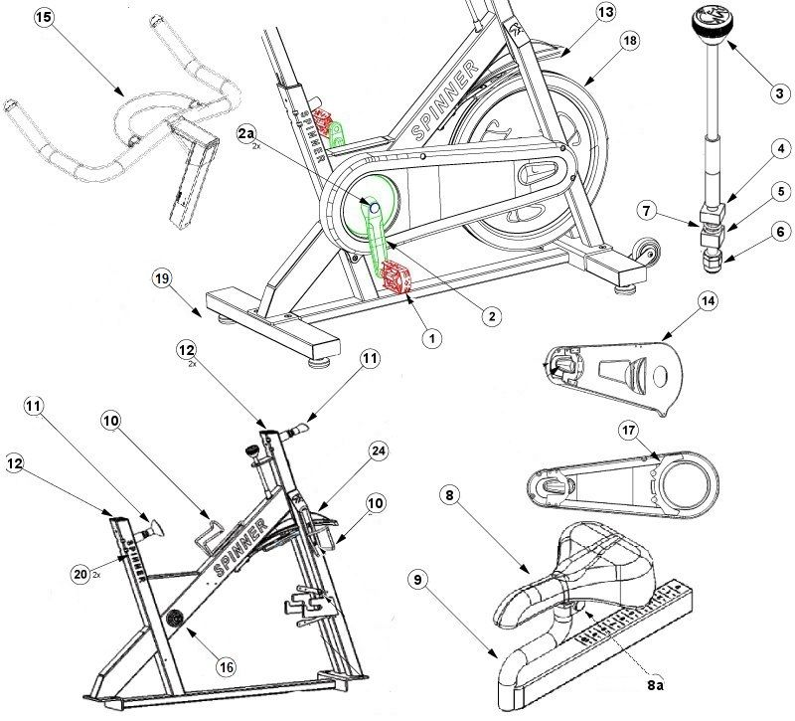
Testing Microservice
Binkal Patel

Slide 32

Deployment of microservice on docker containers
URL :
https://docs.docker.com/get-docker/
https://docs.docker.com/develop/
Binkal Patel

Slide 33
Microservice Security Day
Data Encryption
Different types of authentication and authorization practice
Authentication and Authorization
Network Security
Binkal Patel

Slide 34
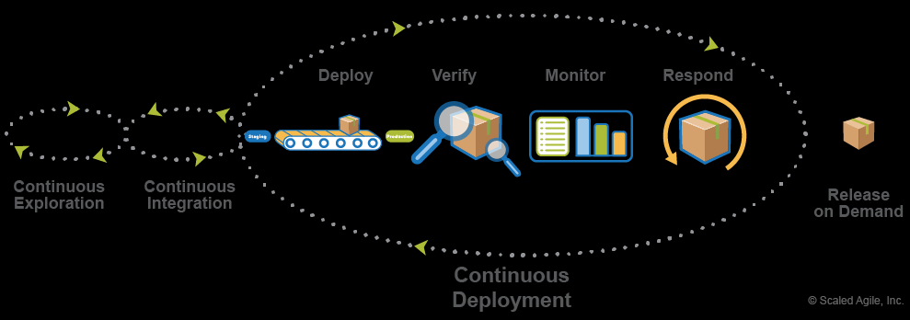
Deployment and Monitoring Day
Manual Deployment
Automated Deployment
Deployment Environments
Centralized Logging Monitoring and health check
Binkal Patel

Slide 35
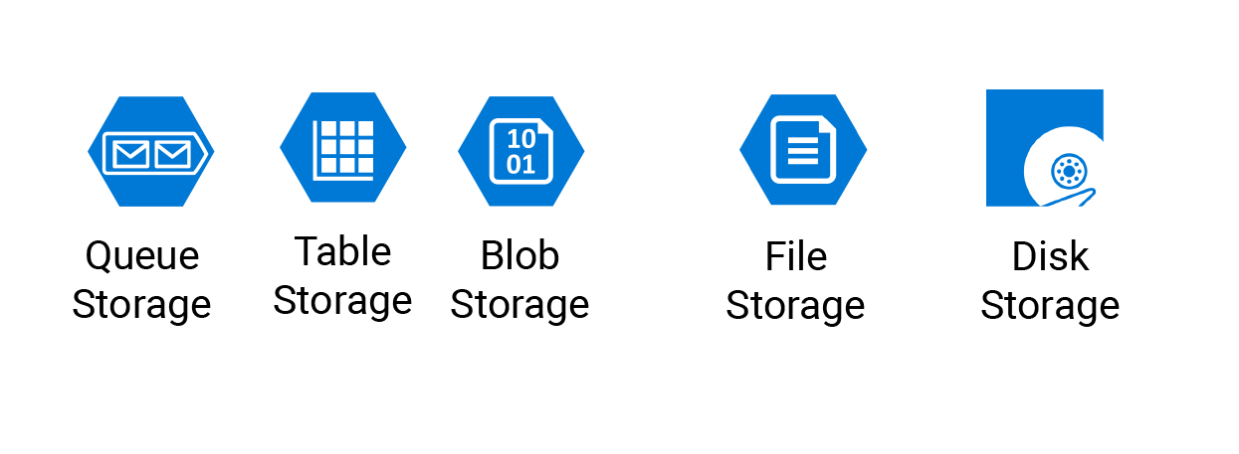
Content Delivery Network
Azure Content Delivery Network (CDN)
Blob Storage
Images /Document /Audio/Binary data
Binkal Patel

Slide 36
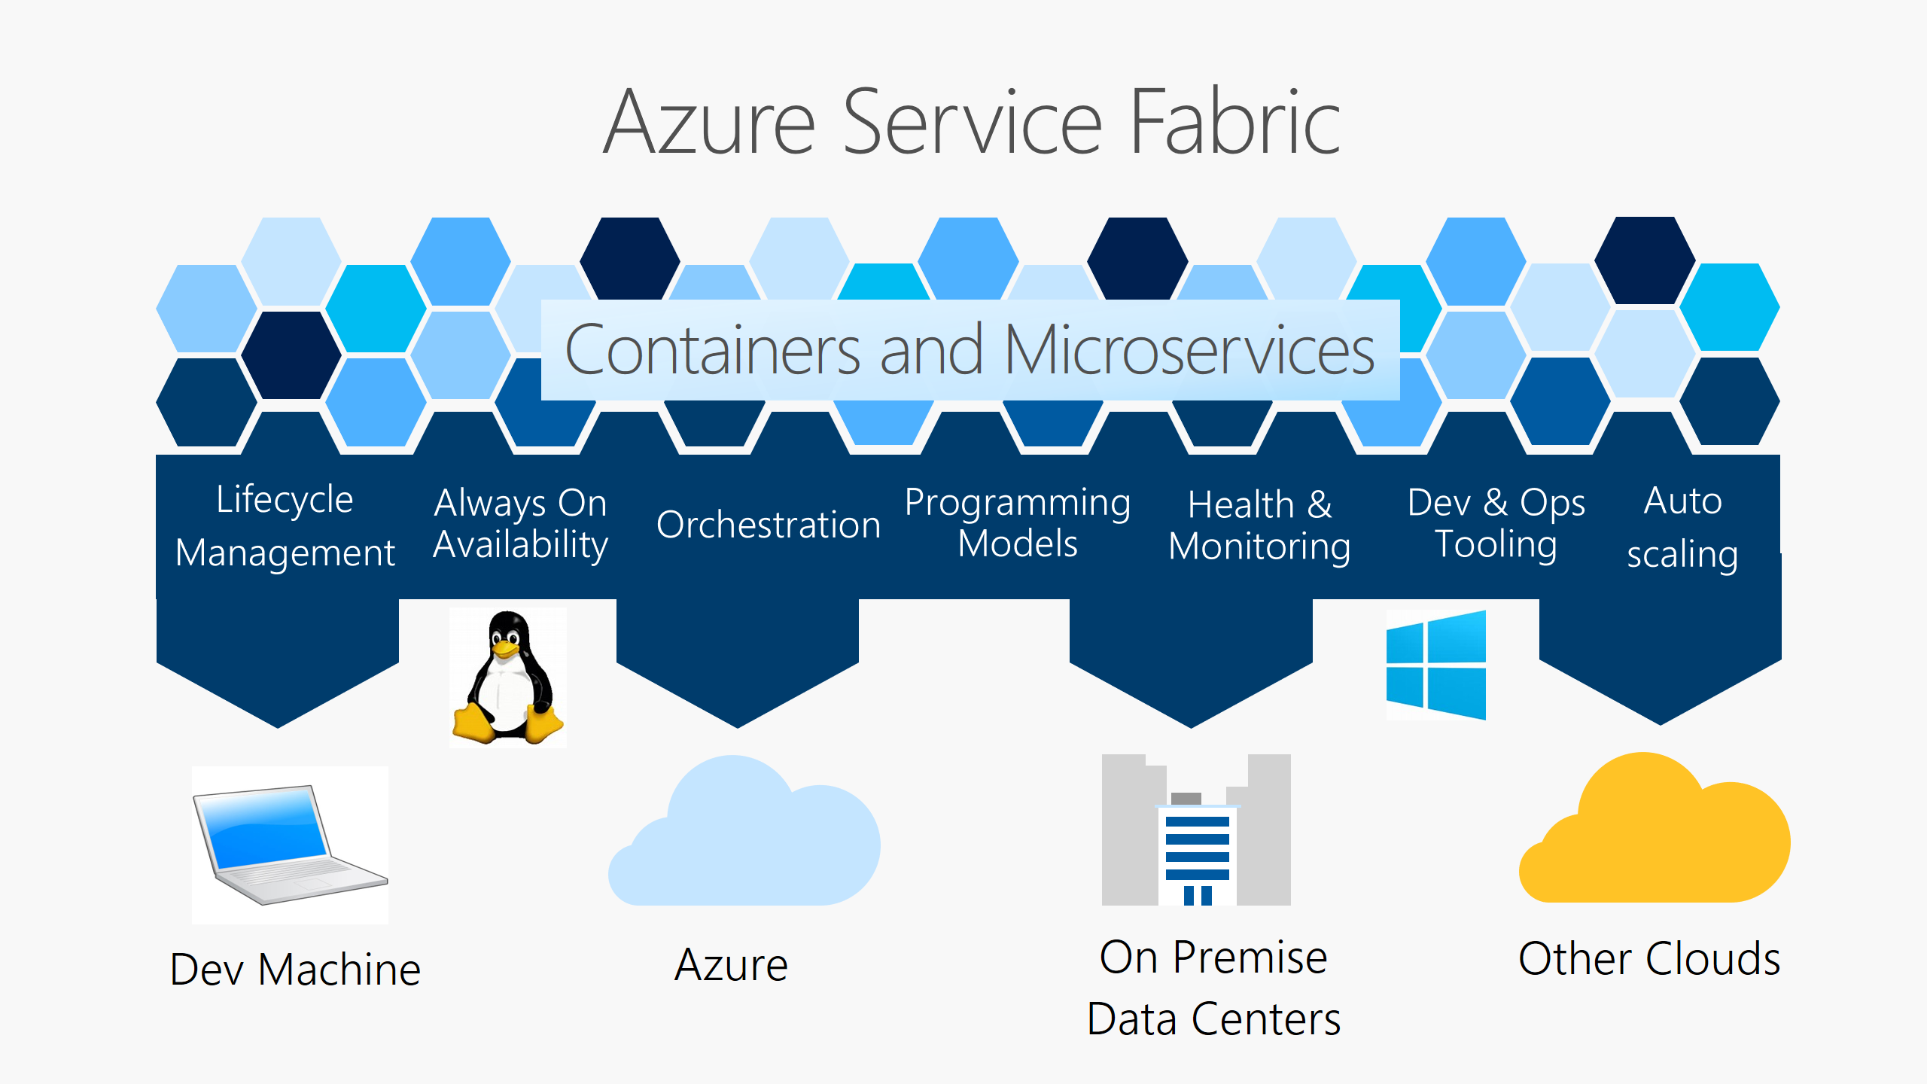
Azure Service Fabric
Binkal Patel
Notes:
https://docs.microsoft.com/en-us/azure/service-fabric/service-fabric-overview

