Slide 1
22C:19 Discrete Structures Trees
Spring 2014
Sukumar Ghosh

Slide 2
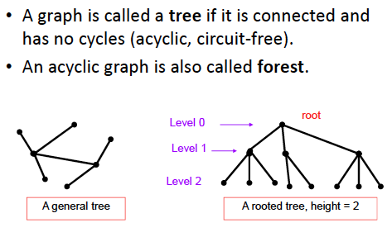
What is a tree?

Slide 3
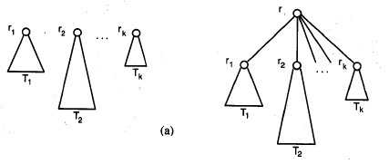
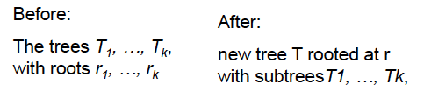
Rooted tree: recursive definition

Slide 4
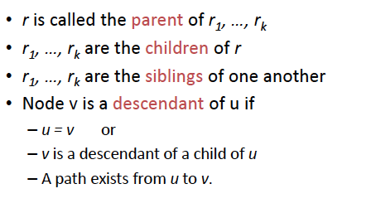
Rooted tree terminology

Slide 5
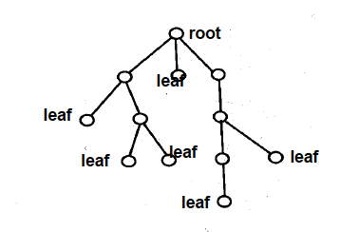
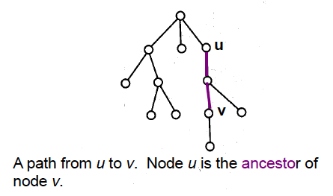
Rooted tree terminology
A subtree

Slide 6
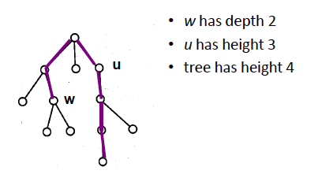
Rooted tree terminology

Slide 7
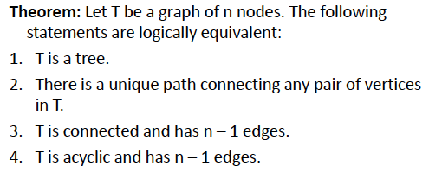
Important properties of trees

Slide 8
Important properties of trees
Theorem. A tree with n nodes has (n-1) edges
Proof. Try a proof by induction

Slide 9
Important properties of trees
Theorem. A tree with n nodes has (n-1) edges
Proof. Try a proof by induction

Slide 10
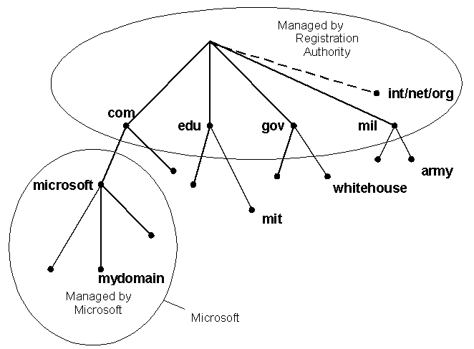
Trees as models
Domain Name System

Slide 11
Trees as models
directory
subdirectory
subdirectory
subdirectory
file
file
file
file
file
file
file
file
file
Computer File System
This tree is a ternary (3-ary) tree, since each non-leaf node has three children

Slide 12
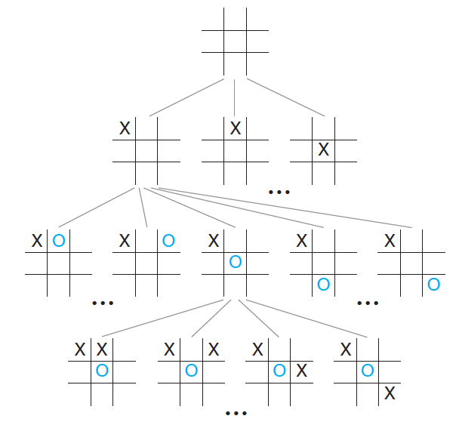
Trees as models: game tree

Slide 13
Binary and m-ary tree
Binary tree. Each non-leaf node has up to 2 children. If every non-leaf
node has exactly two nodes, then it becomes a full binary tree.
m-ary tree. Each non-leaf node has up to m children. If every non-leaf
node has exactly m nodes, then it becomes a full m-ary tree

Slide 14
Properties of trees
Theorem. A full m-ary tree with k internal vertices contains
n = (m.k + 1) vertices.
Proof. Try to prove it by induction.
[Note. Every node except the leaves is an internal vertex]

Slide 15
Properties of trees
Theorem. Every tree is a bipartite graph.
Theorem. Every tree is a planar graph.

Slide 16
Balanced trees
The level of a vertex v in a rooted tree is the length of the unique
path from the root to this vertex. The level of the root is zero. The
height of a rooted tree is the maximum of the levels of vertices.
The height of a rooted tree is the length of the longest path from
the root to any vertex.
A rooted m-ary tree of height h is balanced if all leaves are at
levels h or h − 1.

Slide 17
Balanced trees
Theorem. There are at most m^{h} leaves in an m-ary tree of height h.
Proof. Prove it by induction.
Corollary. If an m-ary tree of height h has l leaves, then
If the m-ary tree is full and balanced, then

Slide 18
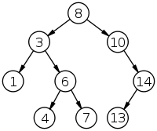
Binary search tree
Ordered binary tree. For any non-leaf node
The left subtree contains the lower keys.
The right subtree contains the higher keys.
How can you search an item? How many steps
does each search take?
A binary search tree of size 9
and depth 3, with root 8 and
leaves 1, 4, 7 and 13

Slide 19
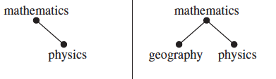
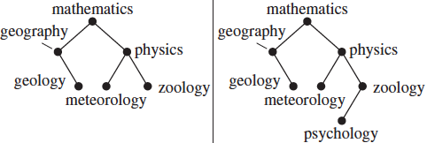
Binary search tree

Slide 20
Insertion in a binary search tree
procedure insertion (T : binary search tree, x: item)
v := root of T {a vertex not present in T has the value null }
while v ≠ null and label(v) ≠ x
if x < label(v) then
if left child of v ≠ null then v := left child of v
else add new vertex as a left child of v and set v := null
else
if right child of v ≠ null then v := right child of v
else add new vertex as a right child of v and set v := null
if root of T = null then add a vertex v to the tree and label it with x
else if v = null or label(v) ≠ x then label new vertex with x and let v be the new vertex
return v {v = location of x}

Slide 21
Decision tree
Decision trees generate solutions via a sequence of decisions.
Example 1. There are seven coins, all of which are of equal weight, and one counterfeit coin that is lighter than the rest. Given a weighing scale, in how many times do you need to weigh (each weighing determines the relative weights of the objects on the the two pans) to identify the counterfeit coin?
{We will solve it in the class}.

Slide 22
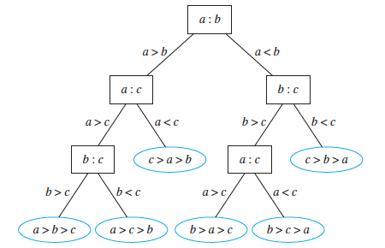
Comparison based sorting algorithms
A decision tree for sorting three elements

Slide 23
Comparison based sorting algorithms
Theorem. Given n items (no two of which are equal), a sorting
algorithm based on binary comparisons requires at least
comparisons
Proof. See page 761-762 of your textbook.
We will discuss it in the class
The complexity of such an algorithm is
Why?

Slide 24
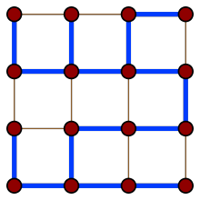
Spanning tree
Consider a connected graph G. A spanning tree is a tree that contains every vertex of G
Many other spanning trees of this graph exist

Slide 25
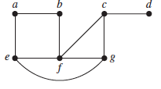
Computing a spanning tree
Given a connected graph G, remove the edges (in some order) without disrupting the connectivity, i.e. not causing a partition of the graph. When no further edges can be removed, a spanning tree is generated.
Graph G

Slide 26
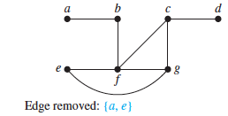
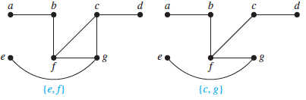
Computing a spanning tree
Spanning tree of G

Slide 27
Depth First Search
procedure DFS (G: connected graph with vertices v1…vn)
T := tree consisting only of the vertex v1
visit(v1) {Recursive procedure}
procedure visit (v: vertex of G)
for each vertex w adjacent to v and not yet in T
add vertex w and edge {v, w} to T
visit (w)
The visited nodes and the edges connecting them form a spanning tree. DFS can also be used as a search or traversal algorithm

Slide 28
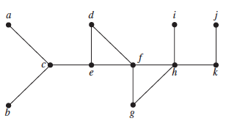
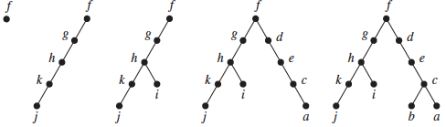
Depth First Search: example

Slide 29
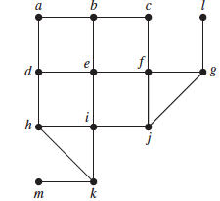
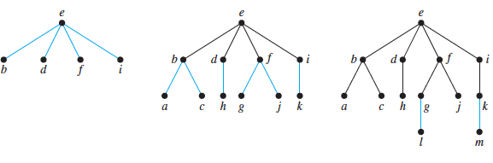
Breadth First Search
A different way of
generating a spanning tree
Given graph G
Spanning tree

Slide 30
Minimum spanning tree
A minimum spanning tree (MST) of a connected weighted graph is a spanning tree for which the sum of the edge weights is the minimum.
How can you compute the MST of a graph G?

Slide 31
Huffman coding
Consider the problem of coding the letters of the English
alphabet using bit-strings. One easy solution is to use
5 bits for each letter (2⁵ > 26). Another such example is
The ASCII code. These are static codes, and do not make
use of the frequency of usage of the letters to reduce the
size of the bit string.
One method of reducing the size of the bit pattern is to use
prefix codes.

Slide 32
Prefix codes
In typical English texts, e is most frequent, folloed by, l, n, s, t … The prefix tree assigns to each letter of the alphabet a code whose length depends on the frequency:
e = 0, a = 10, l= 110, n = 1110 etc
Such techniques are popular for
data compression purposes. The
resulting code is a variable-length
code.
0
1
e
0
1
a
0
1
l
0
1
n
1
0
s
t

Slide 33
Huffman codes
Another data compression technique first developed
By David Huffman when he was a graduate student
at MIT in 1951. (see pp. 763-764 of the textbook)
Huffman coding is a fundamental algorithm in data
compression, the subject devoted to reducing the number
of bits required to represent information.

Slide 34
Huffman codes
Example. Use Huffman coding to encode the following
symbols with the frequencies listed:
A: 0.08, B: 0.10, C: 0.12, D: 0.15, E: 0.20, F: 0.35.
What is the average number of bits used to encode a
character?

Slide 35
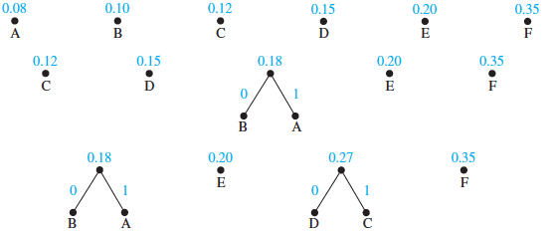
Huffman coding example

Slide 36
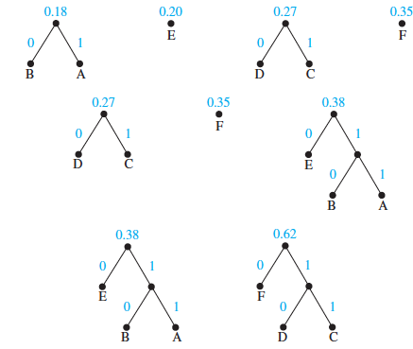
Huffman coding example

Slide 37
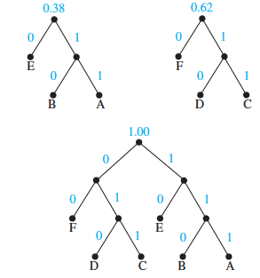
Huffman coding example

Slide 38
Huffman coding example
So, what is the average number of bits needed to encode each letter?

Slide 39
Game trees
How to visualize the moves in a game as a tree?
How does Deep Blue play chess?
We will discuss this in the class

