Slide 1

Basic Web Application Development
AWeber Academy
JIRA: ACADEMY-16

Slide 2

What is node.js?
it is...
JavaScript on the server!
Asynchronous & Event driven
Full stack / single language & tools
npm Package Manager
Awesome!

Slide 3
What to expect from this course...
Build a complete web application!
Use node.js, Express.js, MongoDB, Handlebars
Write the code from start to finish, from scratch… (most of it)
… and understand it!

Slide 4
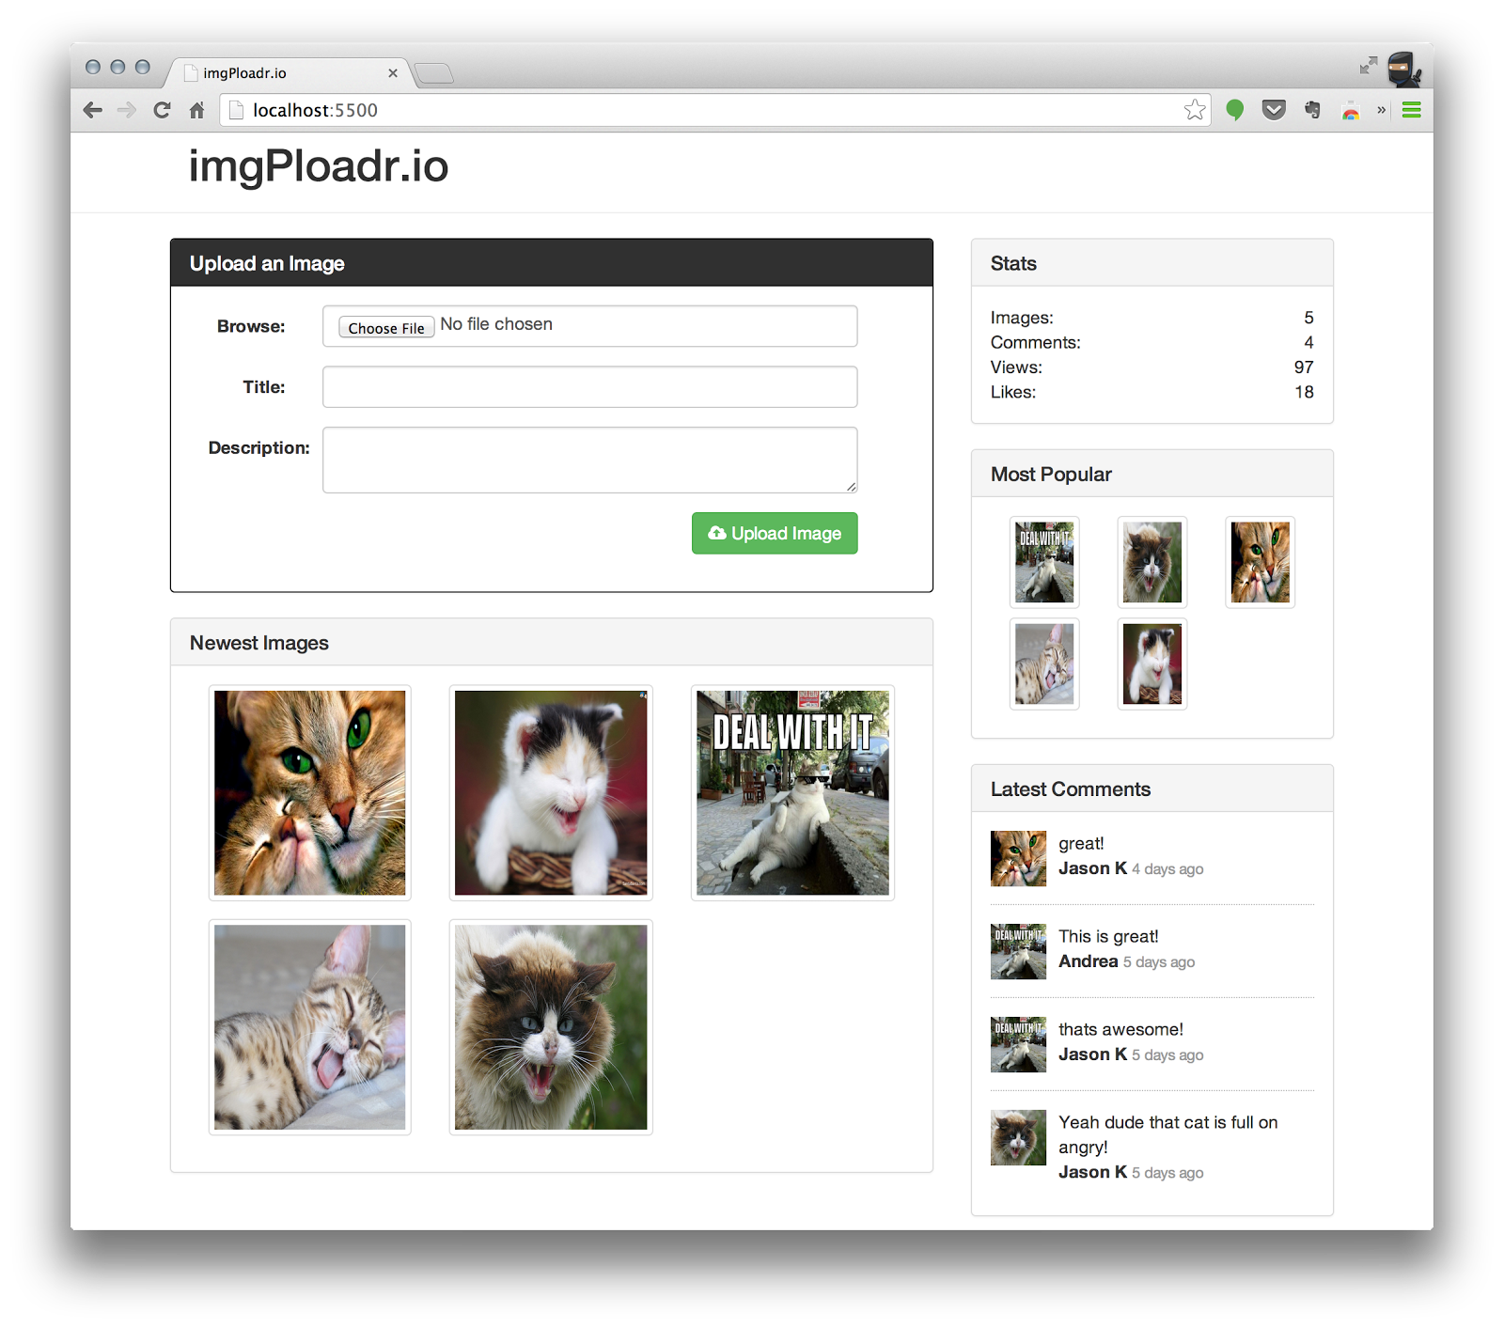
imgPloadr.io
…an imgur.com clone!
Upload images
Browse & view images
Post comments
Like images
Track views
Online in the cloud!

Slide 5
Getting started: Hello world!
Development Environment setup
install node & npm
install mongodb
editor of choice
project home
npm hands on
mongo hands on
https://github-enterprise.colo.lair/gist/jasonk/2270/edit

Slide 6
Week 2:
Server bootup

Slide 7
Basic server bootup
Project file structure and organization
npm install all the things!
server.js - 1 file to rule them all!
Express.js for the win!
Connect middleware

Slide 8
Week 3:
Views: HTML & CSS

Slide 9
Views: HTML & CSS
Routes and Controllers
Bootstrap introduction
Handlebars introduction
main layout
views & partials
Write the HTML (for both pages)
Introducing Rendering

Slide 10
Week 4:
Database Design

Slide 11
Data Schemas for images
Define the Schema
Connect to a local MongoDB server
ViewModels and Wired up Controllers

Slide 12
Week 5:
Likes and Comments

Slide 13
Likes and Comments
Endpoints for Likes and Comments
Improving the UI with jQuery
Reveal Post Comment form (hide by default)
AJAX submit Likes

Slide 14
Week 6:
Sidebar

Slide 15
Sidebar
Create a helper for the sidebar
Use async for all the different asynchronous calls ensuring a single final callback
Tie it together in the Home and Image index controller functions (wrapping res.render)

Slide 16
Week 7:
Deploying with Heroku

Slide 17
Deploying with Heroku
Install Git http://git-scm.com/book/en/Getting-Started-Installing-Git
Register @ Herokuhttps://api.heroku.com/signup/devcenter
Install Heroku toolbelthttps://toolbelt.heroku.com/
Deploy!$ heroku login $ heroku create $ git push heroku master && heroku ps:scale web=1

