Slide 1
Are you ready? [SPACE] to start

Slide 2




Software Tool Time

Slide 3


Slide 4
WebGL 2 Tutorial (Part 1) - Introduction
강사
경북대학교 백낙훈 교수
아주대학교 이환용 교수
목표
WebGL 1 을 공부한 사람들에게 WebGL 2 변경된 기능을 소개
사전 준비
WebGL 1.0 튜토리얼 – YouTube https://www.youtube.com/playlist?list=PLKseYrrlvWNqmtCMZyoraXIAG2F0sG2o7
JavaScript Language 기능
로컬 Web Server 설치 – Python 설치 권장

Slide 5
Program
Part 1 – Introduction
[W01] – context changed to webgl2
Part 2 – GLSL 3.00
[W02] – Hello triangle의 shader code를 glsl 3.00 으로 바꾸기
Part 3 – WebGL 2 의 유용한 기능
[W03] – Not power of 2 texture size, Floating point texture
[W04] – Using texture in Vertex Shader
[W05] – Transform feedback
Part 4 – WebGL 2 Rendering – fbo, rbo
[W06] – fbo, rbo
[W07] – render to texture

Slide 6
PPT 설정 (이 슬라이드는 쇼에 안보임)
반드시 다음 2개 슬라이드를 음악과 함께 캡처해서 동영상에 포함해야 합니다.
SWTT 라이선스
소중사업 사사 문구
맨 첫 타이틀이 이상하게 나오면 아래 글꼴을 설치하세요
https://fontzone.net/font-details/ar-hermann
나눔고딕 글꼴과 D2Coding 글꼴 - https://hangeul.naver.com/font
Mac 사용자는 나눔고딕코딩 글꼴을 설치해야 할 수 있습니다.

Slide 7
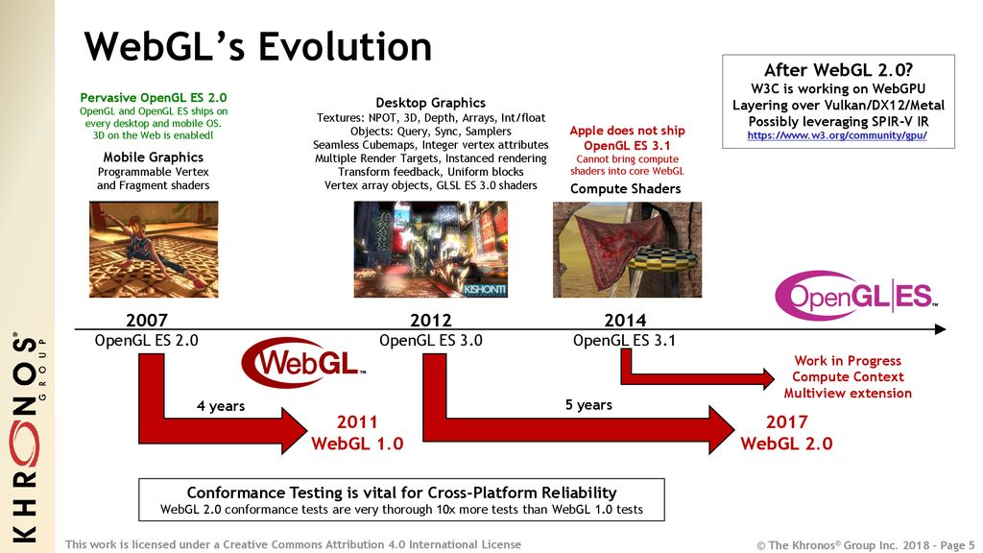
WebGL 2 소개 - History

Slide 8
WebGL 2 환경 설정
WebGL 2 를 지원하는 웹 브라우저
Chrome, Safari, Edge, etc.
로컬 웹 서버
python 설치 & 로컬 웹 서버
python –m http.server 8000
코드 편집기
VS Code 권장

Slide 9
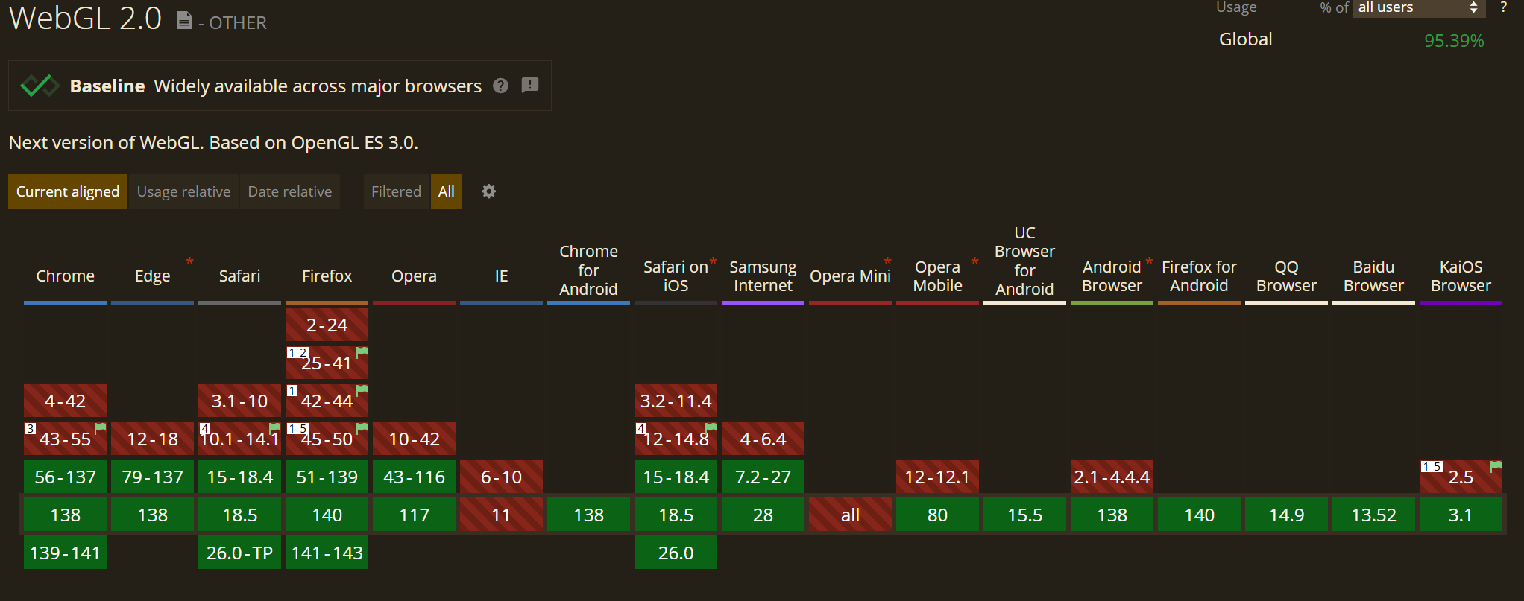
WebGL 2 – Web browser supports
https://caniuse.com/webgl2

Slide 10
W01: WebGL 2 – Backward Compatibility
WebGL 1 코드를 WebGL 2 에서 실행하기
T01 – Hello Triange Code를 webgl2 context에서 실행해 보기
W01 코드 참조
결론
특별한 Error 처리 등의 코드가 없으면 그대로 실행 가능

Slide 11
WebGL 1 vs 2 - Shader, Objects
Item | WebGL 1 | WebGL 2
GLSL Version Directives | version 1.0 No need | version 3.0 #version 300 es, version-300-es, glsl-version-300-es
Vertex Index | UNSIGNED_BYTE,UNSIGNED_SHORT | + UNSIGNED_INT
Vertex Array Object (createVertexArray()) | (Extension) | Always
Shader Matrix Functions | matrix * vec or matrix | + inverse, transpose
Uniform Buffer Objects | Must be send one by one | global data access with number
Sampler Objects | all texture params are per texture | move all texture params to a sampler, single texture to be sampled in different ways
Notes:
const ext = gl.getExtension('OES_element_index_uint');
if (ext) {
// Now you can use gl.UNSIGNED_INT in drawElements}
createVertexArray()

Slide 12
WebGL 1 vs 2 - Shader, Rendering
Item | WebGL 1 | WebGL 2
Transform Feedback |  | Vertex shader can write result back into buffer
Standard Derivatives | normal must be computed in CPU | Computed in shaders with math op
Blend equation |  | + min, max
Shader loop | constant integer expression | no limit
Multiple Render Target (MRT) |  | draw to multiple buffers at once from a shader.
Multi-Sampled Renderbuffers | only with GPU's built in | support to perform our own custom multi-sampling.
Instanced Rendering |  | examples are grass and fur drawArraysInstanced(...)

Slide 13
WebGL 1 vs 2 - Texture (1)
Item | WebGL 1 | WebGL 2
3D Texture Volume or medical imaging (with mipmap) | Extension | Always
Texture Array | Extension | Always
Texture Size in shader (with mipmap) | must be 2^{n} and extension | non 2^{n} in shader vec2 size = textureSize(sampler, lod);
Direct Texel Lookup in shader |  | vec4 values = texelFetch(sampler, ivec2Position, lod);
Compressed texture | Hardware dependent (e.g. S3TC is iOS only) | EAC, ETC2, etc.
Integer Textures and Attributes | Only floating point or normalized int | + integer representation

Slide 14
WebGL 1 vs 2 - Texture (2)
Item | WebGL 1 | WebGL 2
Depth texture | Extension | Always default
Texture access in Vertex Shaders | Optional | At least 16
Texture LOD |  | used to determine which mipmap to fetch from. This allows for mipmap streaming
Shader Texture LOD |  | bias control makes mipmap level control simpler for glossy environment effects in physically-based rendering
Floating point Texture | Optional | Always
More Texture format |  | next page

Slide 15
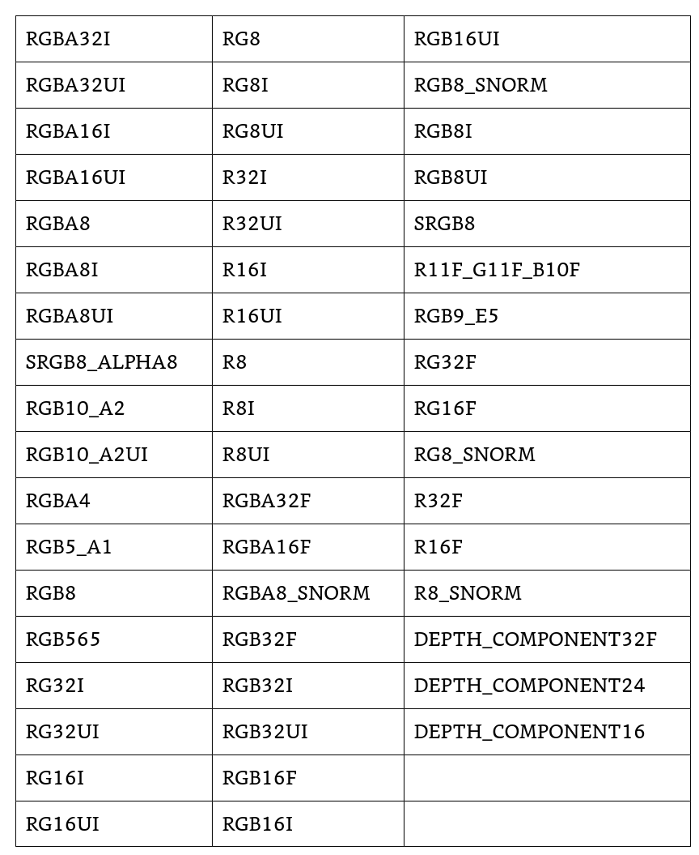
texture format
Notes:
const ext = gl.getExtension('OES_element_index_uint');
if (ext) {
// Now you can use gl.UNSIGNED_INT in drawElements}
createVertexArray()

Slide 16
Software Tool Time (소프트웨어 툴 타임)
(CC-BY-NC 4.0) KNU and Ajou Univ.
Visit “Software Tool Time” channel in YouTube : https://www.youtube.com/c/SoftwareToolTime
All product names, trademarks, and/or company names are used solely for identification and belong to their respective owners.
“Software Tool Time” video is licensed to the public under a Creative Commons Attribution 4.0 License (https://creativecommons.org/license/by/4.0/)
Twin Musicom’s African Drums (Sting) is licensed to the to the public under a Creative Commons Attribution 4.0 License (Artist: http://www.twinmusicom.org/)

Slide 18

본 영상은 2021,2022년도 과학기술정보통신부 및 정보통신기획평가원에서 지원하는 SW중심대학사업의 결과물 입니다.
본 영상의 내용을 전재할 수 없으며, 인용할 때에는 반드시 과학기술정보통신부와 정보통신기획평가원의 'SW중심대학사업'의 결과물이라는 출처를 밝혀야 합니다.

