Slide 1
Atlanta Housing Prices
Module 4 Project – Time Series Data
Matthew E. Parker

Slide 2
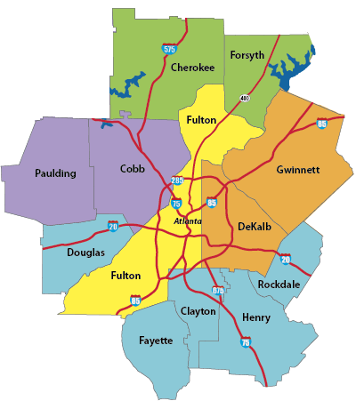
The Data
Nationwide monthly mean housing prices
provided by Zillow.com
14,723 zip codes
April 1996 – April 2018
Atlanta Metro Area
here defined as Fulton and Dekalb Counties
41 Zip Codes (-3 which had incomplete records)

Slide 3
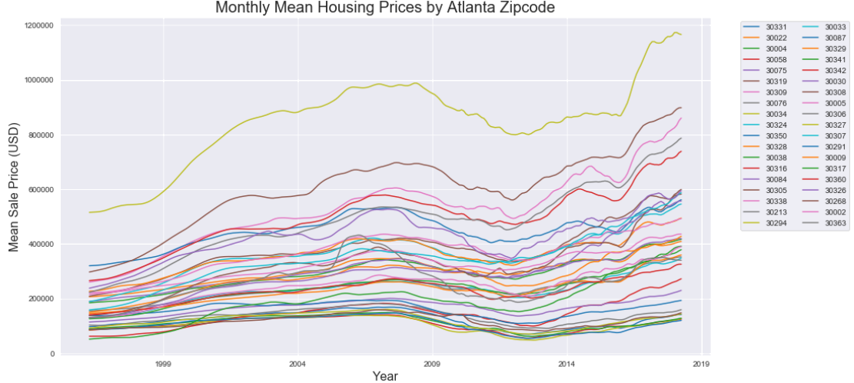
Find the “best” zip codes for bank investment
“Best” = balancing high Return on Investment (ROI) while minimizing price volatility over time
Model needs to:
account for 2008 Market Crash
develop comparative metric for volatility
minimize volatility, then maximize ROI

Slide 4
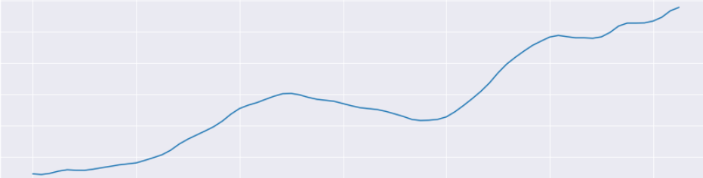
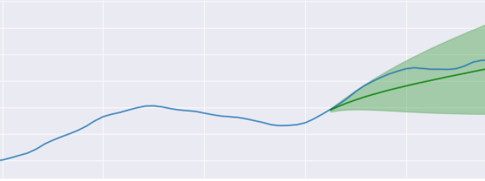
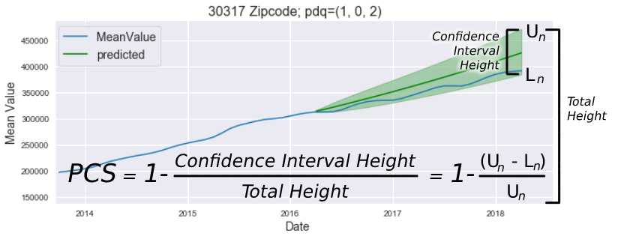
Measuring and Minimizing Volatility
Prediction Spread (confidence interval) is based on past volatility.
Volatility must be measurable to be minimized.
Parker Confidence Score (PCS) measures volatility as ratio of prediction spread to total prediction height
Volatility = Peaks & Troughs
Wide Prediction
Spread
Low Volatility = Narrow Prediction Spread

Slide 5
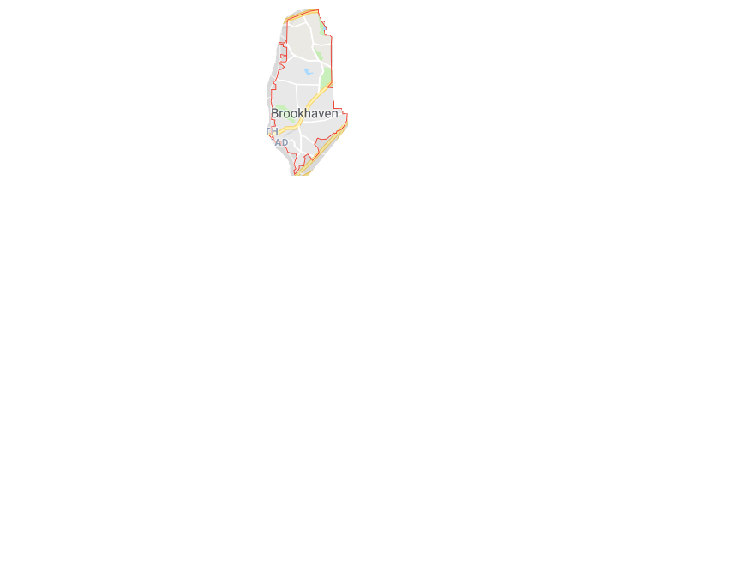
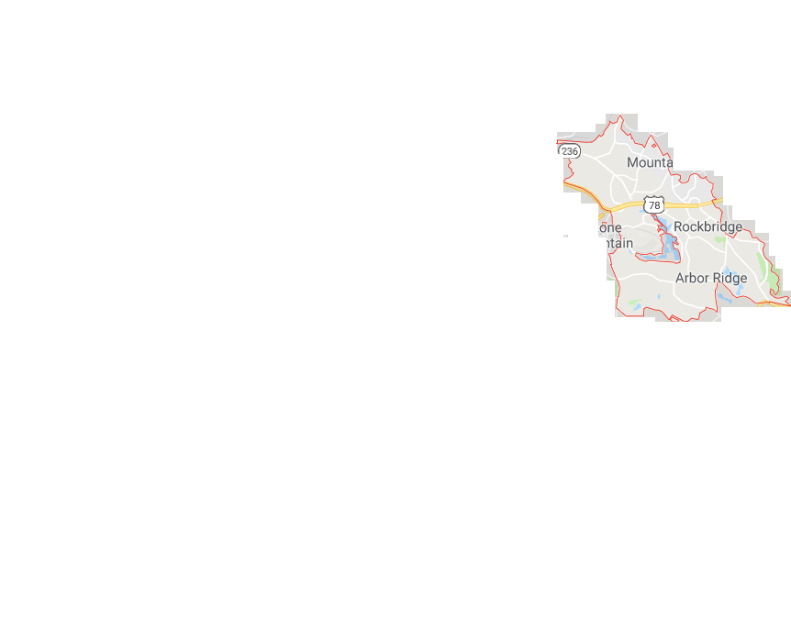



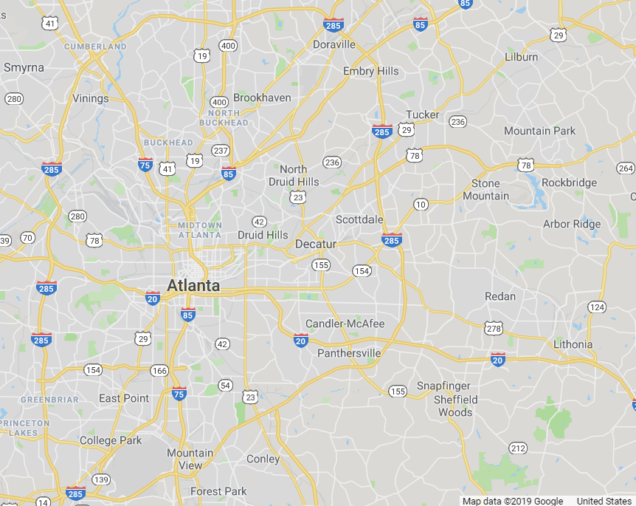
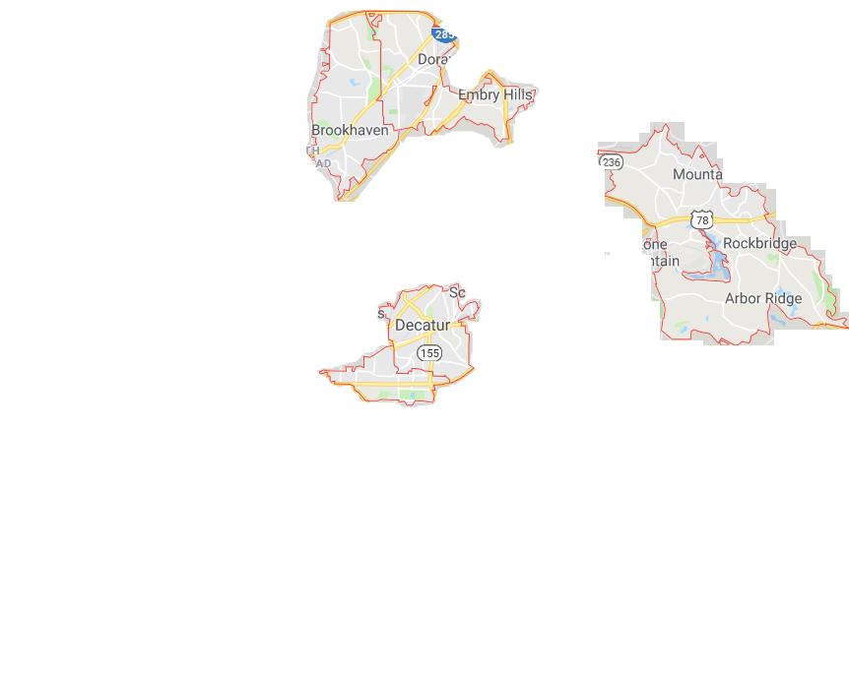
Conclusions & Recommendations
The 5 “best” zip codes are:
30317 (Kirkwood)
30030 (Decatur)
30341 (Chamblee)
30087 (Rockbridge)
30319 (Brookhaven)
Each is expected to produce 18-34% ROI after 2 years
full ROI prediction range is 7-48%

Slide 6

Thank you

