Slide 1
DA-ArcNet: Lightweight Domain-Adversarial Angular-Margin Learning for Unsupervised Anomalous Sound Detection under Domain Shift
Ardhanarieswarar (24I461) | Gokul Kannan (24I463)
Jafer Sathik B (24I464) | Madhan M (24I466)
23I006 Deep Learning Mini Project
PSG College of Technology, Department of Information Technology

Slide 2
Problem and motivation
- Machines are monitored by sound; faults are rare and varied -> train on NORMAL sounds only (unsupervised ASD)
- Domain shift: speed, load, microphone and background noise differ between training (source) and deployment (target)
- Benchmark (DCASE 2022 Task 2): per section 990 source + only 10 target normal clips; test = 50 normal + 50 anomalous per domain
- Metrics: AUC (source, target), partial AUC (FPR <= 0.1), official score = harmonic mean
- Goal: a LIGHTWEIGHT model that stays reliable on the shifted target domain
Ardhanarieswarar (24I461), Gokul Kannan (24I463), Jafer Sathik B (24I464), Madhan M (24I466) | 23I006 Deep Learning Mini Project | PSG College of Technology, Department of Information Technology
Notes:
Explain why only normal data is available and why domain shift breaks naive detectors.

Slide 3
Literature survey and research gap
- 18 papers (2022-2026): DCASE challenge reports, MIMII DG, STgram, Gen-Rep, FeatEx, AdaProj, LoRA adapters, SSAM, diffusion-based UD-ASD ...
- Gap 1: top systems are heavy (pre-trained backbones, LoRA, ensembles) -> costly at the edge
- Gap 2: domain handling is implicit (loss design, memory banks) - no explicit domain-invariance in an angular-margin embedding
- Gap 3: evaluation within one dataset; cross-dataset transfer and noise robustness rarely reported
- Gap 4: little explainability or error analysis
Ardhanarieswarar (24I461), Gokul Kannan (24I463), Jafer Sathik B (24I464), Madhan M (24I466) | 23I006 Deep Learning Mini Project | PSG College of Technology, Department of Information Technology
Notes:
18 verified papers 2022-2026; the full table is in the notebook (Section 0) and paper.

Slide 4
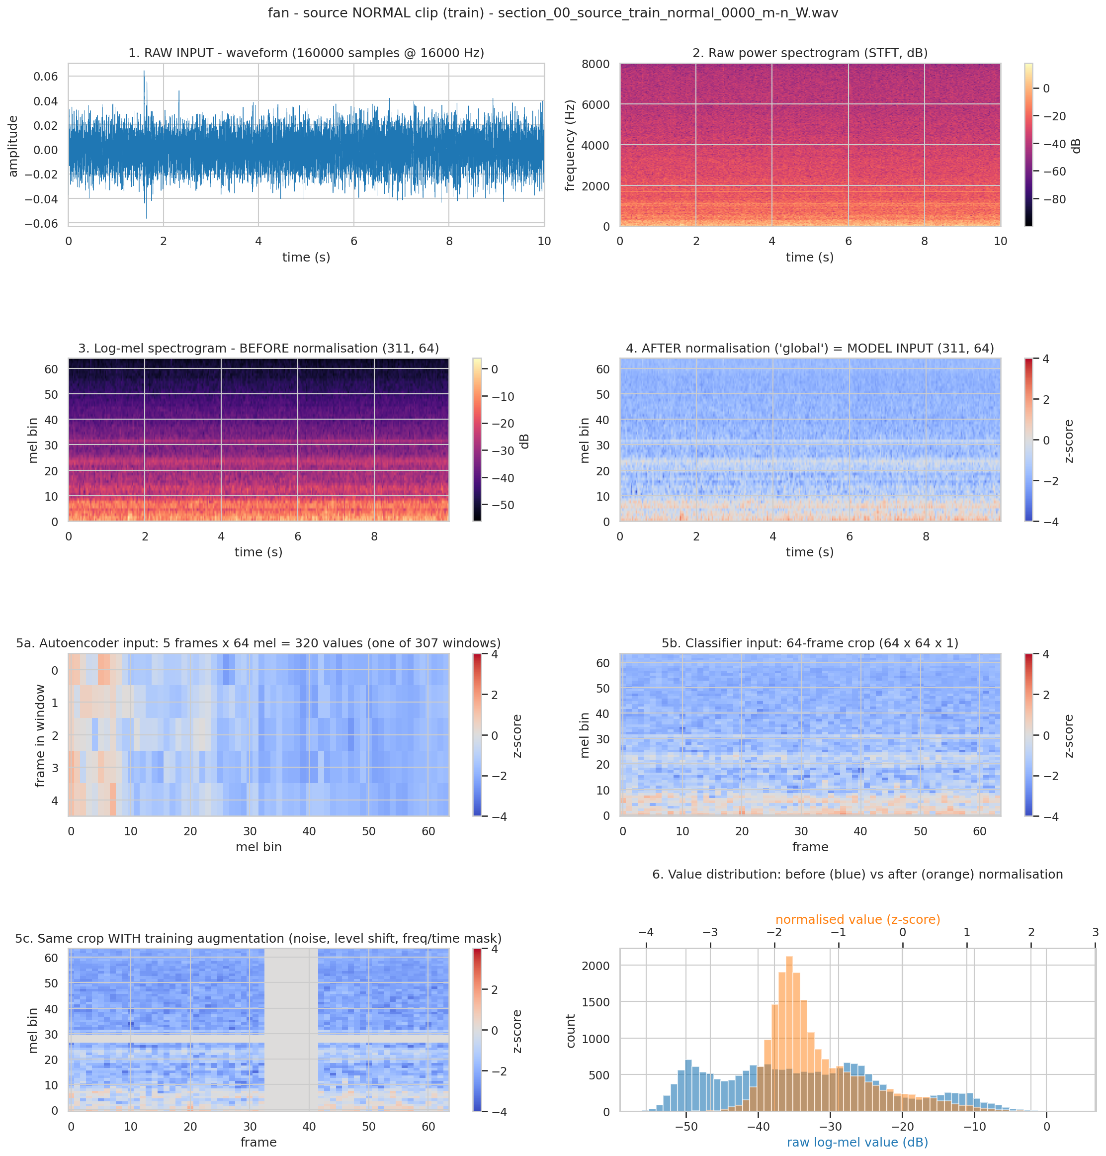
Datasets and pre-processing
- MIMII DG: fan, gearbox, bearing, slider, valve | ToyADMOS2 (ToyCar, ToyTrain via DCASE 2022 dev set)
- Log-mel: 16 kHz, FFT 1024, hop 512, 64 mel bands (dB); global z-norm from TRAIN clips only
- Hold-out: 10 % of source normal clips for threshold / early stopping / fusion scaling / (not kNN references)
- Noise study: white + pink noise at 20/10/5/0 dB added to test clips only
Ardhanarieswarar (24I461), Gokul Kannan (24I463), Jafer Sathik B (24I464), Madhan M (24I466) | 23I006 Deep Learning Mini Project | PSG College of Technology, Department of Information Technology
Notes:
Both datasets, same file format; log-mel with train-only normalisation; no test clip is used for fitting anything.

Slide 5
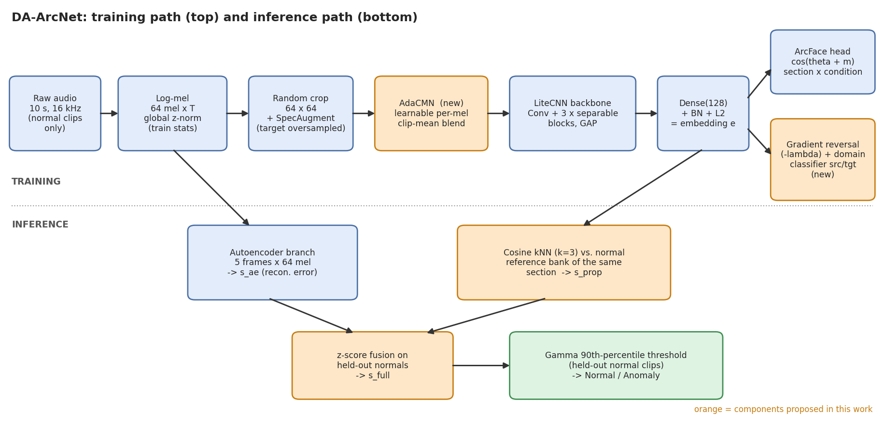
Proposed model: DA-ArcNet
- AdaCMN: learnable per-mel blend between identity and clip-mean normalisation
- Gradient-reversal domain adversary + ArcFace condition classifier, target oversampled x10; kNN scoring; optional AE fusion
Ardhanarieswarar (24I461), Gokul Kannan (24I463), Jafer Sathik B (24I464), Madhan M (24I466) | 23I006 Deep Learning Mini Project | PSG College of Technology, Department of Information Technology
Notes:
Walk through training path and inference path of the diagram; point at the orange parts as the new contributions.

Slide 6
Experimental protocol
- Baselines: (1) DCASE22 AE, (2) DCASE22 MobileNetV2 section classifier, (3) ArcFace-kNN (recent top-system paradigm)
- Metrics: AUC source / target, pAUC, official score, EER, AP; Acc / Prec / Recall / Spec / F1 / MCC and confusion matrices at a gamma threshold
- Statistics: 95 % bootstrap CIs, multi-seed repeats, paired Wilcoxon tests
- Extras: cross-dataset transfer, ablation, noise robustness, Grad-CAM / residual maps, t-SNE + domain probe, size and speed
Ardhanarieswarar (24I461), Gokul Kannan (24I463), Jafer Sathik B (24I464), Madhan M (24I466) | 23I006 Deep Learning Mini Project | PSG College of Technology, Department of Information Technology
Notes:
Baselines are re-implementations with the same budget; say so.

Slide 7
Main results
machine | AE | MNv2 | ArcFace-kNN | DA-ArcNet | DA-ArcNet+AE
fan | 0.607 | 0.500 | 0.614 | 0.597 | 0.611
gearbox | 0.616 | 0.624 | 0.648 | 0.613 | 0.633
bearing | 0.539 | 0.663 | 0.543 | 0.582 | 0.551
slider | 0.603 | 0.500 | 0.711 | 0.758 | 0.715
valve | 0.503 | 0.500 | 0.626 | 0.632 | 0.597
ToyCar | 0.637 | 0.595 | 0.697 | 0.706 | 0.678
ToyTrain | 0.525 | 0.500 | 0.589 | 0.577 | 0.562
Mean | 0.576 | 0.555 | 0.633 | 0.638 | 0.621
- Official score (mean over machines): DA-ArcNet 0.632 | best baseline ArcFace-kNN 0.628 | DA-ArcNet+AE 0.616
Ardhanarieswarar (24I461), Gokul Kannan (24I463), Jafer Sathik B (24I464), Madhan M (24I466) | 23I006 Deep Learning Mini Project | PSG College of Technology, Department of Information Technology

Slide 8
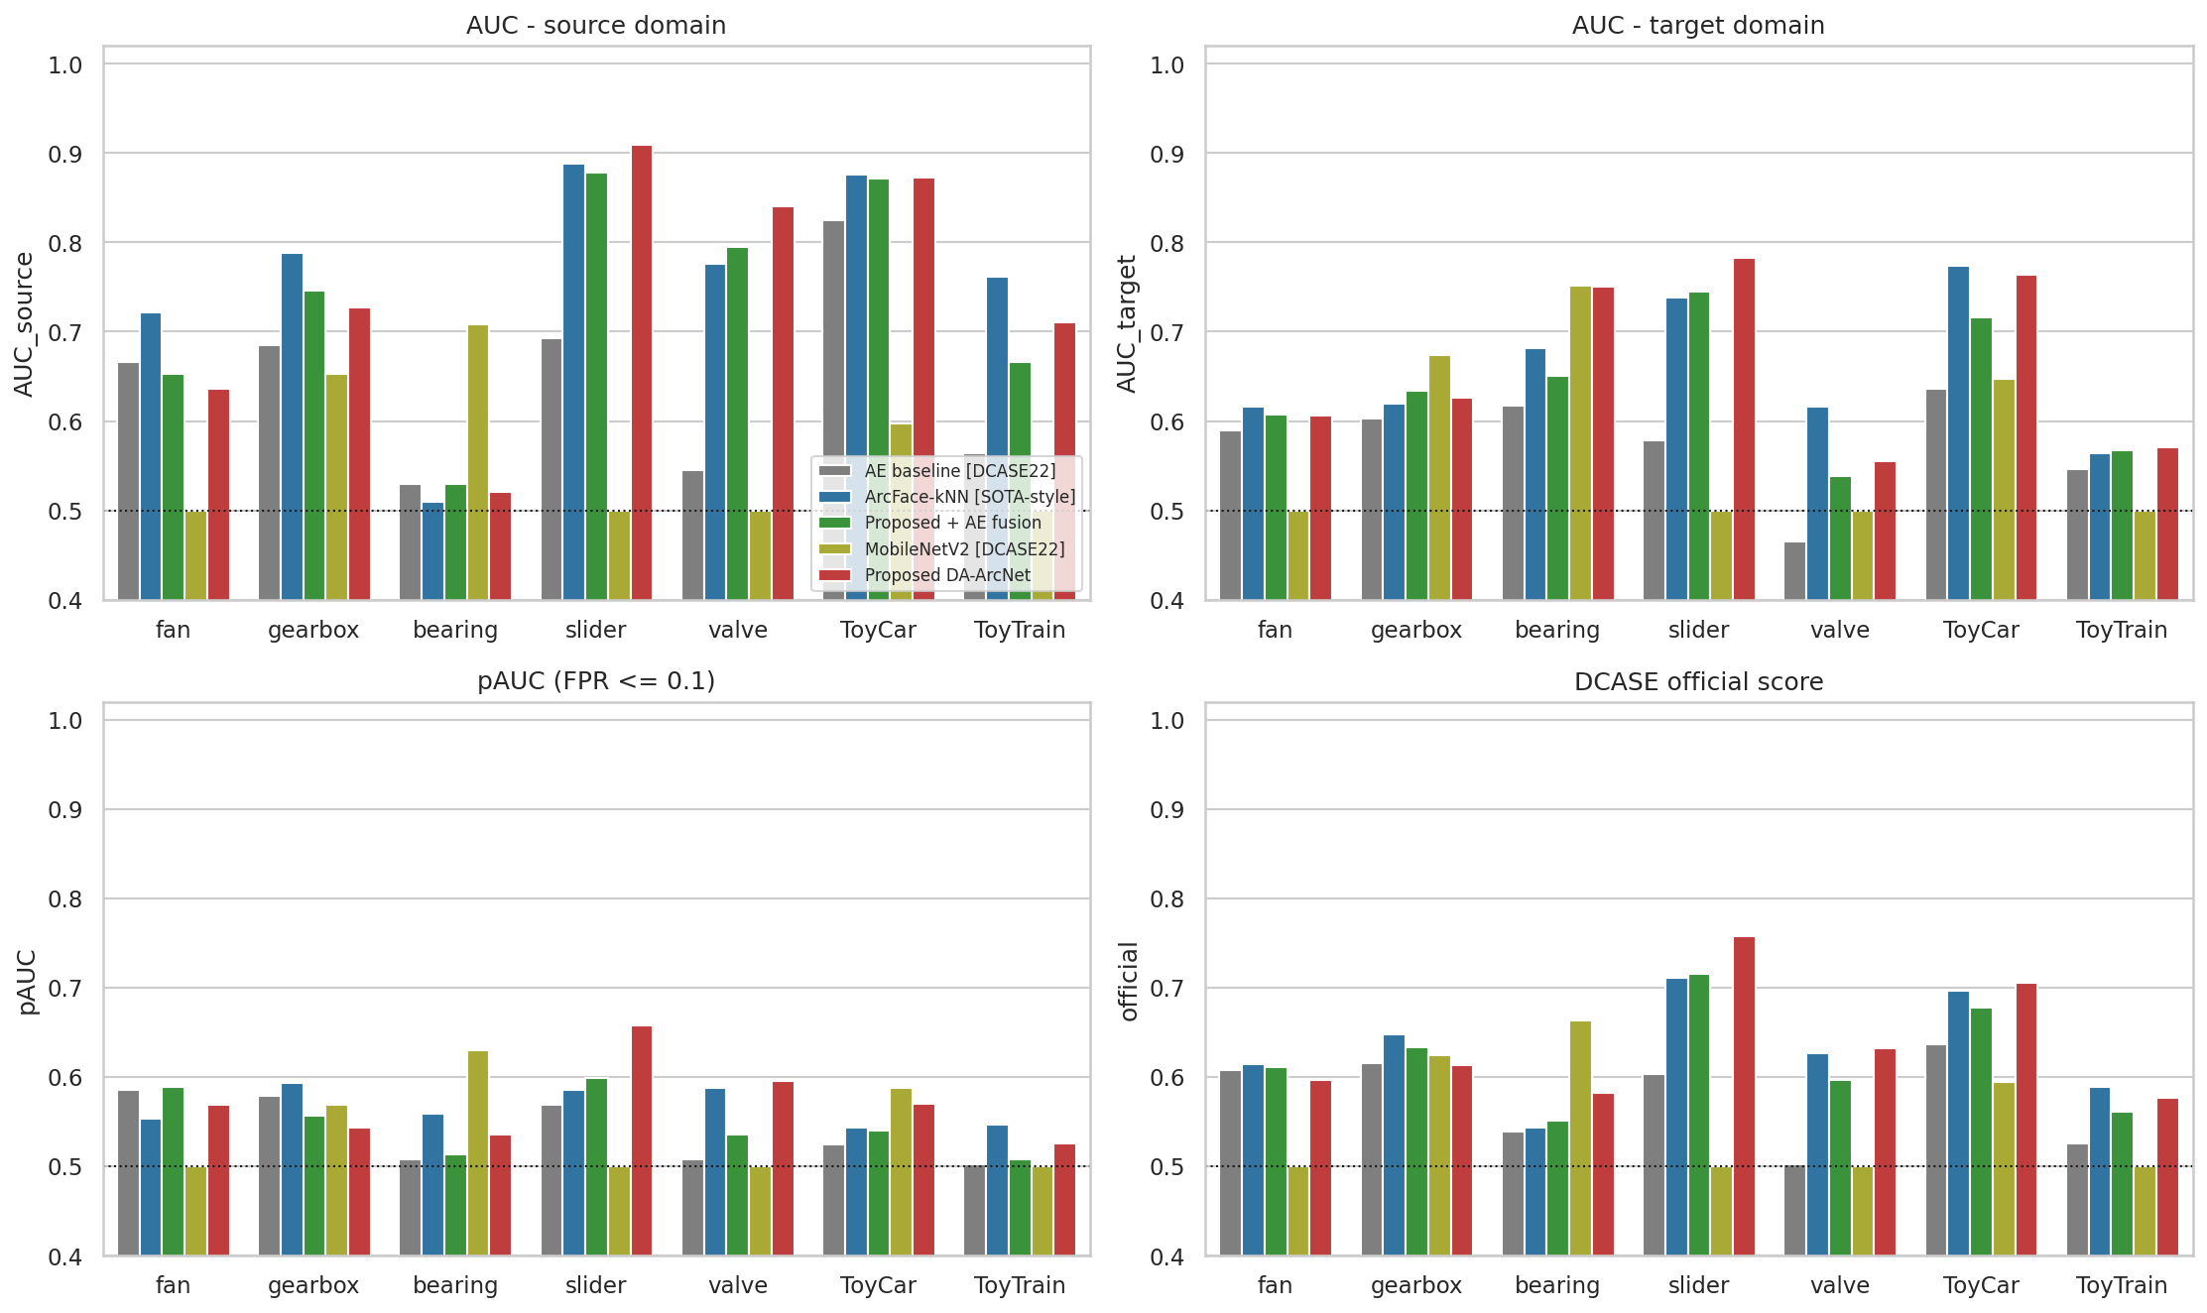
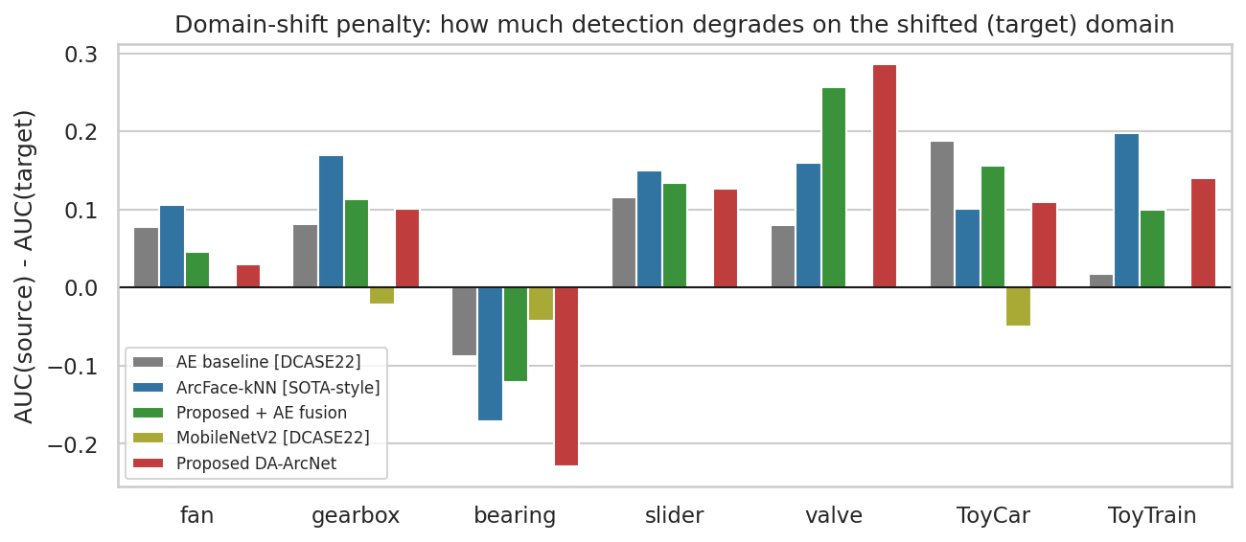
Domain shift: source vs target
- Source-to-target AUC drop: DA-ArcNet +0.080, ArcFace-kNN +0.102
Ardhanarieswarar (24I461), Gokul Kannan (24I463), Jafer Sathik B (24I464), Madhan M (24I466) | 23I006 Deep Learning Mini Project | PSG College of Technology, Department of Information Technology

Slide 9
Statistical rigour
 | AUC src | AUC tgt [95% CI] | pAUC | Official [95% CI]
AE | 0.644 | 0.576 [0.553, 0.601] | 0.539 | 0.571 [0.554, 0.583]
MNv2 | 0.566 | 0.582 [0.567, 0.594] | 0.541 | 0.547 [0.539, 0.552]
ArcFace-kNN | 0.760 | 0.658 [0.635, 0.682] | 0.567 | 0.628 [0.611, 0.642]
DA-ArcNet | 0.745 | 0.665 [0.642, 0.686] | 0.571 | 0.632 [0.615, 0.645]
DA-ArcNet+AE | 0.734 | 0.637 [0.614, 0.658] | 0.549 | 0.616 [0.601, 0.627]
- Wilcoxon (official score, DA-ArcNet vs ArcFace-kNN): p = 0.354
- CIs: bootstrap over test clips; seeds: see notebook Section 19 (mean +/- std in paper Table)
Ardhanarieswarar (24I461), Gokul Kannan (24I463), Jafer Sathik B (24I464), Madhan M (24I466) | 23I006 Deep Learning Mini Project | PSG College of Technology, Department of Information Technology

Slide 10
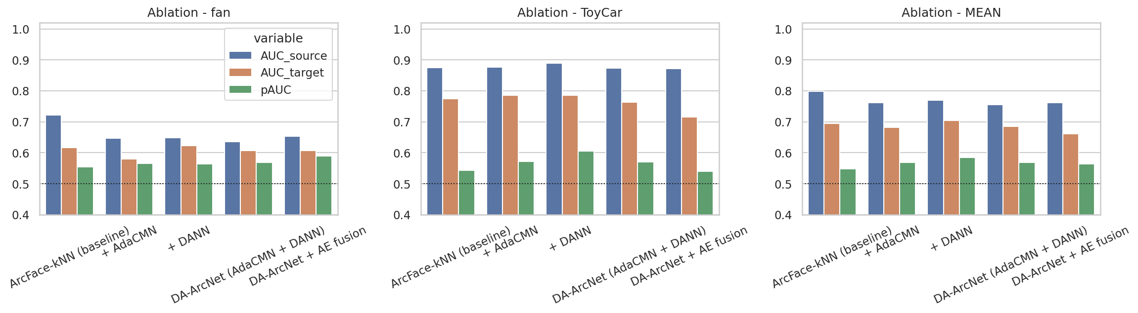
Ablation
- Mean official score: ArcFace-kNN 0.653 -> +AdaCMN 0.646 | +DANN 0.660 | both 0.647
Ardhanarieswarar (24I461), Gokul Kannan (24I463), Jafer Sathik B (24I464), Madhan M (24I466) | 23I006 Deep Learning Mini Project | PSG College of Technology, Department of Information Technology

Slide 11
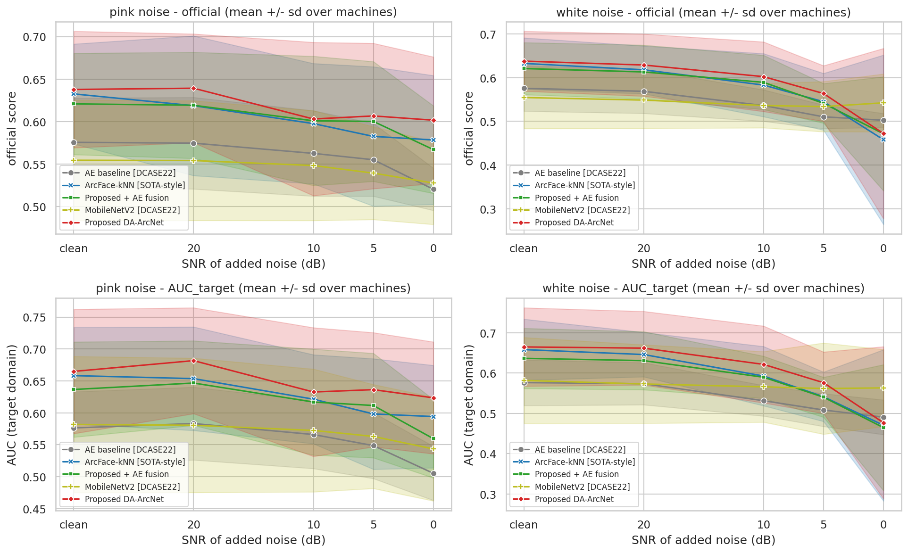
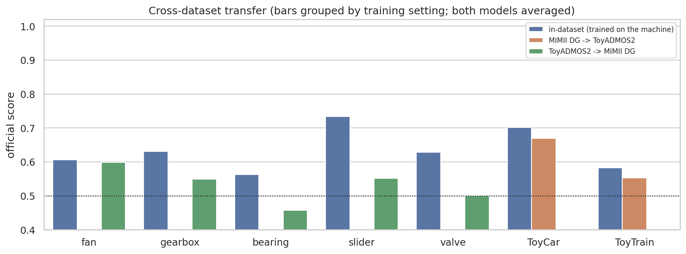
Cross-dataset evaluation and noise robustness
Ardhanarieswarar (24I461), Gokul Kannan (24I463), Jafer Sathik B (24I464), Madhan M (24I466) | 23I006 Deep Learning Mini Project | PSG College of Technology, Department of Information Technology

Slide 12
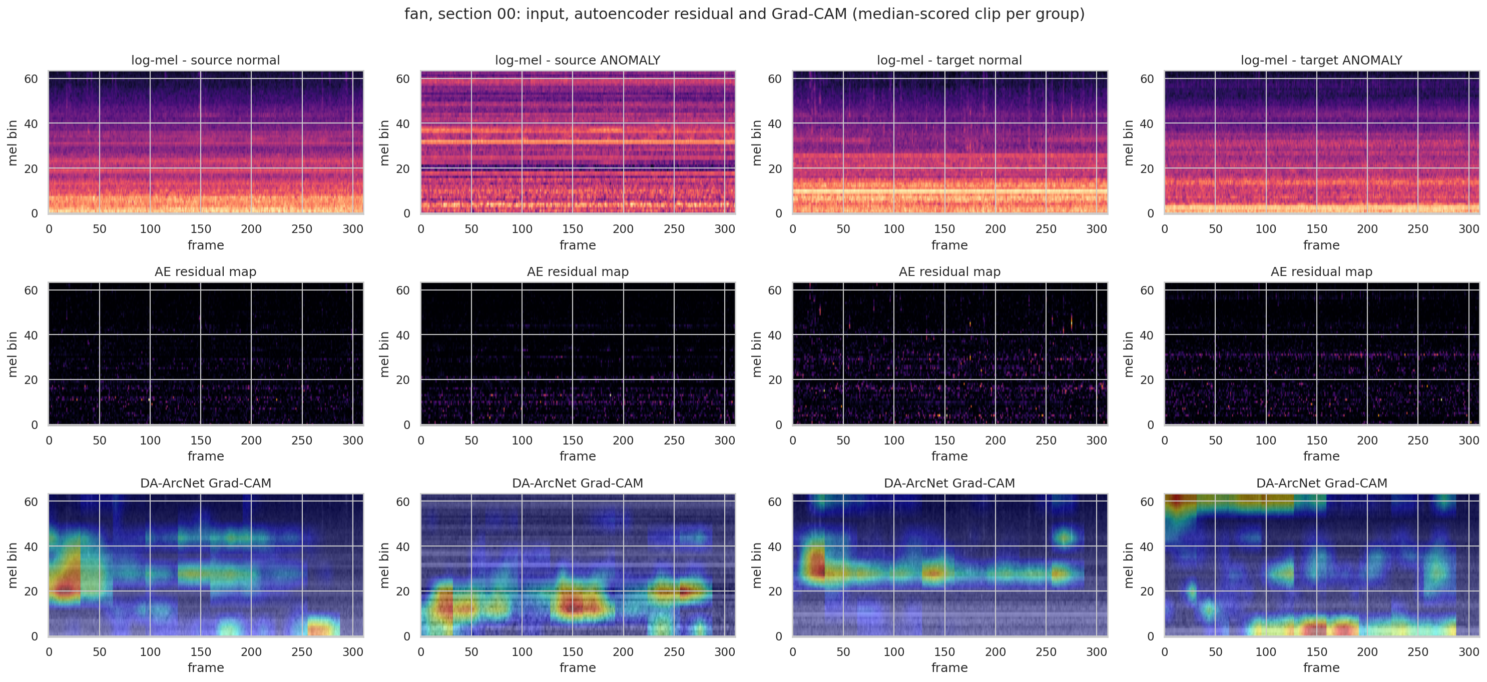
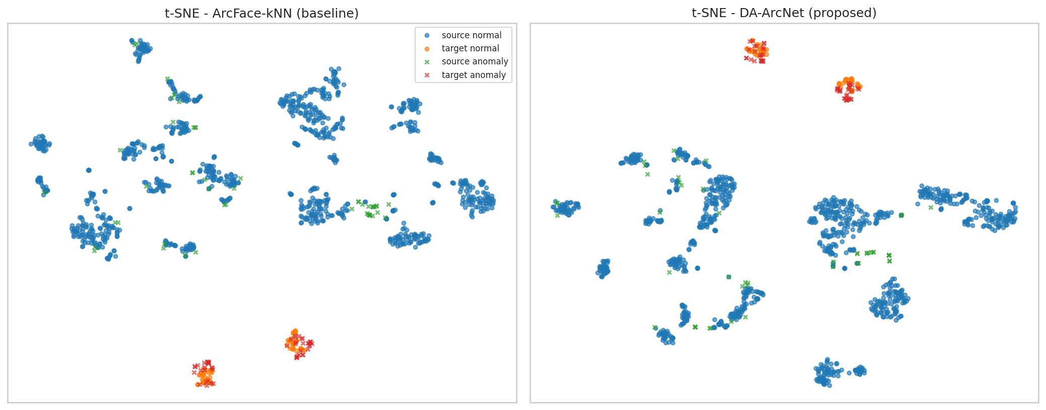
Explainability
- Domain probe accuracy: ArcFace-kNN 1.00 vs DA-ArcNet 1.00 (0.5 = invariant)
Ardhanarieswarar (24I461), Gokul Kannan (24I463), Jafer Sathik B (24I464), Madhan M (24I466) | 23I006 Deep Learning Mini Project | PSG College of Technology, Department of Information Technology

Slide 13
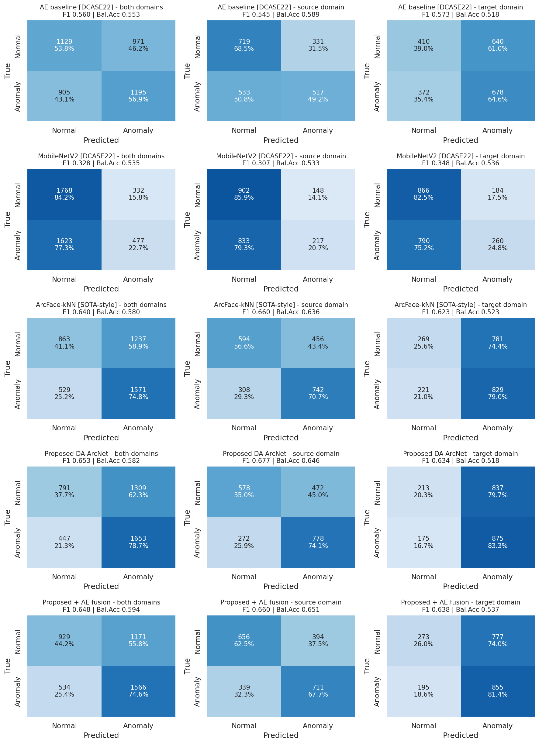
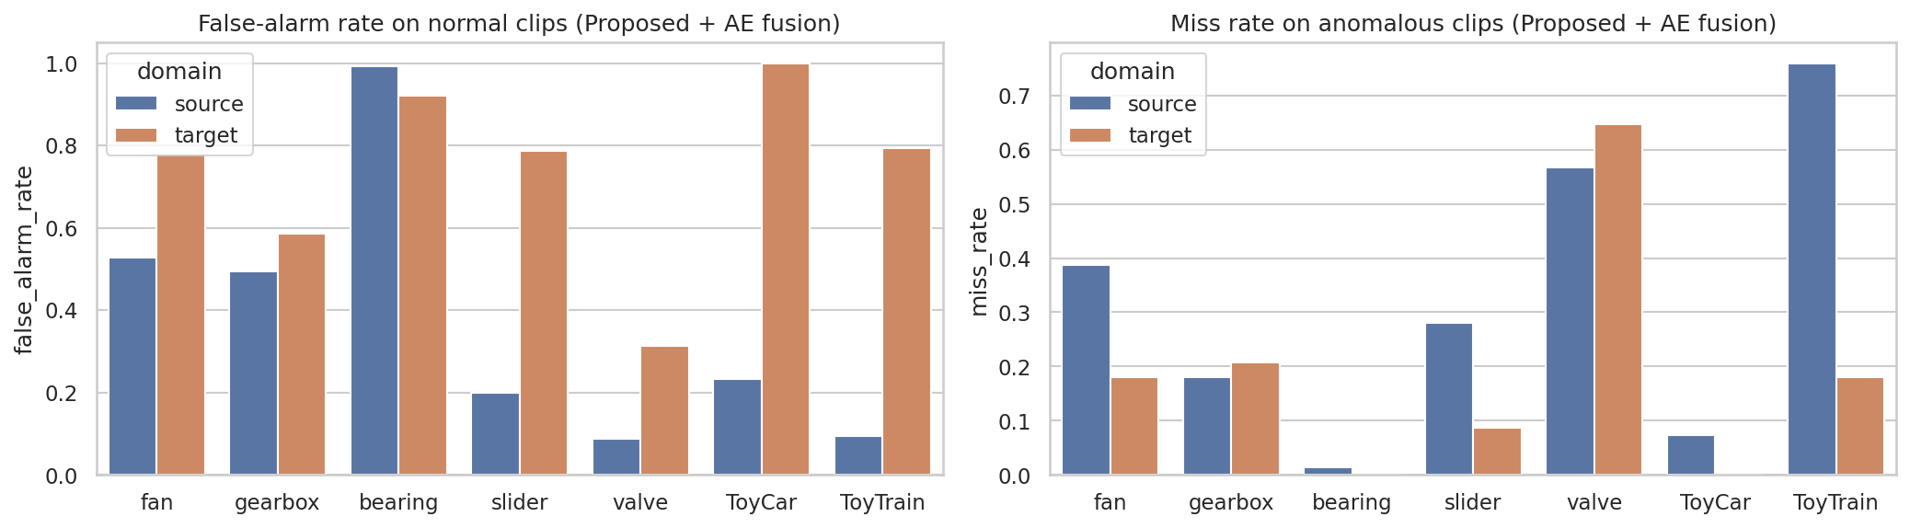
Confusion matrices and error analysis
- Threshold from held-out SOURCE normals only -> more false alarms on target domain
Ardhanarieswarar (24I461), Gokul Kannan (24I463), Jafer Sathik B (24I464), Madhan M (24I466) | 23I006 Deep Learning Mini Project | PSG College of Technology, Department of Information Technology

Slide 14
Limitations and future work
- Single fixed threshold; only 10 target clips per section; ToyADMOS2 limited to ToyCar / ToyTrain
- Baselines are re-implementations, not official challenge systems; few seeds
- Grad-CAM qualitative only
- Future: per-domain calibration, foundation-model distillation, outlier exposure, INT8 on edge device, DCASE 2023-25 settings
Ardhanarieswarar (24I461), Gokul Kannan (24I463), Jafer Sathik B (24I464), Madhan M (24I466) | 23I006 Deep Learning Mini Project | PSG College of Technology, Department of Information Technology

Slide 15
Conclusion
- Averaged over 7 machines, the proposed DA-ArcNet reaches an official score of 0.632, compared with 0.628 for the strongest baseline (ArcFace-kNN), a difference of +0.004.
- On the shifted target domain the AUC of DA-ArcNet is 0.665 (+0.007 relative to ArcFace-kNN); the source-to-target AUC drop is +0.080 for DA-ArcNet and +0.102 for ArcFace-kNN.
- Code, notebook, paper and slides are in the project repository; the live demo runs on any uploaded wav clip.
Ardhanarieswarar (24I461), Gokul Kannan (24I463), Jafer Sathik B (24I464), Madhan M (24I466) | 23I006 Deep Learning Mini Project | PSG College of Technology, Department of Information Technology

