Slide 1
Data Structures & Algorithms – 1 (DSA 1)
United International University (UIU)
Topic: Asymptotic Notations
Previous Mid-Question Solve of UIU
Learn With Mahfuz

Slide 2
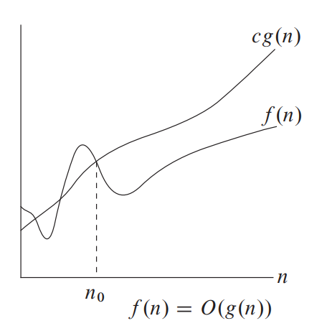
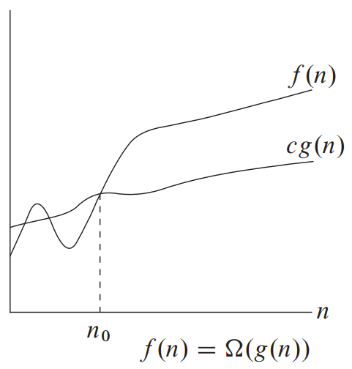
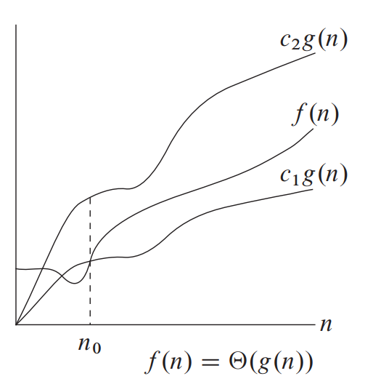

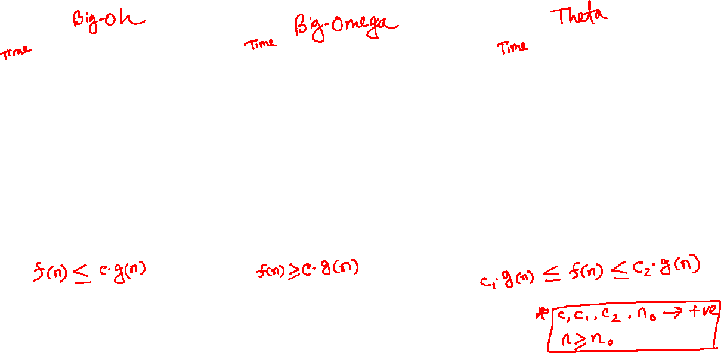
big-oh, big-omega, theta

Slide 3
Spring 2022 – Spring 2025
All Questions Solve of Asymptotic Notations

Slide 4
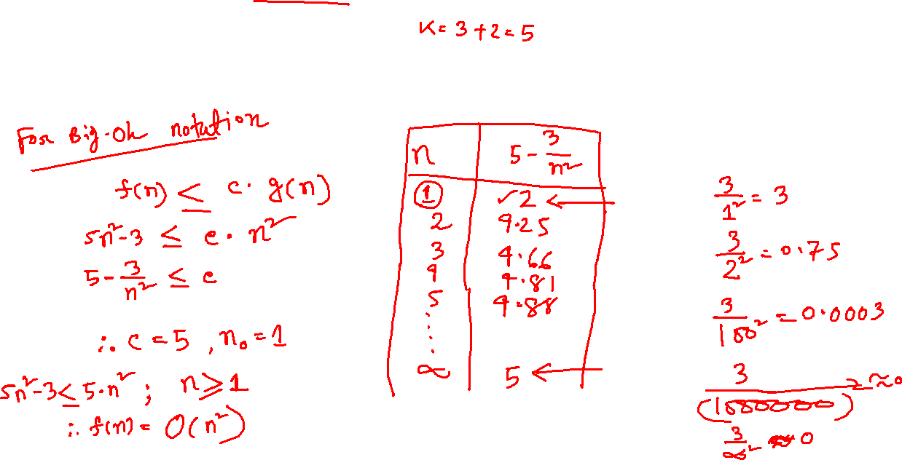
UIU DSA-1 Mid Question: Spring-2022

Slide 5
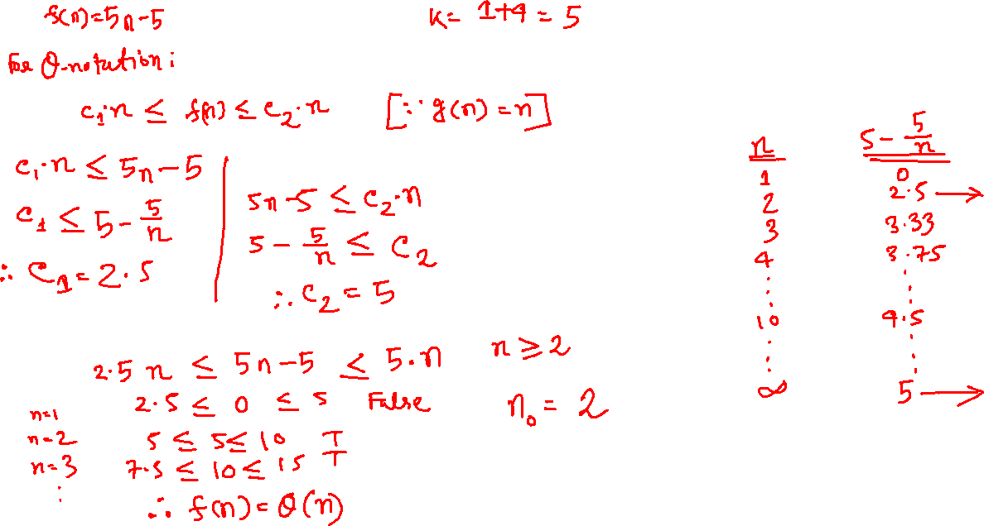
UIU DSA-1 Mid Question: Summer-2022

Slide 6
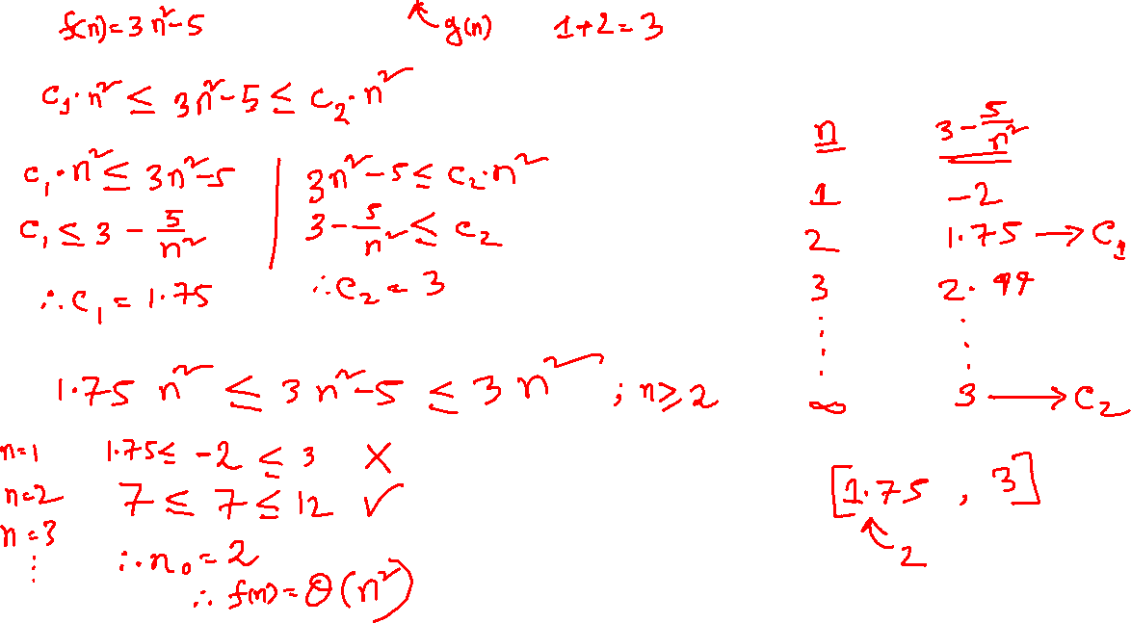
UIU DSA-1 Mid Question: Fall-2022

Slide 7
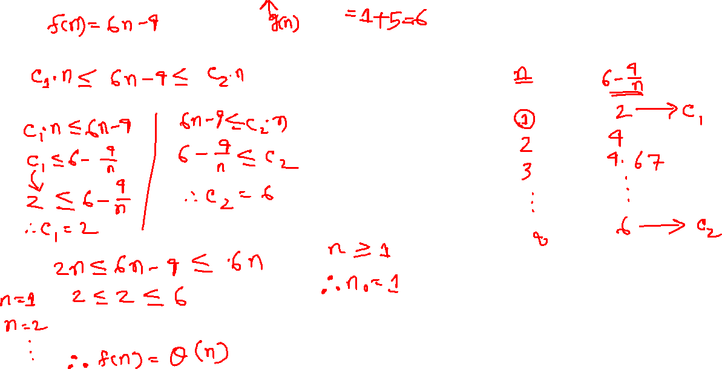
UIU DSA-1 Mid Question: Spring-2023

Slide 8
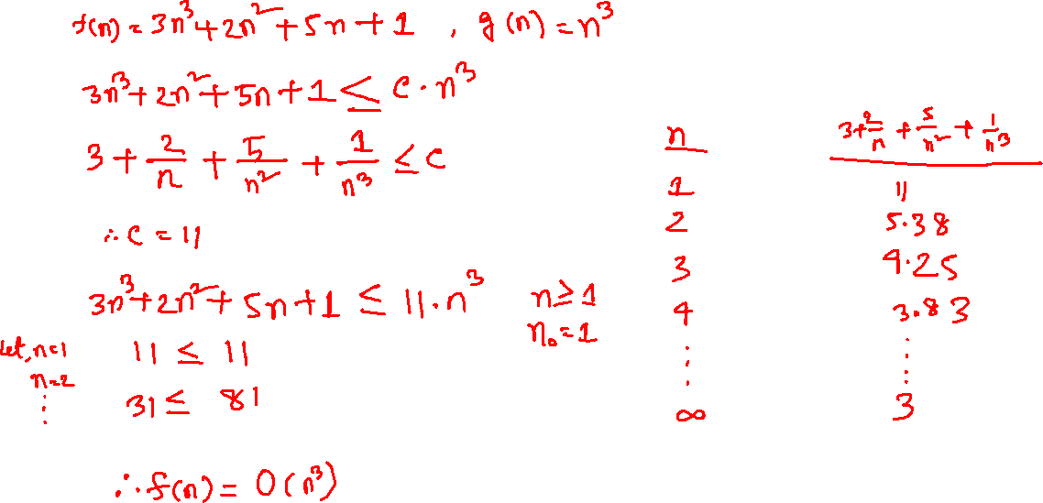
UIU DSA-1 Mid Question: Summer-2023

Slide 9

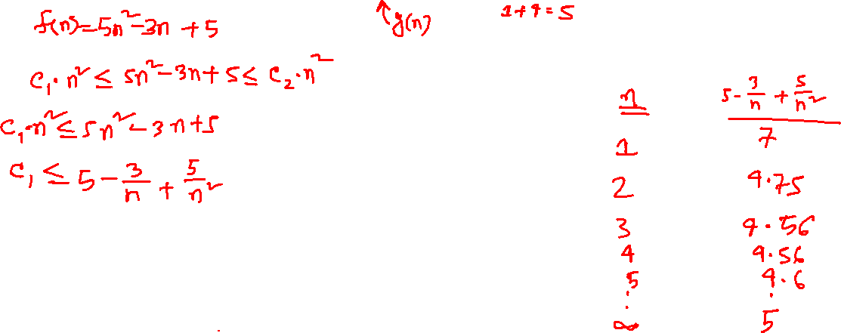
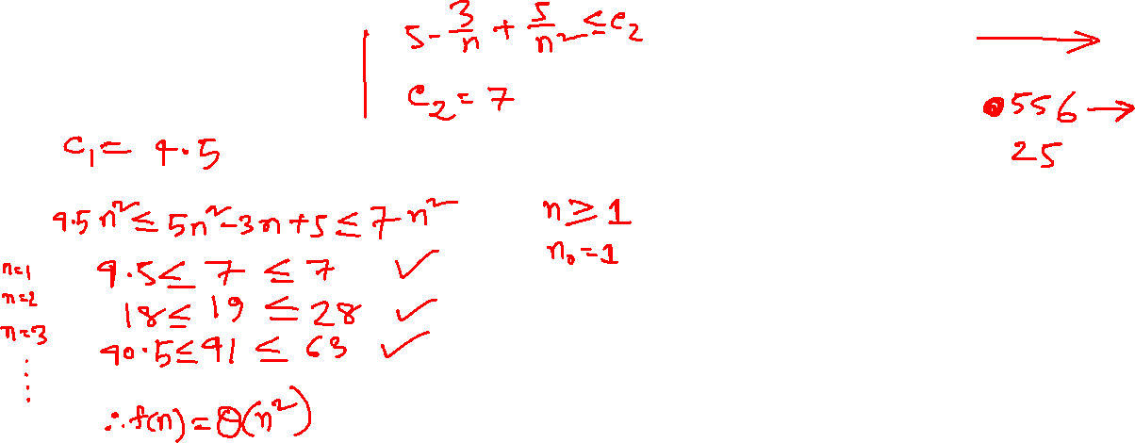
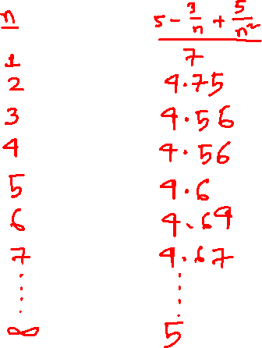
UIU DSA-1 Mid Question: Fall-2023

Slide 10

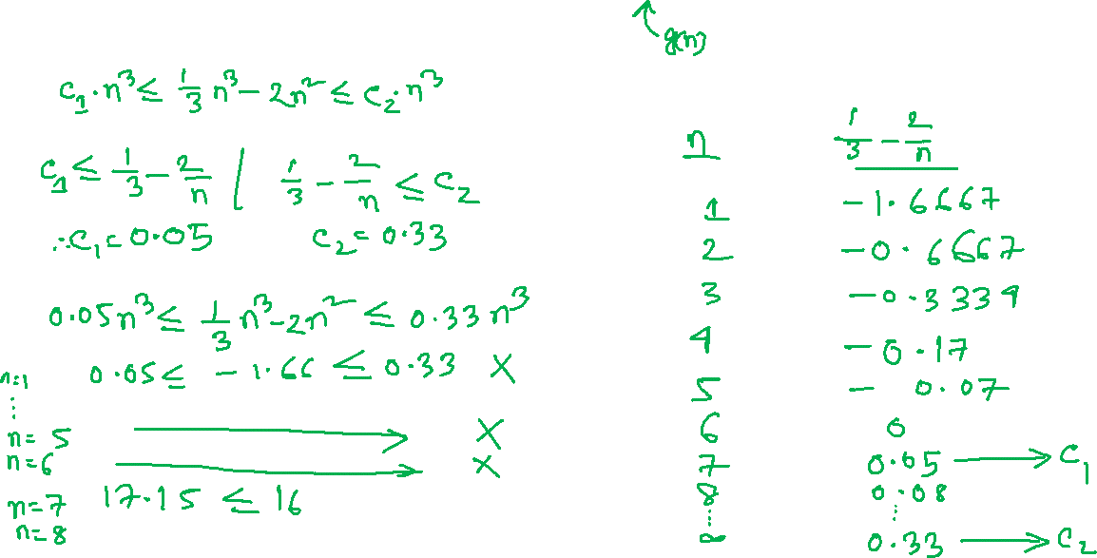
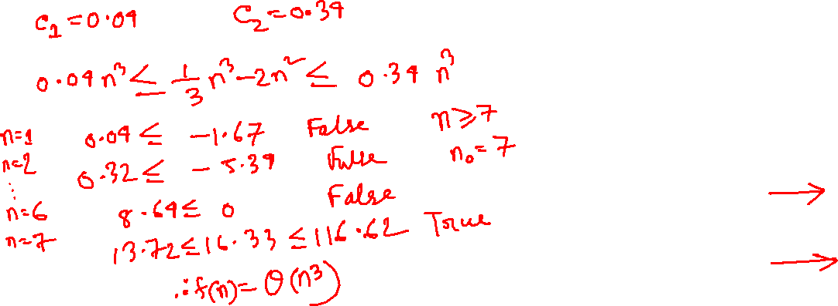
UIU DSA-1 Mid Question: Spring-2025

Slide 11
Click here to go to the GitHub repository

Slide 12
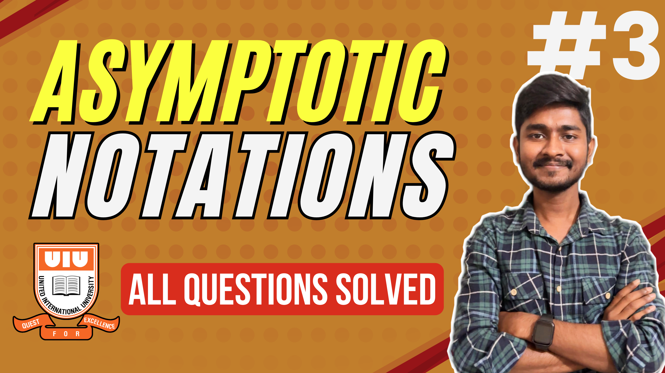
Click here to see this video!

Slide 13
THANK YOU!

