Slide 1
Data Structures & Algorithms – 1 (DSA 1)
Topic: Asymptotic Notation (Part-2)
Some Examples of Asymptotic Notation
Learn With Mahfuz

Slide 2
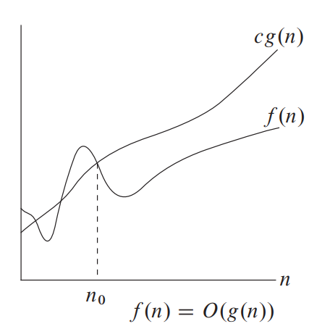
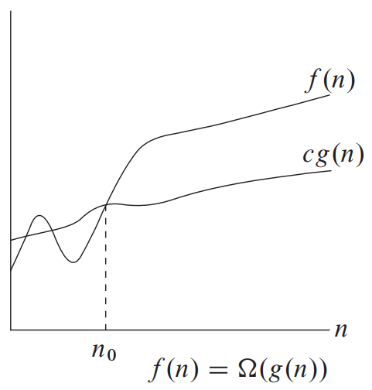
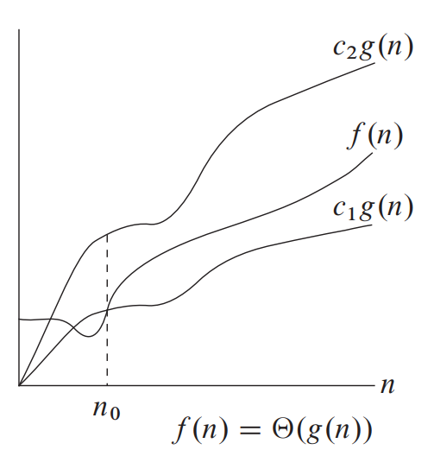

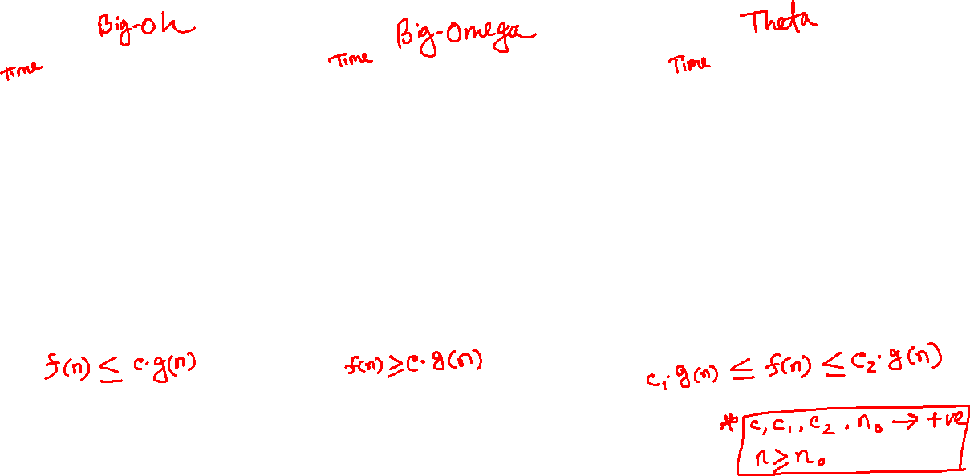
big-oh, big-omega, theta

Slide 3
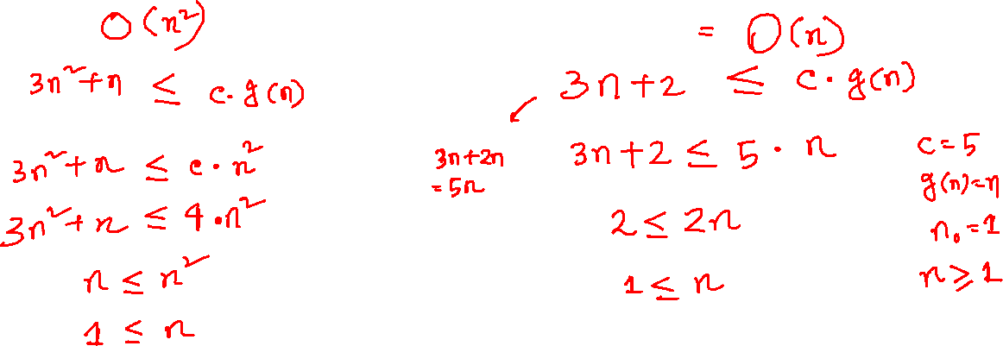
O-notation (big-oh)
f(n) = 3n² + n
f(n) = 3n + 2

Slide 4
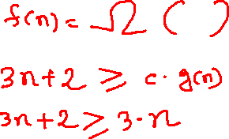
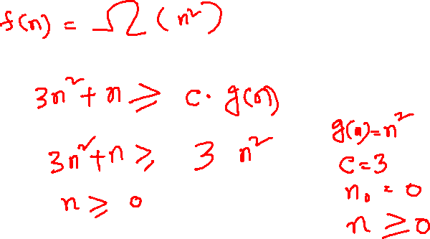
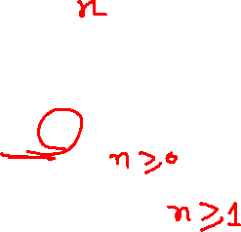
Ω-notation (big-omega)
f(n) = 3n² + n
f(n) = 3n + 2

Slide 5
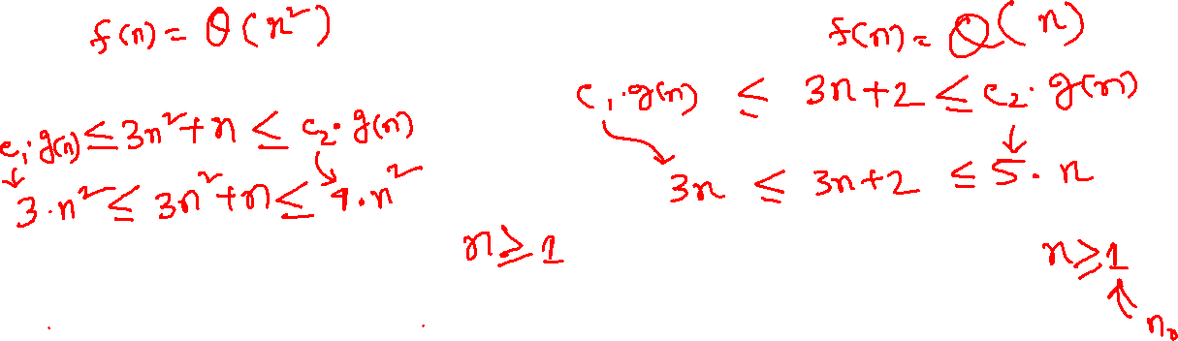
Θ-notation (theta)
f(n) = 3n² + n
f(n) = 3n + 2

Slide 6
Click here to go to the GitHub repository

Slide 7

Click here to see this video!

Slide 8
THANK YOU!

