Slide 1
Data Structures & Algorithms – 1 (DSA 1)
Topic: Asymptotic Notation
Learn With Mahfuz

Slide 2

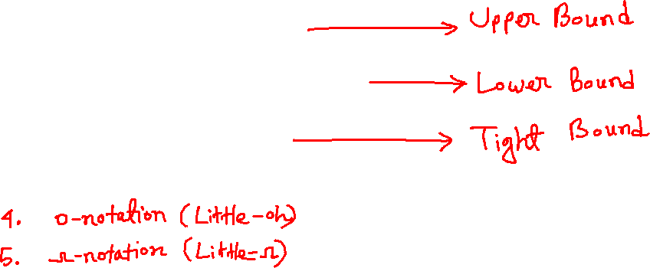
Asymptotic Notation
Big-Oh (O)
Big-omega (Ω)
Theta (Θ)

Slide 3
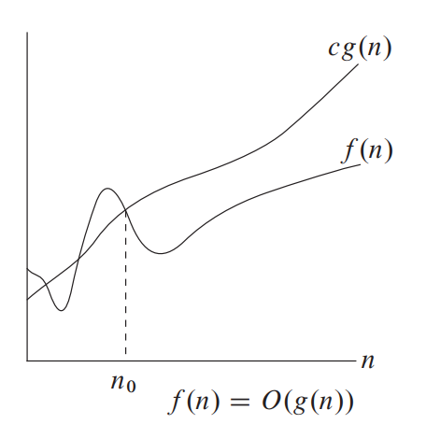

O-notation (big-oh)

Slide 4
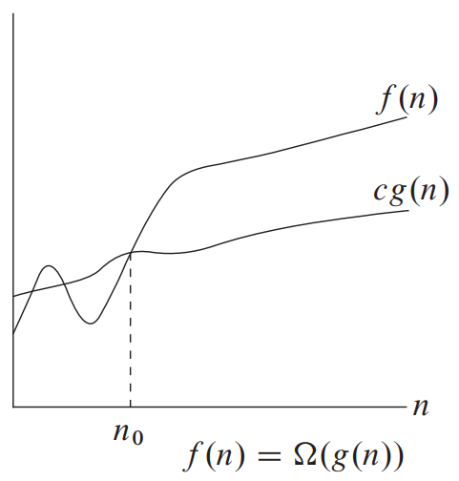

Ω-notation (big-omega)

Slide 5
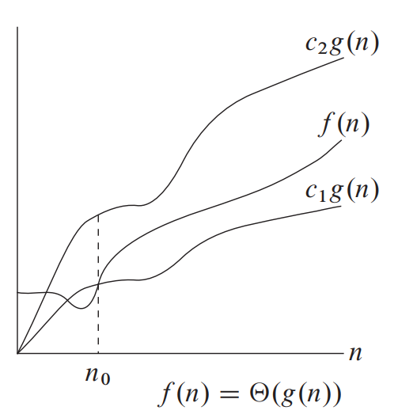
Θ-notation (theta)

Slide 6
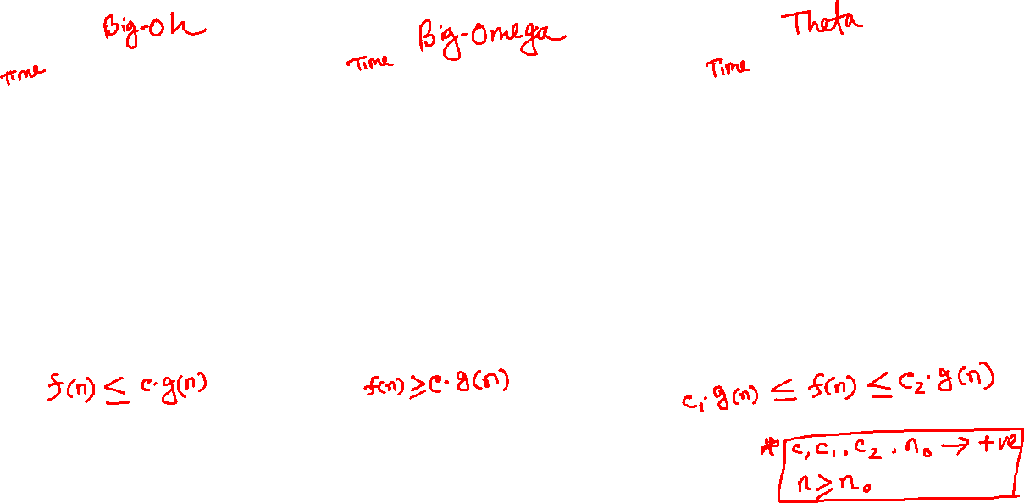
big-oh, big-omega, theta

Slide 7
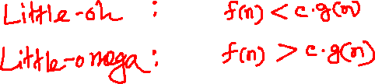
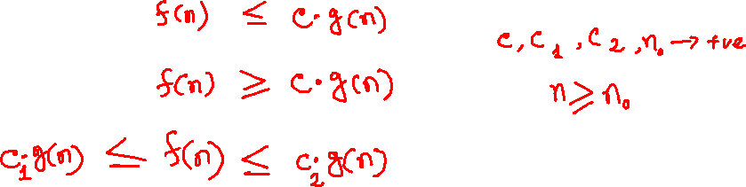
How to remember?
Big-Oh (Upper Bound): Big-Omega (Lower Bound):
Theta (Tight Bound):

Slide 8
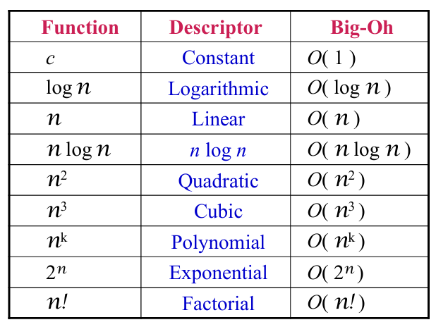
More efficient
(less time)
Slower (more
time)

Slide 9
Click here to go to the GitHub repository

Slide 10

Click here to see this video!

Slide 11
THANK YOU!

