Slide 1

BATCH MEMBERS
G. Narayanamma Institue Of Technology And Science
AUTONOMOUS
(FOR WOMEN)
BATCH: C12
22251A05G9 : HAFSA KHAJA
22251A05H0 : HANIAH FATIMA
22251A05H7 : M. MOUNIKA
22251A05J6 : SUMAYYA KALEEM
INTERNAL GUIDE:
DR. P. SUNITHA DEVI , Assistant Professor,CSE dept, GNITS

Slide 2
INTRODUCTION
Special Minds is a transformative tool that helps parents and teachers recognize early symptoms of learning disabilities, enabling timely intervention and support. By fostering understanding and acceptance, it promotes an inclusive environment where children are valued for their unique qualities. This app empowers parents to better address their child's needs, driving inclusivity and normalizing learning disabilities.

Slide 3
LITERATURE SURVEY
Sl. No | Author | Title | Purpose | Limitation
1 | C. Daetz et al (2007) | Parental compliance after screening social development in toddlers | Understanding parental involvement, timely interventions | Parents understanding and acceptances
2 | J. R. Murph et al (2015) | Risks and Reality | Difference between autism risks and diagnosis | Conveying risks to students and parents
3 | H. Singh et al (2019) | Innovative Approaches for early detection | AI and ML for detecting disabilities | Technology integration
4 | Kasturi Baarik et al (2023) | Autism detection in children | Tailoring educational approaches | Finding skilled practitioners

Slide 4
PROBLEM STATEMENT
The absence of a standardized Disability Screening Checklist for Schools impedes the identification of students with disabilities, hindering inclusive education efforts as per NEP 2020 and the RPwD Act 2016. To address this, NCERT has developed the PRASHAST app for school-based screening, aiming to generate school-level reports for certification. However, effective implementation and integration into existing school systems remain a challenge.

Slide 5
EXISTING SYSTEMS
“PRASHAST” (Proficiency Rationalisation and Analysis through State-of-the-art Software Tools)
Analyze the mental abilities of students
Assist educators
It has questionnaire and surveys
Mental thinking levels, cognitive thinking
Dashboard of student’s performance

Slide 6
PROPOSED SYSTEM
The proposed system, Special Minds, is a user-friendly mobile app designed to detect learning disabilities in children early. It is accessible to everyone, allowing parents, teachers, and caregivers to log in and select from various quiz topics related to disabilities like autism, low vision, and cerebral palsy. The app presents a timed questionnaire and provides immediate scoring with feedback indicating if the child’s abilities are fine, average, or need care.

Slide 7
OBJECTIVES
To formulate appropriate and suitable questionnaire.
To design an intuitive and easy-to-use interface for children, parents and educators.
To develop a reliable survey mechanism that accurately assesses the need for special care based on user responses.
To analyze and generate report according to responses of the user.
To make the app widely accessible to parents and educators via the Google Play Store.

Slide 8
SpecialMinds can detect
Loco Motor Disability
Low Vision
Cerebral Palsy
Autism
Mental Illness

Slide 9
METHODOLOGY
Collecting questions
Celebral Palsy
Locomotor disability
Low vision
Autism
Mental Illness
Collecting User inputs
Survey Analysis

Slide 10
SOFTWARE AND HARDWARE REQUIREMENTS
Mobile Development Framework: Android SDK Database: Firebase Firestore Cloud Services: Firebase Suite (Firestore, Analytics, Cloud Functions) Architecture Components: Android Jetpack Components (ViewModel, LiveData, Navigation Component)
Programming Language: Kotlin

Slide 11
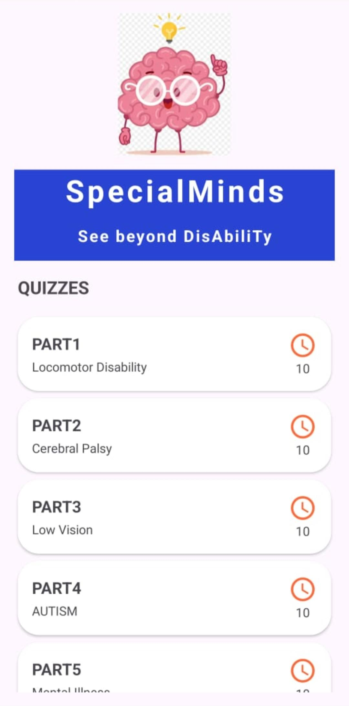
USER SELECT

Slide 12
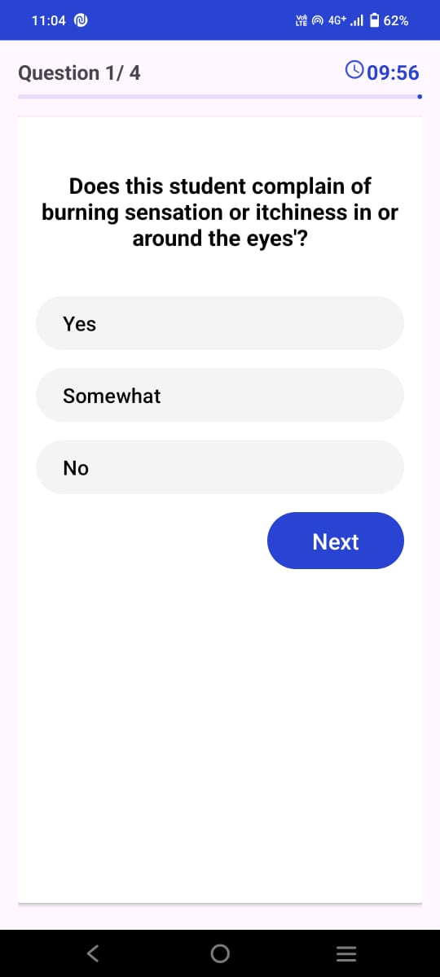
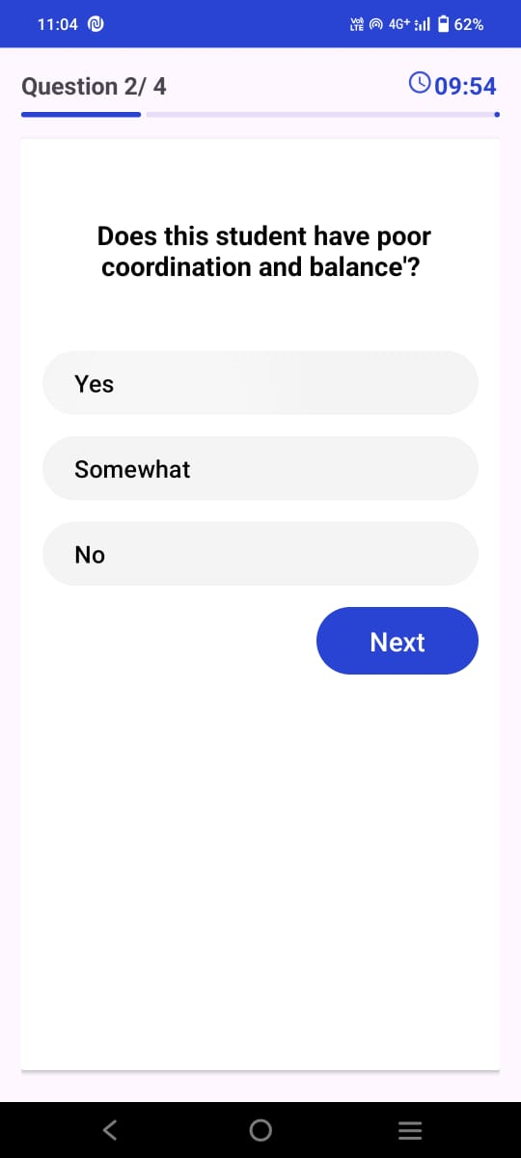
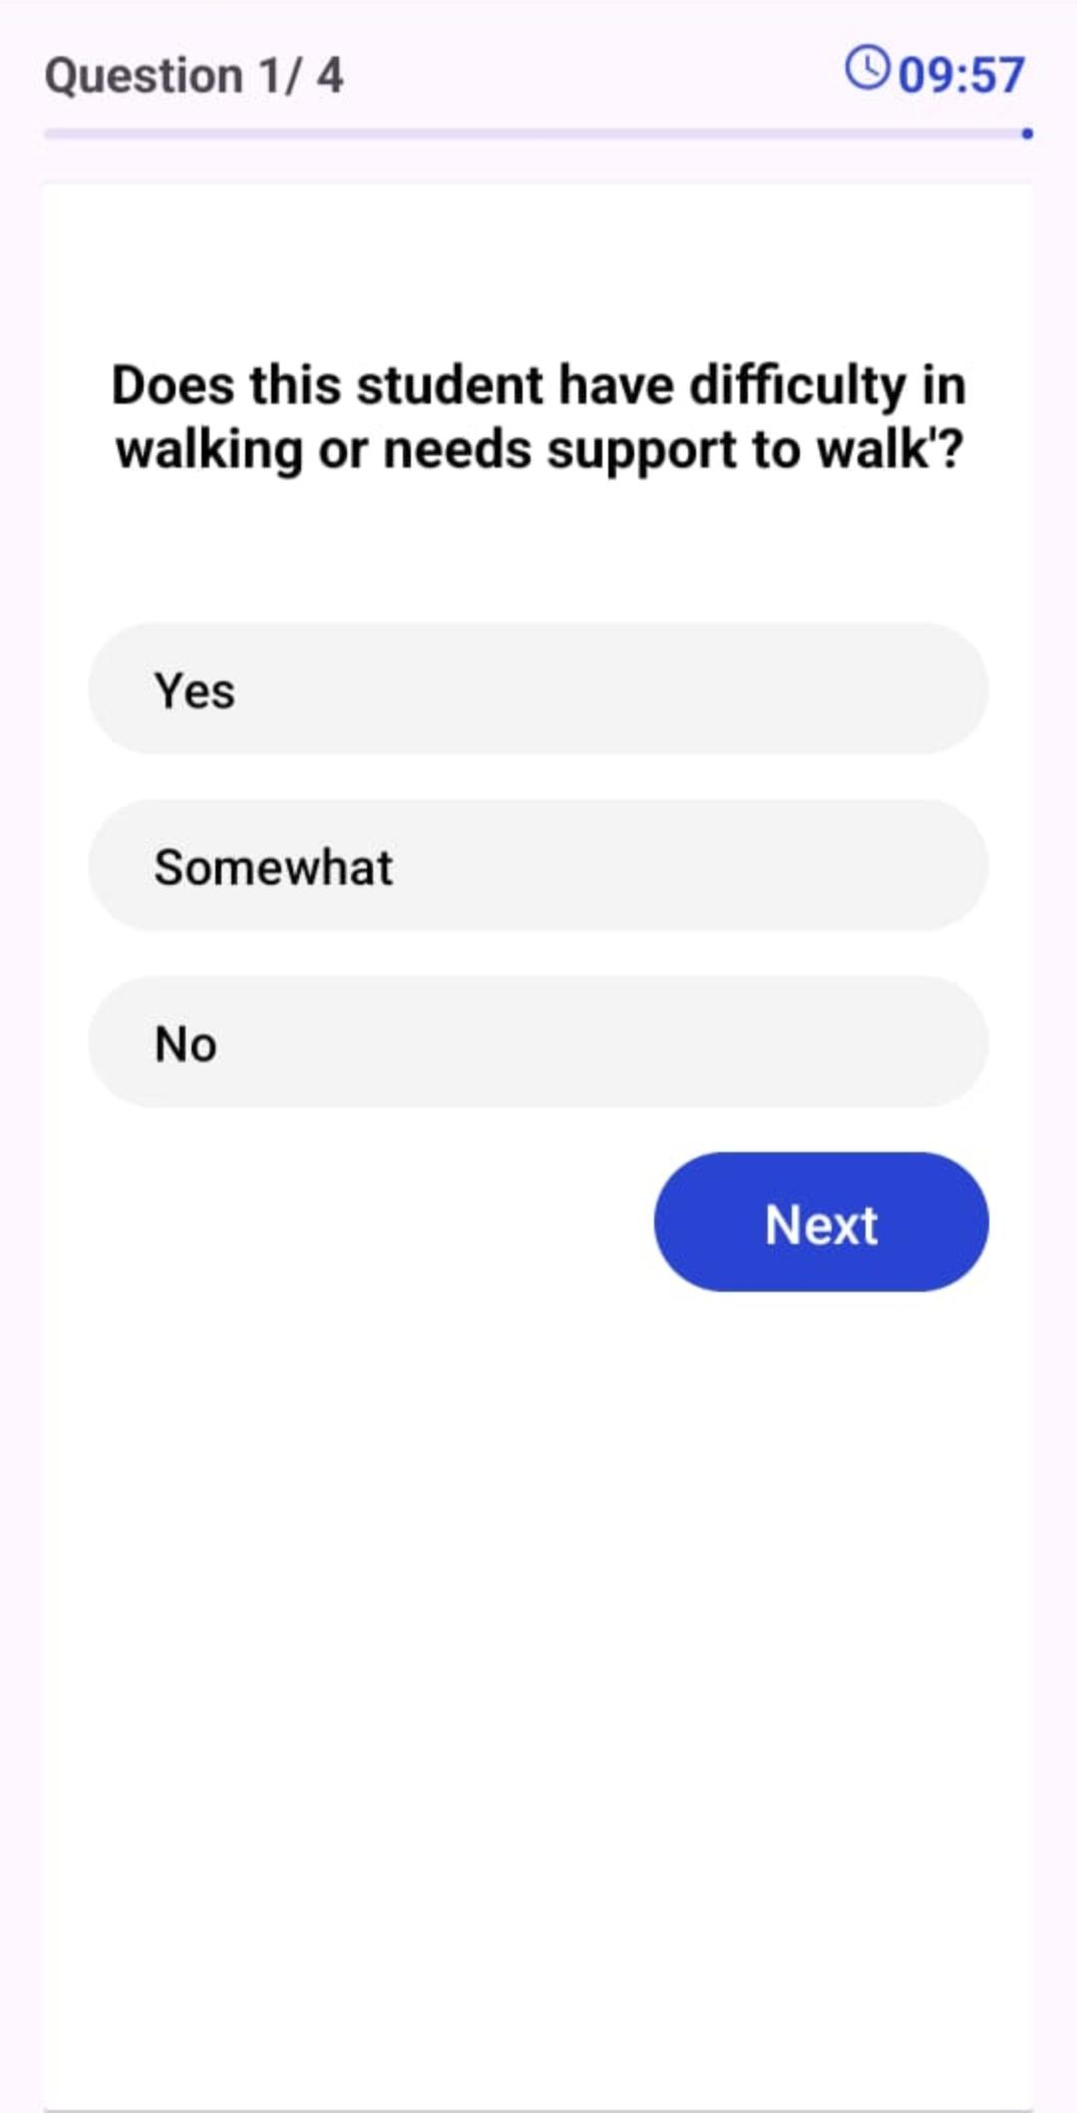
QUESTIONNAIRE INTERFACE
LOCOMOTOR DISABILITY
LOW
VISION
CEREBRAL
PALSY

Slide 13
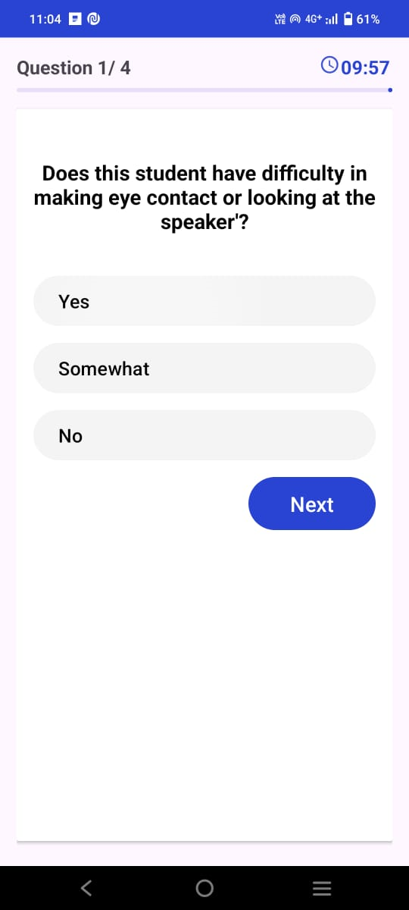
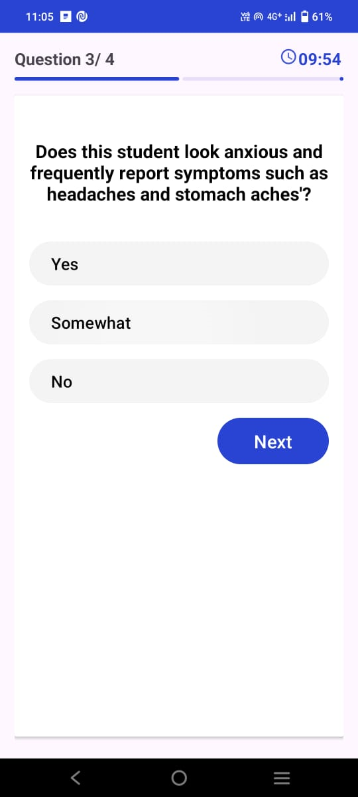
AUTISM
MENTAL ILLNESS

Slide 14
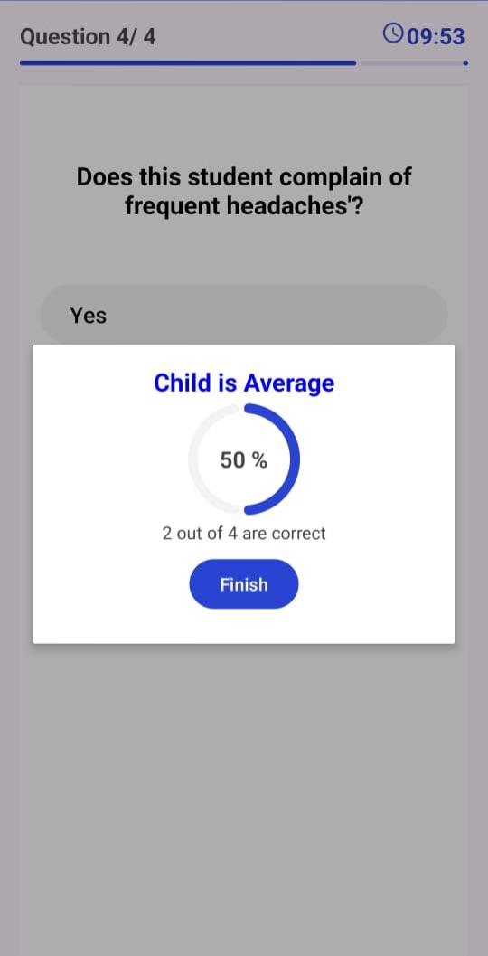
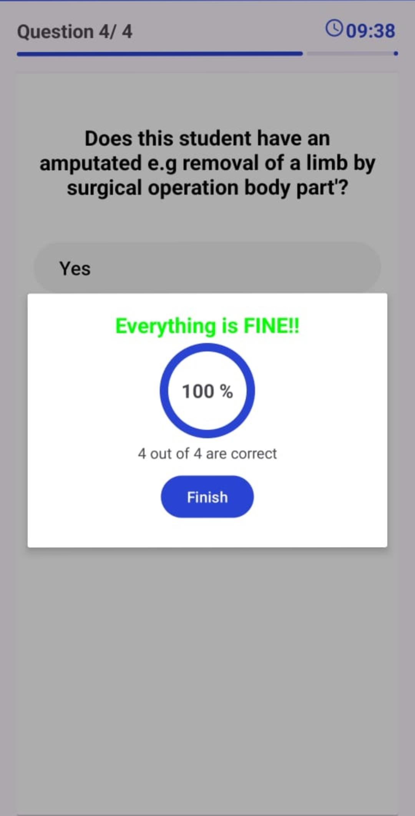
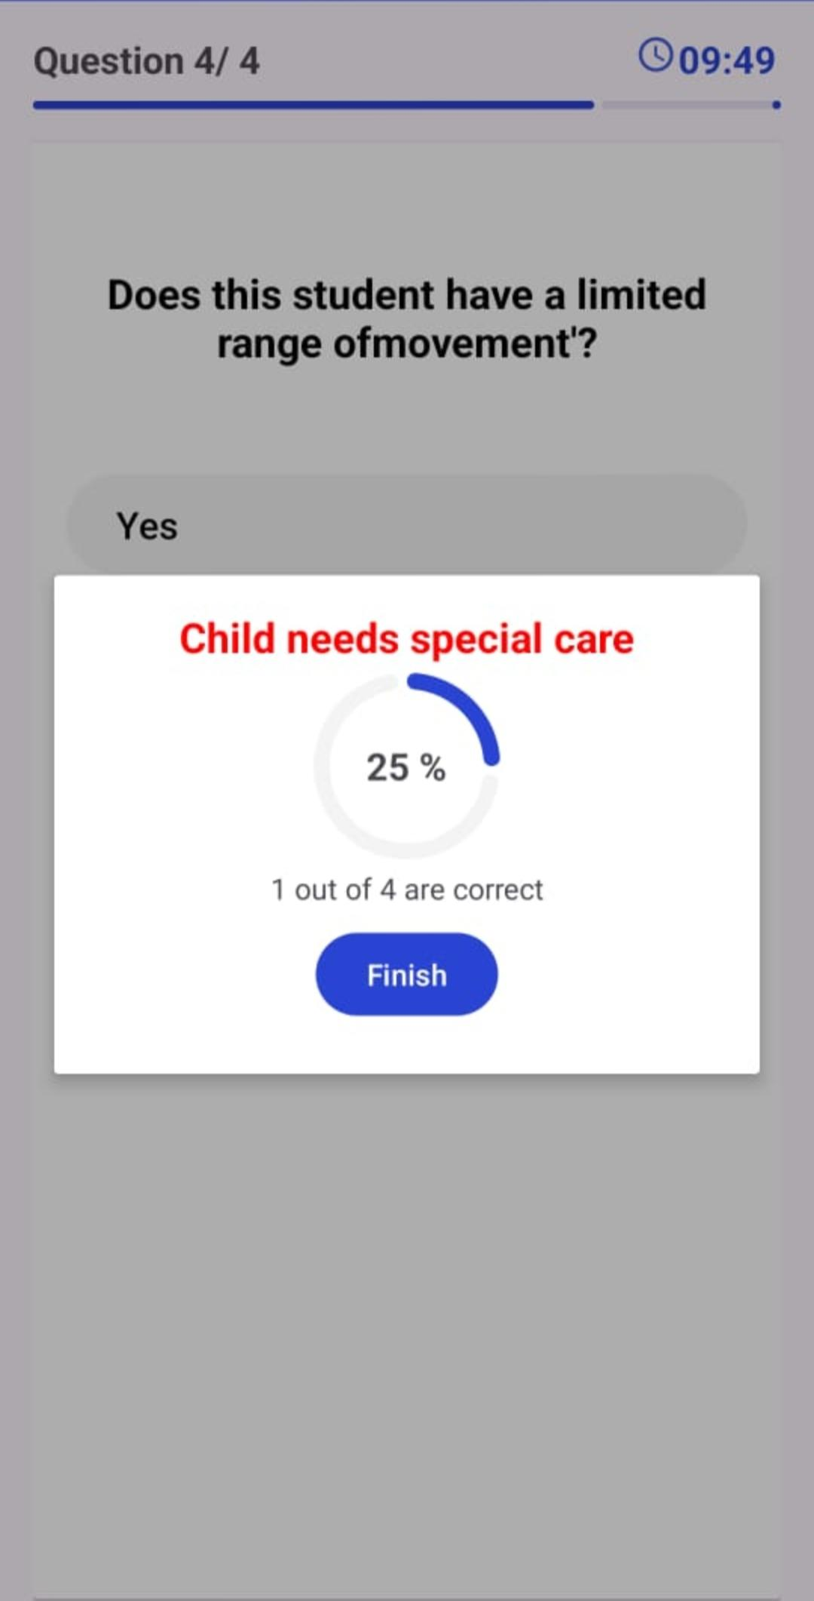
RESULTS

Slide 15
Conclusions
In conclusion, Special Minds provides an accessible, efficient, and secure tool for early detection of learning disabilities in children. By collecting answers, analyzing scores, and delivering clear results, the app empowers parents and educators to take timely action, ensuring better support and care for children’s developmental needs.

Slide 16
FUTURE SCOPE
Expert consultancy
Diversification of question bank
Multilingual support

Slide 17
References
https://link.springer.com/article/10.1007/s10803-012-1546-4
https://www.researchgate.net/publication/51385666_Parental_Compliance_After_Screening_Social_Development_in_Toddlers
https://ieeexplore.ieee.org/document/9411531
https://www.researchgate.net/publication/378919988_Intelligent_approaches_for_early_prediction_of_learning_disabilities_in_children_using_learning_patterns_A_survey_and_discussion

