Slide 1
DynamicDetailing AI
Unified Voice & Chat CRM
Powered by OmniDimension & n8n

Slide 2
System Architecture
📞 Voice & Text: OmniDimension handles calls & WhatsApp natively.
⚙️ Orchestration: n8n workflow background routing.
📊 Backend: Google Sheets CRM Database.
💻 Frontend: Next.js Dashboard (Phase 2).

Slide 3
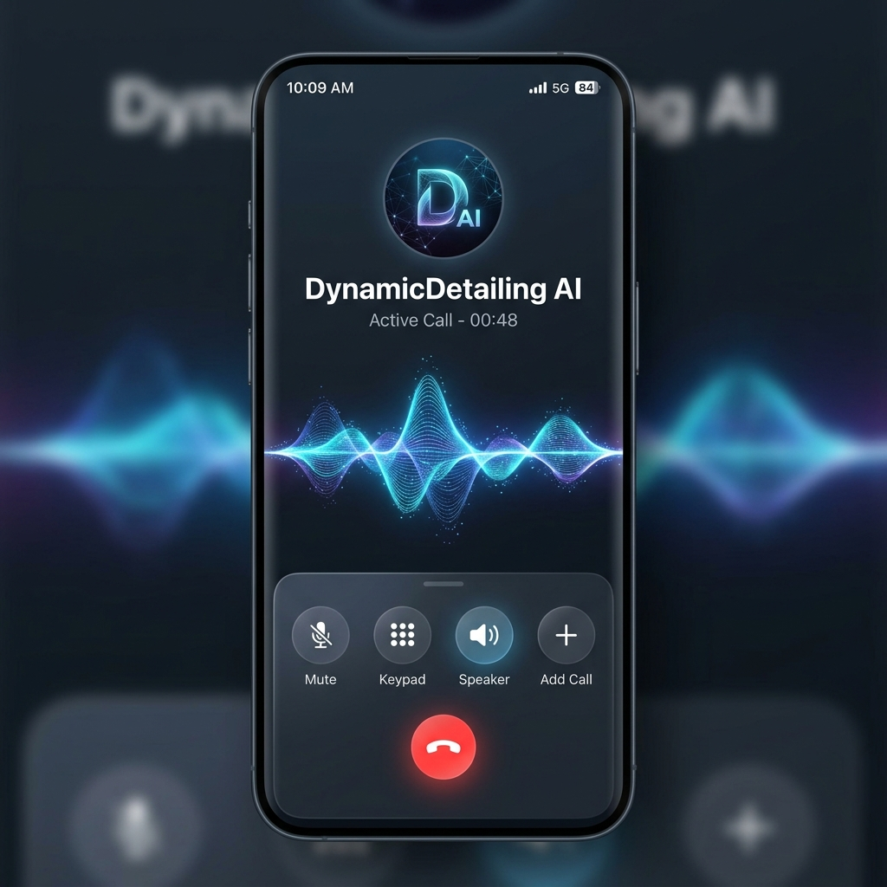
1. The Voice Engine: Code Switching
Hyper-realistic, code-switching conversational AI.
The 'Human' Touch:
- Uses Vyavaharikam (Spoken Telugu), not robotic text.
- Code-switches to English for numbers and tech terms.
- Latencies masked with conversational fillers.

Slide 4
2. Text Engine: WhatsApp Menu
Interactive List Message bypassing raw text blocks.
Instead of typing services, the AI sends a structured WhatsApp menu.
Highlight: Paint Protection Film (PPF)
- Provides a premium, app-like experience inside WhatsApp.

Slide 5
3. Text Engine: PPF Booking Handoff
Utility Message with Quick Reply Action Buttons.
When a user books PPF, the AI confirms: 'Our manager will call you back.'
Includes interactive buttons: [Cancel] [Call Me Now].
Seamlessly routes high-ticket leads without friction.

Slide 6
4. CRM Orchestration (n8n)
Automated background switch logic via n8n Webhooks.
HANDOFFS: Logged to Sheets + Meta API alerts manager via WhatsApp immediately.
COMPLAINTS: Logged to Sheets + Flagged on Dashboard without buzzing manager directly.

Slide 7
Next Steps: Phase 2
Build Next.js React Dashboard
Integrate Google Auth & Sheets API
Migrate to Meta Cloud Business API
Live Production Testing

