Slide 1
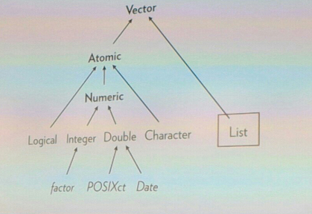
Dataframe
Heterogeneous Data types
Homogenous Data types
Matrix
Two-Dimensional
[Rows, Columns]
Advanced R, Chapter 1

