Slide 1
GitHub Technical Assessment
Customer Scenario Presentation
Vaibhav Patil 3/9/2022

Slide 2
Agenda
Customer Scenario - 2 mins
Concept of Branch Protection - 5 mins
Proposed Solution - 10 mins
Demo of the Solution - 10 mins
Alternate Solution Architecture with AWS - 5 mins
Q & A - 10 mins

Slide 3
Customer Scenario
A renowned social media platform ABC uses GitHub for the source control management.
A recent survey showed that, 12% of ABC’s subscribers were unhappy about the broken features with a potential 3M USD impact on ABC’s annual revenue.
ABC’s site reliability team investigated the issue and figured that there were 10% infrastructure issues, 15% due to device/browser incompability while 75% were due to missing code review process at merge
To address this, ABC’s security team wants to ensure a mandatory review process to the code changes that are being submitted by the product developers.
Since there are several hundred repositories, ABC’s security team wants an automated solution to enforce the mandatory review process every time a new repository is created. They also want to be notified when a new repository is secured by the solution.

Slide 4
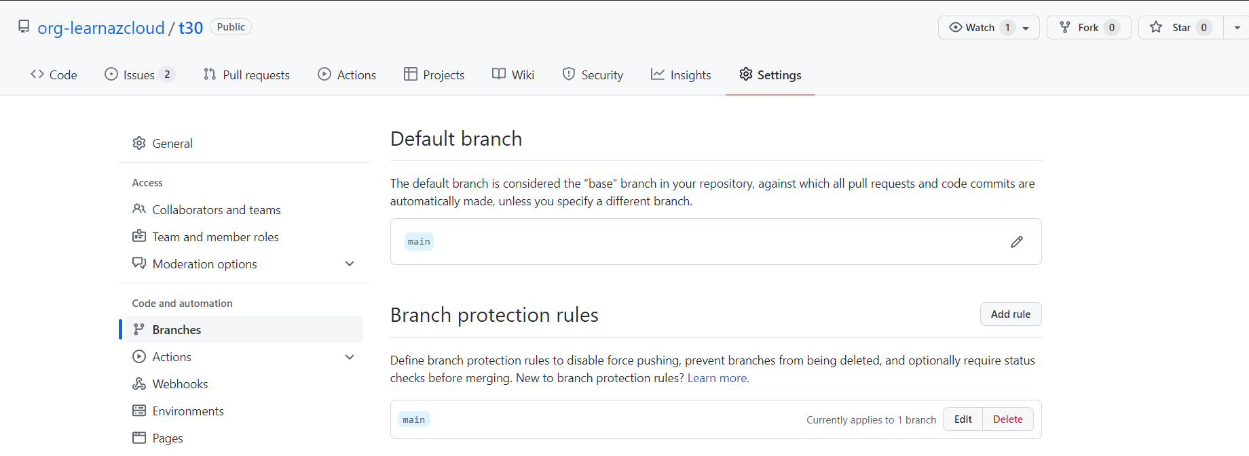
Branch Protection
With GitHub’s branch protection feature, organizations can require pull requests to pass a set of checks before they can be merged.
1
2
3
4

Slide 5
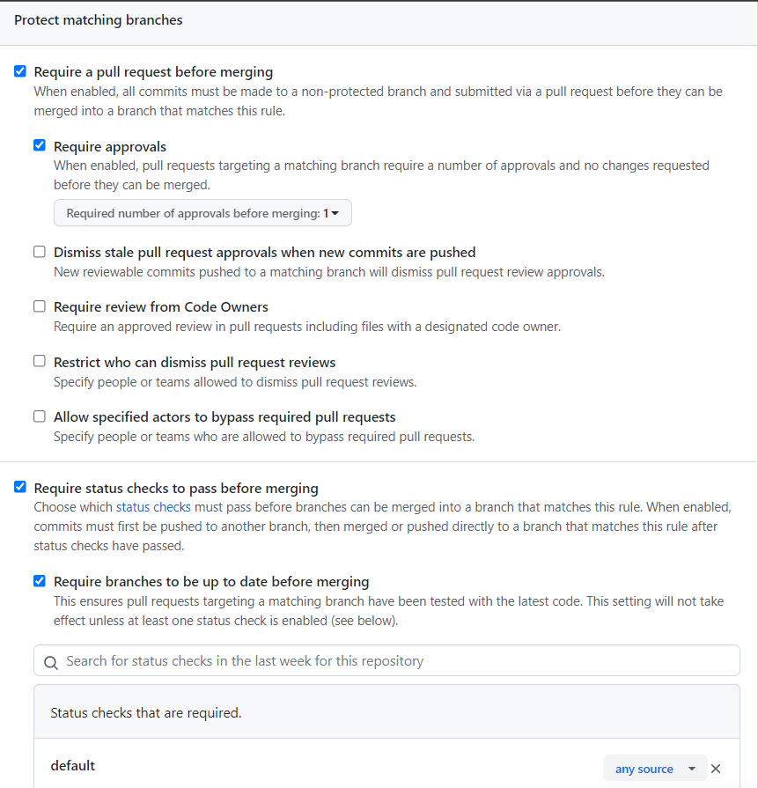
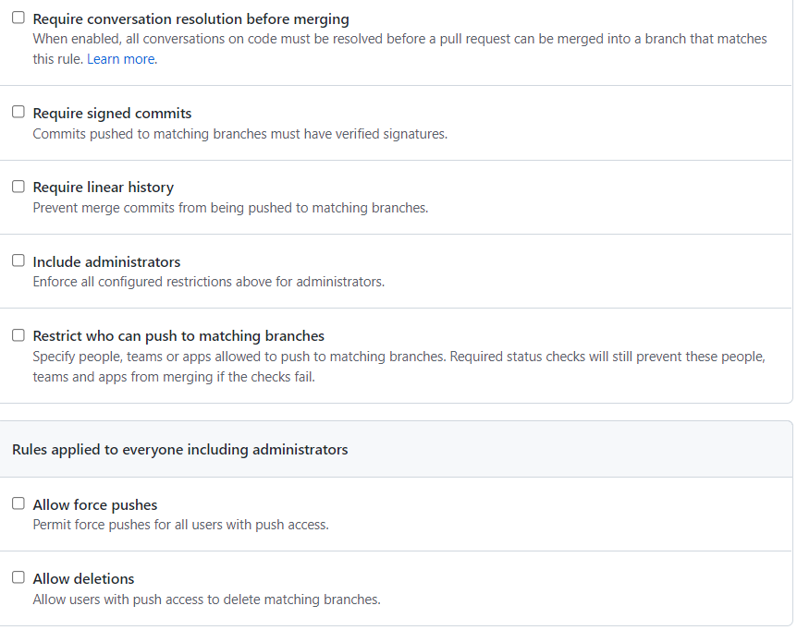
Branch Protection Rules

Slide 6
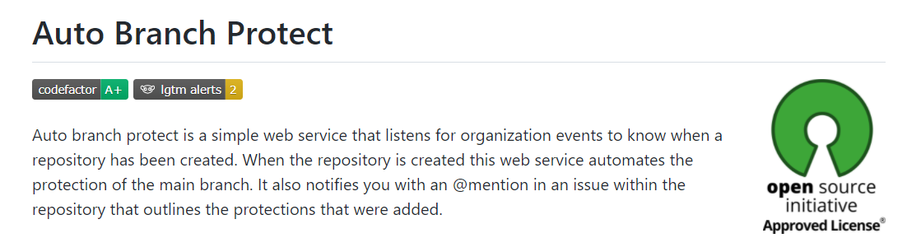
Proposed Solution – Auto Branch Protect Tool
Open source enthusiast & Senior Software Engineer Zack Koppert has come up with a solution for this very scenario → https://github.com/zkoppert/Auto-branch-protect
Here is the repository with proposed solution forked from Zack’s tool → https://github.com/learnazcloud/Auto-branch-protect

Slide 7

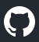
Auto Branch Protect Tool - Architecture
GitHub
Local PC / Server / VM
Event Type API
Python Script
Using GitHub APIs
Actions in GitHub trigger events which produces unique Payload object with detail properties about the event.
Runs locally as a web service using FLASK
Webhooks sends the payload to external service.
NGROK exposes the local webservice as external webhook

Slide 8
Proposed Solution - Workflow
* - First branch is created after a commit is made. Hence a README file must be included with each new repo
Organization Owner
Create Organization
Add members
Setup Teams
Define Branch Protection Rules
Billing Management
Anyone
Anyone
Creates New Public Repo*
Creates New Private Repo*
Auto Branch Protect Tool
Auto Branch Protect Tool
Needs GitHub Pro to add branch protection rules
With Free Plan, protection added on visibility change
Adds Branch Protection Rules
Auto Protect Tool Creates Issue to notify Security Team
Security Team
Code Quality Review Team
Conduct Audits
Code Reviews
Site Reliability Checks
Get Notified

Slide 9
Auto Branch Protect Tool - Demonstration

Slide 10
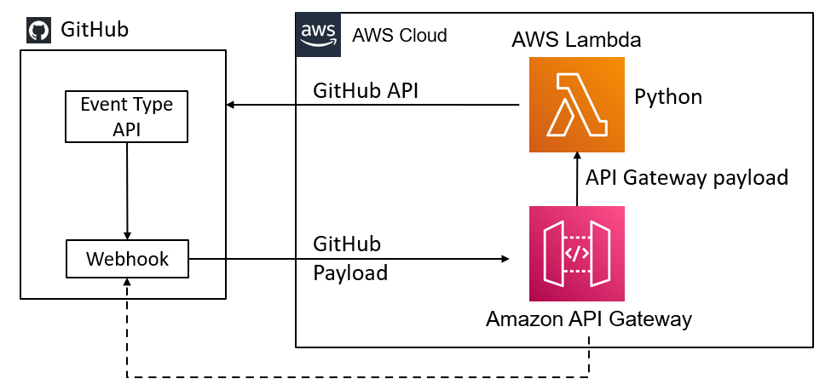
Alternate Solution Architecture with AWS
Benefits
Serverless architecture – No locked-in infrastructure cost
Scalability – Multiple instances of AWS Lambda can be invoked without worrying about additional infrastructure provisioning
Reliability – AWS manages software & hardware upgrades. High reliability standards of 99.9999999% for many services
Agility – Quick & easy to deploy as compared to physical hardware provisioning

Slide 11
Results
GitHub’s Branch Protection Feature will allow ABC to improve the code quality by enforcing the review process
GitHub’s Event Type APIs provides response when certain actions are triggered on GitHub. This response is then passed to a webhook to perform certain set of actions in response.
A lightweight web service written in Python is used on a local machine to trigger the automated branch protection when a new repository is created. Security team is notified via mentions in the issues. Automated Branch Protect tool by Zack Koppert is an excellent starting point for this scenario. (https://github.com/zkoppert/Auto-branch-protect)
Proposed Solution → https://github.com/learnazcloud/Auto-branch-protect
A similar Python based tool can be setup using serverless architecture with AWS Lambda & Amazon API Gateway services.

Slide 12
Thank You

