Slide 1
Dynamic Memory
Management
Jennifer Rexford

Slide 2
Goals of this Lecture
Help you learn about:
  The need for dynamic* memory management (DMM)
  Implementing DMM using the heap section
  Implementing DMM using virtual memory
* During program execution

Slide 3
System-Level Functions Covered
As noted in the Exceptions and Processes lecture…
Linux system-level functions for dynamic memory management (DMM)
Number | Function | Description
12 | brk() | Move the program break, thus changing the amount of memory allocated to the HEAP
12 | sbrk() | (Variant of previous)
9 | mmap() | Map a virtual memory page
11 | munmap() | Unmap a virtual memory page
Notes:
The appendix of the Exceptions and Processes lecture shows many Linux system-level functions
Each system-level function is a thin wrapper around an int instruction
We can think of the Linux OS as a module, and we can think of those system-level function as defining the interface to the Linux OS
To some extent, studying the Linux OS involves learning that interface
The appendix groups the system-level functions into categories
One of those categories is DMM
That’s the category that we’ll study today
Specifically, we’ll study the brk(), sbrk(), mmap() and munmap() system-level functions

Slide 4
Goals for DMM
Goals for effective DMM:
  Time efficiency
    Allocating and freeing memory should be fast
  Space efficiency
    Program should use little memory
Note
  Easy to reduce time or space
  Hard to reduce time and space

Slide 5
Agenda
The need for DMM
DMM using the heap section
DMMgr 1: Minimal implementation
DMMgr 2: Pad implementation
Fragmentation
DMMgr 3: List implementation
DMMgr 4: Doubly-linked list implementation
DMMgr 5: Bins implementation
DMM using virtual memory
DMMgr 6: VM implementation

Slide 6
Why Allocate Memory Dynamically?
Why allocate memory dynamically?
Problem
  Unknown object size
    E.g., unknown element count in array
    E.g., unknown node count in linked list or tree
  How much memory to allocate?
Solution 1
  Guess!
Solution 2
  Allocate memory dynamically
Notes:
Solution 1: Guess!
Guess high => waste memory
Guess low => program fails to handle some data
Solution 2: Allocate memory dynamically
Allocate memory, as needed, during program execution

Slide 7
Why Free Memory Dynamically?
Why free memory dynamically?
Problem
  Program should use little memory, i.e.
  Program should map few pages of virtual memory
    Mapping unnecessary VM pages bloats page tables, wastes memory/disk space
Solution
  Free dynamically allocated memory that is no longer needed

Slide 8
Option 1: Automatic Freeing
Run-time system frees unneeded memory
  Java, Python, …
  Garbage collection
Pros:
  Easy for programmer
Cons:
  Performed constantly => overhead
  Performed periodically => unexpected pauses
Car c;
Plane p;
...
c = new Car();
p = new Plane();
...
c = new Car();
...
Original Car object can’t be accessed
Notes:
A subordinate issue is when the freeing should be performed
Unexpected pauses can be a problem in real-time applications

Slide 9
Option 2: Manual Freeing
Programmer frees unneeded memory
  C, C++, Objective-C, …
Pros
  No overhead
  No unexpected pauses
Cons
  More complex for programmer
  Opens possibility of memory-related bugs
    Dereferences of dangling pointers, double frees, memory leaks
We’ll focus on manual freeing
Notes:
Option 2: Programmer explicitly frees unneeded memory

Slide 10
Standard C DMM Functions
Standard C DMM functions:
Collectively define a dynamic memory manager (DMMgr)
We’ll focus on malloc() and free()
void *malloc(size_t size);
void free(void *ptr);
void *calloc(size_t nmemb, size_t size);
void *realloc(void *ptr, size_t size);

Slide 11
Implementing malloc() and free()
Question:
  How to implement malloc() and free()?
  How to implement a DMMgr?
Answer 1:
  Use the heap section of memory
Answer 2:
  (Later in this lecture)

Slide 12
Agenda
The need for DMM
DMM using the heap section
DMMgr 1: Minimal implementation
DMMgr 2: Pad implementation
Fragmentation
DMMgr 3: List implementation
DMMgr 4: Doubly-linked list implementation
DMMgr 5: Bins implementation
DMM using virtual memory
DMMgr 6: VM implementation

Slide 13
The Heap Section of Memory
Low
memory
High
memory
Heap start
Program break
Supported by Unix/Linux, MS Windows, …
Heap start is stable
Program break points to end
At process start-up, heap start == program break
Can grow dynamically
  By moving program break to higher address
  Thereby (indirectly) mapping pages of virtual mem
Can shrink dynamically
  By moving program break to lower address
  Thereby (indirectly) unmapping pages of virtual mem

Slide 14
Unix Heap Management
Unix system-level functions for heap mgmt:
int brk(void *p);
  Move the program break to address p
  Return 0 if successful and -1 otherwise
void *sbrk(intptr_t n);
  Increment the program break by n bytes
  If n is 0, then return the current location of the program break
  Return 0 if successful and (void*)-1 otherwise
  Beware: On Linux has a known bug (overflow not handled); should call only with argument 0.
Note: minimal interface (good!)
Notes:
So how can we implement a heap manager in Unix?

Slide 15
Agenda
The need for DMM
DMM using the heap section
DMMgr 1: Minimal implementation
DMMgr 2: Pad implementation
Fragmentation
DMMgr 3: List implementation
DMMgr 4: Doubly-linked list implementation
DMMgr 5: Bins implementation
DMM using virtual memory
DMMgr 6: VM implementation

Slide 16
Minimal Implementation
Data structures
  None!
Algorithms (by examples)…
Notes:
A strawman implementation
A thought experiment
Not realistic

Slide 17
Minimal Impl malloc(n) Example
Call sbrk(0) to determine current program break (p)
p
Call brk(p+n) to increase heap size
n bytes
Return p
p
n bytes
p
Notes:
Suppose the client program executes malloc(n)

Slide 18
Minimal Impl free(p) Example
Do nothing!
Notes:
Suppose the client calls free(p)

Slide 19
Minimal Impl
Algorithms
void *malloc(size_t n)
{ char *p = sbrk(0);
if (brk(p + n) == -1)
return NULL;
return p;
}
void free(void *p)
{
}
Notes:
A strawman implementation
A thought experiment
Not realistic

Slide 20
Minimal Impl Performance
Performance (general case)
  Time: bad
    Two system calls per malloc()
  Space: bad
    Each call of malloc() extends heap size
    No reuse of freed chunks

Slide 21
What’s Wrong?
Problem
  malloc() executes two system calls
Solution
  Redesign malloc() so it does fewer system calls
  Maintain a pad at the end of the heap…

Slide 22
Agenda
The need for DMM
DMM using the heap section
DMMgr 1: Minimal implementation
DMMgr 2: Pad implementation
Fragmentation
DMMgr 3: List implementation
DMMgr 4: Doubly-linked list implementation
DMMgr 5: Bins implementation
DMM using virtual memory
DMMgr 6: VM implementation

Slide 23
Pad Impl
Data structures
  pBrk: address of end of heap (i.e., the program break)
  pPad: address of beginning of pad
Algorithms (by examples)…
inuse
pad
pPad
pBrk
char *pPad = NULL;
char *pBrk = NULL;

Slide 24
Pad lmpl malloc(n) Example 1
≥ n bytes
pPad
pBrk
Are there at least n bytes between pPad and pBrk? Yes!
Save pPad as p; add n to pPad
n bytes
p
pPad
pBrk
Return p
n bytes
p
pPad
pBrk

Slide 25
Pad lmpl malloc(n) Example 2
< n bytes
pPad
pBrk
Are there at least n bytes between pPad and pBrk? No!
Call brk() to allocate (more than) enough additional memory
≥ n bytes
pPad
pBrk
Set pBrk to new program break
≥ n bytes
pPad
pBrk
Proceed as previously!

Slide 26
Pad Impl free(p) Example
Do nothing!

Slide 27
Pad Impl
Algorithms
inuse
pad
pPad
pBrk
void *malloc(size_t n)
{ enum {MIN_ALLOC = 8192};
char *p;
char *pNewBrk;
if (pBrk == NULL)
{ pBrk = sbrk(0);
pPad = pBrk;
}
if (pPad + n > pBrk) /* move pBrk */
{ pNewBrk =
max(pPad + n, pBrk + MIN_ALLOC);
if (brk(pNewBrk) == -1) return NULL;
pBrk = pNewBrk;
}
p = pPad;
pPad += n;
return p;
}
void free(void *p)
{
}

Slide 28
Pad Impl Performance
Performance (general case)
  Time: good
    malloc() calls sbrk() initially
    malloc() calls brk() infrequently thereafter
  Space: bad
    No reuse of freed chunks
Notes:
For programs that never call free() until the end of the process, this version is very reasonable.
Time-wise performs very well for SymTable

Slide 29
What’s Wrong?
Problem
  malloc() doesn’t reuse freed chunks
Solution
  free() marks freed chunks as “free”
  malloc() uses marked chunks whenever possible
  malloc() extends size of heap only when necessary

Slide 30
Agenda
The need for DMM
DMM using the heap section
DMMgr 1: Minimal implementation
DMMgr 2: Pad implementation
Fragmentation
DMMgr 3: List implementation
DMMgr 4: Doubly-linked list implementation
DMMgr 5: Bins implementation
DMM using virtual memory
DMMgr 6: VM implementation
Notes:
Summary of last lecture
The need for DMM
Sometimes you know that you need an object, but you don’t know before run-time how large it should be
DMM using the heap section
On Unix, program break marks the end of the heap
Call brk() to move the program break, thereby increasing or decreasing the size of the heap section
Call sbrk(0) to determine the current program break
Minimal implementation
malloc() calls sbrk() and brk()
free() does nothing
Problems: several; malloc() too slow
Pad implementation
malloc() maintains a pad of free memory at end of heap
Whenever it calls brk(), it increases the size of the heap by a large amount
So calls brk() only occasionally
free() does nothing
Reasonable in some cases
But generally, bad wrt space
free() should mark chunks as free
malloc() should reuse marked chunks whenever possible

Slide 31
Fragmentation
At any given time, some heap memory chunks are
in use, some are marked “free”
inuse
free
DMMgr must be concerned about fragmentation…
Notes:
So at any given time some heap memory chunks are in use, and some are marked as free
With such a data structure, the DMMgr must be concerned about fragmentation

Slide 32
Internal Fragmentation
Internal fragmentation: waste within chunks
Example
Generally
  Program asks for n bytes
  DMMgr provides chunk of size n+Δ bytes
  Δ bytes wasted
Space efficiency =>
  DMMgr should reduce internal fragmentation
100 bytes
Client asks for 90 bytes
DMMgr provides chunk of size 100 bytes
10 bytes wasted

Slide 33
External Fragmentation
External fragmentation: waste between chunks
Example
Generally
  Program asks for n bytes
  n bytes are available, but not contiguously
  DMMgr must extend size of heap to satisfy request
Space efficiency =>
  DMMgr should reduce external fragmentation
100 bytes
50 bytes
Client asks for 150 bytes
150 bytes are available, but not contiguously
DMMgr must extend size of heap

Slide 34
DMMgr Desired Behavior Demo
char *p1 = malloc(3);
char *p2 = malloc(1);
char *p3 = malloc(4);
free(p2);
char *p4 = malloc(6);
free(p3);
char *p5 = malloc(2);
free(p1);
free(p4);
free(p5);
Notes:
To demonstrate how a DMMgr should handle (external) fragmentation, consider this (artificial) sequence of statements

Slide 35
DMMgr Desired Behavior Demo
0
Heap
p1
char *p1 = malloc(3);
char *p2 = malloc(1);
char *p3 = malloc(4);
free(p2);
char *p4 = malloc(6);
free(p3);
char *p5 = malloc(2);
free(p1);
free(p4);
free(p5);
}
Heap
Stack
0xffffffff

Slide 36
DMMgr Desired Behavior Demo
0
Heap
p1
char *p1 = malloc(3);
char *p2 = malloc(1);
char *p3 = malloc(4);
free(p2);
char *p4 = malloc(6);
free(p3);
char *p5 = malloc(2);
free(p1);
free(p4);
free(p5);
p2
}
Heap
Stack
0xffffffff

Slide 37
DMMgr Desired Behavior Demo
0
Heap
p1
char *p1 = malloc(3);
char *p2 = malloc(1);
char *p3 = malloc(4);
free(p2);
char *p4 = malloc(6);
free(p3);
char *p5 = malloc(2);
free(p1);
free(p4);
free(p5);
p2
}
p3
Heap
Stack
0xffffffff

Slide 38
DMMgr Desired Behavior Demo
External fragmentation occurred
0
Heap
p1
char *p1 = malloc(3);
char *p2 = malloc(1);
char *p3 = malloc(4);
free(p2);
char *p4 = malloc(6);
free(p3);
char *p5 = malloc(2);
free(p1);
free(p4);
free(p5);
p2
}
p3
Heap
Stack
0xffffffff
Notes:
DMMgr can’t move block upward in heap
Client’s p3 pointer contains address
Moving the block upward would invalidate the client’s pointer

Slide 39
DMMgr Desired Behavior Demo
0
Heap
p1
char *p1 = malloc(3);
char *p2 = malloc(1);
char *p3 = malloc(4);
free(p2);
char *p4 = malloc(6);
free(p3);
char *p5 = malloc(2);
free(p1);
free(p4);
free(p5);
p2
}
p3
p4
Heap
Stack
0xffffffff
Notes:
Free area is too small
So must extend heap size

Slide 40
DMMgr Desired Behavior Demo
DMMgr coalesced two free chunks
0
Heap
p1
char *p1 = malloc(3);
char *p2 = malloc(1);
char *p3 = malloc(4);
free(p2);
char *p4 = malloc(6);
free(p3);
char *p5 = malloc(2);
free(p1);
free(p4);
free(p5);
p2
}
p3
p4
Heap
Stack
0xffffffff
Notes:
Much better to have one free chunk of length 5
Instead of one chunk of length 1 followed by one chunk of length 4

Slide 41
DMMgr Desired Behavior Demo
DMMgr reused previously freed chunk
0
Heap
p1
char *p1 = malloc(3);
char *p2 = malloc(1);
char *p3 = malloc(4);
free(p2);
char *p4 = malloc(6);
free(p3);
char *p5 = malloc(2);
free(p1);
free(p4);
free(p5);
p5, p2
}
p3
p4
Heap
Stack
0xffffffff
Notes:
Free area is big enough
So use it, and don’t extend heap size

Slide 42
DMMgr Desired Behavior Demo
0
Heap
p1
char *p1 = malloc(3);
char *p2 = malloc(1);
char *p3 = malloc(4);
free(p2);
char *p4 = malloc(6);
free(p3);
char *p5 = malloc(2);
free(p1);
free(p4);
free(p5);
p5, p2
}
p3
p4
Heap
Stack
0xffffffff

Slide 43
DMMgr Desired Behavior Demo
0
Heap
p1
char *p1 = malloc(3);
char *p2 = malloc(1);
char *p3 = malloc(4);
free(p2);
char *p4 = malloc(6);
free(p3);
char *p5 = malloc(2);
free(p1);
free(p4);
free(p5);
p5, p2
}
p3
p4
Heap
Stack
0xffffffff

Slide 44
DMMgr Desired Behavior Demo
0
Heap
p1
char *p1 = malloc(3);
char *p2 = malloc(1);
char *p3 = malloc(4);
free(p2);
char *p4 = malloc(6);
free(p3);
char *p5 = malloc(2);
free(p1);
free(p4);
free(p5);
p5, p2
}
p3
p4
Heap
Stack
0xffffffff

Slide 45
DMMgr Desired Behavior Demo
DMMgr cannot:
  Reorder requests
    Client may allocate & free in arbitrary order
    Any allocation may request arbitrary number of bytes
  Move memory chunks to improve performance
    Client stores addresses
    Moving a memory chunk would invalidate client pointer!
Some external fragmentation is unavoidable
Notes:
DMMgr should
Mark freed chunks
Reuse freed chunks
Coalesce freed chunks
DMMgr cannot…

Slide 46
Agenda
The need for DMM
DMM using the heap section
DMMgr 1: Minimal implementation
DMMgr 2: Pad implementation
Fragmentation
DMMgr 3: List implementation
DMMgr 4: Doubly-linked list implementation
DMMgr 5: Bins implementation
DMM using virtual memory
DMMgr 6: VM implementation

Slide 47
List Implementation
Data structures
Algorithms (by examples)…
Free list
Next chunk in free list
size
header
payload
chunk
Free list contains all free chunks
  In order by memory address
Each chunk contains header & payload
Payload is used by client
Header contains chunk size & (if free) addr of next chunk in free list
Notes:
The Assignment 6 baseline implementation

Slide 48
List Impl: malloc(n) Example 1
Free list
< n
>= n
too small
reasonable
Free list
< n
>= n
return this
Search list for big-enough chunk
  Note: first-fit (not best-fit) strategy
Found & reasonable size =>
  Remove from list and return payload
Notes:
Describe data structure
Trace algorithm
Note efficiency

Slide 49
List Impl: malloc(n) Example 2
Free list
< n
>> n
too small
too big
Free list
< n
n
return this
Search list for big-enough chunk
Found & too big =>
  Split chunk, return payload of tail end
  Note: Need not change links
Notes:
Describe data structure
Trace algorithm
Note efficiency

Slide 50
List Impl: free(p) Example
Free list
free this
Free list
Search list for proper insertion spot
Insert chunk into list
(Not finished yet!)
Notes:
Describe data structure
Trace algorithm
Note efficiency

Slide 51
List Impl: free(p) Example (cont.)
Free list
current
chunk
next chunk
In list
Free list
coalesced chunk
Look at current chunk
Next chunk in memory == next chunk in list =>
  Remove both chunks from list
  Coalesce
  Insert chunk into list
(Not finished yet!)
Notes:
Trace algorithm
Note efficiency

Slide 52
List Impl: free(p) Example (cont.)
Free list
prev chunk
in list
current chunk
Free list
coalesced chunk
Look at prev chunk in list
Next in memory == next in list =>
  Remove both chunks from list
  Coalesce
  Insert chunk into list
(Finished!)

Slide 53
List Impl: malloc(n) Example 3
Free list
too small
too small
too small
Free list
≥ n
new large chunk
Search list for big-enough chunk
None found =>
  Call brk() to increase heap size
  Insert new chunk at end of list
(Not finished yet!)
Notes:
Describe data structure
Trace algorithm
Note efficiency

Slide 54
List Impl: malloc(n) Example 3 (cont.)
Free list
≥ n
prev chunk
In list
new large chunk
Free list
≥ n
new large chunk
Look at prev chunk in list
Next chunk memory == next chunk in list =>
  Remove both chunks from list
  Coalesce
  Insert chunk into list
Then proceed to use the new chunk, as before
(Finished!)
Notes:
Describe data structure
Trace algorithm
Note efficiency

Slide 55
List Implementation
Algorithms (see precepts for more precision)
malloc(n)
  Search free list for big-enough chunk
  Chunk found & reasonable size => remove, use
  Chunk found & too big => split, use tail end
  Chunk not found => increase heap size, create new chunk
  New chunk reasonable size => remove, use
  New chunk too big => split, use tail end
free(p)
  Search free list for proper insertion spot
  Insert chunk into free list
  Next chunk in memory also free => remove both, coalesce, insert
  Prev chunk in memory free => remove both, coalesce, insert

Slide 56
List Impl Performance
Space
  Some internal & external fragmentation is unavoidable
  Headers are overhead
  Overall: good
Time: malloc()
  Must search free list for big-enough chunk
  Bad: O(n)
  But often acceptable
Time: free()
  Must search free list for insertion spot
  Bad: O(n)
  Often very bad

Slide 57
What’s Wrong?
Problem
  free() must traverse (long) free list, so can be (very) slow
Solution
  Use a doubly-linked list…

Slide 58
Agenda
The need for DMM
DMM using the heap section
DMMgr 1: Minimal implementation
DMMgr 2: Pad implementation
Fragmentation
DMMgr 3: List implementation
DMMgr 4: Doubly-linked list implementation
DMMgr 5: Bins implementation
DMM using virtual memory
DMMgr 6: VM implementation

Slide 59
Doubly-Linked List Impl
Data structures
Next chunk in free list
Status bit:
0 => free
1 => in use
Prev chunk in free list
1
size
size
header
payload
footer
chunk
Free list is doubly-linked
Each chunk contains header, payload, footer
Payload is used by client
Header contains status bit, chunk size, & (if free) addr of next chunk in list
Footer contains redundant chunk size & (if free) addr of prev chunk in list
Free list is unordered
Notes:
Same as the first assignment 6 implementation

Slide 60
Doubly-Linked List Impl
Typical heap during program execution:
Free list

Slide 61
Doubly-Linked List Impl
Algorithms (see precepts for more precision)
malloc(n)
  Search free list for big-enough chunk
  Chunk found & reasonable size => remove, set status, use
  Chunk found & too big => remove, split, insert tail, set status, use front
  Chunk not found => increase heap size, create new chunk, insert
  New chunk reasonable size => remove, set status, use
  New chunk too big => remove, split, insert tail, set status, use front
Notes:
Review free()

Slide 62
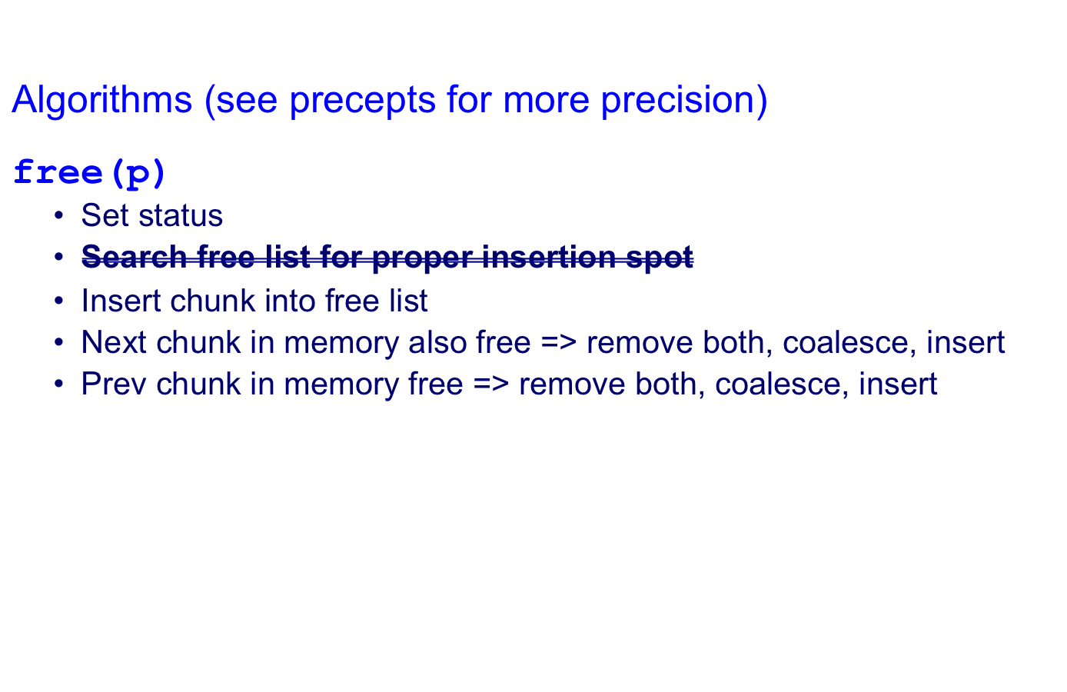
Doubly-Linked List Impl
Notes:
Every part of the free() function works in constant time…

Slide 63
Doubly-Linked List Impl Performance
Consider sub-algorithms of free()…
Insert chunk into free list
  Linked list version: slow
    Traverse list to find proper spot
  Doubly-linked list version: fast
    Insert at front!
Remove chunk from free list
  Linked list version: slow
    Traverse list to find prev chunk in list
  Doubly-linked list version: fast
    Use backward pointer of current chunk to find prev chunk in list

Slide 64
Doubly-Linked List Impl Performance
Consider sub-algorithms of free()…
Determine if next chunk in memory is free
  Linked list version: slow
    Traverse free list to see if next chunk in memory is in list
  Doubly-linked list version: fast
Free list
current
next
Use current chunk’s size to find next chunk
Examine status bit in next chunk’s header

Slide 65
Doubly-Linked List Impl Performance
Consider sub-algorithms of free()…
Determine if prev chunk in memory is free
  Linked list version: slow
    Traverse free list to see if prev chunk in memory is in list
  Doubly-linked list version: fast
Free list
prev
current
Fetch previous chunk’s size from its footer
Do pointer arithmetic to find previous chunk’s header
Examine status bit in previous chunk’s header

Slide 66
Doubly-Linked List Impl Performance
Observation:
  All sub-algorithms of free() are fast
  free() is fast!

Slide 67
Doubly-Linked List Impl Performance
Space
  Some internal & external fragmentation is unavoidable
  Headers & footers are overhead
  Overall: Good
Time: free()
  All steps are fast
  Good: O(1)
Time: malloc()
  Must search free list for big-enough chunk
  Bad: O(n)
  Often acceptable
  Subject to bad worst-case behavior
    E.g. long free list with big chunks at end

Slide 68
What’s Wrong?
Problem
  malloc() must traverse doubly-linked list, so can be slow
Solution
  Use multiple doubly-linked lists (bins)…

Slide 69
Agenda
The need for DMM
DMM using the heap section
DMMgr 1: Minimal implementation
DMMgr 2: Pad implementation
Fragmentation
DMMgr 3: List implementation
DMMgr 4: Doubly-linked list implementation
DMMgr 5: Bins implementation
DMM using virtual memory
DMMgr 6: VM implementation

Slide 70
Bins Impl
Data structures
…
…
10
Doubly-linked list containing free chunks of size 10
11
Doubly-linked list containing free chunks of size 11
12
Doubly-linked list containing free chunks of size 12
…
MAX_BIN
Doubly-linked list containing free chunks of size >= MAX_BIN
Use an array; each element is a bin
Each bin is a doubly-linked list of free chunks
  As in previous implementation
bin[i] contains free chunks of size i
  Exception: Final bin contains chunks of size MAX_BIN or larger
(More elaborate binning schemes are common)
Notes:
Same as your second Assignment 6 implementation

Slide 71
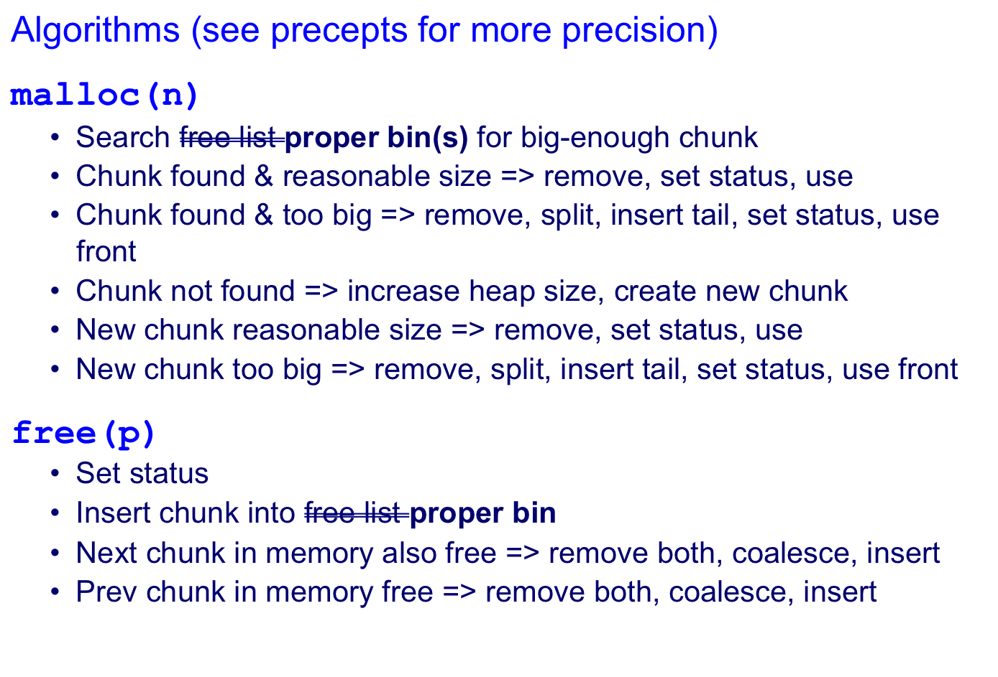
Bins Implemenation

Slide 72
Bins Implementation Performance
Space
  Pro: For small chunks, uses best-fit (not first-fit) strategy
    Could decrease internal fragmentation and splitting
  Con: Some internal & external fragmentation is unavoidable
  Con: Headers, footers, bin array are overhead
  Overall: good
Time: malloc()
  Pro: Binning limits list searching
    Search for chunk of size i begins at bin i and proceeds downward
  Con: Could be bad for large chunks (i.e. those in final bin)
    Performance degrades to that of list version
  Overall: good O(1)
Time: free()
  Good: O(1)

Slide 73
DMMgr Impl Summary (so far)
Implementation | Space | Time
(1) Minimal | Bad | Malloc: Bad Free: Good
(2) Pad | Bad | Malloc: Good Free: Good
(3) List | Good | Malloc: Bad (but could be OK) Free: Bad
(4) Doubly-Linked List | Good | Malloc: Bad (but could be OK) Free: Good
(5) Bins | Good | Malloc: Good Free: Good
Assignment 6: Given (3), compose (4) and (5)

Slide 74
What’s Wrong?
Observations
  Heap mgr might want to free memory chunks by unmapping them rather than marking them
    Minimizes virtual page count
  Heap mgr can call brk(pBrk–n) to decrease heap size
    And thereby unmap heap memory
  But often memory to be unmapped is not at high end of heap!
Problem
  How can heap manager unmap memory effectively?
Solution
  Don’t use the heap!

Slide 75
What’s Wrong?
Reprising a previous slide…
Question:
  How to implement malloc() and free()?
  How to implement a DMMgr?
Answer 1:
  Use the heap section of memory
Answer 2:
  Make use of virtual memory concept…

Slide 76
Agenda
The need for DMM
DMM using the heap section
DMMgr 1: Minimal implementation
DMMgr 2: Pad implementation
Fragmentation
DMMgr 3: List implementation
DMMgr 4: Doubly-linked list implementation
DMMgr 5: Bins implementation
DMM using virtual memory
DMMgr 6: VM implementation

Slide 77
Unix VM Mapping Functions
Unix allows application programs to map/unmap VM explicitly
void *mmap(void *p, size_t n, int prot, int flags, int fd, off_t offset);
  Creates a new mapping in the virtual address space of the calling process
  p: the starting address for the new mapping
  n: the length of the mapping
  If p is NULL, then the kernel chooses the address at which to create the mapping; this is the most portable method of creating a new mapping
  On success, returns address of the mapped area
int munmap(void *p, size_t n);
  Deletes the mappings for the specified address range

Slide 78
Unix VM Mapping Functions
Typical call of mmap() for allocating memory
  p = mmap(NULL, n, PROT_READ|PROT_WRITE,
  MAP_PRIVATE|MAP_ANON, 0, 0);
  Asks OS to map a new read/write area of virtual memory containing n bytes
  Returns the virtual address of the new area on success, (void*)-1 on failure
Typical call of munmap()
  status = munmap(p, n);
  Unmaps the area of virtual memory at virtual address p consisting of n bytes
  Returns 0 on success, -1 on failure
See Bryant & O’Hallaron book and man pages for details

Slide 79
Agenda
The need for DMM
DMM using the heap section
DMMgr 1: Minimal implementation
DMMgr 2: Pad implementation
Fragmentation
DMMgr 3: List implementation
DMMgr 4: Doubly-linked list implementation
DMMgr 5: Bins implementation
DMM using virtual memory
DMMgr 6: VM implementation

Slide 80
VM Mapping Impl
Data structures
size
header
payload
chunk
Each chunk consists of a header and payload
Each header contains size

Slide 81
VM Mapping Impl
Algorithms
void *malloc(size_t n)
{ size_t *p;
if (n == 0) return NULL;
p = mmap(NULL, n + sizeof(size_t), PROT_READ|PROT_WRITE,
MAP_PRIVATE|MAP_ANONYMOUS, 0, 0);
if (p == (void*)-1) return NULL;
*p = n + sizeof(size_t); /* Store size in header */
p++; /* Move forward from header to payload */
return p;
}
void free(void *p)
{ if (p == NULL) return;
p--; /* Move backward from payload to header */
munmap(p, *p);
}

Slide 82
VM Mapping Impl Performance
Space
  Fragmentation problem is delegated to OS
  Overall: Depends on OS
Time
  For small chunks
    One system call (mmap()) per call of malloc()
    One system call (munmap()) per call of free()
    Overall: poor
  For large chunks
    free() unmaps (large) chunks of memory, and so shrinks page table
    Overall: maybe good!
Notes:
DMMgr doesn’t know where OS will decide to place the requested chunk within the application’s virtual memory
Fragmentation problem is delegated to OS!

Slide 83
The GNU Implementation
Observation
  malloc() and free() on fc010 are from the
  GNU (the GNU Software Foundation)
Question
  How are GNU malloc() and free() implemented?
Answer
  For small chunks
    Use heap (sbrk() and brk())
    Use bins implementation
  For large chunks
    Use VM directly (mmap() and munmap())

Slide 84
Summary
The need for DMM
  Unknown object size
DMM using the heap section
  On Unix: sbrk() and brk()
  Complicated data structures and algorithms
  Good for managing small memory chunks
DMM using virtual memory
  On Unix: mmap() and munmap()
  Good for managing large memory chunks
See Appendix for additional approaches/refinements

Slide 85
Appendix: Additional Approaches
Some additional approaches to dynamic memory mgmt…

Slide 86
Selective Splitting
Observation
  In previous implementations, malloc() splits whenever chosen chunk is too big
Alternative: selective splitting
  Split only when remainder is above some threshold
Pro
  Reduces external fragmentation
Con
  Increases internal fragmentation
In
use
In
use

Slide 87
Deferred Coalescing
Observation
  Previous implementations do coalescing whenever possible
Alternative: deferred coalescing
  Wait, and coalesce many chunks at a later time
Pro
  Handles malloc(n);free();malloc(n) sequences well
Con
  Complicates algorithms
In
use
In
use

Slide 88
Segregated Data
Observation
  Splitting and coalescing consume lots of overhead
Problem
  How to eliminate that overhead?
Solution: segregated data
  Make use of the virtual memory concept…
  Use bins
  Store each bin’s chunks in a distinct (segregated) virtual memory page
  Elaboration…

Slide 89
Segregated Data
Segregated data
  Each bin contains chunks of fixed sizes
    E.g. 32, 64, 128, …
  All chunks within a bin are from same virtual memory page
  malloc() never splits! Examples:
    malloc(32) => provide 32
    malloc(5) => provide 32
    malloc(100) => provide 128
  free() never coalesces!
    Free block => examine address, infer virtual memory page, infer bin, insert into that bin

Slide 90
Segregated Data
Pros
  Eliminates splitting and coalescing overhead
  Eliminates most meta-data; only forward links required
    No backward links, sizes, status bits, footers
Con
  Some usage patterns cause excessive external fragmentation
    E.g. Only one malloc(32) wastes all but 32 bytes of one virtual page

Slide 91
Segregated Meta-Data
Observations
  Meta-data (chunk sizes, status flags, links, etc.) are scattered across the heap, interspersed with user data
  Heap mgr often must traverse meta-data
Problem 1
  User error easily can corrupt meta-data
Problem 2
  Frequent traversal of meta-data can cause excessive page faults (poor locality)
Solution: segregated meta-data
  Make use of the virtual memory concept…
  Store meta-data in a distinct (segregated) virtual memory page from user data

