Slide 1
I/O and Process Management
Jennifer Rexford

Slide 2
Goals of this Lecture: I/O
The Unix stream concept
Standard C I/O functions
Unix system-level functions for I/O
How C I/O functions use the Unix functions
Additional abstractions provided by C I/O functions
Streams are a beautiful Unix abstraction

Slide 3
Stream Abstraction
Any source of input or destination for output
  E.g., keyboard as input, and screen as output
  E.g., files on disk or CD, network ports, printer port, …
Accessed in C programs through file pointers
  E.g., FILE *fp1, *fp2;
  E.g., fp1 = fopen("myfile.txt", "r");
Three streams provided by stdio.h
  Streams stdin, stdout, and stderr
    Typically map to keyboard, screen, and screen
  Can redirect to correspond to other streams
    E.g., stdin can be the output of another program
    E.g., stdout can be the input to another program

Slide 4
Sequential Access to a Stream
Each stream has an associated file position
  Starting at beginning of file (if opened to read or write)
  Or, starting at end of file (if opened to append)
Read/write operations advance the file position
  Allows sequencing through the file in sequential manner
Support for random access to the stream
  Functions to learn current position and seek to new one
file
file

Slide 5
Standard I/O Functions
Portability
  Generic I/O support for C programs
  Specific implementations for various host OSes
  Invokes the OS-specific system calls for I/O
Abstractions for C programs
  Streams
  Line-by-line input
  Formatted output
Additional optimizations
  Buffered I/O
  Safe writing
Appl Prog
user
Stdio Library
OS
File System

Slide 6
Example: Opening a File
FILE *fopen("myfile.txt", "r")
  Open the named file and return a stream
  Includes a mode, such as “r” for read or “w” for write
Creates a FILE data structure for the file
  Mode, status, buffer, …
  Assigns fields and returns a pointer
Opens or creates the file, based on the mode
  Write (‘w’): create file with default permissions
  Read (‘r’): open the file as read-only
  Append (‘a’): open or create file, and seek to the end

Slide 7
Example: Formatted I/O
int fprintf(fp1, "Number: %d\n", i)
  Convert and write output to stream in specified format
int fscanf(fp1, "FooBar: %d", &i)
  Read from stream in format and assign converted values
Specialized versions
  printf(…) is just fprintf(stdout, …)
  scanf(…) is just fscanf(stdin, …)

Slide 8
Layers of Abstraction
File descriptor:
An integer that
uniquely identifies
an open file
Appl Pgm
User
process
FILE * stream
Stdio Library
int fd
File System
hierarchical file system
Operating
System
Storage
variable-length segments
Driver
disk blocks
Disk

Slide 9
System-Level Functions for I/O
int creat(char *pathname, mode_t mode);
  Create a new file named pathname, and return a file descriptor
int open(char *pathname, int flags, mode_t mode);
  Open the file pathname and return a file descriptor
int close(int fd);
  Close fd
int read(int fd, void *buf, int count);
  Read up to count bytes from fd into the buffer at buf
int write(int fd, void *buf, int count);
  Writes up to count bytes into fd from the buffer at buf
int lseek(int fd, int offset, int whence);
  Assigns the file pointer of fd to a new value by applying an offset

Slide 10
Example: open()
Converts a path name into a file descriptor
  int open(const char *pathname, int flags, mode_t mode);
Arguments
  Pathname: name of the file
  Flags: bit flags for O_RDONLY, O_WRONLY, O_RDWR
  Mode: permissions to set if file must be created
Returns
  File descriptor (or a -1 if an error)
Performs a variety of checks
  E.g., whether the process is entitled to access the file
Underlies fopen()

Slide 11
Example: read()
Reads bytes from a file descriptor
  int read(int fd, void *buf, int count);
Arguments
  File descriptor: integer descriptor returned by open()
  Buffer: pointer to memory to store the bytes it reads
  Count: maximum number of bytes to read
Returns
  Number of bytes read
    Value of 0 if nothing more to read
    Value of -1 if an error
Performs a variety of checks
  Whether file has been opened, whether reading is okay
Underlies getchar() , fgets(), scanf() , etc.

Slide 12
Example: A Simple getchar()
int getchar(void) {
  char c;
  if (read(0, &c, 1) == 1)
  return c;
  else return EOF;
  }
Read one character from stdin
  File descriptor 0 is stdin
  &c points to the buffer
  1 is the number of bytes to read
Read returns the number of bytes read
  In this case, 1 byte means success

Slide 13
Making getchar() More Efficient
Poor performance reading one byte at a time
  Read system call is accessing the device (e.g., a disk)
  Reading one byte from disk is very time consuming
  Better to read and write in larger chunks
Buffered I/O
  Read a large chunk from disk into a buffer
    Dole out bytes to the user process as needed
    Discard buffer contents when the stream is closed
  Similarly, for writing, write individual bytes to a buffer
    And write to disk when full, or when stream is closed
    Known as “flushing” the buffer

Slide 14
Better getchar() with Buffered I/O
  int getchar(void) {
  static char base[1024];
  static char *ptr;
  static int cnt = 0;
  if (cnt--) return *ptr++;
  cnt = read(0, base, sizeof(base));
  if (cnt <= 0) return EOF;
  ptr = base;
  return getchar();
  }
persistent variables
base
ptr
But, many functions may read (or write) the stream…

Slide 15
Details of FILE in stdio.h (K&R 8.5)
  #define OPEN_MAX 20 /* max files open at once */
  typedef struct _iobuf {
  int cnt; /* num chars left in buffer */
  char *ptr; /* ptr to next char in buffer */
  char *base; /* beginning of buffer */
  int flag; /* open mode flags, etc. */
  char fd; /* file descriptor */
  } FILE;
  extern FILE _iob[OPEN_MAX];
  #define stdin (&_iob[0])
  #define stdout (&_iob[1])
  #define stderr (&_iob[2])

Slide 16
A Funny Thing About Buffered I/O
The standard library also buffers output; example:
int main(void) {
printf("Step 1\n");
sleep(10);
printf("Step 2\n");
return 0;
}
  Run “a.out > out.txt &” and then “tail -f out.txt”
    To run a.out in the background, outputting to out.txt
    And then to see the contents on out.txt
  Neither line appears till ten seconds have elapsed
    Because the output is being buffered
    Add fflush(stdout) to flush the output buffer
    fclose() also flushes the buffer before closing

Slide 17
Summary on I/O Management
System-level I/O functions provide abstractions
  Stream as a source or destination of data
  Functions for manipulating streams
Standard I/O library builds on these abstractions
  Calls system-level functions for low-level I/O
  Adds buffering
Powerful examples of abstraction
  Applications interact with streams at a high level
  Standard I/O library interact with streams at lower level
  Only the OS deals with the device-specific details

Slide 18
Process Management

Slide 19
Goals of this Lecture: Processes
Help you learn about:
  Creating new processes
  Programmatically redirecting stdin, stdout, and stderr
  (Appendix) communication between processes via pipes
Why?
  Creating new processes and programmatic redirection are fundamental tasks of a Unix shell (Assignment 7)

Slide 20
Why Create a New Process?
Run a new program
  E.g., shell executing a program entered at command line
  Or, even running an entire pipeline of commands
  Such as “wc –l * | sort | uniq -c | sort –nr”
Run a new thread of control for the same program
  E.g., a Web server handling a new Web request
  While continuing to allow more requests to arrive
  Essentially time sharing the computer
Underlying mechanism
  A process executes fork() to create a child process
  (Optionally) child does exec() of a new program

Slide 21
Creating a New Process
Cloning an existing process
  Parent process creates a new child process
  The two processes then run concurrently
Child process inherits state from parent
  Identical (but separate) copy of virtual address space
  Copy of the parent’s open file descriptors
  Parent and child share access to open files
Child then runs independently
  Executing independently, including invoking a new program
  Reading and writing its own address space
parent
child

Slide 22
Fork System-Level Function
fork() is called once
  But returns twice, once in each process
Telling which process is which
  Parent: fork() returns the child’s process ID
  Child: fork() returns 0
pid = fork();
if (pid != 0) {
/* in parent */
…
} else {
/* in child */
…
}

Slide 23
Fork and Process State
Inherited
  User and group IDs
  Signal handling settings
  Stdio
  File pointers
  Root directory
  File mode creation mask
  Resource limits
  Controlling terminal
  All machine register states
  Control register(s)
  …
Separate in child
  Process ID
  Address space (memory)
  File descriptors
  Parent process ID
  Pending signals
  Time signal reset times
  …

Slide 24
Example: What Output?
int main(void)
{
pid_t pid;
int x = 1;
pid = fork();
if (pid != 0) {
printf("parent: x = %d\n", --x);
exit(0);
} else {
printf("child: x = %d\n", ++x);
exit(0);
}
}

Slide 25
Executing a New Program
fork() copies the state of the parent process
  Child continues running the parent program
  … with a copy of the process memory and registers
Need a way to invoke a new program
  In the context of the newly-created child process
Example
NULL-terminated array
Contains command-line arguments
(to become “argv[]” of ls)
program
execvp("ls", argv);
fprintf(stderr, "exec failed\n");
exit(EXIT_FAILURE);

Slide 26
Waiting for the Child to Finish
Parent should wait for children to finish
  Example: a shell waiting for operations to complete
Waiting for a child to terminate: wait()
  Blocks until some child terminates
  Returns the process ID of the child process
  Or returns -1 if no children exist (i.e., already exited)
Waiting for specific child to terminate: waitpid()
  Blocks till a child with particular process ID terminates
#include <sys/types.h>
#include <sys/wait.h>
pid_t wait(int *status);
pid_t waitpid(pid_t pid, int *status, int options);

Slide 27
Example: A Simple Shell
Shell is the parent process
  E.g., bash
Parses command line
  E.g., “ls –l”
Invokes child process
  fork(), execvp()
Waits for child
  wait()
bash
fork
child
parent
execvp
wait
ls

Slide 28
Simple Shell Code
Parse command line
Assign values to somepgm, someargv
pid = fork();
if (pid == 0) {
/* in child */
execvp(somepgm, someargv);
fprintf(stderr, "exec failed\n");
exit(EXIT_FAILURE);
}
/* in parent */
pid = wait(&status);
Repeat the previous

Slide 29
Simple Shell Trace (1)
Parent Process
Parse command line
Assign values to somepgm, someargv
pid = fork();
if (pid == 0) {
/* in child */
execvp(somepgm, someargv);
fprintf(stderr, "exec failed\n");
exit(EXIT_FAILURE);
}
/* in parent */
pid = wait(&status);
Repeat the previous
Parent reads and parses command line
Parent assigns values to somepgm and someargv

Slide 30
Simple Shell Trace (2)
Parent Process
Child Process
Parse command line
Assign values to somepgm, someargv
pid = fork();
if (pid == 0) {
/* in child */
execvp(somepgm, someargv);
fprintf(stderr, "exec failed\n");
exit(EXIT_FAILURE);
}
/* in parent */
pid = wait(&status);
Repeat the previous
Parse command line
Assign values to somefile, someargv
pid = fork();
if (pid == 0) {
/* in child */
execvp(somepgm, someargv);
fprintf(stderr, "exec failed\n");
exit(EXIT_FAILURE);
}
/* in parent */
pid = wait(&status);
Repeat the previous
executing
concurrently
fork() creates child process
Which process gets the CPU first? Let’s assume the parent…

Slide 31
Simple Shell Trace (3)
Parent Process
child’s pid
Child Process
Parse command line
Assign values to somepgm, someargv
pid = fork();
if (pid == 0) {
/* in child */
execvp(somepgm, someargv);
fprintf(stderr, "exec failed\n");
exit(EXIT_FAILURE);
}
/* in parent */
pid = wait(&status);
Repeat the previous
Parse command line
Assign values to somefile, someargv
pid = fork();
if (pid == 0) {
/* in child */
execvp(somepgm, someargv);
fprintf(stderr, "exec failed\n");
exit(EXIT_FAILURE);
}
/* in parent */
pid = wait(&status);
Repeat the previous
executing
concurrently
In parent, pid != 0; parent waits; OS gives CPU to child

Slide 32
Simple Shell Trace (4)
Parent Process
0
Child Process
Parse command line
Assign values to somepgm, someargv
pid = fork();
if (pid == 0) {
/* in child */
execvp(somepgm, someargv);
fprintf(stderr, "exec failed\n");
exit(EXIT_FAILURE);
}
/* in parent */
pid = wait(&status);
Repeat the previous
Parse command line
Assign values to somefile, someargv
pid = fork();
if (pid == 0) {
/* in child */
execvp(somepgm, someargv);
fprintf(stderr, "exec failed\n");
exit(EXIT_FAILURE);
}
/* in parent */
pid = wait(&status);
Repeat the previous
executing
concurrently
In child, pid == 0; child calls execvp()

Slide 33
Simple Shell Trace (5)
Parent Process
Child Process
Parse command line
Assign values to somepgm, someargv
pid = fork();
if (pid == 0) {
/* in child */
execvp(somepgm, someargv);
fprintf(stderr, "exec failed\n");
exit(EXIT_FAILURE);
}
/* in parent */
pid = wait(&status);
Repeat the previous
somepgm
executing
concurrently
In child, somepgm overwrites shell program;
main() is called with someargv as argv parameter

Slide 34
Simple Shell Trace (6)
Parent Process
Child Process
Parse command line
Assign values to somepgm, someargv
pid = fork();
if (pid == 0) {
/* in child */
execvp(somepgm, someargv);
fprintf(stderr, "exec failed\n");
exit(EXIT_FAILURE);
}
/* in parent */
pid = wait(&status);
Repeat the previous
somepgm
executing
concurrently
Somepgm executes in child, and eventually exits

Slide 35
Simple Shell Trace (7)
Parent Process
Parse command line
Assign values to somepgm, someargv
pid = fork();
if (pid == 0) {
/* in child */
execvp(somepgm, someargv);
fprintf(stderr, "exec failed\n");
exit(EXIT_FAILURE);
}
/* in parent */
pid = wait(&status);
Repeat the previous
Parent returns from wait() and proceeds

Slide 36
Combined Fork/Exec/Wait
Common combination of operations
  fork() to create a new child process
  exec() to invoke new program in child process
  wait() in the parent process for the child to complete
Single call that combines all three
  int system(const char *cmd);
Example
int main(void) {
system("echo Hello world");
return 0;
}

Slide 37
Fork and Virtual Memory
Incidentally…
Question:
  fork() duplicates an entire process (text, bss, data, rodata, stack, heap sections)
  Isn’t that very inefficient???!!!
Answer:
  Using virtual memory, not really!
  Upon fork(), OS creates virtual pages for child process
  Each child virtual page points to real page (in memory or on disk) of parent
  OS duplicates real pages incrementally, and only if/when “write” occurs

Slide 38
Redirection
Unix allows redirection of stdin, stdout, or stderr
How?
  Use open(), creat(), and close() system calls
    Described in I/O Management lecture
  Use dup() system call…
int dup(int oldfd);
    Create a copy of the file descriptor oldfd. After a successful return from dup() or dup2(), the old and new file descriptors may be used interchangeably. They refer to the same open file description and thus share file offset and file status flags. Uses the lowest-numbered unused descriptor for the new descriptor. Return the new descriptor, or -1 if an error occurred.

Slide 39
Redirection Example
How does shell implement “somepgm > somefile”?
pid = fork();
if (pid == 0) {
/* in child */
fd = creat("somefile", 0640);
close(1);
dup(fd);
close(fd);
execvp(somepgm, someargv);
fprintf(stderr, "exec failed\n");
exit(EXIT_FAILURE);
}
/* in parent */
pid = wait(&status);
Notes:
close(1) closes stdout
dup(fd) duplicates fd as file descriptor 1
close(fd) gets rid of the other descriptor

Slide 40
Redirection Example Trace (1)
Parent Process
/dev/tty
File
descriptor
table
0
1
2
3
…
pid = fork();
if (pid == 0) {
/* in child */
fd = creat("somefile", 0640);
close(1);
dup(fd);
close(fd);
execvp(somepgm, someargv);
fprintf(stderr, "exec failed\n");
exit(EXIT_FAILURE);
}
/* in parent */
pid = wait(&status);
Parent has file descriptor table; first three point to “terminal”

Slide 41
Redirection Example Trace (2)
Parent Process
/dev/tty
Child Process
File
descriptor
table
0
0
File
descriptor
table
1
1
2
2
3
3
…
…
pid = fork();
if (pid == 0) {
/* in child */
fd = creat("somefile", 0640);
close(1);
dup(fd);
close(fd);
execvp(somepgm, someargv);
fprintf(stderr, "exec failed\n");
exit(EXIT_FAILURE);
}
/* in parent */
pid = wait(&status);
pid = fork();
if (pid == 0) {
/* in child */
fd = creat("somefile", 0640);
close(1);
dup(fd);
close(fd);
execvp(somepgm, someargv);
fprintf(stderr, "exec failed\n");
exit(EXIT_FAILURE);
}
/* in parent */
pid = wait(&status);
Parent forks child; child has identical file descriptor table

Slide 42
Redirection Example Trace (3)
Parent Process
/dev/tty
Child Process
File
descriptor
table
0
0
File
descriptor
table
1
1
2
2
3
3
…
…
pid = fork();
if (pid == 0) {
/* in child */
fd = creat("somefile", 0640);
close(1);
dup(fd);
close(fd);
execvp(somepgm, someargv);
fprintf(stderr, "exec failed\n");
exit(EXIT_FAILURE);
}
/* in parent */
pid = wait(&status);
pid = fork();
if (pid == 0) {
/* in child */
fd = creat("somefile", 0640);
close(1);
dup(fd);
close(fd);
execvp(somepgm, someargv);
fprintf(stderr, "exec failed\n");
exit(EXIT_FAILURE);
}
/* in parent */
pid = wait(&status);
Let’s say parent gets CPU first; parent waits

Slide 43
Redirection Example Trace (4)
Parent Process
/dev/tty
Child Process
File
descriptor
table
0
0
File
descriptor
table
1
1
2
somefile
2
3
3
…
…
pid = fork();
if (pid == 0) {
/* in child */
fd = creat("somefile", 0640);
close(1);
dup(fd);
close(fd);
execvp(somepgm, someargv);
fprintf(stderr, "exec failed\n");
exit(EXIT_FAILURE);
}
/* in parent */
pid = wait(&status);
3
pid = fork();
if (pid == 0) {
/* in child */
fd = creat("somefile", 0640);
close(1);
dup(fd);
close(fd);
execvp(somepgm, someargv);
fprintf(stderr, "exec failed\n");
exit(EXIT_FAILURE);
}
/* in parent */
pid = wait(&status);
Child gets CPU; child creates somefile

Slide 44
Redirection Example Trace (5)
Parent Process
/dev/tty
Child Process
File
descriptor
table
0
0
File
descriptor
table
1
1
2
somefile
2
3
3
…
…
pid = fork();
if (pid == 0) {
/* in child */
fd = creat("somefile", 0640);
close(1);
dup(fd);
close(fd);
execvp(somepgm, someargv);
fprintf(stderr, "exec failed\n");
exit(EXIT_FAILURE);
}
/* in parent */
pid = wait(&status);
3
pid = fork();
if (pid == 0) {
/* in child */
fd = creat("somefile", 0640);
close(1);
dup(fd);
close(fd);
execvp(somepgm, someargv);
fprintf(stderr, "exec failed\n");
exit(EXIT_FAILURE);
}
/* in parent */
pid = wait(&status);
Child closes file descriptor 1 (stdout)

Slide 45
Redirection Example Trace (6)
Parent Process
/dev/tty
Child Process
File
descriptor
table
0
0
File
descriptor
table
1
1
2
somefile
2
3
3
…
…
pid = fork();
if (pid == 0) {
/* in child */
fd = creat("somefile", 0640);
close(1);
dup(fd);
close(fd);
execvp(somepgm, someargv);
fprintf(stderr, "exec failed\n");
exit(EXIT_FAILURE);
}
/* in parent */
pid = wait(&status);
3
pid = fork();
if (pid == 0) {
/* in child */
fd = creat("somefile", 0640);
close(1);
dup(fd);
close(fd);
execvp(somepgm, someargv);
fprintf(stderr, "exec failed\n");
exit(EXIT_FAILURE);
}
/* in parent */
pid = wait(&status);
Child duplicates file descriptor 3 into first unused spot

Slide 46
Redirection Example Trace (7)
Parent Process
/dev/tty
Child Process
File
descriptor
table
0
0
File
descriptor
table
1
1
2
somefile
2
3
3
…
…
pid = fork();
if (pid == 0) {
/* in child */
fd = creat("somefile", 0640);
close(1);
dup(fd);
close(fd);
execvp(somepgm, someargv);
fprintf(stderr, "exec failed\n");
exit(EXIT_FAILURE);
}
/* in parent */
pid = wait(&status);
3
pid = fork();
if (pid == 0) {
/* in child */
fd = creat("somefile", 0640);
close(1);
dup(fd);
close(fd);
execvp(somepgm, someargv);
fprintf(stderr, "exec failed\n");
exit(EXIT_FAILURE);
}
/* in parent */
pid = wait(&status);
Child closes file descriptor 3

Slide 47
Redirection Example Trace (8)
Parent Process
/dev/tty
Child Process
File
descriptor
table
0
0
File
descriptor
table
1
1
2
somefile
2
3
3
…
…
pid = fork();
if (pid == 0) {
/* in child */
fd = creat("somefile", 0640);
close(1);
dup(fd);
close(fd);
execvp(somepgm, someargv);
fprintf(stderr, "exec failed\n");
exit(EXIT_FAILURE);
}
/* in parent */
pid = wait(&status);
3
pid = fork();
if (pid == 0) {
/* in child */
fd = creat("somefile", 0640);
close(1);
dup(fd);
close(fd);
execvp(somepgm, someargv);
fprintf(stderr, "exec failed\n");
exit(EXIT_FAILURE);
}
/* in parent */
pid = wait(&status);
Child calls execvp()

Slide 48
Redirection Example Trace (9)
Parent Process
/dev/tty
Child Process
File
descriptor
table
0
0
File
descriptor
table
1
1
2
somefile
2
3
3
…
…
pid = fork();
if (pid == 0) {
/* in child */
fd = creat("somefile", 0640);
close(1);
dup(fd);
close(fd);
execvp(somepfm, someargv);
fprintf(stderr, "exec failed\n");
exit(EXIT_FAILURE);
}
/* in parent */
pid = wait(&status);
somepgm
Somepgm executes with stdout redirected to somefile

Slide 49
Redirection Example Trace (10)
Parent Process
/dev/tty
File
descriptor
table
0
1
2
3
…
pid = fork();
if (pid == 0) {
/* in child */
fd = creat("somefile", 0640);
close(1);
dup(fd);
close(fd);
execvp(somefile, someargv);
fprintf(stderr, "exec failed\n");
exit(EXIT_FAILURE);
}
/* in parent */
pid = wait(&status);
Somepgm exits; parent returns from wait() and proceeds

Slide 50
The Beginnings of a Unix Shell
A shell is mostly a big loop
  Parse command line from stdin
  Expand wildcards (‘*’)
  Interpret redirections (‘<‘, and ‘>’)
  fork(), dup(), exec(), and wait(), as necessary
Start from the code in earlier slides
  And edit till it becomes a Unix shell
  This is the heart of the last programming assignment

Slide 51
Summary
System-level functions for creating processes
  fork(): process creates a new child process
  wait(): parent waits for child process to complete
  exec(): child starts running a new program
  system(): combines fork, wait, and exec all in one
System-level functions for redirection
  open() / creat(): to open a file descriptor
  close(): to close a file descriptor
  dup(): to duplicate a file descriptor

Slide 52
Appendix
Inter-Process Communication (IPC)

Slide 53
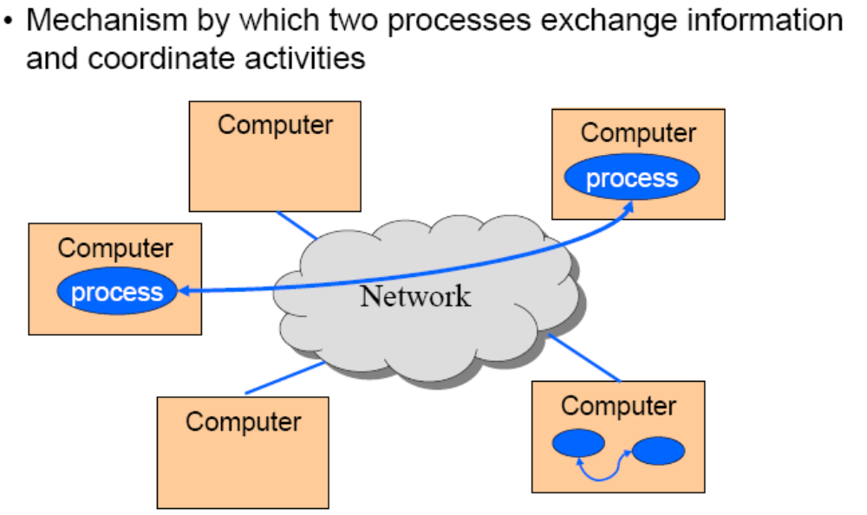
IPC
different machines
same machine

Slide 54
IPC Mechanisms
Pipes
  Processes on the same machine
  Allows parent process to communicate with child process
  Allows two “sibling” processes to communicate
  Used mostly for a pipeline of filters
Sockets (see COS 461)
  Processes on any machines
  Processes created independently
  Used for client/server communication (e.g., Web)
Both provide abstraction of an “ordered stream of bytes”

Slide 55
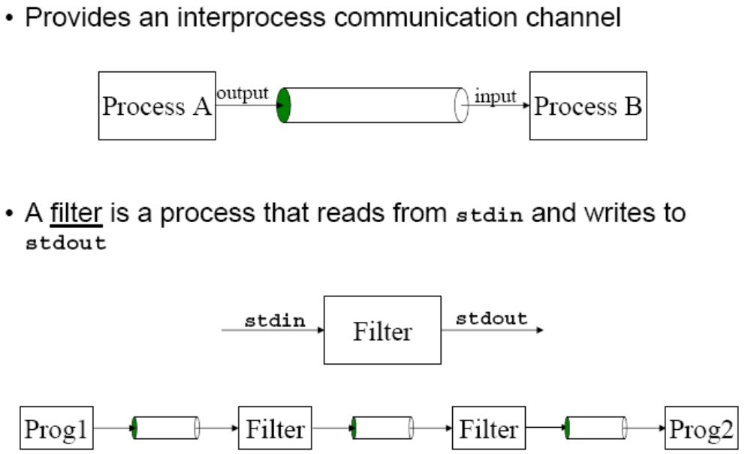
Pipes

Slide 56
Example Use of Pipes
Compute a histogram of content types in my e-mail
  Many e-mail messages, consisting of many lines
  Lines like “Content-Type: image/jpeg” indicate the type
Pipeline of Unix commands
  Identifying content type: grep -i Content-Type *
  Extracting just the type: cut -d" " -f2
  Sorting the list of types: sort
  Counting the unique types: uniq -c
  Sorting the counts: sort –nr
Simply running this at the shell prompt:
  grep -i Content-Type * | cut -d" " -f2 | sort | uniq -c | sort –nr

Slide 57
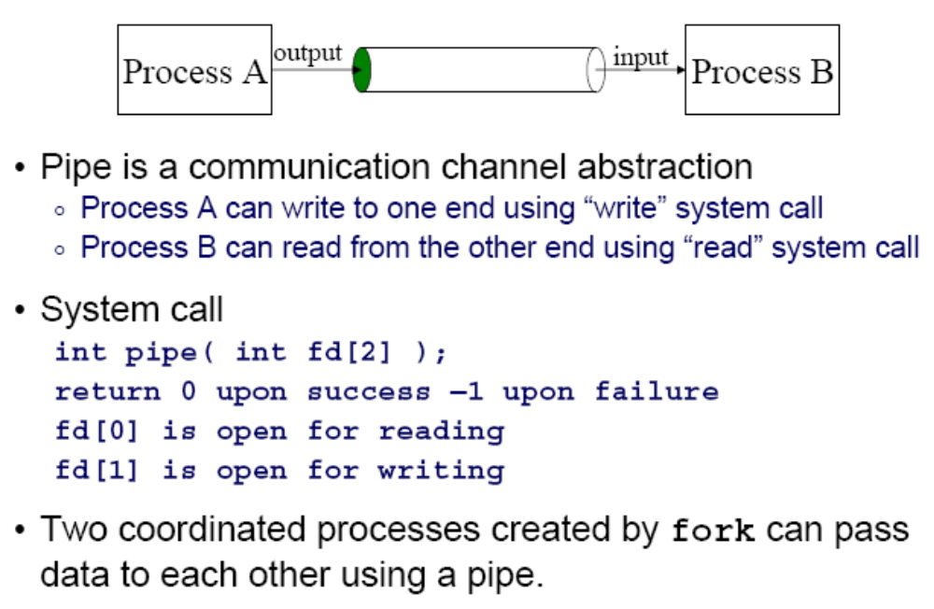
Creating a Pipe

Slide 58
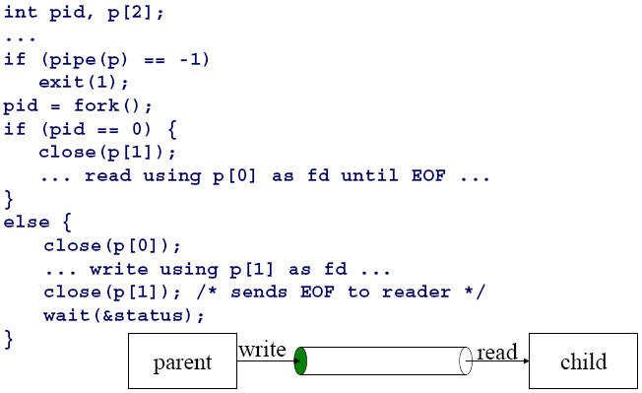
Pipe Example
child
parent

Slide 59
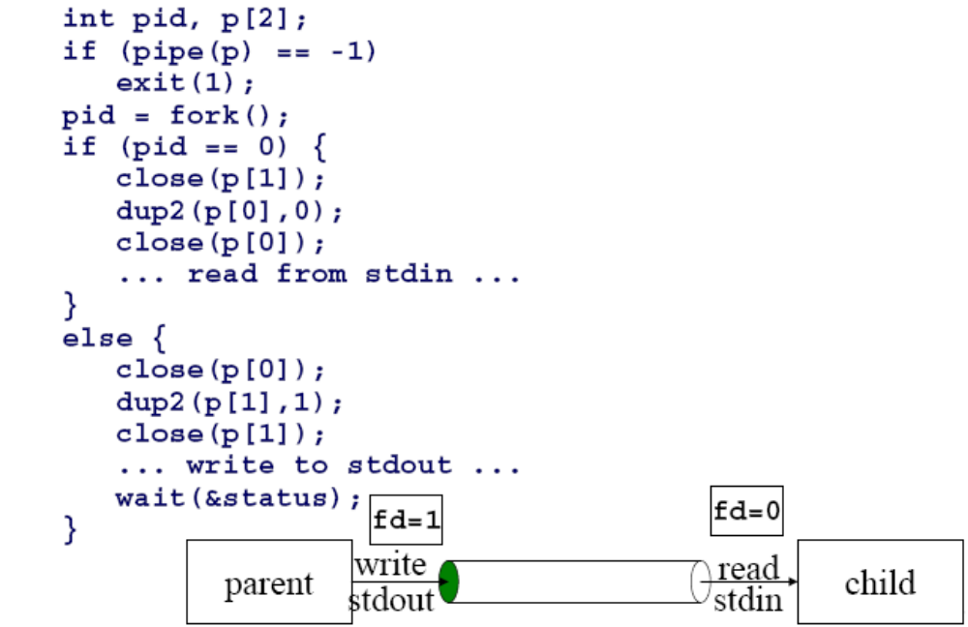
Pipes and Stdio
child makes stdin (0)
the read side of the pipe
parent makes stdout (1)
the write side of the pipe

Slide 60
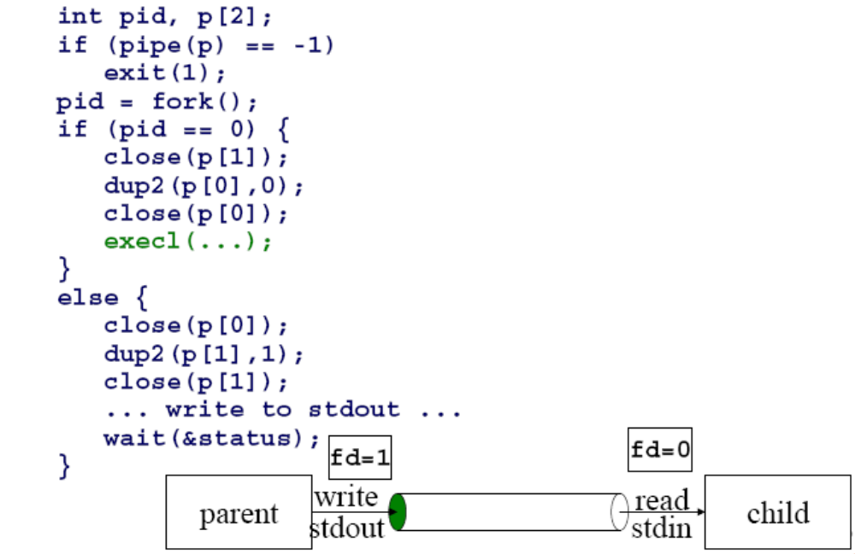
Pipes and Exec
child process
invokes a new program

