Slide 1
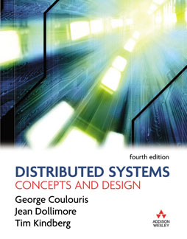
Figure Slides for Chapter 3:
Networking and Internetworking
From Coulouris, Dollimore and Kindberg
Distributed Systems:
Concepts and Design
Edition 4, © Pearson Education 2005

Slide 2
CSC435 DePaul -- Elliott
Slides prepared by…
  Professor Clark Elliott
  DePaul University
Some slides courtesy of Mark Goetsch
  DePaul University
Copyright 2008 Clark Elliott

Slide 3
Networking
Networking for Distributed Systems
Types of networks
Network principles
Internet Protocols
Case studies, Ethernet, WiFi, Bluetooth
Copyright 2008 Clark Elliott

Slide 4
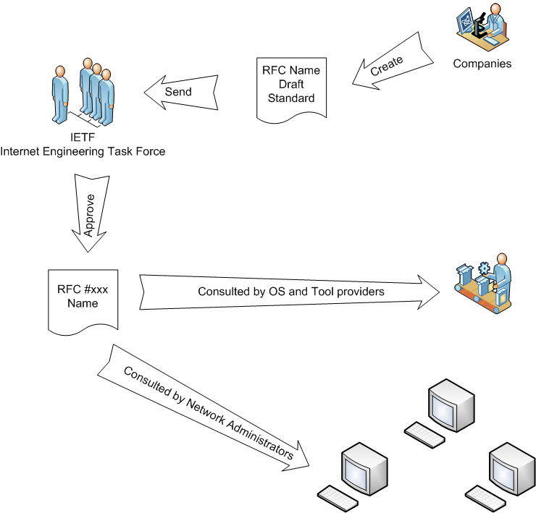
RFC Process – request for comments. You can comment too!
Link to the RFC process and list of RFC’s http://www.rfc-editor.org/
Copyright Mark Goetsch
April 30, 2008

Slide 5
Components
Trasmission lines: wire, cable, fiber, satellite, wireless
Harware: routers, switches, hubs, NICs
Software: protocol stacks, communication handlers, OpSys drivers
Hosts == computers connected by network
Nodes == computer or switching device on network.
Copyright 2008 Clark Elliott

Slide 6
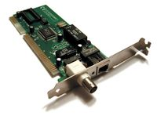
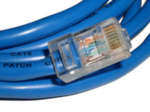
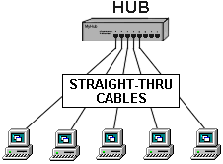

Physical Layer
Network Interface Card
Cat5e Ethernet Cable
Copyright Mark Goetsch

Slide 7
Telephone Line Size
DS-0 64 Kbps 1 Telephone Channel
DS-1/T-1 1.54 Mbps 24 Telephone Channels
DS-3/T-3 44.736 Mbps 28 T-1 Lines
Copyright Mark Goetsch

Slide 8
Bits & Bytes
Transmission quantity is measured in 10^n so that 64K is 64 x 1000 or 64,000.
Computer quantity is measured in 2^n so that 64K is 64 X 1024 or 65,536.
This is a difference of 2.34%. Close enough for government work??
File size and storage is measured in terms of bytes but transmission is measured in terms of bits (i.e. don’t’ forget to multiply/divide by 8).
Here is a twister -> Remember the calculation for Transmission Time?
Transmission Time = RTT + (Transfer Size / Bandwidth)
We have a 100 ms RTT, a 64K sized file, and a 64K single channel.
TT = .1 s+ (64 * 1024 * 8) bps / (64 * 1000) bps
TT = 8.292 s
Copyright Mark Goetsch

Slide 9
Binary Bytes vs. Decimal Bytes
Network, 1K = 1,000, 1M = 1,000,000
Computer 1K = 1024, 1M = 1,048,576
  Except disk drives use powers of ten to artificially inflate the size of the drive.
  1 Terabyte disk drive = 931 GB
So how long does it take to send the payload of 1 GB of data over a “1 GB” network line?
http://www.codinghorror.com/blog/2007/09/gigabyte-decimal-vs-binary.html
Copyright 2008 Clark Elliott

Slide 10
It’s not rocket science – or is it?
The power of ten / powers of two problem causes communication problems between CS people and IT people
IT managers MUST understand this issue
“NASA lost a $125 million Mars orbiter because a Lockheed Martin engineering team used English units of measurement while the agency's team used the more conventional metric system for a key spacecraft operation, according to a review finding released Thursday.” (http://www.cnn.com/TECH/space/9909/30/mars.metric.02/ )
Copyright 2008 Clark Elliott

Slide 11
Calculating
RTT, Throughput, and Transfer Time
RTT is 2 X Latency and is the round trip time delay
Transfer Time = RTT + (Transfer Size/Bandwidth)
Throughput = Transfer Size/Transfer Time
Example: User wants to fetch a 1MB file across a 1 Gbps network with a 50 ms latency.
RTT = 2 X Latency = 100 ms
Transfer Time = .1 sec + (8 X 1,048,576)/1,000,000,000
= .1 sec + .008 sec
= 108 ms
Throughput = (8 X 1,048,576)/.108 sec = 77,393,816
= 77Mbps and not 1Gbps.
Copyright Mark Goetsch

Slide 12
Design
Development hindered by legacy systems integrated in virtually every connected computer.
Internet based on decades old technology
Packet switching discussed in 1962!
Copyright 2008 Clark Elliott

Slide 13
Performance
Latency is delay that occurs after a send before data starts to arrive at dest.
Can be though of as time to send an empty data packet.
Other latency beyond that of network – other levels of protocol stack
Data transfer rate: bits per second rate of data transfer after latency accounted for per channel
Msg trans time = latency + length / data trns rate
Copyright 2008 Clark Elliott

Slide 14
Transfer rate is constrained by physical characteristics
Latency determined by software overhead, routing delays, load of network.
System bandwidth may include many channels at given transfer rate
For DSes with many small messages, latency may be main constraint
Copyright 2008 Clark Elliott

Slide 15
Figure 3.1
Network performance
Example
Range
Bandwidth
Latency
(Mbps)
(ms)
Wired:
LAN
Ethernet
1-2 kms
10-1000
1-10
WAN
IP routing
worldwide
0.010-600
100-500
MAN
ATM
250 kms
1-150
10
Internetwork
Internet
worldwide
0.5-600
100-500
Wireless:
WPAN
Bluetooth (802.15.1)
10 - 30m
0.5-2
5-20
WLAN
WiFi (IEEE 802.11)
0.15-1.5 km
2-54
5-20
WMAN
WiMAX (802.16)
550 km
1.5-20
5-20
WWAN
GSM, 3G phone nets
worldwide
0.01-02
100-500

Slide 16
Times
< 1 micro-sec – access local memory
½ Msec -- get reply for short message on ethernet from cache memory (~1000x!)
4.2 Msec – 7200 RPM hard disk latency
200 Msec round trip for internet request
Copyright 2008 Clark Elliott

Slide 17
DS issues for networking
Growth is going to be significant
Reliability is relatively high already
Security – firewalls are stupid and restrictive, much need for flexible but effective security
Increasing use of mobile devices require addresses schemes for finding them
QoS improvements needed for Multimedia
Groups are important - require multicast
Copyright 2008 Clark Elliott

Slide 18
Transmission rates
4 kbit/s – minimum achieved for encoding recognizable speech (using special-purpose speech codecs)
8 kbit/s – telephone quality
192 kbit/s – Nearly CD quality for a file compressed in the MP3 format
1.4 Mbps/s – CD audio (uncompressed, 16 bit samples × 44.1 kHz × 2 channels)
2.0 Mbit/s — VHS quality, (compressed)
8 Mbit/s — DVD quality, (compressed)
27 Mbit/s — HDTV quality, (compressed)
480 Mbit/s USB 2.0 (USB 3.0 4.8 Gbit/s proposed)
2400 Mbit/s SATA II drives
Copyright 2008 Clark Elliott

Slide 19
Types of networks
WPANs – PDAs, cameras, phones
LANs – support intranets. Ethernet already up to 1000 Mbps. Cheap for 100 Mbps
WANs – large distances, routers, internet, latency. Latency is bounded by speed of light (e.g. 0.13sec) , satellite round trip.
MAN – (metropolitan). DSL, existing wire.
WiFi – up to 1.5 km, ~54 Mbps
Internetworks – link all of them together
Copyright 2008 Clark Elliott

Slide 20
Transmission types
Applications transmit messages
Hardware often transmits packets
Break message into homogenous packets
Media streams require high QoS, especially audio. Delayed packets are simply dropped. IPv6 has QoS slots.
ATM networks are faster, but expensive
Copyright 2008 Clark Elliott

Slide 21
Switching schemes
Broadcast – ethernet, WiFi. No routing
Circuit switching – throw switches in line to prepare a circuit. POTS, train tracks.
Packet switching – processing and storage of computers allows free real-time routing
Frame relay – inspect first few bits, then pass on frame without storing or inspection. ATM uses this. Very fast, parallel, establish virtual circuit first.
Copyright 2008 Clark Elliott

Slide 22
Protocols
Set of rules and formats
Specification of sequence of messages to exchange
Specification of the data format
Copyright 2008 Clark Elliott

Slide 23
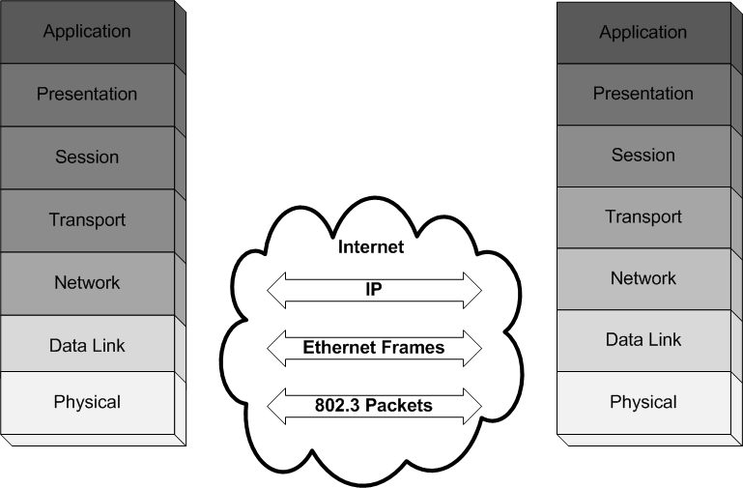
OSI Standard
April 16, 2008
Copyright Mark Goetsch

Slide 24
Figure 3.5
OSI protocol summary
Layer
Description
Examples
Application
Protocols that are designed to meet the communication requirements of
HTTP,
FTP
,
SMTP,
specific applications, often defining the interface to a service.
CORBA IIOP
Presentation
Protocols at this level transmit data in a network representation that is
Secure Sockets
independent of the representations used in individual computers, which may
(
SSL),CORBA Data
differ. Encryption is also performed in this layer, if required.
Rep.
Session
At this level reliability and adaptation are performed, such as detection of
failures and automatic recovery.
Transport
This is the lowest level at which messages (rather than packets) are handled.
TCP,
UDP
Messages are addressed to communication ports attached to processes,
Protocols in this layer may be connection-oriented or connectionless.
Network
Transfers data packets between computers in a specific network. In a WAN
IP,
ATM virtual
or an internetwork this involves the generation of a route passing through
circuits
routers. In a single LAN no routing is required.
Data link
Responsible for transmission of packets between nodes that are directly
Ethernet MAC,
connected by a physical link. In a WAN transmission is between pairs of
ATM cell transfer,
routers or between routers and hosts. In a LAN it is between any pair of hosts.
PPP
Physical
The circuits and hardware that drive the network. It transmits sequences of
Ethernet base- band
binary data by analogue signalling, using amplitude or frequency modulation
signalling,
ISDN
of electrical signals (on cable circuits), light signals (on fibre optic circuits)
or other electromagnetic signals (on radio and microwave circuits).

Slide 25
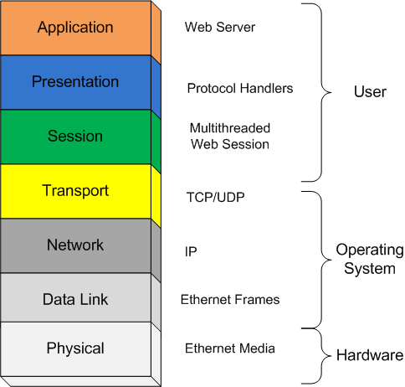
OSI Protocol Stack Implemented
Copyright Mark Goetsch
April 30, 2008

Slide 26
Layers ➔ object code
Each layer makes library calls to the level below which get included in the object code, or as SVC to operating system.
Fully compiled code might have all layers compiled into executable, with entry point into running OpSys procs or kernal code.
Each layer “hides” more complex code below.
Copyright 2008 Clark Elliott

Slide 27
Layers of detail – one line of app code = ~1500 lines of “real” code.
Java App: “open a socket”
.TCP / IP: bind, connect, listen…
..Allocate application buffers
…TCP: handshaking with other host, ports…
…. Transport: break messages into units, route
….. Allocate OpSys buffers
…….[etc.]
………translate to MAC ethernet…
Copyright 2008 Clark Elliott

Slide 28
Figure 3.2
Conceptual layering of protocol software
Message sent
Message received
Layer n
Layer 2
Layer 1
Sender
Communication
Recipient
medium

Slide 29
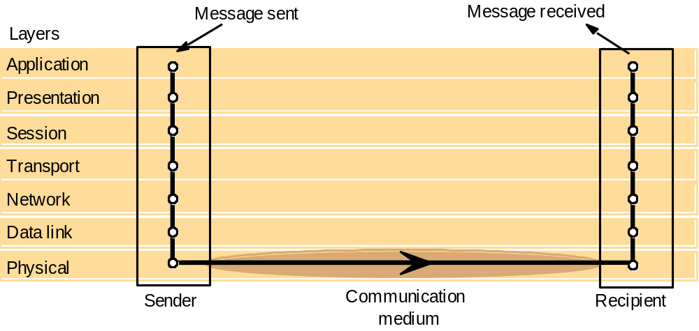
Figure 3.4
Protocol layers in the ISO Open Systems Interconnection (OSI) model

Slide 30
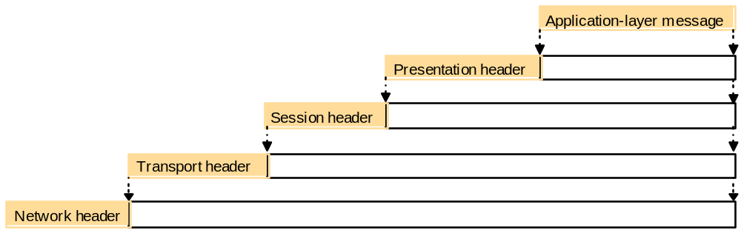
Figure 3.3
Encapsulation as it is applied in layered protocols

Slide 31
Figure 3.13
Encapsulation in a message transmitted via TCP over an Ethernet
Application message
TCP header
port
IP header
TCP
Ethernet header
IP
Ethernet frame

Slide 32
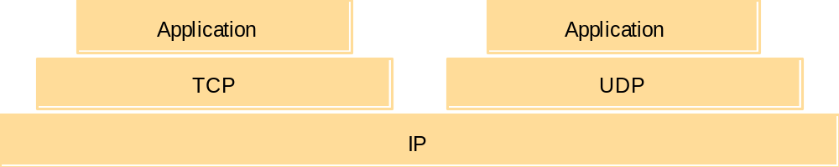
Figure 3.14
The programmer's conceptual view of a TCP/IP Internet

Slide 33
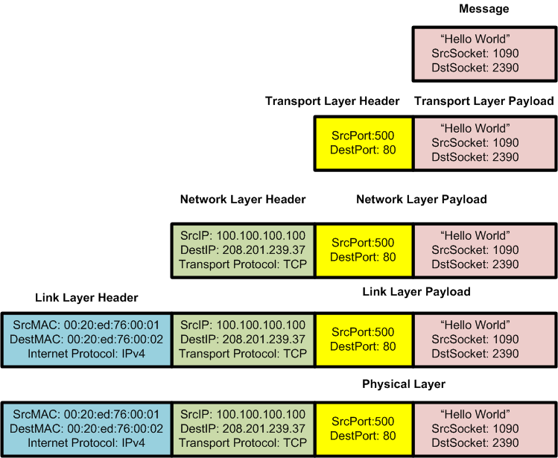
Physical and Link Layer
April 16, 2008
Copyright Mark Goetsch

Slide 34

Data Link Layer
MAC => [Media Access Control] Unique to each Network Interface Card [NIC]. Each frame contains which machine it came from and where it is going.
Ether Type => The Ethernet standard defines this as a sub-type but the 802.3 standard uses this as a length field [64-1,518 bytes]
Payload => In 802.3 standard bytes 43-1,497 contain data. There are three bytes allocated to LLC [where to put the frame in the buffer which is useful when dealing with multiple protocol stacks]
CRC => Validates that there was no corruption in the packet
Ethernet was founded from 1973-1975 by Robert Metcalf and David Boggs at Xerox Parc.
April 16, 2008
Copyright Mark Goetsch

Slide 35
IPv4 Packet
+ | Bits 0–3 | 4–7 | 8–15 | 16–18 | 19–31
0 | Version | Header length | Type of Service (now DiffServ and ECN) | Total Length
32 | Identification |  |  | Flags | Fragment Offset
64 | Time to Live |  | Protocol | Header Checksum
96 | Source Address
128 | Destination Address
160 | Options
160 or 192+ | Data
Notice the fragment offset. The size of an IP packet can be 65,535 bytes. The maximum size [MTU-Maximum Transmission Unit] for an Ethernet packet is 1,500 bytes. To accommodate this IPv4 can fragment its packet into multiple packets that are sequenced using the fragment offset field. More on this in a couple of slides…
April 16, 2008
Copyright Mark Goetsch

Slide 36
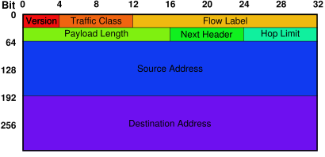
IPv6 Packet
Notice the Traffic Class and Flow Labels that we discuss in relation to QoS. Another thing to notice is the missing fragmentation field. IPv6 uses Path-MTU [PMTU] to query the path for the MTU of every router along the path.
http://www.geocities.com/siliconvalley/vista/8672/network/ipfrag.html for more on fragmentation
April 16, 2008
Copyright Mark Goetsch

Slide 37
IP Addressing
IP number – identifies which subnet the host (computer) belongs to, used to route IP packets through network.
Port numbers are assigned, through OpSys utility calls, to applications that read and write to those ports.
1-1023 reserved for OpSys utilities: e.g. ftp, http, mail
1024 -49151 registered with Internet Assigned Numbers Authority (IANA) that has service descriptions
49,152 – 65,535 for private use
In practice 1024 – 65535 are often used for programming.
Quadrad of send addr / send port / receive addr / receive port is used to identify a conversation and is included in each TCP/IP packet for datagram delivery.
Copyright 2008 Clark Elliott

Slide 38
IANA Port Assignments
Port # | Service | Protocol
21 | FTP | TCP/UDP/SCTP
23 | Telnet | TCP/UDP
25 | SMTP | TCP/UDP
80 | HTTP | TCP/UDP/SCTP
88 | Kerberos | TCP/UDP
118 | SQL Server | TCP/UDP
443 | HTTPS | TCP/UDP/SCTP
Updated this month http://www.iana.org/assignments/port-numbers
Copyright Mark Goetsch
April 30, 2008

Slide 39
IP Address
What is an IP Address?
An IP Address is a set of 4 numbers that represent the address of any host on in your intranet or Internet.
IP Addresses are either static of set dynamically by DHCP every time you log in to a network.
Each IP address has two parts: A network ID (prefix) and a Host ID.
Host | IP Address
Yahoo | 66.94.234.13 and 216.109.112.135
Microsoft | 207.46.232.182 and 207.46.197.32
Whitehouse.gov | 63.161.169.137
April 16, 2008
Copyright Mark Goetsch

Slide 40
Routing
Packets transmitted between local networks (e.g., ethernet) by hopping from one router to another.
Routers keep local tables for various destinations.
In Virtual Circuits (ATM, X.25) a fixed path is first established, and all packets follow this path. For packet-switching (IP) packets are forwarded dynamically to a router that is closer to the destination.
Copyright 2008 Clark Elliott

Slide 41

Packet Switched Network
3
B
C
4
1
6
E
A
2
5
D
Messages are broken up into packets.
Each packet is sent down and individual path [set of nodes]
Messages are reassembled on the other side in the same order
April 16, 2008
Copyright Mark Goetsch

Slide 42
Store and forward
Like the post office. Read the packet into a buffer. Read the header. Select the a router closer to the destination. Forward the packet there on a network line.
Latency is a problem, and can be thought of as the time it takes to send a packet with no data in it from source to dest.
Switches read the header “on the fly” and do not store the packet.
Copyright 2008 Clark Elliott

Slide 43
Routing algorithm
Determine where the packet must go next – has to be simple and fast for packet-switching since each tick is charged against latency
Communicate with neighbor routers about traffic congestion, failures, etc. to know where to forward packets. Slower and more intelligent than the above.
Copyright 2008 Clark Elliott

Slide 44
Distance Vector algorithm
Table of neighbors at each router
“Next hop” link for all destinations
Cost of that route by number of hops
Part one – simply look up next link by destination and send the packet there
Copyright 2008 Clark Elliott

Slide 45
Part two – using RIP (router information protocol) exchange tables with neighbors ~every 30 seconds.
If destination is in neighbor’s table, and less than existing destination + 1, then the neighbor should be the next link for the destination.
Update costs relevant to the neighbor.
If a faulty link is detected, set cost to infinity and send to all neighbors.
Bandwidths can be factored into costs.
Copyright 2008 Clark Elliott

Slide 46
Figure 3.7
Routing in a wide area network
A
1
B
Hosts
2
3
Links
4
or local
C
networks
5
D
6
E
Routers

Slide 47
Figure 3.8
Routing tables for the network in Figure 3.7
Routings from A
Routings from B
Routings from C
To
Link
Cost
To
Link
Cost
To
Link
Cost
A
local
0
A
1
1
A
2
2
B
1
1
B
local
0
B
2
1
C
1
2
C
2
1
C
local
0
D
3
1
D
1
2
D
5
2
E
1
2
E
4
1
E
5
1
Routings from D
Routings from E
To
Link
Cost
To
Link
Cost
A
3
1
A
4
2
B
3
2
B
4
1
C
6
2
C
5
1
D
local
0
D
6
1
E
6
1
E
local
0

Slide 48
Congestion
Rule of thumb: when over 80% use, throughput drops because of packet loss.
When buffers fill at a network node, then packets are dropped. These must be detected at higher levels, and then resent. Each message dropped uses > 1 unit of network resources, further leading to increased thrashing.
Congestion control gracefully delays packets along the way.
Copyright 2008 Clark Elliott

Slide 49
Circuit-Switched Network
B
Hello
Alice
Hello
Charlie
D
A
C
Circuits are checked to see that they are available
Each circuit is switched to create a continuous connection from A to D
The connection is maintained till the conversation ends
This was the traditional phone PBX connections [PSTN] that automated the switchboard that we see in movies. VC or virtual circuits were used by frame relay technology to use this with digital and IP.
April 16, 2008
Copyright Mark Goetsch

Slide 50
Subnet masks
Subnet Mask
IP Address
Subnet Address
255.255.240.000 11111111.11111111.11110000.00000000
150.215.017.009 10010110.11010111.00010001.00001001
150.215.016.000 10010110.11010111.00010000.00000000
So, 150.215.016.000 is the subnet
From http://www.webopedia.com/TERM/S/subnet_mask.htm
Borrows from host portion of class B address, to create more local sub networks.
Copyright 2008 Clark Elliott

Slide 51
Utilities
Utility | Description
Arp | The MAC addresses that your host knows.
NetStat | The status of your network interfaces and bindings.
Ping | Whether another host is active or not.
TraceRoute | The route to another host.
IPConfig | IP address of host.
NSLookup | Returns the Host name of an address.
April 16, 2008
Copyright Mark Goetsch

Slide 52
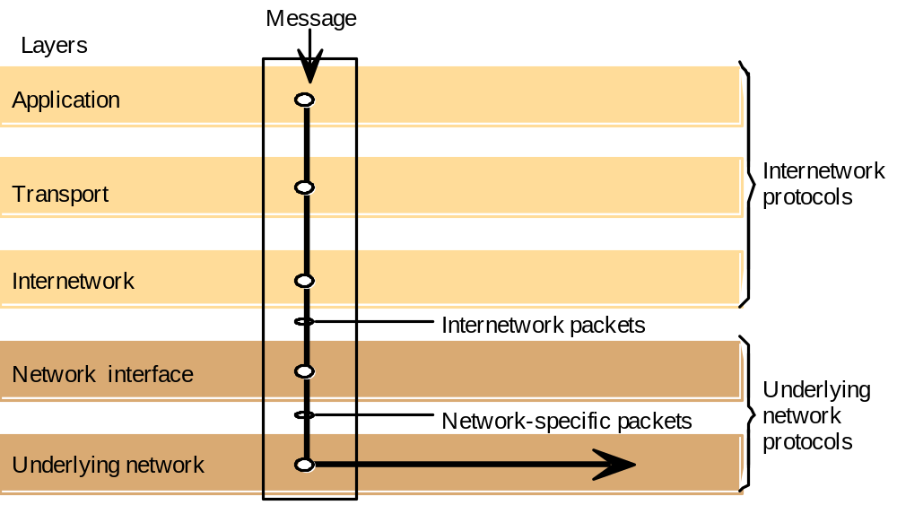
Figure 3.6
Internetwork layers

Slide 53
Figure 3.12
TCP/IP layers
Message
Layers
Application
Messages (UDP) or Streams (TCP)
Transport
UDP or TCP packets
Internet
IP datagrams
Network interface
Network-specific frames
Underlying network

Slide 54
Migration to IPv6
Address space has run out under IPv4
A new standard IPv6 allows for many more addresses, and also includes improvements for security, multimedia QOS, and routing efficiency.
Replaces IPv4 and is not compatible.
Tunneling allows for graceful adoption.
Copyright 2008 Clark Elliott

Slide 55
Figure 3.11
Tunnelling for IPv6 migration
IPv6 encapsulated in IPv4 packets
IPv4 network
IPv6
IPv6
A
B
Encapsulators

Slide 56
Conversion IP / local network address
Different local networks have different addressing schemes.
Ethernet is common, and has 48-bit addresses – ARP (address resolution protocol) is used to translate to/from IP.
Sender: broadcast IP address query.
Receiver: send back MAC address of NIC.
Sender: place pair in table, then send packet using MAC address.
Once all pairs are discovered, no query
Beyond local net, get MAC of gateway & send
Copyright 2008 Clark Elliott

Slide 57
Snooping / spoofing
Set NIC to promiscuous mode, and listen to everyone’s conversation on ethernet
Replace your IP address/port in the “from” part of the packet with someone else’s address.
Note: can include return address in encrypted data for authentication – do not HAVE to use IP header for return address.
Copyright 2008 Clark Elliott

Slide 58
IP Routing
Routing protocols and algorithms have been studied at great length.
Issues:
  Not possible for every node to have complete and current knowledge
  Speed of routing decision is critical
  Internet is dynamic – nodes come and go, failures happen, bandwidths change, usage is dynamic, usage type drifts (media QoS)
Copyright 2008 Clark Elliott

Slide 59
Fixes
Get table updates at random times
Default destination allows for incomplete tables – trade routing efficiency for table size.
IPv6 and retro to IPv4 (after 1993), have geographical and logical meaning to IP adresses.
Copyright 2008 Clark Elliott

Slide 60
CIDR
Classless Interdomain Routing
Borrows some IP address from class C which did not need them, and donates to class B, which did. Uses masking to for dynamic length of domain / host.
Does not otherwise concern us, and will be obviated by IPv6
Copyright 2008 Clark Elliott

Slide 61
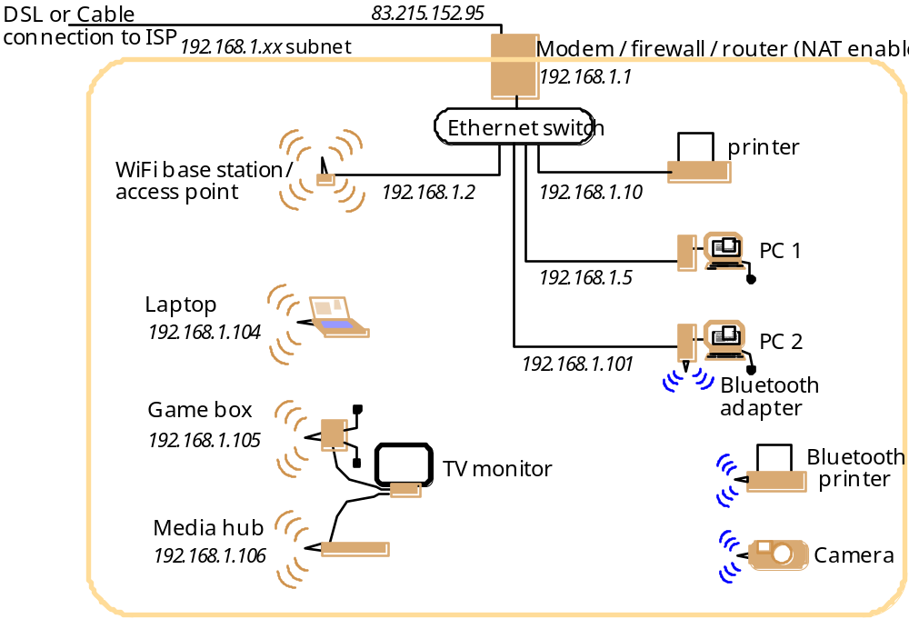
Figure 3.18
A typical NAT-based home network

Slide 62
Network Address Translation
Used in millions (?) of homes / offices
192.168.x.x “home” domain, fake IP address primarily for internal IP hosts that operate as clients to internet.
Copyright 2008 Clark Elliott

Slide 63
NAT…
Local host (lhost) sends packet to internet
Router saves lhost IP/port in table
Replaces with router’s IP address and a virtual port that indexes entry in the table.
Send to dest.
If reply to IP of router, use port for table lookup, replace address with internal IP and port of lhost. Send to ethernet.
Keep entries for a while, then discard
Copyright 2008 Clark Elliott

Slide 64
Servers on NAT
With many ISPs the router IP changes, so have to have a forwarding site to translate domain name, and wait for propagation.
External clients use IP of router (or domain name pointing to it), and a specific port.
Router forwards all incoming traffic for that port to lhost at some manually assigned port.
Lhost servers cannot use DHCP
Copyright 2008 Clark Elliott

Slide 65
IPv6
128 bit addressing, or 1000 IP addresses per square meter of earth’s surface
Geographic and organizational semantics in addresses
Flow labels for QoS improvements
Security headers – but note that destinations are not encrypted (?), authentication for RIP
Slow migration, but 1 billion Devices in China and India by 2014, plus mobile IP needs.
Copyright 2008 Clark Elliott

Slide 66
Your laptop
When you take your laptop to a new location it discovers the local subnet and gets a local IP address from DHCP.
Your laptop can now act as a client.
Legacy service conversations with servers on your laptop can no longer find you.
Address forwarding software can work around this but either low efficiency (every packet is forwarded) or both sides have to know to dynamically update the service address after initial handshaking.
Copyright 2008 Clark Elliott

Slide 67
Home agents and Foreign Agents
Run at home host, and foreign host
HA must have up-to-date knowledge of the IP location of mobile host (mhost).
HA tells local routers to get rid of cached records of mhost.
HA uses ARP (Address Request Protocol) to accept packets as a proxy for mhost.
Mhost works with FA to inform HA of where it is.
HA forwards packets wrapped in Mobile-IP packets.
FA passes to Mhost.
If sender is Mobile-IP enabled, can now communicate directly, otherwise repeat.
Servers can now be mobile.
Copyright 2008 Clark Elliott

Slide 68
Figure 3.20
The MobileIP routing mechanism
Sender
Subsequent IP packets
tunnelled to FA
Mobile host MH
Address of FA
returned to sender
First IP packet
addressed to MH
Internet
Foreign agent FA
Home
First IP packet
agent
tunnelled to FA

Slide 69
Not best solution
Requires HA.
Setup time
Requires clients to be Mobile-IP or have to route ALL packets twice.
Mobile phones are first-class citizens as they move from cell to cell.
Copyright 2008 Clark Elliott

Slide 70
TCP & UDP in IPv6
TCP and UDP exploit most of what IPv4 has to offer.
IPv6 offers much more flexibility so we may finally see new protocols replacing TCP and UDP.
Copyright 2008 Clark Elliott

Slide 71
TCP & UDP
Transport protocols, process-to-process communication msgs, uses ports for this.
Processes acquire ports from the operating system through system calls.
Copyright 2008 Clark Elliott

Slide 72
Universal Datagram Protocol - UDP
“IP up one level”
Source and dest ports for addressing
Length. Checksum optionally used by receiving host.
Cheap, fast.
No guarantees of delivery, or order of arrival.
Copyright 2008 Clark Elliott

Slide 73
Trasmission Control Protocol - TCP
Reliable transmission of streams
Connection-oriented.
Guaranteed delivery in guaranteed order
IP does not know about it. End-to-end.
Copyright 2008 Clark Elliott

Slide 74
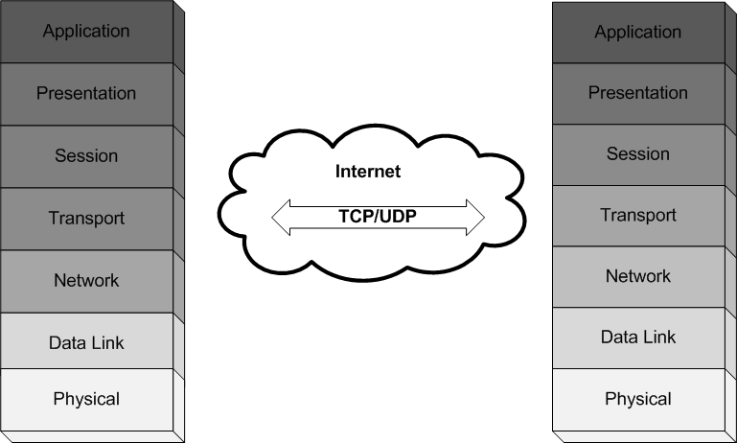
Transport Layer – TCP/UDP
Copyright Mark Goetsch
April 30, 2008

Slide 75
TCP features
Guaranteed sequence – requires “infinite” buffer – wait for first packet to arrive
Flow control – windows, maximum delay before send, configurable, etc. so that receiver or network is not overwhelmed, and user does not have to wait too long.
Auto retransmission of packets as needed
Buffering as needed for flow control and ordering.
Copyright 2008 Clark Elliott

Slide 76
TCP Protocol
Connection-Oriented
Data packets are delivered in the correct order.
Reliable
Every piece of data will arrive.
Duplex
You can send information both ways at the same time, through the same connection.
Byte-Oriented
The data is presented as a stream of data rather than a set of packets.
How does this happen?
Copyright Mark Goetsch
April 30, 2008

Slide 77
The Inner Workings of TCP
Each TCP connection provides a buffer that will hold the data until it has been verified that it has arrived.
The buffer also is used to order the packets in the correct sequence.
Every packet that is sent requires an “Ack” from the receiver so that it knows that it has arrived.
A CRC field is added and checked by the receiver to see that the data was not corrupted.
Each connection is a 4-tuple consisting of the port numbers for both the client and server, and the IP addresses as well.
Which has quite a bit of overhead!
Copyright Mark Goetsch
April 30, 2008

Slide 78
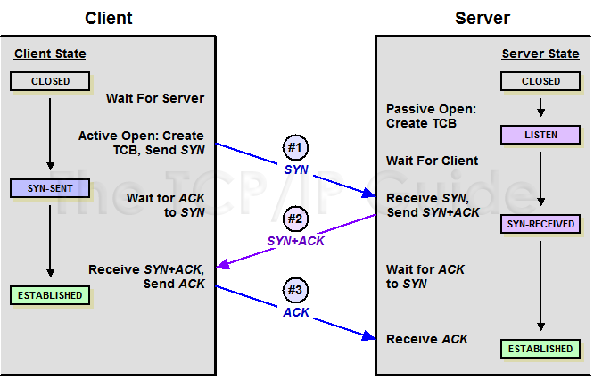
3 – Way Handshake
http://www.tcpipguide.com/free/t_TCPConnectionEstablishmentProcessTheThreeWayHandsh-3.htm
Copyright Mark Goetsch
April 30, 2008

Slide 79
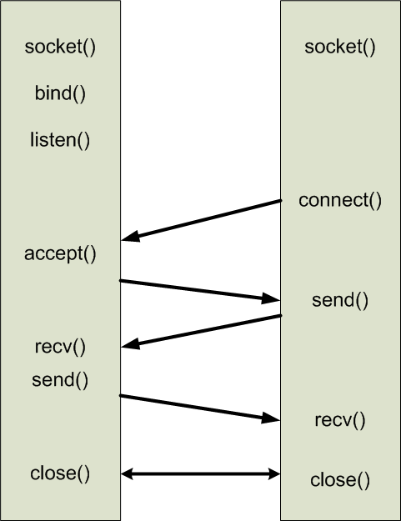
TCP Connection Steps
Server
Client
Copyright Mark Goetsch
April 30, 2008

Slide 80
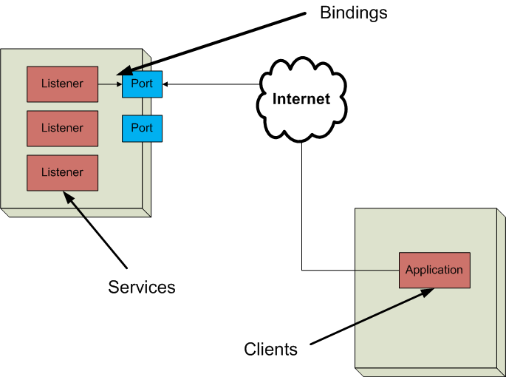
Server TCP/UDP Ports
Copyright Mark Goetsch
April 30, 2008

Slide 81
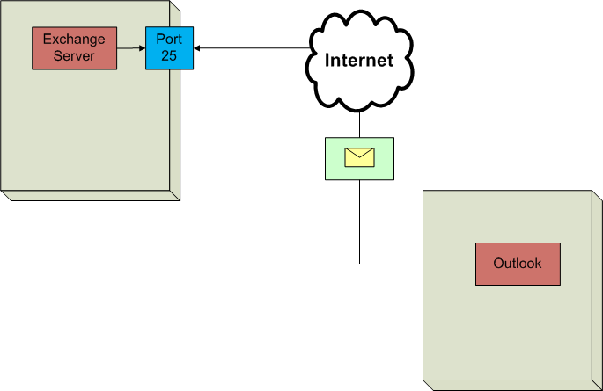
Example : Email
Copyright Mark Goetsch
April 30, 2008

Slide 82
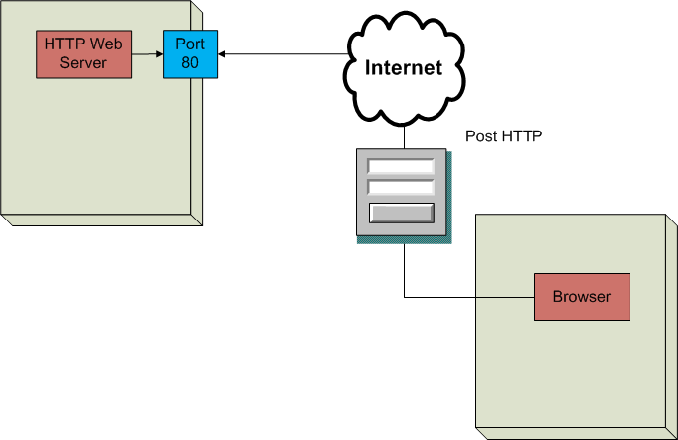
Example: Web Server
Copyright Mark Goetsch
April 30, 2008

Slide 83
DNS
Independent of IP
Tables of symbolic names that get translated to IP addresses.
Correspondence to local networks.
Records are cached around the world on DNS servers, and updates are propagated slowly.
Copyright 2008 Clark Elliott

Slide 84
Firewalls
Border router between intranet and larger internet
Service control – which internal services can be presented, which external service requests are allowed.
  E.g., workers only visit approved web sites; only official internal web servers allowed, Inspect all IP packets, http requests, tcp/udp headers.
Copyright 2008 Clark Elliott

Slide 85
Behavior control by inspecting content
  E.g., controlling spam, pornography
User control – differing levels of authority by user identification.
Copyright 2008 Clark Elliott

Slide 86
Filters
IP packet filtering – discard packets that are not allowed. Inspect addresses, service type, compare service to data
TCP gateway – monitor the setting up of TCP connections, check TCP segments for correctness, watch for known attacks
Application gateway - run proxies for applications to control access. E.g. telnet only to certain locations.
Copyright 2008 Clark Elliott

Slide 87
Collection of processes / boxes
A firewall may be a collection of cooperating processes working at different protocol levels.
May have more than one dedicated computer for efficiency and reliability
Firewalls are computers and processes that, themselves, can be attacked.
Copyright 2008 Clark Elliott

Slide 88
“Bastion”
Firewall that runs TCP and application-level software, usually on a separate computer.
Policy may require that proxies are run for all outside services.
May have firewalls run in series, to protect internal address from outside inspection.
Copyright 2008 Clark Elliott

Slide 89
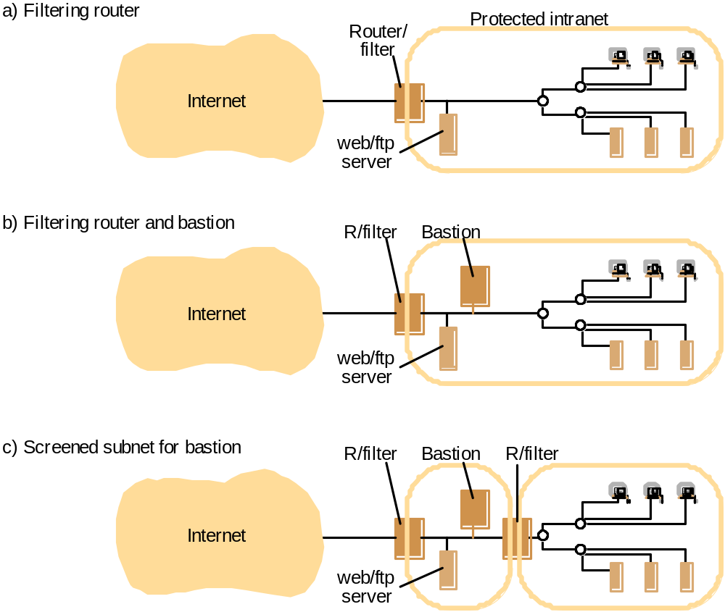
Figure 3.21
Firewall configurations

Slide 90
IPsec (“IP security”)
Operates at a lower level than TSL, SSL, so applicable to wide range of applications including basic TCP and UDP without requiring rewrite apps. Provides:
  Encrypting traffic (so it cannot be read by parties other than those for whom it is intended)
  Integrity validation (ensuring traffic has not been modified along its path)
  Authenticating the peers (ensuring that traffic is from a trusted party)
  Anti-replay (protecting against replay of the secure session).
Uses IKE internet key exchange
Mandated in IPv6, but forced onto IPv4 by need.
Copyright 2008 Clark Elliott

Slide 91
VPNs
Virtual Private Networks
Based on IPsec
Typical: home ISP user exchanges keys with firewall, and can then access intranet
Can also connect two intranets
Copyright 2008 Clark Elliott

Slide 92
Figure 3.22
IEEE 802 network standards
IEEE No.
Name
Title
Reference
802.3
Ethernet
CSMA/CD Networks (Ethernet)
[IEEE 1985a]
802.4
Token Bus Networks
[IEEE 1985b]
802.5
Token Ring Networks
[IEEE 1985c]
802.6
Metropolitan Area Networks
[IEEE 1994]
802.11
WiFi
Wireless Local Area Networks
[IEEE 1999]
802.15.1
Bluetooth
Wireless Personal Area Networks
[IEEE 2002]
802.15.4
ZigBee
Wireless Sensor Networks
[IEEE 2003]
802.16
WiMAX
Wireless Metropolitan Area Networks
[IEEE 2004a]

Slide 93
Ethernet
Cheap, reliable, local area network
Long time defacto standard at 10Mbps
100 Mbps is cheap, and 1000 Mbps available.
Broadcast of all packets
NICs listen to all traffic and normally ignore all that does match, pass those that do up the protocol stack.
Separate send and receive – don’t start send if other is.
Collisions can occur resulting in resends, and ultimately thrashing if overloaded. Longer cable / more collisions.
Use of switches/software, reduces collisions & helps guarantee latency and delivery for QoS. Not obsolete yet
Copyright 2008 Clark Elliott

Slide 94
Ethernet
Uses CSMA/CD:
Sense if the line is free
Every computer has full-time access – Multiple Access
Detect collisions and resend after a random delay.
Medium Access Control (MAC) is protocol, hence MAC addresses are used in hrdwre
Copyright 2008 Clark Elliott

Slide 95
Figure 3.23
Ethernet ranges and speeds
10Base5
10BaseT
100BaseT
1000BaseT
Data rate
10 Mbps
10 Mbps
100 Mbps
1000 Mbps
Max. segment lengths:
Twisted wire (UTP)
100 m
100 m
100 m
25 m
Coaxial cable (STP)
500 m
500 m
500 m
25 m
Multi-mode fibre
2000 m
2000 m
500 m
500 m
Mono-mode fibre
25000 m
25000 m
20000 m
2000 m

Slide 96
WiFi
802.11g (2.4 GHz) and 802.11a (5 GHz) operate at 54 Mbps
MAC (media acces control) is broadcast protocol, all can send and receive.
More lost packets, more collisions:
  Carrier signal is not consistent.
  Cannot detect sends of others (e.g., A and D in figure).
  Nodes may be in range of hub, but not each other.
  Local radio signal dwarfs remote signal, so collisions not detected.
Copyright 2008 Clark Elliott

Slide 97
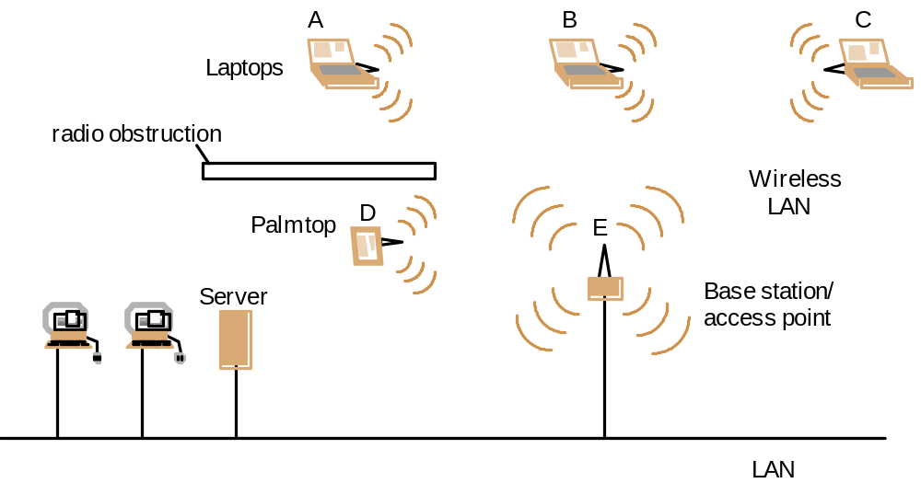
Figure 3.24
Wireless LAN configuration

Slide 98
Slot reservation extension to Ethernet
Collision avoidance augmentation via CSMA/CA; reserves transmission slots.
Short negotiation packets (Request to send, RTS; clear to send, CTS) are sent first between sender and receiver, with duration. Others wait until slot has passed.
Fewer collisions with short packets.
Improves wireless reliability and QoS.
Copyright 2008 Clark Elliott

Slide 99
Bluetooth IEEE 802.15, 2002
Developed by Ericsson.
Voice and data
$5 per device
Low battery consumption – several hours even with earpiece battery. Wake up and listen for a paging call, so long latency to establish contact.
Adaptable power transmission from 1 Mwatt (10 meters) to 100Mwatt (100 meters)
Switches 1600 times / second between 79 sub-bands of 2.4 GHz public frequency for reduced interference
Copyright 2008 Clark Elliott

Slide 100
Master / slave
Pairs operate as master / slave, with master allocating communication slots
Piconet – up to 7 slaves one master and up to 255 parked (dormant) slaves in low power mode waiting for a wakeup signal.
Scatternet – linked piconets.
Most devices can be master or slave.
All devices have 48-bit GUIDs, but slaves assigned 1-7 to save space.
Copyright 2008 Clark Elliott

Slide 101
Bluetooth…
Designed for QoS required of audio.
Synchronous and async transfer.
Up to 1 Mbps
Includes specifications for app-level protocols to encourage interoperation of manufactured devices.
Association of new / parked devices is slow, up to 10 seconds – so not for e.g., toll road pickup of vehicles.
Version 2.0: 3 Mbps (cd quailty audio), larger piconets, faster association is in the works.
Copyright 2008 Clark Elliott

Slide 102
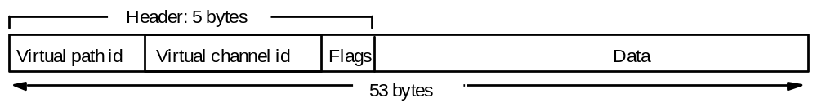
Figure 3.27
ATM cell layout

Slide 103
ATM – asynchronous transfer mode
Fast packet switching w/ suitable QoS for multimedia transmission
Avoids flow control and error checking
Fixed-length units of data (cells) 53 bytes
Establishes a connection first, guarantees bandwidth and latency. Frame relay does not store cell/frame.
High-speed switching, low latency
Similar speed to LANs.
High QoS and speeds of 600Mbps for multimedia will be available for internet.
Pure ATM up to 1 Gbps.
Slow to adopt because of expense compared to e.g., 1000Mbps ethernets.
Copyright 2008 Clark Elliott

Slide 104
Blank
Copyright 2008 Clark Elliott

