Slide 1
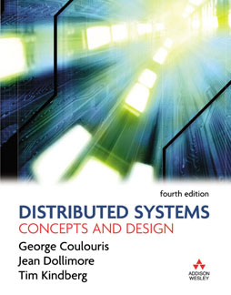
Slides for Chapter 5:
Distributed objects and remote invocation
From Coulouris, Dollimore and Kindberg
Distributed Systems:
Concepts and Design
Edition 4, © Addison-Wesley 2005

Slide 2
ECT425 DePaul -- Elliott
Slides prepared by…
  Professor Clark Elliott
  DePaul University
Some slides courtesy of Mark Goetsch
  DePaul University
Copyright 2008 Clark Elliott

Slide 3
Figure 5.1
Middleware layers
Applications
RMI, RPC and events
Middleware
Request reply protocol
layers
External data representation
Operating System

Slide 4
The Object Model
Objects encapsulate data and the methods that access it
Objects can refer to other objects, and variables can hold these references.
Methods can be invoked by one object to access data in other objects, usually passing arguments.
Interfaces describe collections of methods (arguments, return values, exceptions). Objects may provide interfaces if they implement all the methods.
Invoking a method may affect target object: change its state, instantiate a new object, invoke other methods on the same, or other, objects. Return values can be had.
Copyright 2008 Clark Elliott

Slide 5
Exceptions
Much more common in “real” code
Graceful change of control for non-customary processing keeps code clean
Code blocks throw control to other code that catches it.
Copyright 2008 Clark Elliott

Slide 6
DSes are natural extension of OO programming
Object programs distribute process state (roughly, the contents of a program’s variables) naturally in logically separate, encapsulated, locations already
When clients and servers are in different processes, this mandates encapsulation, which makes software engineers happy
Interfaces fully describe access, so implementation, including on unlike systems, is hidden.
Copyright 2008 Clark Elliott

Slide 7
Distributed Object Model
An object is known as remote if it can be accessed remotely. Think remotely-accessible
Objects must first obtain a reference to the remote object, then can invoke methods on it.
Remote objects must present a remote interface – e.g. in Java can accept RMIs
Remote object references are UUIDs and can be passed around
Copyright 2008 Clark Elliott

Slide 8
IDLs
Interface Definition Languages are used for describing remote interfaces.
All DS middleware systems provide IDLs
The important part of IDLs is the rules. That IDL utilities (“IDL compilers”) also partially generate stub code is handy but not necessary.
Copyright 2008 Clark Elliott

Slide 9
Figure 5.2
CORBA IDL example
// In file Person.idl
struct Person {
string name;
string place;
long year;
} ;
interface PersonList {
readonly attribute string listname;
void addPerson(in Person p) ;
void getPerson(in string name, out Person p);
long number();
};

Slide 10
Figure 5.4
A remote object and its remote interface
remote
object
remote
Data
interface
m4
{
m1
implementation
m2
m5
m3
of methods
m6

Slide 11
Obtaining remote references
In Fig. 5.3 Object A, which already has a reference to B, might also obtain a reference to F.
Copyright 2008 Clark Elliott

Slide 12
Figure 5.3
Remote and local method invocations
remote
local
C
invocation
invocation
local
E
invocation
remote
B
invocation
F
A
local
invocation
D

Slide 13
Instantiating remote objects
Remote objects can be created locally.
Fig. 5.5: If L provides remote methods to instantiate M and N then C and K can, effectively, also create remote objects.
Copyright 2008 Clark Elliott

Slide 14
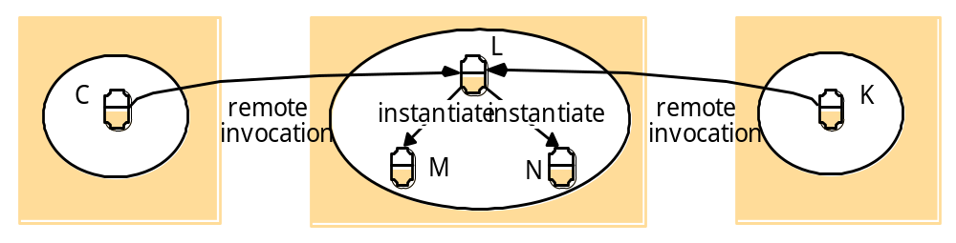
Figure 5.5 Instantiation of remote objects

Slide 15
Remote garbage collection
Much harder than the book implies – in fact the book handles this poorly on p 5.5
The book says that a “reference counting” module added to the local garbage collection system usually will handle this
So, in a system that can pass remote object references, how does reference counting work? Anyone can copy a UUID.
Copyright 2008 Clark Elliott

Slide 16
Request (Call) semantics
Local method calls are performed exactly once.
Retry request message
Duplicate filtering at the server
Retransmit results – keep history of results at server
Copyright 2008 Clark Elliott

Slide 17
Figure 5.6
Invocation semantics
Fault tolerance measures
Invocation
semantics
Retransmit request
Duplicate
Re-execute procedure
message
filtering
or retransmit reply
No
Not applicable
Not applicable
Maybe
Yes
No
Re-execute procedure
At-least-once
Yes
Yes
Retransmit reply
At-most-once

Slide 18
Pick the cheapest semantics
Saves development and maintenance time
Simpler to understand
Copyright 2008 Clark Elliott

Slide 19
Maybe Invocation Semantics
Remote method executed once or not at all
If result message has not been received (e.g. omission/crash failures) it is not certain whether or not execution occurred
Useful when occasional failures are acceptable.
Saves money and time
Copyright 2008 Clark Elliott

Slide 20
At least once semantics
Receive result, or message that operation was not performed
Achieved through retransmission of requests
Works for idempotent operations where duplicate requests are acceptable
E.g., data collection that can later be filtered.
Copyright 2008 Clark Elliott

Slide 21
At most once semantics
Either result is returned, or exception that no result was returned.
Method invoked AT MOST one time.
Resend the request to mask omission failures
Resend results, but do not re-invoke method, to mask omission failures in the other direction.
This is most typical
Copyright 2008 Clark Elliott

Slide 22
Objects that call remote methods
If no result is returned, then in general cannot know if it is a network failure, or a server failure.
Callers must be robust with respect to these kinds of ambiguity that do not occur with local calls. – Detection and recover?
Latency is much greater, and much more varied.
Copyright 2008 Clark Elliott

Slide 23
How transparent?
Transparency of local/remote methods could be good, or bad.
Java RMI methods implement remote interface, and throw RemoteExceptions so the differences can be handled outside the ordinary application code.
Copyright 2008 Clark Elliott

Slide 24
Event-notification systems
Heterogeneous: any kind of system just needs an event-receiving module and/or an event-generating module. This allows interaction of many unlike systems
Asynchronous: publishers and subscribers do not have to synchronize – just publish and let subscriber worry about it. Persistent storage of events?
Copyright 2008 Clark Elliott

Slide 25
Figure 5.7
The role of proxy and skeleton in remote method invocation
client
server
remote
object A
proxy for B
skeleton
object B
Request
& dispatcher
for B’s class
Reply
servant
Remote
Communication
Communication
Remote reference
reference module
module
module
module

Slide 26
Figure 5.8 Role of client and server stub procedures in RPC in the context of a procedural language
client process
server process
Request
Reply
client stub
server stub
procedure
procedure
client
service
program
Communication
Communication
procedure
module
module
dispatcher

Slide 27
Figure 5.9
Files interface in Sun XDR
const MAX = 1000;
typedef int FileIdentifier;
typedef int FilePointer;
typedef int Length;
struct Data {
int length;
char buffer[MAX];
};
struct writeargs {
FileIdentifier f;
FilePointer position;
Data data;
};
struct readargs {
FileIdentifier f;
FilePointer position;
Length length;
};
program FILEREADWRITE {
version VERSION {
void WRITE(writeargs)=1; 1
Data READ(readargs)=2; 2
}=2;
} = 9999;

Slide 28
Figure 5.10
Dealing room system
Dealer’s computer
External
Dealer’s computer
source
Dealer
Notification
Notification
Dealer
Notification
Information
provider
Notification
Notification
Notification
Notification
Dealer’s computer
Dealer’s computer
Notification
Information
provider
Notification
Dealer
Notification
Dealer
External
source

Slide 29
Figure 5.11
Architecture for distributed event notification
Event service
object of interest
subscriber
1.
notification
object of interest
observer
subscriber
2.
notification
notification
object of interest
observer
subscriber
3.
notification

Slide 30
Figure 5.12
Java Remote interfaces Shape and ShapeList
import java.rmi.*;
import java.util.Vector;
public interface Shape extends Remote {
int getVersion() throws RemoteException;
GraphicalObject getAllState() throws RemoteException; 1
}
public interface ShapeList extends Remote {
Shape newShape(GraphicalObject g) throws RemoteException; 2
Vector allShapes() throws RemoteException;
int getVersion() throws RemoteException;
}

Slide 31
Figure 5.13
The Naming class of Java RMIregistry
void rebind (String name, Remote obj)
  This method is used by a server to register the identifier of a remote object by name, as shown in Figure 15.13, line 3.
void bind (String name, Remote obj)
  This method can alternatively be used by a server to register a remote object by name, but if the name is already bound to a remote object reference an exception is thrown.
void unbind (String name, Remote obj)
  This method removes a binding.
Remote lookup(String name)
  This method is used by clients to look up a remote object by name, as shown in Figure 15.15 line 1. A remote object reference is returned.
String [] list()
  This method returns an array of Strings containing the names bound in the registry.

Slide 32
Figure 5.14
Java class ShapeListServer with main method
import java.rmi.*;
public class ShapeListServer{
public static void main(String args[]){
System.setSecurityManager(new RMISecurityManager());
try{
ShapeList aShapeList = new ShapeListServant(); 1
Naming.rebind("Shape List", aShapeList ); 2
System.out.println("ShapeList server ready");
}catch(Exception e) {
System.out.println("ShapeList server main " + e.getMessage());}
}
}

Slide 33
Figure 5.15
Java class ShapeListServant implements interface ShapeList
import java.rmi.*;
import java.rmi.server.UnicastRemoteObject;
import java.util.Vector;
public class ShapeListServant extends UnicastRemoteObject implements ShapeList {
private Vector theList; // contains the list of Shapes 1
private int version;
public ShapeListServant()throws RemoteException{...}
public Shape newShape(GraphicalObject g) throws RemoteException { 2
version++;
Shape s = new ShapeServant( g, version); 3
theList.addElement(s);
return s;
}
public Vector allShapes()throws RemoteException{...}
public int getVersion() throws RemoteException { ... }
}

Slide 34
Figure 5.16
Java client of ShapeList
import java.rmi.*;
import java.rmi.server.*;
import java.util.Vector;
public class ShapeListClient{
public static void main(String args[]){
System.setSecurityManager(new RMISecurityManager());
ShapeList aShapeList = null;
try{
aShapeList = (ShapeList) Naming.lookup("//bruno.ShapeList") ; 1
Vector sList = aShapeList.allShapes(); 2
} catch(RemoteException e) {System.out.println(e.getMessage());
}catch(Exception e) {System.out.println("Client: " + e.getMessage());}
}
}

Slide 35
Figure 5.17
Classes supporting Java RMI
RemoteObject
RemoteServer
Activatable
UnicastRemoteObject
<servant class>

