Slide 1
DISTRIBUTED SYSTEMS Principles and Paradigms Second Edition ANDREW S. TANENBAUM MAARTEN VAN STEEN Chapter 8 Fault Tolerance

Slide 2
Fault Tolerance Basic Concepts
Being fault tolerant is strongly related to what are called dependable systems
Dependability implies the following:
Availability
Reliability
Safety
Maintainability

Slide 3
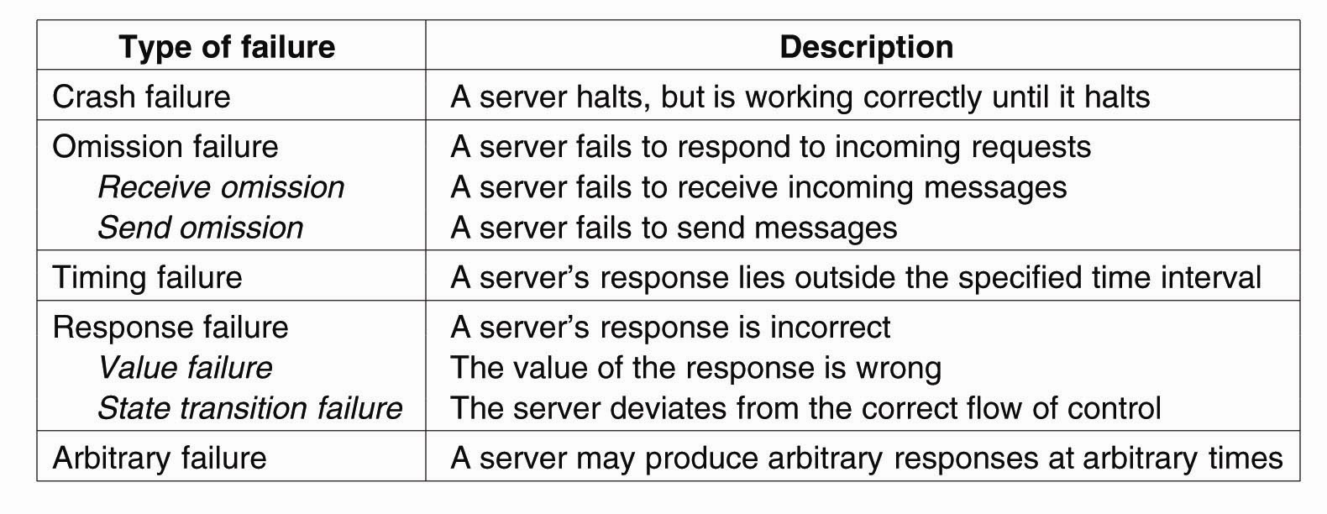
Failure Models
Figure 8-1. Different types of failures.

Slide 4
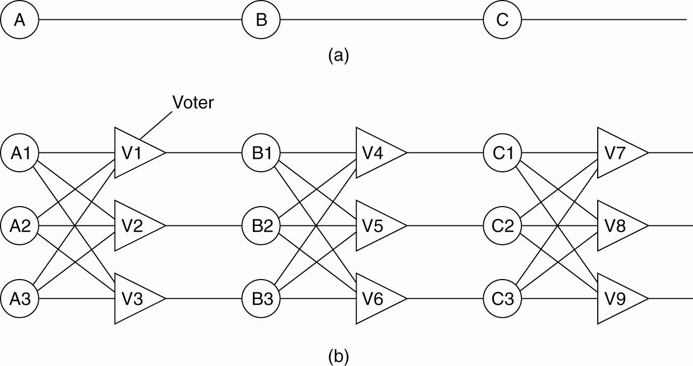
Failure Masking by Redundancy
Figure 8-2. Triple modular redundancy.

Slide 5
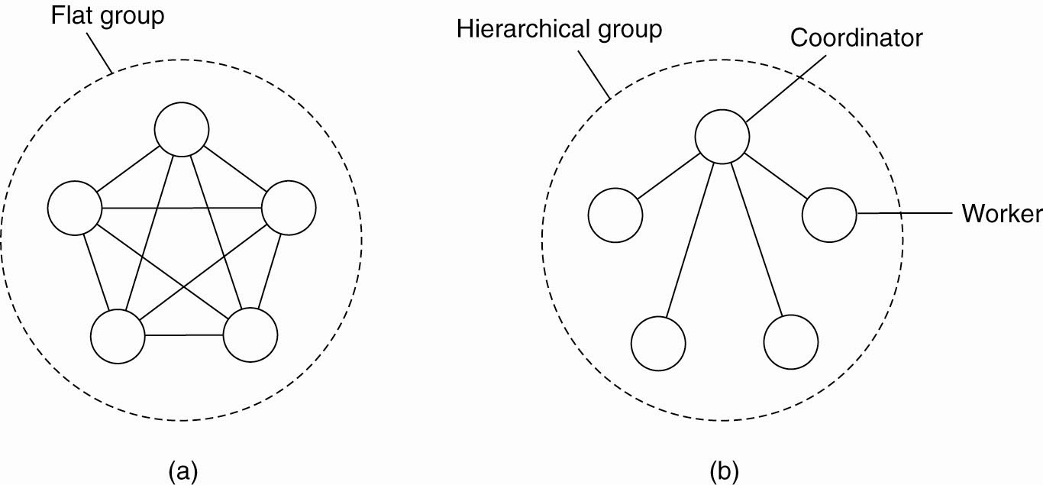
Flat Groups versus Hierarchical Groups
Figure 8-3. (a) Communication in a flat group. (b) Communication in a simple hierarchical group.

Slide 6
Agreement in Faulty Systems (1)
Possible cases:
Synchronous versus asynchronous systems.
Communication delay is bounded or not.
Message delivery is ordered or not.
Message transmission is done through unicasting or multicasting.

Slide 7
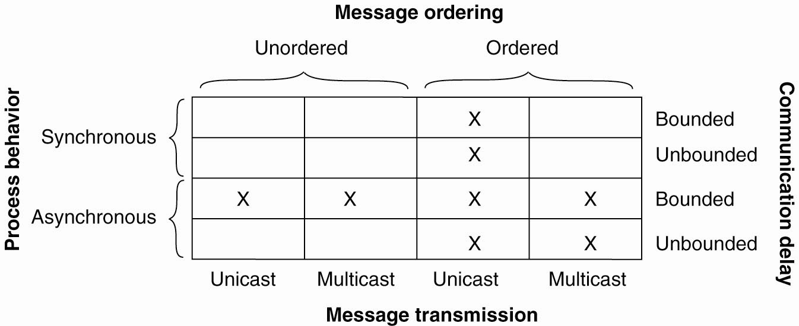
Agreement in Faulty Systems (2)
Figure 8-4. Circumstances under which distributed agreement can be reached.

Slide 8
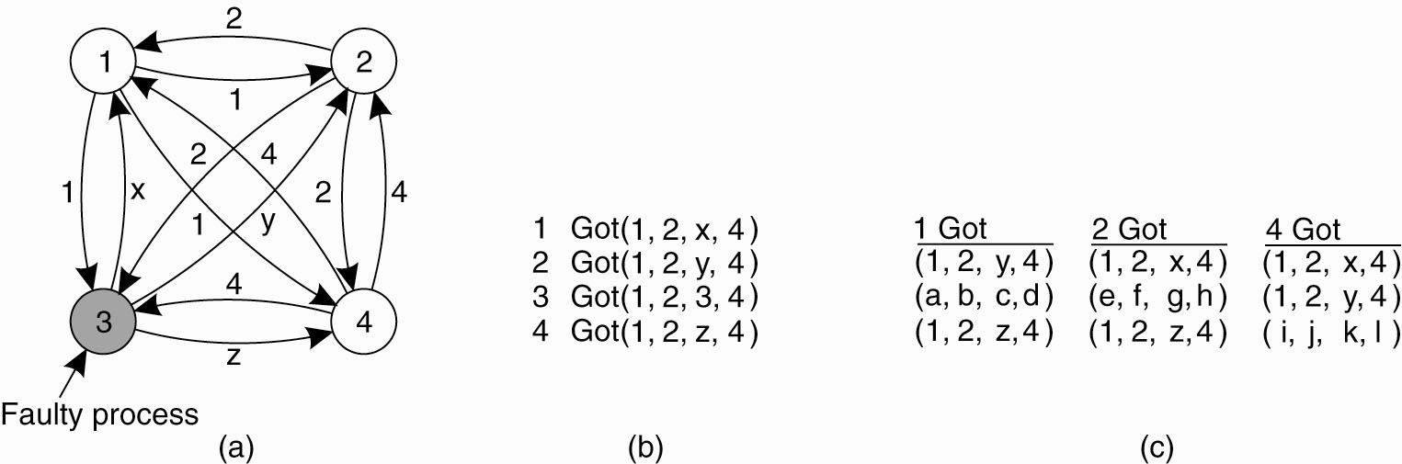
Agreement in Faulty Systems (3)
Figure 8-5. The Byzantine agreement problem for three nonfaulty and one faulty process. (a) Each process sends their value to the others.

Slide 9
Agreement in Faulty Systems (4)
Figure 8-5. The Byzantine agreement problem for three nonfaulty and one faulty process. (b) The vectors that each process assembles based on (a). (c) The vectors that each process receives in step 3.

Slide 10
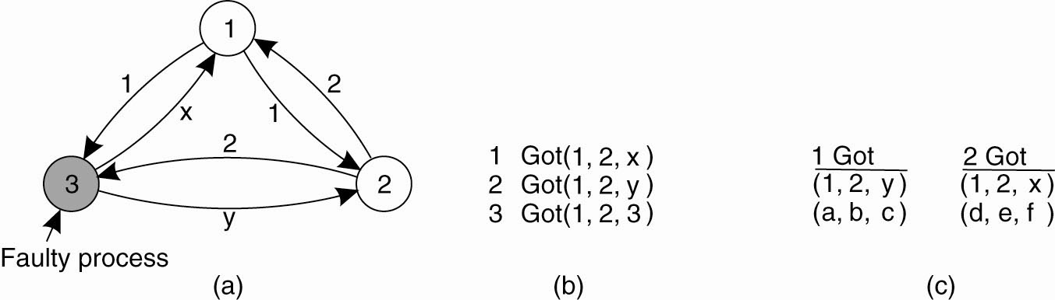
Agreement in Faulty Systems (5)
Figure 8-6. The same as Fig. 8-5, except now with two correct process and one faulty process.

Slide 11
RPC Semantics in the Presence of Failures
Five different classes of failures that can occur in RPC systems:
The client is unable to locate the server.
The request message from the client to the server is lost.
The server crashes after receiving a request.
The reply message from the server to the client is lost.
The client crashes after sending a request.

Slide 12
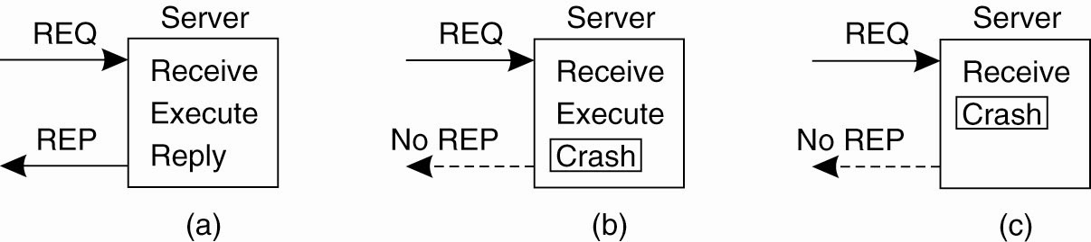
Server Crashes (1)
Figure 8-7. A server in client-server communication. (a) The normal case. (b) Crash after execution. (c) Crash before execution.

Slide 13
Server Crashes (2)
Three events that can happen at the server:
Send the completion message (M),
Print the text (P),
Crash (C).

Slide 14
Server Crashes (3)
These events can occur in six different orderings:
M →P →C: A crash occurs after sending the completion message and printing the text.
M →C (→P): A crash happens after sending the completion message, but before the text could be printed.
P →M →C: A crash occurs after sending the completion message and printing the text.
P→C(→M): The text printed, after which a crash occurs before the completion message could be sent.
C (→P →M): A crash happens before the server could do anything.
C (→M →P): A crash happens before the server could do anything.

Slide 15
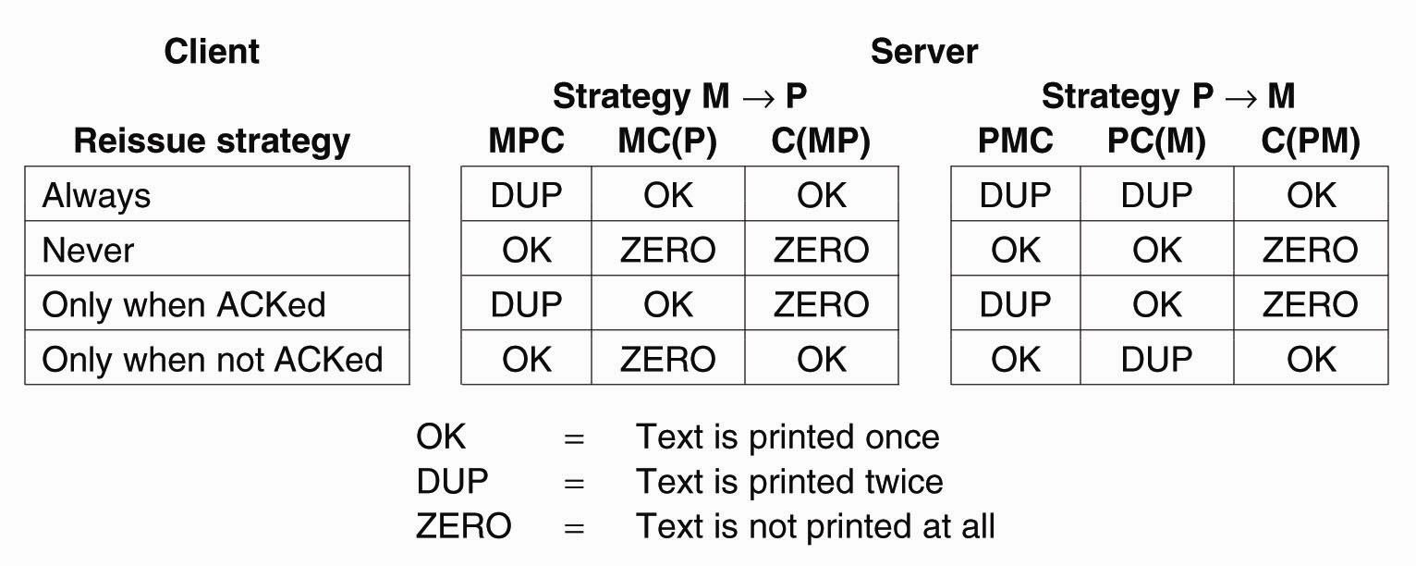
Server Crashes (4)
Figure 8-8. Different combinations of client and server strategies in the presence of server crashes.

Slide 16
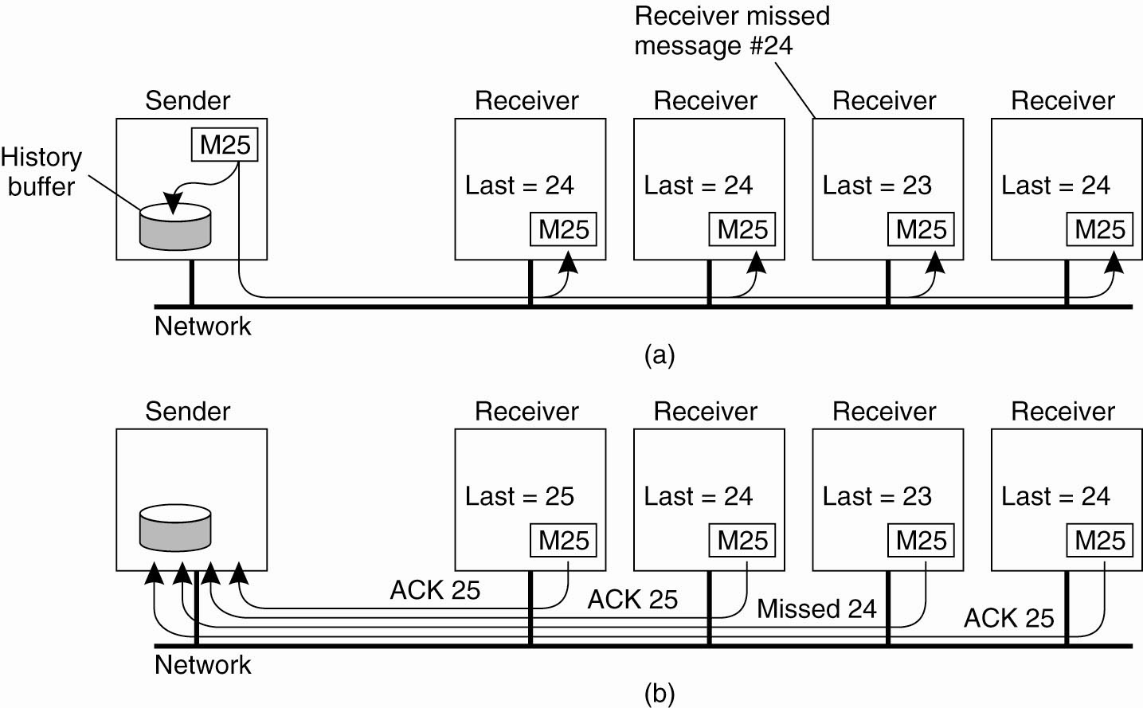
Basic Reliable-Multicasting Schemes
Figure 8-9. A simple solution to reliable multicasting when all receivers are known and are assumed not to fail.
(a) Message transmission. (b) Reporting feedback.

Slide 17
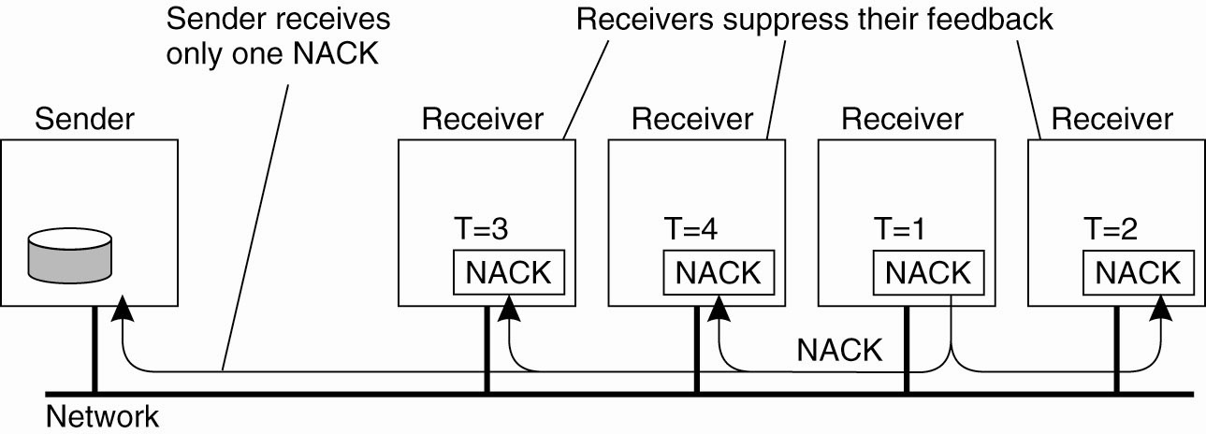
Nonhierarchical Feedback Control
Figure 8-10. Several receivers have scheduled a request for retransmission, but the first retransmission request leads to the suppression of others.

Slide 18
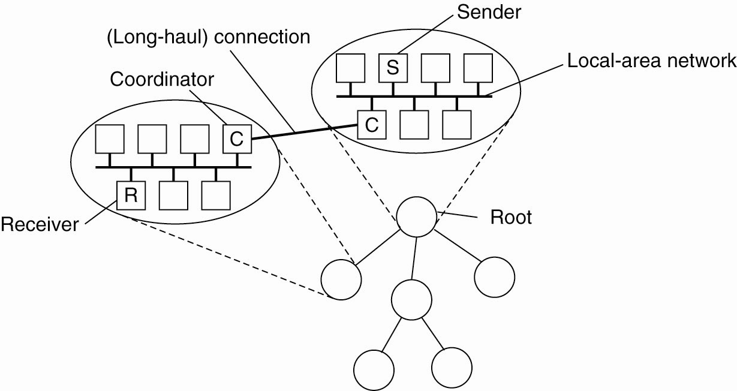
Hierarchical Feedback Control
Figure 8-11. The essence of hierarchical reliable multicasting.
Each local coordinator forwards the message to its children and
later handles retransmission requests.

Slide 19
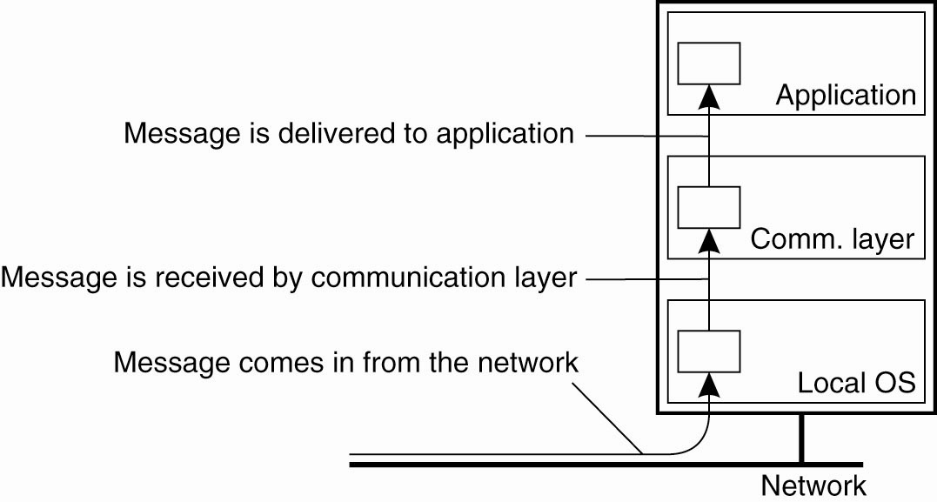
Virtual Synchrony (1)
Figure 8-12. The logical organization of a distributed system to
distinguish between message receipt and message delivery.

Slide 20
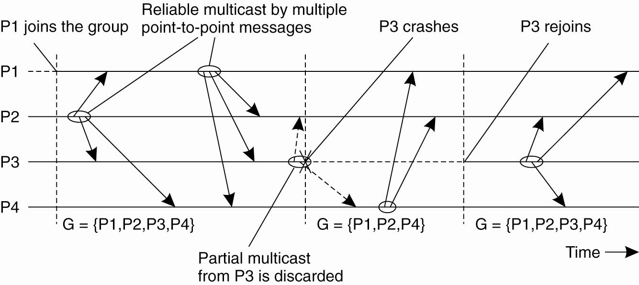
Virtual Synchrony (2)
Figure 8-13. The principle of virtual synchronous multicast.

Slide 21
Message Ordering (1)
Four different orderings are distinguished:
Unordered multicasts
FIFO-ordered multicasts
Causally-ordered multicasts
Totally-ordered multicasts

Slide 22
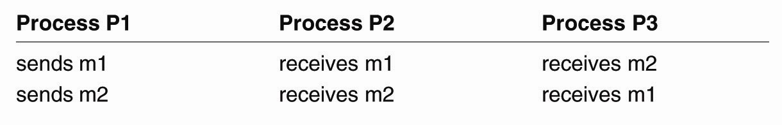
Message Ordering (2)
Figure 8-14. Three communicating processes in the
same group. The ordering of events
per process is shown along the vertical axis.

Slide 23
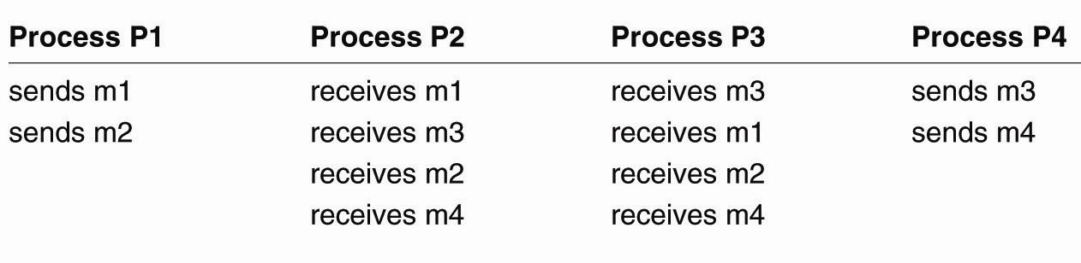
Message Ordering (3)
Figure 8-15. Four processes in the same group with two different senders, and a possible delivery order of messages under FIFO-ordered multicasting

Slide 24
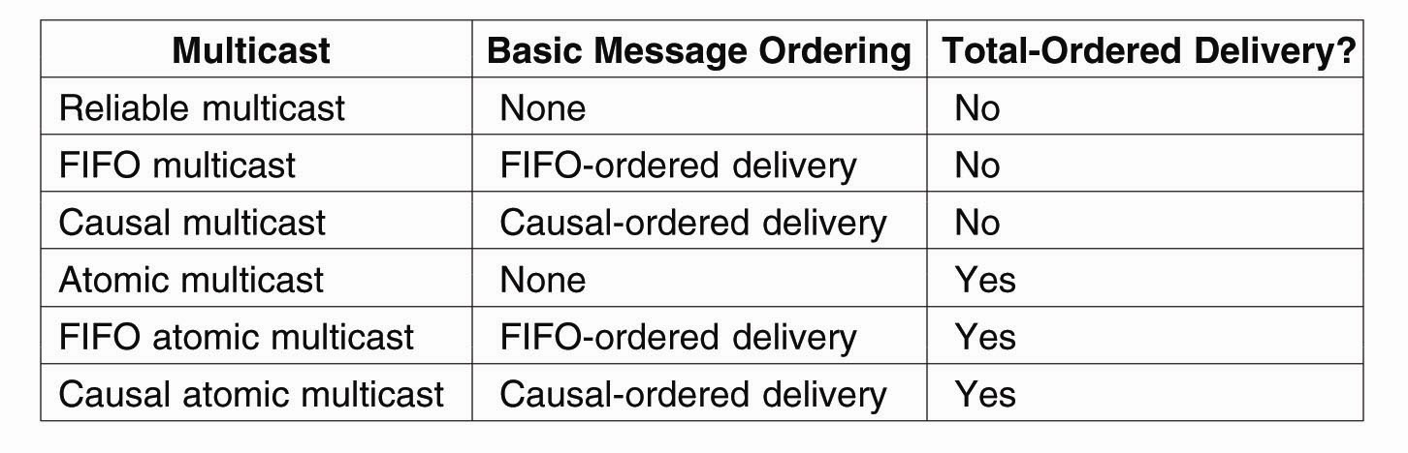
Implementing Virtual Synchrony (1)
Figure 8-16. Six different versions of virtually synchronous reliable multicasting.

Slide 25
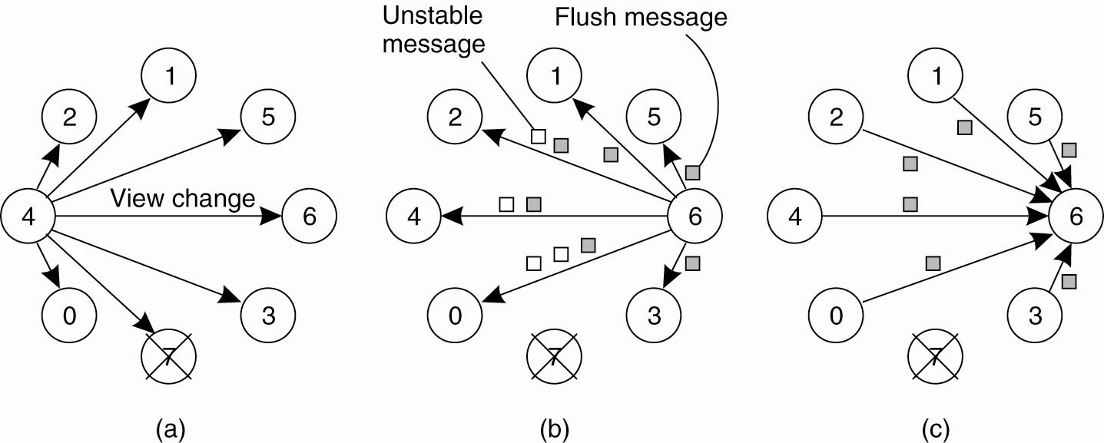
Implementing Virtual Synchrony (2)
Figure 8-17. (a) Process 4 notices that process 7 has crashed and sends a view change.

Slide 26
Implementing Virtual Synchrony (3)
Figure 8-17. (b) Process 6 sends out all its unstable messages, followed by a flush message.

Slide 27
Implementing Virtual Synchrony (4)
Figure 8-17. (c) Process 6 installs the new view when it has received a flush message from everyone else.

Slide 28
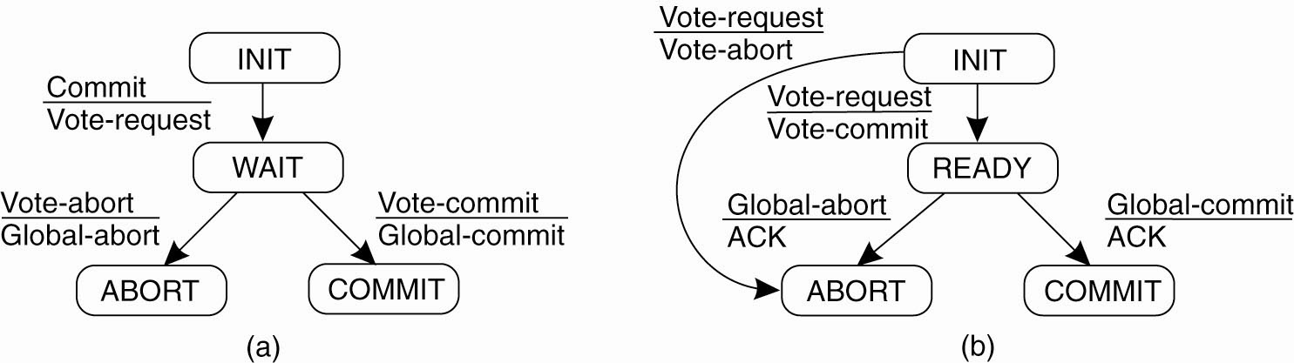
Two-Phase Commit (1)
Figure 8-18. (a) The finite state machine for the coordinator in 2PC. (b) The finite state machine for a participant.

Slide 29
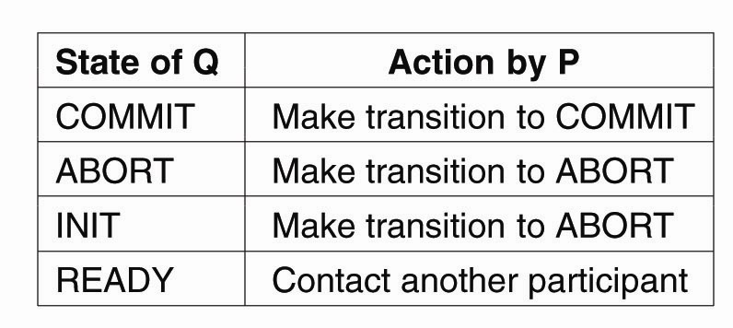
Two-Phase Commit (2)
Figure 8-19. Actions taken by a participant P when residing in state READY and having contacted another participant Q.

Slide 30
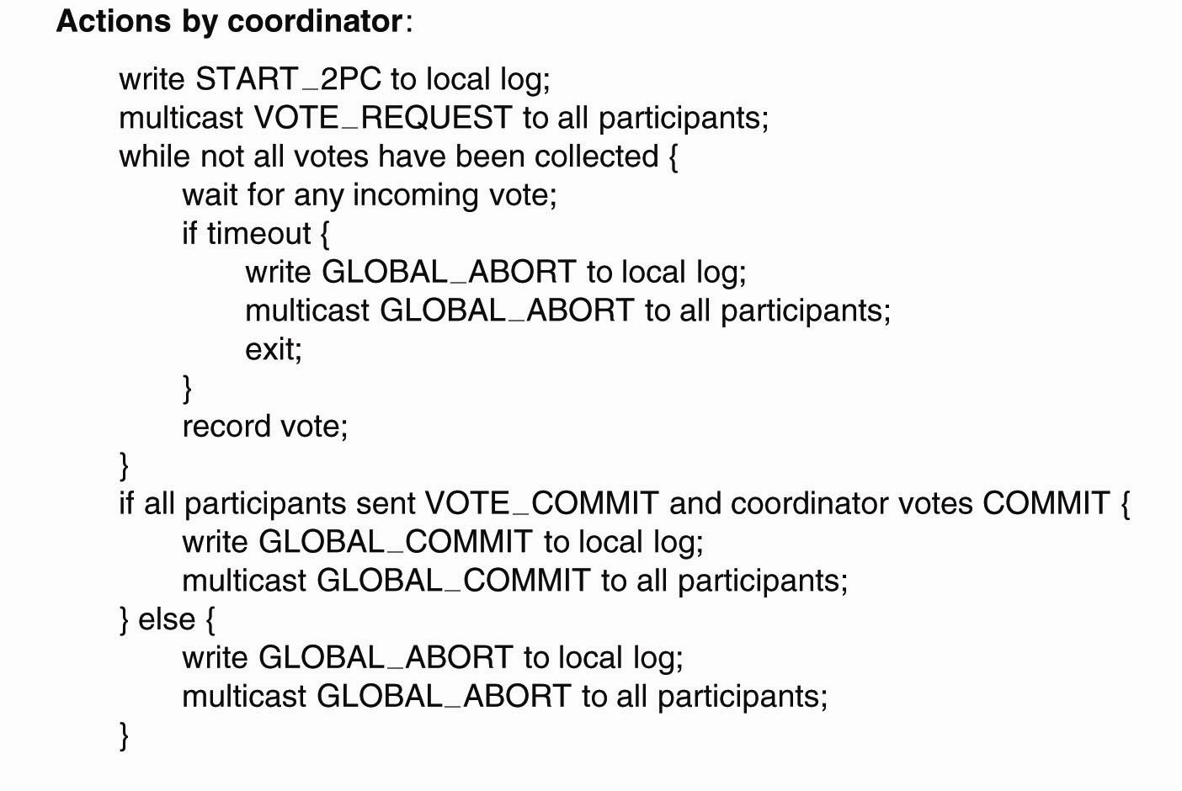
Two-Phase Commit (3)
. . .
Figure 8-20. Outline of the steps taken by the coordinator in a two-phase commit protocol.

Slide 31
Two-Phase Commit (4)
. . .
Figure 8-20. Outline of the steps taken by the coordinator in a two-phase commit protocol.

Slide 32
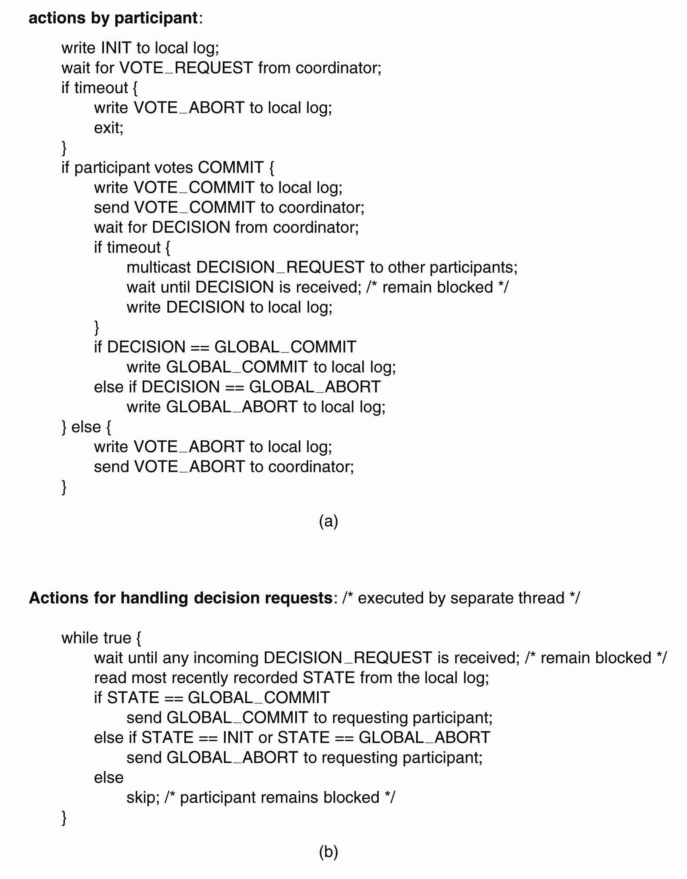
Two-Phase Commit (5)
Figure 8-21. (a) The steps taken by a participant process in 2PC.

Slide 33
Two-Phase Commit (7)
Figure 8-21. (b) The steps for handling incoming decision requests..

Slide 34
Three-Phase Commit (1)
The states of the coordinator and each participant
satisfy the following two conditions:
There is no single state from which it is possible to make a transition directly to either a COMMIT or an ABORT state.
There is no state in which it is not possible to make a final decision, and from which a transition to a COMMIT state can be made.

Slide 35
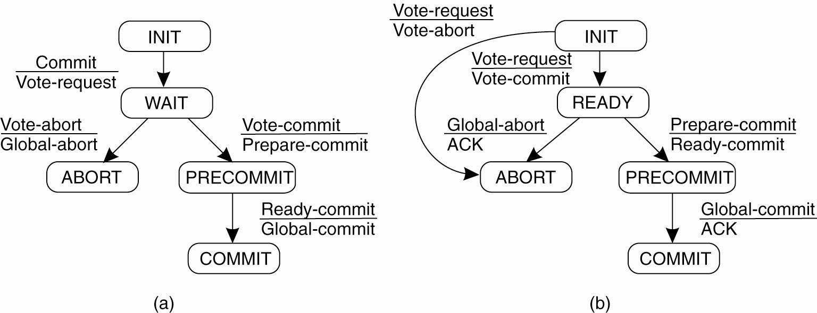
Three-Phase Commit (2)
Figure 8-22. (a) The finite state machine for the coordinator in 3PC. (b) The finite state machine for a participant.

Slide 36
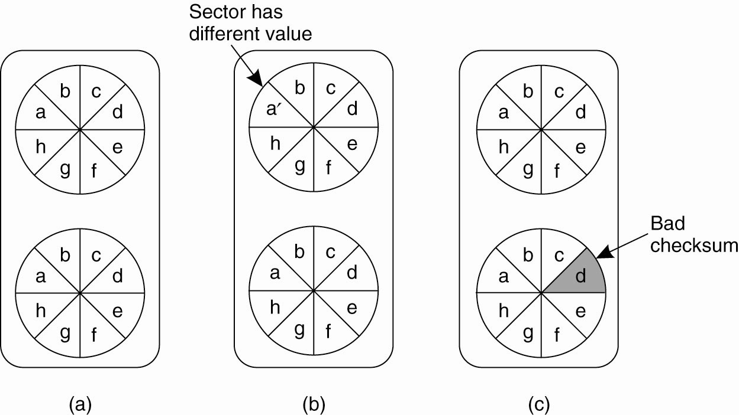
Recovery – Stable Storage
Figure 8-23. (a) Stable storage. (b) Crash after drive 1 is updated. (c) Bad spot.

Slide 37
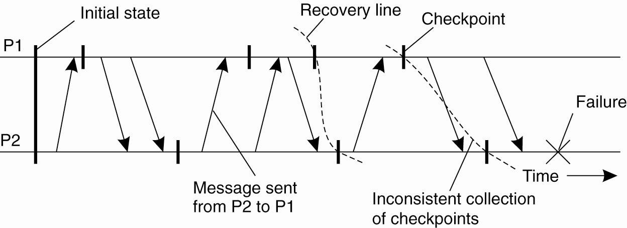
Checkpointing
Figure 8-24. A recovery line.

Slide 38
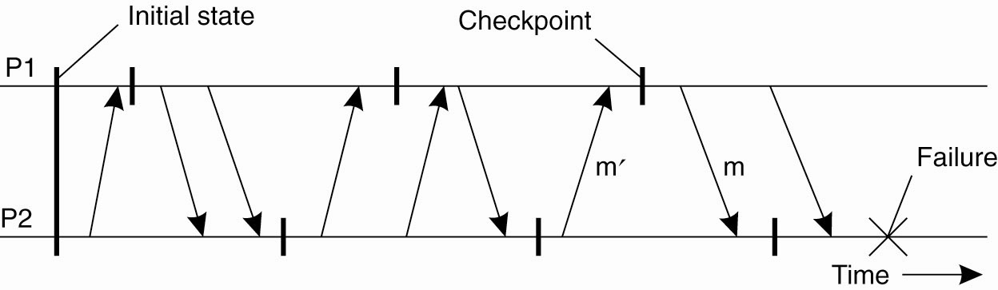
Independent Checkpointing
Figure 8-25. The domino effect.

Slide 39
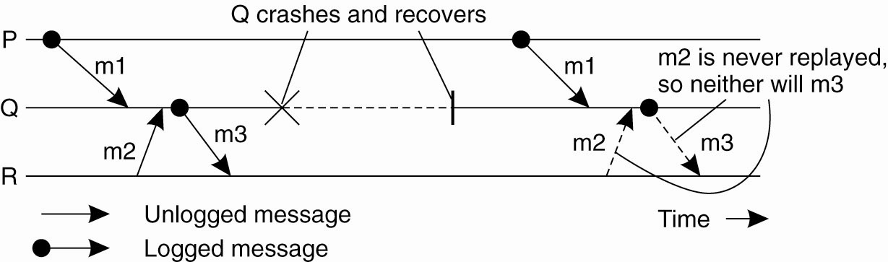
Characterizing Message-Logging Schemes
Figure 8-26. Incorrect replay of messages after recovery, leading to an orphan process.

