Slide 1
DISTRIBUTED SYSTEMS Principles and Paradigms Second Edition ANDREW S. TANENBAUM MAARTEN VAN STEEN Chapter 1 Introduction Elliott mods with Cambria font

Slide 2
CDK
Some slides are courtesy of Coulouris, Dollimore, and Kindberg
“Distributed Systems, concepts and designs”
Copyright 2008 Clark Elliott

Slide 3
Two themes throughout the quarter
There is almost always a compromise. Having distributed systems expertise means knowing the best compromise to make. Relevant to distributed system design.
There is no global clock for coordinating processes which affects the choice of algorithms in a distributed system.
Copyright 2008 Clark Elliott

Slide 4
Keep you toolbox open this quarter…
We will fill it with distributed systems techniques during each lecture.
Copyright 2008 Clark Elliott

Slide 5
Definition of a Distributed System First Pass
A distributed system is:
A collection of independent computers that appears to its users as a single coherent system.

Slide 6
We will use a limited definition of Distributed Systems
Software systems that operate on more than one computer via:
Internet
Intranet – like internet but managed by autonomous organization
Mobile computing
Wireless and other modern ad hoc network technologies

Slide 7
Valid Distributed Systems areas, but we will not study…
Parallel computing
Grid computing
Cluster computing
Distributed operating systems
[shared memory systems]
[Distributed algorithms]

Slide 8
Motivation for Distributed Systems
Resource sharing
Geographical and legacy reasons
Flexibility – buy, sell, add, drop
Scalability – “from my desktop to the web”
Robustness – one node fails, another is up
Security
System design – always a brave new world. What is design of the future?

Slide 9
Computing of the future
Moore’s Law is running out. Was 40% increase a year, now about 15% a year.
More CPUs closely linked keeps total CPU power increase at 40% a year – but requires parallel computation
May lead to more distributed design at higher levels.

Slide 10
Societies
People work in societies, and understand them.
Why not software?
The rise of agents
The rise of autonomy – especially as computers and programs become more intelligent.
The human brain coming online in computer networks with brain/machine interfaces

Slide 11
Example - Intranets
Like internet
Locally administered
Boundary allows policy enforcement, including for security
Firewall might allow/disallow packets based on remote source or content
Translation of protocols?
Possibly connected to internet via router

Slide 12
Example -- Ubiquitous computing
Pervasive home, office, devices that tend not to move, but are not installed, per se, for their access to network
Stationary sensor networks for, e.g., traffic monitoring

Slide 13
Distributed Pervasive Systems
Requirements for pervasive systems -- wireless, small, battery-powered, mobile
Discover environment
Embrace contextual changes.
Encourage ad hoc composition.
Recognize sharing as the default.
Personal space vs. shared space
No central admin

Slide 14
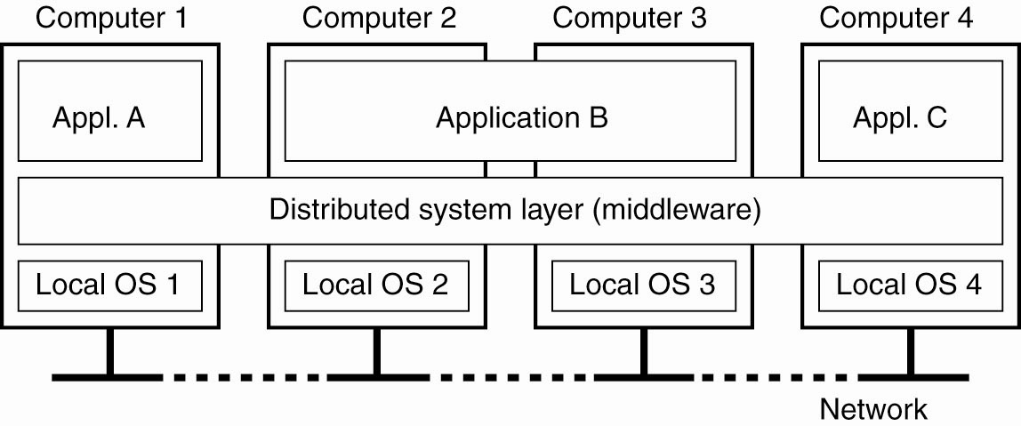
Definition of a Distributed System Second Pass
Figure 1-1. A distributed system organized as middleware. The middleware layer extends over multiple machines, and offers each application the same interface.

Slide 15
Users versus Programmers
As programmers/designers we love to think about computer code and quirky design issues.
There are lots of interesting IT problems and algorithms to solve them in the software running a tin can company.
Users just want to make cans.
This is the motivation behind transparency in distributed systems. Think of “transparent” as meaning “the user can’t see it.”

Slide 16
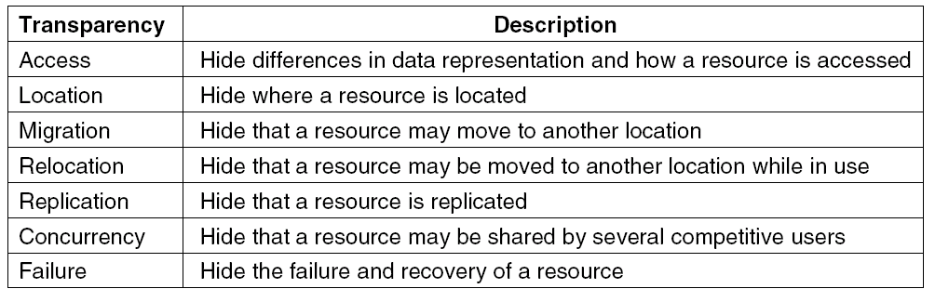
Transparency in a Distributed System
Figure 1-2. Different forms of transparency in a distributed system (ISO, 1995).

Slide 17
Transparency – in a perfect world
Access – local and remote access looks the same
Location – users to not need to bother where a resource is (or do they?)
Concurrency – should not be concerned who else needs the shared resource
Replication – duplicate data to increase performance or reliability, but hide management of it.

Slide 18
Transparency – in a perfect world
Failure – conceal failures from users – or do you we want to?
Mobility – processes, hardware (esp. mobile), users, clients, services, servers all migrate without concern about updating users.
Performance – reconfigure, add hardware, without notification
Scale up – Grow without changing interfaces

Slide 19
Transparency not always good
Sometimes users need knowledge about underlying difficulties so they can make intelligent decisions.
Here is a case:
> Critical data is low bandwidth
> Typical data is high bandwidth
> System appears dead when switched to low bandwidth because of failure. Transparency?
> No! If the user knows, they can switch to only accessing critical data and keep the system running through the failure.

Slide 20
Open Systems
Non-proprietary system
Publicly known set of interfaces
Anyone can write for, and use the defined standard interfaces to communicate with a system that adheres to the same standards.
The interface is defined, the implementation is open

Slide 21
Four requirements
Fully defined, so that all vendors can work within the same framework
Stable over a reasonable length of time, so that the vendors have fixed development targets
Interfaces are publicly available
Are not under arbitrary control any one firm or vendor.
http://www.businessdictionary.com/definition/open-system.html

Slide 22
Open system
Very Popular – but depends on business model.
Also can offer services
Publish the interface requirements – often captured in an IDL – Interface Definition Language. Anyone can write for (either side of) the interface.
IDL – rules are so carefully specified that we can actually use them as a language fit for input to a compiler.
BUT --- Main purpose is to define the interface, and we could do this with pencil and paper. The rest is serendipity for computer scientists.

Slide 23
IDL – Interface Definition Language
http://condor.depaul.edu/elliott/435/idl/Hello.idl.html
Specify the names of procedures or methods, and the precise bitstreams that go through the interface in each direction.
Require a precise language that can be checked for syntax by a program.
Allow any implementation that meets the specifications of the interface.

Slide 24
Interface Definition Language IDL
Name of Remote Procedure = Hello-IDL-World
Return type of Remote Procedure = 32-bit Unsigned Integer
Arg one = 32-bit unsigned integer describing the length of arg two
Arg two = ascii character string of length contained in arg one.

Slide 25
Hello-IDL-World
Remote Procedure name: Hello-IDL-World
(Arg one: Length-of-string;
Arg two: Hello-Message-String)
Integer Return-value

Slide 26
Client Stub
Could generate this client stub for calling the server automatically from the IDL:
Char Hello-Message-String []
int Hello-IDL-World {
(unsigned int) len,
(char *) Hello-Message-String
<NO BODY OF CODE – YOU WRITE>
(int) Return(Remote-opsys-marshaling-call-FB23AA(len, Hello-Message-String));
}
Hides the actual operating system call to the “FB23AA” generic remote-call procedure.

Slide 27
Server Skeleton (Stub)
Could generate this server skeleton stub called by the (un)marshaling RPC OpSys subsystem on remote server automatically from the IDL:
Int Remote-Hello-FB23AA-Receive ((unsigned int) len,
(char-string) HelloMsg){
int return-val == 0;
<NO BODY OF CODE – YOU WRITE>
return (int)
}
Is called by the local server operating system after prompting by remote system. Int return value sent back to caller.

Slide 28
Policy separated from Implementation
Not only are the interfaces defined, but also the parts of the system itself.
Replace or update either the local system, or the remote system, without affecting the other component.

Slide 29
Distributed Algorithms to address scalability
Characteristics of fully decentralized (distributed) algorithms:
> No machine has complete information about the system state.
> Machines make decisions based only on local information.
> Failure of one machine does not ruin the algorithm.
> There is no implicit assumption that a global clock exists.

Slide 30
Distributed Algorithms
A formal area of study
Largely research at this point, but valid study of algorithms that are immune to some problems of DS es
We will not study these much. Could be a full quarter class.
However – I DO require that you understand their characteristics, and know what they are for.

Slide 31
Scaling
Size
Geography
Administration – often not discussed
Example: Online Courses

Slide 32
Scale-up of Online Courses
Size: how many students can fit in a classroom?
Size: How many DL students can the server handle?
Bandwidth for the AV
Room in the grading links
Etc

Slide 33
Scaling Online class -- Geography
DL: what happens when DL becomes global?
Timing problems: deadlines are in the middle of the night, fast turn-around mail, foreign customs
Suppose there is a lecture on security? DeFacto exportation of “munitions”

Slide 34
Scaling of Online Course -- administration
Administration is often the overlooked scale-up problem.
How to give grades for 4,000 students?
Where are the assignments stored?
Hierarchy of instructors – how do they coordinate?
Administration is often forgotten – Elliott notes that this is often the most critical bottleneck in scaling up DS.

Slide 35
Traditional blocking calls – problems in a distributed system
Blocking (synchronous) call: make a procedure call, and do nothing until the call returns
Works fine on a local system – if the called procedure fails, the calling procedure is probably failing too – so who cares?
Distributed system: Caller still alive, but called procedure on remote system fails.
Geography – more failures, longer wait for call to return.

Slide 36
Synchronous vs. Asynchronous
> Blocking calls are synchronous
> Solution is non-blocking, or asynchronous calls.
> New programming paradigm.
> Logic is potentially much more complex.
> Idea is the calling process continues, without waiting for the called process to return.
> Many types of asynchronous calls

Slide 37
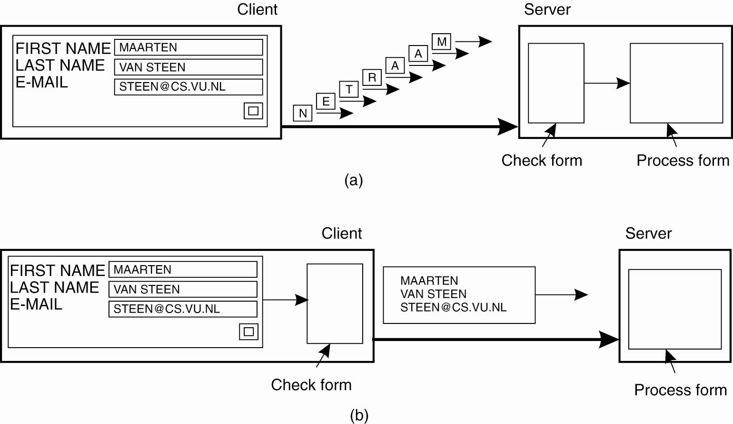
Scaling Techniques (1)
Figure 1-4. The difference between letting (a) a server or (b) a client check forms as they are being filled.

Slide 38
Security tradeoffs thick/thin
Thin: More packets, more exposure and more chance for profiling sender/receiver patterns
Thick: more code exposed on the client, more chance for out-of-date, insecure client code.

Slide 39
Pitfalls when Developing Distributed Systems
False assumptions made by first time developer:
The network is reliable.
The network is secure.
The network is homogeneous.
The topology does not change.
Latency is zero.
Bandwidth is infinite.
Transport cost is zero.
There is one administrator.

Slide 40
Transactions – essential concepts
Before/After: To the outside world there is a before, and an after, and nothing in between. Think of closing on a house: they get the money, you get the house. When does the lighting bolt strike?
Critical Section—May have to reserve resources for the duration of the transaction using locks on resources as part of a critical section [CS] of computer code inside the transaction.

Slide 41
Roll back something went wrong, so go back to the before state.
Commit—everything is complete so continue of to other states, possibly discarding all rollback information
Checkpoint—a saved state of the system to which you can return, discarding all subsequent transactions.

Slide 42
Semaphores / Memory locations
Semaphores:
Usually just a memory location. TRUE (not null) means wait, the CS is busy. FALSE (null) means go ahead into the CS.
If the CS is available [Semaphore is FALSE] set the semaphore to TRUE then proceed into the CS.
When you are done, set the Semaphore to FALSE again so others can use the CS.

Slide 43
Example Critical Section
Five different bank accounts belonging to two different customers.
As part of a complex transaction move a bunch of money around for escrow, taxes, payments, refunds, etc.
The total money before and after is always identical.
But inside the critical section code you always have to chose to either delete from one account or add to another first when you move it. So the total changes temporarily.

Slide 44
During the transaction, the bank accounts are locked to all other processes. They cannot read or write those values.
To the outside world there are five accounts before the transaction, and five after the transaction. There is no access at all during the processing of the critical section.

Slide 45
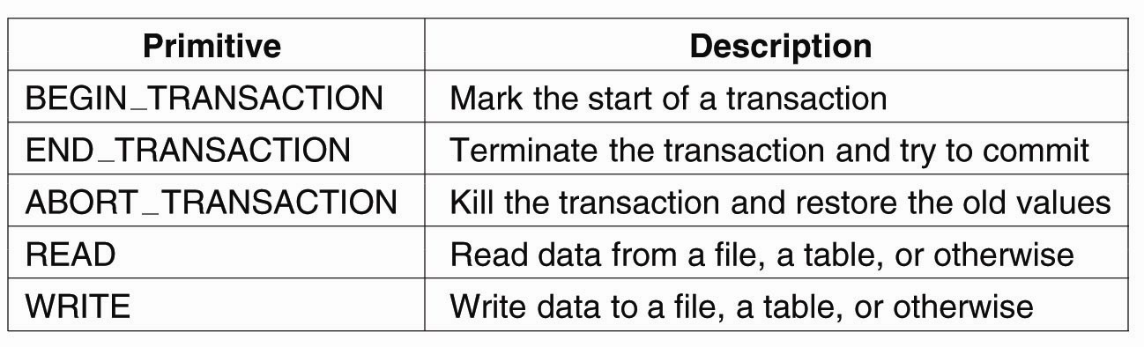
Transaction Processing Systems
Figure 1-8. Example primitives for transactions.

Slide 46
Characteristic properties of transactions:
Atomic: To the outside world, the transaction happens indivisibly.
Consistent: The transaction does not violate system invariants.
Isolated: Concurrent transactions do not interfere with each other.
Durable: Once a transaction commits, the changes are permanent.

Slide 47
Example transaction
Transfer Sam’s money from checking to savings:
Remove $3,000 from Sam’s checking account.
Add $3,000 to Sam’s savings account.
During the process, there is a time when there is a missing $3,000 in the bank. What if the system fails at exactly that moment, then restart outside the transaction? We violate the invariant that the total must remain constant.
The business model requires a transaction: before and after, but nothing in between

Slide 48
Distributed Transactions
Built-in hardware support for critical sections is not available.
The sending of messages is unreliable, and abort messages can go missing as well.
Much more complex than local transactions
But we still need them!

Slide 49
Bank revisted.
Five accounts are maintained by five different servers in a distributed system.
We must lock the accounts in five different databases on five different computers, managed by at least five different processes.
Communication is by messages that travel over the network.

Slide 50
Coordination messages can get lost.
Abort messages can get lost.
Commit messages can get lost.
Rollback messages can get lost.
Most important: where is the memory location for the semaphore managing the critical section? On which machine? Managed by which process?

Slide 51
Real world example
Getting a plane ticket, a hotel, and a rental car at Orbitz…
The transaction manager has to communicate with separate databases, on separate computers, managed by separate processes.

Slide 52
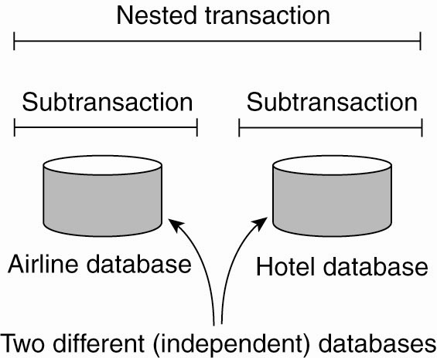
Transaction Processing Systems (3)
Figure 1-9. A nested transaction.

Slide 53
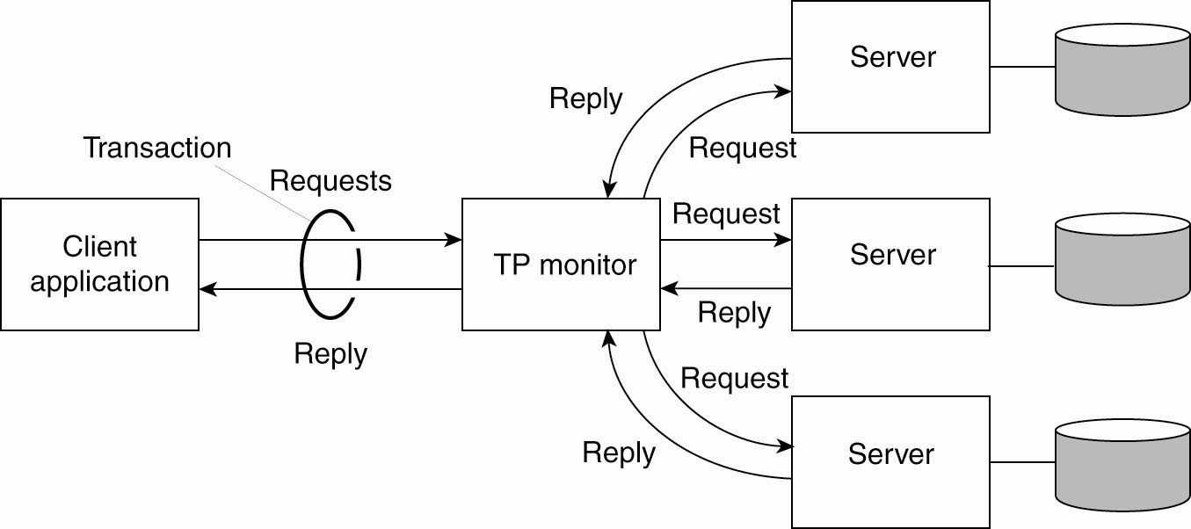
Transaction Processing Systems (4)
Figure 1-10. The role of a TP monitor in distributed systems.

Slide 54
Important!
The basic engine of work on a computer system is the process
This is true in local systems with all processes running on a [single] central processing unit (CPU)
It is also true in a distributed system, where processes may run on different, network-connected, CPUs

Slide 55
What is a process?
A process is a computer program that is being executed.
One program can run in many processes at the same time, such as when you start up multiple instances of a browser on your PC.
The CPU of a computer system runs the instructions of a process one at a time, in order.
Processes use resources, such as disk space, printers, displays.

Slide 56
Inter-process communication
On a local system, processes communicate (share program variables) through shared locations in memory, using Inter-Process Communication (IPC).
In distributed systems, processes must send messages.

Slide 57
Context switching
On a multi-tasking computer, one central processing unit (CPU) is shared by all processes.
[Example: in Windows, run taskmgr]
Processes are continuously swapped in and out of the CPU so that every process gets a chance to run for a while. This is called context switching.
The operating system process managing context switching may switch a process at any time.

Slide 58
Shared memory
The perfect communication solution.
A very simple coordination mechanism between processes
IPCs (InterProcess Communications) are used to communicate between processes through shared memory. One writes, the other reads, then vice versa.
In distributed systems if we do not have some emulation of shared memory we have to send messages over the network.

Slide 59
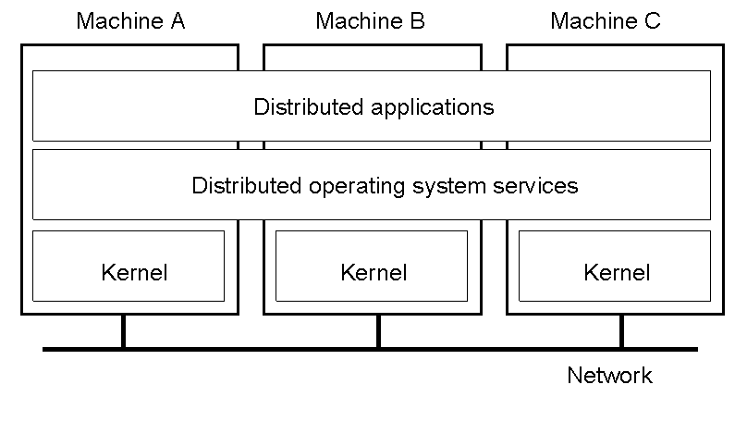
Distributed Systems – hey, where’s my IPC?
1.14
General structure of a multicomputer operating system

Slide 60
Atomic Action
The unit cannot be broken down further. Derives from the idea of an atom, which at the time of discovery was believed to be the basic building block of the universe.
For application systems, this means that any process will be allowed to complete an atomic section of code (as though it were) without being swapped out of the processor and superseded by another process, or interleaved with another process at the software level.

Slide 61
Test and Set Instruction – Problem:
Look at semaphore (“gatekeeper”). If TRUE (busy) then return to A, else if FALSE (free) then just continue
Set the semaphore to TRUE
Complete the Critical Section (CS)
Set semaphore back to FALSE
Process X completes to B, then is switched out
Process Y completes through B and enters CS, then is switched out
Process X continues after B, enters CS – big trouble!
Tanenbaum & Van Steen, Distributed Systems: Principles and Paradigms, 2e, (c) 2007 Prentice-Hall, Inc. All rights reserved. 0-13-239227-5

Slide 62
Test and Set Instruction –How it works:
Look at semaphore. If TRUE (busy) then return to A else if FALSE AND SET TO TRUE (was free – now busy) then…
Complete the Critical Section
Set semaphore back to FALSE
Process X completes to B, then is switched out
Process Y loops to A continuously
Process X switched back in, completes CS, and C
Process Y completes CS and C– all is well.
Tanenbaum & Van Steen, Distributed Systems: Principles and Paradigms, 2e, (c) 2007 Prentice-Hall, Inc. All rights reserved. 0-13-239227-5

Slide 63
Monitors in DS – hey – where’s my hardware support?
Locked / shared resources, may be on a remote machine.
They may involve processes on different machines with different memory spaces – no test and set!
This is relevant to transactions and distributed transactions.
Usually requires a process to monitor the shared resource. Processes can fail.
Dead processes locking a resource can be a big problem, especially on a remote machine.

Slide 64
Universally Unique Identifiers (UUIDs / GUIDs)
Some character string (or number) that no one else in the universe will use.
URLs are UUIDs: One subnet, one machine, [one user], one directory, one file. This is a unique physical path on earth.
A very large random number will be pseudo-unique and often good enough for our purposes.
E.g., for a universe of a thousand processes, a random number between zero and a trillion will have a conflict only one time in a billion.

Slide 65
A range of numbers can be unique, as long as they are divided up and each range is given to a unique process.
We can also generate a range of numbers large enough for a one-to-one mapping of numbers and all possible current and future real memory locations in all computers on earth.

Slide 66
The perfect solution: distributed shared memory systems
In theory we could build a universal shared memory system as middleware.
All core memory is mapped to UUIDs which serve as the middleware memory addresses.
Each machine has its own range of UUID memory addresses mapped to local memory.
Any machine in the distributed system could uniquely address the memory space of any other machine without confusion or conflict.
Distributed IPCs could now be used.

Slide 67
But…
WAY too slow and way too buggy
Has to be implemented with message passing between processes “under the hood” anyway.
Impossible to implement in an efficient way.
Requires predicting how programs will run to make it work.

Slide 68
Why study shared memory systems?
Shared memory systems have not proven practical, because they are too devilish to implement (message passing under the hood)
A shared-memory subsystem would solve many of the problems of DS coordination, including that of a global clock.
Useful to consider when trying to understand DS architectures, and what they are trying to provide.

Slide 69
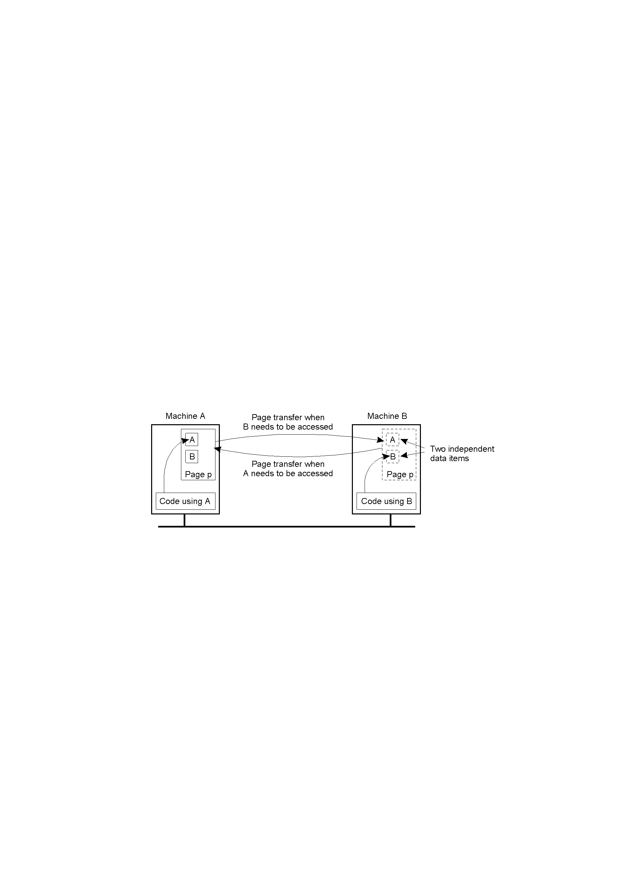
Distributed Shared Memory Systems – an example difficult problem
1.18
False sharing of a page between two independent processes.

Slide 70
What is middleware?
Middleware sits between the application programs, and the operating system library calls and native instructions instructions.
Middleware presents a uniform interface for the application programmer, often (but not always) independent of the underlying operating system.
Berkeley Sockets, Java RMI, CORBA, .NET, RPC, are examples of middleware

Slide 71
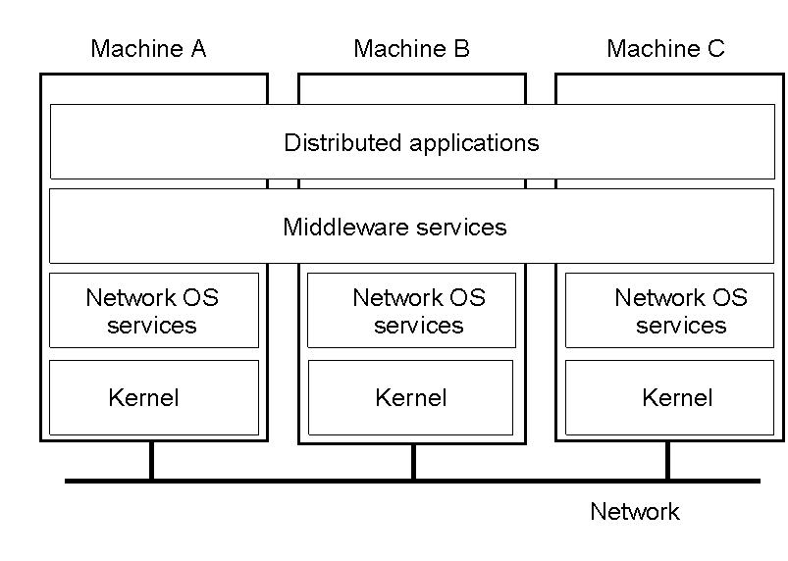
Positioning Middleware
1-22
General structure of a distributed system as middleware.

Slide 72
Usefulness of open systems
In open distributed systems, applications can use one protocol to communicate with other local and remote processes, independent of the operating system on which they are running.
The underlying operating system calls, buffering, network protocols, etc. are hidden from the application programmer who works through an interface.

Slide 73
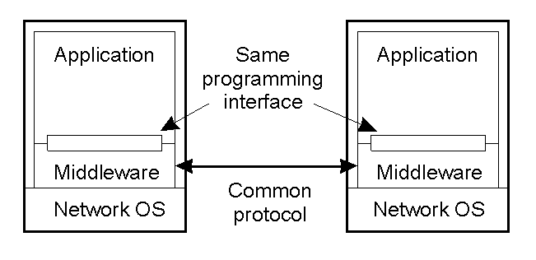
Middleware and Openness
1.23
In an open middleware-based distributed system, the protocols used by each middleware layer should be the same, as well as the interfaces they offer to applications.

Slide 74
Efficiency
There is always a tradeoff between reliability and innate efficiency of the message passing protocol
“Send and forget” is (a) the most efficient, and (b) the least reliable.
“Guarantee delivery for every message,” is [possibly] the least efficient, and the most reliable.
There are many intermediate compromises.

Slide 75
Efficiency
If you don’t care about execution efficiency, then use the most reliable protocol (e.g., the web using TCP/IP) and emphasize programmer efficiency (e.g., XML).
If you do care about execution efficiency, then implement only what you need, when you need it. But these will use more development time, and be less open. Typically associated with UDP.

Slide 76
Producer / Consumer Coordination
Original Problem on single system using IPC:
Producer writes until catches up with Consumer then blocks
Consumer reads until catches up with Producer then blocks
Assume a circular buffer.

Slide 77
Producer / Consumer Coordination
Coordinating for Distributed System:
Block sender until send buffer not full
Block sender until local subsystem sends the message
Block sender until remote subsystem receives the message and sends ack.
Block sender until consumer receives message and sends ack.
Etc.

Slide 78
Messages
When the basic computing entity is a (possibly remote) set of processes, the essential mode of communication is through messages from one process to another, or from process to many others.
But the sending of messages can be problematic, especially the sending of remote messages.

Slide 79
Some problems with messages
Receiver’s receive buffer is full
Sender can’t wait, but the send buffer is full
The message gets lost
The ack gets lost
The message is delayed.
The messages arrive in the wrong order
A process joins a group, but the broadcasting process doesn’t know it
Coordinated messages cross in transit.

Slide 80
RPC / RMI / etc. → MOM
Problems using send/receive
Sender and receiver have to be active
Sender and receiver have to know each other’s address or endpoint
Buffering concerns must always be considered.
Push toward MOMs that handle some of these problems.
Trade control for convenience

Slide 81
Coordination of Processes
Messages are the coordination mechanism for cooperating processes.
Some coordination problems occur over and over again in many types of distributed applications.
Many of these problems have been formalized, and have formal solutions.
Blocking, buffering, and the reliability of the message protocol are among the concerns.

Slide 82
Process coordination w/ msgs
Synchronization point | Send buffer | Reliable comm. guaranteed?
Block sender until buffer not full | Yes | Not necessary
Block sender until message sent | No | Not necessary
Block sender until message received | No | Necessary
Block sender until message delivered | No | Necessary
Relation between blocking, buffering, and reliable communications.

Slide 83
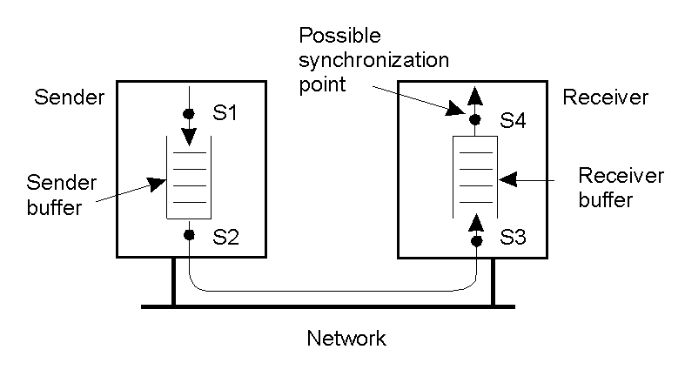
Process coordination w/ msgs
1.15
Alternatives for blocking and buffering in message passing.

Slide 84
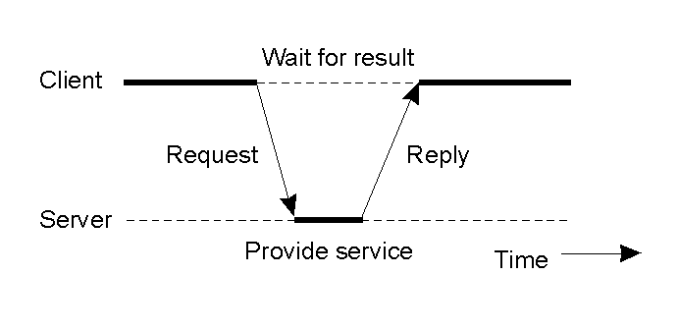
Clients and Servers
1.25
General interaction between a client and a server.

Slide 85
Comparison between Systems
Item | Distributed OS |  | Network OS | Middleware-based OS
 | Multiproc. | Multicomp.
Degree of transparency | Very High | High | Low | High
Same OS on all nodes | Yes | Yes | No | No
Number of copies of OS | 1 | N | N | N
Basis for communication | Shared memory | Messages | Files | Model specific
Resource management | Global, central | Global, distributed | Per node | Per node
Scalability | No | Moderately | Yes | Varies
Openness | Closed | Closed | Open | Open
A comparison between multiprocessor operating systems, multicomputer operating systems, network operating systems, and middleware based distributed systems.

Slide 86
Electronic Health Care Systems (1)
Questions to be addressed for health care systems:
Where and how should monitored data be stored?
How can we prevent loss of crucial data?
What infrastructure is needed to generate and propagate alerts?
How can physicians provide online feedback?
How can extreme robustness of the monitoring system be realized?
What are the security issues and how can the proper policies be enforced?

Slide 87
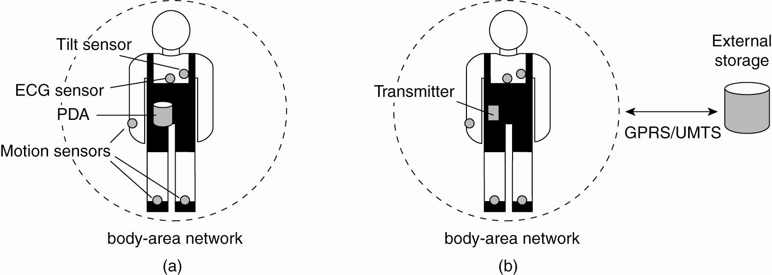
Electronic Health Care Systems (2)
Figure 1-12. Monitoring a person in a pervasive electronic health care system, using (a) a local hub or
(b) a continuous wireless connection.

Slide 88
Sensor Networks (1)
Questions concerning sensor networks:
How do we (dynamically) set up an efficient tree in a sensor network?
How does aggregation of results take place? Can it be controlled?
What happens when network links fail?

Slide 89
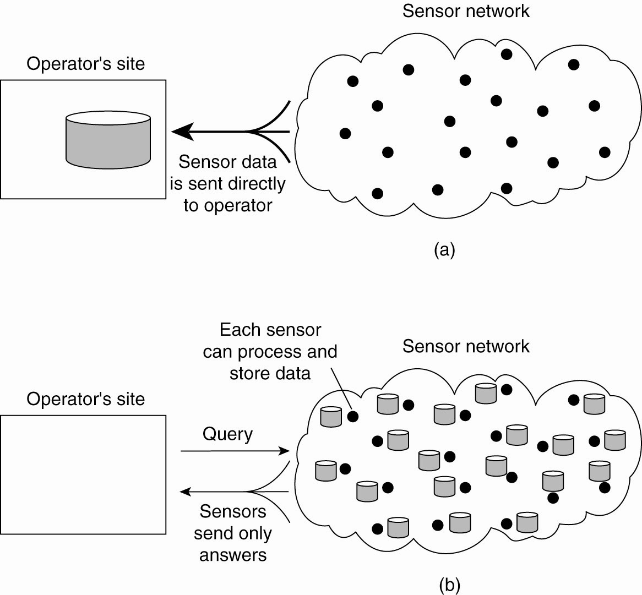
Sensor Networks (2)
Figure 1-13. Organizing a sensor network database, while storing and processing data (a) only at the operator’s site or …

Slide 90
Sensor Networks (3)
Figure 1-13. Organizing a sensor network database, while storing and processing data … or (b) only at the sensors.

Slide 91
Not Used

Slide 92
Clients and servers
Used to cover a broad range of actual designs and activities
General: invoke an operation means to make a request from one computer for service which is performed on another computer.
Two processes connected over network via message passing.
Web clients (browser) and server are ex.

Slide 93
Components of client server
Clients and servers are processes (a program instance in execution)
Server machines run at least some servers and clients machines run at least some clients. Many have both.
A server process may also be a client process to some other server process
Communication via messages
Services (access, update, manage resources) present interfaces and work through servers.

Slide 94
Brief tour of the web
There was internet before the web!
Weak design from CS perspective: bad protocol (http ON TCP/IP?!), not efficient, not secure
Why did it succeed?
Open system
SIMPLE! EASY TO USE!
Filled huge need to interactively connect data stores to client users via formatted text, with INPUT boxes.
Hyper-linked documents and servers

Slide 95
Brief tour / web
High school kid with an afternoon free can now allow shoes in Kansas to be sold in Tokyo.
Gopher system: just document retrieval, always
HTTP connectionless, built on top of TCP connection-maintaining…?!
Each request a new process – secure, simple, wasteful but who cares?
CGI: Stdin, stdout, stderr, Environment vars.
URL: global IDs for any kind of content

Slide 96
Web is OPEN
Protocol (http), markup conventions (ascii html), program interface (cgi) are all simple and well defined: any hardware, any OpSys, any language, any editor.
Almost any content can be shared: MIME typing, distribute handlers for any type of data.

Slide 97
HTML
Just another markup language
Used to just tell students to learn in on their own the first week.
Write your own once or twice! Use an editor and put some content on the web

Slide 98
URL
Uniform [Universal] Resource Locator [Identifier]
Scheme-or-protocol://server id[:port]/ application-specific-string
Scheme is OPEN. Typical http ftp mailto
Server-id[:port] are bound to internet, DNS or IP
Remaining string has conventions, but are under full program control of server process.

Slide 99
URL
URLs can also be used as universally unique identifiers (UUIDs) because they map to exactly ONE physical location on earth, and there are conventions about who controls that location.
http://condor.depaul.edu/~elliott/435/abc.html
140.192.175.100 is the physical network card
/users/faculty/elliott/public_html/435/abc.html is the physical file on disk.
Controlled by Elliott.

Slide 100
HTTP dynamic pages
Application-specific-string is interpreted by the server application listening at the port
Pages can have embedded forms that send query strings and A/V (attribute / value) pairs as part of the request string. By convention these A/V pairs are stored in the string following the “/”

Slide 101
Common Gateway Interface
What made the web work in the first place
Description of simple interface to any program that runs natively in a typical OpSys shell
Shell programs, C programs, Perl programs, (but not java programs!) all have input and output and read from the environment.

Slide 102
Example CGI input form
<html>
<head><TITLE> DS420 Sample Form for AddNum </TITLE></head>
<BODY>
<H1> Addnum </H1>
<FORM method="GET" action="http://localhost:2566/cgi/addnums.fake-cgi">
Enter your name and two numbers:
<INPUT TYPE="text" NAME="person" size=20 value="YourName"><P>
<INPUT TYPE="text" NAME="num1" size=5 value="4"> <br>
<INPUT TYPE="text" NAME="num2" size=5 value="5"> <br>
<INPUT TYPE="submit" VALUE="Submit Numbers">
</FORM> </BODY></html>

Slide 103
CGI conventions
Stdin, stdout, std err – streams to any executable program which is running as forked subprocess to the calling (server) process. Get redirected back to the server.
Print to the console. Read from the console. Print error message to the console.

Slide 104
CGI conventions
Environment variables, including argv[] are r/w by server and r/w by cgi program
Arge[]

Slide 105
Environment vars
WINDOWS: c:\>env
PROMPT=$P$G
CLIENTNAME=Console
COMPUTERNAME=ELLIOTTPC
EM_PARENT_PROCESS_ID=2876
HOMEDRIVE=C:
HOMEPATH=\Documents and Settings\elliott.CSTCIS […]
UNIX: Elliott2> env
LOGNAME=elliott2
MACHTYPE=i386
VENDOR=intel
OSTYPE=linux […]

Slide 106
Arguments
Print MyFile.txt –orientation landscape
Runs print.exe somewhere
Argv[0] points to the string “print.txt”
Argv[1] points to “MyFile.txt”
Argv[2] points to “–orientation”
Argv[3] points to “landscape”

Slide 107
Fork() off CGI process
fork() - system call which creates a new process which is identical to the current process.
Returns 0 to the newly created child process
Returns child's process id [PID] to the parent (original) process.

Slide 108
Fork() off CGI process
PID = fork();
If (PID == 0) then …
[CGI program invocation code]
Set up stream management for stdin, stdout, stderr
set up environment vars
exec(cgi-program.exe [args])
Else…
server management code for subprocesses using the PID value

Slide 109
Openness
Drives the web
Publish interfaces as de facto standards
Standards really usually driven by industry
Industry has its own agenda – publish the interfaces? Diverse developers interoperate.
RFCs are requests for comments from the community at large, and allow a very democratic participation in development of standards.
New services, and extensions of old, are easy.
The rise of Middleware

Slide 110
Security
Its all on the network lines now
World-wide network of evil reaching into your pocket.
Security has been part of DS from its inception.
No more PW protected file system and address space for processes.
Attacks on infrastructure: DOS, IP spoofing, certificate irregularities, cache poison, bad record management, etc.

Slide 111
Blank

