Slide 1
DISTRIBUTED SYSTEMS
Principles and Paradigms
Second Edition
ANDREW S. TANENBAUM
MAARTEN VAN STEEN
Chapter 2
ARCHITECTURES
Elliott mods in Cambria
Tanenbaum & Van Steen, Distributed Systems: Principles and Paradigms, 2e, (c) 2007 Prentice-Hall, Inc. All rights reserved. 0-13-239227-5

Slide 2
Architectural Styles (1)
Important styles of architecture for distributed systems
Layered architectures
Object-based architectures
Data-centered architectures
Event-based architectures
Tanenbaum & Van Steen, Distributed Systems: Principles and Paradigms, 2e, (c) 2007 Prentice-Hall, Inc. All rights reserved. 0-13-239227-5

Slide 3
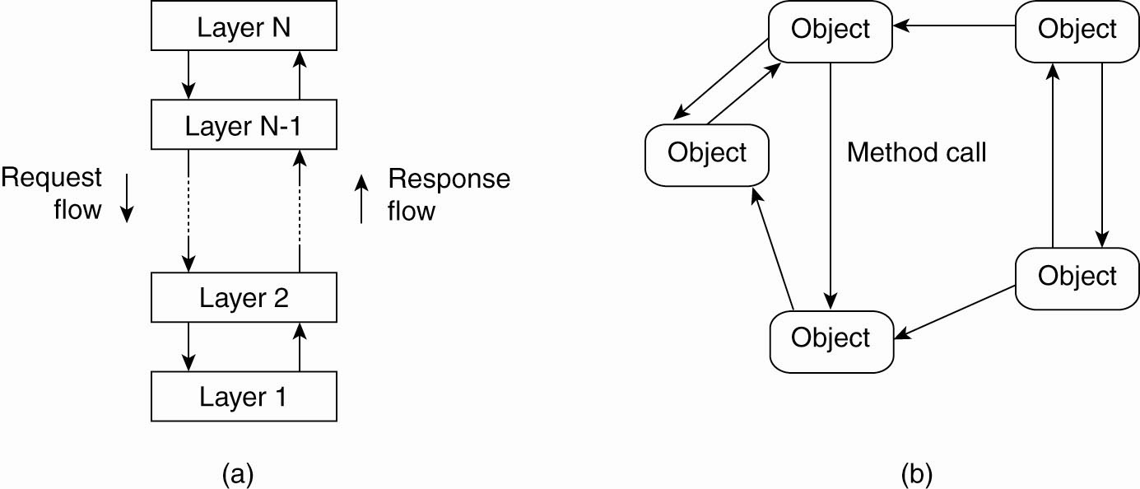
Architectural Styles (2)
Figure 2-1. The (a) layered architectural style and …
Tanenbaum & Van Steen, Distributed Systems: Principles and Paradigms, 2e, (c) 2007 Prentice-Hall, Inc. All rights reserved. 0-13-239227-5

Slide 4
Architectural Styles (3)
Figure 2-1. (b) The object-based architectural style.
Tanenbaum & Van Steen, Distributed Systems: Principles and Paradigms, 2e, (c) 2007 Prentice-Hall, Inc. All rights reserved. 0-13-239227-5

Slide 5
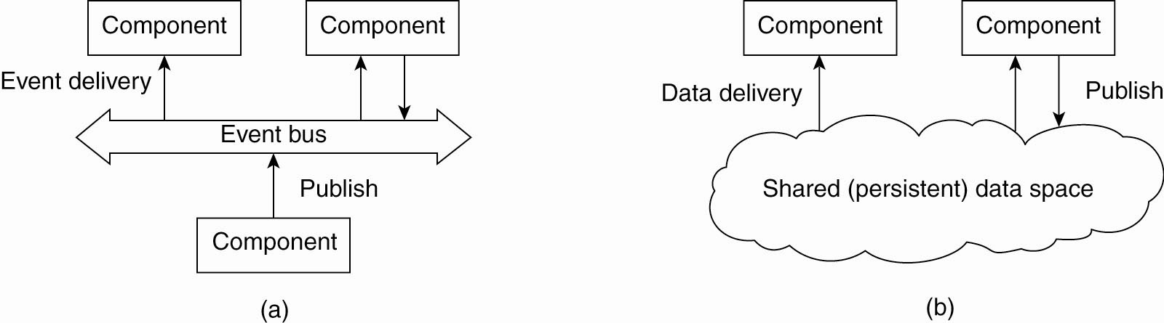
Architectural Styles (4)
Figure 2-2. (a) The event-based architectural style and …
Tanenbaum & Van Steen, Distributed Systems: Principles and Paradigms, 2e, (c) 2007 Prentice-Hall, Inc. All rights reserved. 0-13-239227-5

Slide 6
Publish / subscribe
Publish to, and subscribe from, the event bus
Processes publish events, and the middleware arranges that only those processes that subscribed to that type of event receive them
Processes are referentially decoupled which means that they do not need to know about each other.
Tanenbaum & Van Steen, Distributed Systems: Principles and Paradigms, 2e, (c) 2007 Prentice-Hall, Inc. All rights reserved. 0-13-239227-5

Slide 7
Architectural Styles (5)
Figure 2-2. (b) The shared data-space architectural style.
Tanenbaum & Van Steen, Distributed Systems: Principles and Paradigms, 2e, (c) 2007 Prentice-Hall, Inc. All rights reserved. 0-13-239227-5

Slide 8
Publish / subscribe across time
Publish to, and subscribe from, the persistent data space
Processes publish events, and the middleware arranges that only those processes that subscribed to that type of event receive them – but the processes can be running, or not, at any time
Processes are time decoupled which means that the events (and data) must be stored in some persistent form.
Tanenbaum & Van Steen, Distributed Systems: Principles and Paradigms, 2e, (c) 2007 Prentice-Hall, Inc. All rights reserved. 0-13-239227-5

Slide 9
Data-centric intelligent DB
Can create intelligent databases using logic:
  Modus ponens: A -> B AND A, THEN B
  Resolution: X v Y AND not(Y) v Z THEN X or Z
Forward chaining database:
  Publish A // a fact
  Publish A -> B [not(A) v B] // an implication
Tanenbaum & Van Steen, Distributed Systems: Principles and Paradigms, 2e, (c) 2007 Prentice-Hall, Inc. All rights reserved. 0-13-239227-5

Slide 10
Retrieve B from intelligent DB
Use simple external code on top of the database:
Select *B* (pattern match) from Implications yields
  “not(A) v B”
  […] (all other implications with B in them)
Using: “not(A) v B”
  Search for A;
  If A is true, then report that B is true.
Tanenbaum & Van Steen, Distributed Systems: Principles and Paradigms, 2e, (c) 2007 Prentice-Hall, Inc. All rights reserved. 0-13-239227-5

Slide 11
Using resolution logic…
Forward chaining database:
  Publish X v Y
  Publish not(Y) v Z
Search for proof of X v Z:
  Retrieve terms with X or with Z in them.
  Using resolution, combine:
    X v Y
    Not(Y) v Z
  Yields X v Z
Tanenbaum & Van Steen, Distributed Systems: Principles and Paradigms, 2e, (c) 2007 Prentice-Hall, Inc. All rights reserved. 0-13-239227-5

Slide 12
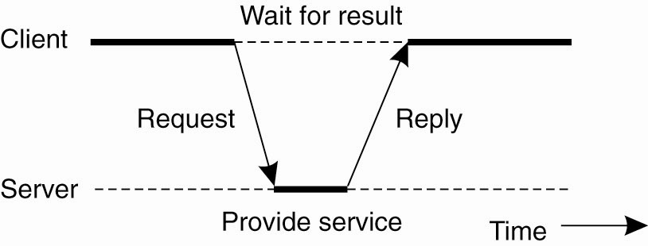
Centralized Architectures
Figure 2-3. General interaction between a client and a server.
Tanenbaum & Van Steen, Distributed Systems: Principles and Paradigms, 2e, (c) 2007 Prentice-Hall, Inc. All rights reserved. 0-13-239227-5

Slide 13
Application Layering (1)
Recall previously mentioned layers of architectural style
The user-interface level
The processing level
The data level
Tanenbaum & Van Steen, Distributed Systems: Principles and Paradigms, 2e, (c) 2007 Prentice-Hall, Inc. All rights reserved. 0-13-239227-5

Slide 14
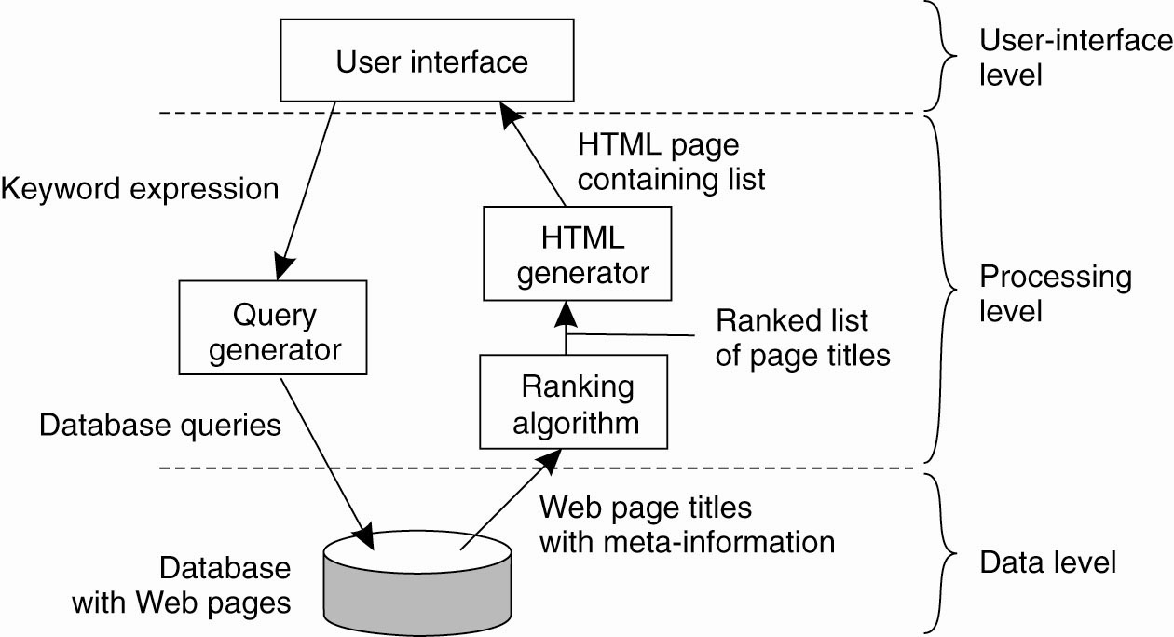
Application Layering (2)
Figure 2-4. The simplified organization of an Internet search engine into three different layers.
Tanenbaum & Van Steen, Distributed Systems: Principles and Paradigms, 2e, (c) 2007 Prentice-Hall, Inc. All rights reserved. 0-13-239227-5

Slide 15
Multitiered Architectures (1)
The simplest organization is to have only two types of machines:
A client machine containing only the programs implementing (part of) the user-interface level
A server machine containing the rest,
  the programs implementing the processing and data level
Tanenbaum & Van Steen, Distributed Systems: Principles and Paradigms, 2e, (c) 2007 Prentice-Hall, Inc. All rights reserved. 0-13-239227-5

Slide 16
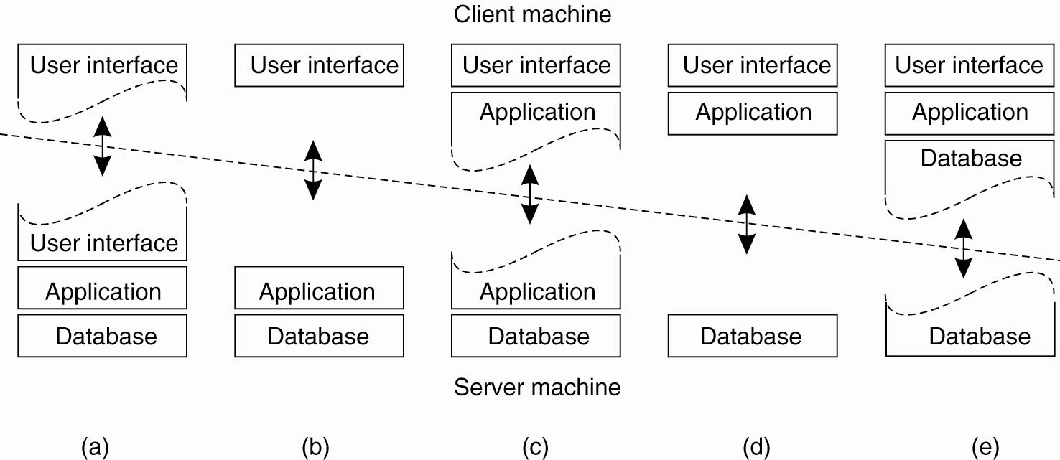
Multitiered Architectures (2)
Figure 2-5. Alternative client-server organizations (a)–(e).
Tanenbaum & Van Steen, Distributed Systems: Principles and Paradigms, 2e, (c) 2007 Prentice-Hall, Inc. All rights reserved. 0-13-239227-5

Slide 17
Heavy Client
Pro:
  Less network traffic
  Quick interactive response
  Handle many exceptions locally and gracefully
  Possibly fewer security issues to address
  Offload computational and data burden to client
  Offload data security problem to client
Con:
  Offline/push update nightmare! ← !!!!!!!!!!!!!!!!
  Code lives in many places at once, versions out of sync.
  More difficult to administer
  Possibly harder to code because of split application.
  System errors must be handled by the client
Tanenbaum & Van Steen, Distributed Systems: Principles and Paradigms, 2e, (c) 2007 Prentice-Hall, Inc. All rights reserved. 0-13-239227-5

Slide 18
Heavy Server
Pro:
  Do not have to distribute updates.
  Simple to code because everything is in one place.
  Simple to maintain and monitor
  May have increased security from code managed on server
  Handle exceptions in one place
Con:
  Lots of (inefficient) traffic over the network
  Slow interactive client response.
  Increased computational and data burden
  May have to ship large amounts of data from client
  Security challenges for sensitive client data
Tanenbaum & Van Steen, Distributed Systems: Principles and Paradigms, 2e, (c) 2007 Prentice-Hall, Inc. All rights reserved. 0-13-239227-5

Slide 19
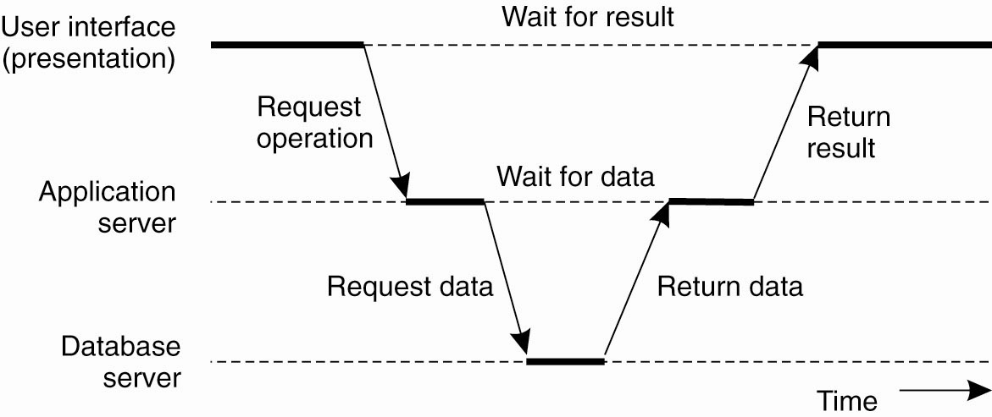
Multitiered Architectures (3)
Figure 2-6. An example of a server acting as client.
Tanenbaum & Van Steen, Distributed Systems: Principles and Paradigms, 2e, (c) 2007 Prentice-Hall, Inc. All rights reserved. 0-13-239227-5

Slide 20
Different types of operations
When messages can be lost, there is a big difference between idempotent operations, and those that can only be executed one time.
“Add $50,000 to Smith’s account” (only once)
“Return the current balance in Smith’s account” (idempotent, can repeat many times if thought lost)
Tanenbaum & Van Steen, Distributed Systems: Principles and Paradigms, 2e, (c) 2007 Prentice-Hall, Inc. All rights reserved. 0-13-239227-5

Slide 21
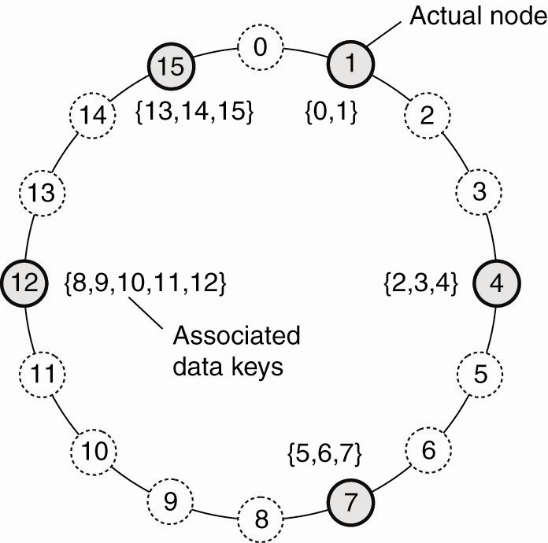
Structured Peer-to-Peer Architectures (1)
Figure 2-7. The mapping of data items onto nodes in Chord.
Tanenbaum & Van Steen, Distributed Systems: Principles and Paradigms, 2e, (c) 2007 Prentice-Hall, Inc. All rights reserved. 0-13-239227-5

Slide 22
Adding/removing a node from DHT
To add a node to a DHT (Distributed Hash Table)
Use a RNG (random number generator) to produce some number in the correct key range
Chance of conflict is low
Look up the next highest numbered node
Communicate with predecessor / successor
Insert new node in between the two. Point to predecessor and successor. Move data as needed.
Removal of node is the reverse.
Tanenbaum & Van Steen, Distributed Systems: Principles and Paradigms, 2e, (c) 2007 Prentice-Hall, Inc. All rights reserved. 0-13-239227-5

Slide 23
DHT dynamics
What makes DHT work:
Deterministic scheme to map key of data item to identifier of some node to store it.
Look up data by same key – get to node that has stored it
Nodes can join and quit at will
Logical organization independent of physical network
General purpose: can support many kinds of applications.
Tanenbaum & Van Steen, Distributed Systems: Principles and Paradigms, 2e, (c) 2007 Prentice-Hall, Inc. All rights reserved. 0-13-239227-5

Slide 24
Rapid communication between nodes
Communication in DHT is not around the ring…
  Nodes maintain overlay network
  O(log(N)) where N is the number nodes.
For our examples we will use the simpler “around the ring” description because it is easier to visualize
Tanenbaum & Van Steen, Distributed Systems: Principles and Paradigms, 2e, (c) 2007 Prentice-Hall, Inc. All rights reserved. 0-13-239227-5

Slide 25
Bit Torrent
Both structured and unstructured.
  Structured: .torrent files/trackers → centralized
  Unstructured: regular nodes → de-centralized
.torrent files (fixed location) point to trackers
Trackers (servers) for F keep lists of active nodes with file F
Download chunks of F from various nodes.
Good behavior enforced: upload and download rates are considered
Two nodes can even trade pieces of F
Tanenbaum & Van Steen, Distributed Systems: Principles and Paradigms, 2e, (c) 2007 Prentice-Hall, Inc. All rights reserved. 0-13-239227-5

