Slide 1
DISTRIBUTED SYSTEMS Principles and Paradigms Second Edition ANDREW S. TANENBAUM MAARTEN VAN STEEN Chapter 6 Synchronization (Elliott additions)

Slide 2
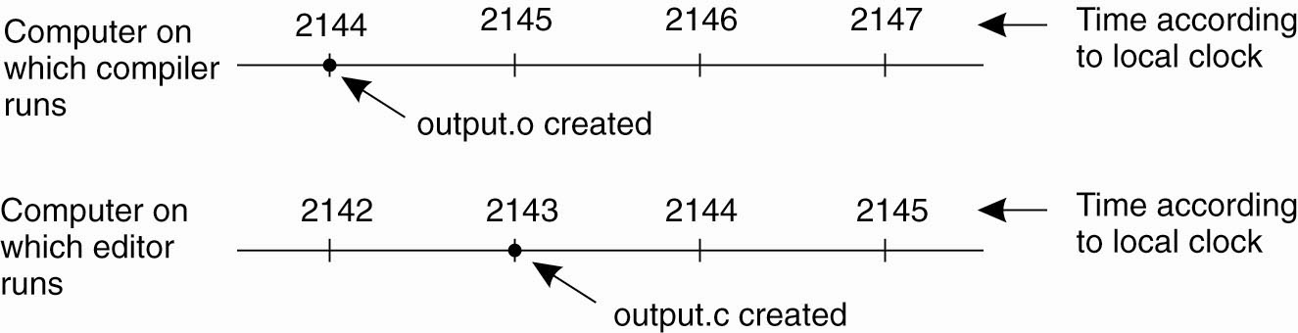
Clock Synchronization
Figure 6-1. When each machine has its own clock, an event that occurred after another event may nevertheless be assigned an earlier time.

Slide 3
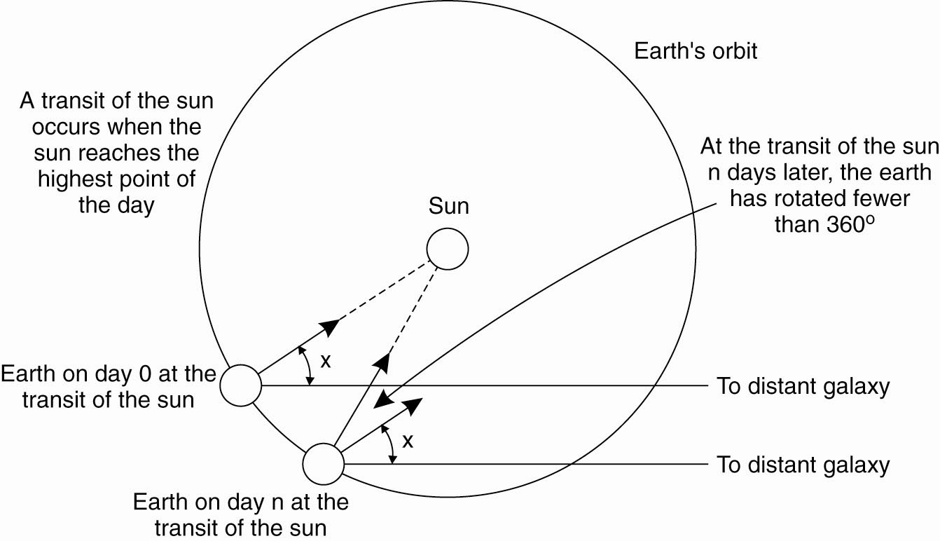
Physical Clocks (1)
Figure 6-2. Computation of the mean solar day.

Slide 4
Figuring a standard measure is hard.
(3600x24) Solar second is 1/86400th of a solar day.
But earth slowing down, and also wobbles.
300 million years ago we had 400 days.
Temporary fluctuations, probably due to molten iron core.
Mean solar day takes an average.
“Longitude” by Dava Sobel

Slide 5
Cesium 133 atom, 9,192,631,770 transitions in a second. (1948)
TAI International atomic time, cesium 133 counter since midnight 1958-01-01.
But 86,400 is now ~3msec less than a solar day, because slowing of Earth’s spin!
Politics! 1582 Pope Gregory removed 10 days from the calendar. Rent/interest vs. month’s pay. “Gregorian Calendar”

Slide 6
BIH (Bureau international de l’Heure) collects reports of Cesium clocks makes and average.
Cesium time is just a count since 1958
Leap seconds introduced.
Universal Coordinated Time UTC

Slide 8
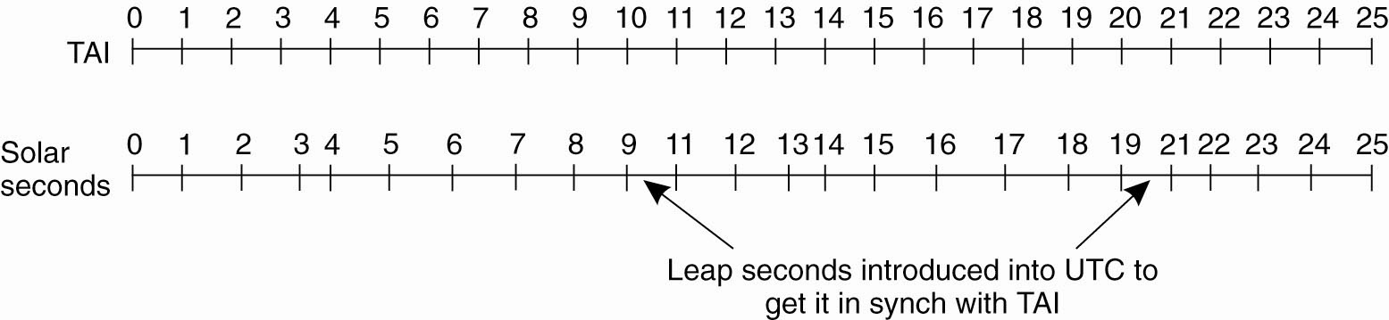
Physical Clocks (2)
Figure 6-3. TAI (Int. Atomic Time) seconds are of constant length, unlike solar seconds. Leap seconds are introduced when necessary to keep in phase with the sun.

Slide 9
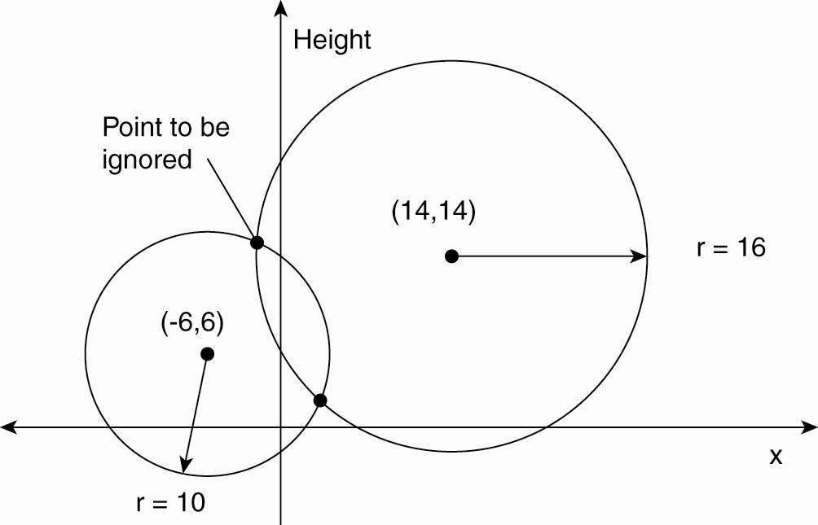
Global Positioning System (1)
Figure 6-4. Computing a position in a two-dimensional space.

Slide 10
GPS – 2 dimensional case
If you known the location of the satellite and you know what time you’ve received its signal, then you know how far away you are from it (the radius).
Using two radii you know where you are on the plane (ignoring the upper intersection).
GPS signals also give us the time

Slide 11
Global Positioning System (2)
Real world facts that complicate GPS
It takes a while before data on a satellite’s position reaches the receiver.
The receiver’s clock is generally not in synch with that of a satellite.

Slide 12
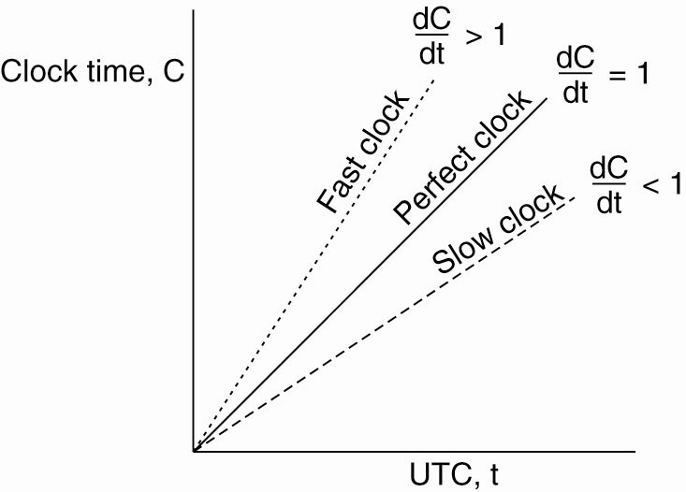
Clock Synchronization Algorithms
Figure 6-5. The relation between clock time and UTC when clocks tick at different rates.

Slide 13
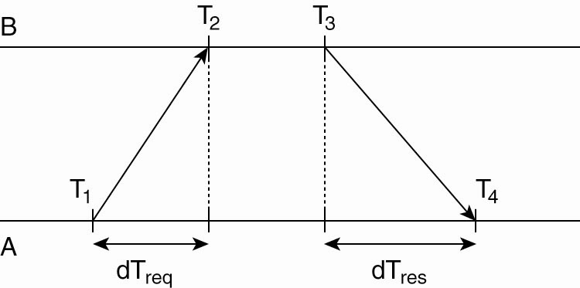
Network Time Protocol
Figure 6-6. Getting the current time from a time server.

Slide 14
Approximately…
Know time of request, and of receipt of response.
Know processing time at TimeServer B.
Know difference of two = sum of delays
Average of the two network delays should be added to time at send

Slide 15
Berkeley Algorithm
When no machine has an accurate clock, can use agreement.
Set the clock manually, from time to time based on an external source

Slide 16
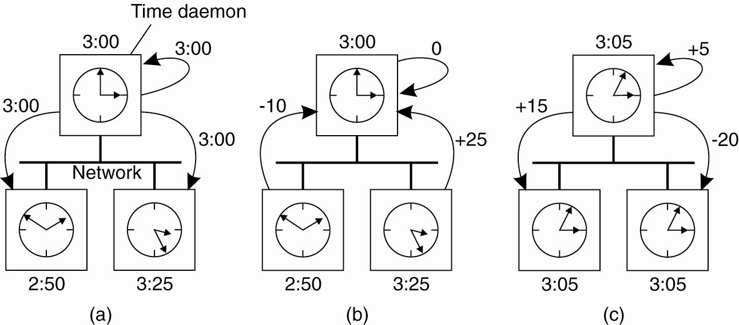
The Berkeley Algorithm (1)
Figure 6-7. (a) The time
daemon asks all the other
machines for their clock
values.

Slide 17
The Berkeley Algorithm (2)
Figure 6-7.
(b) The machines answer.

Slide 18
The Berkeley Algorithm (3)
Figure 6-7. (c) The time
daemon tells everyone how
to adjust their clock.

Slide 19
Adjusting clocks can be problematic:
Time cannot run backwards
Some clocks are known to be more accurate than others.
Changes in time have to take place gradually on a system, because in practice systems use time-outs to simulate a synchronous system

Slide 20
RBS – wireless sensor networks
Reference Broadcast Synchronization
Internally synchronize the clocks – no attempt at UTC
Only the receiver synchronizes
In sensor networks constructing the time message and accessing the network are constant, so not part of the critical path that determines variations in propagation.
No timestamp. Just mark when the reference message is received. Can then trade with other nodes to determine offset. Keeping a record allows for linear regression to account for drift.

Slide 21
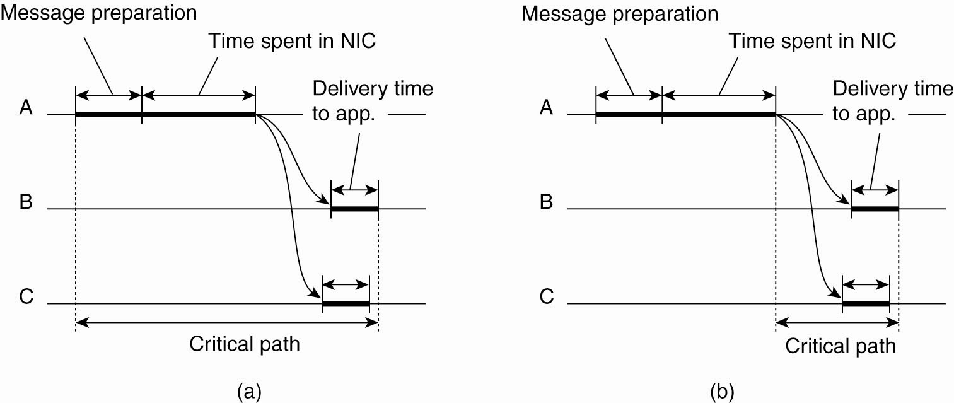
Clock Synchronization in Wireless Networks (1)
Figure 6-8. (a) The usual
critical path in determining
network delays.

Slide 22
Clock Synchronization in Wireless Networks (2)
Figure 6-8. (b) The
critical path in the
case of RBS.

Slide 23
Lamport’s Logical Clocks (1)
The "happens-before" relation → can be observed directly in two situations:
If a and b are events in the same process, and a occurs before b, then a → b is true.
If a is the event of a message being sent by one process, and b is the event of the message being received by another process, then a → b is true.
Transitive: a → b, b →c :== a → c

Slide 24
If events x, y, happen in different processes that do not exchange messages (incl. 3rd party transmission) then neither x →y, or y →x, are true. Instead are said to be concurrent.
C is clock value, C(x) is the clock value when x occurred, as agreed by all processes.
Time only moves forward by incrementing the clock.

Slide 28
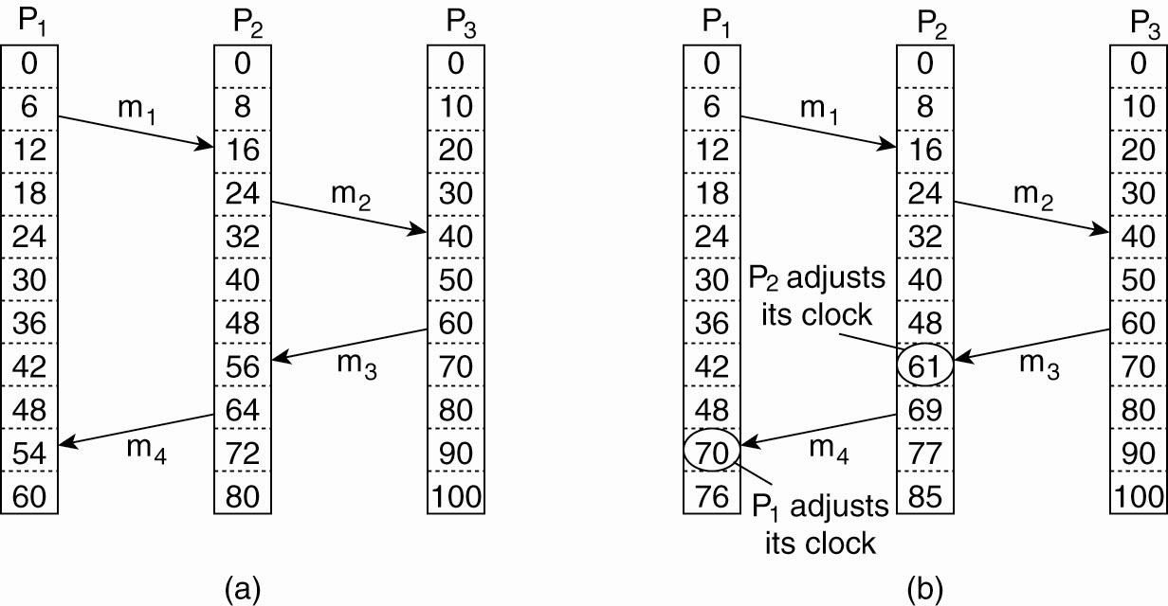
Lamport’s Logical Clocks (2)
Figure 6-9. (a) Three processes, each with its own clock. The clocks run at different rates.

Slide 29
Lamport’s Logical Clocks (3)
Figure 6-9. (b) Lamport’s algorithm corrects the clocks.

Slide 30
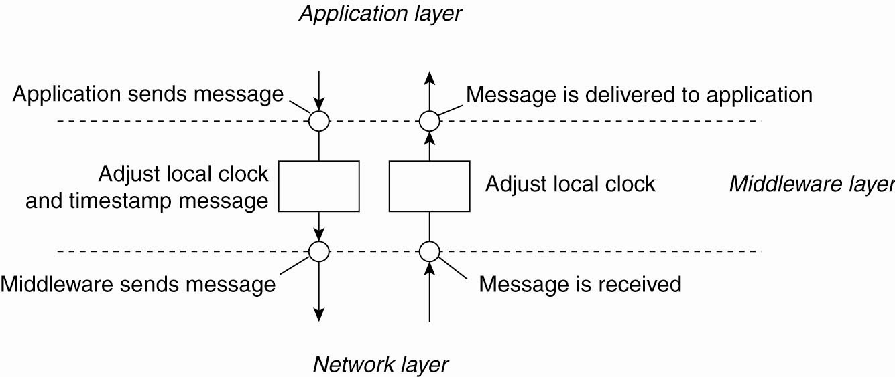
Lamport’s Logical Clocks (4)
Figure 6-10. The positioning of Lamport’s logical clocks in distributed systems.

Slide 31
Lamport’s Logical Clocks (5)
Updating counter C_{i} for process P_{i}
Before executing an event P_{i} executes C_{i} ← C_{i} + 1.
When process P_{i} sends a message m to P_{j}, it sets m’s timestamp ts (m) equal to C_{i} after having executed the previous step.
Upon the receipt of a message m, process P_{j} adjusts its own local counter as C_{j} ← max{C_{j} , ts (m)}, after which it then executes the first step and delivers the message to the application.

Slide 32
Can add the process number on any particular machine after a decimal point, to guarantee unique events and time ordering.

Slide 33
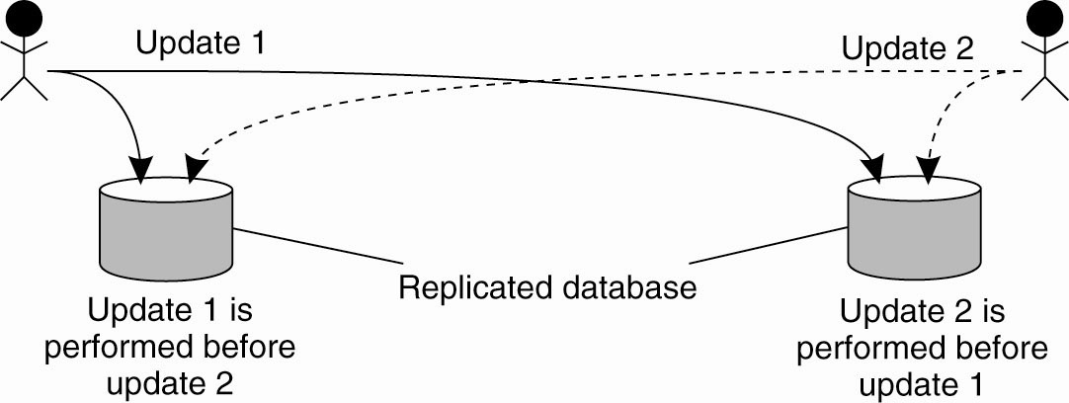
Example: Totally Ordered Multicasting
Figure 6-11. Updating a replicated database and leaving it in an inconsistent state.

Slide 34
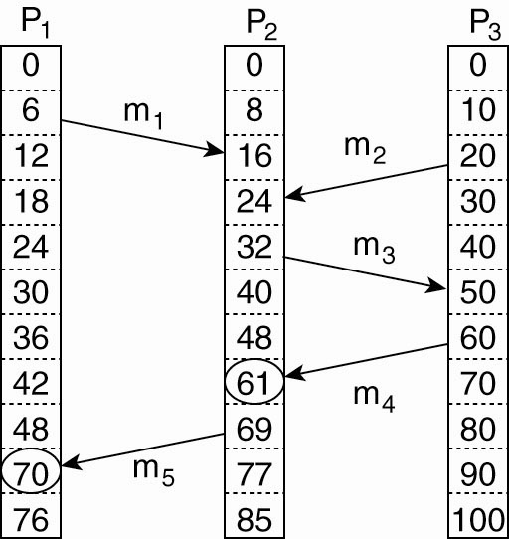
Vector Clocks (1)
Figure 6-12. Concurrent message transmission using logical clocks.

Slide 35
Vector Clocks (2)
Vector clocks are constructed by letting each process P_{i} maintain a vector VC_{i} with the following two properties:
VC_{i} [ i ] is the number of events that have occurred so far at P_{i}. In other words, VC_{i} [ i ] is the local logical clock at process P_{i} .
If VC_{i} [ j ] = k then P_{i} knows that k events have occurred at P_{j}. It is thus P_{i}’s knowledge of the local time at P_{j} .

Slide 36
Vector Clocks (3)
Steps carried out to accomplish property 2 of previous slide:
Before executing an event, P_{i} executes VC_{i} [ i ] ← VC_{i} [i ] + 1.
When process P_{i} sends a message m to P_{j}, it sets m’s (vector) timestamp ts (m) equal to VC_{i} after having executed the previous step. It then sends the entire vector, VC_{i} along with m to the receiving process. (The book is not very clear on this point.)

Slide 37
Vector Clocks (4)
.
.
Upon the receipt of a message m (and the entire vector) from a sender, process P_{j} adjusts its own vector by setting VC_{j} [k ] ← max{VC_{j} [k ], ts (m)[k ]} for each k, after which it executes the first step and delivers the message to the application.
In this way, the maximum amount of time information about all processes in the system are transferred with each message.

Slide 38
Vector clock example, enforcing causal communication
Causally-ordered communication is weaker than totally ordered communication, but might be enough.
In the next example, vector-entry time stamps are only incremented when a message is sent.
Vector adjustment is as usual.

Slide 39
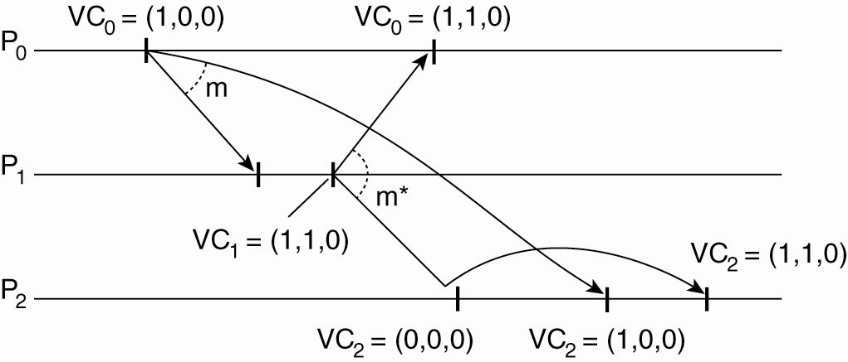
Enforcing Causal Communication
Figure 6-13. Enforcing causal communication.

Slide 40
Problems with middleware ordering of messages
Middleware does not know what a message contains. E.g., two msgs from the same proc may not be related but are treated as causal. Less efficient.
Not all actual causality may be captured. E.g., external causation (say by a phone call) will not be captured.
Refer again to Saltzer (1984) end-to-end argument in system’s design.
But, places non-content burden on the developer, which we like to avoid.

Slide 41
But, places non-content burden on the developer, which we like to avoid.

Slide 42
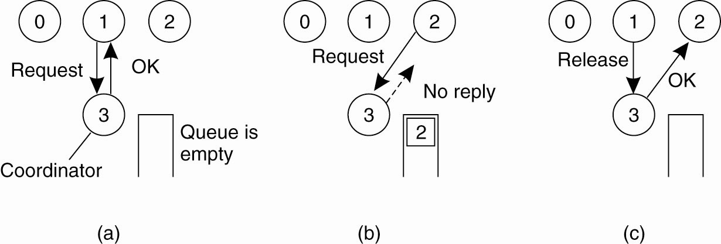
Mutual Exclusion A Centralized Algorithm (1)
Figure 6-14. (a) Process 1 asks the coordinator for permission to access a hared resource. Permission is granted.

Slide 43
Mutual Exclusion A Centralized Algorithm (2)
Figure 6-14. (b) Process 2 then asks permission to access the same resource. The coordinator does not reply.

Slide 44
Mutual Exclusion A Centralized Algorithm (3)
Figure 6-14. (c) When process 1 releases the resource, it tells the coordinator, which then replies to 2.

Slide 45
A Distributed Algorithm (1)
Three different cases:
If the receiver is not accessing the resource and does not want to access it, it sends back an OK message to the sender.
If the receiver already has access to the resource, it simply does not reply. Instead, it queues the request.
If the receiver wants to access the resource as well but has not yet done so, it compares the timestamp of the incoming message with the one contained in the message that it has sent everyone. The lowest one wins.

Slide 46
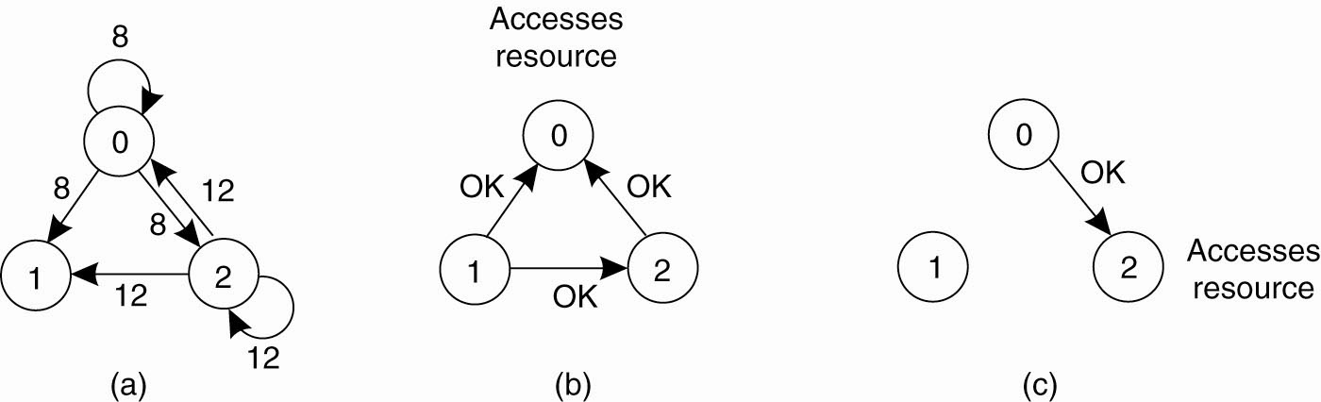
A Distributed Algorithm (2)
Figure 6-15. (a) Two processes want to access a shared resource at the same moment.

Slide 47
A Distributed Algorithm (3)
Figure 6-15. (b) Process 0 has the lowest timestamp, so it wins.

Slide 48
A Distributed Algorithm (4)
Figure 6-15. (c) When process 0 is done, it sends an OK also, so 2 can now go ahead.

Slide 49
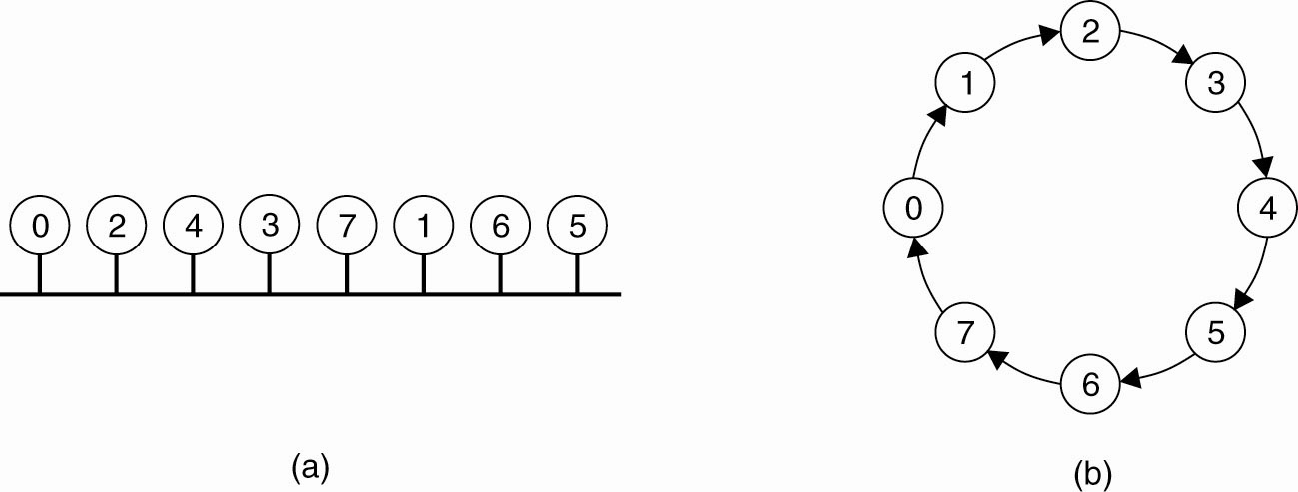
A Token Ring Algorithm
Figure 6-16. (a) An unordered group of processes on a network. (b) A logical ring constructed in software.

Slide 50
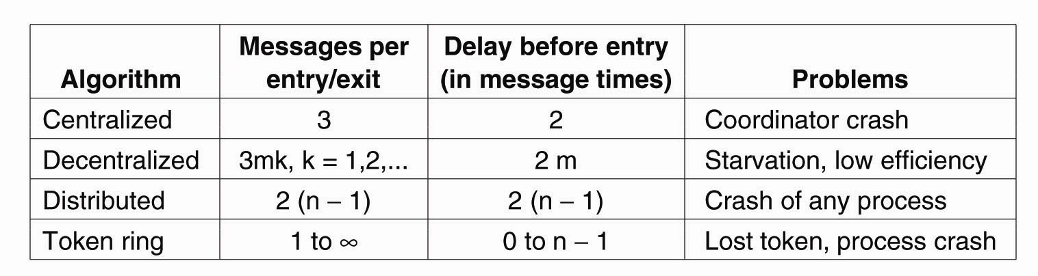
A Comparison of the Four Algorithms
Figure 6-17. A comparison of three mutual exclusion algorithms.

Slide 51
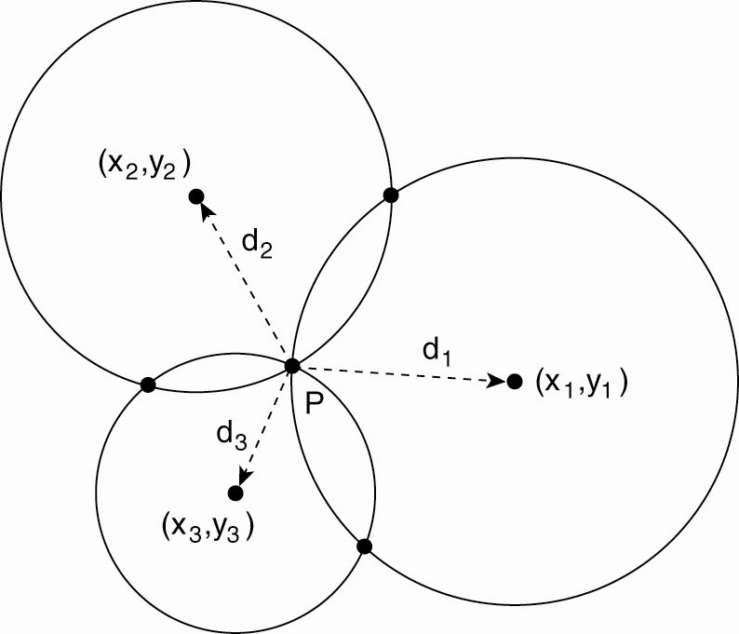
Global Positioning Of Nodes (1)
Figure 6-18. Computing a node’s position in a two-dimensional space.

Slide 52
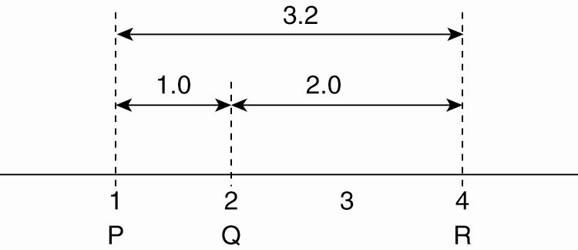
Global Positioning Of Nodes (2)
Figure 6-19. Inconsistent distance measurements in a one-dimensional space.

Slide 53
Election Algorithms
The Bully Algorithm
P sends an ELECTION message to all processes with higher numbers.
If no one responds, P wins the election and becomes coordinator.
If one of the higher-ups answers, it takes over. P’s job is done.

Slide 54
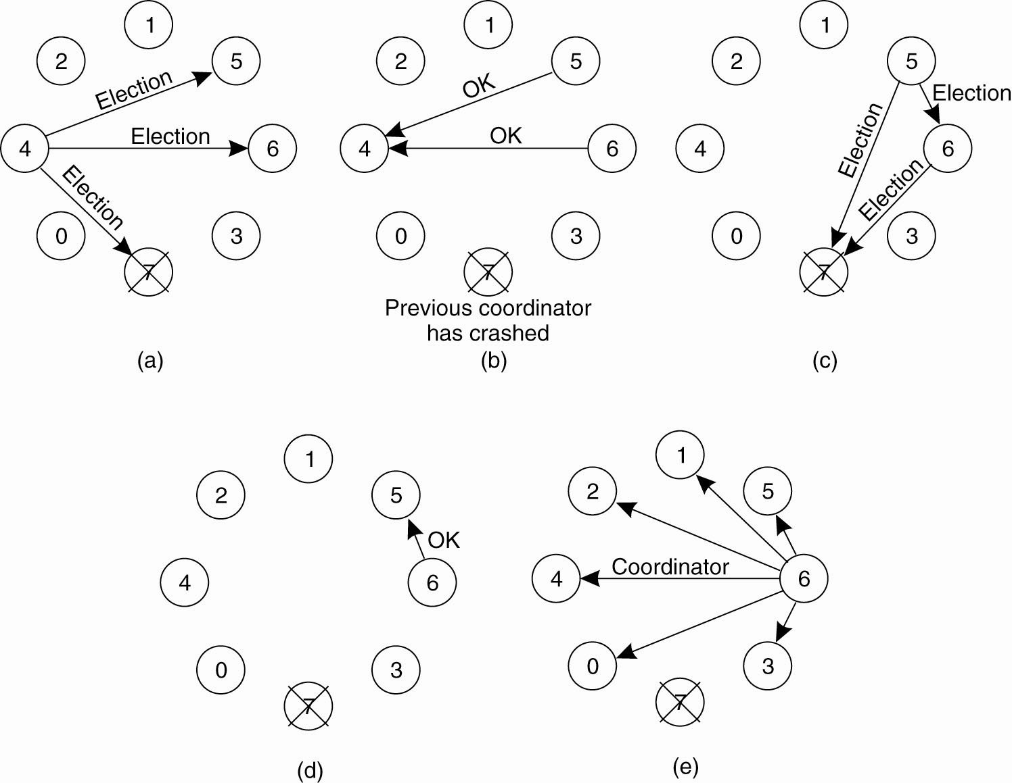
The Bully Algorithm (1)
Figure 6-20. The bully election algorithm. (a) Process 4 holds an
election. (b) Processes 5 and 6 respond, telling 4 to stop.
(c) Now 5 and 6 each hold an election.

Slide 55
The Bully Algorithm (2)
Figure 6-20. The bully election algorithm. (d) Process 6 tells 5 to stop. (e) Process 6 wins and tells everyone.

Slide 56
Non-token Ring Election
Processes know of their successor(s) in ring
Proc notes failure – sends election msg with own proc # to successor, or to succ of succ, etc.
Each proc adds its proc # to the list in elec msg
Message finally gets around ring to start
Select new coordinator (highest proc #?), send around the ring with new list of members
When coordinator msg returns, all are informed
If two sets of messages sent, highest coordinator wins. Presumably, lower coordinator is removed by any node.

Slide 57
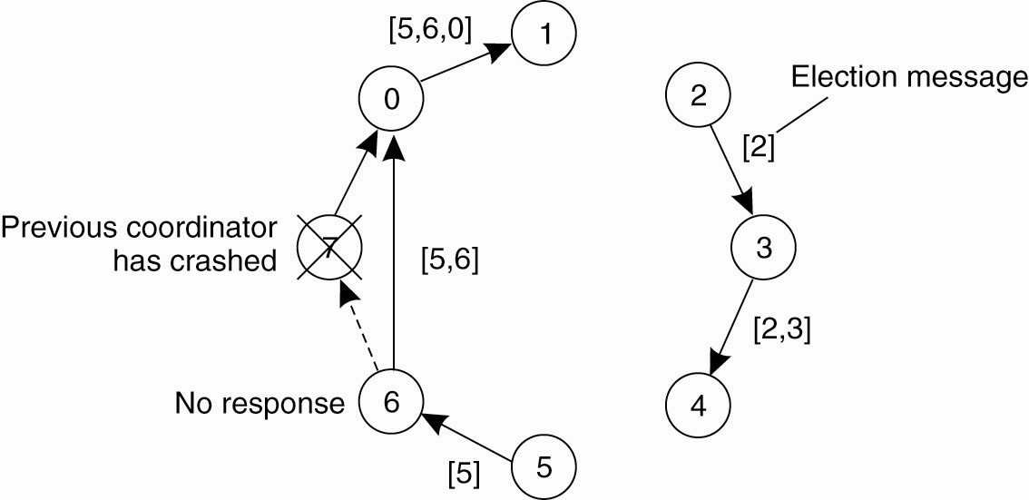
A Ring Algorithm
Figure 6-21. Election algorithm using a ring.

Slide 58
Wireless Election
Cannot assume full network connectivity, stable connections, stable topology (mobile?)
Node and network failure, partitioning?
Need to select BEST (best connected / geography / battery) node for coordinator
Vasudevan et al. (2004): source node sends election msg to all nodes it can reach
Receiving node notes parent (sender) and sends to all nodes IT can reach, minus parent node
If node received msg from node other than its parent, simply send ack, then ignore.

Slide 59
Wireless Election
Each node waits for ack from all its neighbors, then sends back ack to parent. Nodes that have a parent, send back immediate ack. If all acks then node is a leaf node in the network. Leaf nodes respond quickly and send information about qualities as a coordinator (e.g., battery life)
When a node finally sends message to its parent it also sends info about the best available coordinator candidate. This percolates back up to the original source, which then broadcasts a msg about who is the new coordinator.

Slide 60
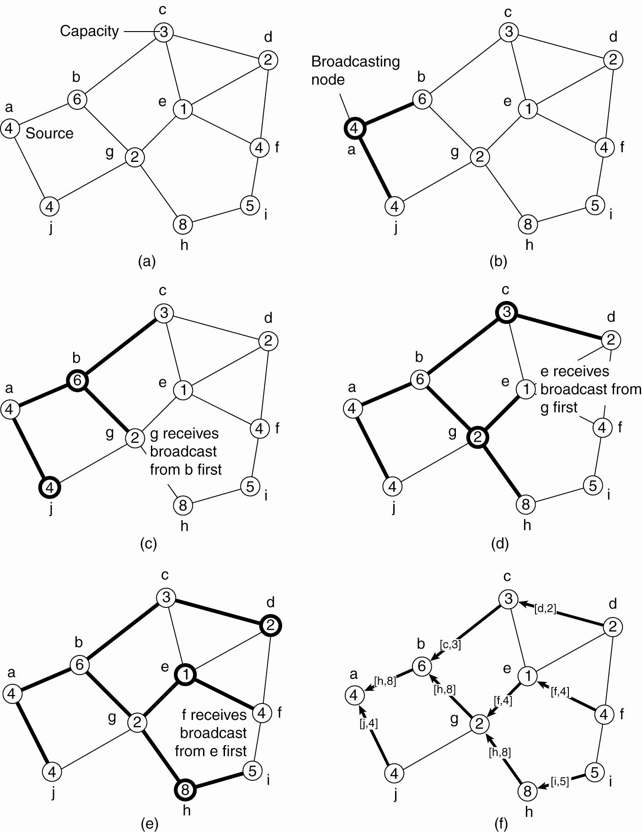
Elections in Wireless Environments (1)
Figure 6-22. Election algorithm in a wireless network, with node a as the source. (a) Initial network. (b)–(e) The build-tree phase

Slide 61
Elections in Wireless Environments (2)
Figure 6-22. Election algorithm in a wireless network, with node a as the source. (a) Initial network. (b)–(e) The build-tree phase

Slide 62
Elections in Wireless Environments (3)
Figure 6-22. (e) The build-tree phase. (f) Reporting of best node to source.

Slide 63
Elections in Large-Scale Systems (1)
Requirements for superpeer selection:
Normal nodes should have low-latency access to superpeers.
Superpeers should be evenly distributed across the overlay network.
There should be a predefined portion of superpeers relative to the total number of nodes in the overlay network.
Each superpeer should not need to serve more than a fixed number of normal nodes.

Slide 64
SuperPeer selection with DHT
DHT addressing is via m-bit space. Just using the leftmost [3] bits:
When m-ID AND 1110000… neq. Zero then you are a SuperPeer

Slide 65
Spreading SuperPeers in an unstructured network
Like multicast packets, each hop degrades the force of a repulsion message
The correct number of tokens are generated in the network (see above to calculate size)
Each node with a token sends repulsion messages.
Each node with a token that receives too much repulsive force, sends the token to a neighbor in the opposite direction.
Can have local maxima problem

Slide 66
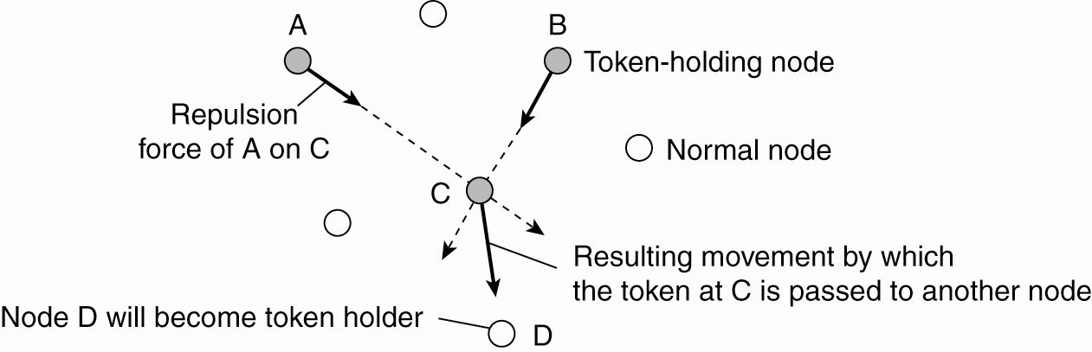
Elections in Large-Scale Systems (2)
Figure 6-23. Moving tokens in a two-dimensional space using repulsion forces.

Slide 74
.

