Slide 1
SE 435
Overview of Security for Distributed Systems
1.3
Clark Elliott
Instructor

Slide 2
General Attacks

Slide 3
Phishing
Social Engineering attack. Most computer users are not computer scientists. Pretend to be an authority, and ask them for the information.
Password Harvesting Fishing (but not really) – from Phone Phreaks
http://www.antiphishing.org/phishing_archive.html
Classic examples:
http://www.antiphishing.org/phishing_archive/05-10-05_Paypal/05-10-05_Paypal.html
http://en.wikipedia.org/wiki/Phishing#Phishing_Example

Slide 4
URL spoofing
Just using an IP address 123.456.654.321 assuming the user will not know what it is.
Different domain, or tricky domain like paypa1.com [pay pa “one”], or ebay-us.com
Internationalized Domain Name substitution with hidden characters
http://en.wikipedia.org/wiki/Phishing#URL_spoofing

Slide 5
Spoofing
“htp://www.google.com@members.tripod.com/. These addresses will attempt to connect as a user www.google.com to the server members.tripod.com.” (wikipedia.org)
Opponents substitute pages that LOOK like the originals, but use them to gain information from users.
Not an attack on an e-commerce site, per se, but on the users of an e-commerce site.

Slide 6
DNS tables / Pharming
http://en.wikipedia.org/wiki/Pharming
http://www.depaul.edu/~elliott/420/general/pharming-example.html
localhost IN A 127.0.0.1 router IN A 192.112.36.1 synop2 IN A 192.112.36.2 synop3 IN A 192.112.36.3 synop4 IN A 192.112.36.4 oldpop IN A 192.112.36.67 tmmsun IN A 192.112.36.230 oper IN A 192.112.36.44

Slide 7
Internal attack: Keylogging
http://dewasoft.com/privacy/kldetector.htm
Easy to purchase, and not hard to install:
http://www.mykeylogger.com/keylogger/keylogger-features.php
Keyboard is a computer that produces a serial output stream. This, in turn, is captured by a system interrupt under program control. So – can do anything you like with the stream.
http://news.com.com/Phishing+attacks+take+a+new+twist/2100-1029_3-5695874.html

Slide 8
Credit Card Information
Data Security Standard, Visa:
http://usa.visa.com/download/business/accepting_visa/ops_risk_management/cisp_PCI_Data_Security_Standard.pdf?it=il|/business/accepting_visa/ops_risk_management/cisp.html|PCI%20Data%20Security%20Standard -- but are these just for “CYA” or real standards?
Users cannot destroy accounts, but can change their credit cards regularly, or can use temporary web CCard numbers.

Slide 9
Multi-factor Authentication
What the user knows, what the user has, what the user is.
http://news.com.com/Finding+a+replacement+for+passwords/2100-1029_3-5586249.html?tag=nl

Slide 10
Denial of Service
http://whatis.techtarget.com/definition/0,289893,sid9_gci213591,00.html
Russian Mafia and NFL Gambling: http://www.americanmafia.com/Feature_Articles_293.html
NAPTHA http://www.securiteam.com/securitynews/6B0031F0KA.html
National Infrastructure Protection Center: will people use government resources?
http://www.fcw.com/fcw/articles/2000/0214/web-fbi-02-14-00.asp

Slide 11
Viruses and ”Malicious Programs”
Computer “Viruses” and related programs have the ability to replicate themselves on an ever increasing number of computers. They originally spread by people sharing floppy disks. Now they spread primarily over the Internet (a “Worm”).
Other “Malicious Programs” may be installed by hand on a single machine. They may also be built into widely distributed commercial software packages. These are very hard to detect before the payload activates (Trojan Horses, Trap Doors, and Logic Bombs).

Slide 12
Taxanomy of Malicious Programs
Malicious Programs
Need Host Program
Independent
Trapdoors
Logic Bombs
Trojan
Horses
Viruses
Bacteria
Worms

Slide 13
Hoax attack
Many dedicated, generous, people exist. Also good business to provide products for free
Hoaxes can scare people away from legitimate products
Legal “hoaxes” as well.

Slide 14
Definitions
Virus - code that copies itself into other programs.
A “Bacteria” replicates until it fills all disk space, or CPU cycles.
Payload - harmful things the malicious program does, after it has had time to spread.
Worm - a program that replicates itself across the network (usually riding on email messages or attached documents (e.g., macro viruses).

Slide 15
Definitions
Trojan Horse - instructions in an otherwise good program that cause bad things to happen (sending your data or password to an attacker over the net).
Logic Bomb - malicious code that activates on an event (e.g., date).
Trap Door (or Back Door) - undocumented entry point written into code for debugging that can allow unwanted users.
Christmas Tree - extraneous code that does something “cool.” A way for programmers to show that they control the product.
Zombies – do the evil bidding of another – DofS from hundreds of sources?

Slide 16
Virus Phases
Dormant phase - the virus is idle
Propagation phase - the virus places an identical copy of itself into other programs
Triggering phase – the virus is activated to perform the function for which it was intended
Execution phase – the function is performed

Slide 17
Virus Protection
Have a well-known virus protection program, configured to
scan disks and downloads automatically for known viruses.
Do not execute programs (or "macro's") from unknown
sources (e.g., PS files, Hypercard files, MS Office documents,
Avoid the most common operating systems and email
programs, if possible.

Slide 18
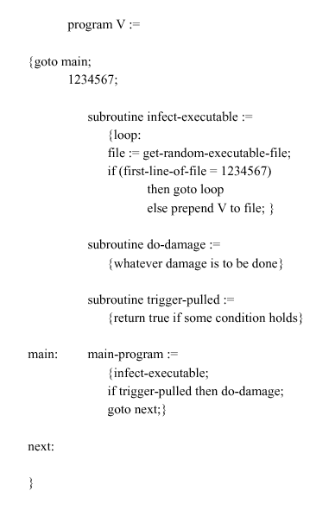
Virus Structure

Slide 19
Types of Viruses
Parasitic Virus - attaches itself to executable files as part of their code. Runs whenever the host program runs.
Memory-resident Virus - Lodges in main memory as part of the residual operating system.
Boot Sector Virus - infects the boot sector of a disk, and spreads when the operating system boots up (original DOS viruses).
Stealth Virus - explicitly designed to hide from Virus Scanning programs.
Polymorphic Virus - mutates with every new host to prevent signature detection.

Slide 20
Macro Viruses
Microsoft Office applications allow “macros” to be part of the document. The macro could run whenever the document is opened, or when a certain command is selected (Save File).
Platform independent.
Infect documents, delete files, generate email and edit letters.

Slide 21
Virus Constructors
http://www.f-secure.com/v-descs/virmaker.shtml
“Constructor is a virus or trojan creation toolkit. A constructor allows its user to create a malware by only choosing its features, it's very easy to use. A user doesn't need to know any programming language to create a virus or a trojan. Some constructors allow to create quite complex viruses and then to add a polymorphic engine to them. Once some person created more than 15000 viruses using a constructor and sent them to anti-virus companies. Constructor-based viruses are usually detected generically as they are built from ready 'blocks' and known polymorphic engines.
Most famous constructors: VCL, SennaSpy, BWG, PS-MPC, TPPE, IVP”

Slide 22
Antivirus Approaches
1st Generation, Scanners: searched files for any of a library of known virus “signatures.” Checked executable files for length changes.
2nd Generation, Heuristic Scanners: looks for more general signs than specific signatures (code segments common to many viruses). Checked files for checksum or hash changes.
3rd Generation, Activity Traps: stay resident in memory and look for certain patterns of software behavior (e.g., scanning files).
4th Generation, Full Featured: combine the best of the techniques above.

Slide 23
Advanced Antivirus Techniques
Generic Decryption (GD)
CPU Emulator
Virus Signature Scanner
Emulation Control Module
For how long should a GD scanner run each interpretation?

Slide 24
Privacy Issues
What happens when a digital immune system agent triggers the forwarding of suspected email to a reviewer?
Do all systems people also have authority to view all data on the computer?

Slide 25
Behavior Blocking
Users hate this, but can be very useful --- especially just asking the user, or delaying gratification.
A user is not allowed to install a program until they ask. Requires a real person to be in the installation loop.

Slide 26
Sme Reading and WEB Sites
Denning, P. Computers Under Attack: Intruders, Worms, and Viruses. Addison-Wesley, 1990
CERT Coordination Center (WEB Site)
AntiVirus Online (IBM’s site)

Slide 27
The players -- seekers
SeekerHonest: honest company requesting bids for the building of road framistats, that needs copper pipes
SeekerSneaky: wants SeekerHonest to go down in flames, so they can build all the framistats
SeekerCheatLater: Accepts bids, but later refuses to pay.

Slide 28
The players -- vendors
VendorHonestA -- vendor that plays by the rules, sends bids for copper pipes.
VendorHonestB: Plays by the rules, sends bid for copper pipes
VendorSaboteur: Sabotages the bids of honest vendors
VendorEavesdropper: Looks at the secret bids of honest vendors.
VendorImposter: Fakes their identity, and replies from honest vendors, to steal business.

Slide 29
Scenarios – one ☺
SeekerHonest sends out electronic bid requests. These are public, and contain the specifications of the bids sought.
"We are SeekerHonest. We build framistats for roads. We need to purchase, from a subcontractor, 10,000 1-inch copper pipes of quality 10.5. Please send us your bids by April 12th, 2005. We will notify you by April 30th if we select you as the pipe subcontrator. Signed: SeekerHonest"

Slide 30
One ☺
VendorHonestA and VendorHonestB each reply with secret bids.
SeekerHonest reviews the bids and picks the one they find most attractive, selecting VendorHonestA.
SeekerH sends notification to VendorHB declining their offer, and to VendorHA accepting their offer.
VendorHA and SeekerH complete their business.

Slide 31
One ☺
Message integrity, authentication, and privacy have all been upheld

Slide 32
Scenarios – two ☹
Like scenario one, but SeekerCheatLater completes business with VendorHA.
VendorHA invests $100K in setting up to make copper pipe.
SeekerCheatLater abandons the project and refuses to pay VendorHA for their loss, saying that the electronic agreements were all faked.

Slide 33
Scenarios – two ☹
Message authentication and dating has been compromised; message non-repudiability has been compromised.

Slide 34
Scenarios – three ☹
After SeekerH sends out the messages to VendorHA and VendorHB, SeekerSneaky who has intercepted the messages, sends a follow-up message to VendorHB telling them they would like their services after all, and forming a contract with them as well.
SeekerH now has 20,000 pipes and two vendors who want to get paid.

Slide 35
Scenarios – three ☹
Message privacy and authentication have been compromised.

Slide 36
Scenarios – four ☹
VendorSaboteur intercepts and sabotages the bids of VendorHA and VendorHB.
“These pipes are expensive to make. We regret to say that we must charge [insert an unworkably high amount]”
VendorS then submits a bid for 120 percent of the real costs of the best original bid, and gets the contract.

Slide 37
Scenarios – four ☹
Message integrity has been compromised

Slide 38
Scenarios – five ☹
VendorEavesdropper looks at the secret bids of honest vendors and then very carefully tweaks their own bid to be just enough superioir to the other vendors in quality, speed, and/or price to get the bid, if they want it.
SeekerH’s secret bid protocol has now been compromised and they form a contract with an unethical business partner.

Slide 39
Scenarios – five ☹
Message privacy has been violated.

Slide 40
Scenarios – six ☹
VendorImposter fakes replies from honest vendors to SeekerH:
“For further conversations on contract x123, please use our secure email and site at…” → referring to VendorI’s email and site, but purporting to be VendorHA’s email and site.

Slide 41
Scenarios – six ☹
Message authentication has been compromised.

Slide 42
Scenarios – seven ☹
VendorEavesdropper sniffs the traffic coming from VendorHA and steals the link address for the proposal, then sends its own unsolicited proposals for subcontracting to SeekerH.
VendorHA loses the time invested in developing salse leads.

Slide 43
Scenarios – seven ☹
Message link privacy has been compromised.

Slide 44
All compromised…
Privacy (confidentiality)
Authentication
Integrity
Non-repudiability
Message link privacy

Slide 45
How cryptography can help
Message privacy -- encrypt the message so that no one in the path between sender and receiver can read it.
Message Integrity -- if no one can read the message the semantics of altering it are difficult. Usually, altering a message will render it unintelligible. Encryption alone will not guarantee delivery however.

Slide 46
How cryptography can help
Message authentication – affix an unalterable source and date tag to the message.
Message non-repudiability – create a message that could only be authored by one source at one time.
Message link integrity – encrypted headers can be used at the link level to hide destinations.

Slide 47
The Web – strange protocol
IP → TCP → HTTP
CS person says, WHAT? This is silly!
TCP is designed to establish a connection that guarantees delivery of the packets, all of them, in order, and intact.
HTTP is a connectionless protocol that breaks the connection after the requested document is returned (although a temporary connection can be requested).

Slide 48
Web = document retrieval
The Web grew from gopher systems: “If you want a document from the library send a request and I will ‘go fer it’”
Strictly simple document retrieval.
Client sends a request for a document
The server:
retrieves the document, sends it back, and breaks the connection, or…
sends some other reply, such as an error message, and breaks the connection, or…
does not reply at all.

Slide 49
Web = document retrieval
Even back-end server programs, which may additionally have side effects, always return documents to the client.

Slide 50
The Web -- messages
The request is a message
The document returned is a message
Everything that applies to message security also applies to the web, and e-commerce that uses a web-like structure

Slide 51
Web infrastructure attacks
E-commerce that uses client/server is also subject to structural security issues such as:
Denial of service attacks
Worm attacks – self-propagating malicious code (with built in denial of service [e.g., Code Red], or site-defacement)
DNS attacks (poison the DNS cache, redirect traffic), steal domain management keys.

Slide 52
Web router attacks
Attacks on routers:
Send messages TO the router – not designed for heavy traffic in this way; like a librarian reading books instead of getting them for people
Use the router to initiate attacks
Exploit trust relationships with other routers
See http://www.cert.org/tech_tips/

Slide 53
The Web – stateless
Because HTTP is a connectionless protocol it does not support state maintenance. It is a stateless protocol.
Typical CS applications support state in the form of context defined by local variables: Let x be 4 in routine MAIN. Call subroutine DoSomething and set the local x to be 9. Return from DoSomething, throw out the local x, and retrieve the value 4 from the stack, thus restoring x in MAIN.

Slide 54
The Web – no stack
Web applications have no stack.
All context information, such as the value of x, must be maintained by the distributed application itself, explicitly.
The full state (context) may be passed back and forth, and restored on the server, but at least a token must be stored on the client, passed to the server, and used by the server as an index to retrieve the state [a cookie].

Slide 55
The Web – Login example
Client form: “Enter your username”
Server replies: “Hello Frank, I need your password”
Client form “Enter your password”
Server replies, “I got your password, but who are you?”
Etc.
Each new connection is new.

Slide 56
The Web – state insecurity
Because the state must be maintained by the application it lives in caches, on disk, wherever the programmer has stashed it, all vulnerable to security mistakes.
“Session variables,” “temporary internet files,” “cookies” are all programming conveniences that simply make it easy to know where to look.

Slide 57
The Web – redundant data
The cardinal sin of computer science is redundant data. But, the web is full of it. Browser caches, replicated servers, server buffers, etc.
Cleaning up after an application (e.g., the state, input data, keys) in one place might not mean it is cleaned up elsewhere.

Slide 58
X.509 / SSL of SAML
Web-Services, X.509, E-law, Kerberos

Slide 59
Web Services Security
Refer to Securing Web Services with WS-Security
By Jothy Rosenberg and David Remey
Recommended reading.
http://webdesign.informit.com/articles/article.asp?p=174324&seqNum=3&rl=1

Slide 60
Intruders…another look
Intruders and Viruses
Thanks H Johnson, modified by Clark Elliott
Henric Johnson
Blekinge Institute of Technology, Sweden
http://www.its.bth.se/staff/hjo/
henric.johnson@bth.se

Slide 61
Outline
Intruders
Intrusion Techniques
Password Protection
Password Selection Strategies
Intrusion Detection
Viruses and Related Threats
Malicious Programs
The Nature of Viruses
Antivirus Approaches
Advanced Antivirus Techniques
Recommended Reading and WEB Sites

Slide 62
Intruders
Three classes of intruders (hackers or crackers):
Masquerader – not authorized to be on
Misfeasor – right person, wrong access
Clandestine user – admin access, and do not know they are there.

Slide 63
Hacker Classes --ce
Two classes of hackers
The sophisticated elite with much expertise, but limited time
Footsoldiers who have the time, and case use the hacking software, but do not really understand it.
CERT Computer Emergency Response Teams – hackers have access information boards too!

Slide 64
Intrusion Techniques
System maintain a file that associates a password with each authorized user.
Password file can be protected with:
One-way encryption – compare after encryption only.
Access Control – use a ”setuid” system.
Download of pw file is typically essential

Slide 65
Setuid (unix)
setuid sets the effective user ID of the current process. If the effective userid of the caller is root, the real and saved user ID's are also set. [...] This allows a setuid (other than root) program to drop all of its user privileges, do some unprivileged work, and then re-engage the original effective user ID in a secure manner.

Slide 66
Intrusion Techniques
Techniques for guessing passwords:
Try default passwords.
Try all short words, 1 to 3 characters long.
Try all the words in an electronic dictionary(60,000).
Collect information about the user’s hobbies, family names, birthday, etc.
Try user’s phone number, social security number, street address, etc.
Try all license plate numbers (MUP103).
Use a Trojan horse
Tap the line between a remote user and the host system.
Prevention: Enforce good password selection (Ij4Gf4Se%f#)

Slide 67
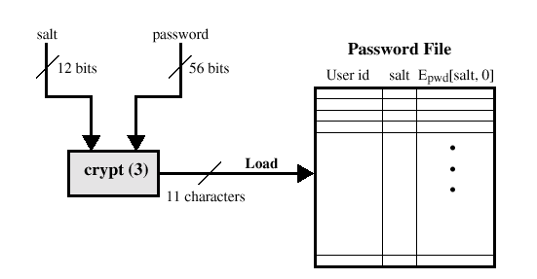
UNIX Password Scheme
Loading a new password

Slide 68
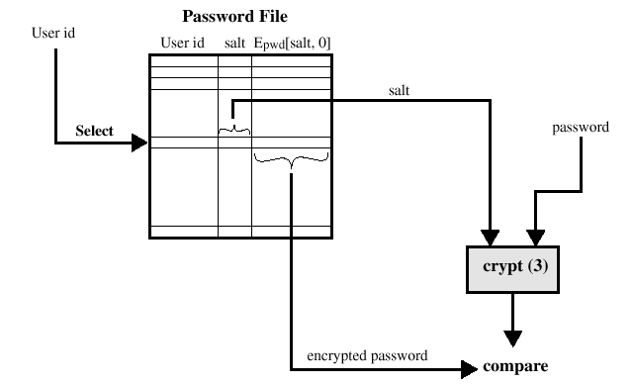
UNIX Password Scheme
Verifying a password file

Slide 69
Storing UNIX Passwords
UNIX passwords were kept in in a publicly readable file, etc/passwords.
Now they are kept in a “shadow” directory and only visible by “root”.

Slide 70
”Salt”
The salt serves three purposes:
Prevents duplicate passwords.
Effectively increases the length of the password (unix: by two characters) 4096
Prevents the use of hardware implementations of DES for cracking

Slide 71
Password Strategies
D. Klein, 1990: 25% of pw’s for 14,000 users guessed in an hour. Table 9.4
Even in 1993, 6.4 million encriptions per second – so PW must be obscure

Slide 72
Password Strategies
Old problem of “keeping secret” not reliable
Users often use the same PW on different systems.
Tradeoff: if pw is hard to remember then users will lose it, and/or write it down.

Slide 73
Password Selecting Strategies
User ducation
Computer-generated passwords
Reactive password checking
Proactive password checking – best idea is to force user to select a good pw that they generate. Best the second time around.
30 Megabytes of bad passwords?

Slide 74
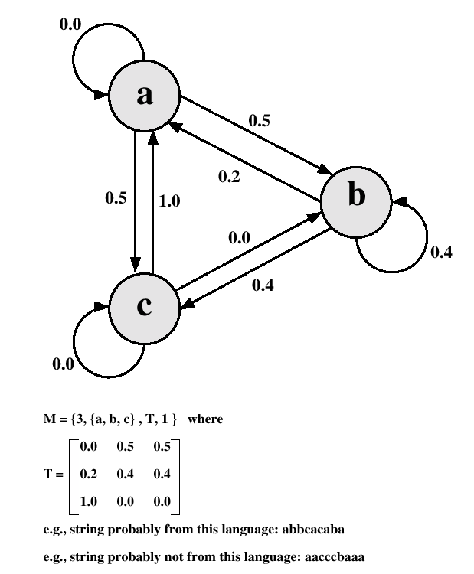
Markov Model

Slide 75
Transition Matrix
Determine the frequency matrix f, where f(i,j,k) is the number of occurrences of the trigram consisting of the ith, jth and kth character.
For each bigram ij, calculate f(i,j, ) as the total number of trigrams beginning with ij.
Compute the entries of T as follows:

Slide 76
Spafford (Bloom Filter)
where
The following procedure is then applied to the dictionary:
A hash table of N bits is definied, with all bits initially set to 0.
For each password, its k hash values are calculated, and the responding bits in the hash table are set to 1

Slide 77
Spafford (Bloom Filter)
Design the hash scheme to minimize false positive.
Probability of false positive:

Slide 78
Spafford (Bloom Filter)
Point is, I guess, to reject passwords, without having a copy of the input pw file available.

Slide 79
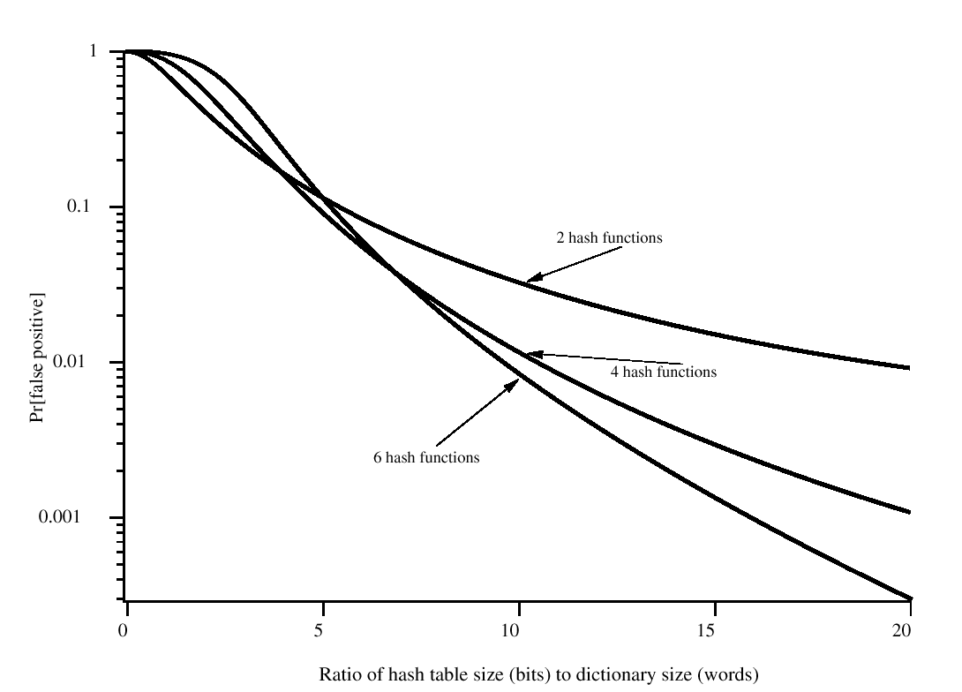
Performance of Bloom Filter

Slide 80
The Stages of a Network Intrusion
1. Scan the network to:
• locate which IP addresses are in use,
• what operating system is in use,
• what TCP or UDP ports are “open” (being listened to by Servers).
2. Run “Exploit” scripts against open ports
3. Get access to Shell program which is “suid” (has “root” privileges).
4. Download from Hacker Web site special versions of systems files that will let Cracker have free access in the future without his cpu time or disk storage space being noticed by auditing programs.
5. Use IRC (Internet Relay Chat) to invite friends to the feast.
80

Slide 81
Intusion Detection
The intruder can be identified and ejected from the system.
An effective intrusion detection can prevent intrusions.
Intrusion detection enables the collection of information about intrusion techniques that can be used to strengthen the intrusion prevention facility.

Slide 82
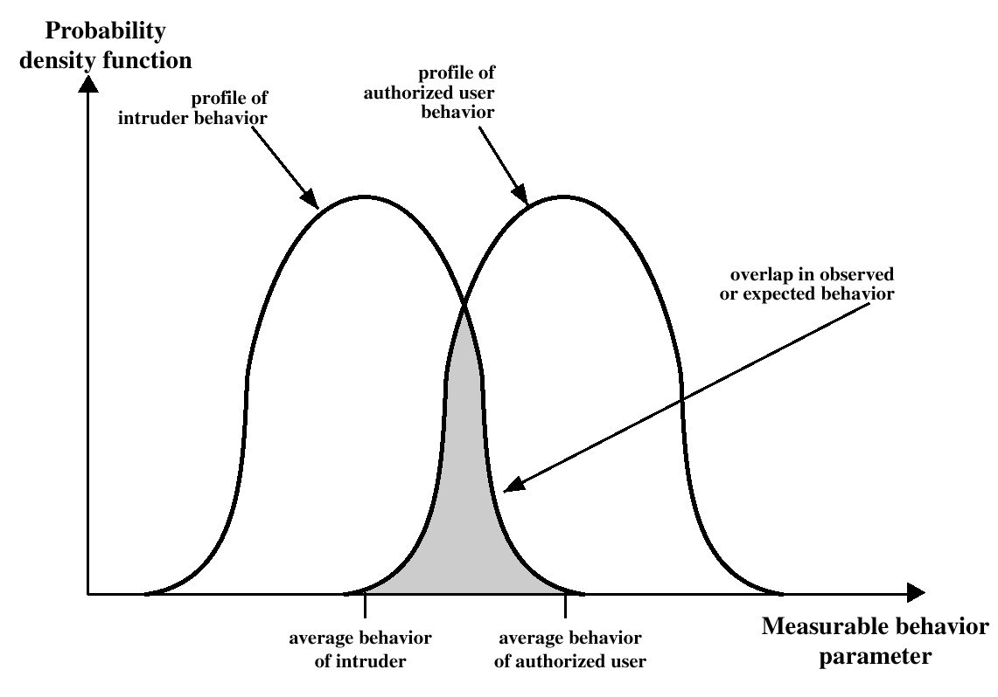
Profiles of Behavior of Intruders and Authorized Users

Slide 83
Intrusion Detection Schemes
Statistical Anomaly – collect data on valid users and compare.
Threshold behavior for system
Profile for each user – like credit card companies
Rule-based detection
Deviation from profile patterns
Search for suspicious behavior

Slide 84
Intrusion Detection Tradeoffs
“Art” of intrusion detection is like the art of Spam detection.
Tradeoff of false positives and false negatives.

Slide 85
Intrusion Detection
Statistical anomaly detection
Treshold detection
Profile based
Rule based detection
Anomaly detection
Penetration identidication

Slide 86
Measures used for Intrusion Detection
Login frequency by day and time.
Frequency of login at different locations.
Time since last login.
Password failures at login.
Execution frequency.
Execution denials.
Read, write, create, delete frequency.
Failure count for read, write, create and delete.

Slide 87
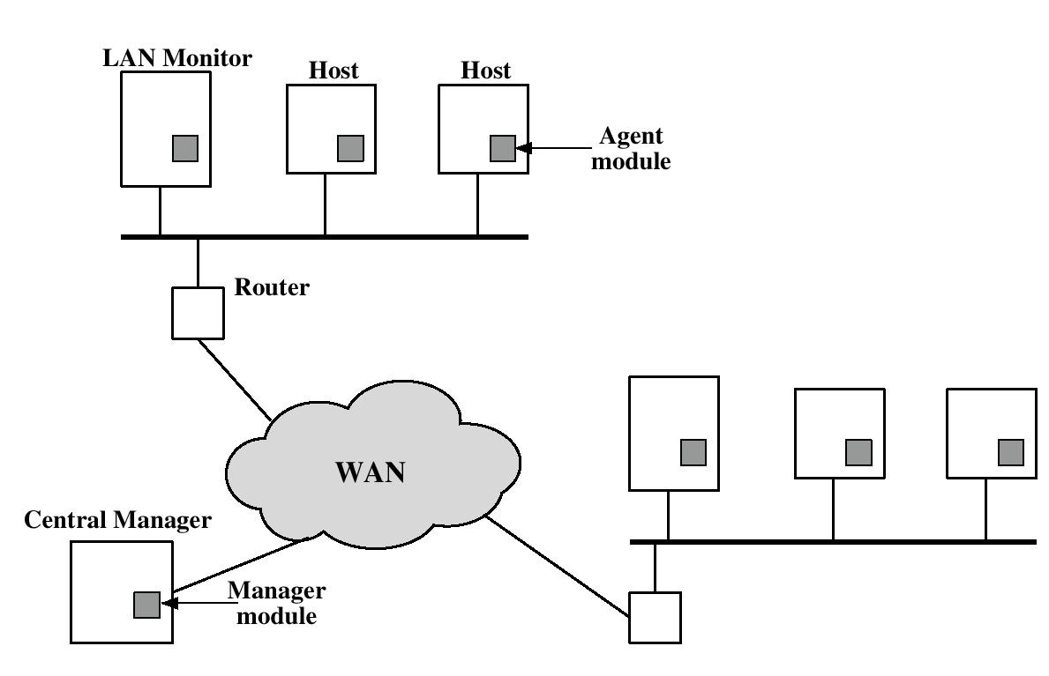
Distributed Intrusion Detection
Developed at University of California at Davis

Slide 88
Distributed Intrusion Detection Agent
Native audit input – apply filter
Produce a canonical host audit record
Apply logic using match w/ templates
Suspicious events like file access
Attack patterns
Historical profiles of users
Send alerts to Central manager

Slide 89
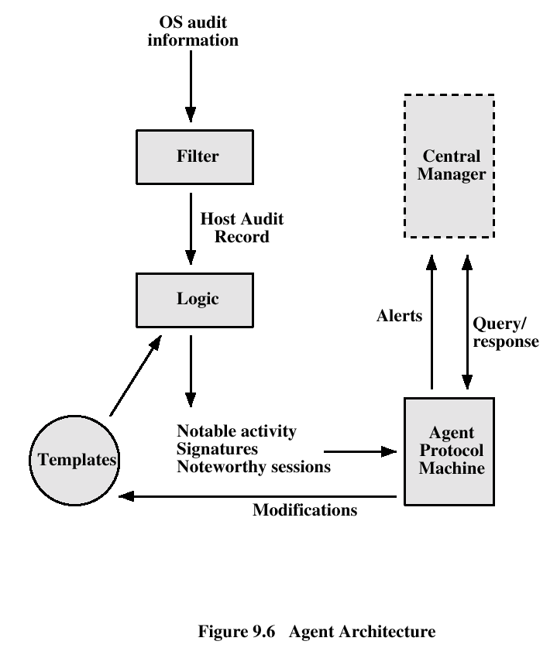
Distributed Intrusion Detection

Slide 90
Base-Rate Fallacy
One person in 10,000 has Framistat’s Disease (yes this is an invented disease)
Test is 99% accurate for positive and negative.
1% inaccurate
99% false alarm rate: when 10,000 tested, 100 people will be told they have F.D., but only one of them really will.
Must know the domain: e.g. what attacks likely

Slide 91
Honeypots
Divert opponent to decoy machine
Collect information about opponent
Encourage opponent to stay on the system as long as possible -- spies
Fabricated information – spies. Enigma machine problem.
Honeypot networks.

Slide 92
IETF data interchange
IETF Detection Exchange Format
http://www.google.com/url?sa=U&start=1&q=http://www.acsac.org/2001/papers/67.pdf&e=747

Slide 93
IETFWorking Group
“Intrusion detection is an area of increasing concern in the Internet community. In response to this, many automated intrusion detection systems have been developed. However, there is no standardized way for them to communicate. To remedy this, the Intrusion DetectionWorking Group was chartered under the auspices of the Internet Engineering Task Force.
This paper gives an overview of the working group and the task it faces. The paper then describes attempts to define and implement a transport protocol for intrusion detection alerts.[…]”

Slide 94
Dark Information
The web has much Dark Information
… very simple, very useful.
Where is the information hidden?
Put the jewels in the fake cabbage in the fridge.
Use server promiscuity settings to hide dark information on the web.
Under unix the “.” attribute typically hides files

Slide 95
Dark Info…
But accessing the information must be secure!
https://www.ourlinux.edux/.abc/letters.htm
Not generally available to search engines.
Once there is a single link to it, the information is compromised, and no longer “dark”

Slide 96
The web server and Dark Info
“http://machine.subplaceabc.net/a/b/file.html”
http://machine.subplaceabc.net is translated into some IP address: 192.168.1.12
/a/b/file.html is ENTIRELY UP TO THE SERVER to use as it wishes. This is just a string that is passed to the server as an argument.
So, the server might, e.g., use tables, or encryption, or (all covered here) to hide the actual location of the real files.

Slide 97
Dark Info…
But accessing the information must be secure!
https://www.ourlinux.edux/.abc/letters.htm
Not generally available to search engines.
Once there is a single link to it, the information is compromised, and no longer “dark”

Slide 98
Secret codes
Table driven model
Entry 7: “The blue sky speaks well of Joseph” → “Do not forget to pick up potatoes at the store on your way home.”
Without other information cannot be broken, but requires a table entry for every utterance.
May be combined with encryption.

Slide 99
Secret codes with Encryption
Encryption can only be broken when something is known about the plaintext. If the plaintext is secret code, then, generally, no isolated cracking algorithm exists.
Code: x13DF7 → “Be on alert for airplanes”
There is no cracking scheme that can come up with “x13DF7” from the cyphertext.
Suppose that the “alert” is observed?

Slide 100
Symmetric key model
Sender and receiver share knowledge of what the key is. No one else has this knowledge. Used to both encrypt, and decrypt a message.

Slide 101
One-time pad - OTP
A one-time-pad is the most basic symmetric key encryption scheme, and is as effective as the length of the key. (Use GUIDgen?)
Sender and receiver each have an identical bit string which is as long as the message being sent. The message and the bit string are used together to compose the encrypted message, and used again to retrieve it.
Each key is used only once.

Slide 102
One-time pad – theory only
Is “perfect” encryption, but only theoretically. In practice the problem is coming up with true randomness of the pad, which is not something provable at this time.
Problems: Keystrokes (large granularity of scan), digital computers (deterministic), etc.

Slide 103
XOR implementation of one-time pad
Message 1011 The original message
Key 1111 Secret, shared, key
XOR 0100 Secret message
Send: 0100 →
Receive 0100 ←
Key 1111 Same key applied
XOR 1011 Original message
Discard key.

Slide 104
Shorter key
Like a one-time-pad but used more than once.
Repeats over and over until the end of the message is reached.
Can be broken with letter frequency counts, and the like.
Which letter is used most? Once tokens are determined (words) what letter is used most often to start a word? What are the vowels?

Slide 105
Data encryption standard
Known by its initials DES
Like a repeating key, but harder to crack.
One-way algorithm so that encrypted material can be read without breaching security.
NSA (maybe??) insisted on a 56-bit key, which allows information to be decrypted using modern PCs given enough time (now hours?)
Very commonly in use (e.g., /etc/passwd file (note: when encrypted messages are exposed, may allow dictionary attack.)

Slide 106
Symmetric Encryption
On a unix system:
Hawk> crypt dog < junk.txt > junk.x
Hawk> ls junk.*
junk.txt junk.x
Hawk> crypt dog < junk.x > junk.txt2
Hawk> diff junk.txt junk.txt2
Hawk>
[ no difference]

Slide 107
Cracking etc/passwd
/etc/passwd is used by many unix programs:
dfiresto:*:1004:10060:Diane Firestone:/condor/ccpfclt/dfiresto:/usr/local/bin/t\csh
elliott:*:1216:10320:Clark Elliott:/condor/cscfclt/elliott:/usr/local/bin/tcsh
wsander:*:1219:10090:William H Sander:/condor/econfclt/wsander:/usr/local/bin/t\csg
Passwords were encrypted, but exposed.
“passwd” was available to authenticate users:
Use crypt to encrypt the user’s password,
Compare to that in the /etc/passwd file
One-way algorithm is correctly used.

Slide 108
Cracking etc/passwd
Any login will help reach the next level of access – so find at least one weak login id and exploit it
Two of the most popular Unix and Linux password crackers are "Crack“ and "John the Ripper."
http://www.openwall.com/john/
http://www.securityfocus.com/data/tools/crackers/crack5.0.tar.gz
Copy /etc/passwd to local machine for ease of cracking.

Slide 109
Cracking etc/passwd
Easy: Is pw blank, carriage return, or login?
Dictionary Attack: Looking at the encrypted passwords in the local file, compare them to the encryption of known words.
Locate all dictionaries on the web.
Encrypt each word to produce encrypted versions
Sort the encrypted “words”
Binary search for each password in the password file.

Slide 110
Binary Search
Each “look” excludes half of the entries in the remaining set.
So, log-2 of N looks.
E.g., 128 entries, 7 looks leaves one value.
How big a space for 500 looks?
(3 with 151 digits after it.)

Slide 111
Cracking etc/passwd
A shadow file is now used, accessible by root, with only a pointer to the password entry in the shadow file (and used by other programs through controlled setuid exectuables?)
Man page: “setuid sets the effective user ID of the current process…” Create an executable, set the running userid to, e.g., “root”, and execute THAT binary code (only) with root privledges.

Slide 112
Football, football, who has the football?
Administration of symmetric key systems is difficult.
How does the secret key get distributed?
Who is given the secret key?
What happens when the key has to be changed? (answer -- everything has to be distributed again.)
System is only as secure as the administration of it

Slide 113
Public key encryption
Non-symmetric keys come in pairs
One key used to encrypt.
The other is used to decrypt.
Either key can be used for either purpose
RSA (Rivest Shamir Adleman) algorithm is the one commonly used
patented, expires in (?2000)
company organized around this

Slide 114
Symmetric key vs. Public-key
Symmetric key is generally faster
Public key is generally more secure because administration is much easier
So, an efficient, but administratively secure, structure is to use Symmetric Key encryption for the bulky messages, with single-session keys. The session (or one-time) keys are encrypted, and distributed, using Public Key encryption

Slide 115
Using public-key encryption
Public keys are published in a “phone book” of public keys, available to all
The matching private key is kept private, and secret
If Joan wants to send a secret message to Ray she encrypts it using his public key.
The message cannot be read until after it is decrypted using the secret key that only Ray knows --- hence only Ray can read the message.

Slide 116
Signing
If Joan wants a signed copy of a message from Ray she can request that he encrypt the message using his private key.
Anyone can now read the message (including a court of law) using Ray’s public key. Assuming a valid publication of his public key, this identifies Ray as the author.
Singing depends on having a reliable source for posting of public keys.

Slide 117
Third party registration
Ray’s signature is only as good as the site where his public key is posted.
Third part vendors exist to guarantee the authenticity of public keys (to certify them), and to give out public and private key pairs.

Slide 118
Certification
The idea is that once an authority is established this can be used to certify other sets of public/private keys.
For example, authority C can sign (with their private key) a document containing the public keys of party A and party B and identifying them as belonging to the respective parties. This document can only be decrypted using C’s public key, verifying it as authentic.
In this way, both A and B are also known to have attributable public keys.

Slide 119
Public key (RSA) example
S is "secret key," P is "public key," M is "message," C is cyphertext.
C = P(M) the ciphertext can be had by applying the public key to the message
M = S(P(M)) the message can be had by applying the secret key to the ciphertext

Slide 120
To work, the system must satisfy (due to Diffie and Hellman, 1976):
(i) S(P(M)) = M for every M
(ii) All (S,P) pairs are distinct
(iii) Deriving S from P is as hard as reading the ciphertext
(iv) Both S and P are easy to compute

Slide 121
RSA implementation
Rivest, Shamir, Adleman
Public Key P is the integer pair (N, p),
Secret Key S is the integer pair (N, s),
N, p, s, large numbers (e.g., N 200 digits, p/s 100 digits)
C = P(M) = M**p, mod N [apply public key]
M = S(C) = C**s, mod N [apply secret key]
Can compute because of modulo operation; otherwise M**p and C**s are impossibly large to compute.

Slide 122
RSA implementation
Generate 3 100-digit (or so) "random" prime numbers, s, x, y such that s > x and s > y, (a way exists to approximate this process efficiently)
N = (x * y)
p such that (s * p) mod (x - 1) (y - 1) == 1
Can be proven that M**(p * s) mod N = M for all messages M.

Slide 123
Large Numbers
Because the pairs (N,p) yield the public key, if the resulting number were small, then a brute force attack could expose N. This would not be good because (N,s), the secret key, has N as an important component.
In general it is hard to factor very large numbers, and thus it is hard to know what are the large prime numbers.

Slide 124
Simplified Example
Based on P. 339 "Algorithms in C" (chapter 23) by Robert Sedgewick:
Pick three prime numbers such that s > x and s > y
x = 2, y = 5, s = 7
Derive N, s, and p:
Derive N:
N = x*y = 2*5 = 10
So, N = 10

Slide 125
Example: derive p
Derive p: (note: x=2, y=5, N=10)
mod = (x - 1)(y - 1) = (2 - 1)(5 - 1) = 1 * 4 = 4
(s * p) mod 4 = 1
(7 * p) mod 4 = 1
p = 3 (one solution)
(7 * 3) mod 4 = 21 mod 4 = 1
Or:
p = 11 (another solution)
(7 * 11) mod 4 = 77 mod 4 = 1

Slide 126
Example: apply P and S
M is the message, here just a number. N=10, p = 3, s = 7.
Examples using (a) M = 6, and (b) M = 8:
(a) 6 ** 3 = 216 ... mod 10 = 6 ; 6 ** 7 = 279936, mod 10 = 6
(b) 8 ** 3 = 512 ... mod 10 = 2 ; 2 ** 7 = 128, mod 10 = 8
Note: 6**(3*7)=21936950640377856, mod 10 = 6
8**(3*7)=9223372036854775808, mod 10 = 8

Slide 127
Kerberos
User and service must have keys registered with the Authentication Server (AS). User key is derived from user password. (Football) service key is random.
User sends message to AS
AS makes two copies of a brand new key -- the session key.
AS puts one copy of the session key in a box, along with the name “Football service” in plain text, locks it with the user key, and sends this to the user.

Slide 128
[Previous step is necessary so that the user can (a) verify that the decryption was successful, and (b) that the box came from the AS.]
AS puts the other copy of the session key in a box, along with the name “Football user” in plain text, locks it with the service’s key, and returns this to the user as well.
User unlocks box 1 using the user key, verifies that decryption was successful by reading “Football service” and extracts the session key.

Slide 129
User puts the current time in box 3, locks it with the session key, and passes box 2, and box 3 to the service. Timestamp thwarts impersonation later.
Service opens box two with service key verifies the decryption by reading “Football user”, and box 3 with the session key (from box 2).
Football User is now identified to Football Service.
Box 2 is the ticket box 3 is the authenticator.
Other kerberos topics: Ticket granting server, cross-realm authentication.
Thanks Brian Tung for notes on Kerberos.

Slide 130
X.500 Series Directory
http://home20.inet.tele.dk/era/x500/x500-technology.htm#x500
“The X.500 Directory is not intended to be a general purpose database, but has mainly been developed for storing information about objects relevant to telecommunications, such as organisations, persons, distribution lists, etc. The information stored about an object is typically information relevant to communication with or about that object, e.g. its communication addresses.”

Slide 131
X.500 Series Directory
“The Directory Specifications provide an information structure model, protocols for communicating directory information between open systems, and procedures that allow the directory information to be distributed among several independent systems, including procedures for navigation to the open system containing the information to be accessed.”

Slide 132
X.500 Series Directory
“An open system can locally maintain its part of the directory information using any suitable database technique.”
An X.509 certificate server need not be an authority, because the certificates cannot be forged. They are public documents.

Slide 133
X.509 Certificates
Containers for Public Keys
Signed by a certificate authority
Links the public key with the individual.
Have to trust the authority, have to trust the initial verification process, have to trust the certificate.
Check the certificate against the CA public key. Check the certification process.

Slide 134
X.509
Version 3 allows extensions, but not currently uniform.
Version, serial number, Sig. algorithm, Issuer, Valid period, Owner of signed public key, Public key, other fields.
CA signs the certificate yielding a thumbprint

Slide 135
X.509 – some other elements
A sends to B
Time stamp: creation / expiration
Nonce: Cache at B, no duplicates
Annoying not useful fields compatible with version 1 (now version 3).
ID of B.
Session key encrypted with B’s PK
Other data

Slide 136
Certification Practice Stmnt
What level of identity verification needed?
How confident are we that they are who they say they are?
What do we lose if they trick us?
How severe are the consequences of losing it?

Slide 137
CPS cont.
Level 1 – email address, let the user claim.
2 – May have to follow up the transaction but do not need a real name
3 – Real identity required. Secret, private information
4 – Must be physically present and show physical documentation. Guaranteed transactions. Audit trail.

Slide 138
Root CA secret key
Armed guards
Physically protected entry to rooms.
Two people enter at one time, only.
Electromagnetically shielded room.
Under threat the secret key hardware self-destructs
Re-creation of keys requires five or more individuals physically present.

Slide 139
CA hierarchy / peer model
Hierarchy: Root authority vouches for other authorities, and may vouch for them vouching for others. Follow back to root.
Cross-certification: spontaneous root CAs agree to trust each other, and thus those they trust. E.g., two banks decide to trust each other. Pass auditing levels?
Federation, with levels of trust, acceptable to AICPA – auditing authority (American Institute of Certified Public Accountants)

Slide 140
Generating work for CPAs
VeriSign just started their own business and made deals with MS and Netscape to get certificates into browsers.
2001 MS decided the ad hoc exposure was too great, and adopted AICPA best practices.
CAs must now pass WebTrust audit to be placed in store of browser.

Slide 141
Lost your key?
Either the secret key really is secret, and if you lose it, all information it protects is irretrievably lost, or…
Key is not really secret, and is stored in some repository from which it can be recovered, which defeats PKI.
Big deal to decide this for organizations.
Key to arm or disarm nuclear weapons?
Key to DNA-map data, or surface data from Mars lander?

Slide 142
Certificate Revocation
If a secret key gets exposed, we have to be able to revoke it.
Duplicate data is the cardinal sin of computer science.
So – we must go back to the original authority to check if the certificate is valid, or to some agreed-upon knowledge sink: Certificate Deployment Point, noted in the certificate itself, where a list exists.

Slide 143
How long to revoke?
How long does this take? (RSA-VeriSign for Amazon took me about five seconds for the CRL to download.) How long to look up?
Less than one millisecond required? Microseconds?
OSCP Online Certificate Status Protocol is probably too slow (~20ms) to be useful.
Maintain local list for speed? Duplicate data? Canonical data?

Slide 144
SSL / TLS
From Netscape – Browser to server security for secure web transactions
http://www.ietf.org/html.charters/tls-charter.html

Slide 145
SSL Handshake
Client sends Hello
Server sends Hello
Server sends Certificate
Server requests Client’s Certificate -- optional
Client certificate returned -- optional
Session key to Server
Client Certificate verify – opt, two-way
Finished messages from each – hash of conversation.

Slide 146
SAML / X.509 / SSL review
SAML uses assertions, certificates, SSL
SAML attempts shared trust and single-sign-on.
SSL/TLS is relatively simple, and has been used extensively, so understood
Usually one-way, but can be two-way. Two way is harder because of managing client certificates

Slide 147
Simple Digital Signature Law
Should be easy – but ouch it is not
Original problem is hard and technical
More importantly: a good question to ask is – who gets the money? Sorry but contention supports lawyers, politics.
Whose law anyway? UCC? NCCUSL? UCITA? EFTA? UN Model Law? U.S. Federal? States Rights?

Slide 148
Digital Signature Law
Based on existing law – at least not discriminate against e-sign?
New, flexible law, that recognizes careful agreements?
Complex law that requires correctness?
Free market, or require specific technology?
Pre-emption of existing e-sign laws?

Slide 149
E-law
Multimedia extensions? Signed audio or video documents? Oral contract law?
U.S. Federal law should not preempt state laws.
Confusion between confidentiality and signing.
Installed base of Notary Publics works, e-sign laws may invite fraud.
Retention of information, keys, documents.

Slide 150
…
International (dis) agreement? EU law. U.S. Federal law. U.S. State law. International Law. UN Model law. Trading partner factions.
Enforcement jurisdiction?
Encryption export restrictions?
Who is liable? User? Software vendor? Contract parties?
Audit requirements?

Slide 151
Attempts
California simple, and flexible. Minimalist, technology-neutral.
Not consistent with common defninitions
Utah, Washington are more comprehensive
But technology is not yet ossified.
Stop-gap measures?

Slide 152
…
Governmental control of certification authorities?
Freedom from government control?

Slide 153
Complexity mounting ☹
Simple PGP should be easy, but it can be an administrative nightmare.
The technology guarantees are straightforward, so the law should be simpler than what exists now – but they are not.
Certificates are simple public documents – should be easy to use, but they are not. Ouch!
Securing Web services should be simpler because of the standard ascii-text marshaled data – but it is not

Slide 154
PGP – easy?
http://www.cypherspace.org/adam/timeline/
http://en.wikipedia.org/wiki/Pgp -- see compatibility
Complex decisions the user must make, especially regarding trust. https://engineering.purdue.edu/ECN/Resources/KnowledgeBase/Docs/20041215154920
User Key management: http://www.geocities.com/Athens/1802/pgpcard.html

Slide 155
So – maybe take a step back
Kerberos is part of Windows XP http://www.microsoft.com/technet/prodtechnol/windowsserver2003/library/TechRef/792ed95d-6f13-4181-a218-e4eaab361c1b.mspx
Simpler is better.
Single-sign-on for user.
Relies on existing address-space security.
Consistent with client/server paradigm.

Slide 156
Kerberos
Trusted third-party protocol for use with non-trusted clients, and possibly non-trusted services.
Tickets for identity, symmetric secret keys known to kerberos server, session key
Kerberos server has shared secret keys of client, and of services.
Centralized authentication at Kerberos server, and ticket-granting server.

Slide 157
Step by step
Go to “The (High Level) Details” at:
http://www.isi.edu/gost/brian/security/kerberos.html
Kerberos predates the web, and WS-security, but is still used, and is part of XP operating system security.
Symmetric key has to be distributed to Kerberos Server from client, and also from individual application servers.

Slide 158
Kerberos -- stallings
Technical details are useful grounding.
Most operate “under the hood”

Slide 159
Mix of old and new
Web Services, new, seeks simplicity ☺
Uses PKI, Shared key, certificates, SAML
SAML uses SSL
SSL uses Certificates which use PKI and X.500 directories.
Complexity grows ☹
Even simple technological outcome means complex law ☹
E.g., why not use Kerberos if you can? ☺

Slide 160
Mix of old and new
Web Services / WS-security uses SAML as a token but also allows X.509, Kerberos…
Occam’s razor --- simple is best ☺

