Slide 1
RMI (Java RMI)
P 460 in text
UUIDs / system-wide references
Remote object means remotely-accessible object

Slide 2
All remote
All objects can be remotely accessed
Pass reference by copying the reference to the remote object
Bind to the actual object when you need it.
Easy system, but not efficient, especially, e.g., when the object is a Boolean, or integer. Worst case: refer to Boolean on a remote machine

Slide 3
Local vs. Remote
For efficiency, treat local and remote references differently.
Remote objects are passed by reference (book typo) the (reference is copied) and local objects are passed by the value of the object (the whole object is copied).

Slide 4
Figure 10.8
Client A has local object O1, and ref. to remote O2 on machine B.
Passes O1 and O2 to server machine C: makes whole copy of O1 (pass by value) and copy of the ref. to O2 (pass by ref.)
In Java RMI the two references are very similar in look, but quite different in implementation.
In most languages, look very different!

Slide 5
Copying an object is different than copying a reference to is, so we have to make this distinction non-transparent!
RMI: proxies are local objects that present the same interface as remote objects.

Slide 6
RMI remote vs. local
Clone local yields a copy with the same state as the original. Exact copy
Clone remote cannot be cone by client, because no knowledge of all the other proxies accessing it.
Clone remote can only be done by the server. Rebinding by clients to new object is necessary.

Slide 7
Passing objects as parmaters.
Any object can be passed as a parm as long as it is serializable.
Some objects, such as file descriptors or socket descriptions cannot be serialized.
Local objects are copied then passed, remote objects have references copied, then passed.

Slide 8
Remote objects built from two “classes”
The server endpoint is included, and the reference on the server to the object. Stored as part of the state of the proxy.
The server class – the object, its state, its interface, its methods.
The client class – the proxy implementation of the interface
Proxies convert invocations into a message that is sent to the server.

Slide 9
For each call a connection is set up, then torn down again when the call is finished.

Slide 10
Two cool things about RMI
Proxies are themselves serializable, so they can be sent to other remote sites, as parameters, which can then fully access the original remote object. Yay!
In fact even though large local objects have to be “copied” as parameters – in fact much of the implementation of them can be assumed to exist always as part of the JVM, and thus not actually sent!

Slide 11
Symbolic values representing objects in the real world are basis of programming
Real world objects live in one place. When they move they are no longer where they used to be.
Not true in computer world, so how to enforce the semantics?

Slide 12
Protocol part of both classes (remote and local) that make a remote object.
Network address / endpoint (port) and local name, yielding effective UUID.
Object on server. Contains state, methods
Server side stub / skeleton for code interface
Client side stub, or proxy, for code interface
Each invocation sets up connection, then connection is torn down.
Proxies themselves can be marshaled and sent to other locations. Portable ref to obj.

Slide 13
Proxy is a local object.
So, proxy can be passed as a ref in RMI
In theory whole proxy is sent (copied) as argument, but in practice implementation classes are often already available, and thus passed by reference.
So, references to remote objects are small.
Can also tweak to make local copies of object that does not change often.
Only possible because of virtual machine. DCE: has to pre-compile all code.

Slide 14
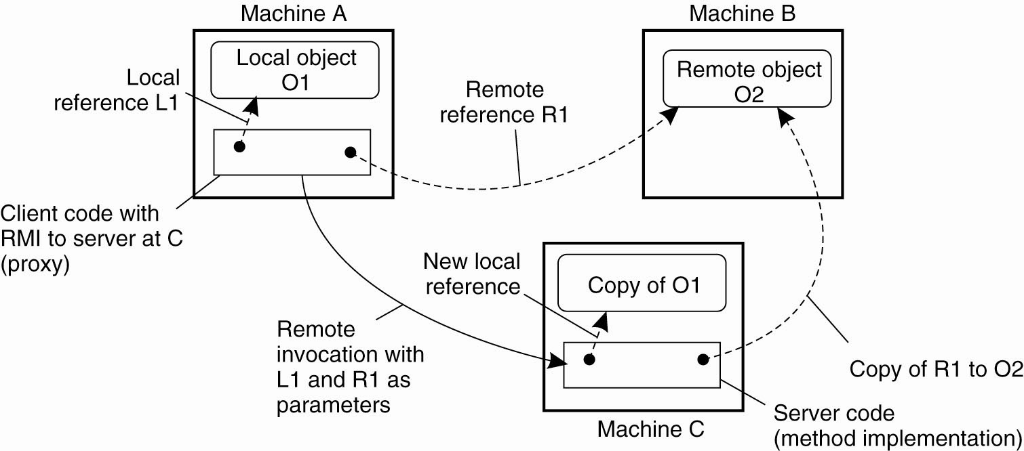
Parameter Passing
Figure 10-8. The situation when passing an object by reference or by value.

