Slide 1
GIT

Slide 2
GIT
Git is a version control system (VCS).
It helps manage your software project files.
It keeps a history of events that happen with the files.

Slide 3
GIT
As a developer you always want to modify and improve your code.
Thus once a functionality is developed, you experiment with that code to make it better.
However in case of problems you want to revert back to earlier working code.

Slide 4
GIT
The version control system helps you achieve this.
It keeps the files as old versions when they are modified.
Thus at any moment you can roll back to earlier files.

Slide 5
GIT
Another advantage of Git is that it allows multiple developers to collaborate and work on a single project.
Also these multiple developers can work independently without affecting each others file.
Later code can be merged.

Slide 6
GIT - History
The Linux kernel is an open source software project of fairly large scope. During the early years of the Linux kernel maintenance (1991–2002), changes to the software were passed around as patches and archived files. In 2002, the Linux kernel project began using a proprietary DVCS called BitKeeper.

Slide 7
GIT - History
In 2005, the relationship between the community that developed the Linux kernel and the commercial company that developed BitKeeper broke down, and the tool’s free-of-charge status was revoked. This prompted the Linux development community (and in particular Linus Torvalds, the creator of Linux) to develop their own tool based on some of the lessons they learned while using BitKeeper.

Slide 8
GIT - History
Some of the goals of the new system were as follows:
Speed
Simple design
Strong support for non-linear development (thousands of parallel branches)
Fully distributed
Able to handle large projects like the Linux kernel efficiently (speed and data size)

Slide 9
GIT HUB
Git Hub is a web based version control system using Git.
It is an open site for developers to share their code with other developers.
It allows developers to contribute to each other's code.

Slide 10
GIT HUB
Git Hub provides developers with a platform to discuss issues they face during development.
The developers from all over world can suggest solutions to such problems.
This is most helpful for open source projects.

Slide 11
GIT
CVS, Subversion, Perforce, Bazaar are some of the other version control systems.
Most these systems store information as a list of file-based changes.
These systems think of the information they keep as a set of files and the changes made to each file over time

Slide 12
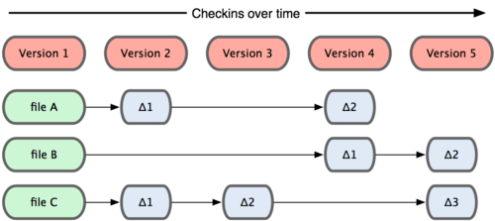
GIT
The VCS systems

Slide 13
GIT
Git doesn’t think of or store its data this way.
Instead, Git thinks of its data more like a set of snapshots of a mini filesystem.
Every time you commit, or save the state of your project in Git, it basically takes a picture of what all your files look like at that moment.

Slide 14
GIT
Git then stores a reference to that snapshot.
To be efficient, if files have not changed, Git doesn’t store the file again—just a link to the previous identical file it has already stored.

Slide 15
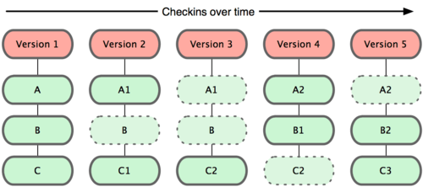
GIT
The git way of storing data

Slide 16
GIT
This makes Git more like a mini filesystem with some incredibly powerful tools built on top of it, rather than simply a VCS.
Most operations in Git only need local files and resources to operate — generally no information is needed from another computer on your network.

Slide 17
GIT
With Git you have the entire history of the project right there on your local disk, most operations seem almost instantaneous.
For example, to browse the history of the project, Git doesn’t need to go out to the server to get the history and display it for you—it simply reads it directly from your local database.

Slide 18
GIT
Thus Git allows you to work offline for most of the operations.
Everything in Git is check-summed before it is stored and is then referred to by that checksum.
This means it’s impossible to change the contents of any file or directory without Git knowing about it.

Slide 19
GIT
This functionality is built into Git at the lowest levels and is integral to its philosophy.
You can’t lose information in transit or get file corruption without Git being able to detect it.
The mechanism that Git uses for this checksumming is called a SHA-1 hash.

Slide 20
GIT
This is a 40-character string composed of hexadecimal characters (0–9 and a–f) and calculated based on the contents of a file or directory structure in Git.
Git has three main states that your files can reside in: committed, modified, and staged.
Committed means that the data is safely stored in your local database.

Slide 21
GIT
Modified means that you have changed the file but have not committed it to your database yet.
Staged means that you have marked a modified file in its current version to go into your next commit snapshot.

Slide 22
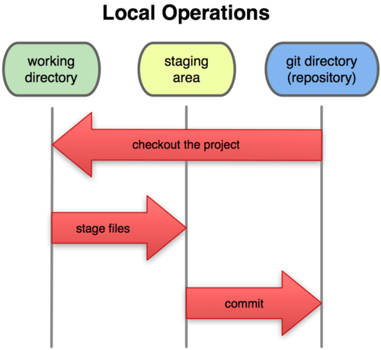
GIT
This leads us to the three main sections of a Git project: the Git directory, the working directory, and the staging area.

Slide 23
GIT
The Git directory is where Git stores the metadata and object database for your project.
This is the most important part of Git, and it is what is copied when you clone a repository from another computer.

Slide 24
GIT
The working directory is a single checkout of one version of the project.
These files are pulled out of the compressed database in the Git directory and placed on disk for you to use or modify.

Slide 25
GIT
The staging area is a simple file, generally contained in your Git directory, that stores information about what will go into your next commit.
It’s sometimes referred to as the index, but it’s becoming standard to refer to it as the staging area.

Slide 26
GIT
The basic Git workflow goes something like this:
You modify files in your working directory.
You stage the files, adding snapshots of them to your staging area.
You do a commit, which takes the files as they are in the staging area and stores that snapshot permanently to your Git directory.

Slide 27
GIT
If a particular version of a file is in the Git directory, it’s considered committed.
If it’s modified but has been added to the staging area, it is staged.
And if it was changed since it was checked out but has not been staged, it is modified.

Slide 28
GIT
BLOB Object
BLOB stands for Binary Large Object.
Each version of a file in Git is represented as a BLOB.
A BLOB holds a file’s data but doesn’t contain any metadata about the file or even its name.

Slide 29
GIT
BLOB Object
The blob is stored as a single file per piece of content, named with the SHA-1 checksum of the content and its header.
The subdirectory is named with the first 2 characters of the SHA-1, and the filename is the remaining 38 characters.
But remembering the SHA-1 key for each version of your file isn’t practical. Also you aren’t storing the filename in your system — just the content.

Slide 30
GIT
Tree Objects
The tree object type, which solves the problem of storing the filename and also allows you to store a group of files together.
Git stores content in a manner similar to a UNIX filesystem, but a bit simplified.

Slide 31
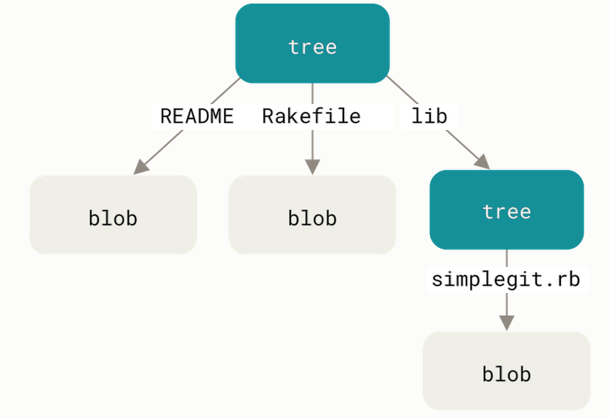
GIT
Tree Objects
A single tree object contains one or more entries, each of which is the SHA-1 hash of a blob or subtree with its associated mode, type, and filename.

Slide 32
GIT
Commit Object
If you’ve done all of the above, you now have three trees that represent the different snapshots of your project that you want to track, but the earlier problem remains: you must remember all three SHA-1 values in order to recall the snapshots.

Slide 33
GIT
Commit Object
You also don’t have any information about who saved the snapshots, when they were saved, or why they were saved.
This is the basic information that the commit object stores for you.

Slide 34
GIT
Forking a repository
A fork is a copy of a repository that allows you to freely experiment with changes without affecting the original project.
A forked repository differs from a clone in that a connection exists between your fork and the original repository itself.

Slide 35
GIT
In this way, your fork acts as a bridge between the original repository and your personal copy where you can contribute back to the original project using Pull Requests.
Forking a project is as easy as clicking the Fork button in the header of a repository. Once the process is complete, you'll be taken right to your the forked copy of the project so you can start collaborating!

Slide 36
GIT
Master
The default development branch.
Whenever you create a git repo, a branch named “master” is created which becomes the default active branch.

Slide 37
GIT
Cloning a repository
When you create a new repository on GitHub, it exists as a remote location where your project is stored.
You can clone your repository to create a local copy on your computer so that you can sync between both the local and remote locations of the project.

Slide 38
GIT
Unlike forking, you won't be able to pull down changes from the original repository you cloned from, and if the project is owned by someone else you won't be able to contribute back to it unless you are specifically invited as a collaborator.
Cloning is ideal for instances when you need a way to quickly get your own copy of a repository where you may not be contributing to the original project.

Slide 39
GIT
Pull Request
Pull requests let you tell others about changes you've pushed to a branch in a repository on GitHub. Once a pull request is opened, you can discuss and review the potential changes with collaborators and add follow-up commits before your changes are merged into the base branch.

Slide 40
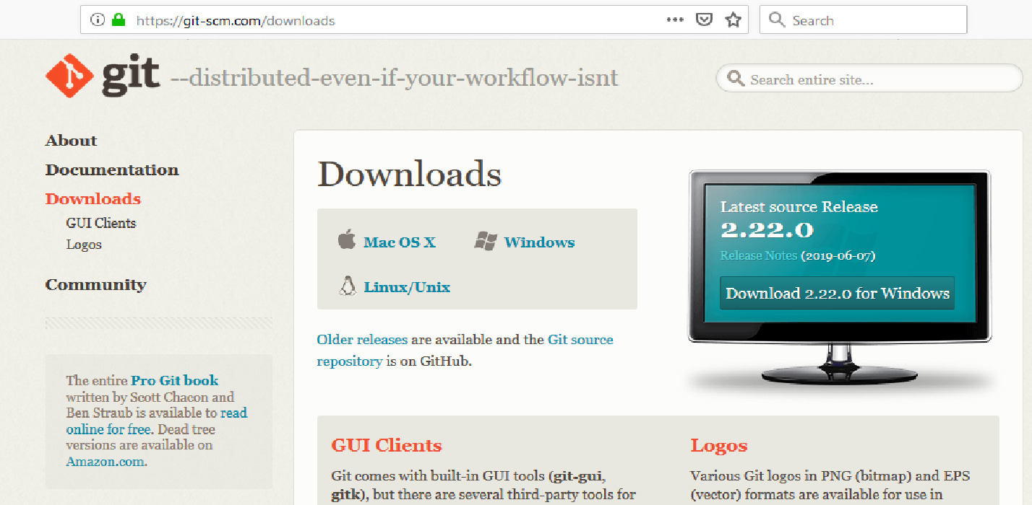
GIT
Installing Git on Windows

Slide 41
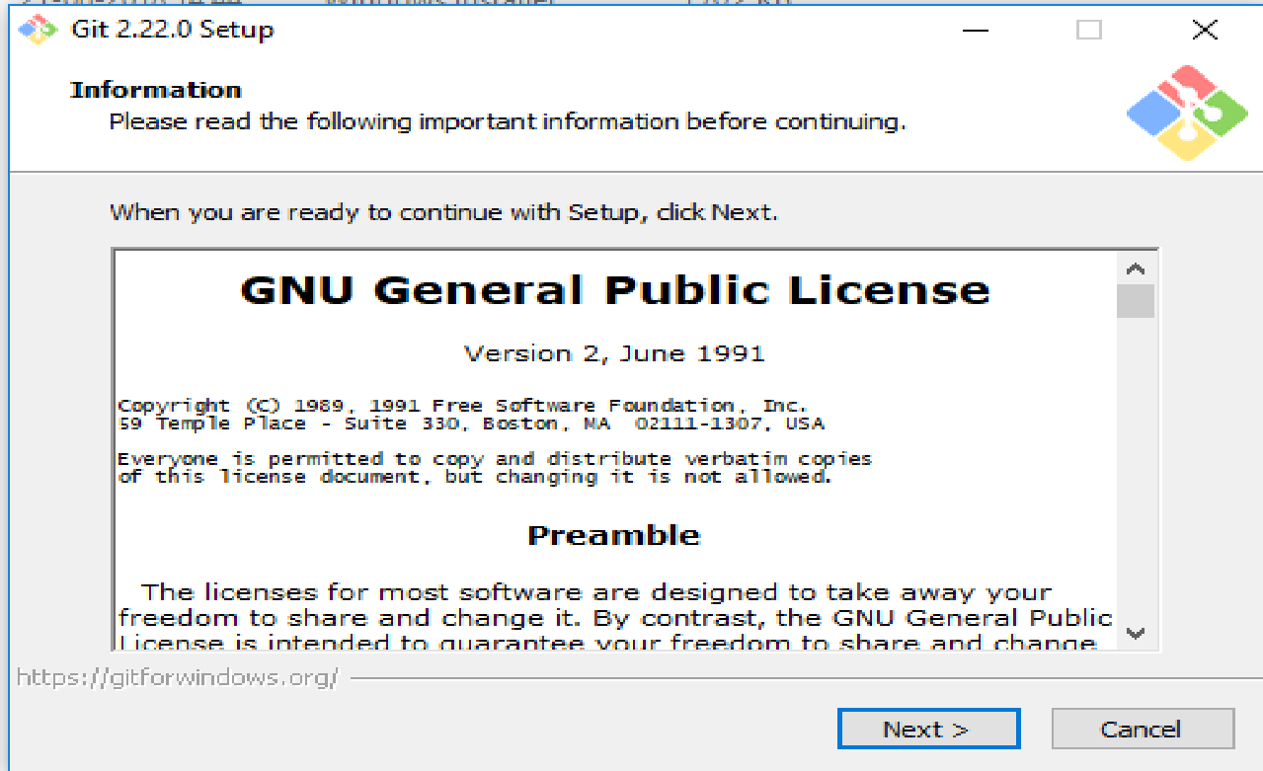
GIT
Download the latest exe file for windows.
Double click to start installation.

Slide 42
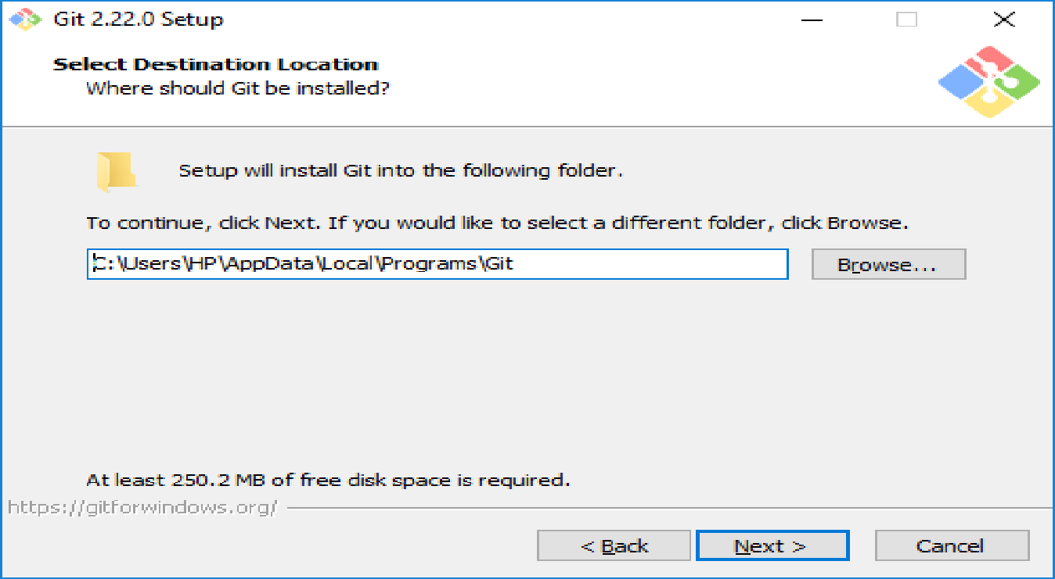
GIT

Slide 43
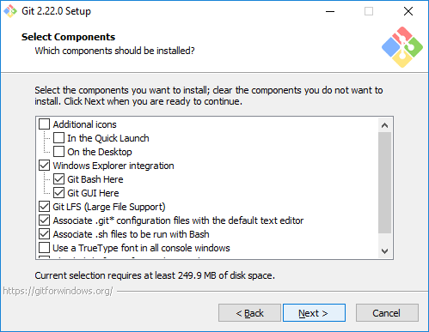
GIT

Slide 44
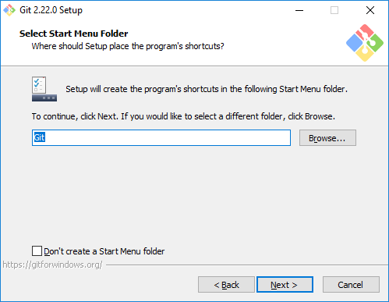
GIT

Slide 45
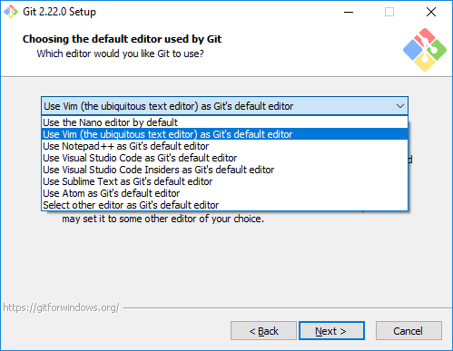
GIT

Slide 46
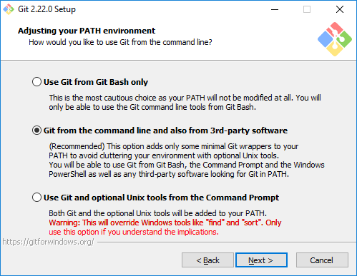
GIT

Slide 47
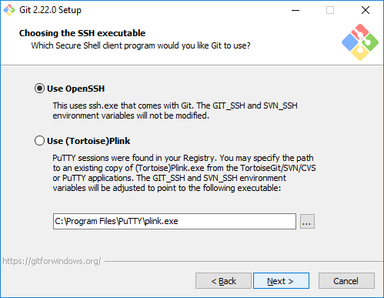
GIT

Slide 48
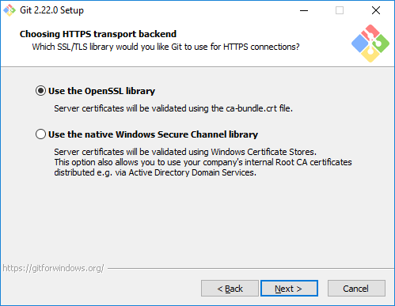
GIT

Slide 49
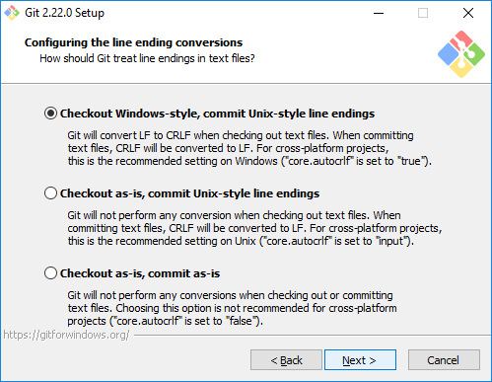
GIT

Slide 50
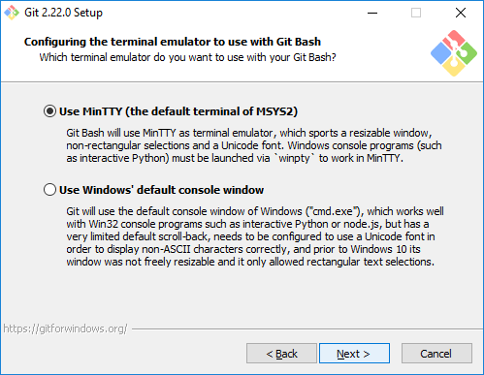
GIT

Slide 51
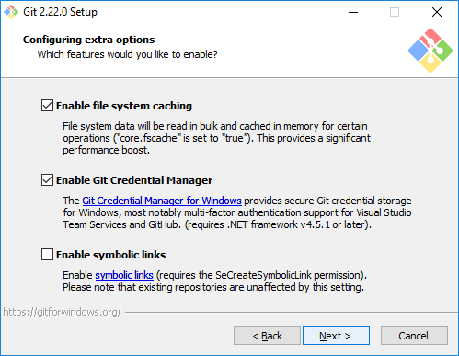
GIT

Slide 52
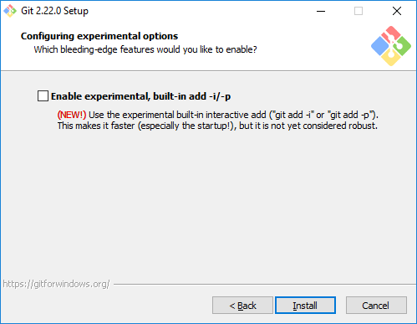
GIT

Slide 53
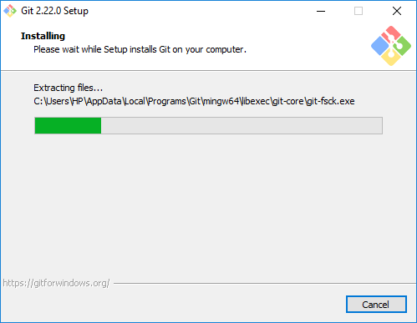
GIT

Slide 54
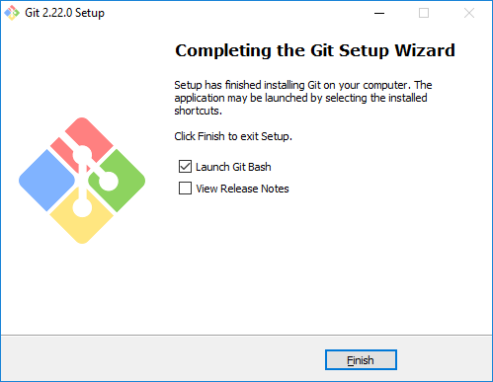
GIT
Once the setup finishes ...click aunch Git Bash

Slide 55
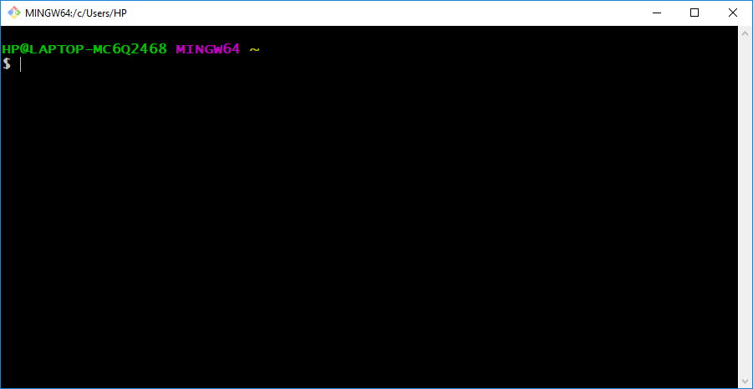
GIT
The Git Bash Window will open.

Slide 56
GIT
Install Git on Linux
On Centos/RedHat
yum install git -y
On Ubuntu
apt-get install git

