Slide 1
Restful services

Slide 2
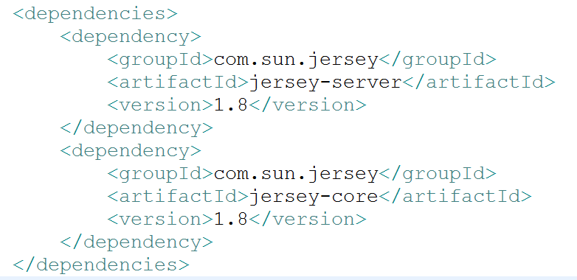
Jax-rs – jersy – Maven-dependencies

Slide 3
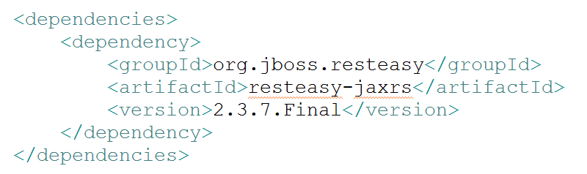
JAX-RS – RESTEASY – MAVEN - DEPENDENCIES

Slide 4
JAX-RS ANNOTATIONS
The JAX-RS API uses Java programming language annotations to simplify the development of RESTful web services.
Developers decorate Java programming language class files with HTTP-specific annotations to define resources and the actions that can be performed on those resources.

Slide 5
http annotations
In order to map HTTP requests with REST resources, JAX-RS API has provided some Annotations.
These annotations will map HTTP requests with the respective resource classes based on the HTTP method and request URI. These annotations can be called as Request Method Designators. These annotations are as follows.
@javax.ws.rs.GET
@javax.ws.rs.POST
@javax.ws.rs.PUT
@javax.ws.rs.DELETE

Slide 6
basic Annotations provided by JAX-RS API
@javax.ws.rs.Path
@javax.ws.rs.Consumes
@javax.ws.rs.Produces
@javax.ws.rs.QueryParam
@javax.ws.rs.PathParam
@javax.ws.rs.HeaderParam
@javax.ws.rs.FormParam
@javax.ws.rs.CookieParam
@javax.ws.rs.MatrixParam
@javax.ws.rs.BeanParam

Slide 7
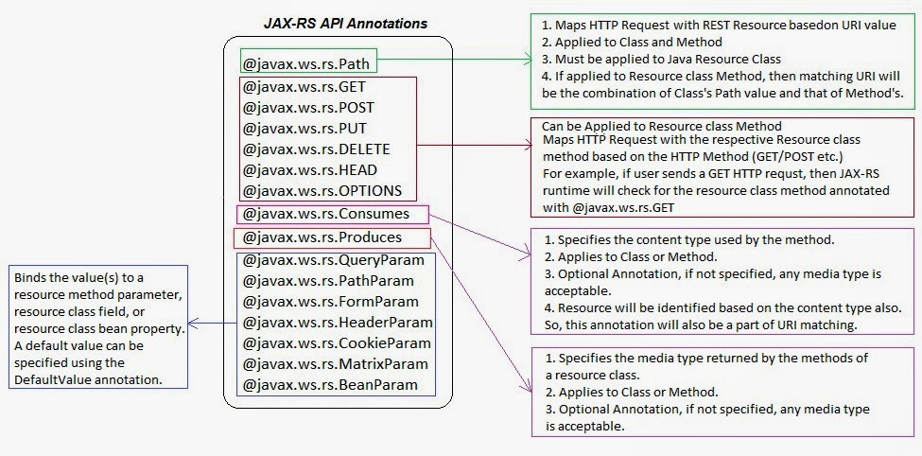
Annotations overview

Slide 8
Jax-rs injection
A lot of JAX-RS is pulling information from an HTTP request and injecting it into a Java method. You may be interested in a fragment of the incoming URI.
You might be interested in a URI query string value.
The client might be sending critical HTTP headers or cookie values that your service needs to process the request.
JAX-RS lets you grab this information as you need it, through a set of injection annotations and APIs.

Slide 9
Jax-rs injection
Usually, these annotations are used on the parameters of a JAX-RS resource method.
When the JAX-RS provider receives an HTTP request, it finds a Java method that will service this request.
If the Java method has parameters that are annotated with any of these injection annotations, it will extract information from the HTTP request and pass it as a parameter when it invokes the method.

Slide 10
@PATH
The @javax.ws.rs.Path annotation in JAX-RS is used to define a URI matching pattern for incoming HTTP requests. It can be placed upon a class or on one or more Java methods. For a Java class to be eligible to receive any HTTP requests, the class must be annotated with at least the @Path("/")expression. These types of classes are called JAX-RS root resources.
The value of the @Path annotation is an expression that denotes a relative URI to the context root of your JAX-RS application.

Slide 11
@PATH - example
@Path("/message")
public class MessageResource {
@GET
public Response pingMe(){
String defaultResp = "Hi... How are you?";
return Response.status(200).entity(defaultResp).build();
}
@GET
@Path("/birthday")
public Response printBdayMessage(){
String bDayMessage = "Happy Birthday";
return Response.status(200).entity(bDayMessage).build();
}
}

Slide 12
@PATHparam
@javax.ws.rs.PathParam
This annotation allows you to extract values from URI template parameters.

Slide 13
Dynamic URI with parameter matching
@Path("/message")
public class MessageResource {
@GET
@Path("{msg}")
public Response printMsg(@PathParam(“msg") String msg){
return Response.status(200).entity(msg).build();
}
}

Slide 14
@path param-example
@Path("/employee")
public class EmployeeService {
@GET
@Path("{empId}")
public Response getEmployeeById(@PathParam("empId") String empId){
return Response.status(200).entity("Got employee with id : " + empId).build();
}
@GET
@Path("{branch}/{department}")
public Response getEmployeeList(@PathParam("branch") String branchName,
@PathParam("department") String deptName){
String resp = "Total number of employees in the "+deptName+" department from "
+branchName+" is 100";
return Response.status(200).entity(resp).build();
}
}

Slide 15
@QueryParam and @DefaultValue
@javax.ws.rs.QueryParam
This annotation allows you to extract values from URI query parameters.

Slide 16
@QueryParam and @DefaultValue
@GET
@Path("/query")
public Response getEmployeeQueryDefault(
@DefaultValue("accounts") @QueryParam("dept") String department,
@DefaultValue("bangalore") @QueryParam("branch") String branch){
String resp = "Query parameters are received. 'dept' value is: "
+department+" and branch value is: "+branch;
return Response.status(200).entity(resp).build();
}

Slide 17
@MatrixParam
The idea of matrix parameters is that they are an arbitrary set of name-value pairs embedded in a uri path segment. A matrix parameter example is:
GET http://web.com/spring;name=aop;annotation=@Aspect
The basic idea of matrix parameters is that it represents resources that are addressable by their attributes as well as their raw id. The @MatrixParam annotation allows you to inject URI matrix paramters into your method invocation

Slide 18
@Matrix PARAM - example
@Path("/inventory")
public class Inventory {
@GET
@Path("{deviceType}")
public Response getInventoryDetails(@PathParam("deviceType") String deviceType,
@MatrixParam("company") String company,
@MatrixParam("model") String model){
String resp = "Received request for device: "+deviceType+
", comany: "+company+" and model: "+model;
return Response.status(200).entity(resp).build();
}
}
/inventory/switch;company=cisco;model=nexus-5596

Slide 19
@MATRIXPARAM-EXAMPLE 2
@Path("/car")
public class CarResource {
@GET
@Path("/order/{brand}/{model}")
public String orderCar(@PathParam("brand") String brand, @PathParam("model") int model,@MatrixParam("color") String color) {
System.out.println("Brand : "+brand);
System.out.println("Model : "+model);
System.out.println("Color : "+color);
return "Car orderd successfully..!";
}
}
http://localhost:6060/FirstRestEasyWeb/rest/car/order/benz;color=red/2001

Slide 20
@Matrixparam-example - 3
@Path("/myhome")
public class RealEstateResource {
@GET
@Path("{property}/{type}/{city}/{area}")
public String getProperty(@PathParam("property") String property,
@PathParam("type") String type, @PathParam("city") String city,
@PathParam("area") String area,@MatrixParam("syards") int syards) {
String msg = "Property : " + property + "-- Type : " + type
+ "-- City :" + city + "-- Area : " + area+"--square yards : "+syards;
return msg;
}
}
http://localhost:6060/FirstRestEasyWeb/rest/myhome/plot;syards=200/Furnished/hyd/banjara

Slide 21
How to read multiple values of a query parameter in JAX-RS restful services?
http://localhost:8080/RestfulWebServices/employee/query?id=1016&id=1017&id=1415
In the above URL, the id value is same, but with different values, this can be easily readable as a list of values using UriInfo object.

Slide 22
How to read multiple values of a query parameter in JAX-RS restful services?
@Path("/employee")
public class QueryParamResource {
@GET
@Path("/query")
public Response getEmployeeQuery(@Context UriInfo uriInfo){
/** read complete employee id list from request query parameter**/
List<String> empIdList = uriInfo.getQueryParameters().get("id");
System.out.println("Received List: "+empIdList);
/** read first employee id from request query parameter **/
String firstEmpId = uriInfo.getQueryParameters().getFirst("id");
System.out.println("First emp record from the request: "+firstEmpId);
return Response.status(200).entity("processed request").build();
}
}
http://localhost:6060/JersyWeb/rest/emp/query?id=101&id=102

Slide 23
How to pass header parameters as method inputs in JAX-RS restful web services?
@Path("/http-header")
public class HttpHeaderResource {
@GET
@Path("query")
public Response queryHeaderInfo(@HeaderParam("Cache-Control") String ccControl,
@HeaderParam("User-Agent") String uaStr){
String resp = "Received http headers are Cache-Control: "+ccControl+
"<br>User-Agent: "+uaStr;
return Response.status(200).entity(resp).build();
}
}

Slide 24
How to read header parameters in JAX-RS restful web services?
@Path("/http-header")
public class HttpHeaderResource {
@GET
@Path("query")
public Response queryHeaderInfo(@Context HttpHeaders httpHeaders){
/** how to get specific header info? **/
String cacheControl = httpHeaders.getRequestHeader("Cache-Control").get(0);
System.out.println("Cache-Control: "+cacheControl);
/** get list of all header parameters from request **/
Set<String> headerKeys = httpHeaders.getRequestHeaders().keySet();
for(String header:headerKeys){
System.out.println(header+":"+httpHeaders.getRequestHeader(header).get(0));
}
return Response.status(200).entity("successfully queried header info").build();
}
}

Slide 25
@FormParam
@FormParam to bind html form fields to your method inputs.
It works for http method POST.

Slide 26
Html Form
<form action="rest/user-form/register" method="post">
<p>Name : <input type="text" name="name" /></p>
<p>Address : <input type="text" name="address" /></p>
<input type="submit" value=“Register" />
</form>

Slide 27
Capturing form data
@Path("/user-form")
public class UserRegResource {
@POST
@Path("/register")
public Response registerUserInfo(@FormParam("name") String name,
@FormParam("address") String address){
String response = "Successfully added user details, name: "+
name+" and address: "+address;
return Response.status(200).entity(response).build();
}
}

Slide 28
@beanparam
The @BeanParam annotation is something new added in the JAX-RS 2.0 specification.
It allows you to inject an application-specific class whose property methods or fields are annotated with any of the injection parameters

Slide 29
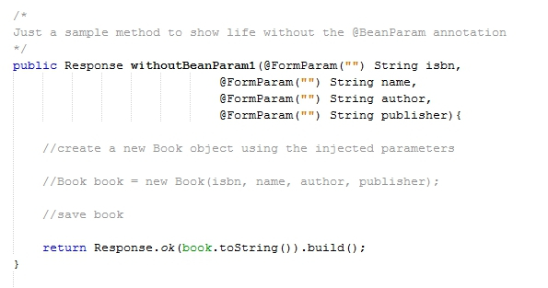
Life without beanparam

Slide 30
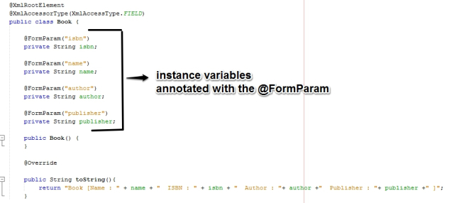
Life with beanparam

Slide 31
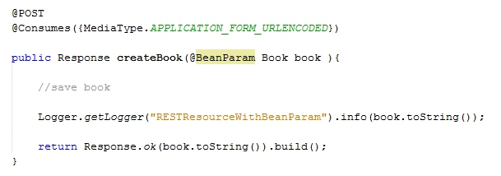
Life with beanparam…. contd
JAX-RS provider automatically constructs and injects an instance of your domain object which you can now use within your methods.

Slide 32
@HEADERPARAM
The @javax.ws.rs.HeaderParam annotation is used to inject HTTP request header values.
For example, what if your application was interested in the web page that referred to or linked to your web service? You could access the HTTP Referer header using the @HeaderParam annotation

Slide 33
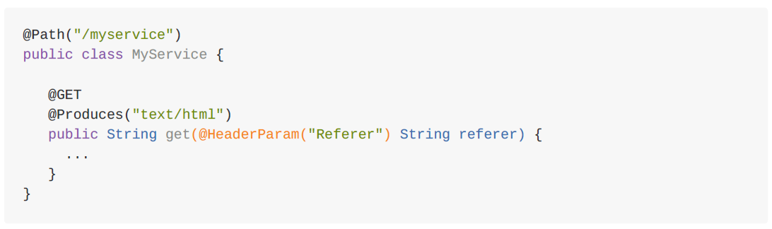
@HEADERPARAM - EXAMPLE

Slide 34
Get-request-headers-map
The getRequestHeader() method allows you to get access to one particular header
getRequestHeaders() gives you a map that represents all headers.
As with UriInfo, you can use the @Context annotation to obtain an instance of HttpHeaders.

Slide 35
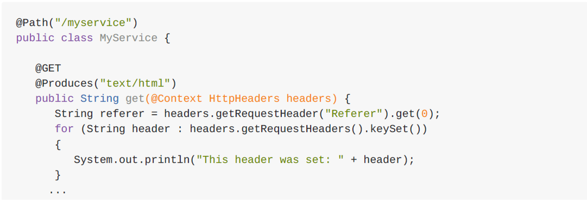
Get-request-headers-map-examaple

Slide 36
@COokieparam
Servers can store state information in cookies on the client, and can retrieve that information when the
client makes its next request. Many web applications use cookies to set up a session between the client
and the server. They also use cookies to remember identity and user preferences between requests.
These cookie values are transmitted back and forth between the client and server via cookie headers.

Slide 37
@COOKIEPARAM
The @javax.ws.rs.CookieParam annotation allows you to inject cookies sent by a client request into
your JAX-RS resource methods. For example, let’s say our applications push a customerId cookie to our
clients so that we can track users as they invoke and interact with our web services. Code to pull in this
information might look like this:

Slide 38
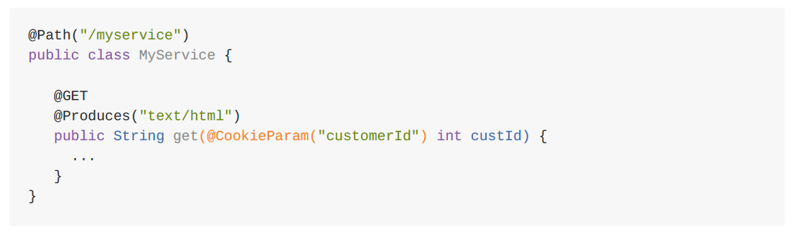
@COOKIEPARAM - EXAMPLE

Slide 39
Thankyou..!!

