Slide 1
The Use of Semidefinite Programming in Approximation Algorithms
Uriel Feige
The Weizmann Institute

Slide 2
Combinatorial Optimization
A combinatorial optimization problem.
Example: max-cut.
Input. A graph.
Feasible solution. A set S of vertices.
Value of solution. Number of edges cut.
Objective. Maximize.

Slide 3
Coping with NP-hardness
Finding the optimal solution is NP-hard.
Practical implication: no polynomial time algorithm always finds optimum solution.
Approximation algorithms: polynomial time, guaranteed to find “near optimal” solutions for every input.
Heuristics: useful algorithmic ideas that often work, but fail on some inputs.

Slide 4
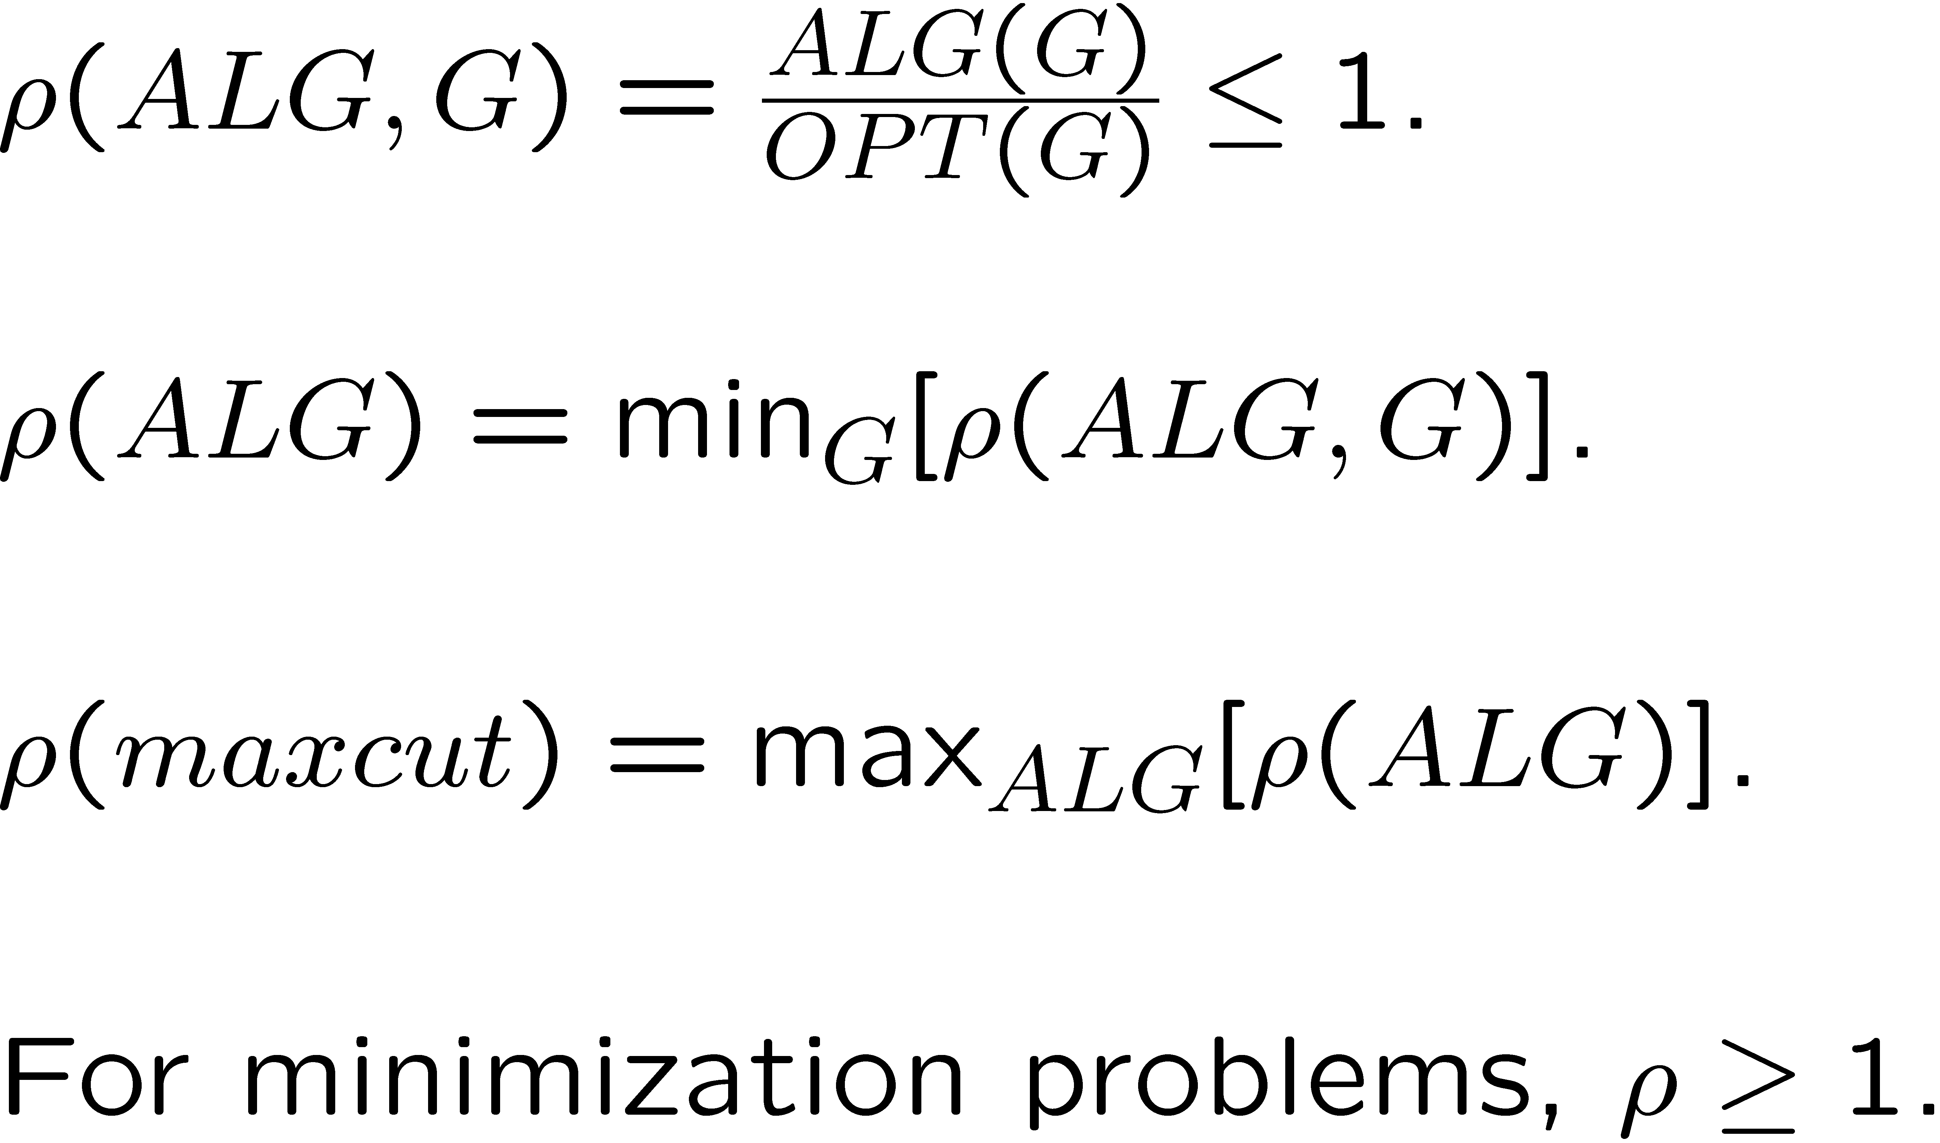
Approximation Ratio
For maximization problems (max cut):

Slide 5
A diverse picture
Many approximation algorithms designed, for many combinatorial optimization problems, using a variety of algorithmic techniques.
A large variation between approximation ratios of different problems. (PTAS, constant, super-constant, logarithmic, polylogarithmic, polynomial, trivial.)

Slide 6
Hardness of Approximation
How can we tell if there is room for further improvement in the approximation ratio?
NP-hardness of approximation: improving over an approximation ratio implies P=NP.
“Gap preserving” reductions. The PCP theorem.
Hardness of approximation under other assumptions.

Slide 7
State of the art
Tight thresholds: k-center, max-coverage, max 3SAT.
Reasonable bounds: max 2SAT, max-cut, min vertex cover.
Poor bounds: min bisection.
Almost no progress: max bipartite clique.
Inapproximable: max clique, longest directed path.

Slide 8
Semidefinite Programming
A generalization of linear programming.
Most effective for maximization problems involving constraints over pairs of variables.
Leads to reasonably good approximation ratios, though in most cases they are not known to be best possible.

Slide 9
In this talk
The use of SDP for max-cut.
Main result – Goemans and Williamson. But will survey much more.
The use of SDP for other problems.
Impractical to fully cover (and understand) in three hours. Will mention references for additional reading.

Slide 10
Outline for max-cut
IP formulation of max-cut.
LP relaxation.
Inherent weakness of LP.
A heuristic that almost always works.
SDP relaxation – captures the heuristic.
Proving a good approximation ratio.
Extensions and limitations of SDP approach.

Slide 11
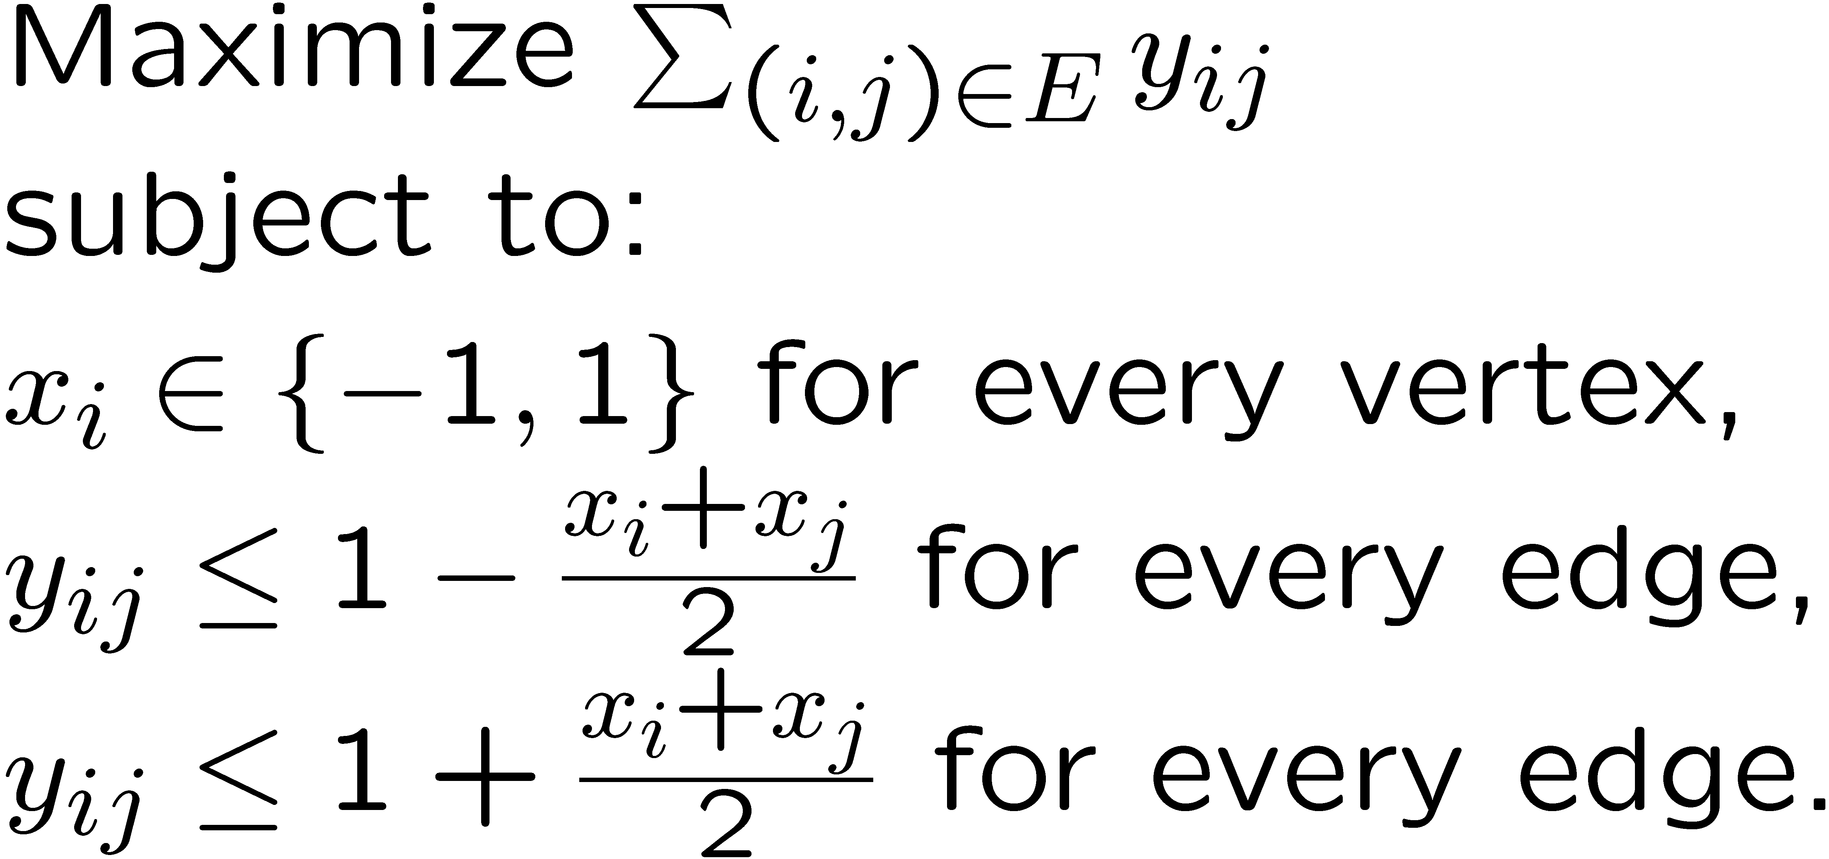
Integer Programming
Max-cut is the solution of the IP:

Slide 12
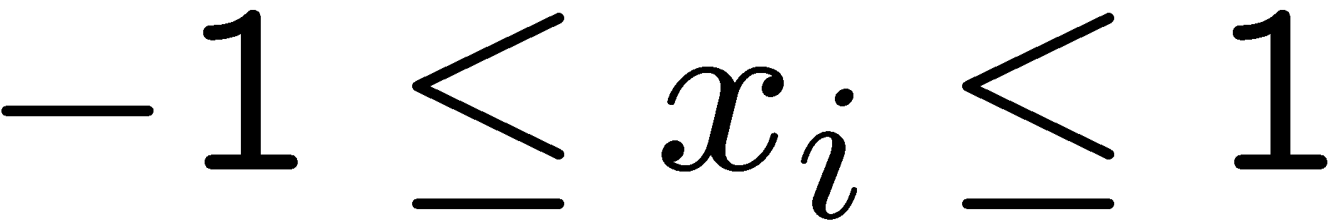
LP relaxation
Solving the IP is NP-hard.
Relax integrality constraints so as to allow fractional values.
LP provides an upper bound for max-cut.
The LP is polynomial time solvable.
However, x_{i} = 0 for every vertex gives an optimal solution of value |E|.
Hence LP upper bound is not informative.

Slide 13
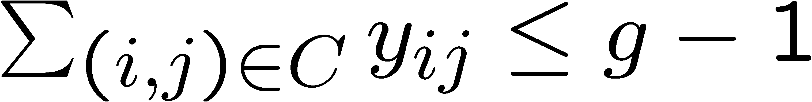
Adding valid constraints
For every odd cycle C of length g,
Violated constraints can be found in polytime. Hence LP solvable in polytime.
Opt(LP) = |E| only on bipartite graphs.
Gives true optimum for every planar graph.
LP upper bound may be very informative.

Slide 14
Weakness of LP
For graph of odd-girth g, every edge can have value (g-1)/g.
For every ε, there are graphs with arbitrarily large girth and max-cut below ½+ε. (Slightly altered sparse random graphs.)
Hence LP does not provide an asymptotic approximation ratio better than 2.

Slide 15
Good heuristics
For almost all graphs with n vertices, and dn edges, where d is a large enough constant, the value of the LP is almost a factor of 2 away from maxcut.
Is there a good heuristic that provides a nearly tight upper bound on most such graphs?

Slide 16
Algebraic Graph Theory
A graph can be represented by its adjacency matrix.
This is a square symmetric matrix with nonnegative entries.
It has only real eigenvalues and eigenvectors.
Eigenvalues can be computed in polytime.

Slide 17
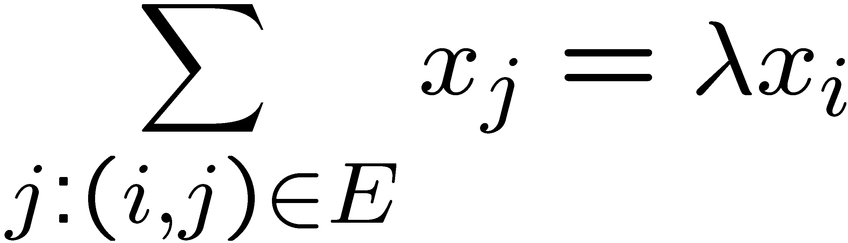
Eigenvectors of graphs
Assign values X_{i} to vertices.
1
1
-2
1
1

Slide 18
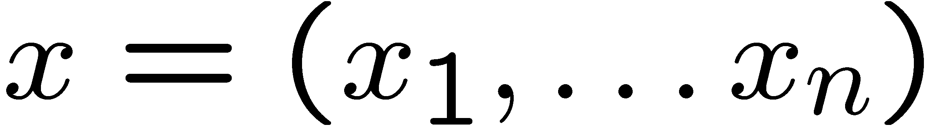
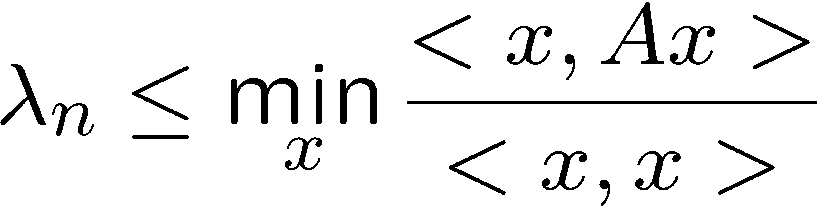
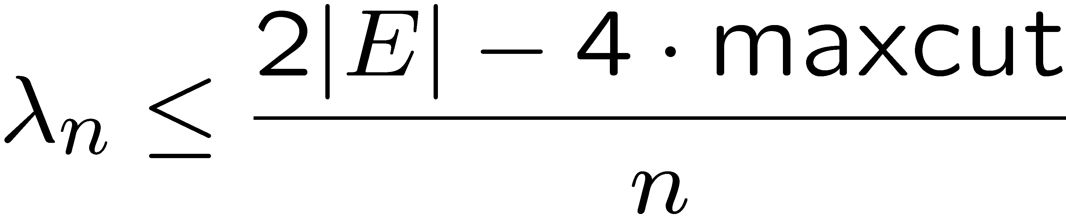
Raleigh quotients
For

Slide 19
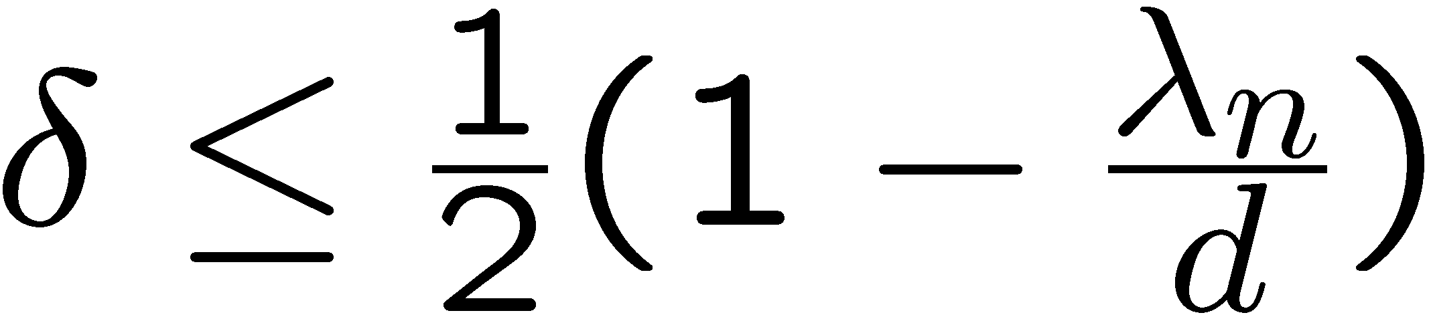
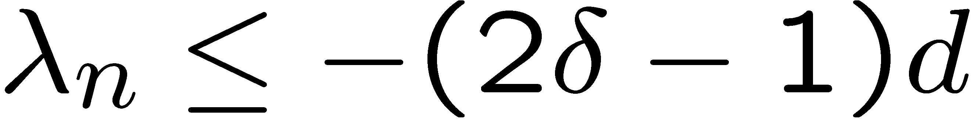
Excluding a large cut
Graph with average degree d and cut with δ fraction of edges.
To prove that a graph does not have a large maxcut, it suffices to compute the smallest eigenvalue of its adjacency matrix, and verify that it is not very negative.

Slide 20
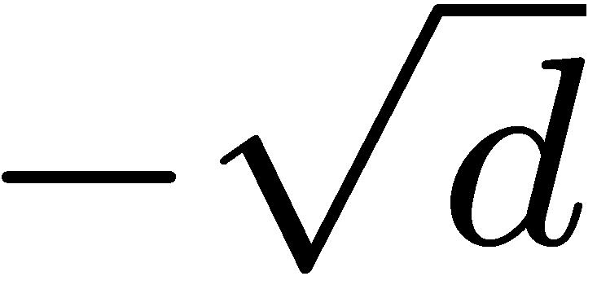
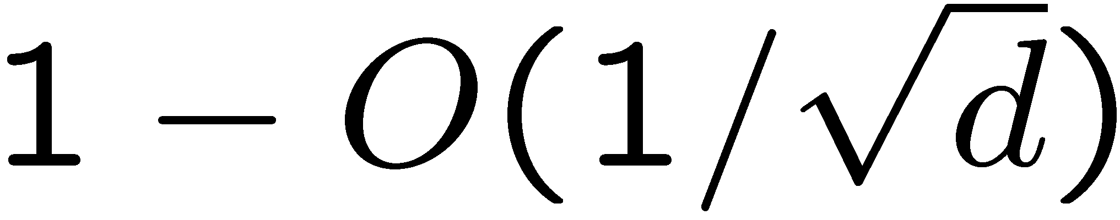
A good heuristic
For almost all graphs of average degree d, λ_{n} is of order
(For d < log n, this may require slight preprocessing of the graph, removing a negligible fraction of the edges.)
For most graphs, λ_{n} proves that any cut with half the edges is a approximation.

Slide 21
What might go wrong?
There are graphs for which λ_{n} ' –d but with no large cuts.
For example, add to any graph a disjoint copy of a complete bipartite graph on 2d vertices. Creates –d eigenvalue without significantly affecting size of maxcut.

Slide 22
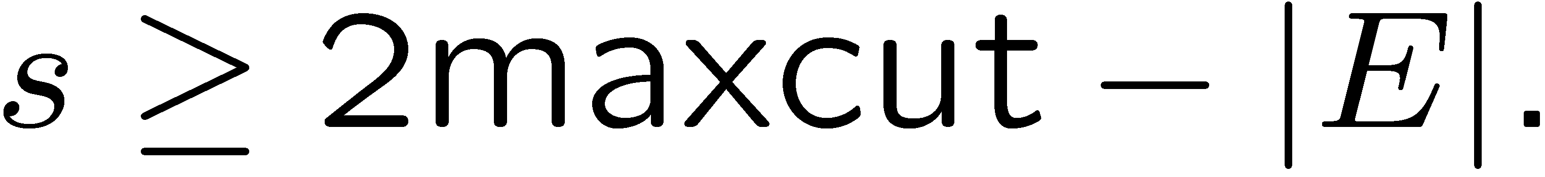
Adding self loops
A self loop is not included in any cut.
Let s be the smallest number of self loops that can be added to a graph so that all eigenvalues are nonnegative.
If maxcut is large, then s is large.
The contribution of small subgraphs to s is small. Solves previous bad example.

Slide 23
An optimization problem
Given the adjacency matrix A of a graph, find the minimum value of s such that adding a total of s to the diagonal entries makes A positive semidefinite (no negative eigenvalues).
This problem can be solved in polytime by semidefinite programming.
Appears to be strongly related to max-cut.

Slide 24
Rounding an SDP solution
Transforming an optimum solution of the SDP to a feasible solution for max-cut.
A possible approach: find eigenvector that corresponds to 0 eigenvalue.
Partition vertices to those with positive entries and those with negative entries.
This is a common heuristic, but its worst case approximation ratio is unclear.

Slide 25
References
Boppana [FOCS 87]. For most graphs with a cut containing significantly more than half the edges, the SDP heuristic finds the exact max cut.
Feige and Kilian [JCSS 2001]. Extensions to more graphs and to other problems.

Slide 26
Goemans and Williamson
[JACM 95]
Showed how to get from the SDP provably good approximation ratios for max-cut.
A minimization SDP has a dual maximization SDP of the same value.
The dual SDP in our case (after a linear transformation on the objective function) can also be viewed as a relaxation for an integer quadratic program for maxcut.

Slide 27
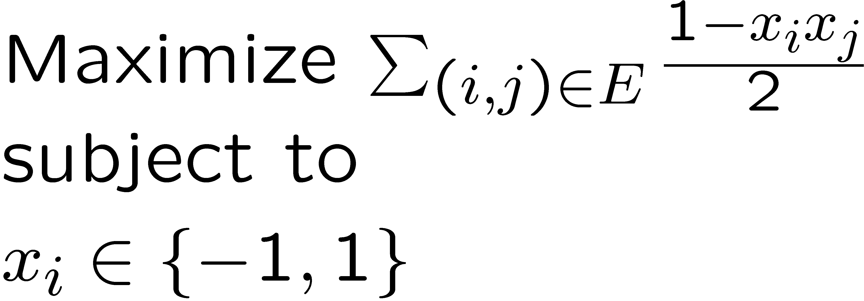
An integer quadratic program
Max-cut is the optimum of:

Slide 28
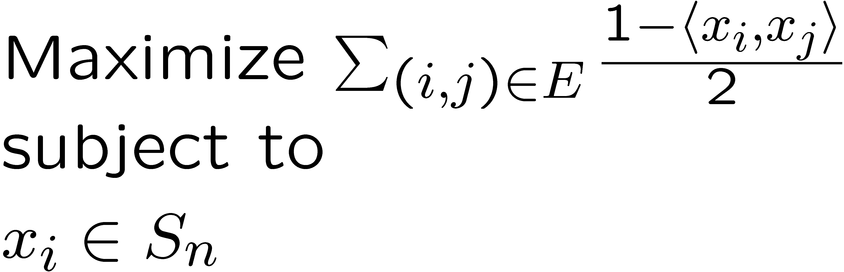
A vector relaxation
An upper bound on max-cut:
Vertices are mapped to points on the unit sphere, pushing adjacent vertices away from each other.

Slide 29
A geometric view
.

Slide 30
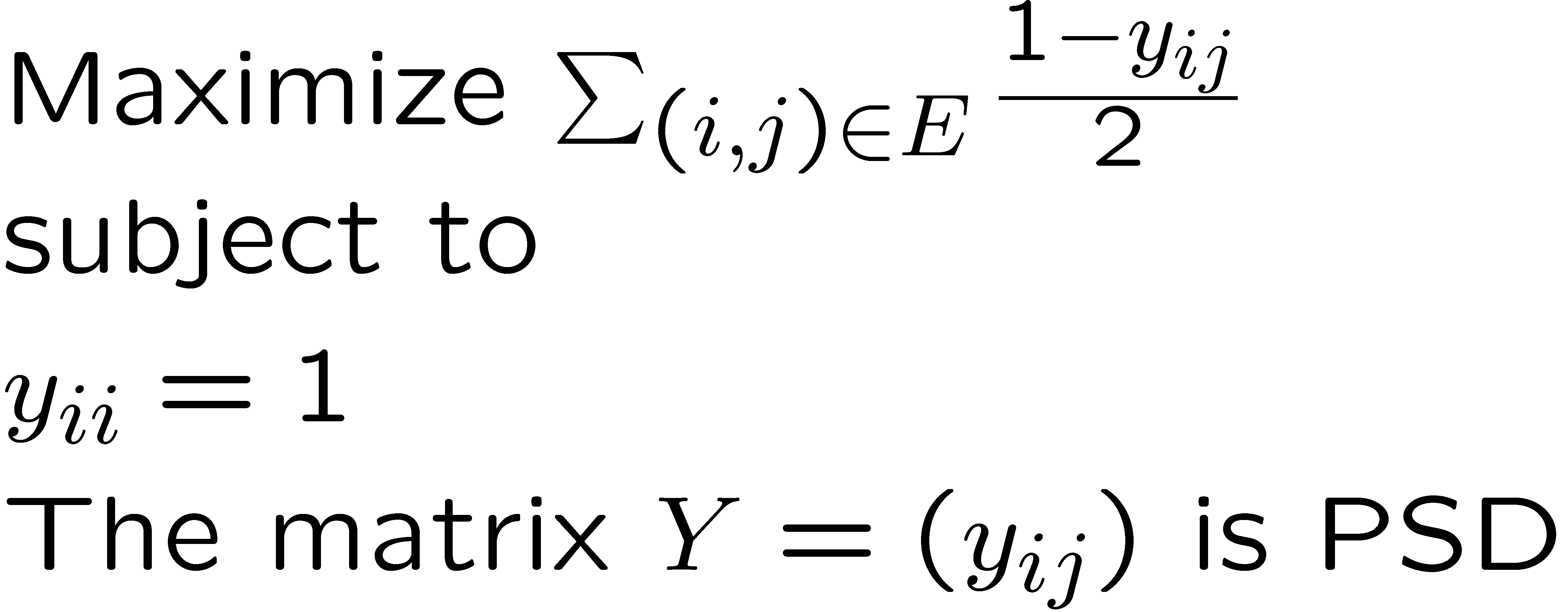
A semidefinite program
The vector program is equivalent to an SDP

Slide 31
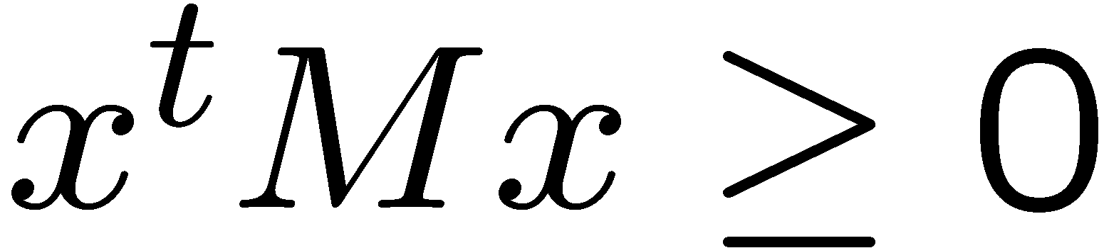
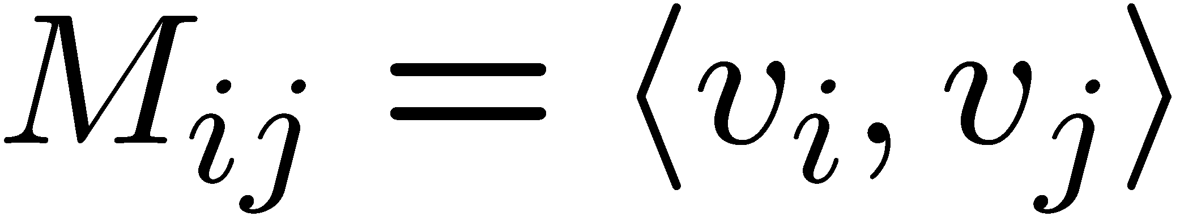
PSD matrices
Equivalent conditions for a symmetric matrix M to be positive semidefinite:
Non-negative eigenvalues.
Non-negative Raleigh quotients.
A matrix of inner products.

Slide 32
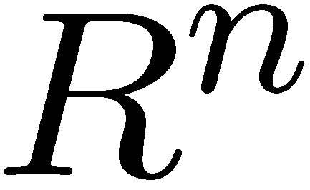
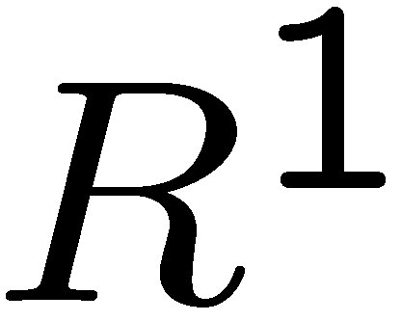
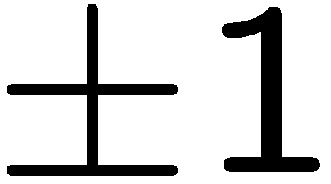
Rounding an SDP solution
A feasible solution to the SDP associates with every vertex a unit vector in , or a point on the unit sphere.
A feasible solution to max cut associates with every vertex a unit vector in , or a value.
Need a rounding process that does not lose much in value of SDP.

Slide 33
Using geometry of SDP
Optimal solution of SDP tends to send adjacent vertices to antipodal points, so as to maximize (1–x_{i}x_{j})/2.
Needs a rounding technique that keeps most far away pairs separated, and hence keeps together close pairs.
Geometrically, the best choice is a half-sphere. (Isoperimetric inequalities.)

Slide 34
Cut by Hyperplane
A half sphere is defined by taking a hyperplane through the center of the sphere.
A hyperplane is defined by its normal vector.

Slide 35
Random hyperplane
There are infinitely many hyperplanes. Which is the best one for a particular solution to the SDP?
Surprise: it does not really matter. Just choose one at random. This partitions sphere in two. Two vertices are on same side of cut if their corresponding points are on the same side of the hyperplane.

Slide 36
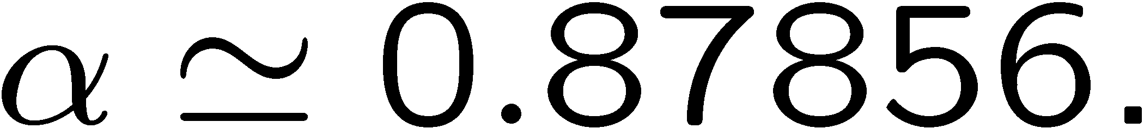
Analysis for single edge
Consider arbitrary edge (i,j).
The SDP gets (1 – x_{i}x_{j})/2.
The rounded solution gets angle(i,j)/π in expectation. (Proof: project the normal vector to the (i,j) plane.)
For any two points on the sphere, the ratio between these two values is never worse than

Slide 37
Worst case expectation
rnd 1 1
0.878
0
θ 1 sdp

Slide 38
Analysis for whole graph
For every edge, in expectation recover at least 0.87856 of SDP value.
Even though the outcomes for different edges depend on each other, the linearity of expectation principle holds, implying an overall expected approximation ratio of at least 0.87856.

Slide 39
A deterministic algorithm
At least one hyperplane must give cut of value at least as high as expectation.
Such a hyperplane (or its normal vector) can be found in polynomial time. (The derandomization approach is beyond the scope of this lecture.)

Slide 40
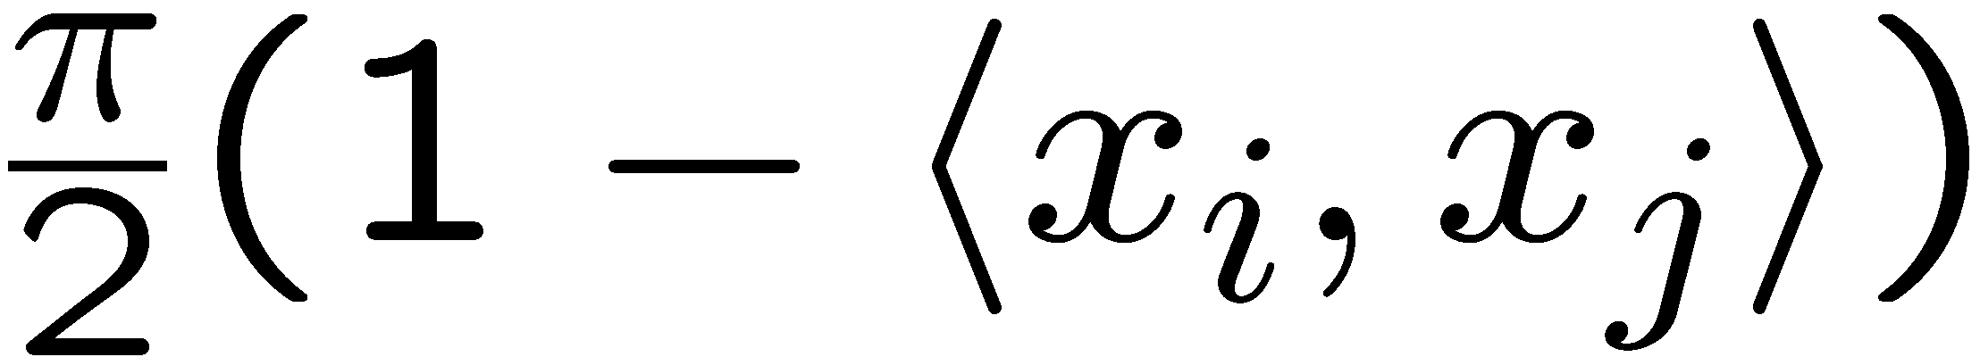
A different view
Max cut is the optimum of (scale by π):
Associate unit vectors with vertices so as to maximize sum of angles between endpoints of edges.
(Random hyperplane proves equivalence.)
The function is a good approximation for the angle.
One can optimize over it using SDP.

Slide 41
Summary
Naïve approaches (including LP) approximate max cut within a ratio of ½.
On almost all graphs, the most negative eigenvalue provides upper bounds that are close to true max-cut.
Eigenvalues are sensitive to small changes, and can be fooled in worst case graphs.
SDP generalizes eigenvalue techniques.

Slide 42
Summary continued
SDP dual gives a maximization problem in which vertices are mapped to points on unit sphere.
Random hyperplane through the origin produces a true cut of expected value not far from value of SDP.
One can efficiently find a hyperplane giving a cut of value at least the expectation.

Slide 43
Some questions
Can we do better than random hyperplane?
Can a different SDP produce better approximations for max cut?
What other problems have good approximations based on semidefinite programs?

Slide 44
Four parameters
1
sdp
opt
alg
rnd
0

Slide 45
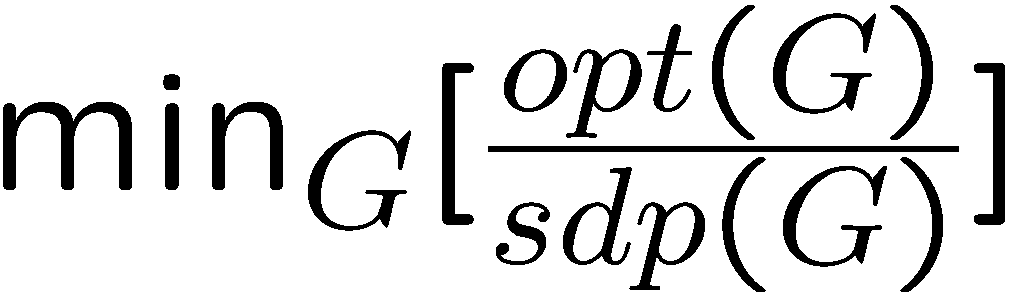
Integrality ratio
The integrality ratio of an LP or an SDP is the worse possible ratio between the optimal value of the SDP and the true optimal solution.
Measures the quality of the SDP as an estimation algorithm.

Slide 46
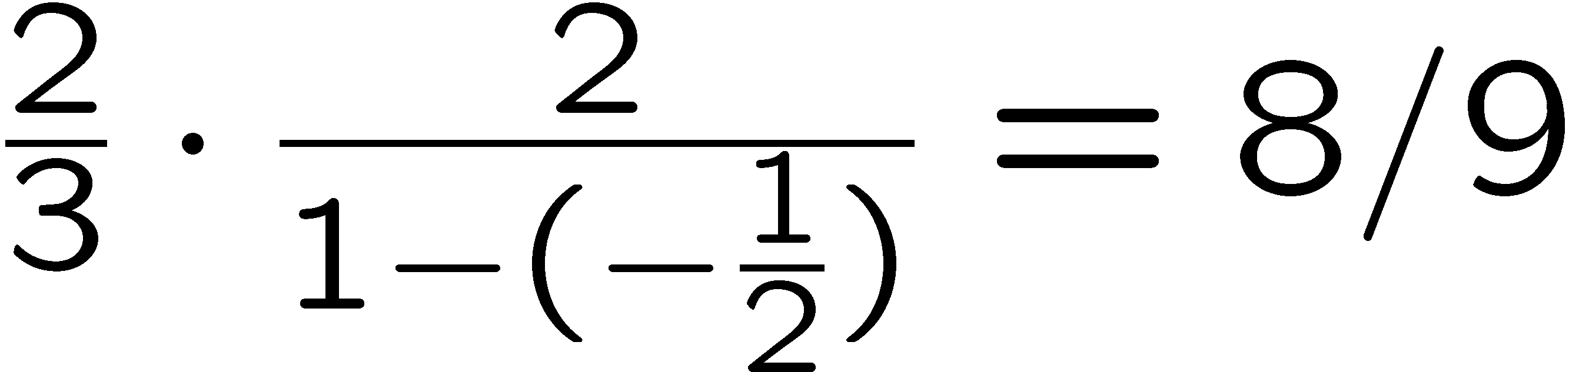
Triangle example
.

Slide 47
0.87856 integrality ratio
A sphere in d dimensions.
A dense set of points.
Edge if angle > θ.
Concentration of measure.
Isoperimetric inequality.
Half-sphere is best cut.
Hence integrality ratio of α.
.

Slide 48
Additional constraints
The naïve LP for max cut was quite useless.
With the addition of odd cycle constraints, it became more useful.
Can we add useful constraints for SDP?
Must remain polytime solvable.
Rule of thumb: can add arbitrary valid linear constraints on the inner products x_{i} ¢ x_{j}.

Slide 49
Triangle constraints
At most two edges are cut in a triangle.
The intended solution has +1/-1 values. Hence also (and even if i,j,k not a triangle)

Slide 50
Significance of constraints
Imply all odd cycle constraints.
Forbid certain vector configurations.
SDP optimal for all planar graphs.
SDP optimal whenever the vector configuration is 2-dimensional.
Worst integrality ratio known: roughly 0.891.
Can we get approximation ratio better than α?

Slide 51
The approximation ratio
We showed that rnd/sdp is at least α.
The algorithm eventually outputs a true cut.
The approximation ratio is alg/opt.
Can it be that the approximation ratio is always strictly better than α?
Do triangle constraints (or other constraints help in this respect)?

Slide 52
The ratio rnd/opt
To show that rnd/opt is not significantly better than α, one needs to show a graph and an embedding of its vertices on a sphere such that:
This is an optimal solution to the SDP.
The value of the sdp is equal to maxcut.
Almost all edges make angle θ.

Slide 53
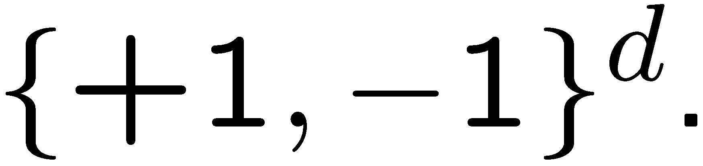
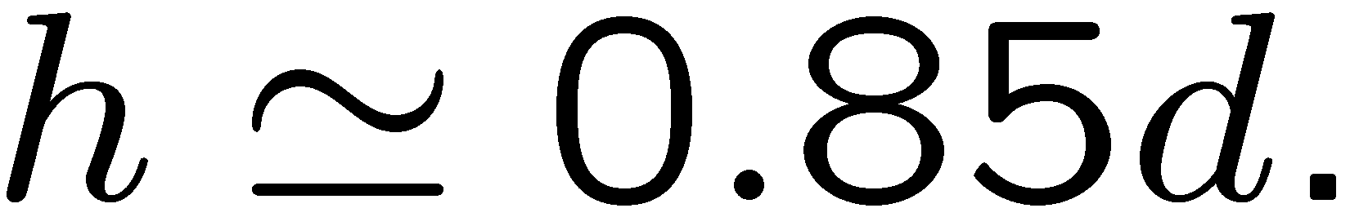
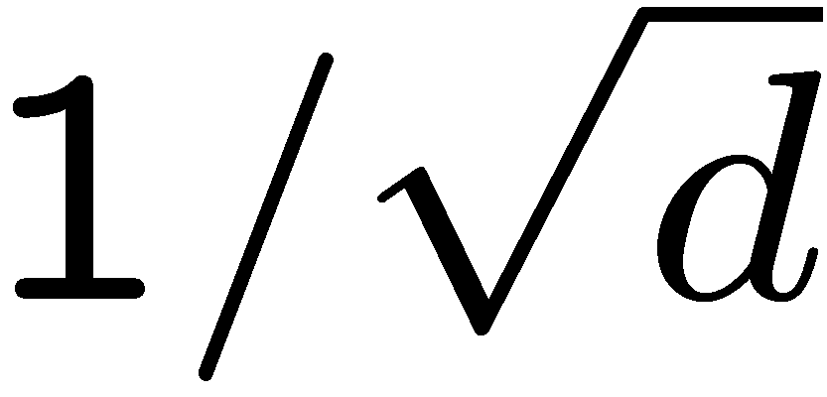
Hypercube graphs
All vertices are vectors in
Edges connect vertices of Hamming distance (at least)
Scaling all vectors by gives feasible solution to sdp.
Under certain conditions (in particular, h must be even), this sdp solution can be shown to be optimal (by matching dual).

Slide 54
In 3 dimensions
(+1,+1,+1)
(+1,-1,-1)
(-1,+1,+1)
(-1,-1,-1)

Slide 55
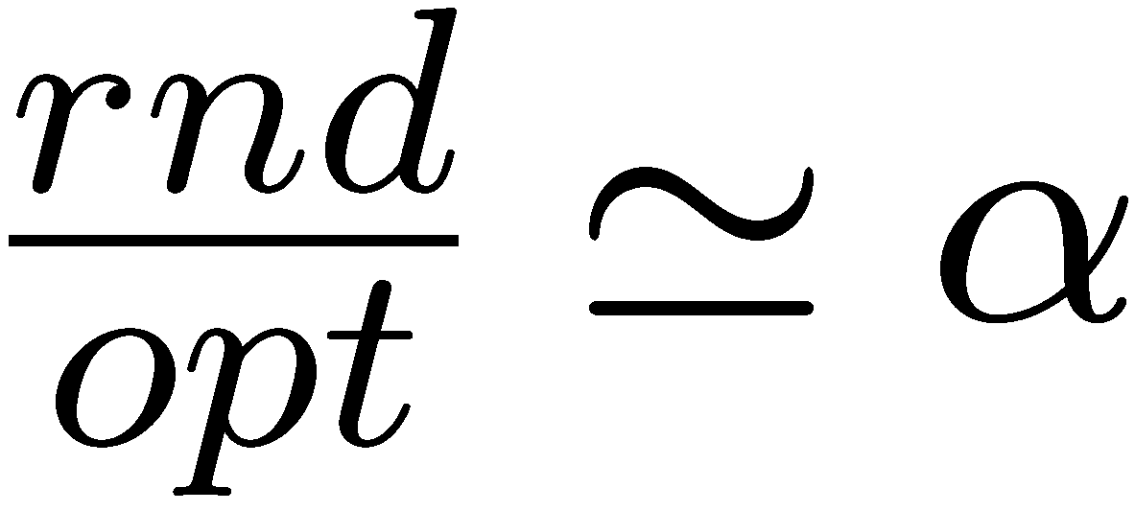
Convex combinations
Every one of the d coordinates induces a (+1,-1) cut.
Value of sdp solution is convex combination of values of the d cuts.
Hence every such cut is optimal, and sdp=opt.
For appropriately chosen h, gives

Slide 56
Additional constraints
Hypercube embedding is a convex combination of true cuts.
True cuts satisfy all “reasonable” constraints.
Hypercube embeddings satisfy all reasonable (including triangle) constraints.
Negative example applies without change.

Slide 57
Best hyperplane
The hyperplane eventually chosen by the algorithm is not random.
Hence potentially, alg > rnd.
Hypercube graphs can be generalized to show that even best hyperplane does not give approximation ratio better than α.

Slide 58
Summary
Max-cut can be formulated as SDP.
Random hyperplane within α of sdp.
Integrality ratio opt/sdp might be α.
Approximation ratio alg/opt might be α.
It is an open question whether triangle constraints improve integrality ratio beyond α. Need different rounding technique.

Slide 59
References
Karloff [SICOMP 99] shows that for the hypercube, the natural embedding is an optimal solution to the SDP.
Feige and Schechtman [RSA 02] provide an extensive discussion of the integrality ratio and the approximation ratio for max cut.

Slide 60
Special cases
Approximation ratio better than α:
Graphs with very large cuts.
Graphs with only small cuts.
Very dense graphs.
Very sparse graphs.

Slide 61
Worst case angle
rnd 1
0
θ 1 sdp

Slide 62
Useful principle
Favorable solution of SDP: a significant part of the weight of the solution comes from edges whose angle significantly differs from θ.
Then the expected size of a cut given by a random hyperplane is significantly above an α fraction of sdp.

Slide 63
Heavy max-cut (> 0.844)
Say opt > 0.99.
Then sdp > 0.99.
Then typical edges contribute > 0.99 to sdp.
This corresponds to an angle > θ.
Random hyperplane expected to recover more than α fraction of their value.
Approximation ratio > α.

Slide 64
Light max-cut (< 0.844)
Say sdp < 0.7.
Then typical edges contribute < 0.7 to sdp.
This corresponds to an angle < θ.
Random hyperplane expected to recover more than α fraction of their value.
Approximation ratio > α.

Slide 65
What goes wrong
We may have an sdp solution in which edges either make angle of θ, or an angle of 0.
Neither sdp nor random hyperplane get anything from edges with angle 0.
Hence approximation ratio remains α.

Slide 66
Basic idea
On edges with angle 0, even a random cut gets much more than sdp does.
Willing to lose a little on edges of angle θ, if can win a lot on edges of angle 0.
Use a rounding technique that blends random hyperplanes and random cuts.

Slide 67
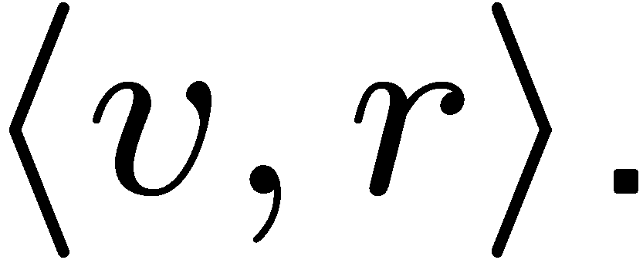
RPR²
Random projection, randomized rounding.
Choose random hyperplane by choosing random normal vector r.
The distance of a point v on the sphere from the hyperplane is simply
So far we used the sign of this value.
RPR² uses the actual value d_{v}.

Slide 68
Randomized rounding
For every vertex v independently, v = 1 with probability f(d_{v}), and -1 otherwise.
1
-1
-1 0 1 d_{v}

Slide 69
The rounding function f
The optimal choice of f depends on the value sdp. For lower sdp, lower slope.
Near-optimal choice is piecewise linear.
Computer assisted analysis to find best “worst case” approximation ratio.

Slide 70
Overall picture
Approximation ratio as function of sdp value.
1
0.878
0.5 0.844 1 sdp

Slide 71
References
Heavy max-cut was already analysed by Goemans and Williamson.
Light max-cut was first analysed by Zwick [STOC 99], using outward rotations.
The RPR² technique was introduced by Feige and Langberg [ICALP 01].

Slide 72
Biased vertices
For the maximum cut, a vertex is biased if significantly more than half its neighbors are on the other side.
Intuitively, if we could recognize (most) biased vertices and place them correctly, then we will get a near optimal cut. We can afford to make mistakes with the unbiased vertices.

Slide 73
Dense graphs
Number of edges Ω(n²).
Assume for simplicity that all degrees > n/2.
Pick at random O(log n) vertices, and guess on which side of the cut they are (try all possibilities).
For the correct guess, majority vote will then place correctly almost all biased vertices.
With extra work, get a PTAS.

Slide 74
Sparse graphs
Graphs with O(n) edges.
Assume for simplicity that all degrees < d.
Even without SDP can guarantee approximation ratio > ½ + Ω(1/d) (homework).
With SDP can get approximation ratio better than α + Ω(1/d⁴).
For degree < 4, approximation ratio > 0.92.

Slide 75
Misplaced vertices
A vertex is misplaced w.r.t. a cut if most of its neighbors are on its own side.
Post-processing: iteratively, misplaced vertices switch sides. Improves the cut.

Slide 76
Desirable situation
For post-processing to improve approximation ratio of an algorithm:
A constant fraction of the vertices need to be misplaced by the algorithm.
Switching a misplaced vertex needs to contribute Ω(1/n) to the cut.
Second condition holds for bounded degree graphs.

Slide 77
Misplaced vertices for SDP
In general, random hyperplane might not produce any misplaced vertices, and post-processing does not help.
However, we are interested only in the following case:
Maximum degree is d.
- (most) angles are θ.

Slide 78
A problem
.

Slide 79
Solution
Add triangle constraints.
They forbid certain vector configurations.
Lemma: for every pair of edges (u,v), (u,w), with angles roughly θ (and M constraints), random hyperplane places u,v,w on same side with constant probability.
If d=2,3, this means that u is misplaced.
For d > 3, more work is needed.

Slide 80
References
Dense max-cut (and dense instances of other problems) was considered by Arora, Karger and Karpinski [JCSS 99], and by others.
Sparse max-cut is analysed in Feige, Karpinski and Langberg [JALG 02].

Slide 81
Summary for max-cut
SDP + random hyperplane give ratio α.
If opt > 0.844 then ratio improves.
If opt < 0.844 then ratio improves with RPR².
If |E| = Ω(n²), PTAS using sampling.
If |E| = O(n), improvement using triangle constraints and post-processing.
Known hardness of approximation: 16/17.

Slide 82
Related problems
We shall survey the use of SDP for approximating some other problems.
Some new ideas involved.
Some cases where SDP looks like it may work, but it does not seem to work well enough.

Slide 83
Weighted instances
In weighted max-cut, edges have nonnegative weights, and one seeks a cut of maximum weight.
SDP (with weighted objective function) leads to the same approximation ratio α.
This is a common phenomenon for approximation algorithms based on LP or SDP.

Slide 84
Min bipartization
The complement of max-cut. Remove the smallest number of edges so that the graph becomes bipartite.
Not known to be approximable within constant factors.
If opt = ε² |E| , SDP for max-cut + random hyperplane might pay ε |E| . Approximation ratio as bad as 1/ε. (See homework.)

Slide 85
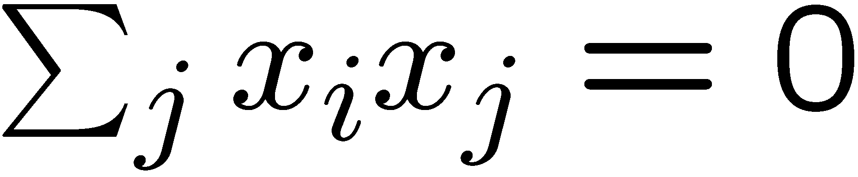
Max bisection
Max-cut, with n/2 vertices on each side.
Add to the SDP the constraints
for every i.
Random hyperplane produces a cut. To balance it, move vertices from the large side to the small side. Hard to analyse.
Provable approximation ratio drops significantly below α.

Slide 86
Improved analysis
Use RPR², followed by a greedy correction.
RPR² looses a little in the number of edges cut, but produces an initial cut that is more balanced. Hence one loses less in the greedy correction phase.
Provable approximation ratio above 0.7.
Can a different rounding technique or analysis lead to much better bounds?

Slide 87
Min bisection
Min-cut solvable in polynomial time.
Min-bisection: n/2 vertices on each side.
Same SDP as for max-bisection, replacing max by min. (-1,+1,0) (0,-1,+1)
Appears useless.
Pseudo-approximation.
Major open question. (+1,0,-1)

Slide 88
Max 2Lin
A system of linear equations, each with 2 Boolean variables.
Maximize number of equations satisfied.
Max cut is a special case.
Same approximation ratio α.
Stronger hardness of approximation, 11/12.

Slide 89
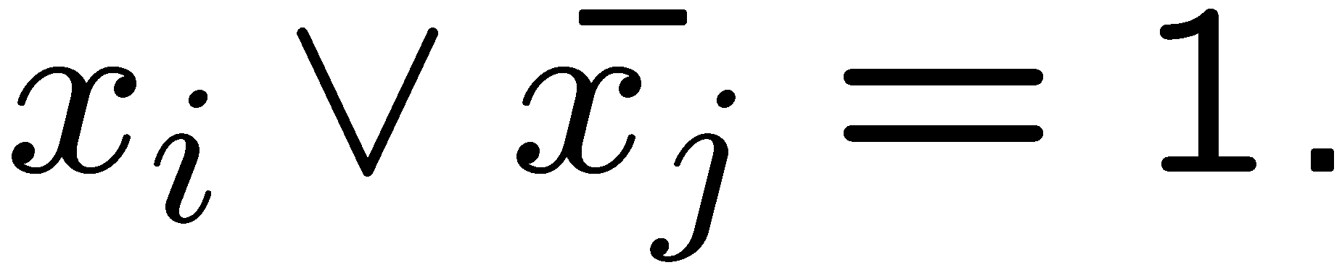
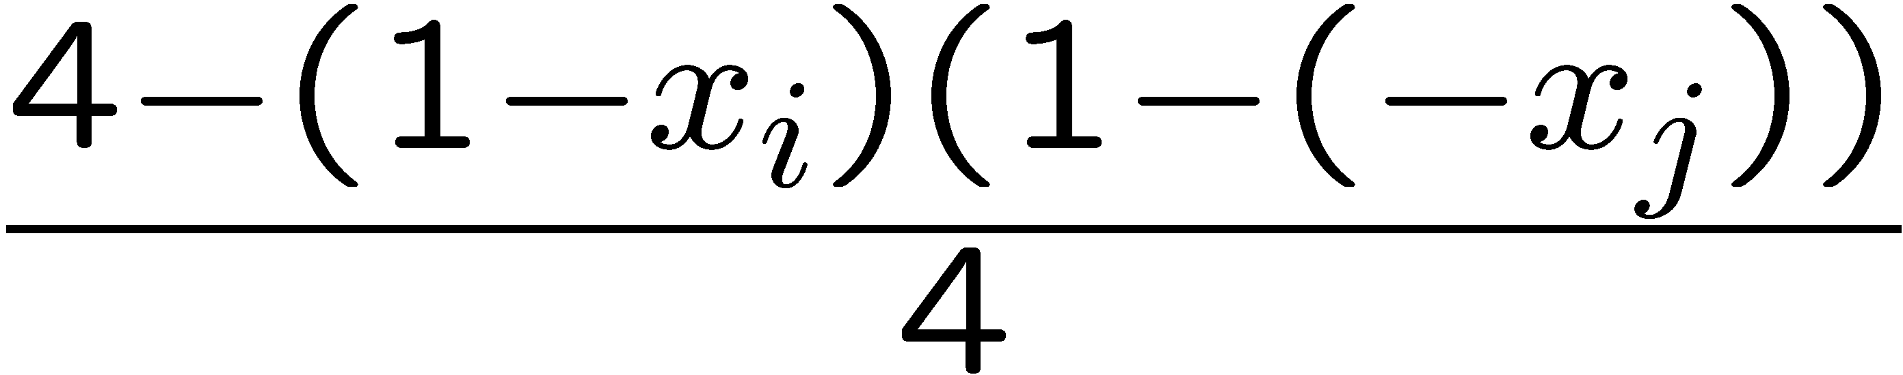
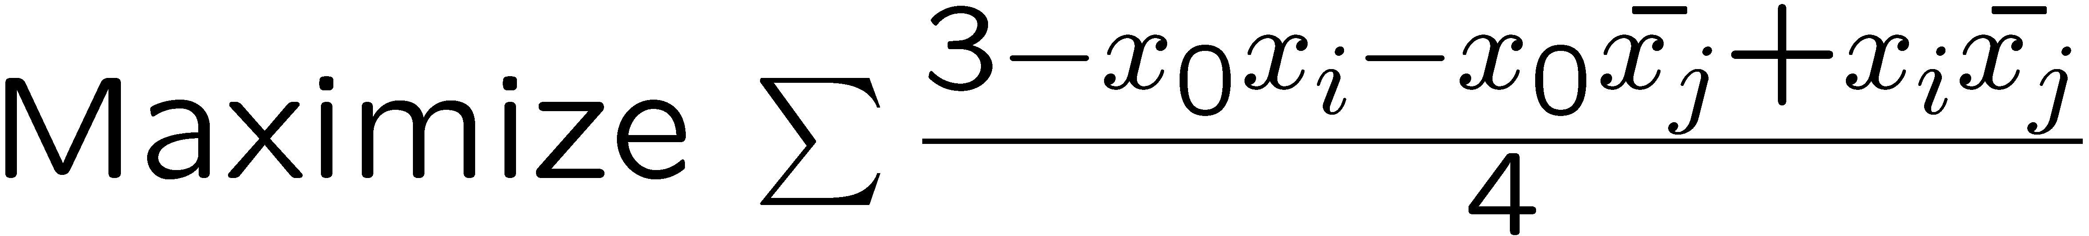
Max 2sat
Maximize number of clauses satisfied.
View variables as +1/-1.
Define x₀ = 1.

Slide 90
Rounding technique
Allow variables to be arbitrary unit vectors.
Solve SDP.
Take random hyperplane.
Give literals on same side of x₀ value 1, and their complements value 0.
Approximation ratio α, same as max-cut (though analysis more difficult).

Slide 91
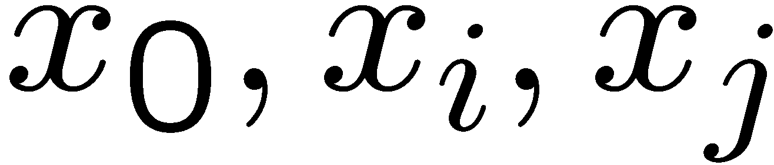
Improved version
Include triangle constraints on
Implies that a clause contributes at most 1.
Can be shown that sdp=m iff opt=m.
Improved rounding technique: rather than select r (normal to hyperplane) at random, give a bias towards x₀.
Approximation ratio above 0.94 (computer assisted analysis).

Slide 92
References
Max 2sat was already considered by Goemans and Williamson.
Triangle constraints were added and analysed (using rotations) by Feige and Goemans [ISTCS 95].
Best current bounds, Lewin, Livnat and Zwick [IPCO 02].

Slide 93
Some other problems
Color 3-color graphs with (m/n)^{1/3} colors.
Gives a bound on the size of MIS (the Lovasz theta function).
Does not appear to give an approximation ratio better than 2 for vertex cover.
Tight approximation ratio 7/8 for max 3sat.

Slide 94
References
3-coloring: Karger, Motwani and Sudan [JACM 98].
Independent set: Alon and Kahale [Math. Programming 98].
Vertex cover: Charikar [SODA 02].
Max 3SAT: Karloff and Zwick [FOCS 97].
Many more works on SDP.
Hardness results: Hastad [JACM 01].

Slide 95
Summary
SDP produces the best known approximation ratios for many maximization problems involving 2 variables per constraint.
Computer assisted design and analysis of approximation ratio is quite common.
Often, there are no known matching hardness of approximation results.

