Slide 1






OEC-CSM701A:- AI WITH ROBOTICS
Programme name – Btech CSE
Artificial Intelligence and Machine Learning
(OEC-CSM701A)- AI WITH ROBOTICS
Topic- Depth-First Search (DFS) Algorithm
in AI with Robotics
By – Ayan Roy
Student Code – BWU/BTA/22/025

Slide 2










OEC-CSM701A:- AI WITH ROBOTICS
Introduction to Graph Search Algorithms
Graph Search Algorithms
Key Applications in Robotics
Fundamental methods for exploring and navigating complex data structures, providing systematic approaches to problem-solving in AI.
Path planning and navigation
Maze solving and exploration
Task planning and execution
Role in Robotics
Intelligent decision-making
Enable intelligent decision-making, navigation, and task execution in complex environments.
Upcoming: We'll explore the Depth-First Search (DFS) algorithm in detail, focusing on its implementation and applications in robotics.

Slide 3






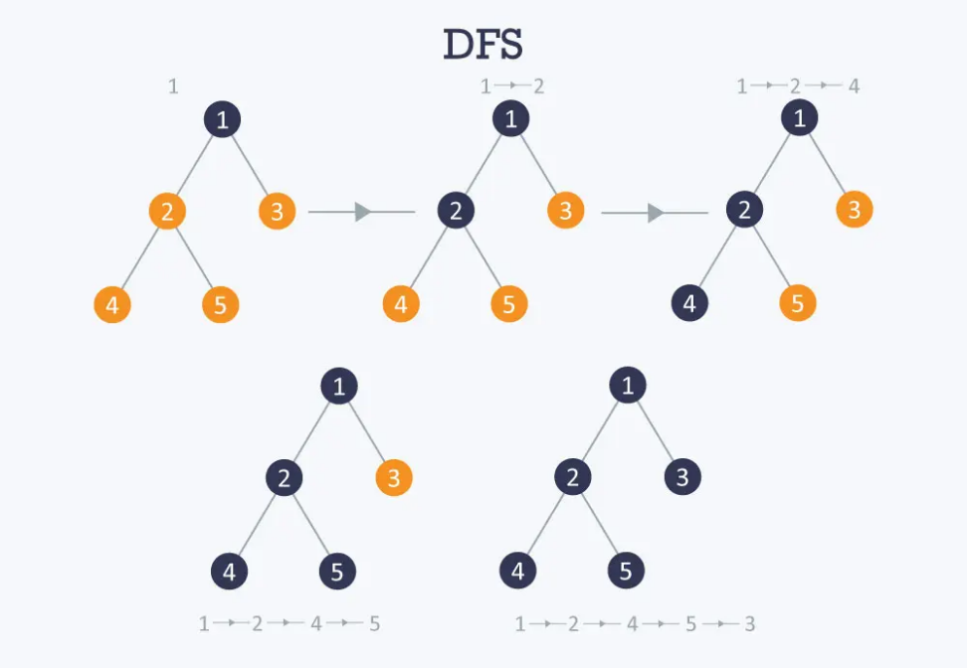



OEC-CSM701A:- AI WITH ROBOTICS
Understanding the DFS Algorithm
Core Principle
Algorithmic Steps
"Go deep first!" - DFS consistently follows a single path as far as possible until it reaches a dead end or destination.
1. Initialization
Create empty stack and visited set. Push start node, mark as visited.
DFS Traversal Example
2. Iteration
While stack not empty: pop node, check goal, explore unvisited neighbors.
3. Backtracking
When dead end reached, backtrack to last decision point and explore alternative paths.
Stack Implementation
Uses LIFO (Last-In, First-Out) principle to keep track of nodes to visit.

Slide 4











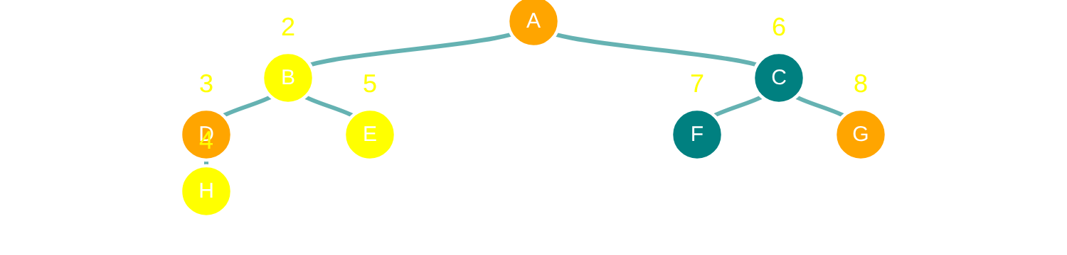
OEC-CSM701A:- AI WITH ROBOTICS
DFS Implementation and Properties
Algorithmic Steps
Key Properties
1. Initialization
Core Principle
Create an empty stack and a set for visited nodes. Push the starting node onto the stack and mark it as visited.
"Go deep first" strategy - explores as far as possible along each branch before backtracking.
2. Iteration
Space Efficiency
While the stack is not empty:
Lower memory usage compared to BFS - only stores the current path from start to current node.
Pop a node from the top of the stack
Check if it's the goal
For each unvisited neighbor:
Risk Factors
Mark as visited
Can get trapped exploring a single path indefinitely in deep or infinite search spaces.
Push onto the stack
Key Point: DFS uses a LIFO (Last-In, First-Out) approach, typically managed with a stack data structure.
DFS Traversal Example

Slide 5












OEC-CSM701A:- AI WITH ROBOTICS
Advantages of DFS in Robotics
DFS offers several benefits that make it suitable for specific robotic tasks, particularly in memory-constrained and exploration-focused applications.
Low Memory Consumption
Implementation Simplicity
Finding Solutions Quickly
Requires less memory than BFS
Recursive or stack-based implementation
Quickly finds a valid path
Only stores current path
Explores deeply into search space
Advantageous for embedded systems
Relatively easy to code
Useful for exploring unknown environments
Simple integration into control systems

Slide 6









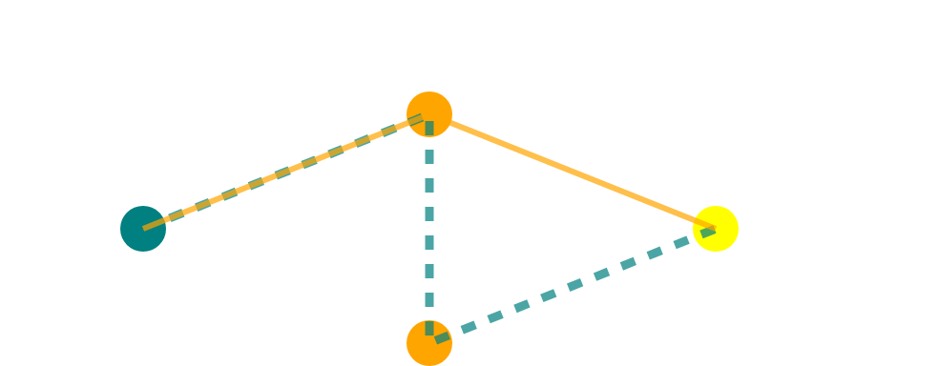




OEC-CSM701A:- AI WITH ROBOTICS
Limitations and Challenges
Despite its advantages, DFS presents critical drawbacks when applied to robotic systems:
Non-Optimality
Infinite Paths
Shortest Path Limitation
DFS does not guarantee finding the shortest or most optimal path.
DFS can get trapped exploring a single path indefinitely.
Not suitable for applications requiring the shortest path.
Can result in inefficient movements in robotic navigation.
Critical for real-time robot operation where timely decisions are essential.
Unacceptable for efficient navigation in known environments.
Real-world robotic applications often combine DFS with other algorithms to overcome these limitations.

Slide 7
OEC-CSM701A:- AI WITH ROBOTICS
References
Artificial Intelligence for Robotics - Second Edition by Francis X. Govers III
Life 3.0: Being Human in the Age of Artificial Intelligence by Max Tegmark
Artificial Intelligence: A Modern Approach by Stuart Russell (British) and Peter Norvig (American)

Slide 8
OEC-CSM701A:- AI WITH ROBOTICS
Thank
You

