Slide 1
LUMORA AI
Learn from evidence. Know your gaps. Build your path.
EARLY SIGNAL
8
4
REAL USERS
PAID USERS
A production-style learning product built for Chai Code Combinator.
₹2.25K
EARLY GROSS REVENUE
EVIDENCE-BACKED
SKILL
USAGE
~20K content views • 97% non- follower reach
answers
intelligence
economics
small sample · real behaviour · no fake conversion claims
Hackathon Project Deck
01
Notes:
INTENT: Open with confidence: Lumora is already more than a prototype. EMPHASIS: real users + paid users PAUSE: Pause after ₹2.25K.

Slide 2
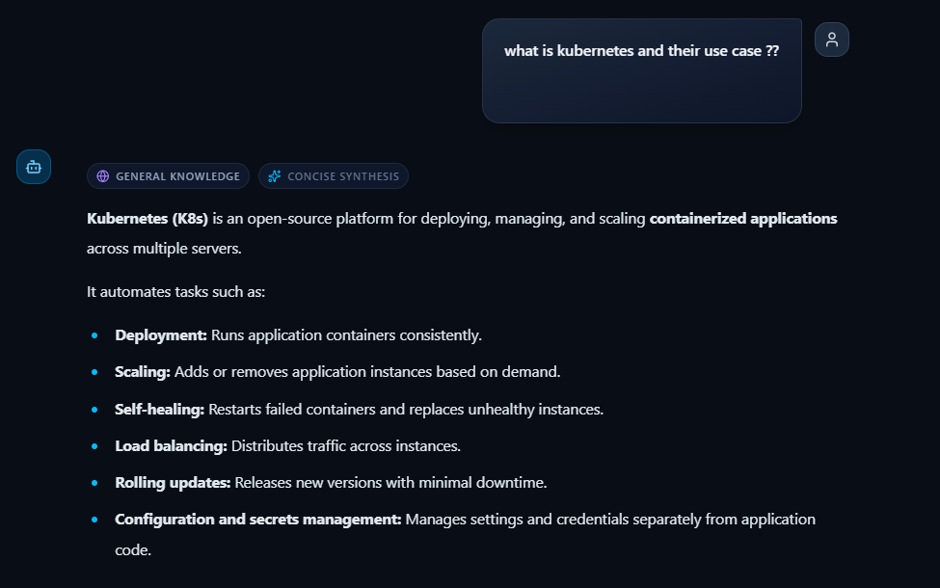
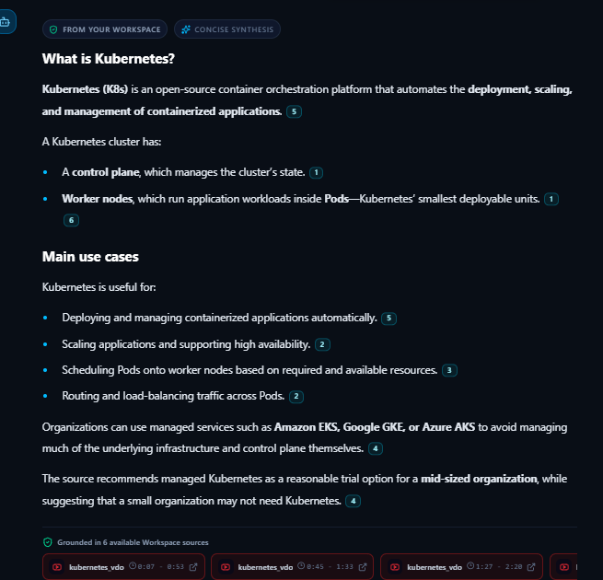
Same question. Different trust level.
General answers can be useful. Workspace answers are inspectable.
This is the product tension: the model can sound confident before evidence exists. Lumora makes the answer auditable once the source enters the workspace.
BEFORE SOURCE
GENERAL KNOWLEDGE
WORKSPACE SOURCE AVAILABLE
FROM YOUR WORKSPACE
SOURCE ADDED
Useful answer, but no visible evidence trail.
Citations + source chips make the answer inspectable.
Target judge takeaway: Lumora is not claiming that every answer is magic — it separates unaudited synthesis from workspace-grounded evidence.
02
Notes:
INTENT: Create the tension before revealing Lumora. EMPHASIS: provable PAUSE: Let the wrong underline sit without explanation.

Slide 3
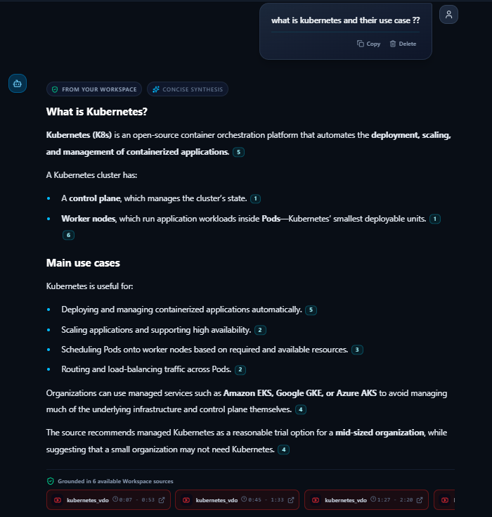
One workspace. Answers with receipts.
LIVE PRODUCT VIEW
Same chat. Different grounding. Evidence appears when workspace sources can support the answer.
Lumora turns sources into a learning workspace — not a loose document chat.
The judge should see three things instantly:
Workspace grounding
answer comes from uploaded sources
Citation markers
claims point back to source evidence
Source chips
YouTube evidence is visible at the bottom
This is the important shift: Answer → Evidence → Understanding
The deck does not need to replay citation-clicking — the demo video proves the interaction. This slide proves the product exists and is readable.
CITATIONS VISIBLE
SOURCE CHIPS
WORKSPACE-GROUNDED
03
Notes:
INTENT: Define the product proof without depending on the broken router. EMPHASIS: answers with receipts PAUSE: Pause after “you can check.”

Slide 4
Trust is an audit trail.
Lumora does not ask the user to believe the model. It gives the user something to inspect.
The product verdict is not “AI answered.” The product verdict is whether the answer is supported by workspace evidence.
QUESTION
CLAIM
EVIDENCE
VERDICT
What is Kubernetes?
K8s manages and scales containerized apps.
Citation [5] · YouTube 08:07–08:53
SUPPORTED
User intent
Model statement
Source context
Workspace-grounded
Why this matters
NO FAKE CERTAINTY
Generic AI optimizes for fluency. Lumora optimizes for inspectability: claim, evidence, context, verdict.
Demo video covers the click-through citation proof. This slide explains the product philosophy behind it.
04
Notes:
INTENT: This slide will receive final citation screenshots if they are ready. EMPHASIS: citation landing PAUSE: Hold on the second frame.

Slide 5
How evidence becomes an answer.
The system is simple enough for a judge to understand, but serious enough to control quality and cost.
SOURCE
INGEST
CHUNK
RETRIEVE
CITE
STREAM
METER
PDF YouTube Website Text CV
extract transcript metadata
small units + source refs
find relevant evidence
attach exact source trail
answer arrives fast enough
usage event + cost control
Evidence packet
source_id · chunk_id · timestamp/page · citation marker · usage event
TRACEABLE
Quality
Claims must point back to source evidence.
Learning
The same pipeline powers sources and resumes.
Business
Metering connects product UX to unit economics.
This is why the later slides can talk about real cost, rolling limits and pricing — the product records what it spends.
05
Notes:
INTENT: Signal technical depth without exposing broken router behavior. EMPHASIS: real evidence PAUSE: Short, do not over-explain.

Slide 6
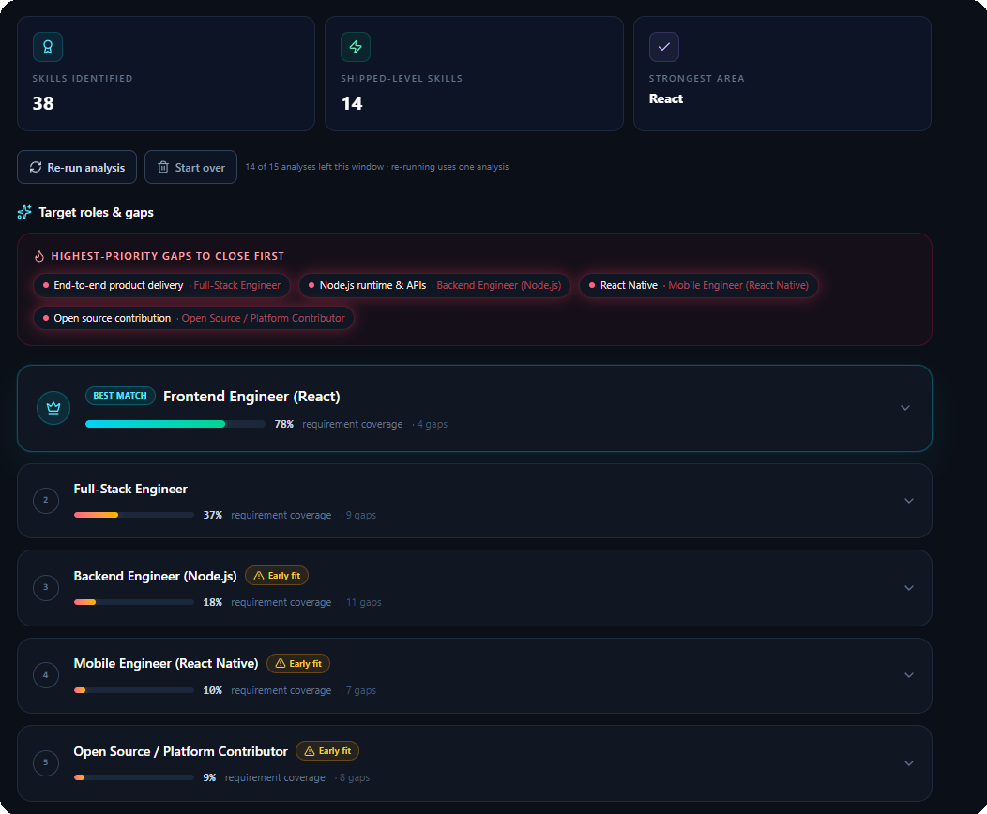
Your CV becomes a source.
Lumora turns a resume into a skill map, role fit and gap inventory.
38
LIVE PRODUCT VIEW
SKILLS IDENTIFIED
5
TARGET ROLES
React
STRONGEST AREA
It does not just score a resume. It tells the learner where they can credibly fit next.
06
Notes:
INTENT: Introduce Skill Intelligence as the second hero system. EMPHASIS: CV → role fit PAUSE: Pause on the five-role list.

Slide 7
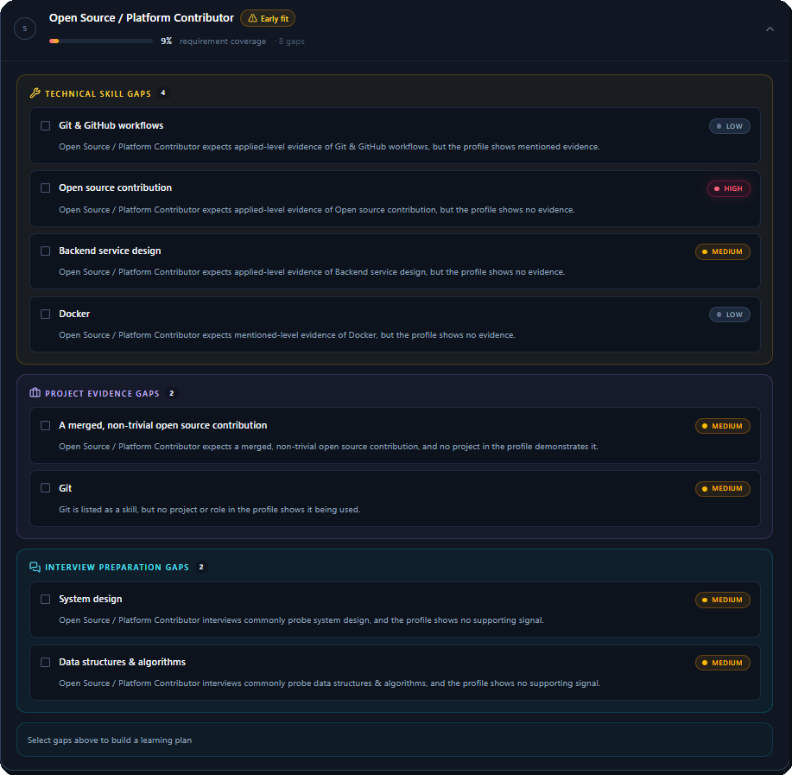
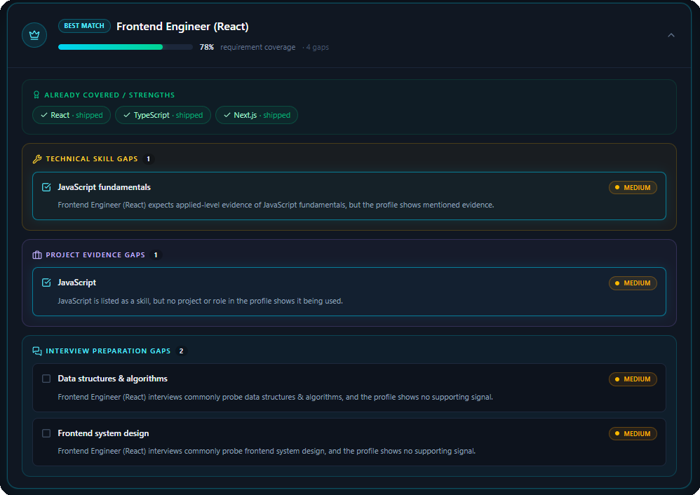
Fit score is only the start.
The useful part is the specific gap breakdown: skill, project evidence and interview readiness.
Same resume. Multiple career paths. Different gaps. That is why this is Skill Intelligence, not resume scoring.
07
Notes:
INTENT: Show that the system can analyze multiple role directions. EMPHASIS: different gaps PAUSE: Move quickly.

Slide 8
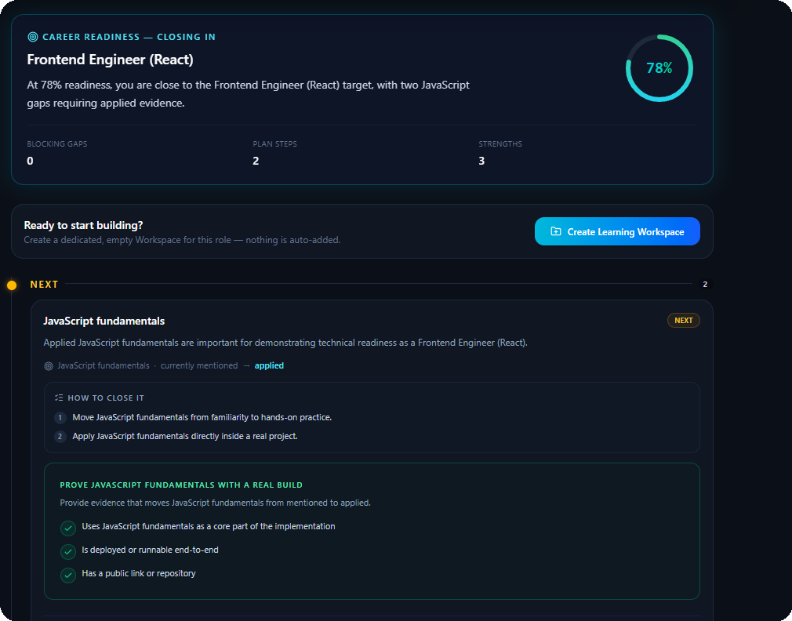
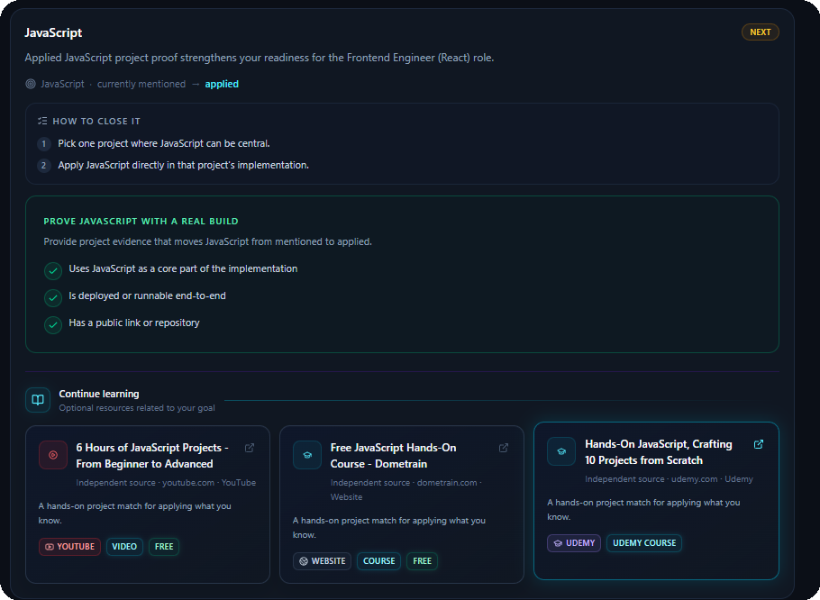
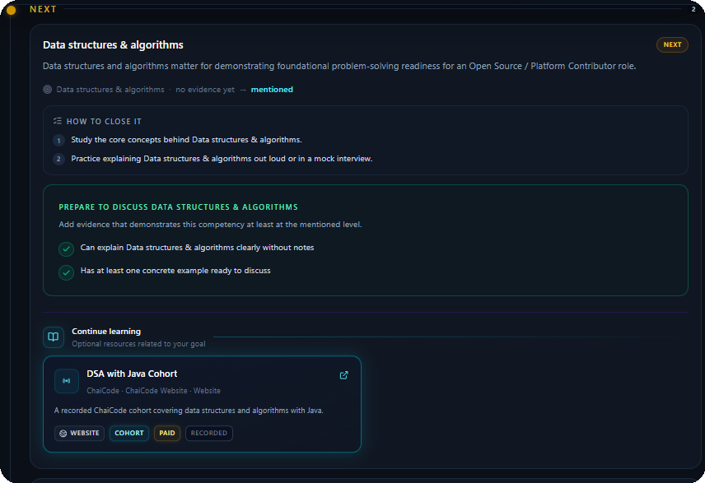
Knowing the gap is the easy half.
A gap you cannot close is just another report.
GAP
PLAN
RESOURCE
›
›
Gap → roadmap → project evidence → courses → YouTube / ChaiCode resources
08
Notes:
INTENT: Land the feature users repeatedly praised. EMPHASIS: gap → resource PAUSE: Mention ChaiCode resource explicitly.

Slide 9
Early Validation
LIVE PRE-SUBMISSION SIGNAL
Real, not modelled
8
4
₹2.25K
~20K
REAL USERS
PAID USERS
GROSS REVENUE
CONTENT VIEWS
people actually used Lumora
real willingness to pay
3 Core full-price · 1 Max coupon
97% from non-followers
Early willingness-to-pay validation — small sample, but real behaviour.
DISCOVERY → CONVERSATION → TRIAL → PAID
20K
›
97%
›
10–12
›
8
›
4
VIEWS
NON-FOLLOWERS
CONVERSATIONS
USERS
PAID
No fake conversion claim. No inflated traction.
09
Notes:
INTENT: Frame this as signal, not scale. EMPHASIS: small sample, real behaviour PAUSE: Let the four cards land before explaining the funnel.

Slide 10
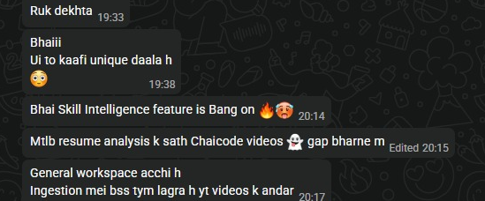
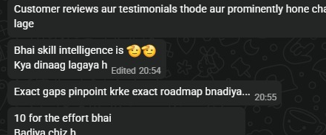
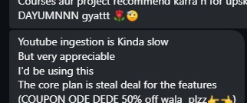
What Paid Users Valued Most
HINGLISH · VERBATIM
Real feedback from early paid users
“
SKILL INTELLIGENCE
PAID · MAX
“
GAP → ROADMAP
PAID · CORE
“
HONEST FRICTION
PAID · CORE
“Skill Intelligence
feature is Bang on...”
“Exact gaps pinpoint krke
exact roadmap bnadiya...”
“YouTube ingestion
is kinda slow.”
Resume analysis + ChaiCode resources were explicitly called out.
The value was not the score — it was knowing exactly what to do next.
We keep the criticism visible because real feedback is more credible than perfect praise.
RAW PROOF
RAW PROOF
RAW PROOF
Three reactions. One repeated value chain: GAP → ROADMAP → RESOURCES
10
Notes:
INTENT: Read one quote aloud; let the other two work visually. EMPHASIS: gap → roadmap → resources PAUSE: Do not sanitize the YouTube criticism.

Slide 11
What One User Costs Us
112 DB EVENTS · AUG 14–20
Measured where possible. Modelled only where necessary.
HIGHEST COST
AI WORKFLOW
VARIABLE RANGE
Skill Intelligence
AI Action
Chat
₹4.96
₹3.28
₹2.23–₹6.25
avg / operation
13 measured events
avg / action
7 measured events
p50 → p90 / chat
67 measured events
MICRO-COST OPERATIONS
KNOWN COST GAP
Learning Path
₹0.81
Gemini video
pricing
avg / plan
PDF / text ingestion
< ₹0.01
embedding-only
YouTube duration is measured; full provider token cost is not yet captured.
₹ / completed operation
MEASURED
cost values come from production UsageEvent data
UNKNOWN ≠ ZERO
we surface the blind spot instead of hiding it
11
Notes:
INTENT: Treat this as a financial architecture slide, not a cost table. EMPHASIS: three major costs + one known gap PAUSE: Point to Skill Intelligence first, then Gemini gap.

Slide 12
How Lumora earns.
A conservative model: assumptions visible, outputs derived, no hockey-stick theatre.
INPUT ASSUMPTIONS
OUTPUTS
Signups / month
100
6 MONTHS
365 MAU
25 paid
SUBSCRIPTION ENGINE
₹16K MRR
Growth
12% MoM
Free → Core → Max
Activation
60%
›
›
YEAR 1
1,086 MAU
64 paid
Free → paid
6%
capacity creates upgrade pressure
₹41K MRR
Churn
8%
Core:Max
85:15
YEAR 2
5,317 MAU
271 paid
₹1.76L MRR
INITIAL INVESTMENT
₹20K–₹30K runway + API float
EARLY GROSS
₹2.25K gross · 4 paid users
COST REDUCTION NEXT
routing · caching · dedupe
14
We are not projecting 50% conversion from a sample of eight.
Notes:
INTENT: Show the revenue model as falsifiable and conservative. EMPHASIS: assumptions visible PAUSE: Say the honesty line aloud.

Slide 13
The Limit That Comes Back
Usage does not hard reset. Capacity returns as old actions age out.
STEP 1
STEP 2
STEP 3
Active 12-hour window
Capacity returns
30-day safeguard
NO MIDNIGHT / MONTHLY BULK RESET
monthly envelope ceiling
CEILING
+2
AGED OUT
AGED OUT
credits restored
ACTIVE 12H
Rolling window controls bursts. Monthly ceiling protects worst-case cost.
CHAT
INGEST
ACTION
CHAT
2/10 → 4/10
The window moves. Events leave one by one.
Free users recover capacity over time instead of hitting a dead wall.
FREE
Capacity comes back
CORE / MAX
More capacity, less waiting
SYSTEM
Cost-aware by design
12
Notes:
INTENT: Explain it left to right as three frames. EMPHASIS: age out individually PAUSE: Call Step 3 NEXT — it is not shipped yet.

Slide 14
Why ₹499. Why ₹1,499.
Free costs time. Paid buys throughput.
COST
CAPACITY
VALUE
PRICE
measured ops
12h window
less waiting
₹499 / ₹1,499
START HERE
MOST POPULAR
POWER USERS
FREE
CORE
MAX
₹0
₹499
₹1,499
/ 30 days
/ 30 days
/ 30 days
Time-constrained entry
Best balance for active learners
Power users · heavy workspaces
10
✓
40
Chats
150
✓
Chats
✓
Chats
4
✓
15
Ingestions
50
✓
Ingestions
✓
Ingestions
2
✓
6
Skill Intelligence
15
✓
Skill Intelligence
✓
Skill Intelligence
All limits shown per rolling 12-hour window · AI Actions and Learning Paths also scale by tier
WHY PAY?
Free costs time.
Paid buys throughput.
More capacity · less waiting · heavier learning workflows
13
Notes:
INTENT: Point to Core as the practical paid plan. EMPHASIS: price follows capacity and value PAUSE: Do not imply Free is blocked forever; capacity returns.

Slide 15
How people find it.
The first channel is already running: build in public → conversations → users → paid.
~20K
97%
10–12
8
4
›
›
›
›
VIEWS
NON-FOLLOWERS
CONVERSATIONS
USERS
PAID
BUILD IN PUBLIC
COMMUNITIES
CREATORS
Short demos + daily build posts
ChaiCode, developer and campus groups
Pre-built workspaces around lectures
reels · stories · progress logs
feedback → conversations → activation
topic-led entry into paid workspaces
Next: faster YouTube ingestion → 30-day cost ceiling → creator workspaces
15
Notes:
INTENT: Show distribution is already being tested. EMPHASIS: content → paid PAUSE: Do not oversell 20K views as users.

Slide 16

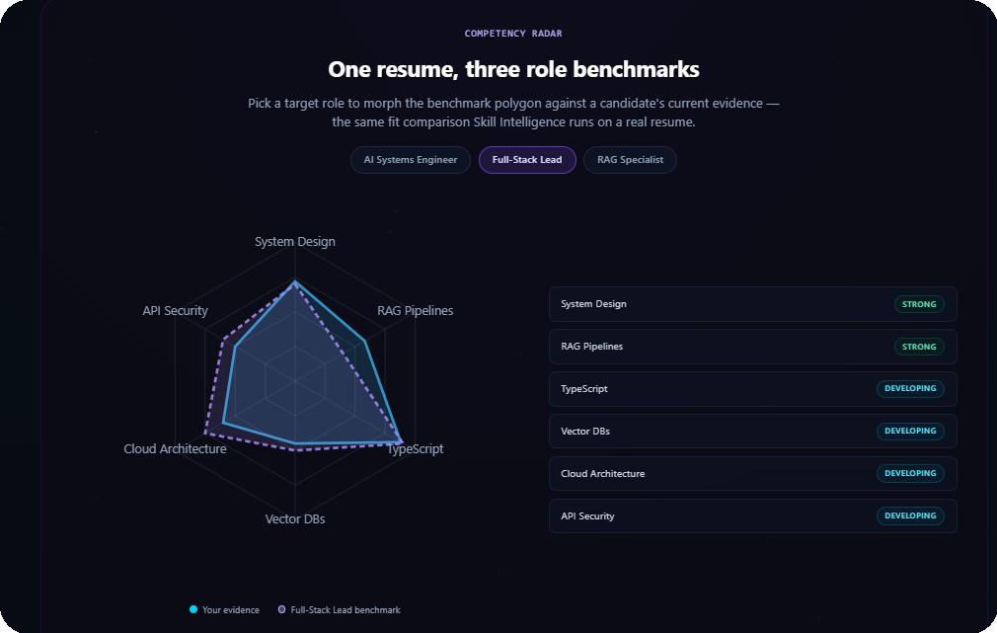
LUMORA
Answers are easy.
Trust is the product.
A learning workspace for answers you can verify and gaps you can close.
Akshay Krishna
getlumora.in
Live product proof: real resume → benchmark gaps
Role fit → evidence → gap clarity
Founder, Lumora AI
SPECIAL THANKS
Hitesh Choudhary Sir · Piyush Garg Sir · Anirudh Sir · Suraj Jha Sir · ChaiCode Team
16
Notes:
INTENT: End clean. Let the tagline be the last impression. EMPHASIS: Trust is the product PAUSE: Hold for three seconds.

