Slide 1
Basics of Cloud & Azure
Classroom Training PPT

Slide 2
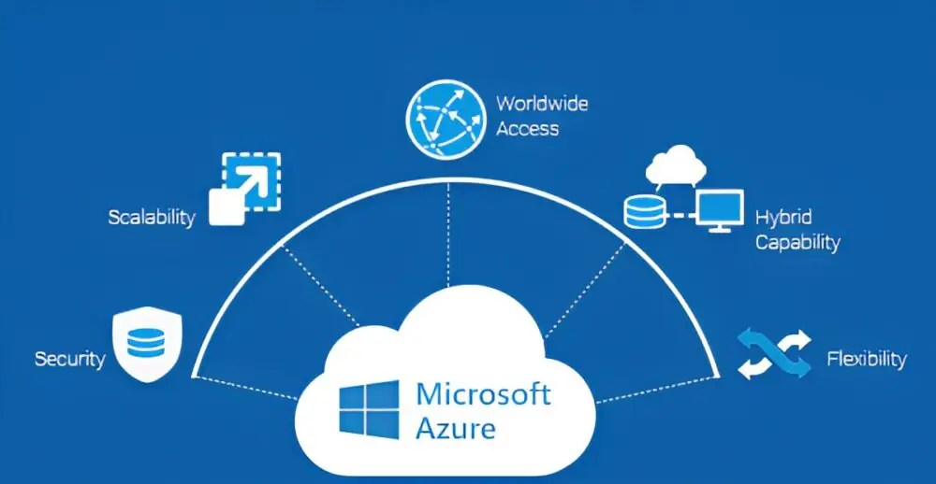

Slide 3
What is Cloud Computing?
On-demand access to computing resources over the internet
Elasticity, scalability, pay-as-you-go
Cloud deployment models: Public, Private, Hybrid

Slide 4
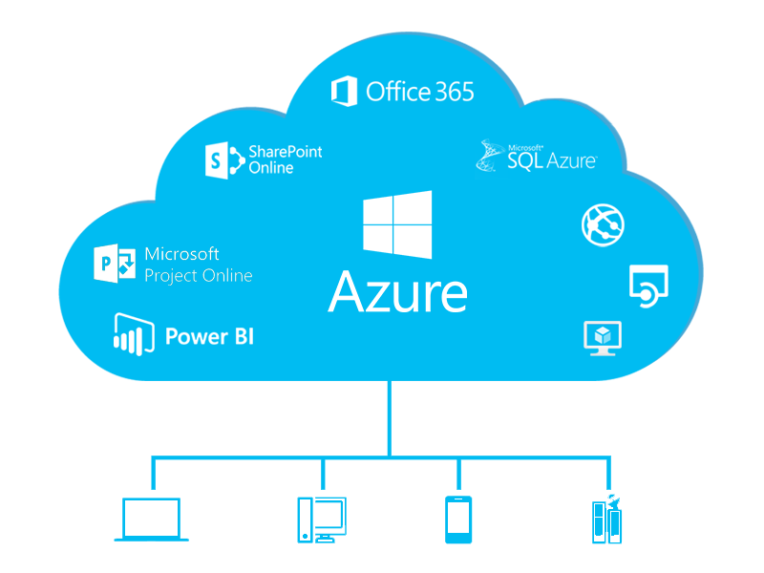

Slide 5
Azure Architecture Diagram (With Labeled Components)
Virtual Network (VNet)
Subnets
Network Security Group (NSG)
Azure VM
Azure Storage Account
Blob Storage
Azure App Service
Azure SQL DB

Slide 6
Azure Cloud Overview
Microsoft’s cloud computing platform
Global infrastructure: Regions & Availability Zones
Azure Resource Manager (ARM)

Slide 7
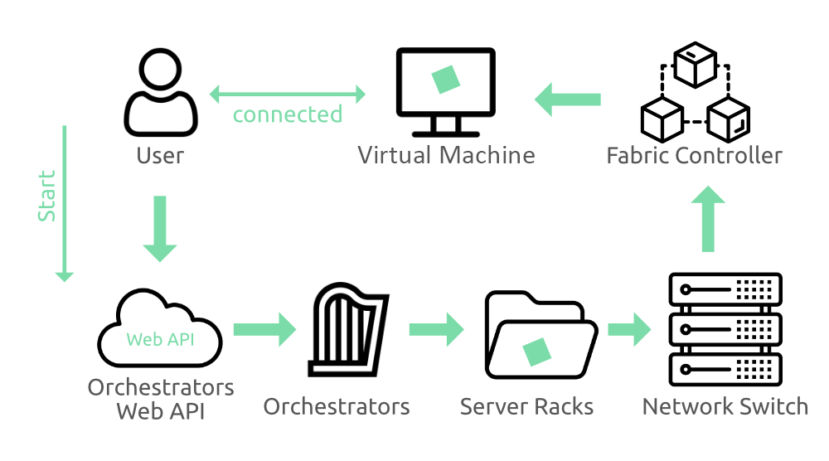

Slide 8
Azure Portal Navigation
Dashboard and favorites
Search bar for services
Resource groups and subscription overview

Slide 9
What is the Azure portal?
The Azure portal is a web-based, unified console that lets you create and manage all your Azure resources. With the Azure portal, you can manage your Azure subscription using a graphical user interface. You can build, manage, and monitor everything from simple web apps to complex cloud deployments in the portal. For example, you can set up a new database, increase the compute power of your virtual machines, and monitor your monthly costs. You can review all available resources, and use guided wizards to create new ones.
The Azure portal is designed for resiliency and continuous availability. It has a presence in every Azure datacenter. This configuration makes the Azure portal resilient to individual datacenter failures and helps avoid network slowdowns by being close to users. The Azure portal updates continuously, and it requires no downtime for maintenance activities.

Slide 10
Home
By default, the first thing you see after you sign in to the portal is Home. This page compiles resources that help you get the most from your Azure subscription. Select Create a resource to quickly create a new resource in the current subscription, or choose a service to start working in. For quick and easy access to work in progress, we show a list of your most recently visited resources. We also include links to free online courses, documentation, and other useful resources.
Portal elements and controls
The portal menu and page header are global elements that are always present in the Azure portal. These persistent features are the "shell" for the user interface associated with each individual service or feature. The header provides access to global controls.
The working pane for a resource or service may also have a service menu with commands specific to that area.
The illustration below labels the basic elements of the Azure portal, each of which are described in the following table. In this example, the current focus is a virtual machine (VM), but the same elements generally apply, no matter what type of resource or service you're working with.

Slide 11
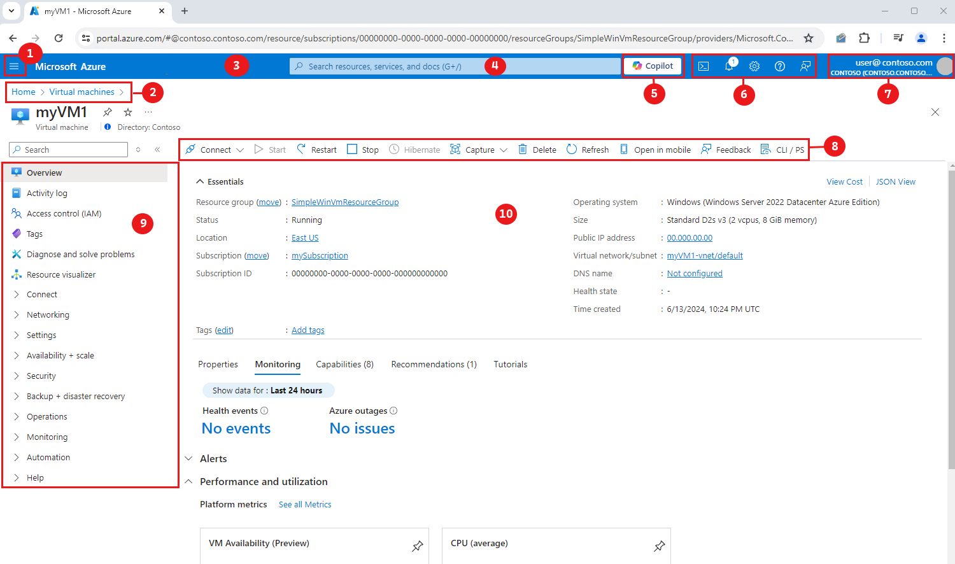

Slide 12
Resource Creation in Azure
Creating Resource Groups
Creating Virtual Machines
Creating Web Apps (App Service)
Understanding ARM templates

Slide 13
EXERCISE 1

Slide 14
Azure Free Tier Lab (No VMs)
Learn Resource Group, Storage Account, App Service, Function App, Budgets.
All steps use free-tier friendly services.

Slide 15
Step 1 – Create a Resource Group
Portal → Search 'Resource groups'.
Click '+ Create'.
Subscription: Free Trial.
Name: rg-free-demo.
Region: East US.
Review + Create → Create.

Slide 16
Step 2 – Create a Storage Account
Home → Create a resource → Search 'Storage account'.
Subscription: Free Trial.
Resource Group: rg-free-demo.
Name: mystorage<yourname>.
Performance: Standard.
Redundancy: LRS.
Review + Create → Create.

Slide 17
Storage Lab – Upload a Blob
Open Storage Account.
Left menu → Containers.
+ Container → Name: demo-container.
Open container → Upload → Select any file.
Confirm blob is visible.

Slide 18
Step 3 – Create App Service (Free Tier)
Create a resource → Web App → Create.
Subscription: Free Trial.
Resource Group: rg-free-demo.
Name: webapp-demo-<yourname>.
Runtime: Node/Python/.NET.
Plan: Create new → Pricing → F1 Free.
Review + Create → Create.

Slide 19
Deploy Simple Web App (ZIP Deploy)
Open Web App → Deployment Center.
Choose ZIP Deploy.
Upload a ZIP containing your HTML file.
Click 'Browse' to open your app.
URL: https://webapp-demo-<yourname>.azurewebsites.net

Slide 20
Simple Web Page (Copy & Use)
Create a file named index.html with the code below:
<html>
<body>
<h1>Hello from Azure App Service!</h1>
<p>This is a simple free-tier web app.</p>
</body>
</html>

Slide 21
Step 4 – Create Azure Function App
Create a resource → Search 'Function App'.
Subscription: Free Trial.
Resource Group: rg-free-demo.
Runtime: Python/Node/.NET.
Hosting: Consumption (Free).
Review + Create → Create.

Slide 22
Function App Lab – HTTP Trigger
Open Function App → Functions → Create.
Development environment: Portal.
Template: HTTP Trigger.
Name: helloFunction.
Run test → Copy function URL → Open in browser.

Slide 23
Step 5 – Add a Cost Budget
Search: Cost Management + Billing.
Budgets → + Add.
Name: demo-budget.
Amount: ₹100 or $2.
Add Email Alert.
Create.

Slide 24
Step 6 – Cleanup
Portal → Resource Groups.
Select rg-free-demo.
Click 'Delete resource group'.
Confirm name.
All resources deleted safely.

Slide 25
Azure Storage Overview
Blob Storage
File Storage
Tables & Queues
Storage accounts and access tiers

Slide 26
END OF EXERCISE

Slide 27
LABS 1

Slide 28
Azure Containers: Real-World Use Case
Student Assignment Submission App

Slide 29
Use Case Overview
Students upload assignments
Web app runs in Docker
Hosted in ACI
Files saved to Blob Storage
No VMs

Slide 30
Architecture
User → Container Web App
Container → Azure Blob Storage
Optional → Azure Container Registry

Slide 31
Step 1: Create Storage Account
Portal → Storage Accounts → Create
Create container: assignments

Slide 32
Step 2: Build Docker App
Simple upload form
Dockerfile
docker build -t app:v1 .

Slide 33
Step 3: Push to ACR
Create ACR
docker tag
docker push

Slide 34
Step 4: Deploy to ACI
Container Instances → Create
Select image
Enable public IP

Slide 35
Step 5: Test
Open URL
Upload file
Check Blob Storage

Slide 36
Azure Security Basics
Identity & Access Management (IAM)
Role-Based Access Control (RBAC)
Azure Security Center
Virtual Network & Firewalls

Slide 37
Azure IAM & RBAC Lab – Screenshots
Auto‑generated Azure Portal Light Theme Screenshots

Slide 38
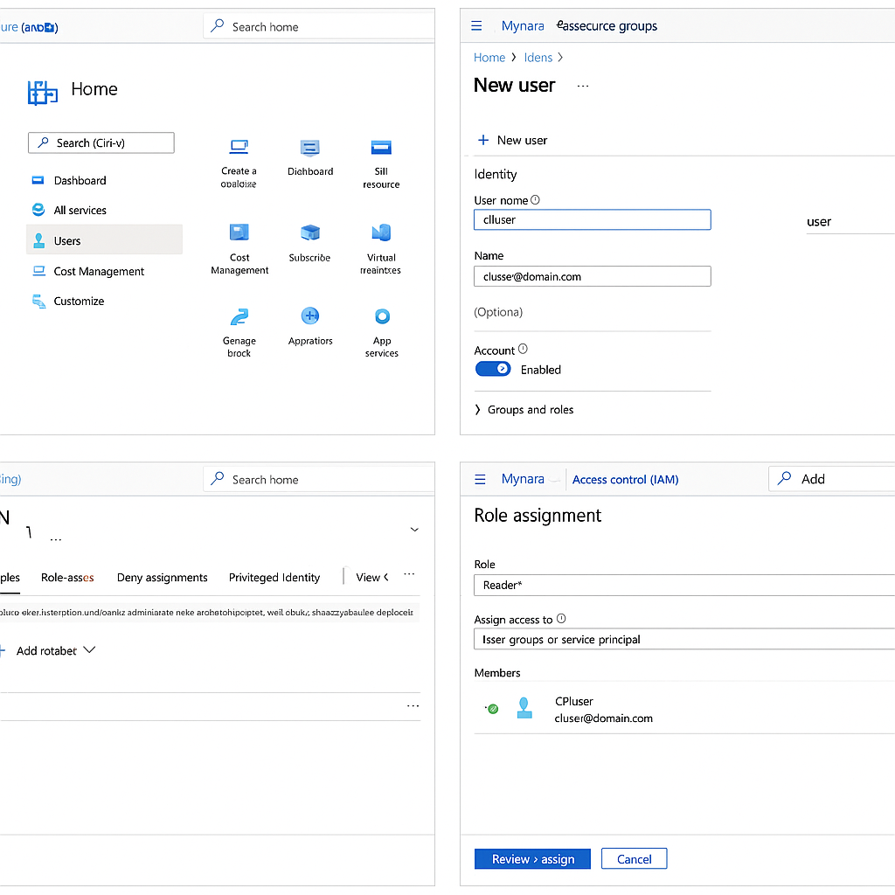

Slide 39
Azure Security Labs – Step-by-Step Guide
Covers IAM, RBAC, Defender for Cloud, VNet + NSG, Storage Firewall.

Slide 40
Lab 1 – Create a User in Azure AD (IAM)
1. Go to https://portal.azure.com
2. Search for 'Azure Active Directory'.
3. Click 'Users'.
4. Click '+ New User'.
5. Enter username and name.
6. Leave account enabled → Click 'Create'.

Slide 41
Lab 2 – Assign RBAC Role to a User
1. Go to any resource (example: Storage Account).
2. Left menu → 'Access Control (IAM)'.
3. Click 'Add' → 'Add role assignment'.
4. Choose role: Reader / Contributor / Owner.
5. Click 'Next'.
6. Select the user created earlier.
7. Click 'Review + Assign'.

Slide 42
Lab 3 – Create a Virtual Network
1. Home → Create a resource → Search 'Virtual Network'.
2. Click 'Create'.
3. Resource Group: select existing or create new.
4. Enter VNet name.
5. Define IP space (default fine).
6. Add a subnet: default-subnet.
7. Click 'Review + Create'.

Slide 43
Lab 4 – Create and Configure NSG
1. Search 'Network Security Groups'.
2. Click '+ Create'.
3. Choose subscription + resource group.
4. Name: nsg-demo.
5. Click 'Review + Create'.
6. After creation → Open NSG.
7. Inbound Security Rules → Add rule.
8. Allow HTTP: Port 80, Action Allow, Priority 100.
9. Save rule and associate NSG with VNet subnet.

Slide 44
Lab 5 – Enable Storage Firewall
1. Open Storage Account.
2. Left menu → 'Networking'.
3. Select 'Enabled from selected networks'.
4. Add your current IP address.
5. Save settings.
6. Try accessing container from another network → Blocked.

Slide 45
Lab 6 – Explore Defender for Cloud
1. Search 'Defender for Cloud'.
2. Open 'Overview'.
3. Check your Secure Score.
4. Click 'Recommendations'.
5. Review each recommendation.
6. Open one recommendation → Click 'Fix'.
7. Run the suggested hardening steps.

Slide 46
Lab 7 – Create Conditional Access Policy (IAM Security)
1. Go to Azure Active Directory.
2. Click 'Security'.
3. Click 'Conditional Access'.
4. Create new policy.
5. Assign a user → Select cloud app.
6. Grant → Require MFA.
7. Enable policy → Create.

Slide 47
App Deployment on Azure
Deploying web apps with App Service
Using GitHub Actions / DevOps pipelines
Monitoring and scaling apps

Slide 48
Deployment on Azure
Web Apps • GitHub Actions • Azure DevOps • Monitoring • Scaling

Slide 49
Azure App Service Overview
Fully managed hosting
Supports Node, Python, .NET, Java, PHP
CI/CD integrated
Autoscaling
Managed identities

Slide 50
Lab 1: Create App Service
1. Azure Portal → App Services → Create
2. Resource Group: rg-webapp-demo
3. Name: mywebapp-kenny-demo
4. Runtime: Node/Python/.NET
5. App Service Plan: F1 Free tier
6. Review and create

Slide 51
Lab 2: Deploy Code (ZIP Deploy)
• Prepare app folder
• Create ZIP
• App Service → Deployment Center → Zip Deploy
• Upload and test URL

Slide 52
Deploy Using VS Code
1. Install Azure App Service extension
2. Sign in to Azure
3. Right-click project → Deploy to Web App
4. Choose the App Service

Slide 53
Deploy Using GitHub Actions
• App Service → Deployment Center → GitHub
• Select repo and branch
• Azure auto-generates GitHub workflow (.yml)
• Push → Auto deploy

Slide 54
Example GitHub Workflow
YAML pipeline auto-created to build + deploy.
Stored under .github/workflows/azure-webapp.yml

Slide 55
Azure DevOps Pipeline
1. Create project
2. Connect GitHub repo
3. Generate YAML pipeline
4. Publish artifacts
5. Create Release Pipeline
6. Deploy to App Service

Slide 56
Monitoring with App Insights
• Requests
• Response time
• Failures
• Dependency calls
• Live Metrics
• Alerts

Slide 57
Scaling Web Apps
• Scale Up: Increase CPU/RAM
• Scale Out: More instances
• Autoscale rules based on metrics
Example:
CPU > 70% → Scale out +1

Slide 58
Thank You
Hands-on Azure Deployment Module Completed.

Slide 59
Azure CLI Basics
Install & login: az login
Create resources: az group create, az vm create
Manage storage and deployments
Scripting and automation

Slide 60
Azure CLI Basics
Install • Login • Create Resources • Storage • Deployments • Automation

Slide 61
Install Azure CLI
Windows: MSI Installer
macOS: brew install azure-cli
Linux: curl | bash
Verify: az --version

Slide 62
Login to Azure
Interactive login:
az login
Set subscription:
az account set --subscription "<ID>"

Slide 63
Lab 1: Create Resource Group
Command:
az group create --name rg-azurecli-demo --location CentralIndia
View RG:
az group show -n rg-azurecli-demo -o table

Slide 64
Lab 2: Create VM
Create Ubuntu VM:
az vm create --resource-group rg-azurecli-demo --name demoVM --image UbuntuLTS --generate-ssh-keys --size Standard_B1s

Slide 65
VM Management
Open Port 80:
az vm open-port -g rg-azurecli-demo -n demoVM --port 80
Get IP:
az vm list-ip-addresses -n demoVM -g rg-azurecli-demo -o table

Slide 66
Delete / Start / Stop VM
az vm stop -g rg -n vm
az vm start -g rg -n vm
az vm delete -g rg -n vm --yes

Slide 67
Storage Account Creation
Create:
az storage account create -n mystorageacct12345 -g rg-azurecli-demo --sku Standard_LRS
Get Key:
KEY=$(az storage account keys list -g rg -n acct --query "[0].value" -o tsv)

Slide 68
Blob Container & Upload
Create container:
az storage container create -n demo-container --account-name acct --account-key $KEY
Upload:
az storage blob upload --account-name acct --account-key $KEY --container-name demo-container --file file.txt --name file.txt

Slide 69
ARM/Bicep Deployment
Validate:
az deployment group validate -g rg --template-file template.json
Deploy:
az deployment group create -g rg --template-file template.json --parameters @params.json

Slide 70
Automation: Bash Script
Use SP login:
az login --service-principal -u <appId> -p <pwd> --tenant <tenant>
Run scripts for infra creation.

Slide 71
Thank You
Azure CLI Training PPTX Completed.

Slide 72
Automation & Best Practices
Use ARM Templates and Bicep
Use CLI for repeatable deployments
Use tagging for resource management

Slide 73
Azure Cloud – Advanced Lab & Architecture PPT
With Diagrams & Hands-on Exercises

Slide 74
Lab 1: Azure Portal Basics
Login to portal.azure.com
Navigate Dashboard & Resource groups
Create a Resource Group
Create a Storage Account
Create a Web App

Slide 75
Lab 2: Deploy an App using Azure App Service
Create Azure App Service
Configure runtime stack (Node/Python/.NET)
Deploy sample app using Deployment Center
Verify URL and monitor logs

Slide 76
Lab 3: Azure CLI Automation
Install Azure CLI
Login: az login
Create Resource Group: az group create
Create VM: az vm create
Check resources: az resource list

Slide 77
Lab 4: Automate Storage Creation
az storage account create ...
az storage container create ...
Upload and download blobs

Slide 78
Azure Architecture – Basic Cloud Components
Users
Azure Front Door
App Service
Database

Slide 79
Storage Workflow Diagram
Client
Storage Account
Blob Container
Files

Slide 80
VM Lifecycle Diagram
Create VM
Start
Run / Monitor
Stop / Deallocate

